Slide 1
Question Answering with KG
Group 7
1930026026 冯昊轩 Franklin
Notes:
Hello everyone, in this machine learning project, I focus on question answering with KG problem.

Slide 2







Content Title
Introduction & Problem definition
Dataset overview
Model
Experiment Results
Interpretation and Conclusion
Notes:
I will split my presentations into 5 main parts, which is:

Slide 3
Introduction and Problem definition

Slide 4
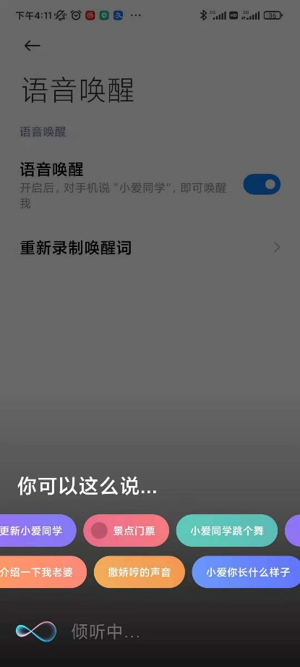
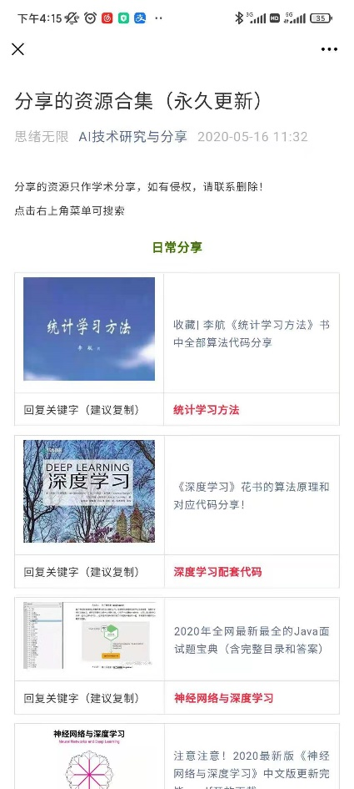
What is QA system?
Notes:
What is QA system?
A question answering system is an advanced form of information retrieval system that answers users' questions in accurate and concise natural language. It is a research direction in the field of artificial intelligence and natural language processing, which has attracted much attention and has a broad development prospect.
For example, some apps like 小爱同学 and WeChat Public. You can ask them some questions, they will finally return the most similarity question-answer pair and the corresponding answer.

Slide 5
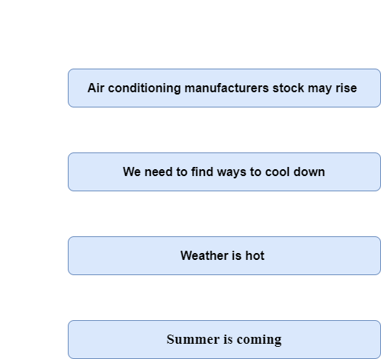
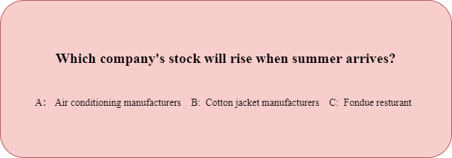
Why we need KG in QA system?
Consider a Multiple choice question:
Notes:
Let’s consider a multiple choice question:
Which company’s stock will rise when summer arrives? As a human, we will reasoning it as following steps:
1. Summer is coming, use common knowledge infer to weather is hot
2. Use world knowledge infer to we need to find ways to cool down
3. Use other-sources knowledge like industry knowledge to infer the air conditioning manufacturers stock may rise.
It’s obvious to notice that human could only understand those sentences by using extra knowledge base. Also, since a lot of language models are pretrained on unstructured text (BERT), or explicitly represented in structured knowledge graphs (Concept net),. LMs already covered a broad knowledge, however, they are not performing well on inference text, especially in structured reasoning. That’s why knowledge graphs are needed in deep learning area, to make model have better interpretability and robustness.

Slide 6
Problem definition
In this project, pre-trained language models and knowledge graphs will be used to select a corresponding subgraph for each question and reason based on the structure of the subgraph to finally give a corresponding answer.

Slide 7
Dataset overview
Commonsense QA dataset
ConceptNet KG

Slide 8
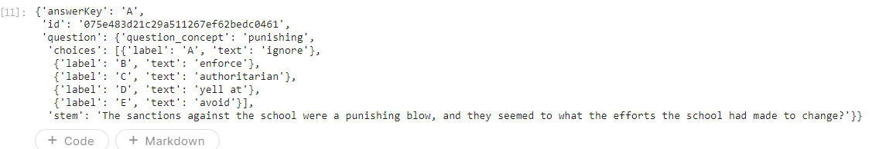
Overview of dataset
Commonsense QA:
5-way multiple choices dataset
Containing 12102 questions
Concept Net:
General-domain
799273 nodes and 2487810 edges in total
Notes:
CommonsenseQA dataset is used for this task, which is a 5-way multiple choice QA task that requires reasoning with commonsense knowledge, containing 12102 questions.
ConceptNet knowledge graph is used for this task, which is a general-domain knowledge graph. This graph is the most important knowledge sources for all the question. It has 799273 nodes and 2487810 edges in total.

Slide 9
Model Architecture
Roberta-large + MLP
QA-GNN

Slide 10
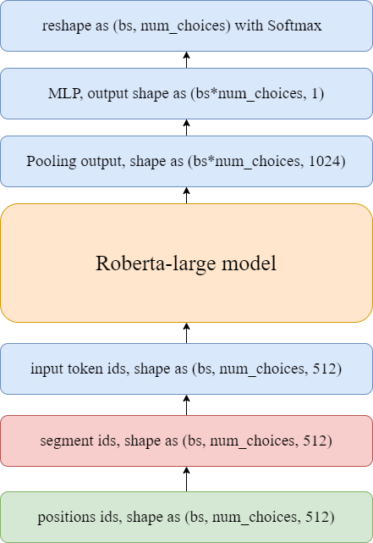
Roberta-large + MLP as Baseline
Processing data / Working flow
Modified BERT on:
More data, larger bs, longer training time
Remove NSP
Dynamic masked
BPE encoding
Processing data as:
Token mapping index
Padding
Masking
Notes:
Roberta is a Bert-based model, modified Bert on the following 5 part:
Use more data, larger batch size, longer training time
Remove next sentence prediction task, input as many sentences as possible onto meet max input length 512. So, all the segment ids are 0.
Train on longer sequence
Use dynamic masked instead of static (means for every epochs, generate different mask position)
Use BPE(byte pair encoding)

Slide 11
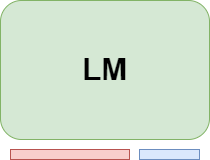
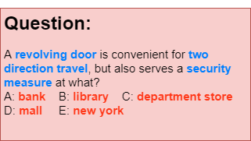
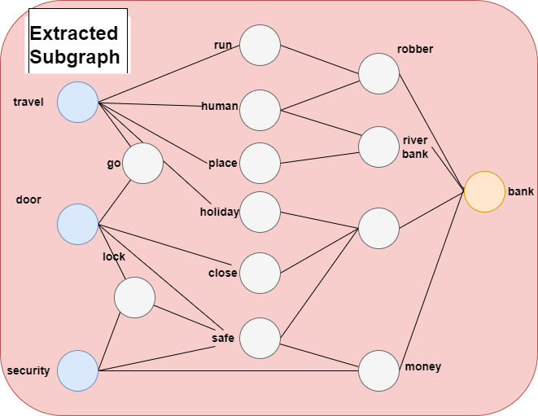
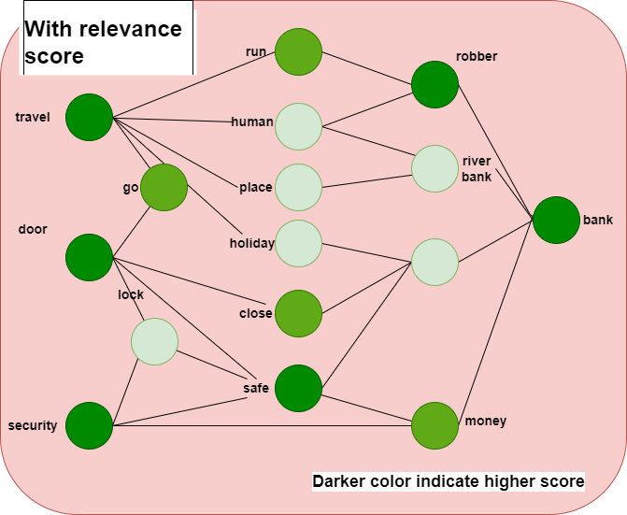
QA-GNN Processing Part
Processing step
Process KG
Extract only English version.
Change multi-relation as top relation. E.g. (atlocation/locatednear -> atlocation)
Merged relations
Construct graph info
Process Commonsense QA
Extract all the concepts from question/answer
Extract k-hops subgraph for each QA-pair
Get relevance score per edge
MLM
(QA Context|entity)
Notes:
Then, the model I focus on is called QA-GNN, let me introduce the processing part first:
Processing KG:
## Process CSQA
Lets consider a question: …
We first select all the concept in the question and answer, using blue and red color to show
Then, a k-hops subgraph of each concept will be formed. In detailed, get each question concepts adj list and each answer concepts adj list, then intersect them and get the final hidden node, shown as white.
Finally, use LM to get relevance score. It’s obvious to understand that, for each question-answer-node, the hidden node has different importance on it. So, LMS are used to calculate masked language model task (MLM) with cross-entropy loss as each hidden node score.
MLM detailed: here create all the sentence pair as: question,answer, and do the MLM per each sentence, to get the relevance score per each concept

Slide 12
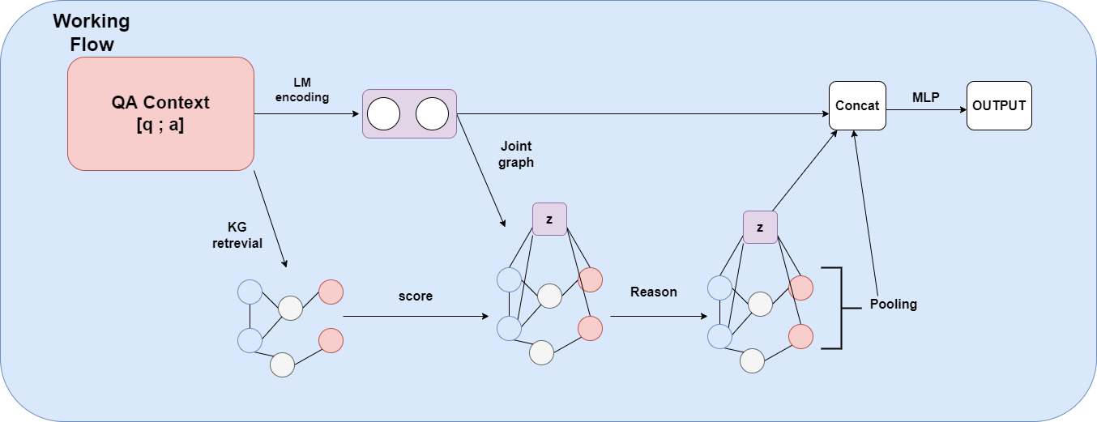
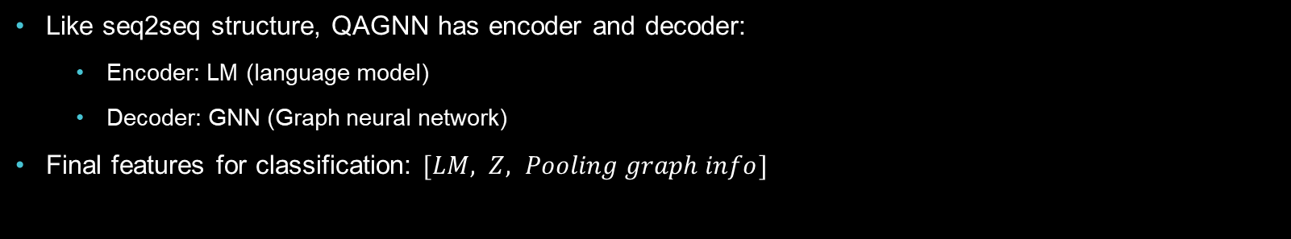
QA-GNN Model forward propagation
Like seq2seq structure, QAGNN has encoder and decoder:
Encoder: LM (language model)
Decoder: GNN (Graph neural network)
Final features for classification: $[LM, Z, Pooling graph info]$
Notes:
Then, the basic forward propagation step is shown on ppt:
Just like other QA task, using LM to obtain a representation for QA context, and retrieve the subgraph $G_{sub}$ from KG.
A $QA context node Z$ is introduced, which represent the QA context embedding. This node is $connected to the topic entites of QA concept$, which form a jointly graph called working graph.
Attention-based GNN is used to capture the information between node with weight.
Passing a MLP with all the info representation $[LM, Z, pooling graph info]$

Slide 13
Model Architecture Details

Slide 14
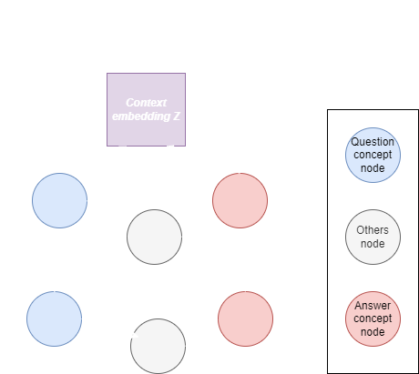

Working graph definition
Formula and Definition
$G_{w}=\left(V_{w}, E_{w}\right)$
$T=\{Z,Q,A,O\}$
Notes:
Context node z is generated by LM, which is Roberta-large in my replication, represent the QA context. As you can see on the right hand side of PPT, two type of edges $r_{z,q}, r_{z,a}$ are introduced to connect z with the question node and the answer node respectively in the working graph.

Slide 15
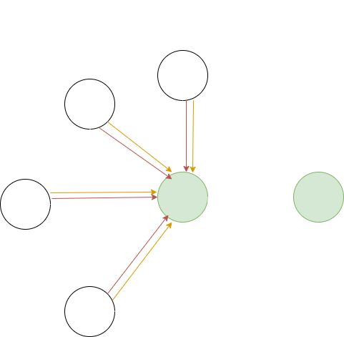












GNN Architecture
For a $L−layer GNN$
$$h_{t}^{l+1}=f_{n}\left(\sum_{\left\{s∈N_{t}∪\left\{t\right\}\right\}}{α_{s,t} m_{s,t}}\right)+h_{t}^{\left(l\right)}$$
Where:
$$h_{t}^{l}:lth hidden layer of each node$$
$$α_{s,t}:attention weight$$
$$m_{s,t}:message passing from source node s to target node t$$
$$h_{1}^{l}$$
$$h_{2}^{l}$$
$$α_{2,5}$$
$$α_{1,5}$$
$$α_{3,5}$$
$$sum/MLP$$
$$h_{3}^{l}$$
$$h_{5}^{l}$$
$$h_{5}^{l+1}$$
$$α_{4,5}$$
$$h_{4}^{l}$$
Notes:
The next part is attention-based GNN architecture, I draw a basic graph which represent the formula shown on the right hand side of ppt, where white node means the source node, green node means target node, alpha means multi-head attention weight:
Then, for a Lth –layer GNN, the model will take the attention weight to scaled each message for different sources, and sum all of it and passing a MLP, with add on last layer.

Slide 16
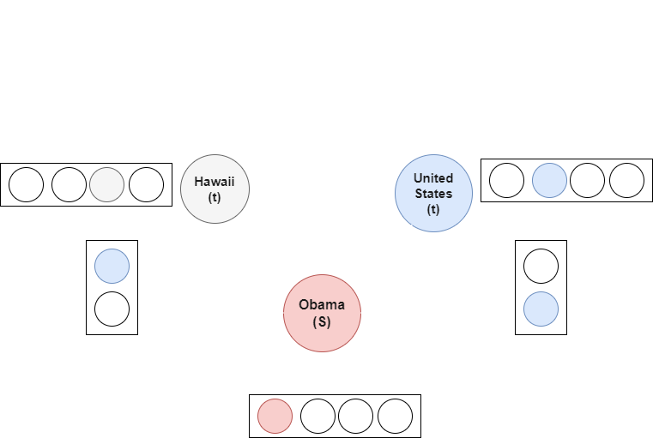

Message passing detailed
Formula
Example
Formula:
$u_{t}=f_{u}\left(u_{t}\right), r_{s,t}=f_{r}(e_{s,t}, u_{s}, u_{t})$
$m_{s,t}=f_{m}(h_{S}^{l} , u_{s}, r_{s,t})$
Where:
$u_{t},$node type of node t, one-hot vector
$r_{s,t}$, relation embedding
$e_{s,t}$, one hot vector of different edge
$h_{s}^{l}$, last hidden state of source node s
$m_{s,t}$, message from source node s to target node t
Notes:
Then let me move to the message passing detailed part:
Here the model encode the following 3 type of information as message:
Node type
Relation type with direction
Previous layers hidden state
Let’s consider an example shown on the ppt, the question is: Who has been president of the united states? Answer is …
It’s clear to see that:
Source node s is Obama, target node are Hawaii and united states, with relation born in and is the president of respectively. Then, model will first embedding the type of source node s, which is question node here. Then, model will encode the relation type from source to target with direction. So, the final message is calculated by passing an MLP with concatenation of (last hidden state of source node, node type embedding ,relation embedding)
Then, the attention weight of each edge is just the dot product attention with score aware.

Slide 17
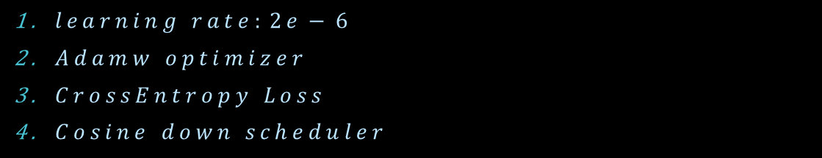
Experiment Result
$learning rate:2e−6$
$Adamw optimizer$
$CrossEntropy Loss$
$Cosine down scheduler$
Notes:
For baseline and QA-GNN, I set the hyper-parameter to:

Slide 18
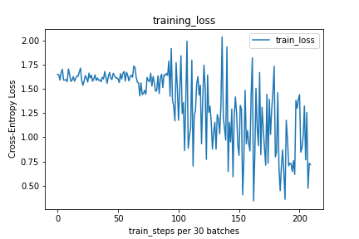
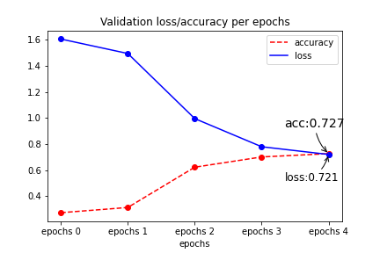
ROBERTA-LARGE + MLP (Baseline)
Train
Validation
Notes:
We can see that the train loss is not stable, with serious fluctuation. Also, the validation accuracy is almost 0.727, with mean of validation loss 0.721.

Slide 19
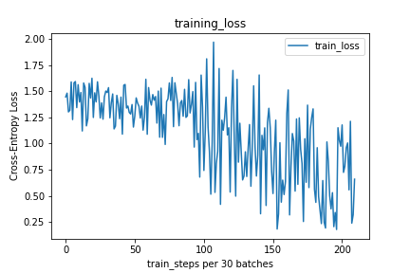
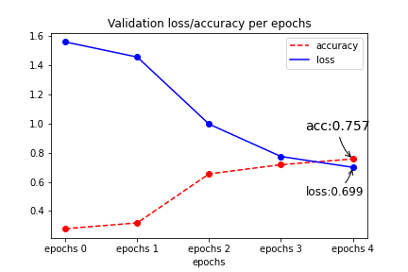
QA-GNN
Train
Validation
Notes:
For QA-GNN, the model loss is still not stable since I only train with 4 epochs which is the same as Roberta-large with MLP, but the accuracy is increased for almost 3% here.

Slide 20
Interpretation and Conclusion

Slide 21
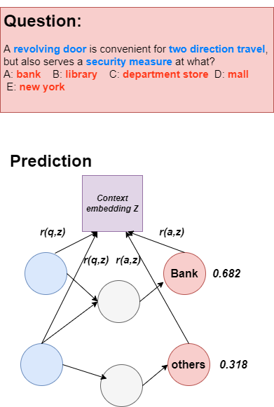
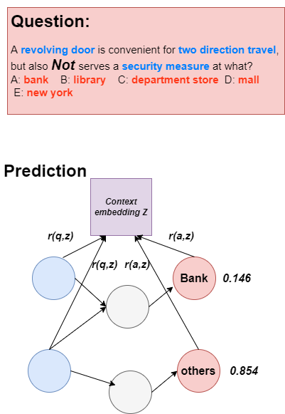
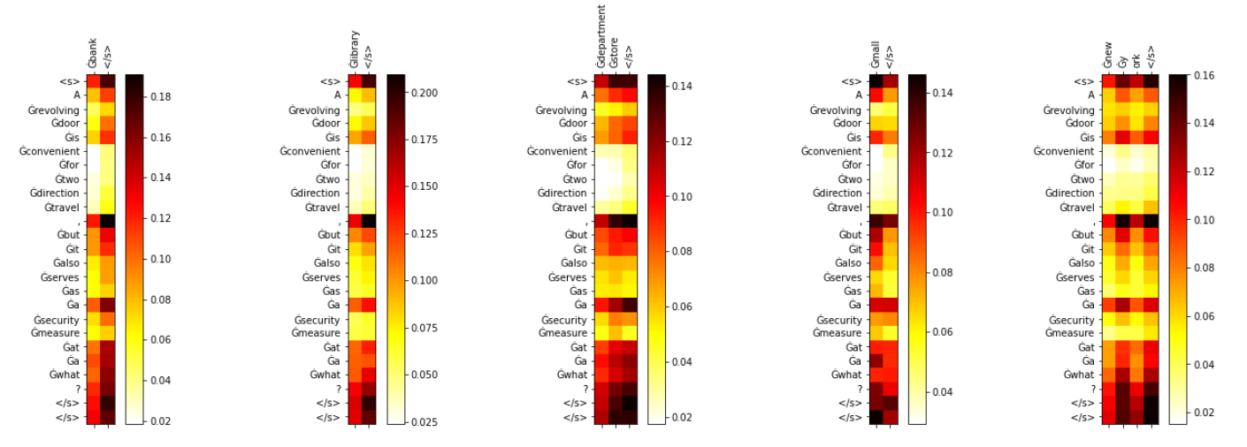
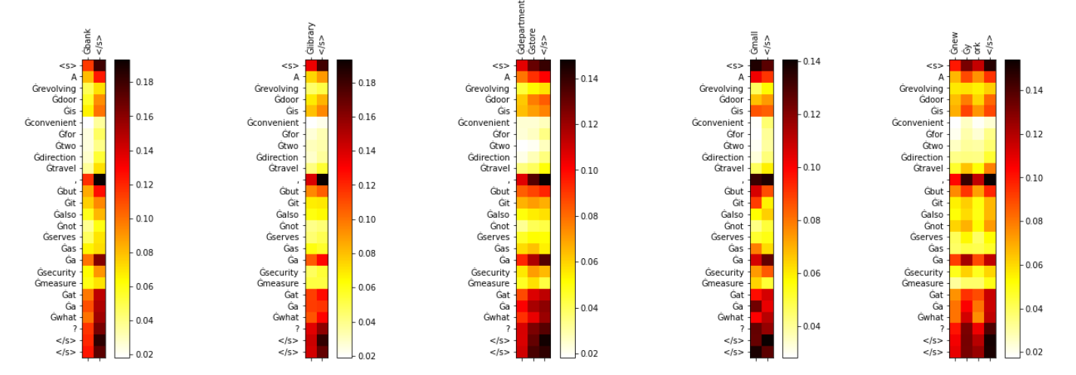
Interpretation and Conclusion
Notes:
If we flipped the original function, for example …
QA-GNN correctly reasoning the “Not” word, and changed the attention weight of the actual solution.
However, our baseline model, known as Roberta-large + MLP, I plot the attention weight with mean of head for multi-head attention on the final attention layer, the result is shown on the ppt. You can see that, the model could not judge the not in a large scale (and already predict wrong here).
In conclusion, the QA-GNN model combine relevance-scoring and joint-reasoning for both LM and KG, which can judge the result in a better way.

Slide 22
References
Speer, R., Chin, J., & Havasi, C. (2017). ConceptNet 5.5: An Open Multilingual Graph of General Knowledge. ArXiv, abs/1612.03975.
Vashishth, S., Sanyal, S., Nitin, V., & Talukdar, P.P. (2020). Composition-based Multi-Relational Graph Convolutional Networks. ArXiv, abs/1911.03082.
Yasunaga, M., Ren, H., Bosselut, A., Liang, P., & Leskovec, J. (2021). QA-GNN: Reasoning with Language Models and Knowledge Graphs for Question Answering. ArXiv, abs/2104.06378.
Velickovic, P., Cucurull, G., Casanova, A., Romero, A., Lio’, P., & Bengio, Y. (2018). Graph Attention Networks. ArXiv, abs/1710.10903.
Liu, Y., Ott, M., Goyal, N., Du, J., Joshi, M., Chen, D., Levy, O., Lewis, M., Zettlemoyer, L., & Stoyanov, V. (2019). RoBERTa: A Robustly Optimized BERT Pretraining Approach. ArXiv, abs/1907.11692.

Slide 23
Thank You

