Slide 1
ACADEMIC COMPILER & ENGINE PROJECT
Shader Program Compiler
2D/3D Graphics & Game DSL Engine
A Declarative High-Level Domain-Specific Language (DSL) & C++ Transpiler Compiling to Native Hardware-Accelerated OpenGL 2.1 + SDL2 Binaries
⚡ C++17 Transpiler
🎮 Hardware OpenGL 2.1
✨ Real-time GLSL Shaders
🏓 2D Pong with AI Physics
🕹️ 3D First-Person POV World
Student Author: Eldho | Semester 3 Mini Project | Repository: github.com/eldhoGI2/shader-compiler

Slide 2
PROJECT OVERVIEW
Executive Summary: The Bridge from High-Level Script to GPU Native Code
1. Declarative DSL (.my)
• High-level declarative syntax that replaces hundreds of lines of OpenGL boilerplate.
• Expressive commands: 'window 800 600', 'bg #060614', 'shader grid', 'pong', 'mode_3d'.
• 35+ named color dictionary (cyan, crimson, gold, neon_green) + hex codes (#RRGGBB).
• Built-in 2D shapes, outlines, transformations, and multi-color linear gradients.
2. Automated Transpiler
• Full source-to-source compiler architecture built with modern C++ (Lexer, Parser, AST, CodeGen).
• Translates .my domain language into high-efficiency intermediate C code (generated_game.c).
• Automatically invokes GCC and links hardware libraries (-lSDL2 -lGL -lGLU -lm).
• Produces an optimized, standalone 60 FPS desktop binary in one seamless step: ./mycompiler script.my.
3. GPU Hardware Engine
• OpenGL 2.1 + SDL2 backend engine with hardware-accelerated vertex & fragment pipeline.
• 8+ real-time GLSL fragment shaders (Plasma, Cyberpunk Grid, Waves, CRT, Starfield).
• Interactive 2D Pong with ball reflection physics, AI paddle tracking, and live retro scoreboard.
• Navigable 3D first-person POV world with WASD movement, mouse camera, and wall collision.

Slide 3
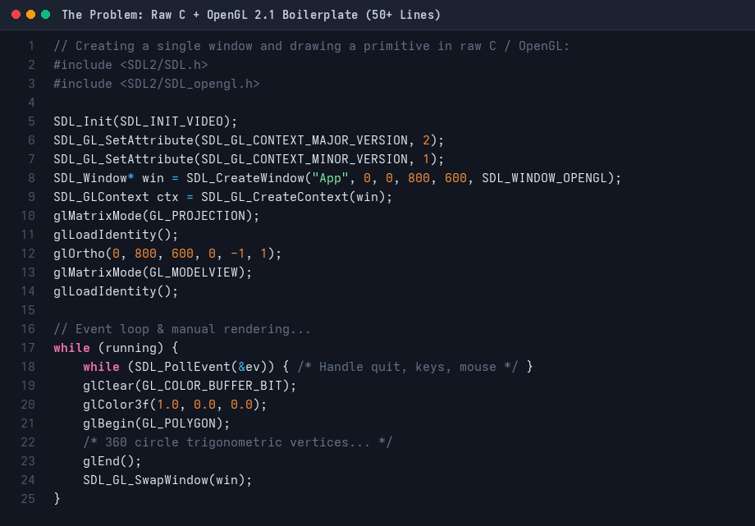
CHALLENGE & MOTIVATION
The Problem: The Extreme Verbosity of Raw C & OpenGL
Why Low-Level C Graphics Frustrates Developers
❌ Massive Boilerplate Overhead
To draw a single circle or rectangle, a developer must write 50+ lines of window subsystem initialization, pixel formats, and GL context setup.
❌ Manual OpenGL State Machine
Developers must manually manage matrix stacks (GL_PROJECTION, GL_MODELVIEW), orthogonal projections, vertex arrays, and double-buffering.
❌ Complex GLSL Shader Lifecycle
Compiling shaders requires manual shader object creation, source loading, error log querying, program attachment, uniform location caching, and linking.
❌ High Cognitive Barrier
Students and designers spending 90% of their time fighting syntax and API quirks instead of focusing on graphics logic, animations, or gameplay.
Actual Raw C + OpenGL 2.1 Code (50+ Lines Required)

Slide 4
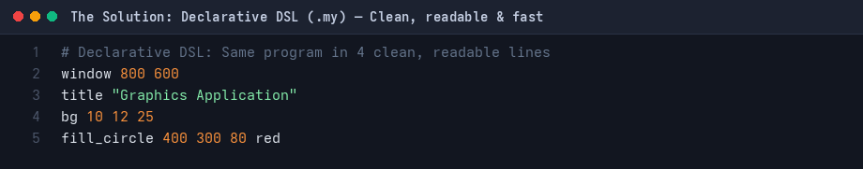
THE DSL SOLUTION
How We Made It Easier: Declarative Syntax & One Command, One Intent
The Declarative Language Philosophy
✅ One Intent = One Readable Line
Replacing 50 lines of C boilerplate with 'window 800 600', 'bg #060614', 'fill_circle 400 300 80 red'.
✅ Zero Boilerplate Programming
The programmer declares WHAT should be on screen, while the compiler and runtime handle HOW the GPU renders it.
✅ Color & Math Abstraction
Built-in 35+ named color dictionary (gold, cyan, lime, coral), hex support (#00d2ff), and automatic degree-to-radian conversion.
✅ Instant Game & 3D Modes
Activating full interactive physics and 3D camera with single declarative keywords: 'pong' and 'mode_3d'.
The DSL Equivalent: 4 Clean, Readable Lines
Code Reduction & Efficiency Impact
• Lines of Code: Reduced from 55 lines to 4 lines (92.7% reduction)
• Compilation Time: < 0.6 seconds from .my script to running native binary
• Error Prevention: Zero dangling pointers, zero GL state leaks, zero context bugs.

Slide 5
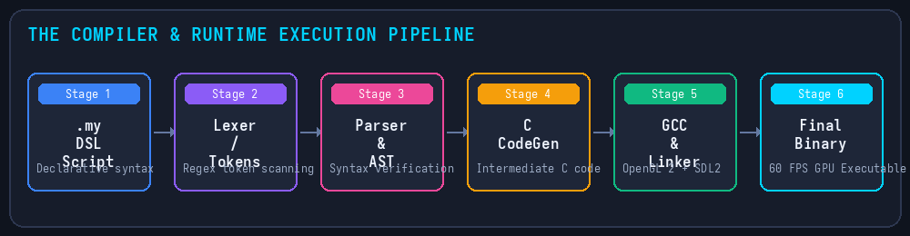
COMPILER PIPELINE
System Architecture: End-to-End Transpiler & Execution Pipeline
1. Frontend (Lexer & AST)
• Reads .my source file and strips comments.
• Tokenizes into classified tokens (TOKEN_WINDOW, TOKEN_CUBE, TOKEN_PONG).
• Validates parameters and builds structured AST.
2. Transpiler CodeGen
• Emits ANSI C code into generated_game.c.
• Injects #include "graphics_runtime.h".
• Packages draw calls into high-speed compiled OpenGL display lists (glNewList).
3. GCC Linking & Binary
• Invokes GCC automatically via system().
• Flags: -lSDL2 -lGL -lGLU -lm.
• Outputs final_game: a 60 FPS standalone native desktop executable with GPU support.

Slide 6
FILE-BY-FILE GUIDE
Codebase Architecture: What Each Group of Files Does
1. Compiler Frontend Core (compiler.cpp)
• Token definitions: 50+ token types for environment, shapes, 3D, and games.
• Lexer & Scanner: Regex/string analysis, stripping comments (#), token stream.
• Syntax Analyzer & AST: Parameter count checking and syntax enforcement.
• Code Generator: Emits generated_game.c and triggers GCC build command.
2. Runtime Backend Engine (graphics_runtime.h)
• Hardware Lifecycle: SDL2 window creation & OpenGL 2.1 context management.
• Shader Engine: Compiles GLSL fragment shaders (Plasma, Grid, CRT, Starfield).
• 2D & 3D Math: Trigonometric circle approximations, matrix stacks, 3D camera.
• Physics & Collision: Pong ball reflection physics and 3D wall sliding collision.
3. DSL Game & Graphics Programs (*.my)
• demo.my: Original Review 1 baseline proof-of-concept.
• showcase.my: 10+ 2D shapes, 35+ named colors, and linear gradient fills.
• cyberpunk.my: GLSL fragment shaders, gradients, and affine transformations.
• pong.my: Full interactive 2D Pong game with AI paddle and live scoreboard.
• world3d.my: Navigable 3D first-person POV room with collision obstacles.
4. Intermediates & Native Artifacts
• generated_game.c: Intermediate ANSI C code generated by compiler.cpp.
• mycompiler: The compiled C++ compiler binary (built via g++ compiler.cpp).
• final_game: The final linked OpenGL 2.1 + SDL2 desktop graphics executable.
• plasma.frag: User-loadable custom GLSL fragment shader source file.

Slide 7
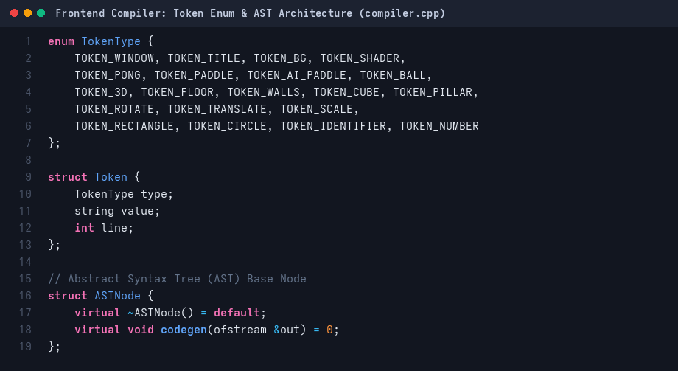
COMPILER FRONTEND
Frontend Compiler: Token Enum, Lexer & Abstract Syntax Tree
compiler.cpp — Token Definitions & AST Node Structure
Lexer & Parser Mechanics
• Token Classification:
Categorizes source text into Window, Shapes, Gradients, Transformations, 3D Commands, and Game Entities.
• Smart Color Tokenizer:
The lexer intercepts named colors (gold, cyan, lime), hex strings (#RRGGBB), and numeric triplets (255 128 0), unifying them into ColorRGB structs.
• Comment & Whitespace Handling:
Strips shell-style comments (# ...) and normalizes tabs/spaces while preserving accurate line tracking for syntax error messages.
• AST Node Hierarchy:
Each statement maps to an AST node that enforces argument count and type requirements before code emission begins.

Slide 8
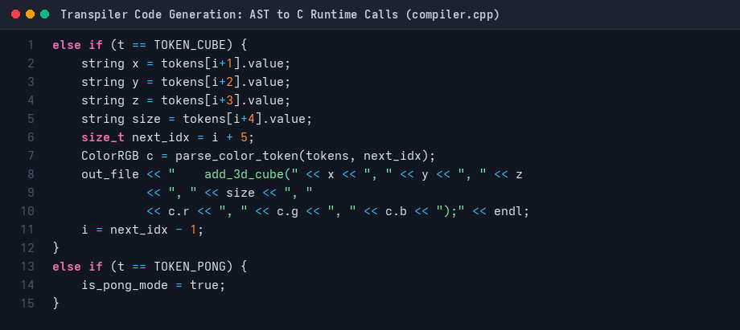
CODE GENERATION
Backend Transpiler: Code Generation & Automated GCC Linker
From DSL Tokens to High-Speed C Code
⚙️ Intermediate Code Emission
The compiler outputs generated_game.c, transforming high-level DSL primitives into clean C runtime function calls.
⚙️ Display List Pre-compilation
Static geometry is wrapped inside glNewList(scene, GL_COMPILE) blocks, offloading primitive vertex calculations to the GPU driver during setup.
⚙️ Mode Flag Detection
Detects is_pong_mode and is_3d_mode flags to route control flow to run_pong_game() or run_3d_engine() respectively.
⚙️ Automated Native Linker
Runs: gcc generated_game.c -lSDL2 -lGL -lGLU -lm -o final_game seamlessly in the background without needing a manual Makefile.
compiler.cpp — Code Generation Logic

Slide 9
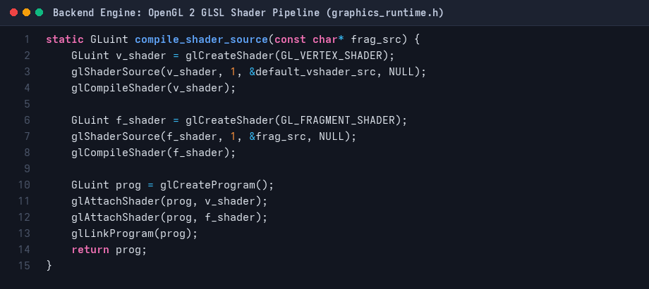
GRAPHICS ENGINE
Runtime Backend: OpenGL 2.1 & GLSL Fragment Shader Pipeline
graphics_runtime.h — GLSL Shader Compiler & Linker
Hardware Engine Features
✨ Fixed & Programmable Dual Pipeline
Combines high-speed OpenGL 2 fixed-function display lists with programmable GLSL fragment shaders.
✨ Dynamic Uniform Passing
Automatically passes u_time (seconds elapsed since launch) and u_resolution (width, height) to active fragment shaders at 60 FPS.
✨ 8+ Built-in Shaders
Plasma, Cyberpunk Grid, Waves, CRT Scanlines, Starfield, Neon Tunnel, Water Ripple, and Custom Shader file loading.
✨ Live Hot-Swapping [SPACE]
Users can press the Spacebar during runtime to cycle between GPU shaders on the fly without restarting the application.

Slide 10
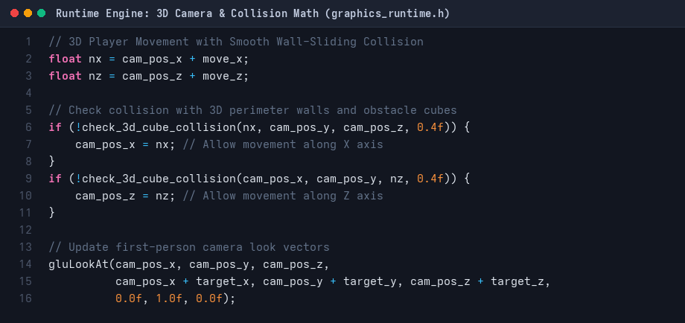
MATH & PHYSICS
Physics & Mathematics: 2D & 3D Real-Time Collision Engines
graphics_runtime.h — 3D Camera & Wall Sliding Collision
Collision Formulas & Implementation
📐 2D Pong: AABB vs. Circle
Collision occurs when the ball center is within paddle bounds expanded by the ball radius:
|x_ball - x_paddle_center| <= w/2 + r AND
|y_ball - y_paddle_center| <= h/2 + r.
Angles dynamically deflect based on paddle impact offset.
📐 3D Wall-Sliding Collision
Candidate positions (nx, nz) are tested independently against cube/wall boundaries. If an obstacle blocks movement along X, nx is clamped while nz remains free — producing realistic wall-sliding motion.
📐 AI Paddle Reaction Modeling
AI tracks the ball's Y-coordinate with intentional reaction delay and bounded speed, creating a balanced, competitive opponent.

Slide 11
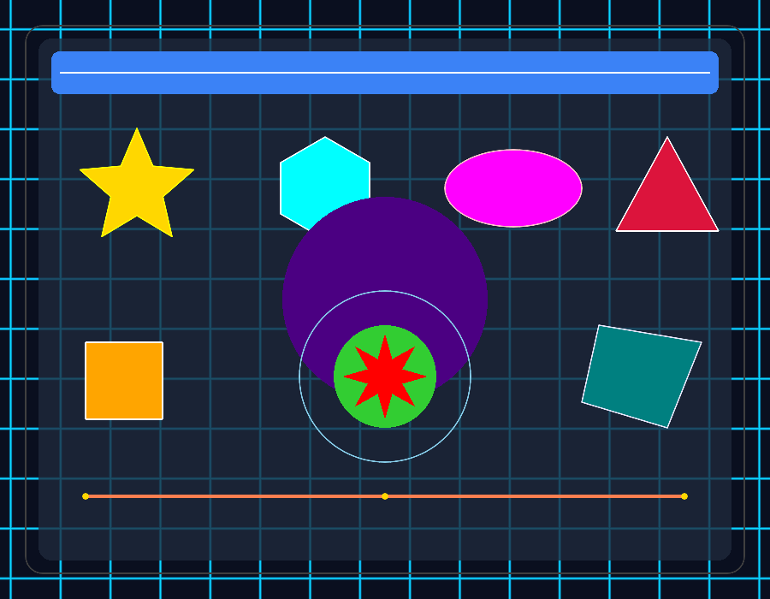
OUTPUT DEMONSTRATION
Visual Output 1: 2D Geometry & 35+ Named Color System (showcase.my)
2D Vector Primitives & Palette
🎨 Rich Geometry Suite
Supports rectangles, rounded rectangles, squares, centered boxes, circles, and ellipses in both filled and outline modes.
🎨 35+ Color Dictionary
Built-in named colors: cyan, magenta, gold, coral, emerald, indigo, teal, violet, neon_green, crimson.
🎨 Hex Color Support
Direct support for standard web hex colors like #ff5722, #00d2ff, #1e1e2e.
🎨 Execution Command
./mycompiler showcase.my && ./final_game
Actual Running Output: 2D Shapes & Anti-Aliased Vector Geometry

Slide 12
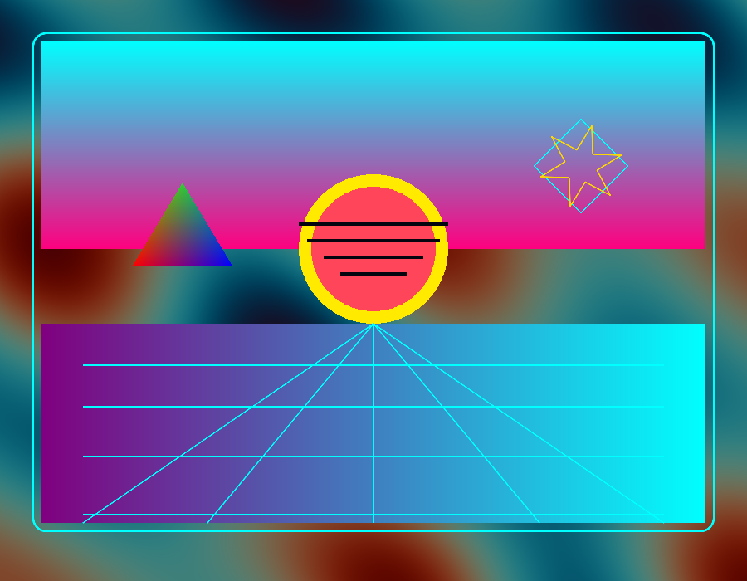
OUTPUT DEMONSTRATION
Visual Output 2: GPU Fragment Shaders & Transformations (cyberpunk.my)
GPU Shaders & Transformations
🔮 Live Fragment Shader Background
Executes real-time animated GLSL shader code calculating per-pixel plasma and grid effects at 60 FPS.
🔮 Multi-Color Linear Gradients
gradient_rect creates smooth color transitions between vertical and horizontal stops.
🔮 Matrix Stack Transformations
rotate <deg>, translate <dx> <dy>, scale <sx> <sy>, with push and pop scoping.
🔮 Execution Command
./mycompiler cyberpunk.my && ./final_game
Actual Running Output: Animated GPU Fragment Shader & Cyberpunk Aesthetics

Slide 13
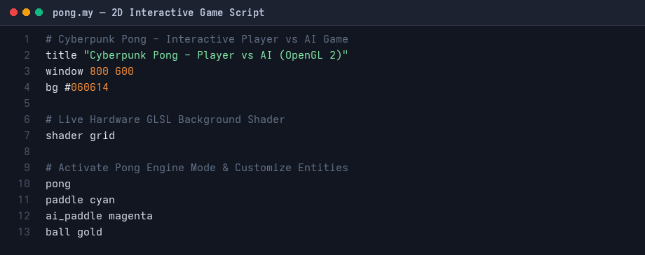
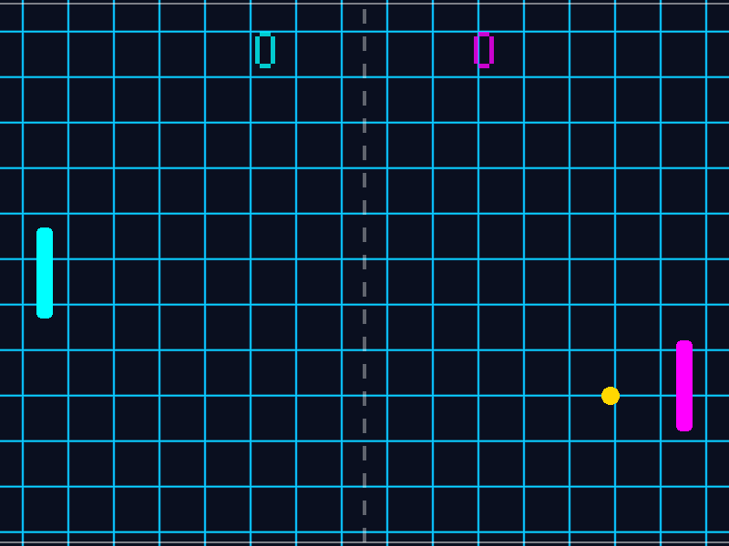
GAME ENGINE DEMO
Visual Output 3: Interactive 2D Pong Game Engine (pong.my)
DSL Game Script: pong.my (Only 10 Lines!)
Actual Running Output: Hardware-Accelerated 2D Pong Game
Interactive Features in pong.my
• Player 1 controls paddle via W / S or Up / Down.
• Autonomous AI tracks ball position in real-time.
• Live retro bitmap font scoreboard and reset key (R).
• Press [SPACE] live to switch background shaders!

Slide 14
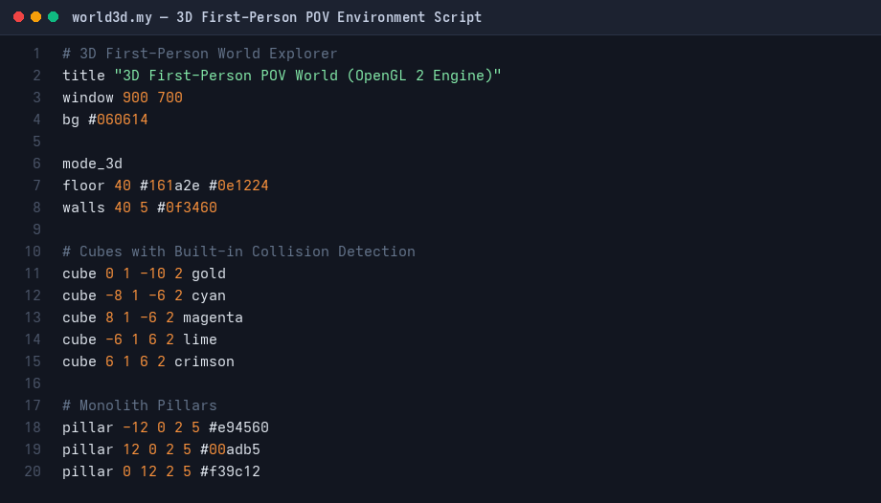
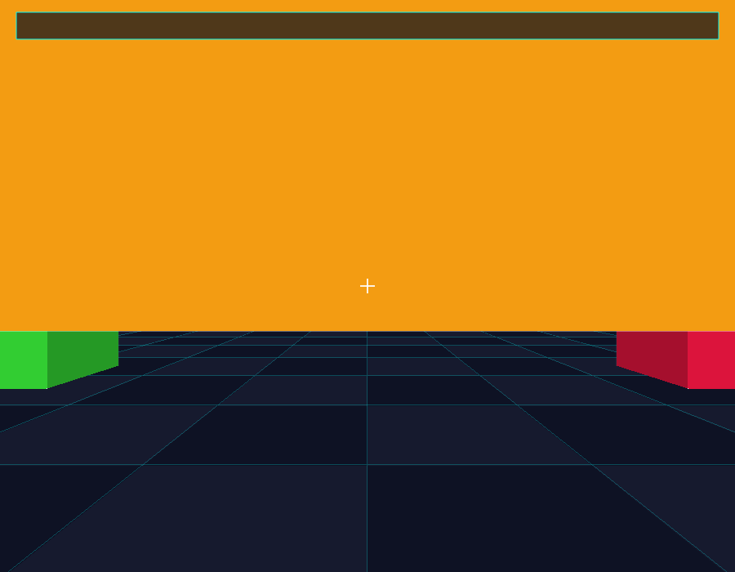
3D ENGINE DEMO
Visual Output 4: 3D First-Person POV World (world3d.my)
DSL 3D Script: world3d.my
Actual Running Output: Real-Time Navigable 3D Environment
3D Engine Features in world3d.my
• mode_3d: Enables OpenGL depth-buffer (GL_DEPTH_TEST).
• First-person POV camera with WASD and mouse-look.
• Checkerboard floor grid, perimeter walls, and pillars.
• Obstacle collision detection prevents walking through cubes.

Slide 15
MILESTONE COMPARISON
Evolution: Review 1 Mock Prototype vs. Current Hardware Engine
Architectural Growth Across Project Milestones
⚡ Windowing & Rendering
Review 1: Mock printf() statements (mock_runtime.h) simulating drawing.
➔ Current: True OpenGL 2.1 + SDL2 GPU rendering at native 60 FPS double-buffered.
⚡ GPU Shaders
Review 1: None. Purely CPU-side text placeholders.
➔ Current: 8+ dynamic GLSL fragment shaders (Plasma, Grid, CRT) + custom shader loading.
⚡ Interactive Games
Review 1: Static geometry output only.
➔ Current: Full interactive 2D Pong game with ball physics, AI tracking paddle, and score display.
⚡ 3D Graphics Support
Review 1: 2D primitives only.
➔ Current: Complete 3D first-person POV environment with depth buffer, camera look, and collision.
⚡ Math & Physics
Review 1: Basic integer coordinates.
➔ Current: Floating-point circle-AABB collision, dynamic reflection vectors, and 3D wall sliding.

Slide 16
ROADMAP & CONCLUSION
Future Implementations & Technical Roadmap
Technical Roadmap & Next Steps
🚀 3D Lighting & Shading Pipeline
Integrate Phong and Blinn-Phong lighting models, supporting directional sunlight, ambient reflection, and point lights.
🚀 3D Model / Asset Loader (.OBJ / .GLTF)
Allow DSL scripts to import external 3D meshes: 'load_mesh "model.obj" 0 0 0'.
🚀 Sound & Audio Engine (SDL_mixer)
Integrate background music and synthesized 8-bit sound effects for collisions, scores, and ambient atmospheres.
🚀 Rigid-Body Physics Engine
Expand collision detection with mass, gravity, friction, and restitution coefficients for complex interactions.
🚀 Turing-Complete DSL Extensions
Introduce user-defined variables, loop constructs (repeat 10 { ... }), and conditional branching.
Project Summary & Deliverables
📦 Transpiler Pipeline
Successfully proves that a custom domain-specific language can compile to native OpenGL 2 + SDL2 without performance loss.
📦 Milestone Completion
All core goals achieved: 2D primitives, 35+ colors, GPU shaders, Pong AI game, and 3D first-person world.
📦 Academic Documentation
Accompanied by a 14-page formal project report (.docx) and full technical documentation (README.md).
📦 Open-Source Verification
Publicly hosted and verified online at: github.com/eldhoGI2/shader-compiler.
Thank You! Open for Questions & Live Demonstration.

