Slide 1
ASSIGNMENT: EXPLORATORY DATA ANALYSIS ON FACEBOOK UTILIZATION DATA
Data Exercise Response
1)Load the data and impute missing values
For loading the data into a pandas data frame we can make use of the read_csv() function in the pandas library.
Imputation of missing values:
1.1) Replace the null values (NA) of gender column with its mode or median and explain why mode/median is used to replace NA values?
Approach: since the number of missing values(175) is high ,if we replace the missing values(NAN) in the gender column with mode it will lead to biasing or imbalance and the insights from the data analysis will be less accurate, so we replace the missing values with the median.
Result: Here the median is the value of gender in the 49502th row(central observation) and median = female.
We can fill the null values by using the fillna() function.
1.2) Replace the null values (NA) of tenure column (numerical variable) with its median,and explain why mode/median used to replace NA values?

Slide 2
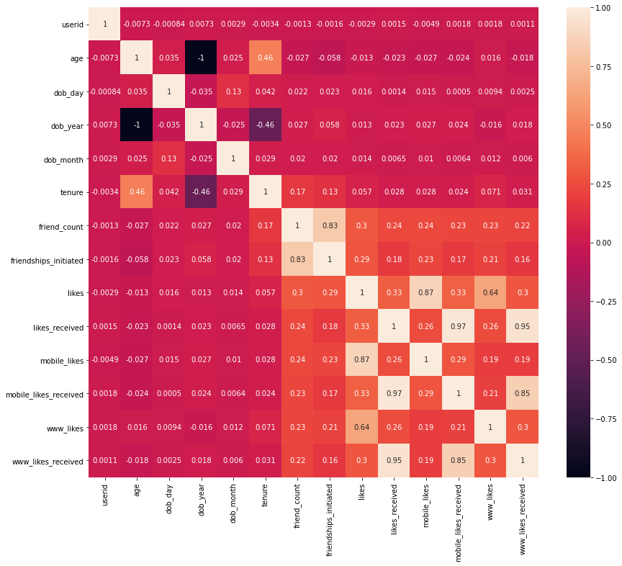
Approach: if we replace the missing values(NAN) in the tenure column with mode , it will lead to biasing or imbalance and the insights from the data analysis will be less accurate, so we replace the missing values with the median. Result: Median = 412
2) Plot heatmap / correlation matrix on all the columns

Slide 3
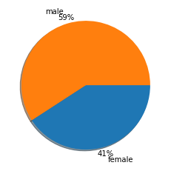
3) Analysis based on gender of the users 3.1) What is composition of male and female users? Result : Number of female users = 40429 Number of male users = 58574 Percentage of male users =59%
Percentage of female users =41%
Approach : we can use the groupby() function to group the male and female users and then use the count() function to compute the count of each group.

Slide 4
3.2)Which category of gender has more friends? Result : females have more friends compared to males Approach : we can use the groupby() function to group the dataset by gender and then select the friend _count column and perform the sum() function to get the total friend count of all males and females.
3.3) Which category of gender initiated more friendships?
Result: males initiated more friendships than females
Number of friendships initiated by males = 6037023
Number of friendships initiated by females = 4601094
Approach : we can use the groupby() function to group the dataset by gender and then select
the friendship_initiated column and perform the sum() function to get the total friendships
initiated by all males and females.

Slide 5
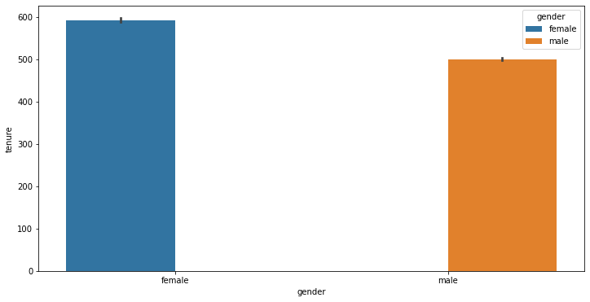
3.4)What is the distribution of tenure across different categories of gender?

Slide 6
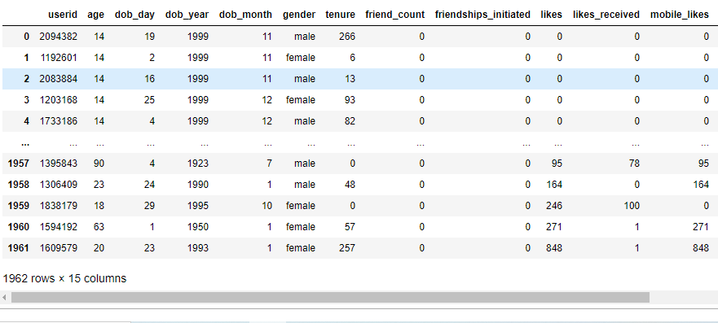
4) Analysis based on the least active users on Facebook
4.1) How many users have no friends?
Result : There are 1962 users who have no friends.
Approach : select all the rows where friend_count is equal to zero and note the count of rows
which is equal to the number of users with no friends.

Slide 7
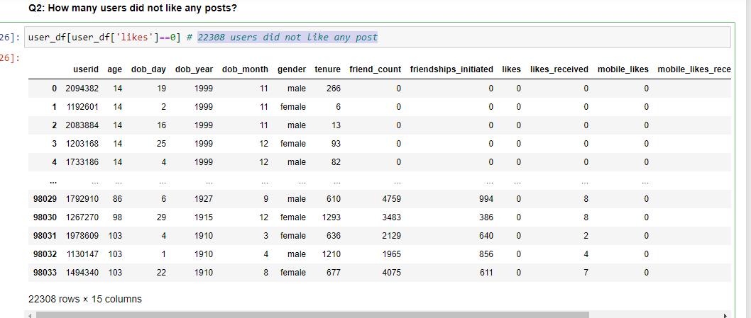
4.2)How many users did not like any posts? Result : 22308 users did not like any post
Approach : select all the rows in which the likes column is zero and note the count of rows ,
which is ultimately the number of users who did not like any post.

Slide 8
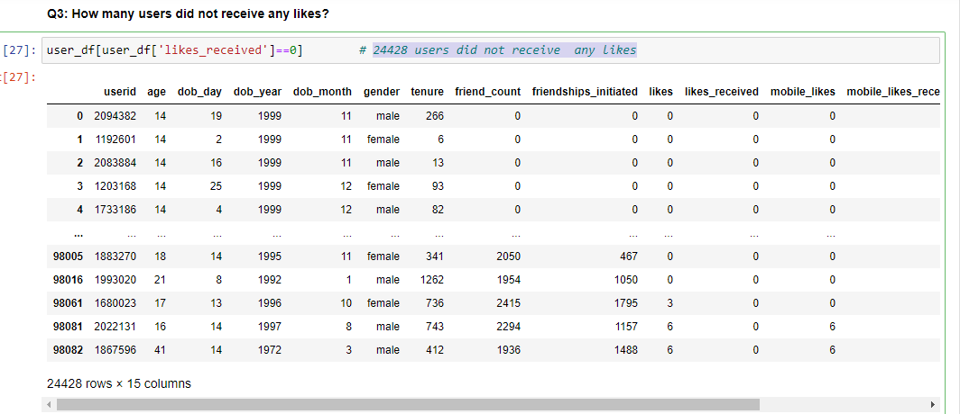
4.3)How many users did not receive any likes?
Result : 24428 users did not receive any likes
Approach : select all the rows in which the likes_received column is zero and note the count of rows
which is the number of users who did not receive any likes.

Slide 9
5) Analysis based on the user accessibility (Mobile Devices vs. Web Devices)
5.1) What is the average number of posts liked by users (based on gender) through web vs mobile devices?
Result : average number of posts liked by females through mobiles = 172
average number of posts liked by males through mobiles = 60
average number of posts liked by females through web devices = 87
average number of posts liked by males through web devices = 24
Approach : first group the dataset by gender ,then select the mobile_likes column and perform the
mean() function to get the average number of post liked by males and females through
mobiles.
similarly we can find the average number of post liked by males and females through
web devices.

Slide 10
5.2) What is the average number of likes received by users (based on gender) through web vs mobile devices?
Result : average no : of likes received by females through mobiles = 147
average no : of likes received by males through mobiles = 41
average no : of likes received by females through web devices = 104
average no : of likes received by males through web devices = 27
Approach : first group the dataset by gender, then select the mobile_likes_received column and
perform the mean() function to get the average number of likes received by male and
female users through mobiles.
similarly we can find the average number of likes received by male and female users
through web devices.

Slide 11
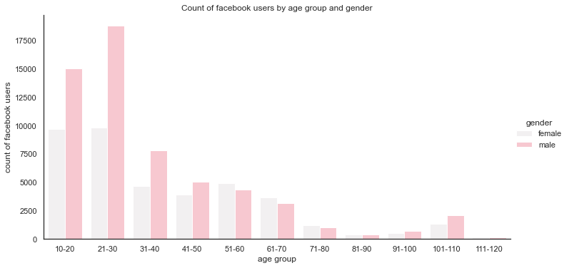
INSIGHTS AND PATTERNS
Most of the facebook users are in the age group of 21-30
Youngest user is 13 years old
Oldest user is 113 years old

Slide 12
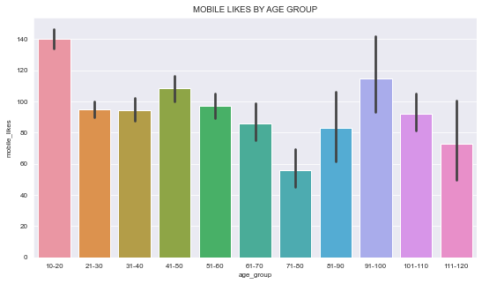
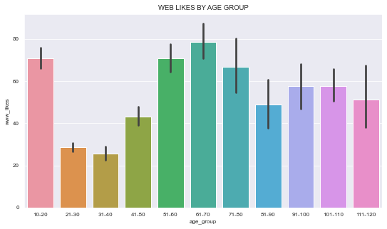
Users in 51-70 age group uses website for using facebook and around age group between 10-20 uses the mobile app.

Slide 13
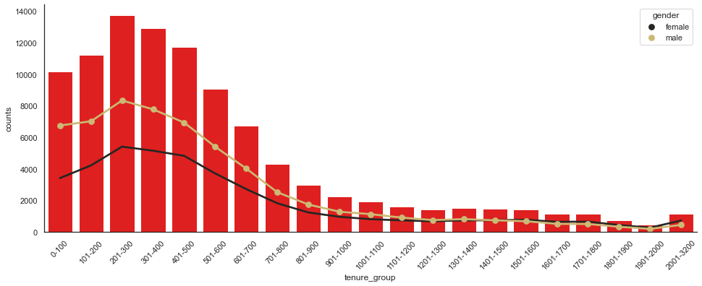
users with a tenure of (201-300) days are the most and within that males are more.

Slide 14
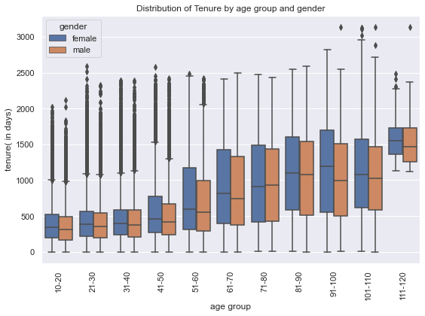
Females are socialising more compared to men across all age groups

Slide 15
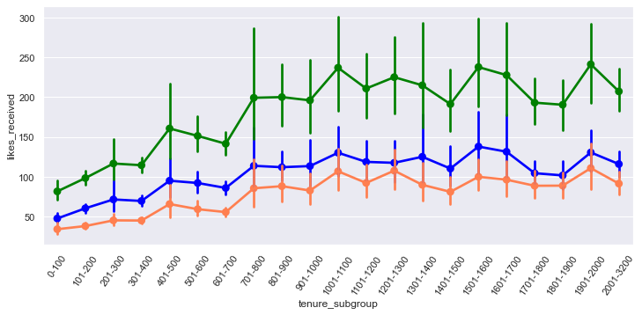
There is a huge rise in usage of mobile phones compared to web devices.

Slide 16
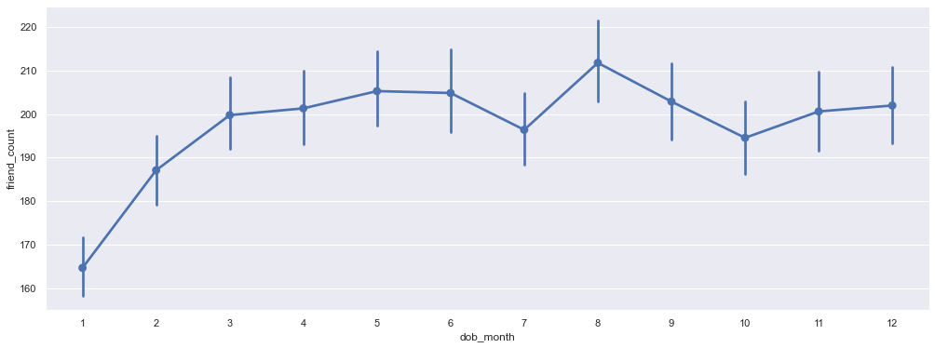
Users born in the month of august seems to have more friends

