Slide 1
Abusing the Bridge
Using Docker Images
(and a little Linux magic)
To Provision Baremetal Machines

Slide 2
Dramatis personæ
Docker (why we’re here)
DHCP (a venerable protocol for dynamically configuring hosts since RFC 1531 est. 1993)
TFTP (an even older protocol (1981) for, you guessed it, trivial file transfer)
GRUB (a bootloader)
CoreOS (an operating system)
Network Bridging (802.1D)
And BusyBox (a multicall binary)

Slide 3
Objective
Deploy a bunch of hosts to the Cloud! Yay! I clicked “Launch” and we’re done!
DEPLOY ON METAL

Slide 4
Objective
Deploy a bunch of hosts to the Cloud! Yay! I clicked “Launch” and we’re done!
DEPLOY ON METAL

Slide 5
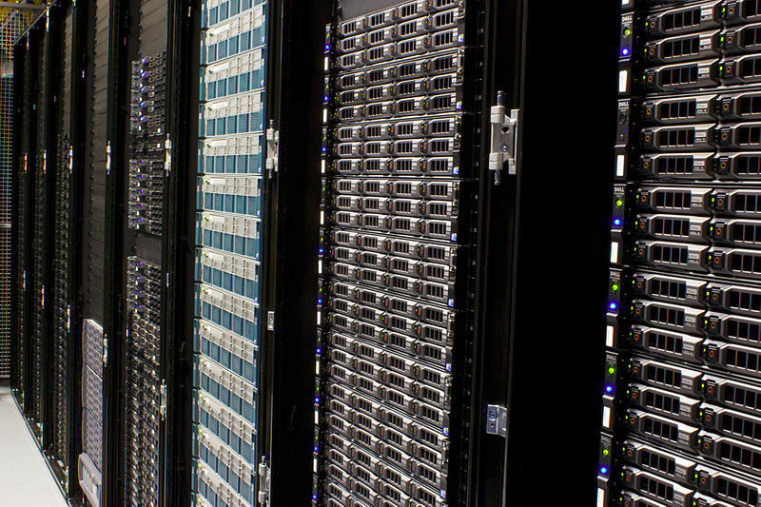
How do orgs deploy on baremetal?
A question nearly as old as the processor:
I have a big stack of these machines, how do I deploy something on them?
Wikimedia Foundation Servers
Victorgrigas

Slide 6
Manually!
Insert install CD
Click
Type
Click, Type
Type click click type click
Challenges:
Why you don’t want to do it:
Time consuming
BORING!
How to sell to other stakeholders:
Very hard to keep quality consistent when primarily performed by humans.
Hard to modify procedures (people build specific series of habits).

Slide 7
Have it baked at the factory
The mechanism is essentially that a set of images is provided to the machine builder. This is probably the easiest way from a time-I-spend perspective. HOWEVER:
Potentially expensive
Have to build machine images.
Out of your control
More challenging to change build process.
No capability for redo/deploy in the field.
Maybe somebody else has more experience?

Slide 8
PXE
What? I thought those were just in fairytales.
  Stands for Preboot Execution Environment
    Why did they not use the first letter of all words?
      ☑ bathroom joke
  Could existing in one of three places:
    Baked into the BIOS itself (some simple/older systems)
    Built into the networking card (some fun things can be done with this)
    Executed by the bootloader as a second stage
Bootloader? What’s that?

Slide 9
A Quick Overview of the Linux
Boot Process
Operating systems are in some sense just another program that a computer runs. Usually there are a few steps to a working computer.

Slide 10
A Quick Overview of the Linux
Boot Process
The motherboard has a special built-in program called the BIOS* that loads a (very small?) program (usually from a disk drive).
* Recently, BIOS has been replaced by a successor called UEFI, or Unified Extensible Firmware Interface. Intended to make securing computers easier, it has been an interesting technology to play with, but it may actually make computers less secure, and has already been bungled to a degree:
http://arstechnica.com/security/2016/08/microsoft-secure-boot-firmware-snafu-leaks-golden-key/

Slide 11
A Quick Overview of the Linux
Boot Process
Usually, the BIOS starts another program called the bootloader. On Linux systems there are two main versions that are used:
GRUB for desktops/servers/etc.
Das U-Boot is popular on “Embedded” devices
fastboot on android

Slide 12
A Quick Overview of the Linux
Boot Process
The Bootloader
“Initializes” hardware
  Usually a disk
Loads a program
  Linux kernel/”Chainloader”
May load other information
  Initrd, recently password/key

Slide 13
A Quick Overview of the Linux
Boot Process
Just like the bootloader the “kernel” (linux) is essenially just another program.
Sometime the bootload loads an “Initial RAM Disk” (initrd)

Slide 14
A Quick Overview of the Linux
Boot Process
Aside: Bootloaders historically have also been used to load diagnostic programs. Examples:
Memtest (when RAM goes bad)
VerifyMedium (for verifying the CD you’re booting burned correctly)
You can write your own if you want! In Rust!
Boot2Rust efi payload

Slide 15
A Quick Overview of the Linux
Boot Process
When the Linux kernel starts, one of the first things it looks for is an initrd.
Kinda like a zip or tarball (cpio)
Can be embedded directly into the same file as the kernel
  Change requires rebuild
Can be compressed

Slide 16
A Quick Overview of the Linux
Boot Process
If there is an initrd, then start the program called “init” in the initrd.
Unlock encrypted drives
Start RAID arrays
Initialize external hardware
Mount network shares

Slide 17
A Quick Overview of the Linux
Boot Process
Once init in the initrd is done, then start the program called “init” in the regular root of the filesystem.
These days in many cases this is systemd everywhere.

Slide 18
A Quick Overview of the Linux
Boot Process
Initrd: So often required that almost all Linux systems use them, even if they’re not strictly necessary.
Pet peeve: Ubuntu will rebuild your initrd (sometimes multiple times) when updating. If you are waiting for an update, it’s terrible!

Slide 19

Whew! That was a lot! What now?
All that was important (maybe) to understand where we are going next.

Slide 20
PXE
Basically everything we just talked about, but over the network.
  BIOS/EFI (or NIC firmware (or bootloader)) loads a bootloader (over network, dhcp directed)
  Bootloader loads kernel/initrd (over network)
  PROFIT?

Slide 21
PXE
Basically everything we just talked about, but over the network.
  BIOS/EFI (or NIC firmware (or bootloader)) loads a bootloader (over network, dhcp directed)
  Bootloader loads kernel/initrd (over network)
  PROFIT? Not yet, we don’t even have the OS started!
  Kernel starts, runs init. PROFIT?

Slide 22
PXE
Basically everything we just talked about, but over the network.
  BIOS/EFI (or NIC firmware (or bootloader)) loads a bootloader (over network)
  Bootloader loads kernel/initrd (over network)
  PROFIT? Not yet, we don’t even have the OS started!
  Kernel starts, runs init. PROFIT? NOT YET!
  Start docker, run services, finally PROFIT!

Slide 23
PXE
Doesn’t sound too bad. Why doesn’t everybody do it?
Several services to run:
  DHCP tells which server and what files to pick for pxe booting.
    Managing DHCP at this scale is not always awesome.
  TFTP serves the files. (Not secure!)
  Repacking custom initrd’s and updating kernels is not awesome either.
  Not always easy to debug (can’t just unrack a machine and bring it back, because turning it off may lose debug info)

Slide 24
PXE
Doesn’t sound too bad. Why doesn’t everybody do it?
The Cattle-vs-Pets distinction is new for many organizations.
It opens questions of how to automate provisioning, replication, and allocation of the persistent storage that likely exist on these machines.
No one owns it per-se. Many organizations build products around it, (openstack, etc), but those can be quite complex.

Slide 25
PXE
Can we make it easier with docker?
Yes!
Docker can run the services (this is what it does!)
The servers have to be hooked into some kind of network interface to PXE. We can connect to that.
Docker uses a special kind of networking tool called a bridge to let containers talk to each other. We can put that on the larger network.

Slide 26
CoreOS
PXE booting is in its DNA
Runs docker natively, so we know the kernel will have all the special goodies
Actively maintained
Also has cons:
  Huge initrd means longer startuptimes (>2 minutes)
  Company has investment in own tools.
  Kinda complicated

