Slide 1
Forecasting Stock Returns Using Fractional Differencing and LSTM

Slide 2
Intro and Background
Models that rely solely on historical returns when predicting future returns might have limitations in capturing long-term dependencies and irregularities in stock price dynamics.
Working with prices instead of returns is also not helpful as price data is highly nonstationary (very hard to model because properties of the data change very frequently)
This is where fractional differencing can be useful. It is a way to make a time series stationary (the mean and the variance are time-invariant) while preserving as much memory as possible. Although the idea was developed a long time ago (in 1970), it was not applied to for finance problems such as stock return prediction.
To take advantage of preserved memory, we are going to use LSTM, which is a deep learning model specifically designed to capture long-term dependencies in the time series data.

Slide 3
Intro and Background
Our objective is to investigate whether applying fractional differencing on log stock prices enhances the accuracy of predicting future stock returns and helps us build a better performing portfolio compared to a benchmark (portfolio build on the predictions coming from the historical returns).
The dataset that we chose consists of adjusted close prices and volume data spanning from 2000 to 2023 for companies included in S&P 500 (since training period for our forecasting model was decided to be 10 years, we decide to look at the components of S&P 500 in 2010)
As some companies had their stock tickers changed after 2010, we were not able to get the data for all 500 companies and only for about 400 companies.
After removing companies that did not have 10-year trading history before 2010, we left with 300 companies. Out of those 300 companies, we randomly sampled 30 companies because it would have taken too much time (one or two days) to build a model for all companies even if we used GPUs.

Slide 4
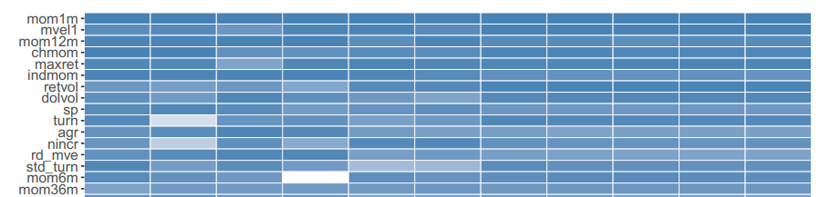
Why Did We Choose
Historical Adjusted Close Price and Volume Data as Features?

Slide 5
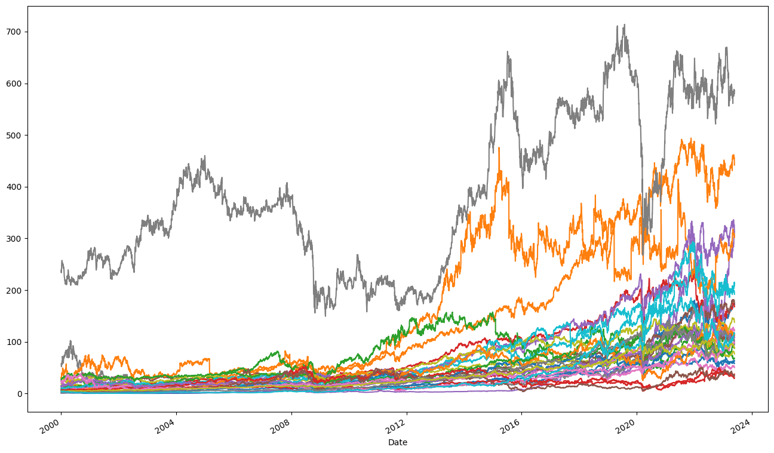
Randomly Selected 30 Stocks

Slide 6


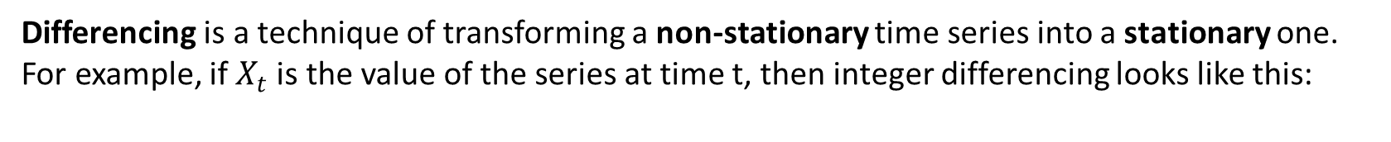
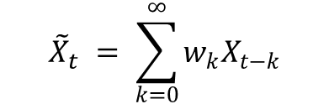
(Fractional) Differencing
Differencing is a technique of transforming a non-stationary time series into a stationary one.
For example, if $X_{t}$is the value of the series at time t, then integer differencing looks like this:
$${first difference:{ \tilde{X}}_{t}= X}_{t}−X_{t−1}$$
Then what is fractional differentiation?
Value at a current time can be expressed as the sum of all past values with the weight assigned for each of the past values (the weight is calculated using fractional derivative):
$${\tilde{X}}_{t} = \sum_{k=0}^{∞}{w_{k}X_{t−k}}$$
When d is a positive integer, like 1 (first differencing), the memory is removed, but when d is between 0 and 1, the memory will be preserved. We used a library called “fracdiff”, which has a function that automatically finds min d (order difference) which makes the data stationary.

Slide 7
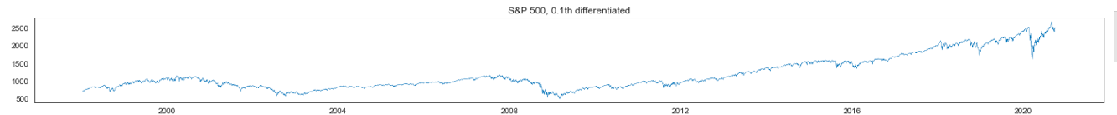
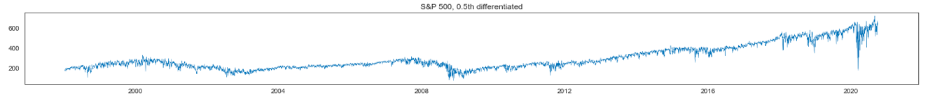
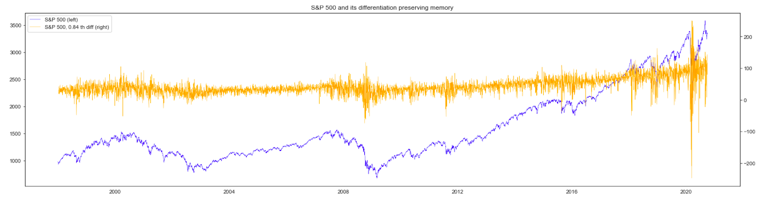
FracDiff applied to S&P index (d=0.1, d=0.5, 0.84 (optimal))

Slide 8

Is there a relationship between returns and fractionally differentiated log prices?
$$R_{t}≈\log{S_{t}} −\log{S_{t−1}}$$
$$\tilde{S_{t}}=\log{S_{t}} −d\log{S_{t−1}+\log{S_{t−2} }\frac{d\left(d−1\right)}{2!}} −\log{S_{t−3}}\frac{d\left(d−1\right)\left(d−2\right)}{3!}+ …$$
It approximately equals to $R_{t}$ if d (order difference) is high, which also cause other terms in the above sum approach zero.
Since we saw that there is a relationship between $R_{t}$and fractionally differentiated log price, we will model directly forecast $R_{t+1}$ using $\tilde{S_{t}}$ as a feature.

Slide 9
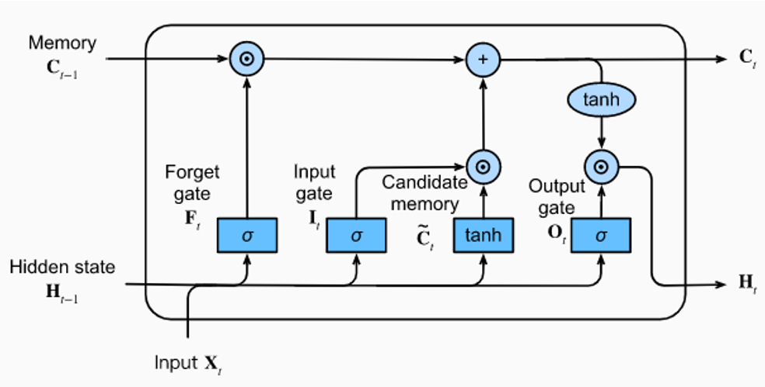
Long Short-Term Memory (LSTM) Model
A type of recurrent neural network (RNN) that is designed to capture long-term dependencies in sequential data
Inputs for target portfolio: 1) fractionally differentiated log price
2) daily trading volume
Inputs for benchmark portfolio:
1) historical returns
2) daily trading volume
- (in both cases, the features are standardized for model training)
Hyperparameters:
7 hidden nodes;
21 lag terms (in one month there are 21 trading days);
100 epochs
128 batch size

Slide 10
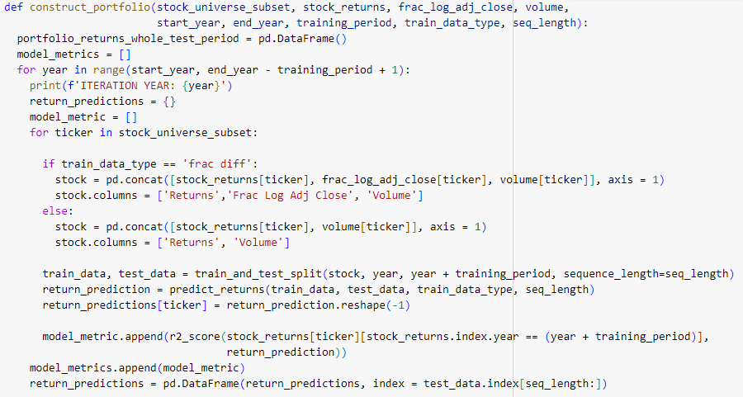
Portfolio Construction
Build an LSTM model on 10- year training data for each stock
Get its daily stock return prediction for the following year
Each day rank the chosen stocks based on the estimated stock returns
Buy top 5 stocks (‘High’)) that had highest predicted returns and short 5 stocks (‘Low’) that had lowest predicted returns

Slide 11
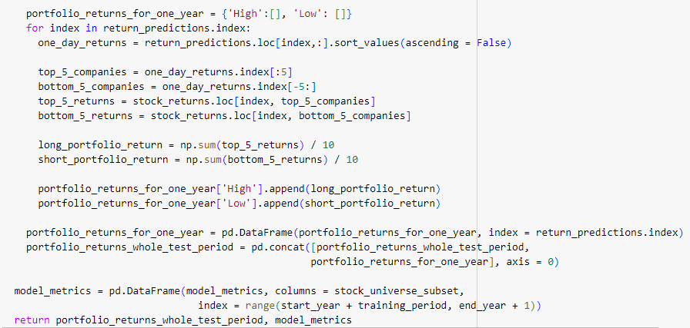
Portfolio Construction
Build an LSTM model on 10- year training data for each stock
Get its daily stock return prediction for the following year
Each day rank the chosen stocks based on the estimated stock returns
Buy top 5 stocks (‘High’)) that had highest predicted returns and short 5 stocks (‘Low’) that had lowest predicted returns

Slide 12
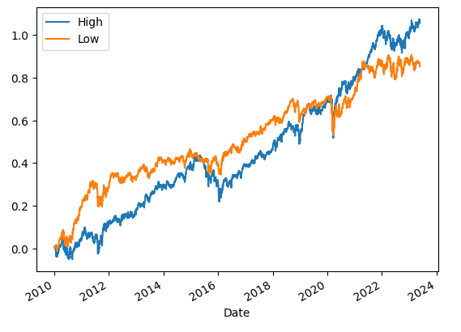
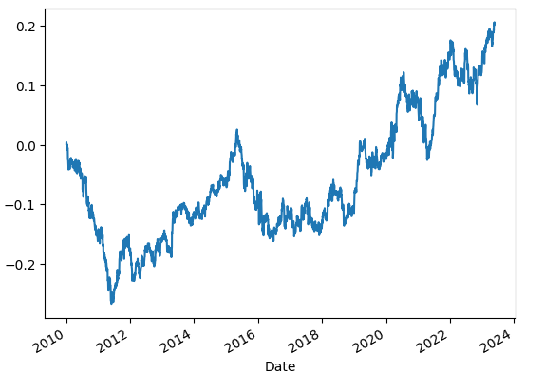
Target Portfolio Results
Orange: Long Portfolio
Blue: Short Portfolio
Long - Short Portfolio

Slide 13
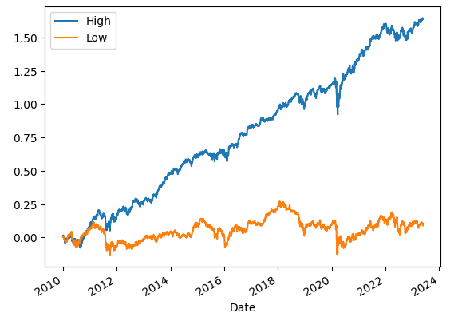
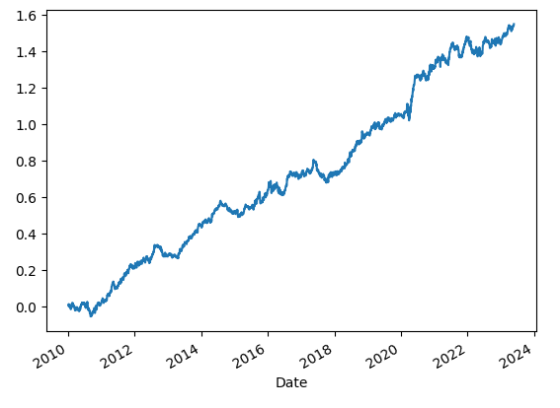
Benchmark Portfolio Results
Orange: Long Portfolio
Blue: Short Portfolio
Long - Short Portfolio

Slide 14
Limitations and Future Research
Throughout our project, we investigated the use of fractionally differentiated log price data in constructing a long short portfolio.
However, the portfolio results showed that the benchmark portfolio performed considerably better than the target portfolio
This might be due to a variety of reasons:
- Unluckily defined or too small stock universe
Misspecification and overtraining of the LSTM model for target portfolio
Fractional differencing might not actually be effective to predict stock returns (past data, regardless of high preserved historic pattern, does not predict future behavior)
More extensive analysis might be required to fully know the effect of fractional differencing on stock return prediction

Slide 15
References
1. Gu S., Kelly B. & Xiu D. (2018, September). Empirical Asset Pricing via Machine learning https://academic.oup.com/rfs/article-pdf/33/5/2223/33209812/hhaa009.pdf
Shah I. (2020, February). Historical Stock Price Data in Python https://towardsdatascience.com/historical-stock-price-data-in-python-a0b6dc826836
Gui K. (2020, August). Feature Engineering: Fractionally differentiated features https://medium.com/swlh/fractionally-differentiated-features-9c1947ed2b55
Example of Fractional differencing applied to S&P 500 index https://colab.research.google.com/github/fracdiff/fracdiff/blob/main/examples/example_prado.ipynb#scrollTo=P9dnVAHftZtn
Investment Portfolio Optimization using LSTM https://github.com/georgemuriithi/investment-portfolio-optim/tree/main
Shah I & Gupta A. (2021, September) Long Short Equity Strategy https://blog.quantinsti.com/long-short-equity-strategy/
Lopez De Prado M. (2018, February) Advances in Financial Machine Learning

Slide 16
THANK YOU

