Slide 1
Kinematics for NAO
Forward and Inverse Kinematics
for the NAO robot
Nikolaos Kofinas
Diploma Thesis
Thesis Committee:
Assistant Professor Michail G. Lagoudakis (ECE)
Professor Minos Garofalakis (ECE)
Assistant Professor Aggelos Bletsas (ECE)

Slide 2
Motivation
How we can feel where our without we can see them?
How we can move our hand to a surtend point around us?
Can we make this happens with the robots too?

Slide 3
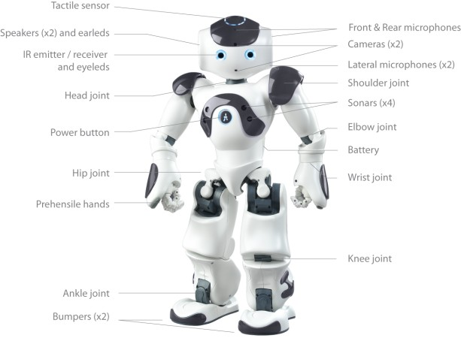
The NAO Robot (1)
0

Slide 4
Kinematics and Robocup
RoboCup soccer competion needs from robots to do a lot of complicate motions
Walk is the most difficult movement
Dynamic kicking and balancing
Find the accurate position of the horizon for better robot Vision

Slide 5
3D-Space and Joint-Space
The space around us is the three-dimensional space
Its point in the three dimensional space can be described by the position and the orientation
The orientation can be described by the three Euler angles
Joint-space is a n-dimensional space where n the number of the joint of interestler

Slide 6
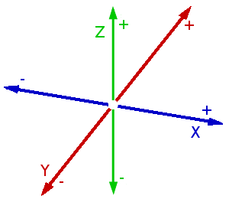
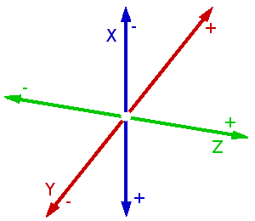
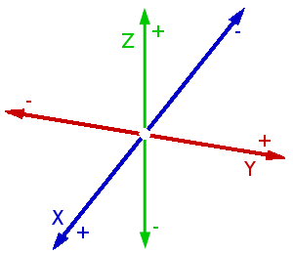
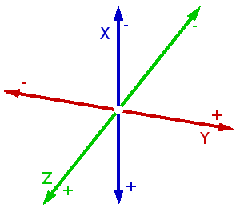
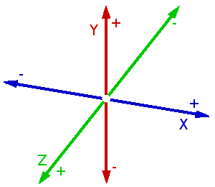
Euler angles

Slide 7
Affine, Translation, Rotation Transformations
Affine matrices are (n x n) matrices where the last line are always zeros followed by an 1

Slide 8
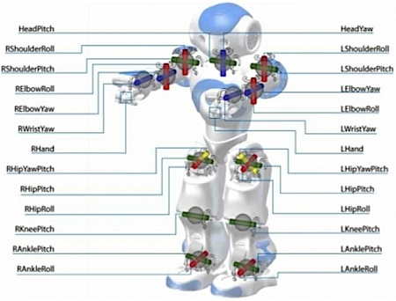
The NAO Robot (2)
Alisides tou nao

Slide 9
Forward Kinematics

Slide 10
DH Parameters

Slide 11
The hand chain of NAO (1)

Slide 12
The hand chain of NAO (2)

Slide 13
Inverse Kinematics

Slide 14
Inverse Kinematics for nao
Genika giati einai dyskoles ktlp

Slide 15
Inverse Kinematics for the legs

Slide 16
Inverse Kinematics For the legs2

Slide 17
Implementation Of Kinematics

Slide 18
Execution Times

Slide 19
Demo 1

Slide 20
Demo2

Slide 21
Questions
Questions?

Slide 22
Thank you
010101000110100001100001011011100110101101110011

