Slide 1
Speech Analytics on Live Streams
Gabriel Sammut
Nicholas Frendo

Slide 2
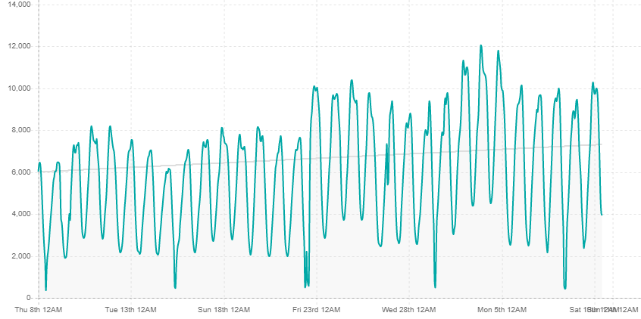
Problem Definition - Video Livestream Capture
Identified Challenges (Variety, Velocity)
A massive, constant stream of video and audio data being emitted
Current top streamed game on Twitch - Fortnight
Stream Time ( 30 days ): 484 years, 37 days
Streamers (30 days): 485,379
Data velocity (and volume?) problem
Different live streaming platforms
Various streaming content platforms
Twitch.Tv
YouTube Live
Facebook Live
Data variety problem
Figure i) Fortnight Streaming Seasonality on Twitch.Tv platform

Slide 3
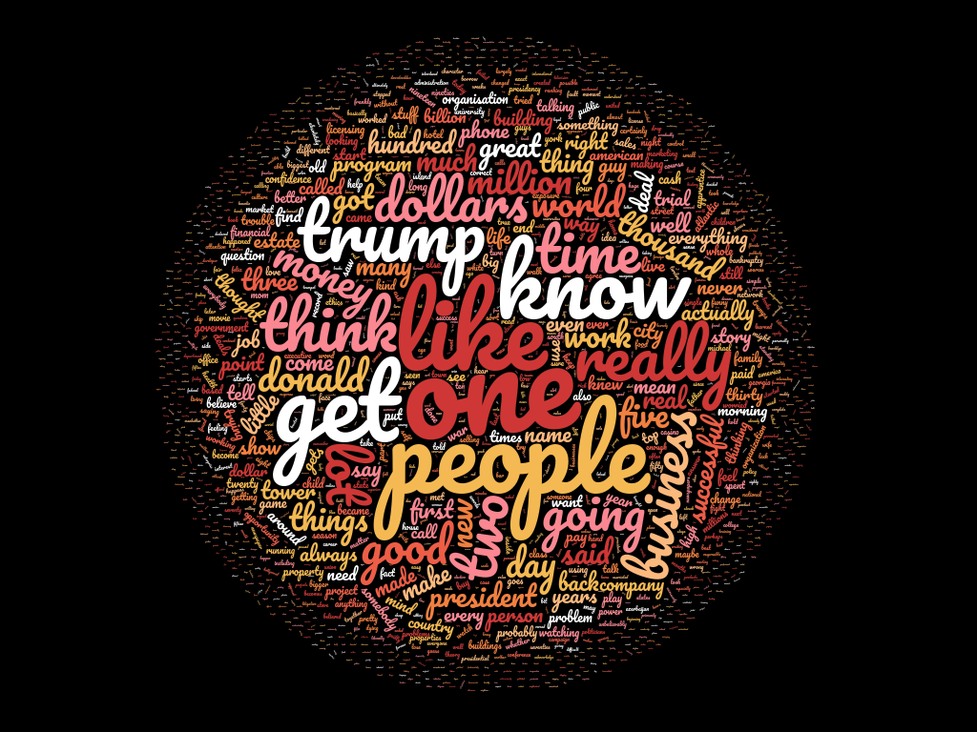
Envisioned Solution
Envisioned Solution
Convert the streaming audio into text
Handling multiple video streams in parallel
Capable of supporting multiple streaming platforms, focussed on big 3:
Twitch
YouTube
Facebook
Initial Prototype
Audio clip duration: 77 minutes
Processing time: 127 minutes
Notes:
Netflix official site → Link
Transcription library → Link

Slide 4







Pipeline
Notes:
Google Cloud Platform is optional. Can be replaced by something in house installed with the system.

Slide 5

Additional Requirements
Data Analytics
Trending words per channel
Trending words per game
Word pair frequencies - Word collocation
Data Visualisations
Game & Streamer Interactions
Streamer & Viewer Interactions
Streamer & word count utterance
Content Recommendation
Foul language tracking
Game classification / Similarity
Notes:
Data Analytics
Trending words per channel
Trending words per game
Data Visualisations
Game & Streamer Interactions
Streamer & Viewer Interactions
Streamer & word count utterance
Content Recommendation
Inappropriate streaming flagging
Foul language tracking
Game classification
Attempt to classify which game is being streamed based off extracted wording

Slide 6
Questions?

Slide 7
References
W.Zhang, L.Xu, P.Duan, W.Gong, Q.Lu and S.Yang, “A video cloud platform combing online and offline cloud computing technologies”, 2015.
W.Zhang, L.Xu, Z.Li and Q.Lu, “A deep-intelligence framework for online video processing”, 2016.
https://cmusphinx.github.io/
https://www.ffmpeg.org/
https://www.nltk.org/
https://sullygnome.com/

