Slide 1
Speech Analytics on Live Streams
Gabriel Sammut
Nicholas Frendo

Slide 2
Contents
Problem Definition
Use Case Example
Challenges
Proposed Solution
Architecture
Installation
Milestones & Evaluation

Slide 3
Problem Definition
Massive amounts of data being live streamed constantly, most of which is not retained and deleted by the platform
Livestreams pose following challenges:
Velocity
Variety
Volume (Not tackled in this use case)
Proposed architecture must:
Process data quickly
Handle multiple stream formats
Remain flexible to scale

Slide 4
Problem Definition
Livestream data can qualify as following categories:
Video
Audio
Textual
Notable mentions towards real time streaming platforms:
Twitch.tv
YouTube Live
Captured data useful for data analytics:
Word linking per streamer/viewer
Advertisement targeting
Foul Language Tracking

Slide 5
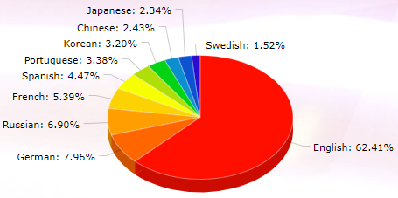
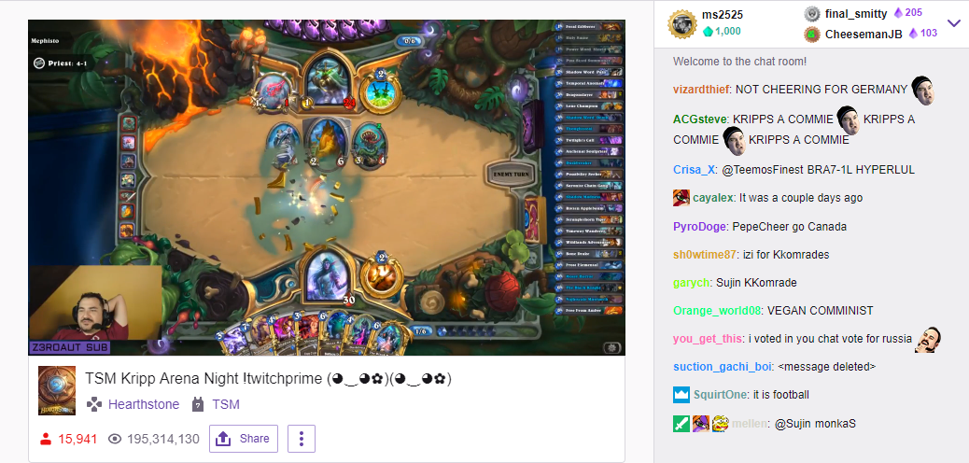
Twitch.tv Use Case
Multilingual, multi-platform game related livestreams
Twitch Stats based over last 7 days
3,241,304 Twitch Live Streams
192,903,221 hours of viewer watch time
6,662,740 hours of streaming
Notes:
https://twitchstats.net/
https://sullygnome.com/channels

Slide 6
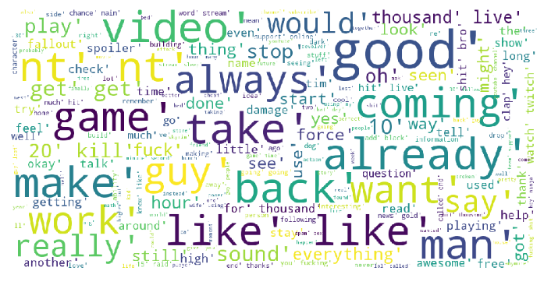
Challenges
System must be capable of processing and handling livestream in an archivable manner, useful for data analytics:
Capture livestream speech as text
Capture livestream chat
Represent captured text in structured manner
Allow room to scale on demand
Ensure minimal downtime

Slide 7



Proposed Solution
4-Staged, distributed pipeline, capable of meeting the demands:
Data Velocity
Data Variety
Proposed solution should at least integrate with following platforms:

Slide 8
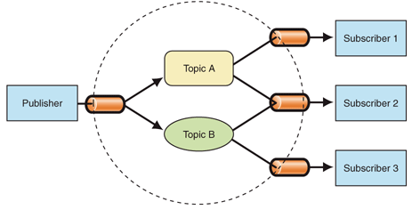
Architecture
Technologies:
Neo4j Graph Store
Apache Kafka
Apache Storm
Google Cloud Platform
Azure Cloud Platform
Pipeline Terminology:
Producer Node
Data Source, recording text / video
Kafka Node
Zookeeper Instance
Apache Kafka brokers
Storm Node
KafkaSpout / Consumer
Text Processing Bolts
Graph Coordinator Bolt
Graph Node
Instance of Neo4j Graph Database

Slide 9
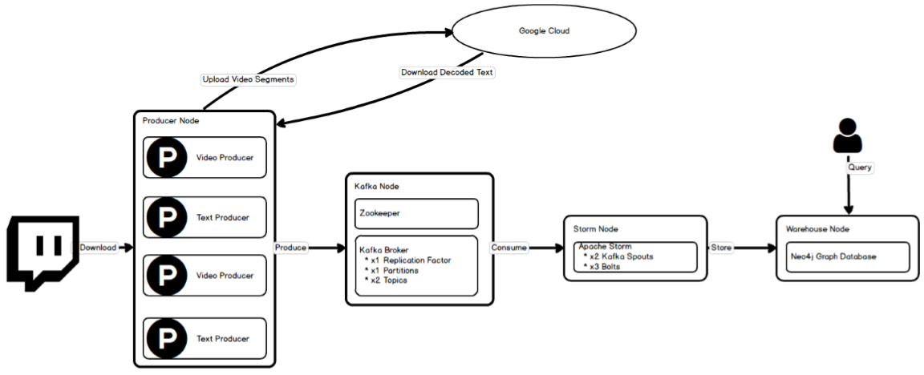
Notes:
Streaming Mode

Slide 10
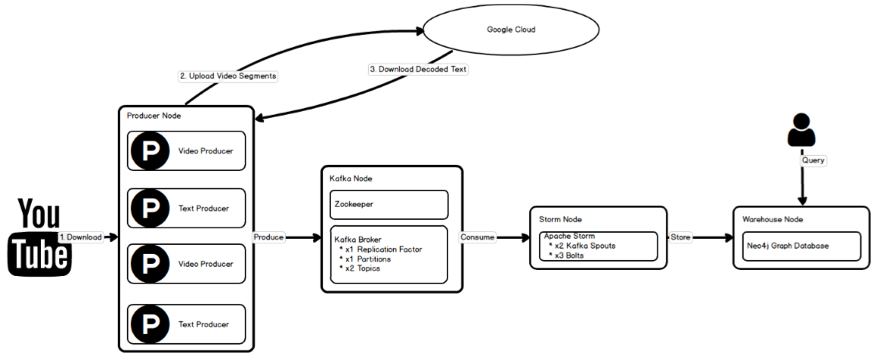
Notes:
Recording Mode

Slide 11
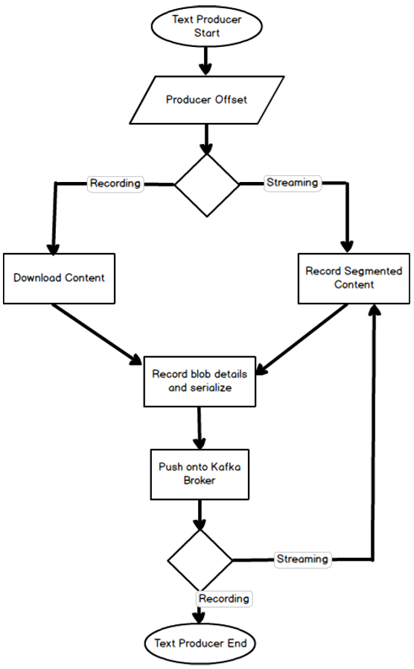
Text Producer Flow

Slide 12
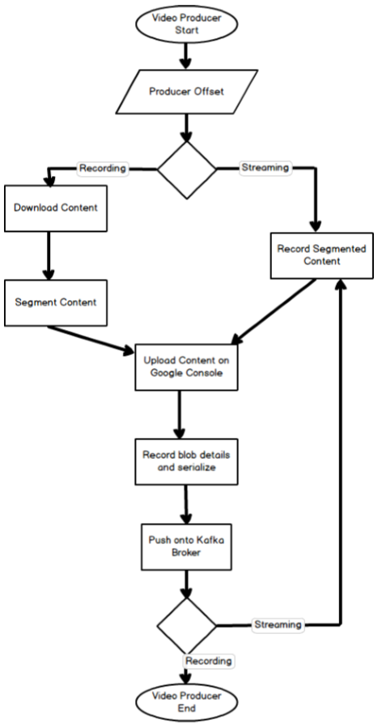
Video Producer Flow

Slide 13
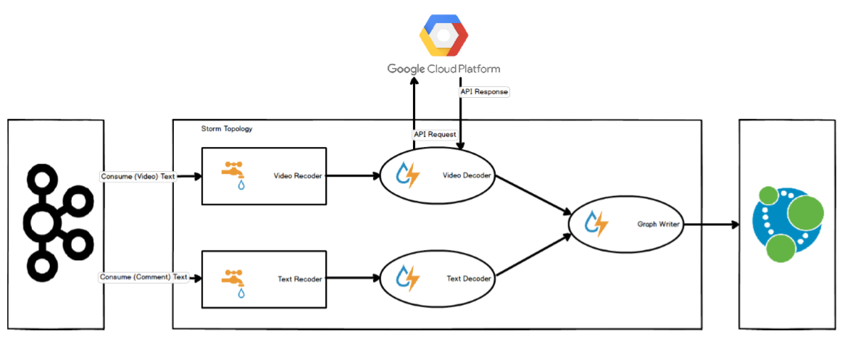

Slide 14
Installation
Pipeline is composed of 4 modules
Each module was contained within a separate Docker Image
All shared components and Python modules housed within a base image
Specific images were also created
Speech Analytics
Self written system tool to automate local/cloud execution
Docker
Docker Machine

Slide 15
Installation
Utility offers following functionality:
VM creation / deletion
VM start / stop
Docker container start / stop
Utility pulls from github repository ensuring latest build upon VM inception
Capture of telemetry information from docker containers:
CPU usage
Memory Usage
Block I/O Usage
Net I/O Usage

Slide 16
Milestones
Data Analytics
Data Dynamics
Data Visualizations
Two proposed milestones, to test and evaluate the pipeline end-to-end
Milestone One:
Smoke test the pipeline throughout
First fully fledged test on the architecture, to gauge weaknesses & flaws
Target Platform - YouTube (Recorded Content)
Milestone Two:
More comprehensive and voluminous
Aimed at stress testing the system with increased loads, for a longer period of time
Target Platform - Twitch (Live Content)

Slide 17

Milestone 1
Objective:
Monitor system vitals at minimal load
Test Producer ‘recording’ logic
Use Case:
Season 1 of ‘Last Week Tonight’
Total of 20 episodes, all on YouTube
Each video is of length ~20 minutes
All respective video YouTube comments are extracted

Slide 18
Milestone 1
Input data streams channelled through 4 producers
x2 video dedicated
x2 text dedicated
Node Distribution
Producer Node
Kafka Node
Storm Node
Graph Node
VM Component | VM Specification
CPU | x2
Main Memory | 7 Gb
SSD Storage | 100 Gb
HD Storage | 6000 Gb
IOPS Read/Write | 93/46 Mbps

Slide 19
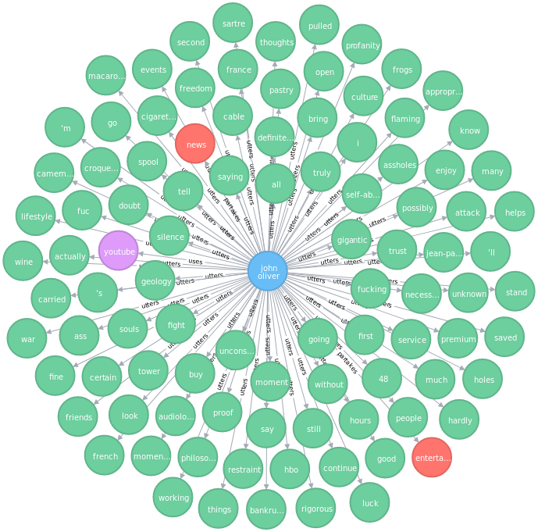
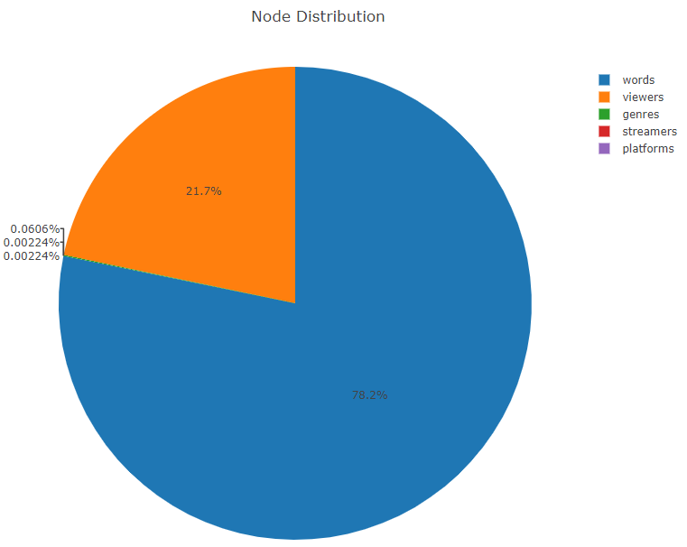
Milestone 1 - Results
Entity | Process Start | Process End | Total Time
Producer2 (Video) | 05:37:44 | 10:37:00 | 5hrs
Producer3 (Text) | 05:37:44 | 13:00:00 | 7hrs 23mins
Producer4 (Video) | 05:37:44 | 10:37:00 | 5hrs
Producer5 (Text) | 05:37:44 | 13:00:00 | 7hrs 23mins
Kafka | 05:37:44 | 13:00:00 | 7hrs 23mins
Storm | 05:37:44 | 13:00:00 | 7hrs 23mins
Neo4j | 05:37:44 | 13:00:00 | 7hrs 23mins
Notes:
Pause on this slide, showcase some further visualizations

Slide 20

Milestone 2
Objective:
Stress test the system
Real-time processing
Increase pipeline processing time
Use Case:
Focussed on variety of Twitch.tv Channels
24x7 streams, low popularity
8x5 stream, high popularity
Stream is indefinite length
No control over stream duration
E3 coverage during our run
Attracts more viewers on Twitch.tv

Slide 21
Milestone 2
Input data streams channelled through 8 producers
x4 video dedicated
x4 text dedicated
Node Distribution
Producer Node 1 (4 Producers)
Producer Node 2 (4 Producers)
Kafka Node
Storm Node
Graph Node
VM Component | VM Specification
CPU | x2
Main Memory | 7 Gb
SSD Storage | 100 Gb
HD Storage | 6000 Gb
IOPS Read/Write | 93/46 Mbps

Slide 22
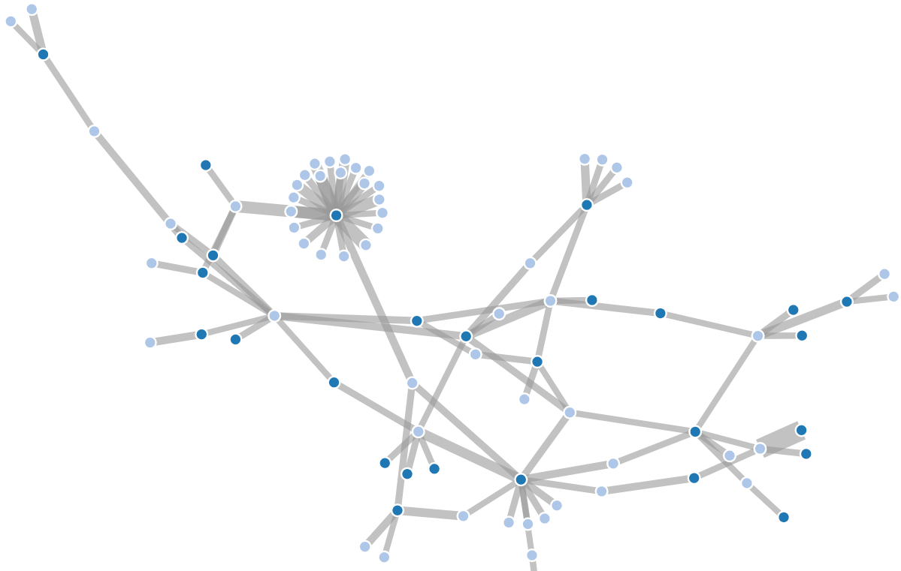
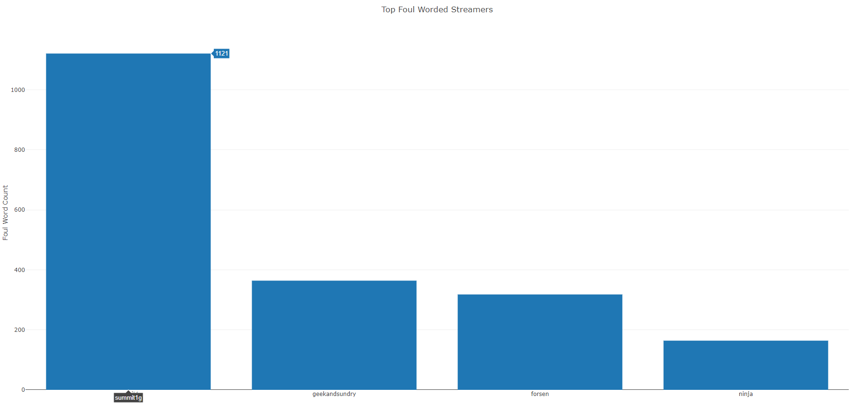
Milestone 2 - Results
Whole test ran for 19 hours
Total of 23350 nodes
Capable of asserting claims on targeted streams:
Highest occurance of foul word used
Highest foul worded streamer
Top foul worded genre
Measure ‘viewer’ toxicity
Notes:
Pause on this slide, showcase some further visualizations

Slide 23
Future Work
Pipeline Security
No Azure authentication
Processes run as root on cloud
Distribution of Google accounts
Increase system robustness
Investigate for potential memory leaks

Slide 24
Presentation End

