Slide 1
DSC40B:
Theoretical Foundations of Data Science II
Lecture 17: Kruskal’s algorithm for MST, and hierarchical clustering
Instructor: Yusu Wang

Slide 2
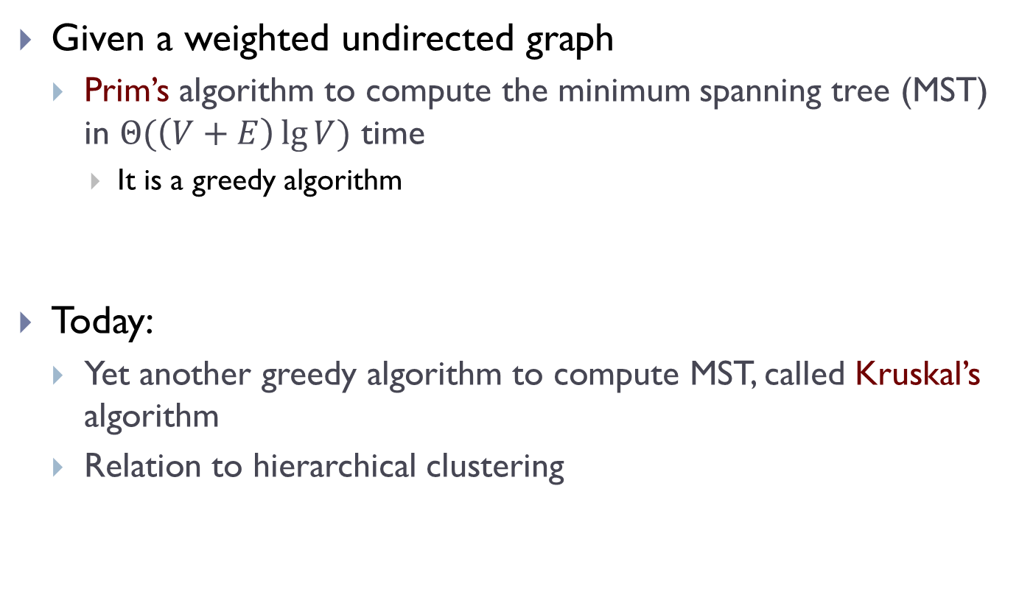
Previously
Given a weighted undirected graph
  Prim’s algorithm to compute the minimum spanning tree (MST) in $Θ(\left(V+E\right)\lg{V})$ time
    It is a greedy algorithm
Today:
  Yet another greedy algorithm to compute MST, called Kruskal’s algorithm
  Relation to hierarchical clustering

Slide 3
Kruskal’s Algorithm for MST

Slide 4
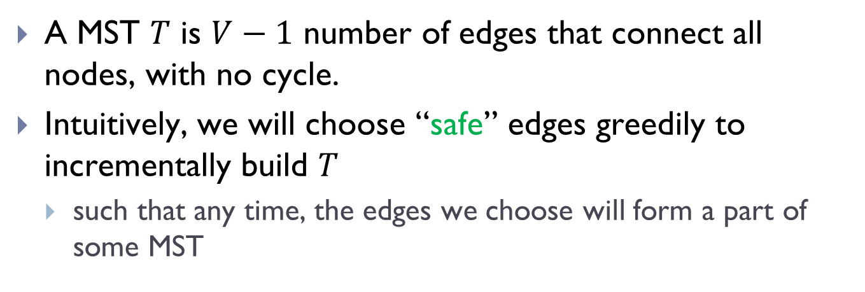
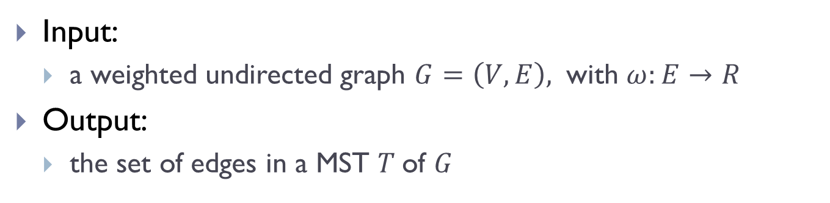
Recall the general greedy idea:
Input:
  a weighted undirected graph $G=\left(V,E\right),$ with $ω:E→R$
Output:
  the set of edges in a MST $T$of $G$
A MST $T$ is $V−1$ number of edges that connect all nodes, with no cycle.
Intuitively, we will choose “safe” edges greedily to incrementally build $T$
  such that any time, the edges we choose will form a part of some MST

Slide 5
Last time: Prim’s algorithm
  Starting from any node, it starts to grow a partial tree, by repeatedly choosing the minimum-weight edge to reach an unvisited node, till it connects all graph nodes
Today: Kruskal’s algorithm
  We will choose the ``safe” edges in a different order, and still grow the tree edge by edge
    However, during the intermediate stages, what we have may not be a partial tree, could be disconnected.

Slide 6
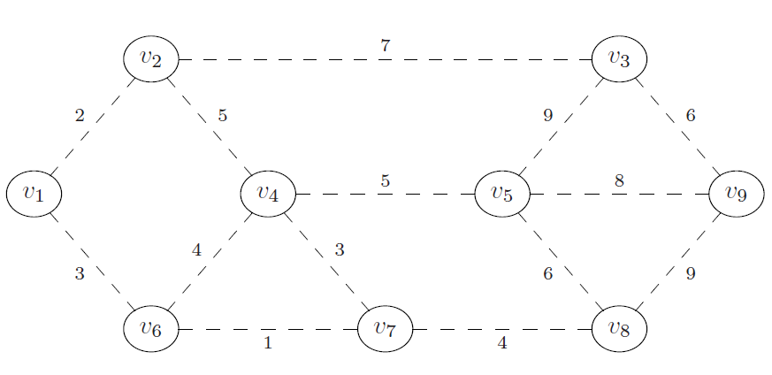
Example
What is a “safe” edge to add first?
What will be the next a “safe” edge to add?

Slide 7
Strategy of Kruskal
We will add edges gradually in a greedy manner using smallest weights, while maintaining what we have so far does not have any cycle
  add edges to tree in ascending order by weight
  but if an edge creates a cycle, no not add it, and move on to next edge

Slide 8
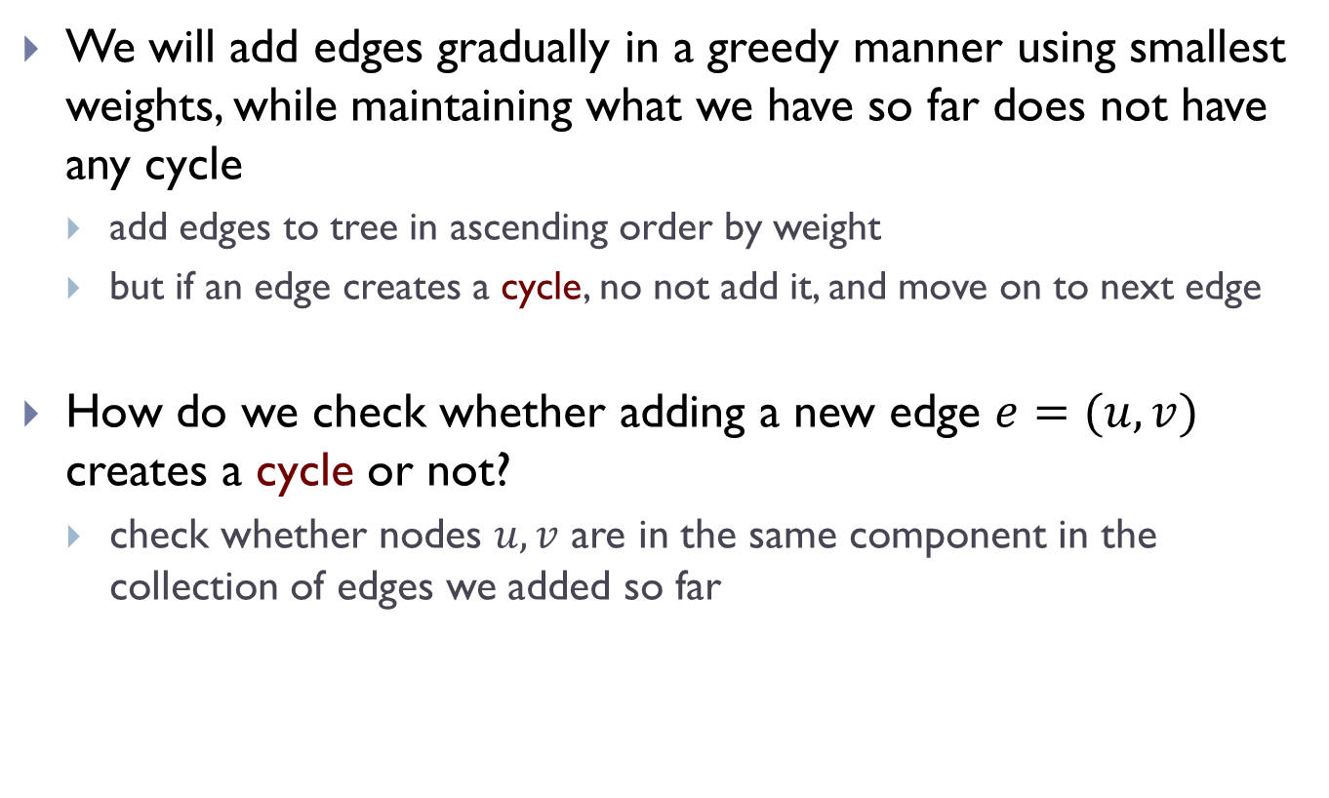
Strategy
We will add edges gradually in a greedy manner using smallest weights, while maintaining what we have so far does not have any cycle
  add edges to tree in ascending order by weight
  but if an edge creates a cycle, no not add it, and move on to next edge
How do we check whether adding a new edge $e=(u,v)$ creates a cycle or not?
  check whether nodes $u, v$ are in the same component in the collection of edges we added so far

Slide 9
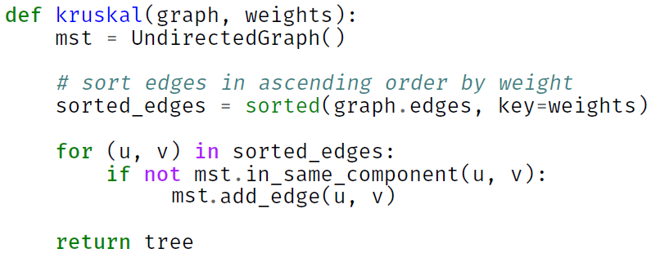
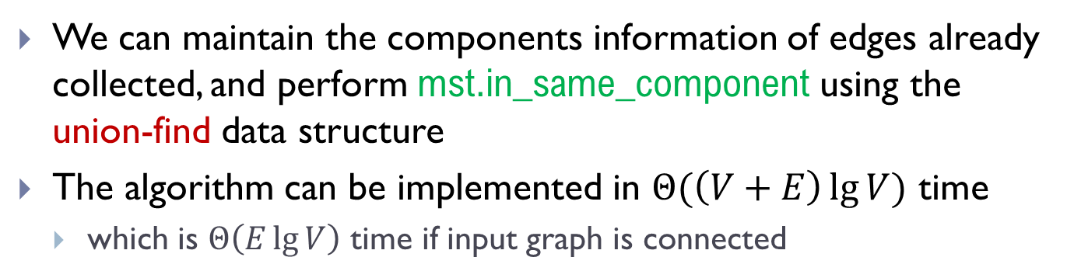
Kruskal’s algorithm
We can maintain the components information of edges already collected, and perform mst.in_same_component using the union-find data structure
The algorithm can be implemented in $Θ(\left(V+E\right)\lg{V})$ time
  which is $Θ\left(E\lg{V}\right)$ time if input graph is connected

Slide 10
MSTs and (hierarchical) clustering

Slide 11
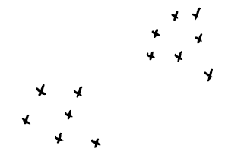
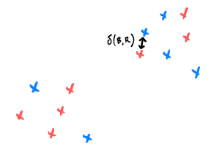
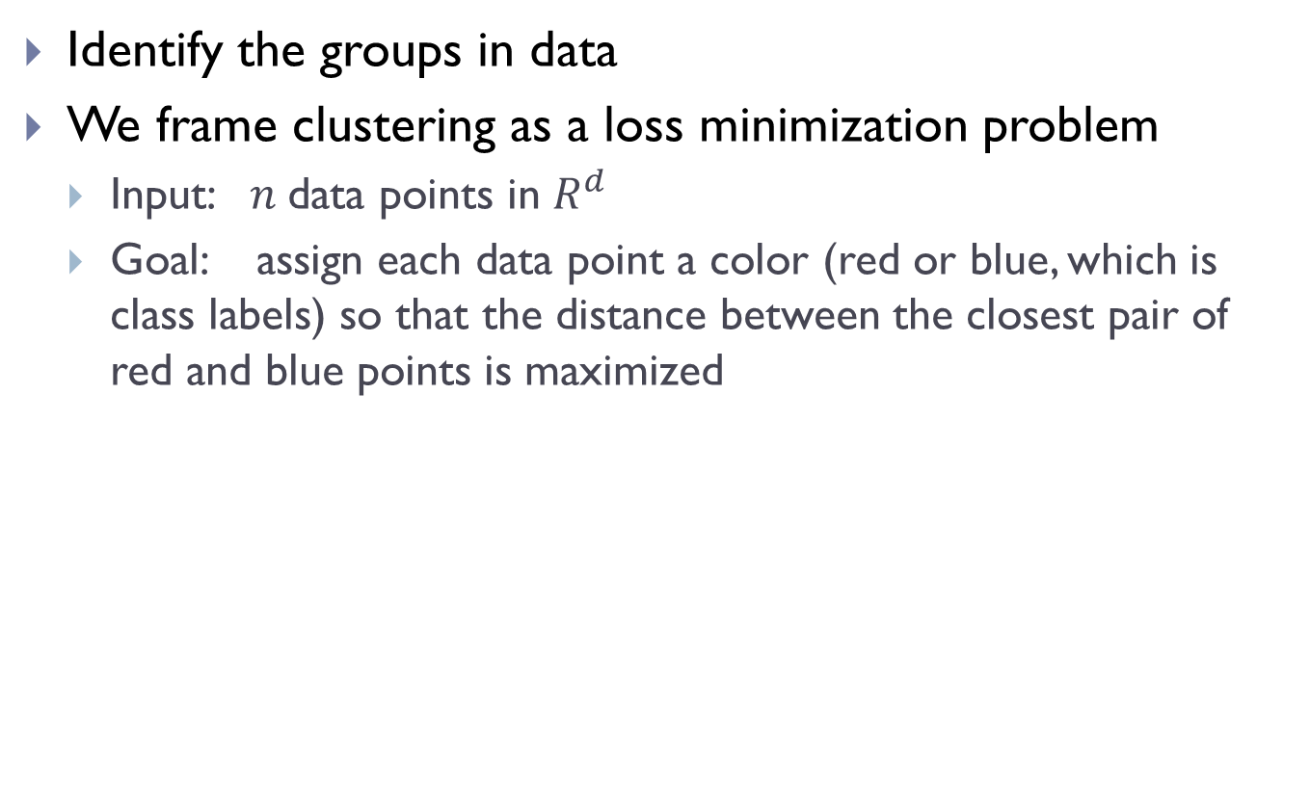
Clustering problem
Identify the groups in data
We frame clustering as a loss minimization problem
  Input: $n$data points in $R^{d}$
  Goal: assign each data point a color (red or blue, which is class labels) so that the distance between the closest pair of red and blue points is maximized
input points
bad clustering

Slide 12
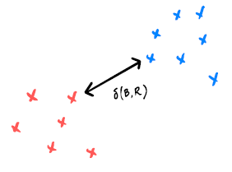
Clustering problem
Identify the groups in data
We frame clustering as a loss minimization problem
  Input: $n$data points in $R^{d}$
  Goal: assign each data point a color (red or blue, which is class labels) so that the distance between the closest pair of red and blue points is maximized
input points
good clustering

Slide 13

Recall the brute-force solution
Try all possible assignments
  there are $2^{n}$ possible assignments! ($n$ is the number of input points)
  highly not efficient!
Instead, we will convert it to a graph problem

Slide 14
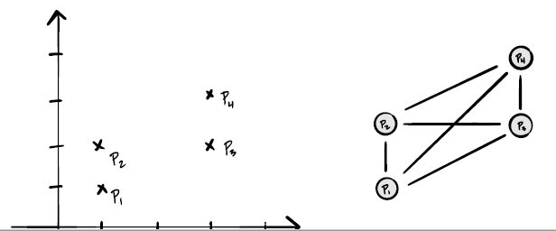
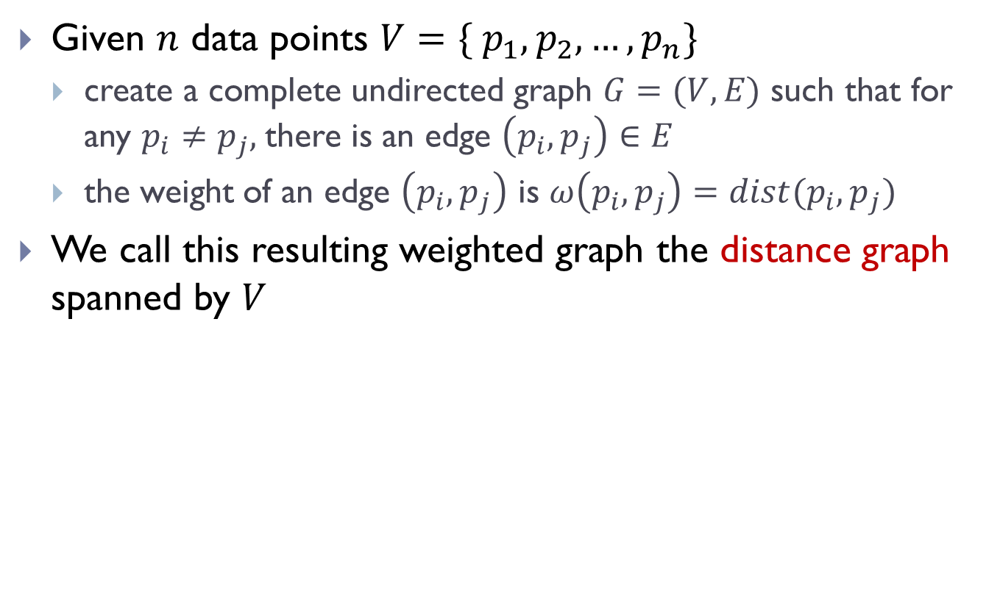
Distance graph
Given $n$ data points $V=\{ p_{1}, p_{2},…, p_{n}\}$
  create a complete undirected graph $G=(V, E)$ such that for any $p_{i}≠p_{j},$there is an edge $\left(p_{i}, p_{j}\right)∈E$
  the weight of an edge $\left(p_{i}, p_{j}\right)$ is $ω\left(p_{i}, p_{j}\right)=dist(p_{i}, p_{j})$
We call this resulting weighted graph the distance graph spanned by $V$

Slide 15
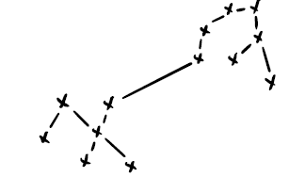
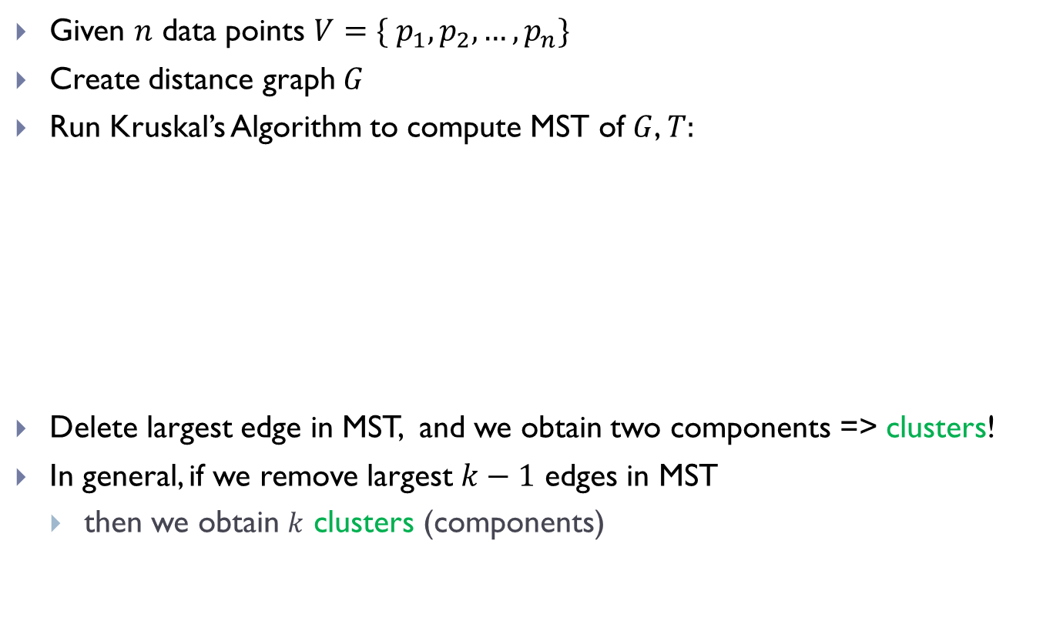
Single linkage clustering
Given $n$ data points $V=\{ p_{1}, p_{2},…, p_{n}\}$
Create distance graph $G$
Run Kruskal’s Algorithm to compute MST of $G$, $T:$
Delete largest edge in MST, and we obtain two components => clusters!
In general, if we remove largest $k−1$ edges in MST
  then we obtain $k$ clusters (components)

Slide 16
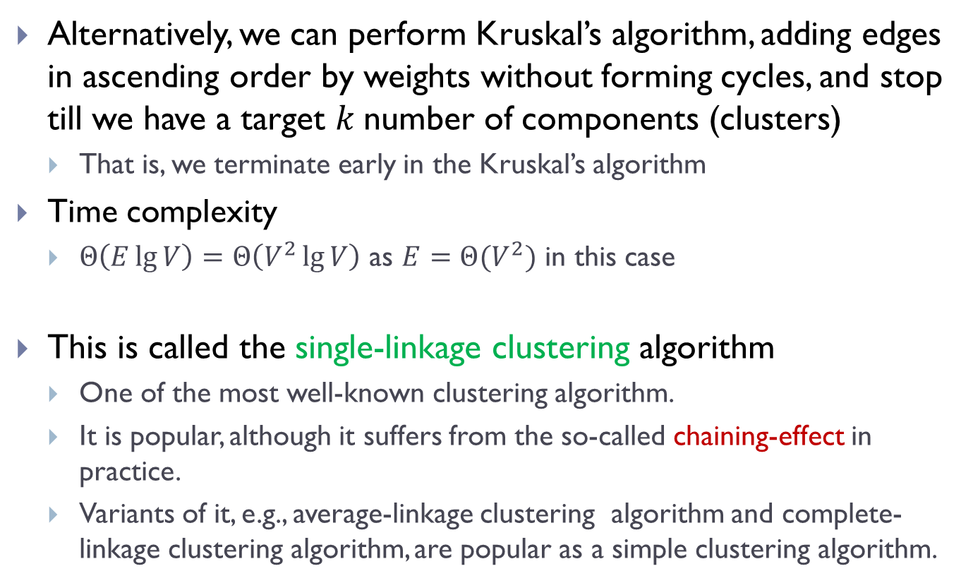
Single linkage clustering
Alternatively, we can perform Kruskal’s algorithm, adding edges in ascending order by weights without forming cycles, and stop till we have a target $k$number of components (clusters)
  That is, we terminate early in the Kruskal’s algorithm
Time complexity
  $Θ\left(E\lg{V}\right)=Θ\left(V^{2}\lg{V}\right)$ as $E=Θ(V^{2})$ in this case
This is called the single-linkage clustering algorithm
  One of the most well-known clustering algorithm.
  It is popular, although it suffers from the so-called chaining-effect in practice.
  Variants of it, e.g., average-linkage clustering algorithm and complete-linkage clustering algorithm, are popular as a simple clustering algorithm.

Slide 17
Example of chaining effect

Slide 18
Hierarchical clustering

Slide 19
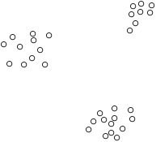
Clustering

Slide 20
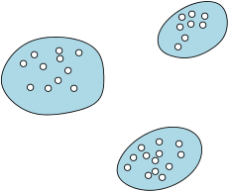
Clustering

Slide 21
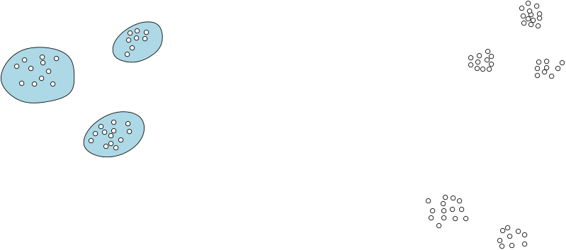
Hierarchical Clustering

Slide 22
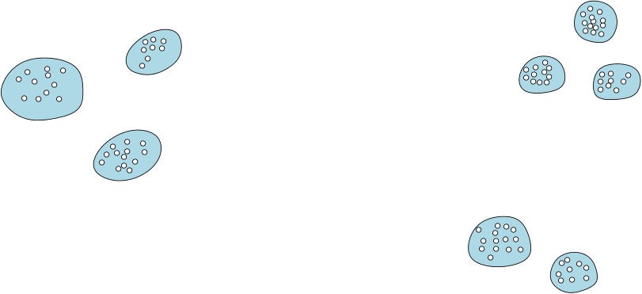
Hierarchical Clustering

Slide 23
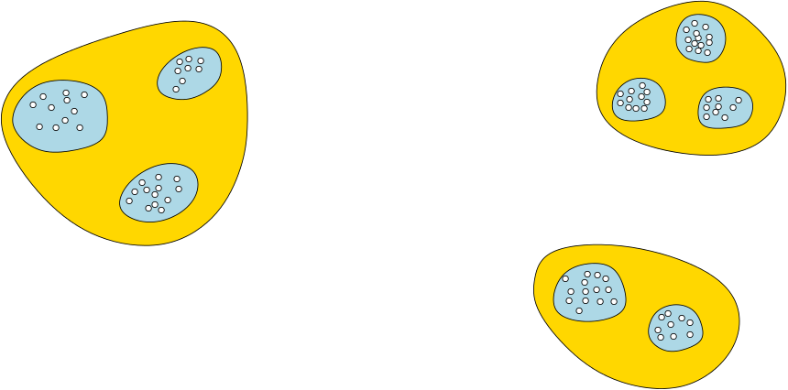
Hierarchical Clustering

Slide 24
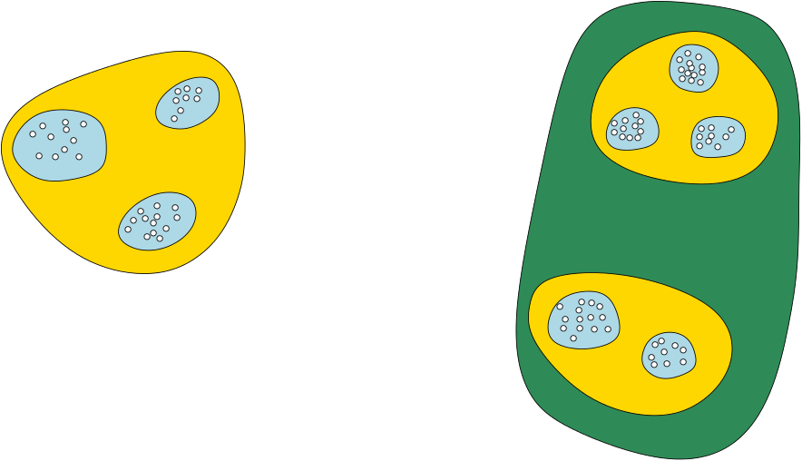
Hierarchical Clustering

Slide 25
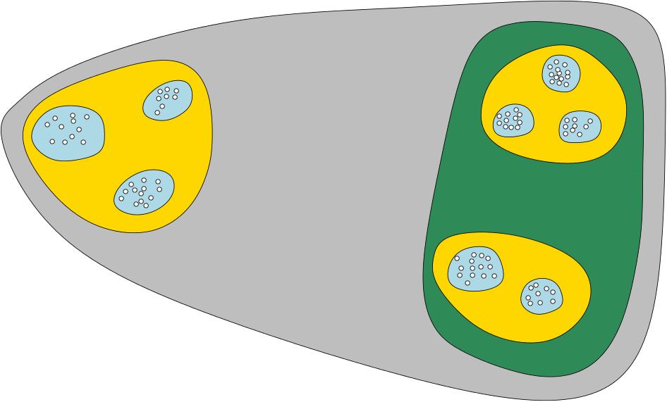
Hierarchical Clustering

Slide 26
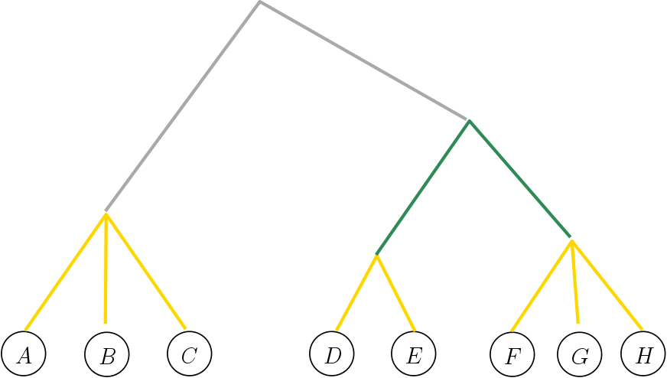

Hierarchical Clustering Tree (HCT)
Each internal tree node indicates a cluster, containing all leaves in subtree
Ancestor/descendent indicates containment relation
Height at each tree node corresponds to certain cost of the corresponding cluster (e.g, tightness of cluster)

Slide 27
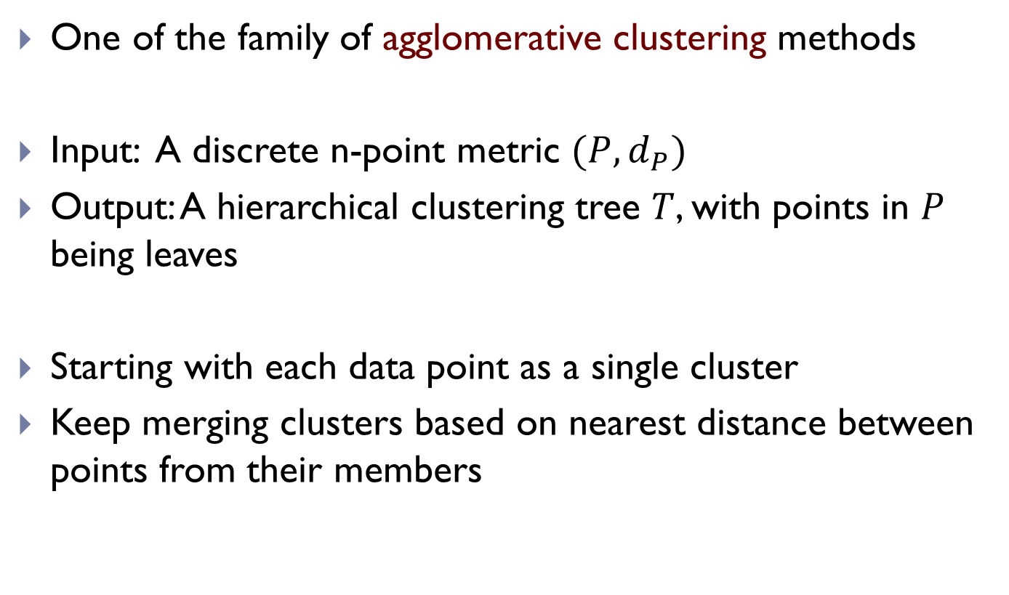
Single Linkage Clustering
One of the family of agglomerative clustering methods
Input: A discrete n-point metric $(P, d_{P})$
Output: A hierarchical clustering tree $T$, with points in $P$ being leaves
Starting with each data point as a single cluster
Keep merging clusters based on nearest distance between points from their members

Slide 28
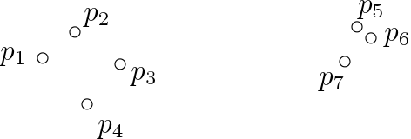
Single Linkage Clustering
Starting with each data point as a single cluster
Keep merging clusters based on nearest distance between points from their members

Slide 29
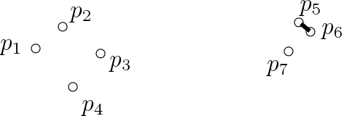
Single Linkage Clustering
Starting with each data point as a single cluster
Keep merging clusters based on nearest distance between points from their members

Slide 30
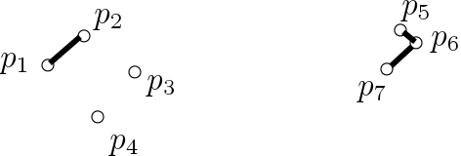
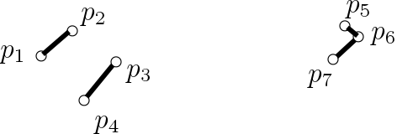
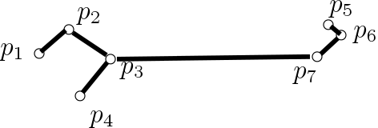
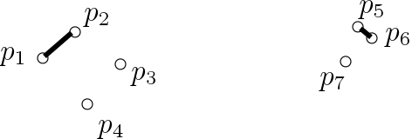
Single Linkage Clustering
Starting with each data point as a single cluster
Keep merging clusters based on nearest distance between points from their members

Slide 31
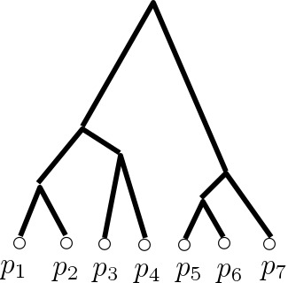
Single Linkage Clustering
Starting with each data point as a single cluster
Keep merging clusters based on nearest distance between points from their members

Slide 32




One Example: Single Linkage Clustering
Starting with each data point as a single cluster
Keep merging clusters based on nearest distance between points from their members
This procedure is exactly Kruskal’s algorithm!
$$d_{6}$$
$$d_{5}$$
$$d_{5}$$
$$d_{6}$$

Slide 33
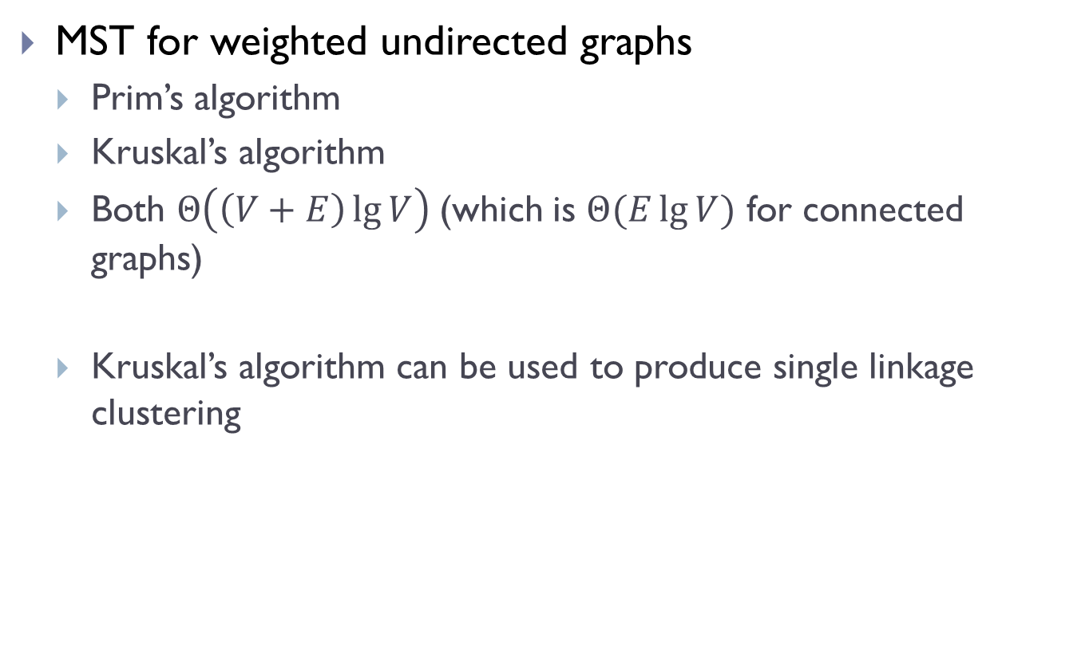
Summary
MST for weighted undirected graphs
  Prim’s algorithm
  Kruskal’s algorithm
  Both $Θ\left(\left(V+E\right)\lg{V}\right)$(which is $Θ(E\lg{V})$ for connected graphs)
  Kruskal’s algorithm can be used to produce single linkage clustering

Slide 34
FIN

