Slide 1
DSC40B:
Theoretical Foundations of Data Science II
Lecture 4: Expected time complexity
Instructor: Yusu Wang

Slide 2
Previously
Worst-case and best-case time complexity analysis
  Worst-case time complexity analysis
    Most commonly used. Guarantees performance even in the worst case
However, both worst- and best-case time can be caused by just some specific input
How about average time complexity
  Intuitively measures how the algorithm works on a typical input?

Slide 3
Expected Analysis
Probabilistic method:
  Given a distribution for all possible inputs
  Derive expected time based on distribution
Randomized algorithm:
  Add randomness in the algorithm
  Analyze the expected behavior of the algorithm

Slide 4
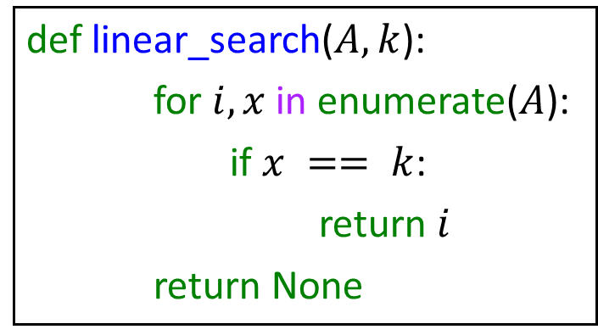
A simple example
def linear_search($A, k$):
for $i, x$in enumerate($A$):
if $x == k$:
return $i$
return None
What is worst case time complexity?
What is expected / average time complexity?

Slide 5
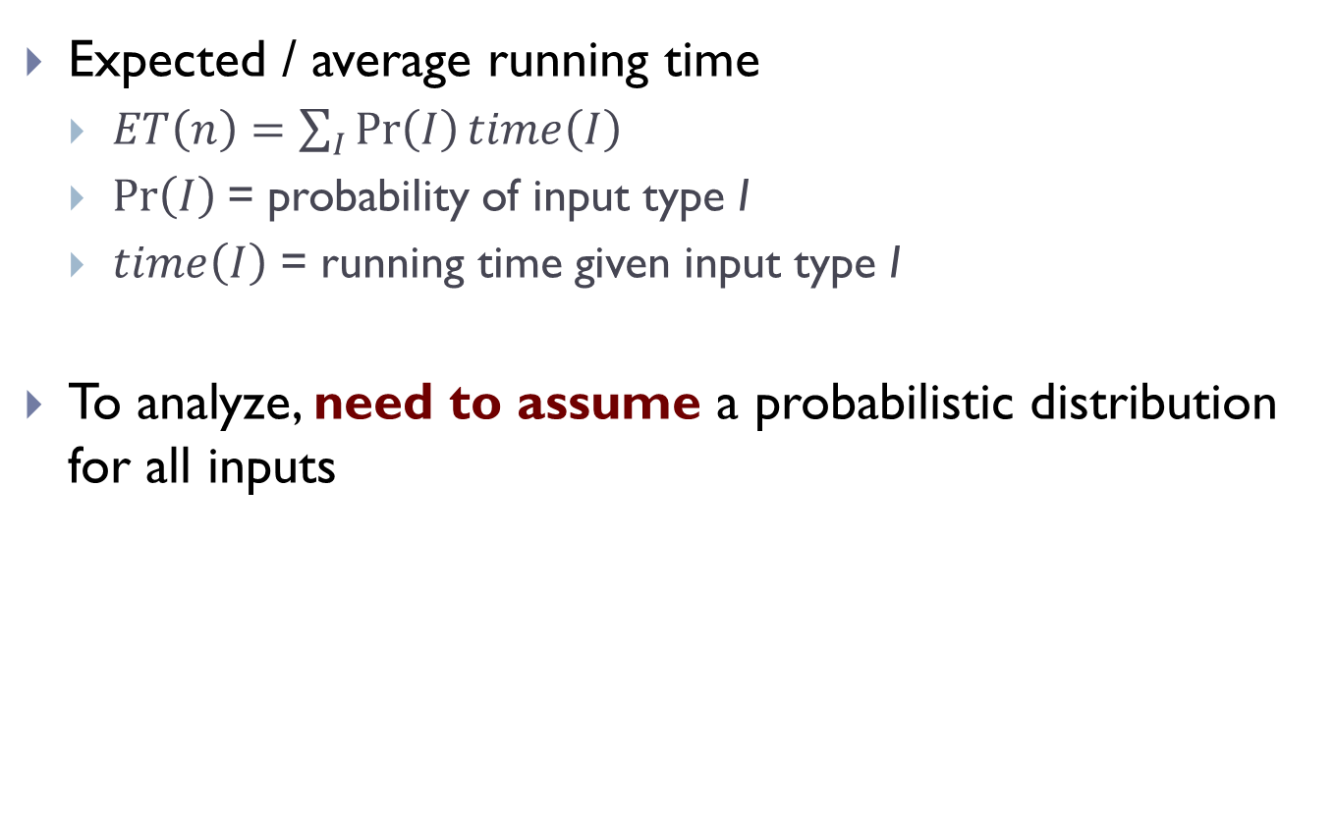
Expected Running Time
Expected / average running time
  $ET\left(n\right)=\sum_{I}{\operatorname{Pr}\left(I\right)time\left(I\right)}$
  $\operatorname{Pr}\left(I\right)$= probability of input type I
  $time\left(I\right)$ = running time given input type I
To analyze, need to assume a probabilistic distribution for all inputs

Slide 6
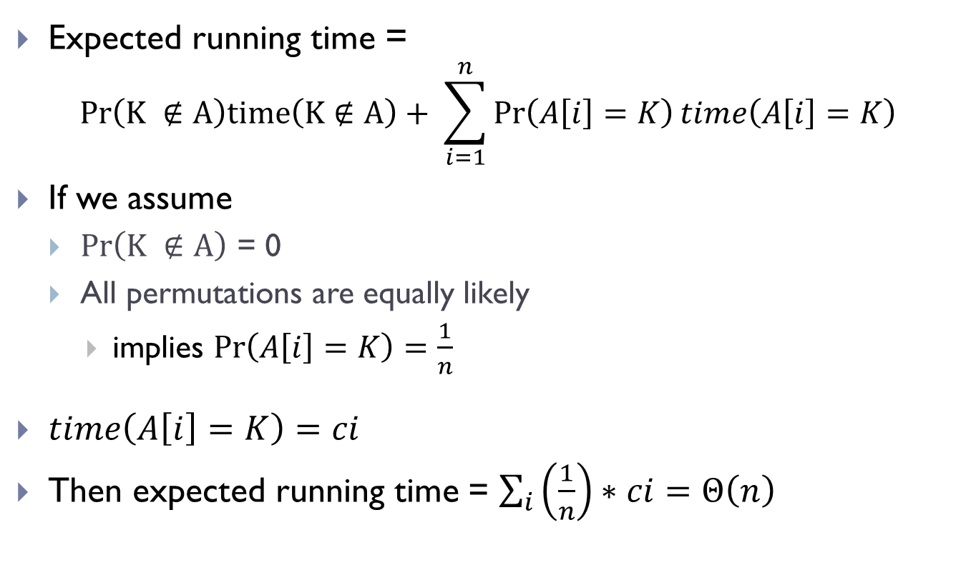
Linear-search algorithm
Expected running time =
$$Pr\left(K ∉A\right)time\left(K∉A\right)+ \sum_{i=1}^{n}{\operatorname{Pr}\left(A\left[i\right]=K\right)time\left(A\left[i\right]=K\right)}$$
If we assume
  $Pr\left(K ∉A\right)$ = 0
  All permutations are equally likely
    implies $\operatorname{Pr}\left(A\left[i\right]=K\right)=\frac{1}{n}$
$time\left(A\left[i\right]=K\right)=ci$
Then expected running time = $\sum_{i}{\left(\frac{1}{n}\right)∗ci}=Θ\left(n\right)$

Slide 7
Remark
For probabilistic analysis
  An input probabilistic distribution input model has to be assumed!
  For a fixed input, the running time is fixed.
  The average / expected time complexity is for if we consider running it for a range of inputs, what the average behavior is.
Randomized algorithm
  No assumption in input distribution!
  Randomness is added in the algorithm
    For a fixed input, the running time is NOT fixed.
    The expected time is what we can expect when we run the algorithm on any single input.

Slide 8
Analyzing randomized algorithms

Slide 9
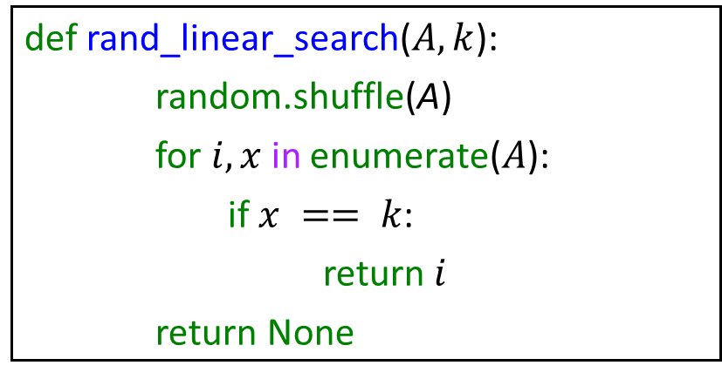
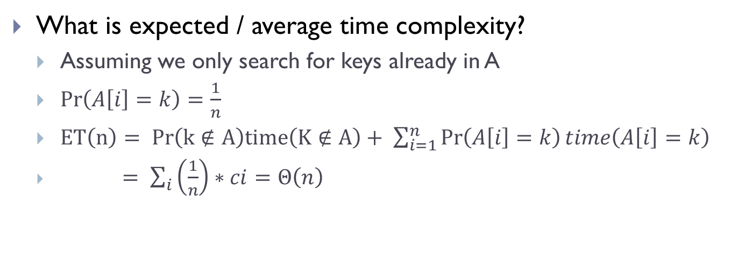
Randomized linear search example
def rand_linear_search($A, k$):
random.shuffle(A)
for $i, x$in enumerate($A$):
if $x == k$:
return $i$
return None
What is expected / average time complexity?
  Assuming we only search for keys already in A
  $\operatorname{Pr}\left(A\left[i\right]=k\right)=\frac{1}{n}$
  $ET\left(n\right)= Pr\left(k∉A\right)time\left(K∉A\right)+ \sum_{i=1}^{n}{\operatorname{Pr}\left(A\left[i\right]=k\right)time\left(A\left[i\right]=k\right)}$
  $= \sum_{i}{\left(\frac{1}{n}\right)∗ci}=Θ\left(n\right)$

Slide 10
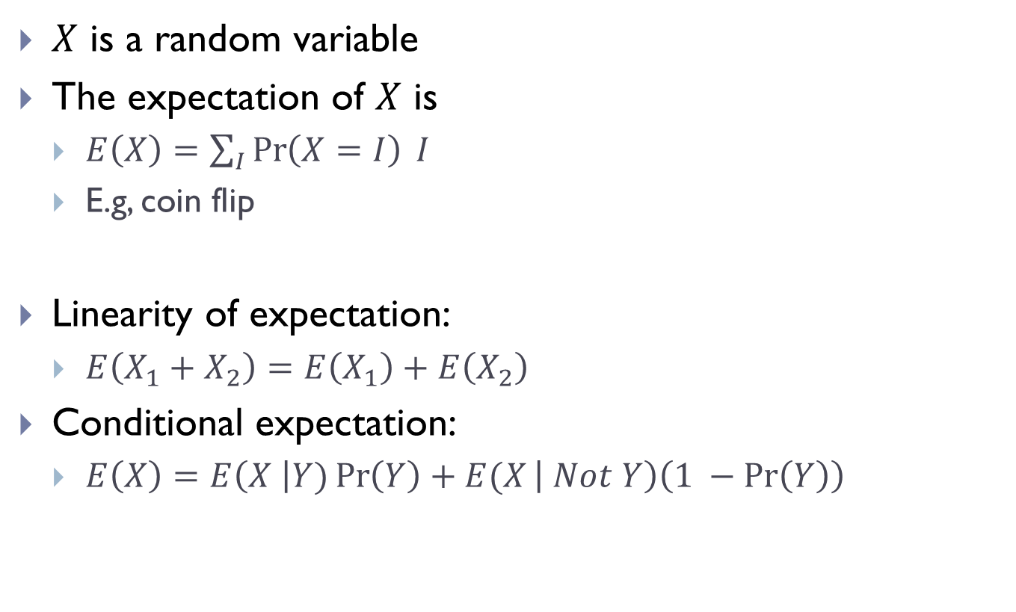
Review of Expectation
$X$ is a random variable
The expectation of $X$ is
  $E\left(X\right)=\sum_{I}{\operatorname{Pr}\left(X=I\right) I}$
  E.g, coin flip
Linearity of expectation:
  $E\left(X_{1}+X_{2}\right)=E\left(X_{1}\right)+E\left(X_{2}\right)$
Conditional expectation:
  $E\left(X\right)=E\left(X \right|Y)\operatorname{Pr}\left(Y\right)+E(X\left| Not Y\right)\left(1 −\operatorname{Pr}\left(Y\right)\right)$
Notes:
They’ve seen in 40A

Slide 11
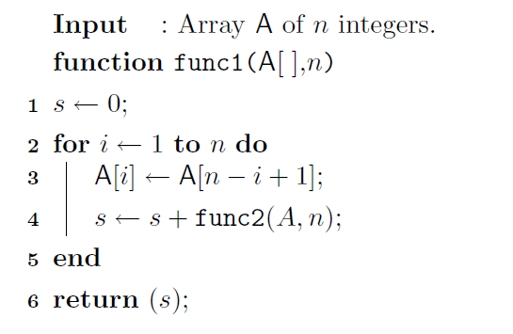
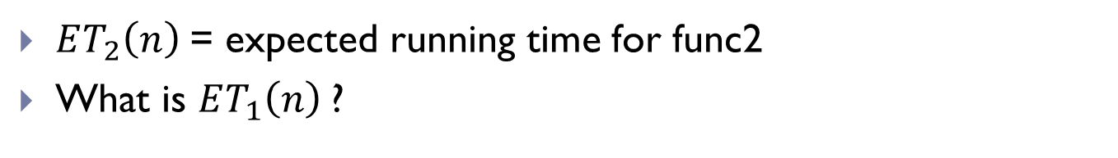
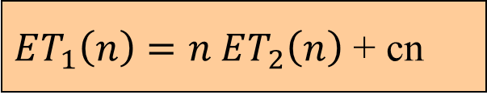
Use of linearity of expectation
$ET_{1}\left(n\right)=n ET_{2}\left(n\right)$ + cn
$ET_{2}\left(n\right)$= expected running time for func2
What is $ET_{1}\left(n\right)$?

Slide 12
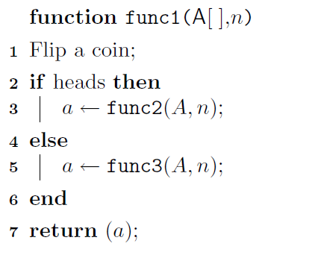
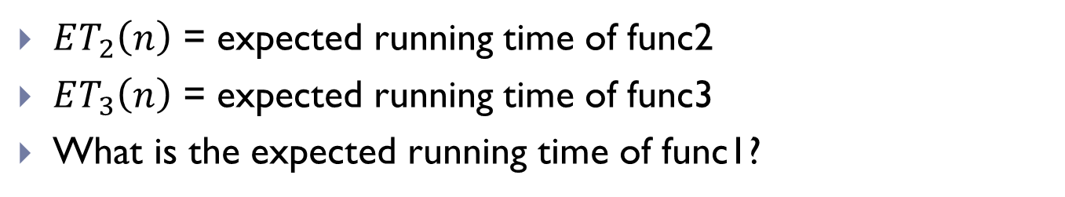
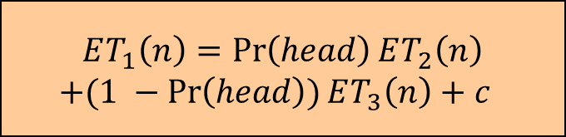
Use of Conditional expectation
$$ET_{1}\left(n\right)=\operatorname{Pr}\left(head\right)ET_{2}\left(n\right)$$
$+(1 −\operatorname{Pr}\left(head\right))ET_{3}\left(n\right)+c$
$ET_{2}\left(n\right)$ = expected running time of func2
$ET_{3}\left(n\right)$ = expected running time of func3
What is the expected running time of func1?

Slide 13
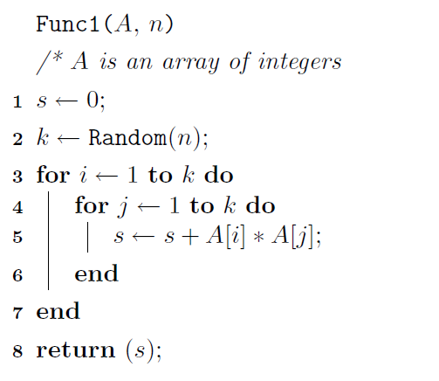
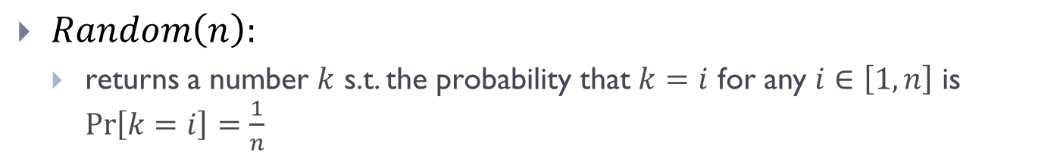
Randomized example 1
$Random\left(n\right):$
  returns a number $k$ s.t. the probability that $k=i$ for any $i∈\left[1, n\right]$ is $\operatorname{Pr}\left[k=i\right]=\frac{1}{n}$

Slide 14
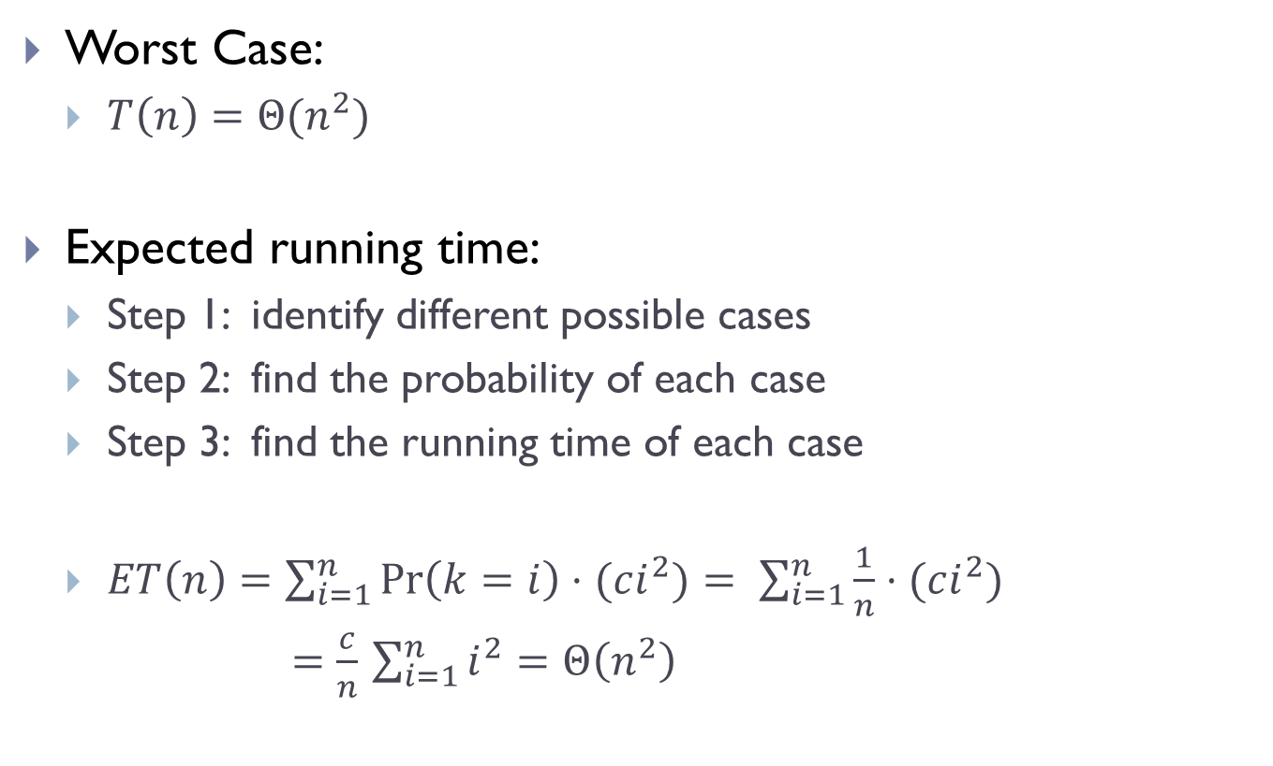
Running time analysis
Worst Case:
  $T\left(n\right)=Θ(n^{2})$
Expected running time:
  Step 1: identify different possible cases
  Step 2: find the probability of each case
  Step 3: find the running time of each case
  $ET\left(n\right)=\sum_{i=1}^{n}{\operatorname{Pr}\left(k=i\right)⋅(ci^{2})}= \sum_{i=1}^{n}{\frac{1}{n}⋅(ci^{2})}$
  $=\frac{c}{n}$ $\sum_{i=1}^{n}{i^{2}}=Θ\left(n^{2}\right)$

Slide 15
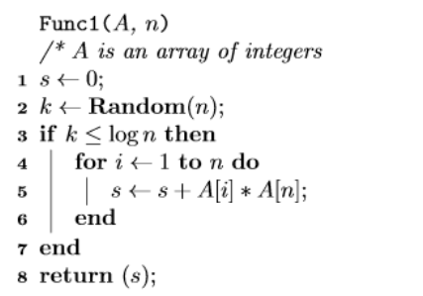
Randomized example 2

Slide 16
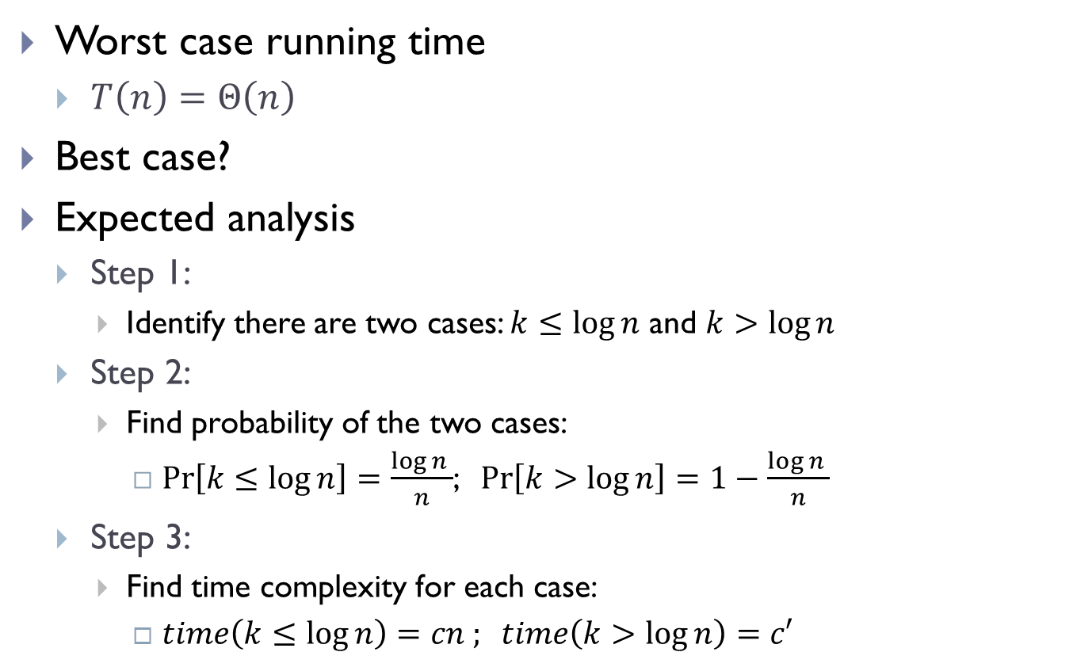
Running time analysis
Worst case running time
  $T\left(n\right)=Θ\left(n\right)$
Best case?
Expected analysis
  Step 1:
    Identify there are two cases: $k≤\log{n}$ and $k>\log{n}$
  Step 2:
    Find probability of the two cases:
      $\operatorname{Pr}\left[k≤\log{n}\right]=\frac{\log{n }}{n}$; $\operatorname{Pr}\left[k>\log{n}\right]=1−\frac{\log{n }}{n}$
  Step 3:
    Find time complexity for each case:
      $time\left(k≤\log{n}\right)=cn ; time\left(k>\log{n}\right)=c′$

Slide 17

Expected analysis
Expected running time:
  $ET\left(n\right)=\operatorname{Pr}\left(k≤\log{n}\right)⋅time(k≤\log{n})+$
  $$\operatorname{Pr}\left(k>\log{n}\right)⋅time\left(k>\log{n}\right)$$
  $$=\frac{\log{n}}{n}⋅\left(cn\right)+\left(1−\frac{\log{n}}{n}\right)⋅(c^{′})$$
  $⇒ET(n)=Θ(\log{n})$
These are artificial examples. We will see later a randomized algorithm for the sorting problem.

Slide 18
Lower bound theory

Slide 19
Problems and algorithms
There can be many algorithms for solving the same problem.
  Some have better time complexity than others.
An important question:
  For a given problem, what is the best possible time complexity?
Such questions can be hard to answer
  as typically we cannot ``enumerate” all possible algorithms
Often we try to provide a lower-bound
  that is as tight as we can
  Sometimes we know we have the right (tight) bound when there is an algorithm whose worst-case running time matches this lower bounds

Slide 20
Lower Bound
No algorithm can have a better (worst case) time complexity than a theoretical lower bound.
Definition:
𝑓(𝑛) is a theoretical lower bound for a problem if every possible algorithm’s worst-case time complexity is Ω(𝑓(𝑛)).

Slide 21
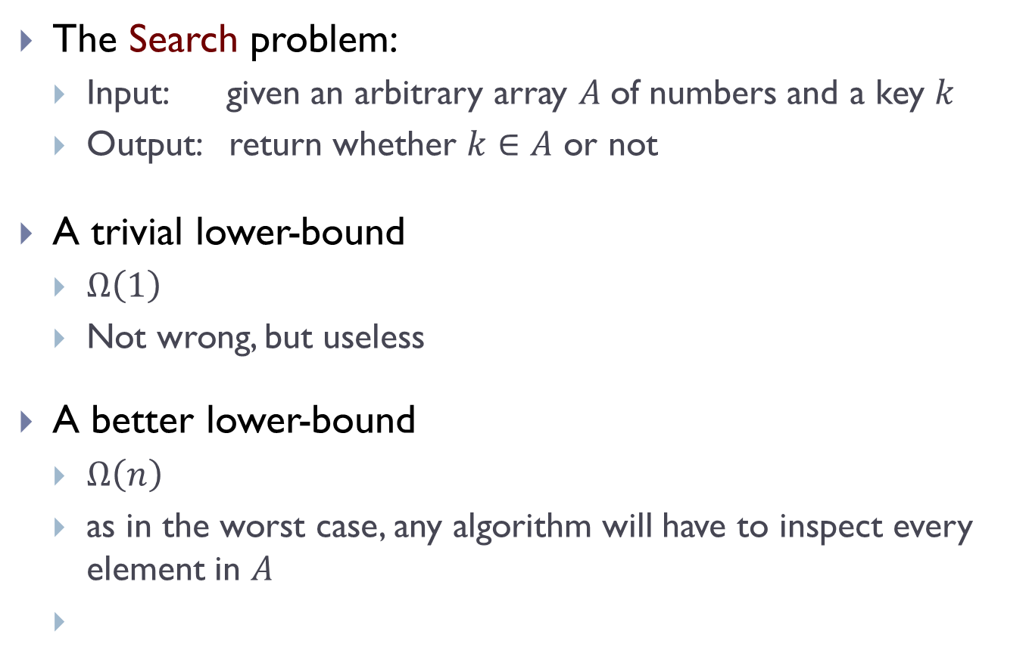
A simple example
The Search problem:
  Input: given an arbitrary array $A$of numbers and a key $k$
  Output: return whether $k∈A$ or not
A trivial lower-bound
  $Ω\left(1\right)$
  Not wrong, but useless
A better lower-bound
  $Ω\left(n\right)$
  as in the worst case, any algorithm will have to inspect every element in $A$
Can we get a better lower-bound?

Slide 22
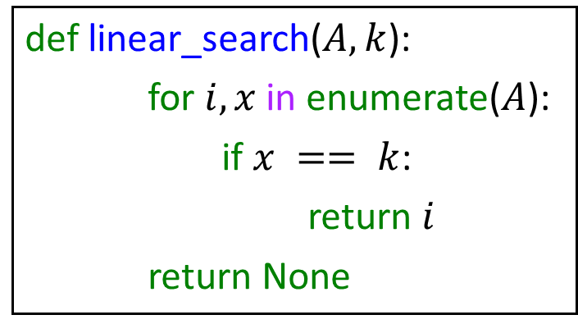
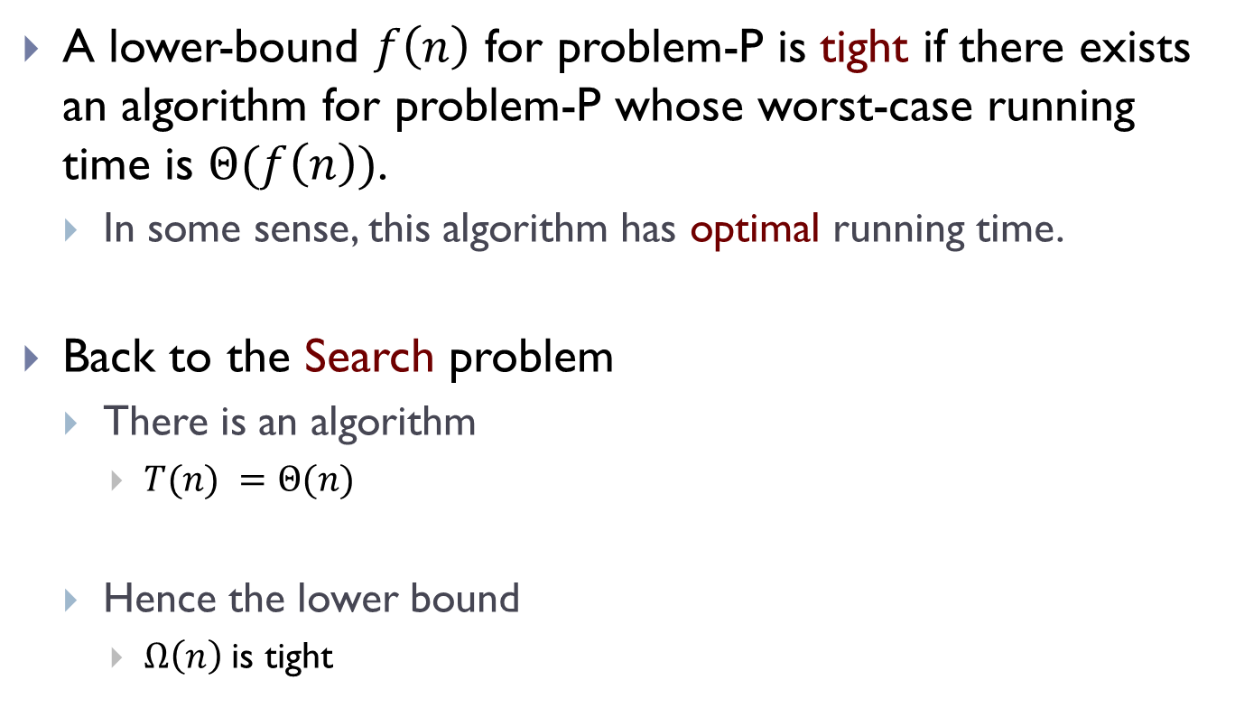
Tight Lower bound
A lower-bound $f\left(n\right)$ for problem-P is tight if there exists an algorithm for problem-P whose worst-case running time is $Θ(f\left(n\right))$.
  In some sense, this algorithm has optimal running time.
Back to the Search problem
  There is an algorithm
    $T(n) =Θ(n)$
  Hence the lower bound
    $Ω\left(n\right)$is tight
def linear_search($A, k$):
for $i, x$in enumerate($A$):
if $x == k$:
return $i$
return None

Slide 23
FIN

