Slide 1
DSC40B:
Theoretical Foundations of Data Science II
Lecture 8: Binary search tree
Instructor: Yusu Wang

Slide 2





Set operations
Imagine you are maintaining a database indexed by some keys (real values), and you hope to support the following operations:
  Search
  Maximum
  Minimum
  Successor
  Predecessor
  Insert
  Delete
  Extract-Max
  Increase-key
First approach: sort the array of keys
$$Θ(\lg{n)}$$
$$Θ(1)$$
$$Θ(1)$$
$$Θ(1)$$
$$Θ(1)$$
Can we use a linked list instead?
$$Θ(n)$$
How to have a good data structure so we can support all these operations efficiently?

Slide 3
Today
Binary search tree
  support all the operations from previous slide
    in time proportional to height of tree
(Review): how to implement key operations, and time complexity
  search, insert (and delete)
Extension to balanced binary search tree
Select query: augmenting data structure
  median, order statistics

Slide 4
What is binary search tree?

Slide 5
Binary tree
A binary tree is a rooted tree
  where each node has at most 2 children
Represented by a linked data structure
Each node contains at least fields:
  Key
  Left
  Right
  Parent
3
2
4

Slide 6

Example
From root, following left pointers, we will visit
  $13, 6, 3, 2, Nil$
13
6
18
3
7
17
20
13
2
4
9

Slide 7
Binary tree
A binary tree is a rooted tree where
  each node has at most 2 children
A node is the root of the tree
  if its parent is Nil
A node is a leaf
  if both children are Nil
Left sub-tree, right sub-tree
A complete binary tree
  is a binary tree where each node has two children other than leaves
3
2
4
5
12
1
6

Slide 8
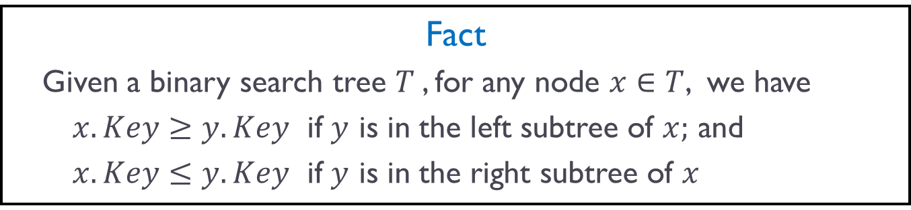
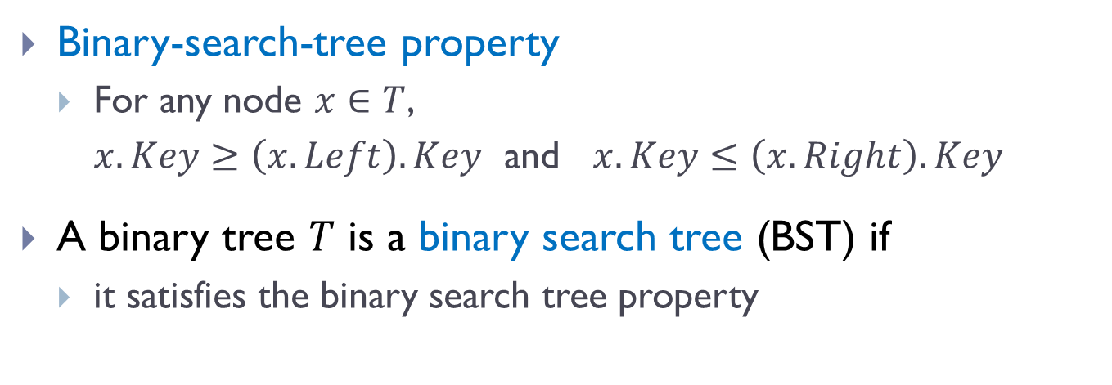
Binary search tree (BST)
Binary-search-tree property
  For any node $x∈T$,
  $x.Key≥\left(x.Left\right).Key$ and $x.Key≤\left(x.Right\right).Key$
A binary tree $T$ is a binary search tree (BST) if
  it satisfies the binary search tree property
Fact
  Given a binary search tree $T$, for any node $x∈T$, we have
  $x.Key≥y.Key$ if $y$ is in the left subtree of $x;$ and
  $x.Key≤y.Key$ if $y$ is in the right subtree of $x$

Slide 9
Example
A valid BST
13
6
18
3
7
17
20
13
2
4
9

Slide 10
Example
?
13
6
18
3
7
19
20
13
2
4
9

Slide 11
Properties
Given the same set of elements
  there are many possible BSTs over them
Minimum?
  Does it have to be a leaf?
6
3
7
2
4
9
Notes:
Ask about three nodes, what is the easiest

Slide 12
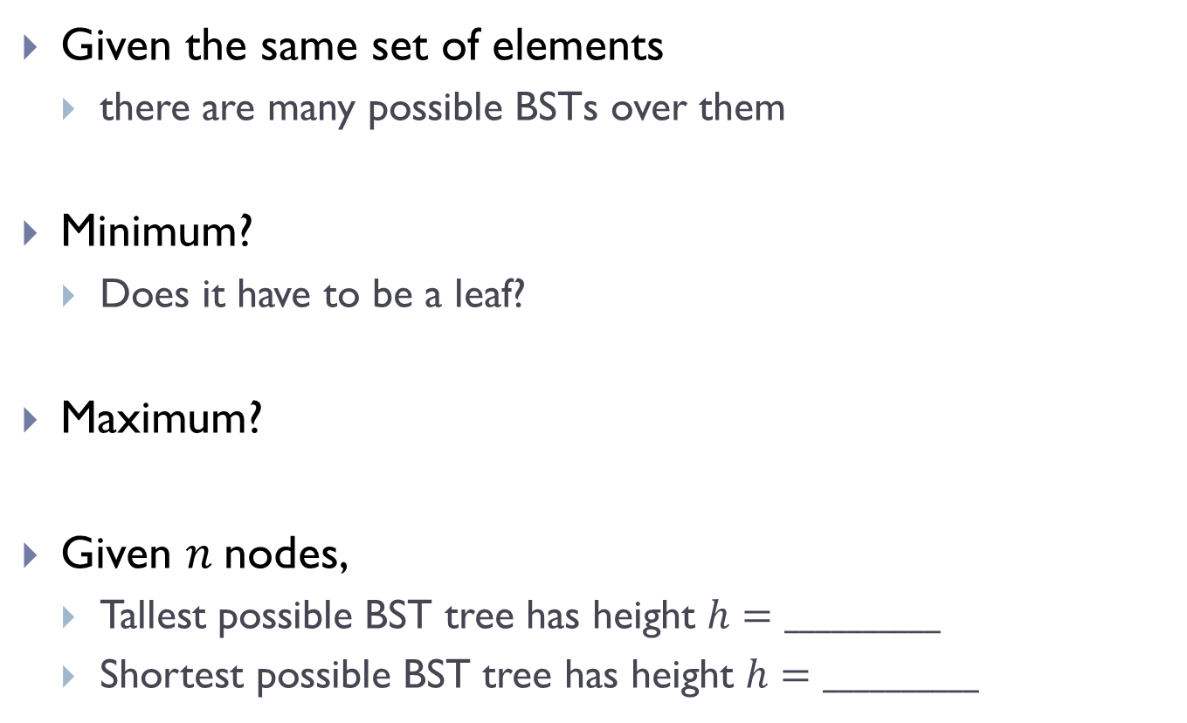


Properties
Given the same set of elements
  there are many possible BSTs over them
Minimum?
  Does it have to be a leaf?
Maximum?
Given $n$nodes,
  Tallest possible BST tree has height $h=__________$
  Shortest possible BST tree has height $h=__________$
6
3
8
4
7
9
$$n$$
$$\log_{2}{n=Θ(\lg{n)}}$$
Notes:
Ask about three nodes, what is the easiest

Slide 13
Operations in BST

Slide 14

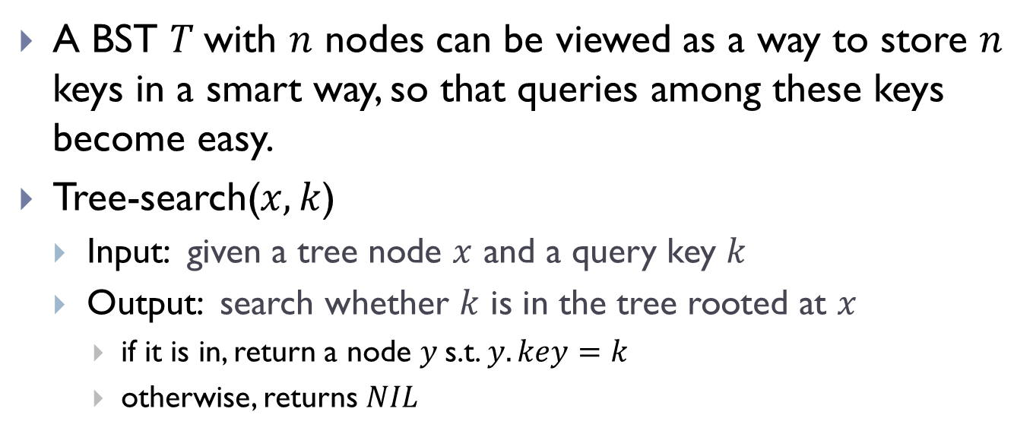



Search operation
A BST $T$with $n$ nodes can be viewed as a way to store $n$ keys in a smart way, so that queries among these keys become easy.
Tree-search($x, k$)
  Input: given a tree node $x$ and a query key $k$
  Output: search whether $k$ is in the tree rooted at $x$
    if it is in, return a node $y$s.t. $y.key=k$
    otherwise, returns $NIL$
6
$$x$$
Tree-search($x, 8$)
3
8
Tree-search($x, 4$)
Tree-search($x, 5$)
4
7
9

Slide 15

Tree-search algorithm, recursive version
Tree-search ( x, k)
  if x = Nil or k = x.key
  then return x
  if k < x.key
  then return Tree-search( x.left, k )
  else return Tree-search( x.right, k )
6
3
8
4
7
9
Given an input tree $T$ and a key $k$
  we will start by calling Tree-search($T.$root$, k$)

Slide 16
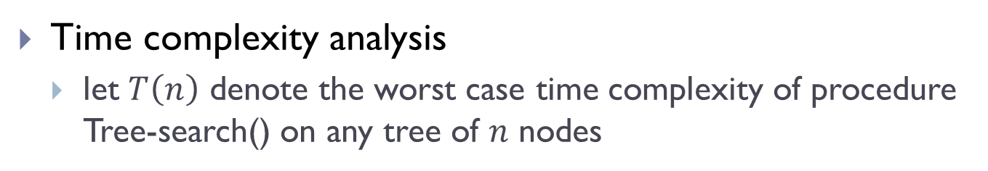
Tree-search algorithm, recursive version
Tree-search ( x, k)
  if x = Nil or k = x.key
  then return x
  if k < x.key
  then return Tree-search( x.left, k )
  else return Tree-search( x.right, k )
6
3
8
4
7
9
Time complexity analysis
  let $T\left(n\right)$ denote the worst case time complexity of procedure Tree-search() on any tree of $n$ nodes

Slide 17
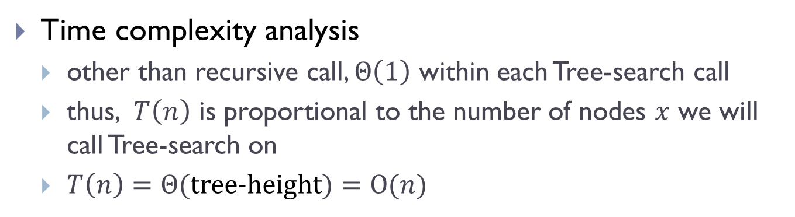
Tree-search algorithm, recursive version
Tree-search ( x, k)
  if x = Nil or k = x.key
  then return x
  if k < x.key
  then return Tree-search( x.left, k )
  else return Tree-search( x.right, k )
6
3
8
4
7
9
Time complexity analysis
  other than recursive call, $Θ\left(1\right)$ within each Tree-search call
  thus, $T\left(n\right)$ is proportional to the number of nodes $x$ we will call Tree-search on
  $T\left(n\right)=Θ($tree-height$)=O(n)$

Slide 18
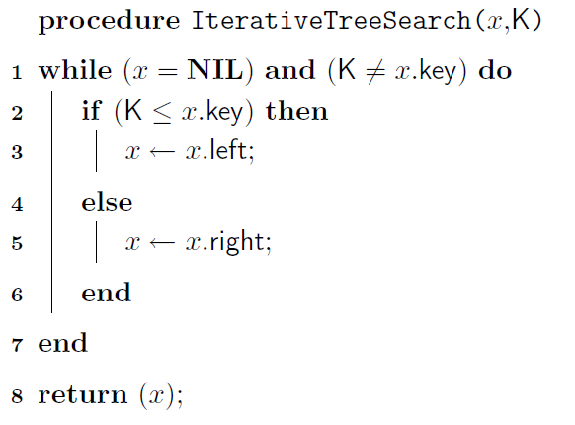
Tree-search: iterative version

Slide 19



Minimum / Maximum
Tree-minimum($x$)
  Input: a node $x$ of a BST $T$
  Output: return the node containing minimum key in the subtree rooted at $x$
$$x$$
6
$$y$$
3
8
4
7
9

Slide 20
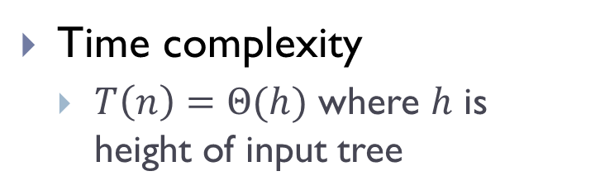
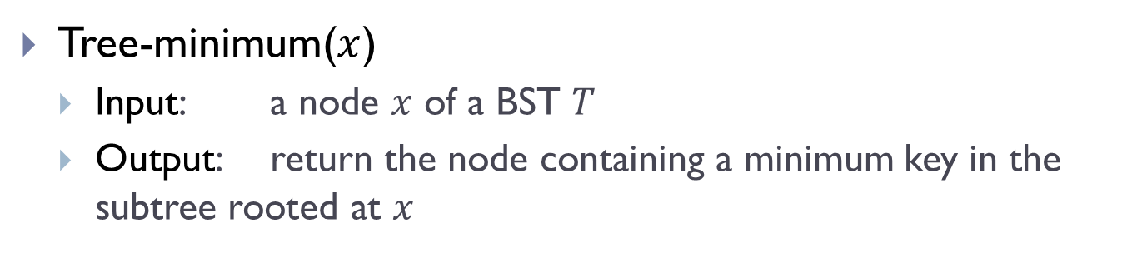
Minimum / Maximum
Tree-minimum($x$)
  Input: a node $x$ of a BST $T$
  Output: return the node containing a minimum key in the subtree rooted at $x$
Tree-minimum(x)
    while ( x.left ≠ Nil)
    do x = x.left;
    return x;
6
3
8
Time complexity
  $T\left(n\right)=Θ(h)$ where $h$ is height of input tree
4
7
9

Slide 21
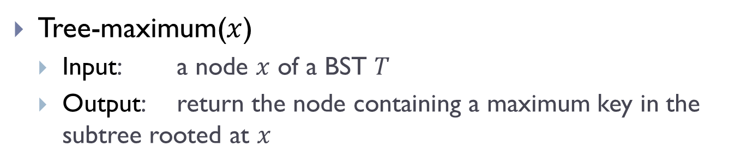
Minimum / Maximum
Tree-maximum($x$)
  Input: a node $x$ of a BST $T$
  Output: return the node containing a maximum key in the subtree rooted at $x$
Tree-maximum(x)
    while ( x.right ≠ Nil)
    do x = x.right;
    return x;
6
3
8
Time complexity
  $T\left(n\right)=Θ(h)$ where $h$ is height of input tree
4
7
9

Slide 22
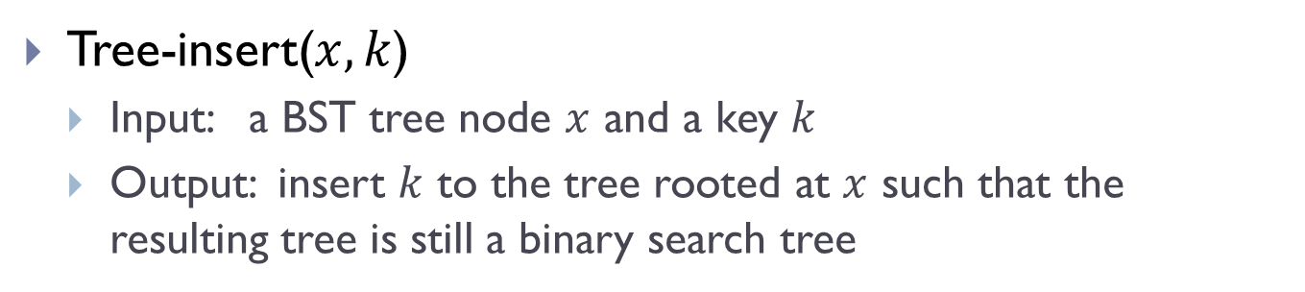
Tree-insert
Tree-insert($x, k$)
  Input: a BST tree node $x$ and a key $k$
  Output: insert $k$ to the tree rooted at $x$ such that the resulting tree is still a binary search tree

Slide 23
Examples
T.root
15
6
Tree-Insert(T.root, 8)
3
7
Tree-Insert(T.root, 6.5)
2
4
13
9
Use tree-search !

Slide 24

Tree-insert
Tree-insert($T, k$)
y = Nil; x = T.root
z.key = $k;$z.left = Nil; z.right=Nil
while (x ≠ Nil) do
  y = x
  if ( z.key < x.key )
  then x = x.left
  else x = x.right
  z.parent = y
  if (y = Nil) then T.root = z
  else if (z.key < y.key)
  then y.left = z
  else y.right = z
z is the new node to be inserted
Locate potential parent y of z.
Set up z as appropriate child of y

Slide 25

Tree-insert
Tree-insert($T, k$)
y = Nil; x = T.root
z.key = $k;$z.left = Nil; z.right=Nil
while (x ≠ Nil) do
  y = x
  if ( z.key < x.key )
  then x = x.left
  else x = x.right
  z.parent = y
  if (y = Nil) then T.root = z
  else if (z.key < y.key)
  then y.left = z
  else y.right = z
Time complexity
  $T\left(n\right)=Θ(h)$, where $h$ is height of input tree

Slide 26



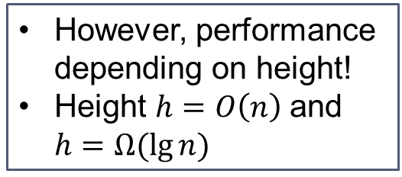






Summary
Suppose $n$ input keys are already stored in a BST of height $h$
  Search
  Maximum
  Minimum
  Successor
  Predecessor
  Insert
  Delete
  Extract-Max
  Increase-key
Time complexity
$$Θ(h)$$
$$Θ(h)$$
However, performance depending on height!
Height $h=O\left(n\right)$and $h=Ω(\lg{n)}$
$$Θ(h)$$
$$Θ(h)$$
$$Θ(h)$$
To have good performance, we want to keep the tree height low!
$$Θ(h)$$
$$Θ(h)$$
$$Θ(h)$$
$$Θ(h)$$

Slide 27
Balanced binary search tree

Slide 28
Good tree
13
6
18
3
7
17
20
13
19
2
4
6
9

Slide 29
Bad Tree

Slide 30
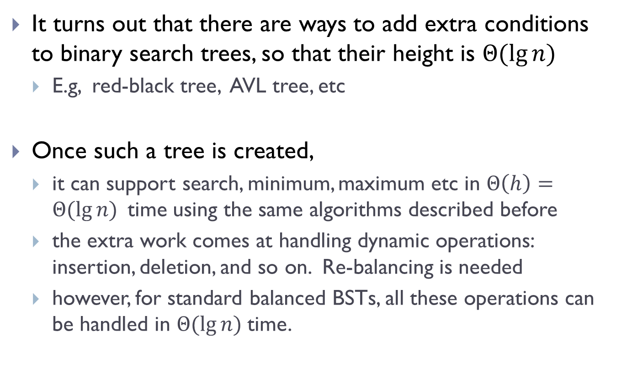
Balanced binary search tree
It turns out that there are ways to add extra conditions to binary search trees, so that their height is $Θ(\lg{n)}$
  E.g, red-black tree, AVL tree, etc
Once such a tree is created,
  it can support search, minimum, maximum etc in $Θ\left(h\right)=Θ(\lg{n) }$time using the same algorithms described before
  the extra work comes at handling dynamic operations: insertion, deletion, and so on. Re-balancing is needed
  however, for standard balanced BSTs, all these operations can be handled in $Θ(\lg{n) }$time.

Slide 31
Rotation operation
Left rotation or Right rotation to keep tree height low
x
y
y
right rotation
x
C
A
left rotation
A
B
B
C

Slide 32



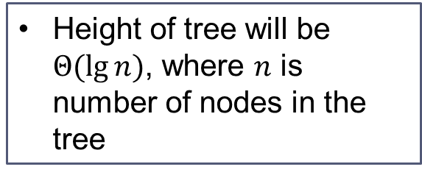






With balanced BST
Suppose $n$ input keys are already stored in a balanced BST
  Search
  Maximum
  Minimum
  Successor
  Predecessor
  Insert
  Delete
  Extract-Max
  Increase-key
Time complexity
$$Θ(\lg{n})$$
$$Θ(\lg{n})$$
$$Θ(\lg{n})$$
$$Θ(\lg{n})$$
Height of tree will be $Θ(\lg{n)}$, where $n$ is number of nodes in the tree
$$Θ(\lg{n})$$
$$Θ(\lg{n})$$
$$Θ(\lg{n})$$
$$Θ(\lg{n})$$
$$Θ(\lg{n})$$

Slide 33
Select queries augmenting data structure

Slide 34
What if we also want to perform Select operation
Select ( T, k ):
  Given a list of records whose keys are stored in T, return the node whose key has rank k.
We can do linear search to find it. But can we do better?
Goal:
  Augment the binary search tree data structure so as to support Select ( T, k ) efficiently

Slide 35
In particular,
Select ( T, k )
Goal:
  Augment the binary search tree data structure so as to support Select ( T, k ) efficiently
Ordinary binary search tree
  O(h) time for Select(T, k)
Using balanced search tree)
  O(lg n) time for Select(T, k)

Slide 36
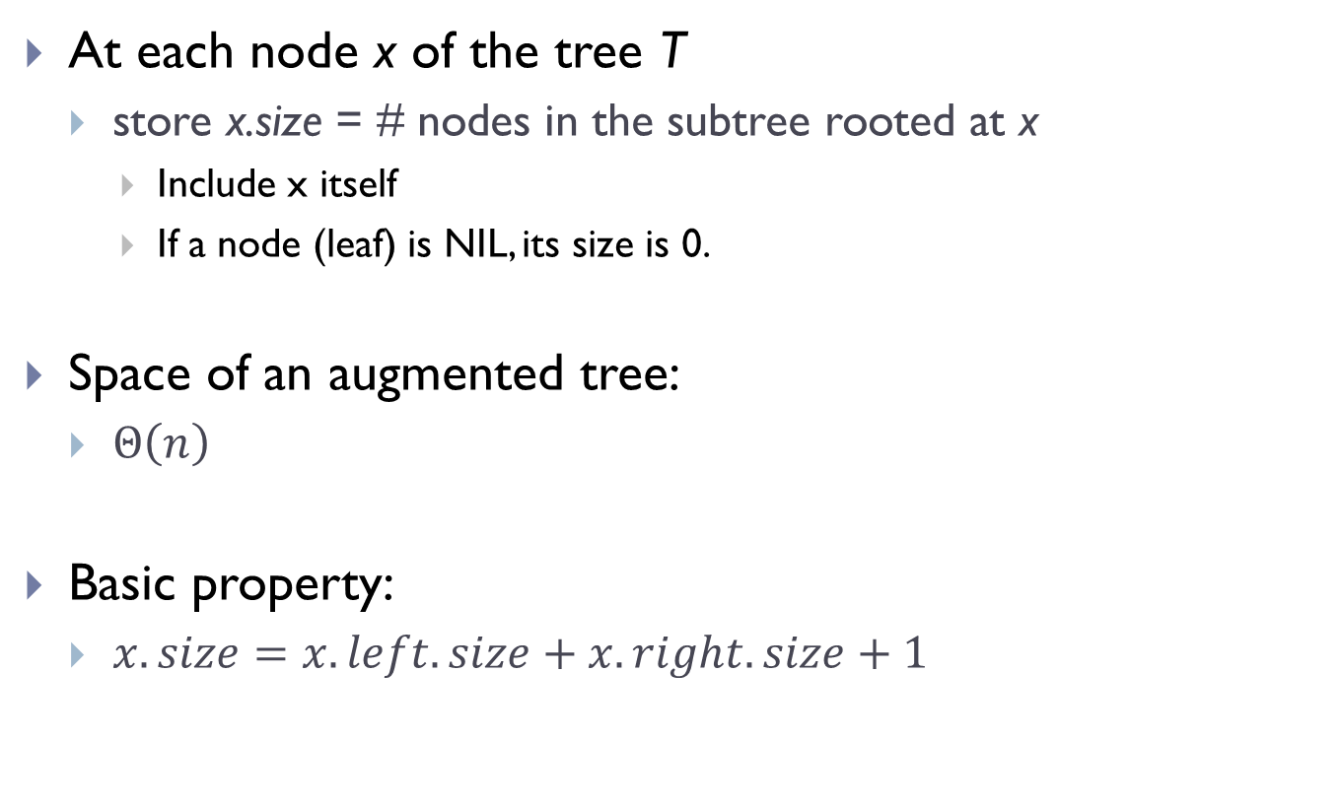
How do we augment a BST T?
At each node x of the tree T
  store x.size = # nodes in the subtree rooted at x
    Include x itself
    If a node (leaf) is NIL, its size is 0.
Space of an augmented tree:
  $Θ\left(n\right)$
Basic property:
  $x.size=x.left.size+x.right.size+1$

Slide 37
An example
M
9
C
5
P
3
F
3
T
2
A
1
D
1
H
1
Q
1

Slide 38
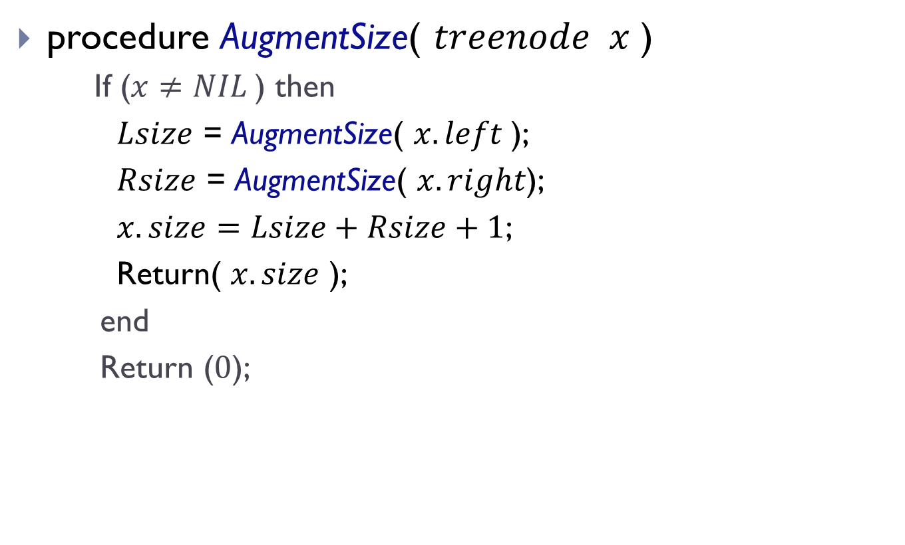
How to setup size information?
procedure AugmentSize( $treenode x$ )
  If ($x≠NIL$) then
    $Lsize$ = AugmentSize( $x.left$);
    $Rsize$ = AugmentSize( $x.right$);
    $x.size=Lsize+Rsize+1$;
    Return( $x.size$ );
  end
  Return ($0$);
Postorder traversal
of the tree !

Slide 39
How to perform select with aug-BST?
M
9
Select element
with rank 3?
Select element
with rank 7?
C
5
P
3
Select element
with rank 6?
F
3
T
2
A
1
D
1
H
1
Q
1

Slide 40
Let T be an augmented binary search tree
BST-Select(x, k):
  Return the k-th smallest element in the subtree rooted at x
  BST-Select(T.root, k) returns the k-th smallest elements in the entire tree.

Slide 41
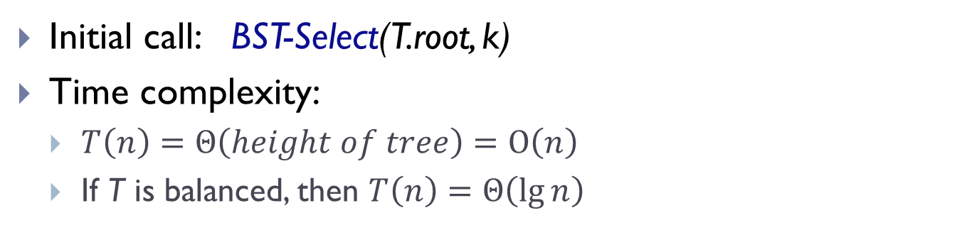
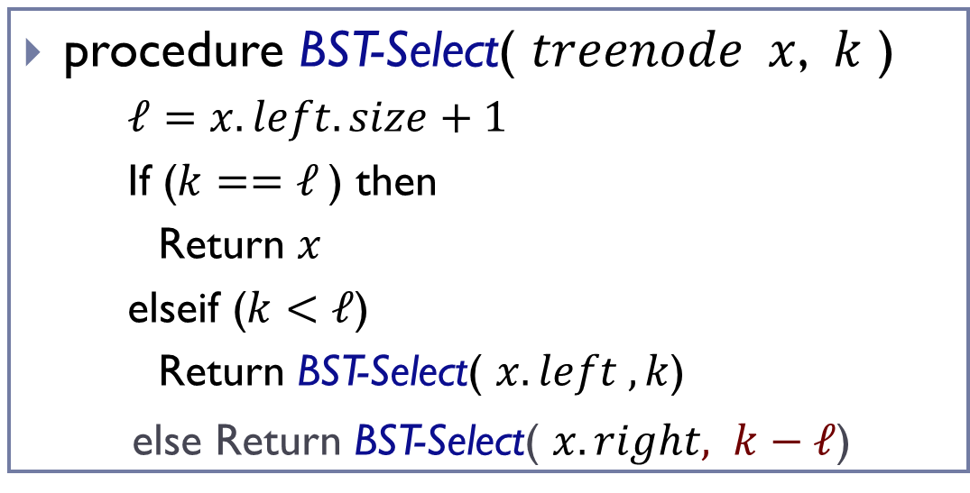
procedure BST-Select( $treenode x$, $k$ )
  $ℓ=x.left.size+1$
  If ($k==ℓ$) then
  Return $x$
  elseif ($k<ℓ$)
    Return BST-Select( $x.left , k$)
  else Return BST-Select( $x.right, k−ℓ$)
Initial call: BST-Select(T.root, k)
Time complexity:
  $T\left(n\right)=Θ\left(height of tree\right)=O\left(n\right)$
  If T is balanced, then $T\left(n\right)=Θ\left(\lg{n}\right)$

Slide 42
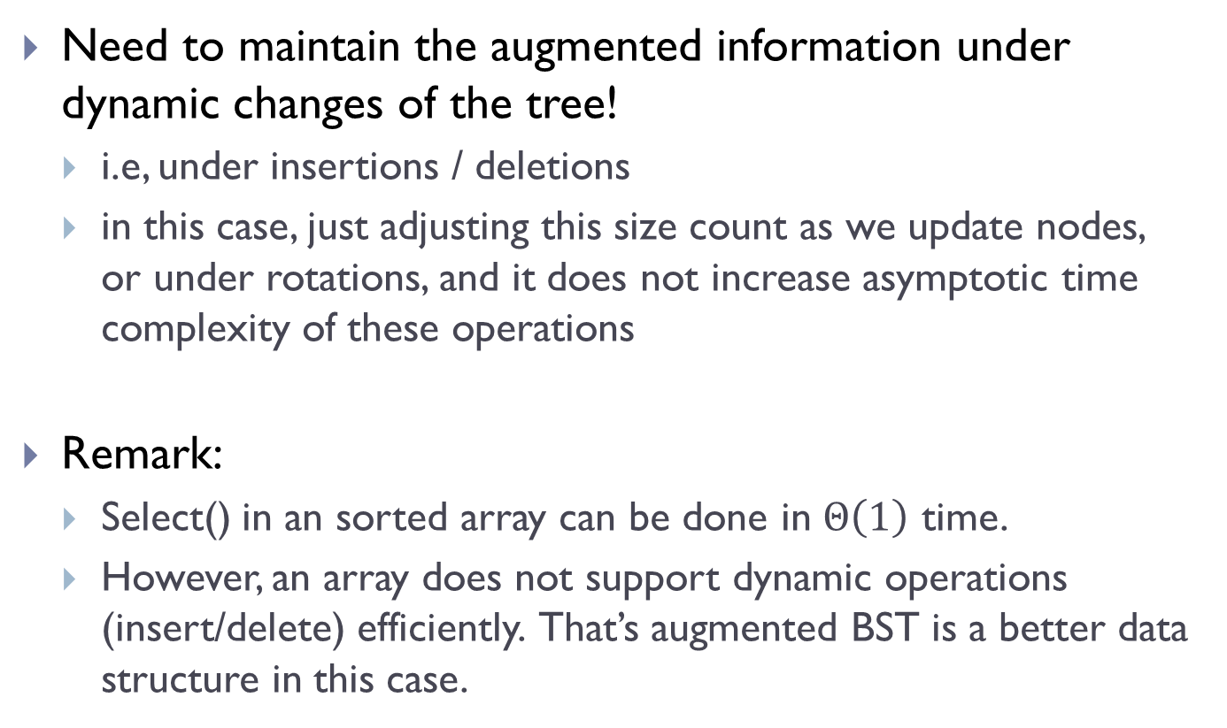
Are we done?
Need to maintain the augmented information under dynamic changes of the tree!
  i.e, under insertions / deletions
  in this case, just adjusting this size count as we update nodes, or under rotations, and it does not increase asymptotic time complexity of these operations
Remark:
  Select() in an sorted array can be done in $Θ\left(1\right)$ time.
  However, an array does not support dynamic operations (insert/delete) efficiently. That’s augmented BST is a better data structure in this case.

Slide 43
Summary
Simple example of augmenting data structures
In general, the augmented information can be quite complicated
  Can be a separate data structure!
Need to consider how to maintain such information under dynamic changes

Slide 44
FIN

Slide 45
In-order tree walk
Tree walk:
  refers to having a tool to visit (traverse) all tree nodes
Intuitively:
  we can start from the root, and visit all tree nodes by following children pointers
  how to do this systematically?
6
3
8
4
7
9

Slide 46
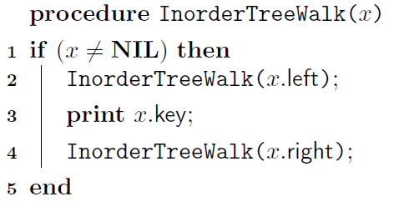
In-order tree walk
6
3
8
4
7
9
Notes:
Need to draw on the nodes

Slide 47
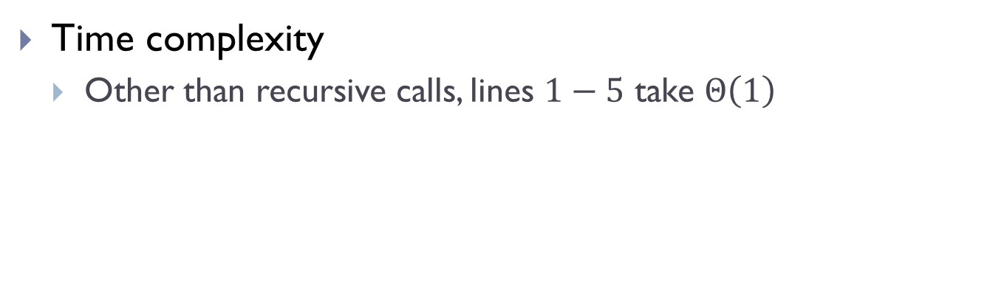
In-order tree walk
Time complexity
  Other than recursive calls, lines $1−5$ take $Θ\left(1\right)$
Notes:
Need to draw on the nodes

