Slide 1
DSC40B:
Theoretical Foundations of Data Science II
Lecture 2: Nested loops and asymptotic time complexity
Instructor: Yusu Wang

Slide 2
More examples: Nest loops

Slide 3
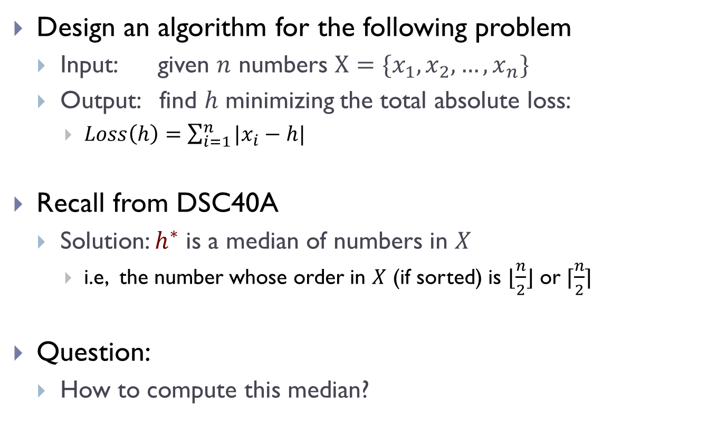
The median problem
Design an algorithm for the following problem
  Input: given $n$ numbers $X=\{x_{1},x_{2},…, x_{n}\}$
  Output: find $h$ minimizing the total absolute loss:
    $Loss\left(h\right)=\sum_{i=1}^{n}{|x_{i}−h|}$
Recall from DSC40A
  Solution: $h^{∗}$ is a median of numbers in $X$
    i.e, the number whose order in $X$ (if sorted) is $⌊\frac{n}{2}⌋$ or $⌈\frac{n}{2}⌉$
Question:
  How to compute this median?

Slide 4

One algorithm
Idea:
  $h^{∗}$ has to be one of $X=\{x_{1},x_{2},…, x_{n}\}$
  compute all $Loss\left(x_{1}\right), …, Loss\left(x_{n}\right)$
  return the one whose loss is smallest
Notes:
There are many ways to compute this. We will see other solutions later.

Slide 5
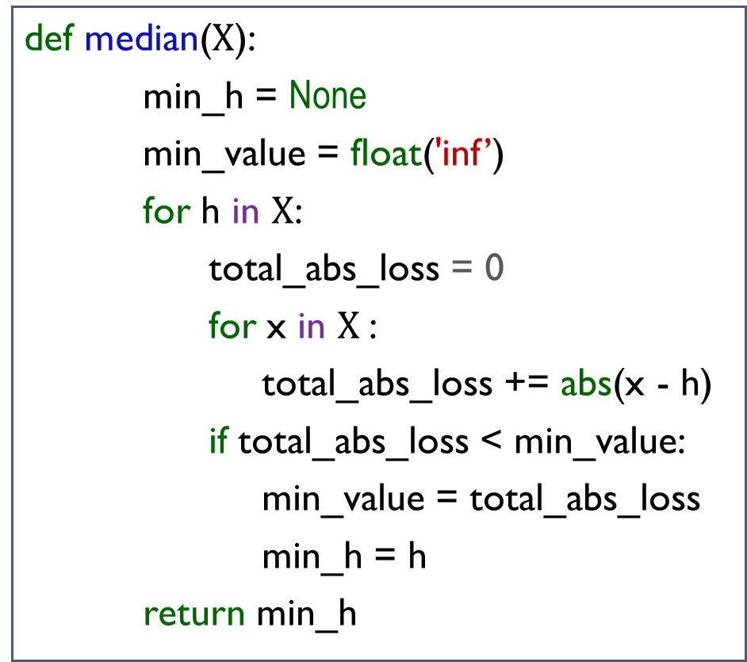
One algorithm
def median($X$):
min_h = None
min_value = float('inf’)
for h in $X$:
total_abs_loss = 0
for x in $X$:
total_abs_loss += abs(x - h)
if total_abs_loss < min_value:
min_value = total_abs_loss
min_h = h
return min_h
Inner-for loop:
Outer-for loop:
Total:

Slide 6
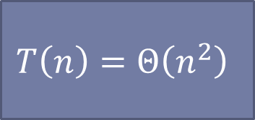
One algorithm
def median($X$):
min_h = None
min_value = float('inf’)
for h in $X$:
total_abs_loss = 0
for x in $X$:
total_abs_loss += abs(x - h)
if total_abs_loss < min_value:
min_value = total_abs_loss
min_h = h
return min_h
$$T\left(n\right)=Θ\left(n^{2}\right)$$
We will see how to do better later in class.

Slide 7



Caution!
Not all nested loop takes $Θ\left(n^{2}\right)$ time
def foo_1(n):
for x in range(n):
for y in range(n, n+10):
print(x + y)
$$T_{1}\left(n\right)=Θ\left(n\right)$$
def foo_2(n):
for x in range(n):
for y in range(n, 2n-10):
print(x + y)
$$T_{2}\left(n\right)=Θ\left(n^{2}\right)$$

Slide 8


Another example
Alex is given $n$ sticks. He needs to design an algorithm to compute the tallest pole he can make by stacking two sticks
How many times does line $5−7$ (inner body) run?
def tallest_pole(heights):
1. max_height = -float (‘inf’)
2. n = len(heights)
3. for i in range(n):
4. for j in range(i+1, n):
5. h = heights[i] + heights[j]
6. if h > max_height
7. max_height = h
8. return max_height
On outer iter.#1, inner body runs ____ times
On outer iter.#2, inner body runs ____ times
On outer iter.#3, inner body runs ____ times
On outer iter.#n, inner body runs ____ times
For the k-th iteration of outer loop, the inner loop takes $c(n−k)$ time.

Slide 9
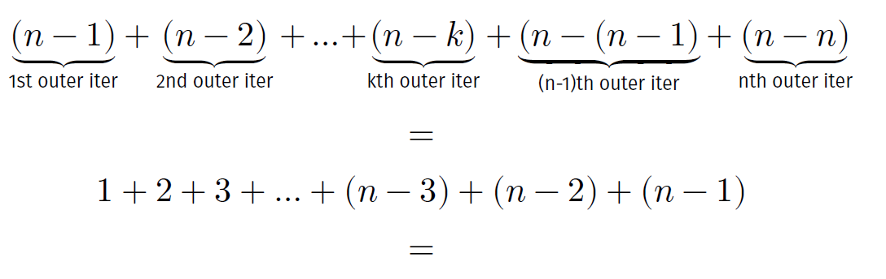

Tallest_pole, cont.
Total times line 5-7 (inner body) is executed:
Algorithm tallest_pole has $T\left(n\right)=Θ\left(n^{2}\right)$
Another way to see the time complexity:
  Number of pairs of n objects is $\left({n \atop 2}\right)=\frac{n\left(n−1\right)}{2}=Θ(n^{2})$
Exercise: Find a linear-time algorithm for this problem.
Notes:
Arithmetic sum
We could have also analyzed this in another way –

Slide 10
Linear vs quadratic growth

Slide 11
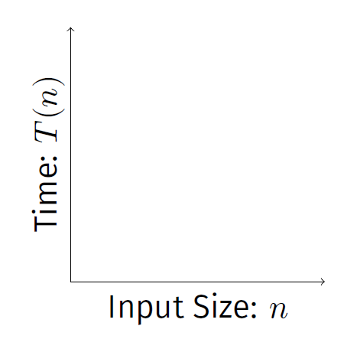
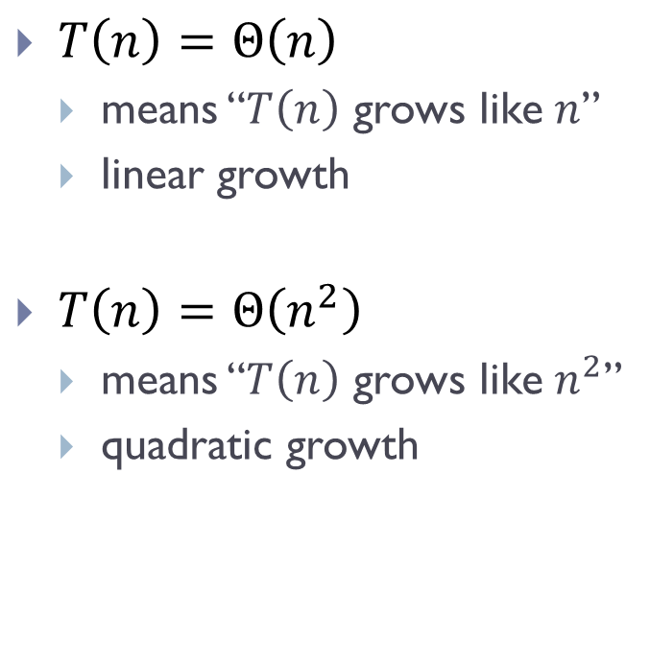
Scaling
$T\left(n\right)=Θ\left(n\right)$
  means “$T\left(n\right)$ grows like $n$”
  linear growth
$T\left(n\right)=Θ\left(n^{2}\right)$
  means “$T\left(n\right)$ grows like $n^{2}$”
  quadratic growth

Slide 12
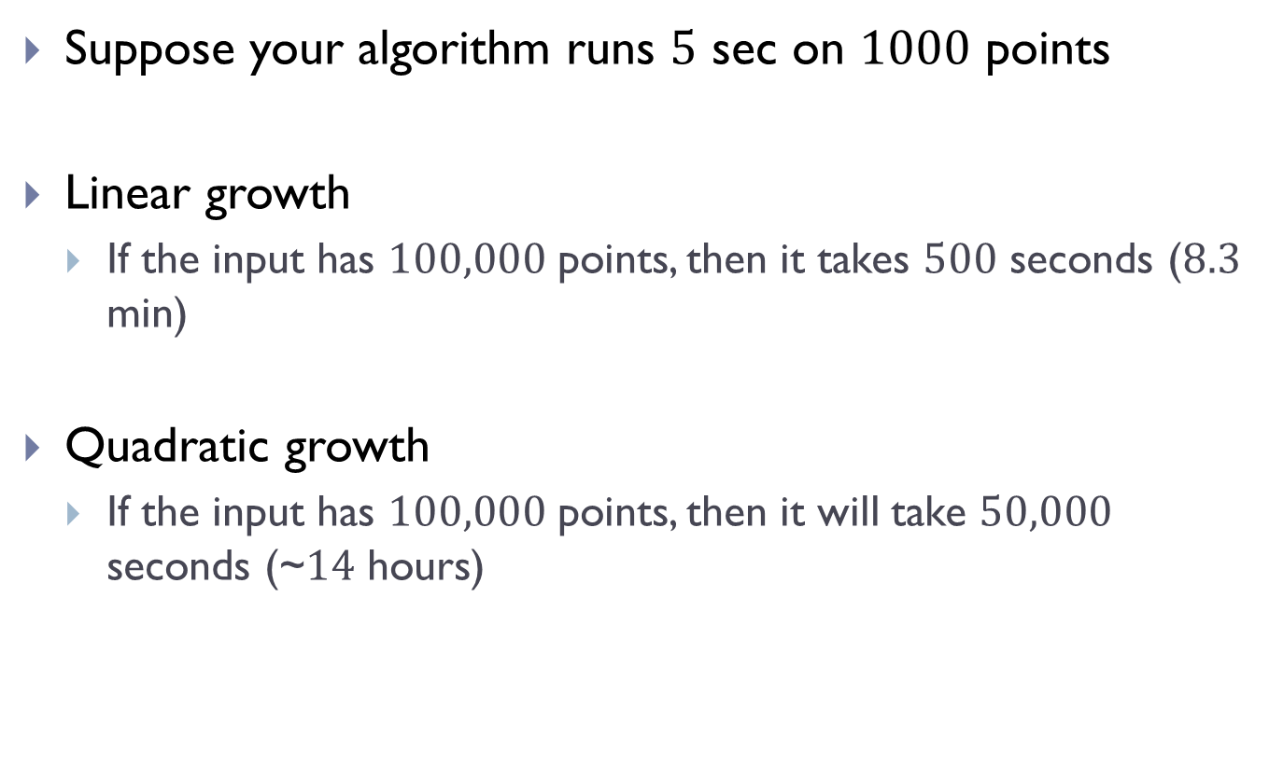
Suppose your algorithm runs $5$ sec on $1000$ points
Linear growth
  If the input has $100,000$ points, then it takes $500$ seconds ($8.3$ min)
Quadratic growth
  If the input has $100,000$ points, then it will take $50,000$ seconds (~$14$ hours)

Slide 13

Some common growth rates
$Θ\left(1\right) :$ constant
$Θ\left(\log{n}\right) :$ logarithmic
$Θ\left(n\right) :$ linear
$Θ\left(n\log{n}\right) :$ linearithmic
$Θ(n^{2}):$ quadratic
$Θ(n^{3}):$ cubic
$Θ\left(2^{n}\right) :$ exponential

Slide 14
Asymptotic notations

Slide 15
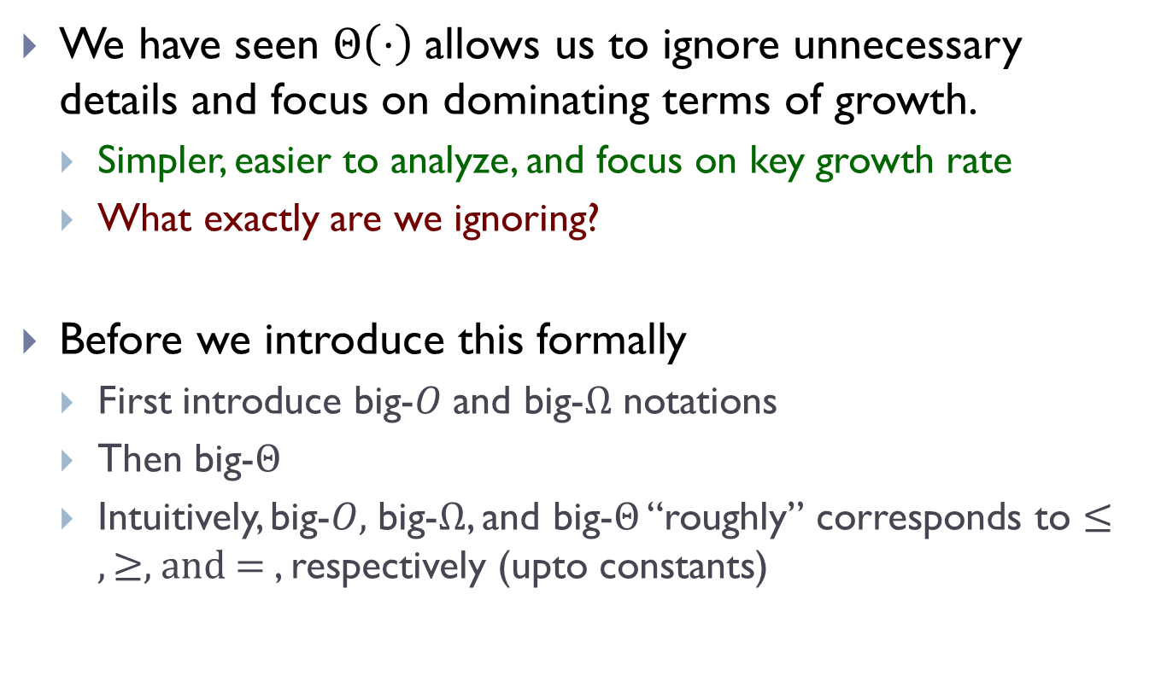
We have seen $Θ\left(⋅\right)$allows us to ignore unnecessary details and focus on dominating terms of growth.
  Simpler, easier to analyze, and focus on key growth rate
  What exactly are we ignoring?
Before we introduce this formally
  First introduce big-$O$ and big-$Ω$ notations
  Then big-$Θ$
  Intuitively, big-$O,$ big-$Ω$, and big-$Θ$ “roughly” corresponds to $≤, ≥,$and $=$, respectively (upto constants)

Slide 16
Big-O notation

Slide 17
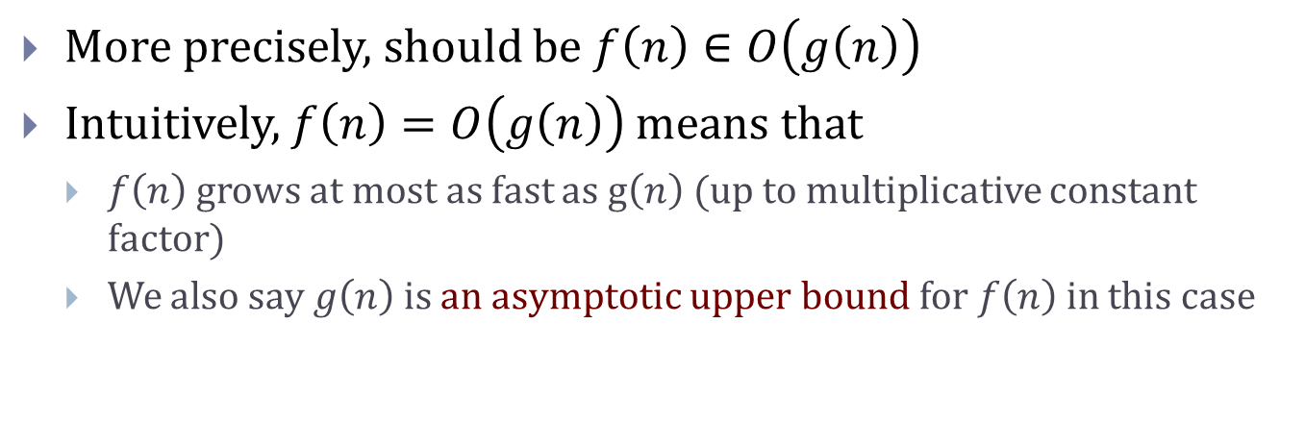
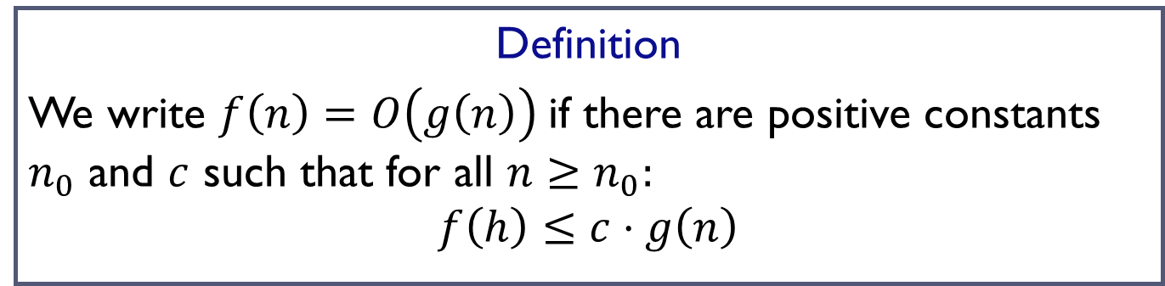
Big-O notation
Definition
We write $f\left(n\right)=O\left(g\left(n\right)\right)$if there are positive constants $n_{0}$ and $c$ such that for all $n≥n_{0}:$
$$f\left(h\right)≤c⋅g\left(n\right)$$
More precisely, should be $f\left(n\right)∈O\left(g\left(n\right)\right)$
Intuitively, $f\left(n\right)=O\left(g\left(n\right)\right)$ means that
  $f\left(n\right)$ grows at most as fast as g$\left(n\right)$ (up to multiplicative constant factor)
  We also say $g\left(n\right)$ is an asymptotic upper bound for $f\left(n\right)$ in this case

Slide 18
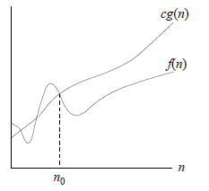
Big-O notation
Definition
We write $f\left(n\right)=O\left(g\left(n\right)\right)$if there are positive constants $n_{0}$ and $c$ such that for all $n≥n_{0}:$
$$f\left(h\right)≤c⋅g\left(n\right)$$

Slide 19

Examples
$n^{3}−3n^{2}+5n −1 =O\left(n^{3}\right)$
Proof:
$5n^{2}+6\sqrt{n}+8=O\left(n^{2}\right)$?
Proof:

Slide 20

More examples
$\sqrt{6n^{3}+7n^{2}+3n }=O(n^{2})$ ?
$\sqrt{6n^{3}+7n^{2}+3n }=O(n^{1.5})$ ?
$\frac{n}{\lg{n}}=O(n)$ ?
$\frac{100 n}{\lg{n}}=O(\frac{n}{\lg{n}})$ ?
$n\lg{n}=O(n)$ ?
$\log_{2}{n}=O(\log_{10}{n})$ ?

Slide 21
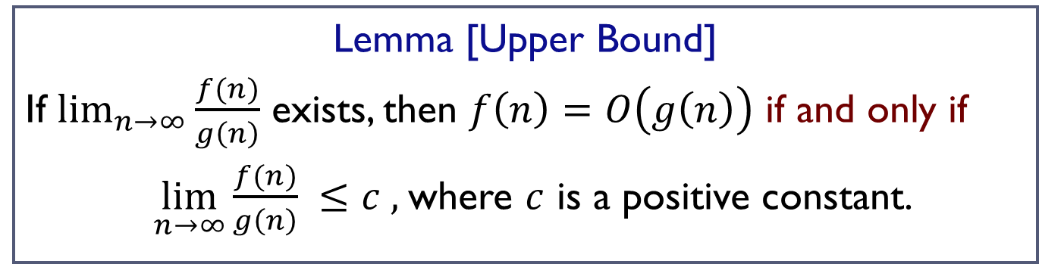
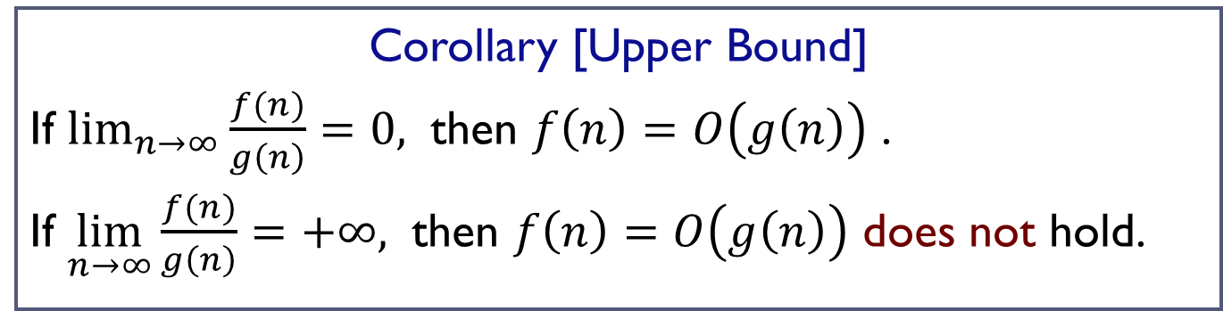
A useful result
Lemma [Upper Bound]
If $\lim_{n→∞}{\frac{f(n)}{g\left(n\right)}}$ exists, then $f\left(n\right)=O\left(g\left(n\right)\right)$ if and only if
$\lim_{n→∞}{\frac{f(n)}{g\left(n\right)}} ≤c ,$where $c$ is a positive constant.
Corollary [Upper Bound]
If $\lim_{n→∞}{\frac{f(n)}{g\left(n\right)}=0, }$ then $f\left(n\right)=O\left(g\left(n\right)\right)$ .
If $\lim_{n→∞}{\frac{f(n)}{g\left(n\right)}=+∞, }$ then $f\left(n\right)=O\left(g\left(n\right)\right)$ does not hold.

Slide 22

More examples
$n^{100}=O(n^{2})$ ?
$50\lg{n}=O(n)$ ?
$n^{100}=O(2^{n})$ ?
$2^{n}=O(3^{n})$ ?

Slide 23

Big-$Ω$ notation

Slide 24
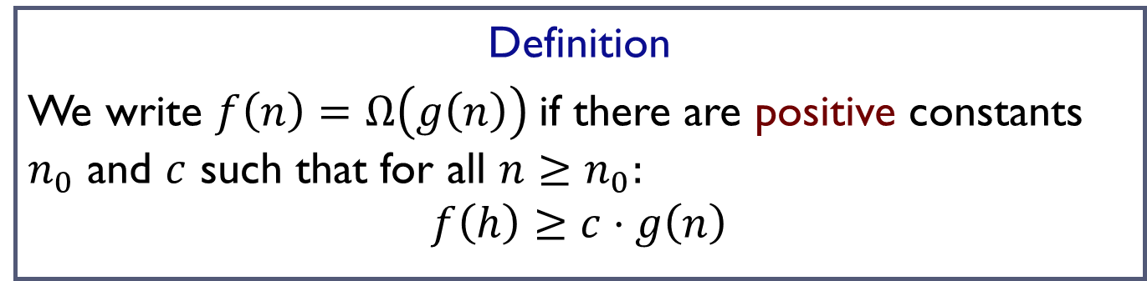
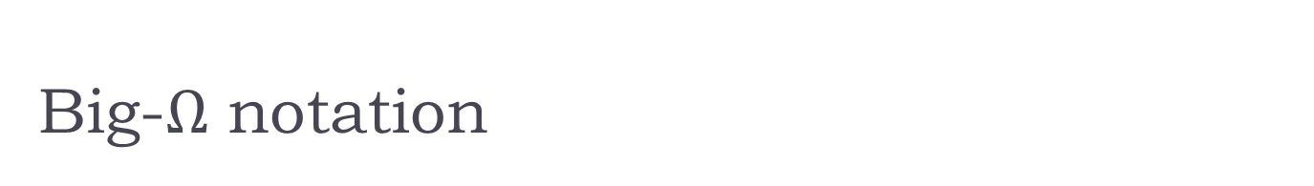
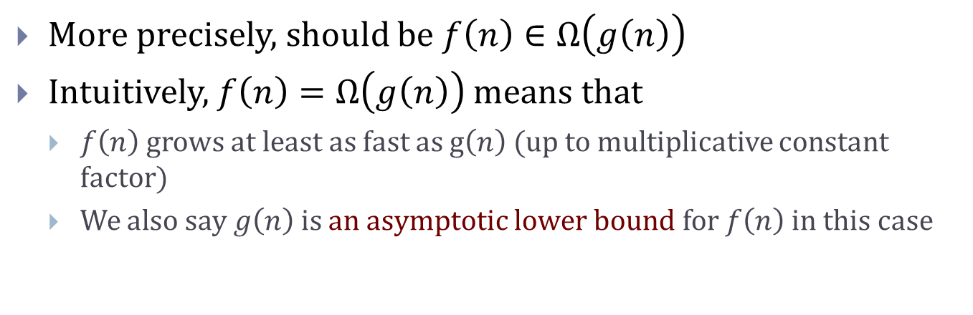
Big-$Ω$ notation
Definition
We write $f\left(n\right)=Ω\left(g\left(n\right)\right)$if there are positive constants $n_{0}$ and $c$ such that for all $n≥n_{0}:$
$$f\left(h\right)≥c⋅g\left(n\right)$$
More precisely, should be $f\left(n\right)∈Ω\left(g\left(n\right)\right)$
Intuitively, $f\left(n\right)=Ω\left(g\left(n\right)\right)$ means that
  $f\left(n\right)$ grows at least as fast as g$\left(n\right)$ (up to multiplicative constant factor)
  We also say $g\left(n\right)$ is an asymptotic lower bound for $f\left(n\right)$ in this case

Slide 25
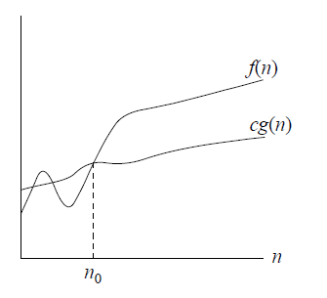
Big-$Ω$ notation
Definition
We write $f\left(n\right)=Ω\left(g\left(n\right)\right)$if there are positive constants $n_{0}$ and $c$ such that for all $n≥n_{0}:$
$$f\left(h\right)≥c⋅g\left(n\right)$$

Slide 26

Examples
$n^{3}−3n^{2}+5n =Ω\left(n^{3}\right)$ ?
Proof:

Slide 27
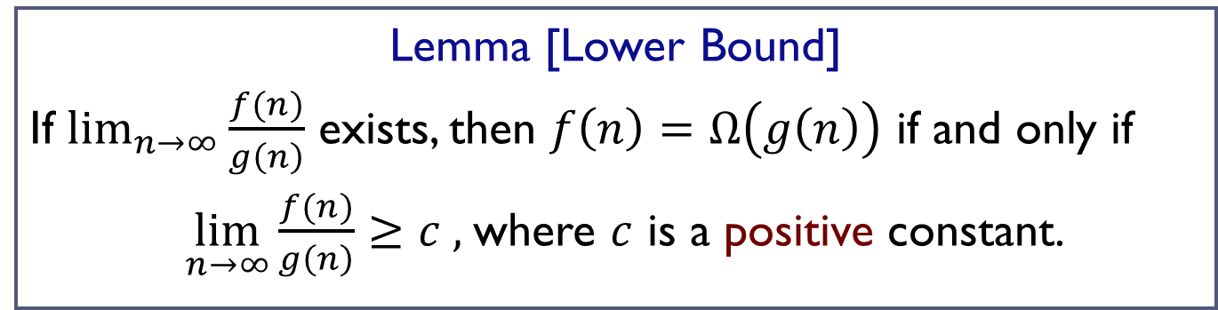
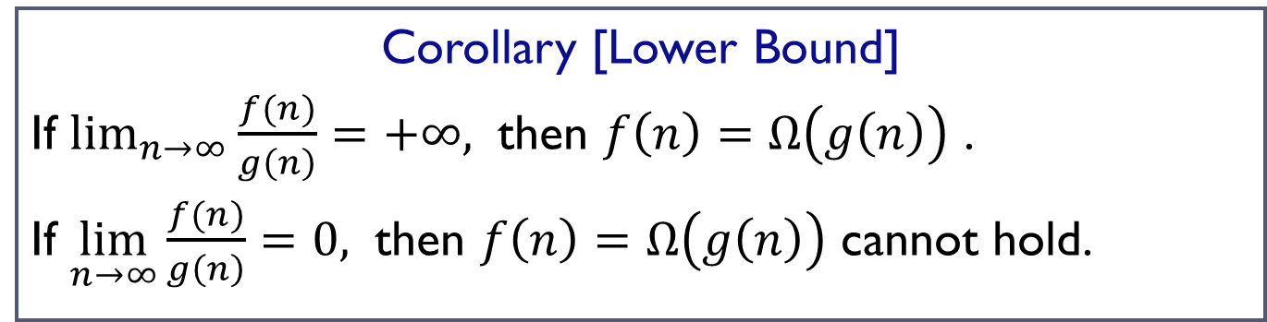
A useful result
Lemma [Lower Bound]
If $\lim_{n→∞}{\frac{f(n)}{g\left(n\right)}}$ exists, then $f\left(n\right)=Ω\left(g\left(n\right)\right)$ if and only if
$\lim_{n→∞}{\frac{f(n)}{g\left(n\right)}}≥c ,$where $c$ is a positive constant.
Corollary [Lower Bound]
If $\lim_{n→∞}{\frac{f(n)}{g\left(n\right)}=+∞, }$ then $f\left(n\right)=Ω\left(g\left(n\right)\right)$ .
If $\lim_{n→∞}{\frac{f(n)}{g\left(n\right)}=0, }$ then $f\left(n\right)=Ω\left(g\left(n\right)\right)$ cannot hold.

Slide 28
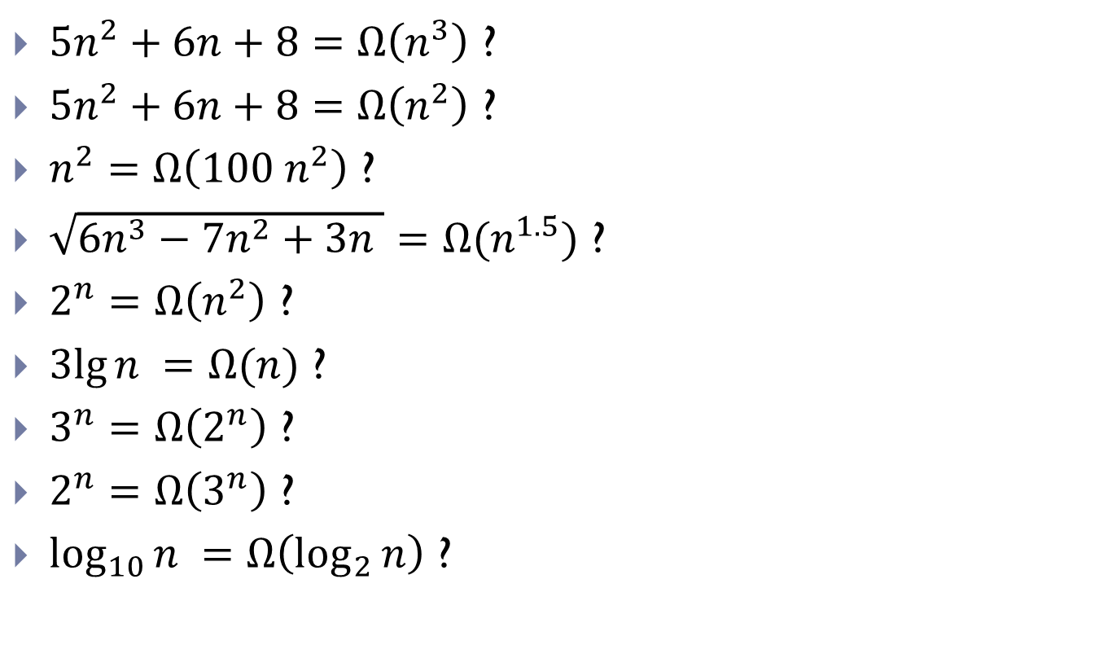
More Examples
$5n^{2}+6n+8=Ω\left(n^{3}\right)$ ?
$5n^{2}+6n+8=Ω\left(n^{2}\right)$ ?
$n^{2}=Ω\left({100 n}^{2}\right)$ ?
$\sqrt{6n^{3}−7n^{2}+3n }=Ω(n^{1.5})$ ?
$2^{n}=Ω\left(n^{2}\right)$ ?
$3lg{n }=Ω(n)$ ?
$3^{n}=Ω\left(2^{n}\right)$ ?
$2^{n}=Ω\left(3^{n}\right)$ ?
$\log_{10}{n }=Ω\left(\log_{2}{n}\right)$ ?

Slide 29

Big-$Θ$ notation

Slide 30


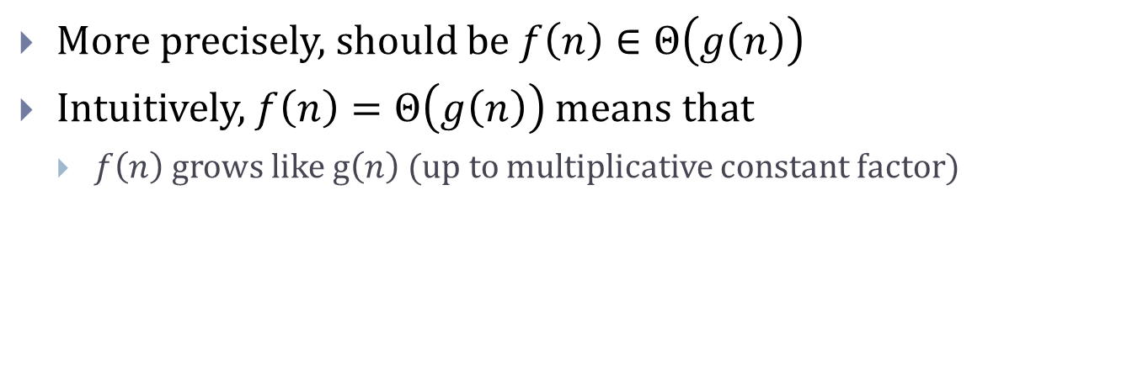
Big-$Θ$ notation
Definition
We write $f\left(n\right)=Θ\left(g\left(n\right)\right)$if there are positive constants $n_{0},$ $c_{1},$ and $c_{2}$such that for all $n≥n_{0}:$
$$c_{1}⋅g\left(n\right)≤f\left(h\right)≤c_{2}⋅g\left(n\right)$$
More precisely, should be $f\left(n\right)∈Θ\left(g\left(n\right)\right)$
Intuitively, $f\left(n\right)=Θ\left(g\left(n\right)\right)$ means that
  $f\left(n\right)$ grows like g$\left(n\right)$ (up to multiplicative constant factor)

Slide 31
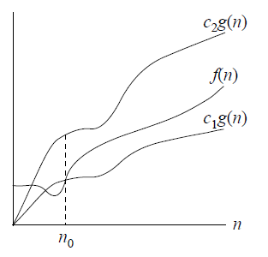
Big-$Θ$ notation
Definition
We write $f\left(n\right)=Θ\left(g\left(n\right)\right)$if there are positive constants $n_{0},$ $c_{1},$ and $c_{2}$such that for all $n≥n_{0}:$
$$c_{1}⋅g\left(n\right)≤f\left(h\right)≤c_{2}⋅g\left(n\right)$$

Slide 32
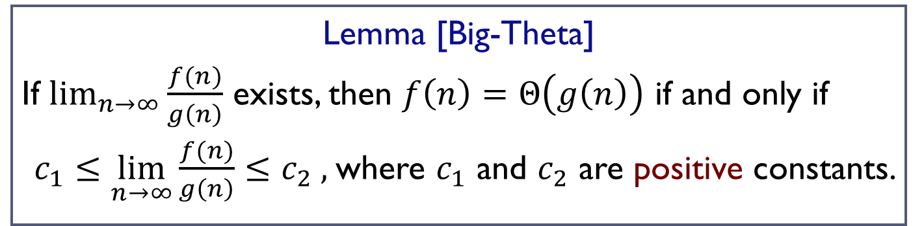
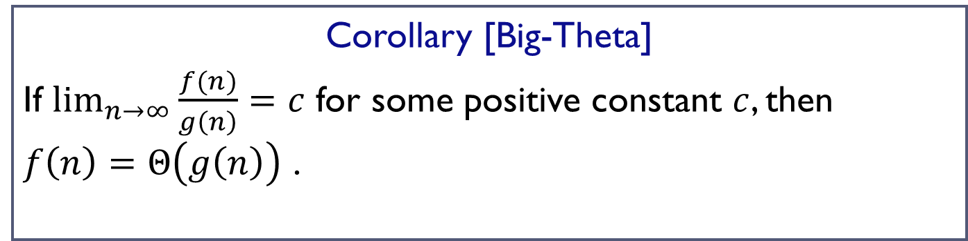
A useful result
Lemma [Big-Theta]
If $\lim_{n→∞}{\frac{f(n)}{g\left(n\right)}}$ exists, then $f\left(n\right)=Θ\left(g\left(n\right)\right)$ if and only if
$c_{1}≤\lim_{n→∞}{\frac{f(n)}{g\left(n\right)}}≤c_{2} ,$where $c_{1}$ and $c_{2}$ are positive constants.
Corollary [Big-Theta]
If $\lim_{n→∞}{\frac{f(n)}{g\left(n\right)}=c}$ for some positive constant $c$, then $f\left(n\right)=Θ\left(g\left(n\right)\right)$ .

Slide 33

Examples
$2n^{3}−3n^{2}=Θ\left(n^{3}\right)$
Proof:

Slide 34

More Examples
$5n^{2}+6n+8=Θ\left(n^{2}\right)$ ?
$\sqrt{6n^{3}−7n^{2}+3n }=Θ(n^{1.5})$ ?
$n^{2}−\lg{n }=Θ\left(n^{2}\right)$?
$3^{n}=Θ\left(2^{n}\right)$ ?
$\log_{10}{n }=Θ\left(\log_{2}{n}\right)$ ?

Slide 35
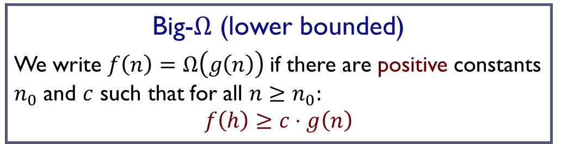
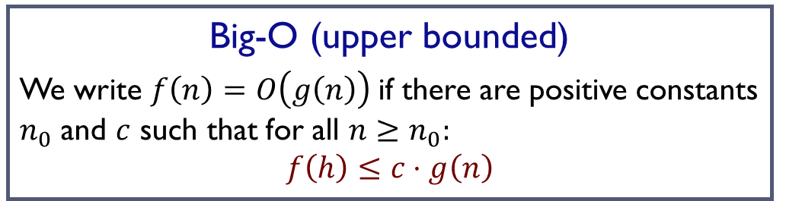
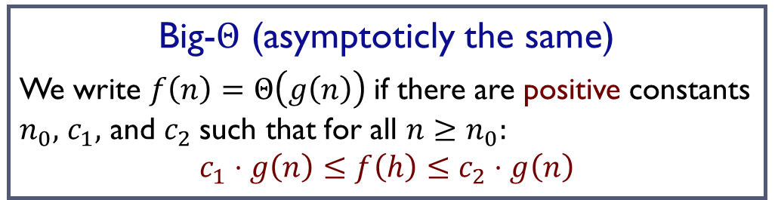
In summary
Big-O (upper bounded)
We write $f\left(n\right)=O\left(g\left(n\right)\right)$if there are positive constants $n_{0}$ and $c$ such that for all $n≥n_{0}:$
$$f\left(h\right)≤c⋅g\left(n\right)$$
Big-$Ω$ (lower bounded)
We write $f\left(n\right)=Ω\left(g\left(n\right)\right)$if there are positive constants $n_{0}$ and $c$ such that for all $n≥n_{0}:$
$$f\left(h\right)≥c⋅g\left(n\right)$$
Big-$Θ$ (asymptoticly the same)
We write $f\left(n\right)=Θ\left(g\left(n\right)\right)$if there are positive constants $n_{0},$ $c_{1},$ and $c_{2}$such that for all $n≥n_{0}:$
$$c_{1}⋅g\left(n\right)≤f\left(h\right)≤c_{2}⋅g\left(n\right)$$

Slide 36
More on nested loops analysis

Slide 37
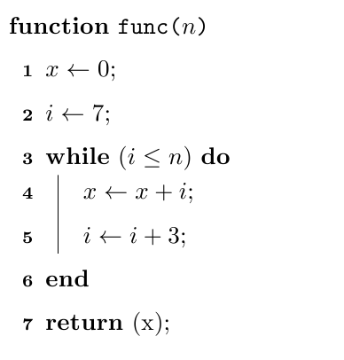
A pseudo-code example
Cost of this iteration
#iteration
value of i

Slide 38

A second example
Cost of this iteration
#iteration
value of i
$$∗$$

Slide 39
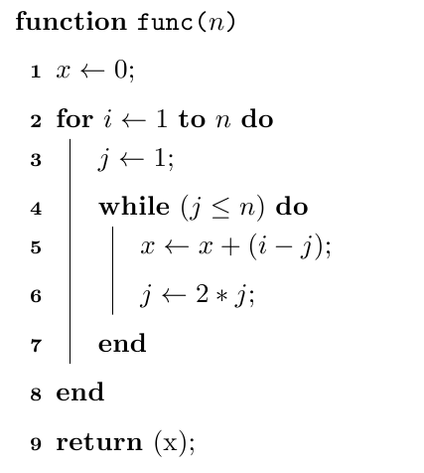
A third example

Slide 40

A third example
$$i$$

Slide 41
FIN

