Slide 1
DSC40B:
Theoretical Foundations of Data Science II
Lecture 13: Depth-First Search (DFS)
Instructor: Yusu Wang

Slide 2
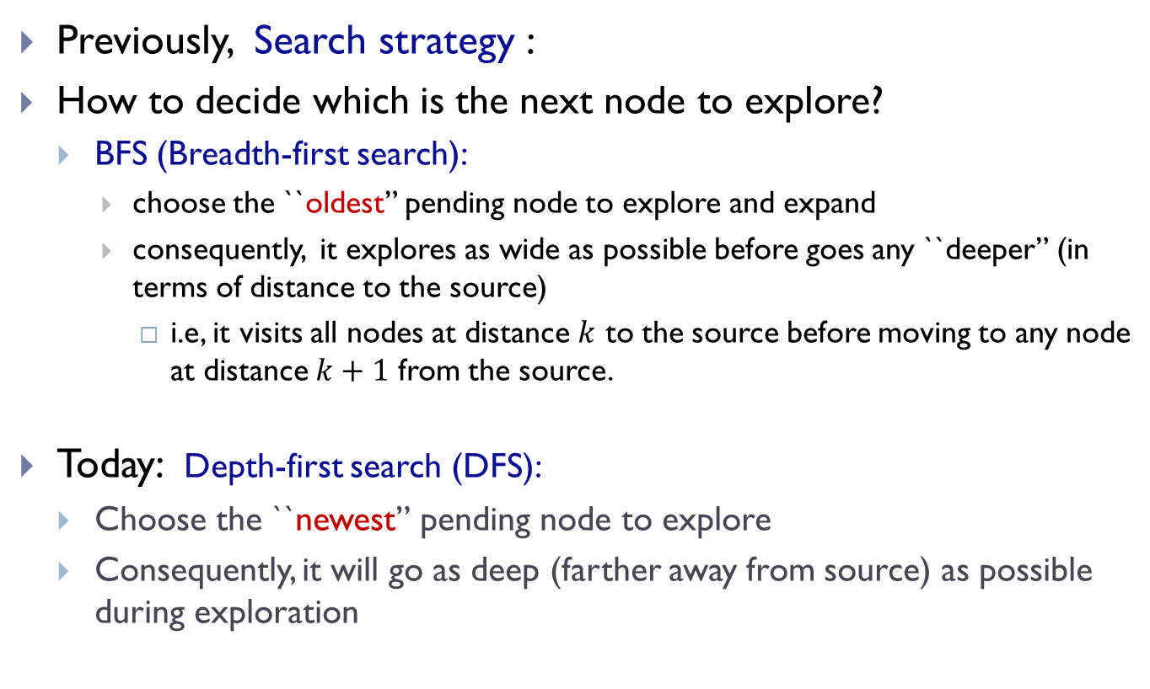
Prelude
Previously, Search strategy :
How to decide which is the next node to explore?
  BFS (Breadth-first search):
    choose the ``oldest” pending node to explore and expand
    consequently, it explores as wide as possible before goes any ``deeper” (in terms of distance to the source)
      i.e, it visits all nodes at distance $k$ to the source before moving to any node at distance $k+1$ from the source.
Today: Depth-first search (DFS):
  Choose the ``newest” pending node to explore
  Consequently, it will go as deep (farther away from source) as possible during exploration

Slide 3
DFS algorithm and time complexity

Slide 4
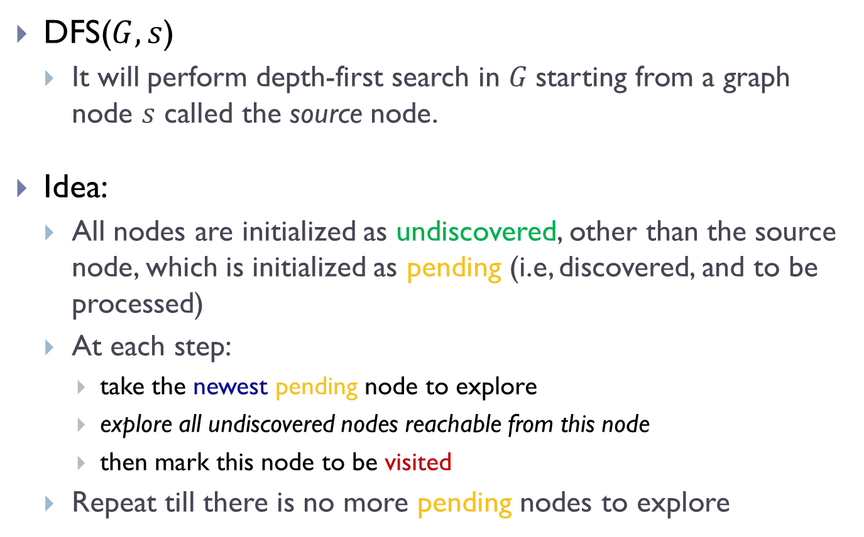
Depth-first Search (DFS)
DFS($G, s$)
  It will perform depth-first search in $G$starting from a graph node $s$ called the source node.
Idea:
  All nodes are initialized as undiscovered, other than the source node, which is initialized as pending (i.e, discovered, and to be processed)
  At each step:
    take the newest pending node to explore
    explore all undiscovered nodes reachable from this node
    then mark this node to be visited
  Repeat till there is no more pending nodes to explore

Slide 5
To be able to extract the “newest” pending node
  we need a standard stack data structure to provide FILO (first-in-last-out)
In algorithm implementation,
  we use recursive algorithm to achieve this FILO/stack idea implicitly

Slide 6
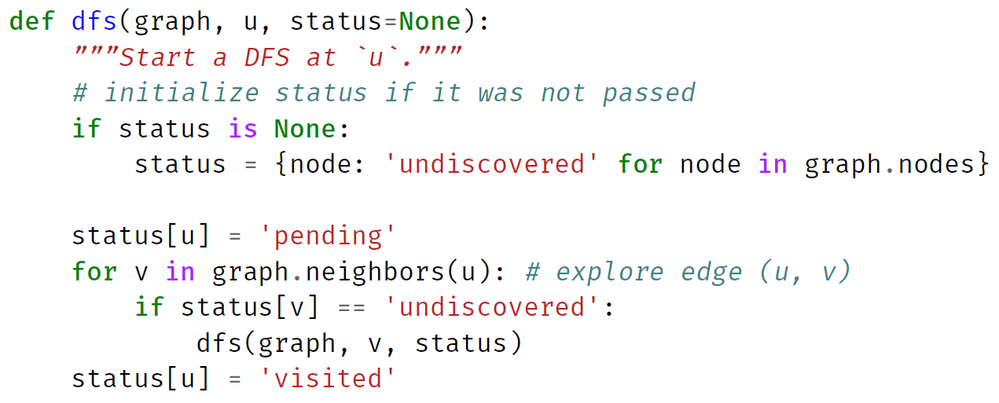
Implementation in Python

Slide 7
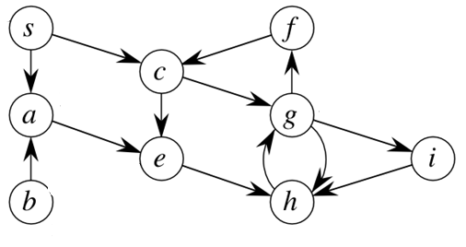
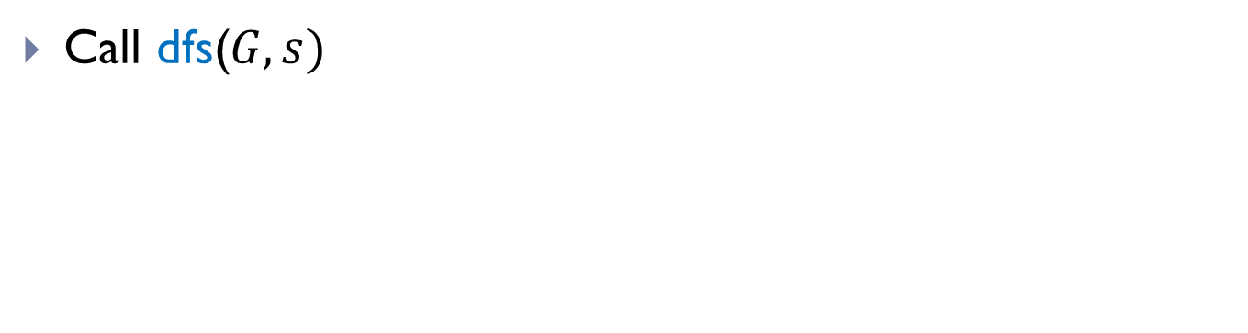

Example
$G$:
Call dfs($G, s)$

Slide 8
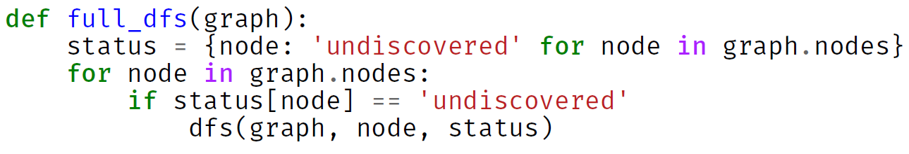
Full DFS
DFS will visit all nodes reachable from the source node
  If the input graph is connected, then it will visit all nodes in the same connected component as the source
To visit all nodes in a graph
  Needs full-DFS
    which requires we restart from undiscovered nodes.

Slide 9
Complete code

Slide 10
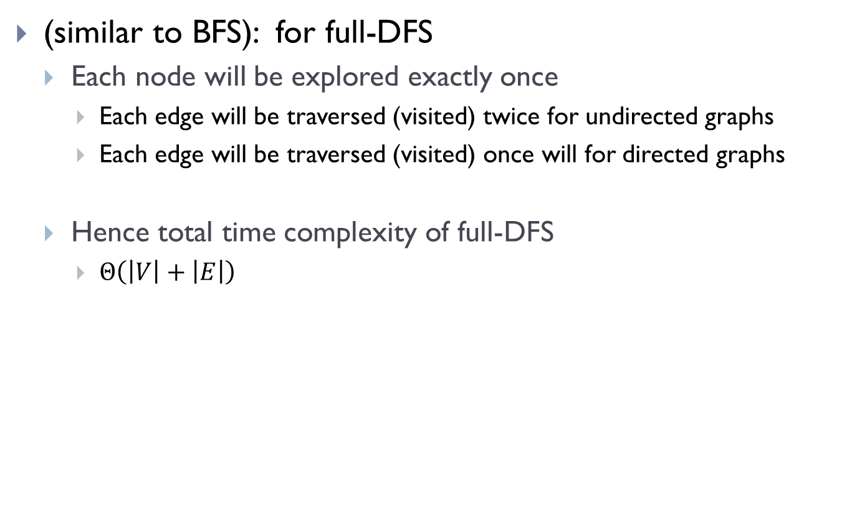
Time complexity analysis
(similar to BFS): for full-DFS
  Each node will be explored exactly once
    Each edge will be traversed (visited) twice for undirected graphs
    Each edge will be traversed (visited) once will for directed graphs
  Hence total time complexity of full-DFS
    $Θ\left(\left|V\right|+\left|E\right|\right)$

Slide 11
Nesting properties in DFS

Slide 12

Observations
Between marking a node as pending and visited, many other nodes are marked pending or visited.
$G$:

Slide 13
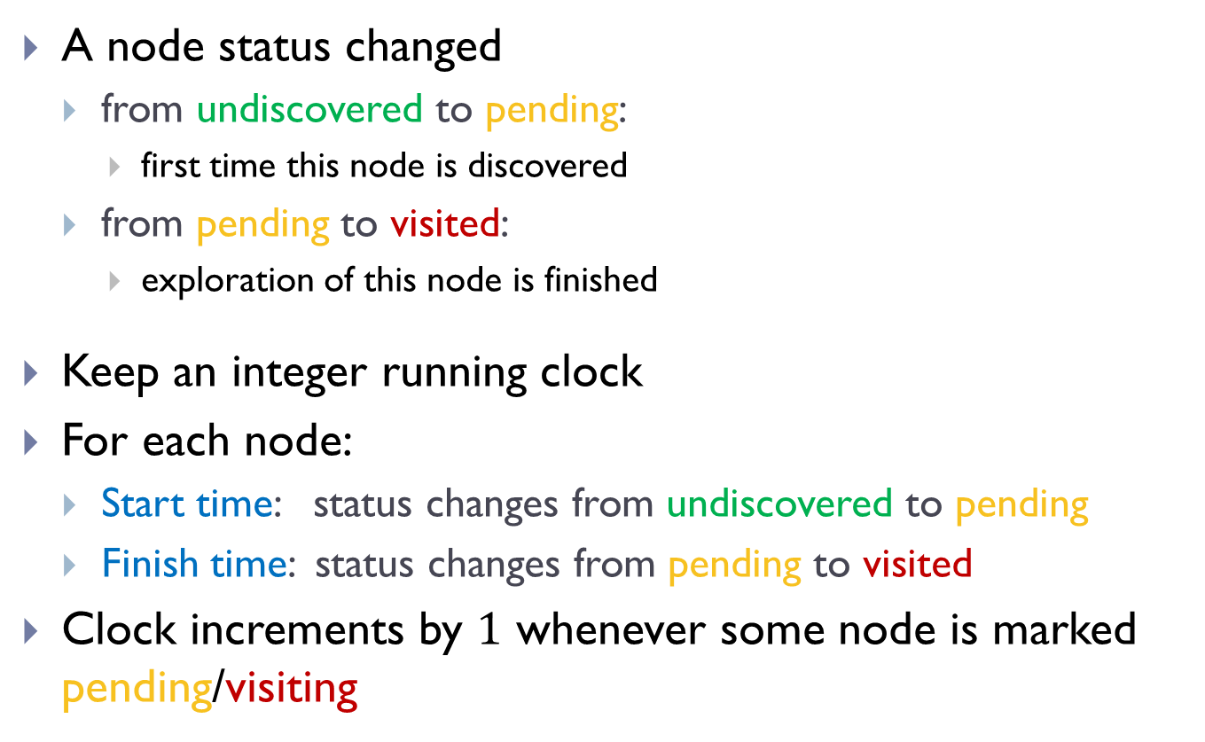
Start and Finish times
A node status changed
  from undiscovered to pending:
    first time this node is discovered
  from pending to visited:
    exploration of this node is finished
Keep an integer running clock
For each node:
  Start time: status changes from undiscovered to pending
  Finish time: status changes from pending to visited
Clock increments by $1$ whenever some node is marked pending/visiting

Slide 14
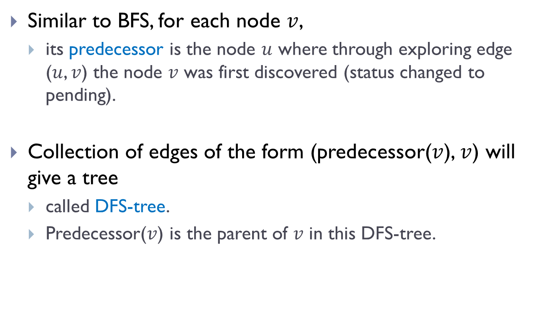
“Parent” (Predecessor) information
Similar to BFS, for each node $v$,
  its predecessor is the node $u$ where through exploring edge ($u$, $v$) the node $v$ was first discovered (status changed to pending).
Collection of edges of the form (predecessor($v$), $v$) will give a tree
  called DFS-tree.
  Predecessor($v$) is the parent of $v$ in this DFS-tree.

Slide 15

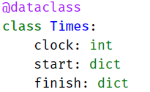
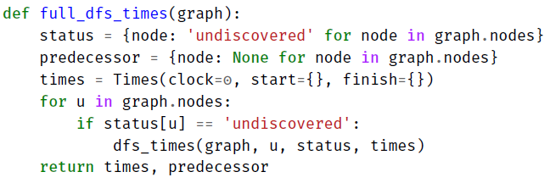
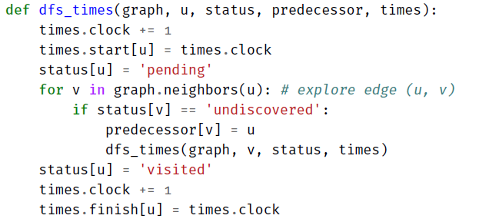
full_DFS_times implementation

Slide 16

Example
$G$:

Slide 17
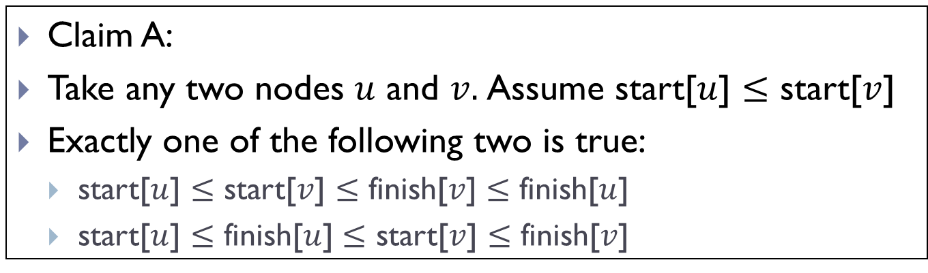
Nesting Property of DFS
Claim A:
Take any two nodes $u$ and $v.$Assume start[$u$] $≤$ start[$v$]
Exactly one of the following two is true:
  start[$u$] $≤$ start[$v$] $≤$ finish[$v$] $≤$ finish[$u$]
  start[$u$] $≤$ finish[$u$] $≤$ start[$v$] $≤$ finish[$v$]

Slide 18
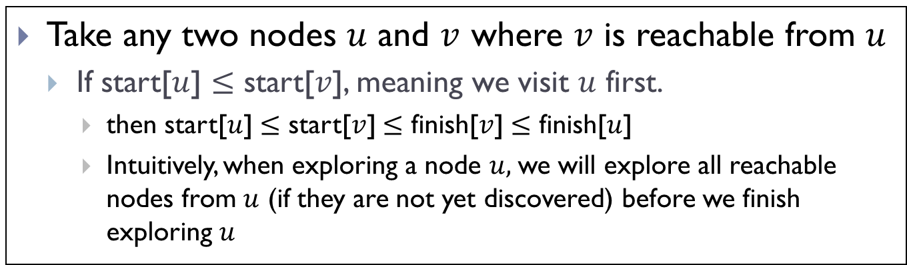
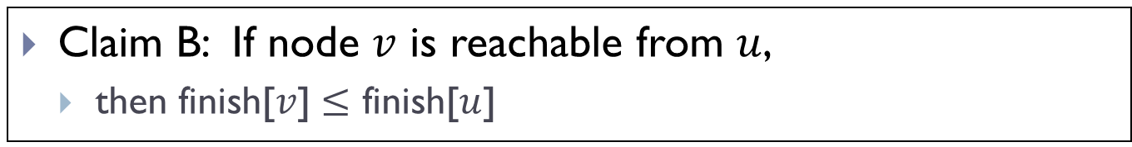
Nesting Property of DFS
Take any two nodes $u$ and $v$ where $v$ is reachable from $u$
  If start[$u$] $≤$ start[$v$], meaning we visit $u$ first.
    then start[$u$] $≤$ start[$v$] $≤$ finish[$v$] $≤$ finish[$u$]
    Intuitively, when exploring a node $u,$we will explore all reachable nodes from $u$ (if they are not yet discovered) before we finish exploring $u$
Claim B: If node $v$ is reachable from $u$,
  then finish[$v$] $≤$ finish[$u$]

Slide 19
DAGs and topological sort

Slide 20
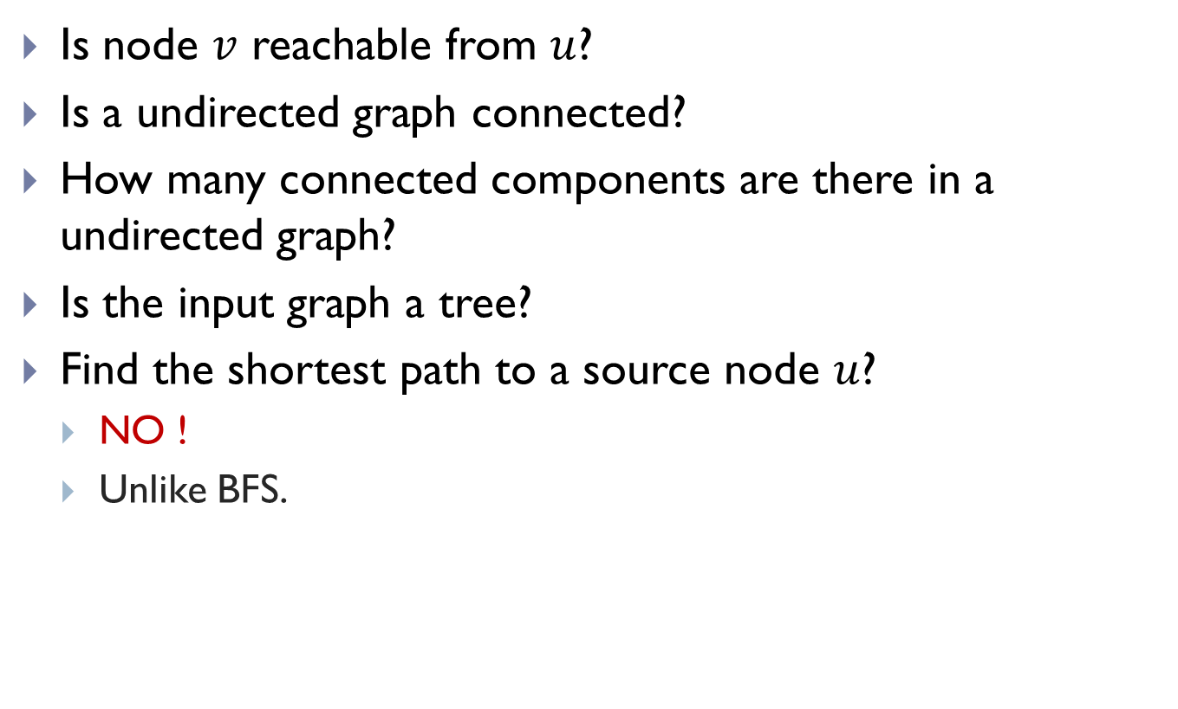
Applications of DFS
Is node $v$ reachable from $u$?
Is a undirected graph connected?
How many connected components are there in a undirected graph?
Is the input graph a tree?
Find the shortest path to a source node $u$?
  NO !
  Unlike BFS.

Slide 21
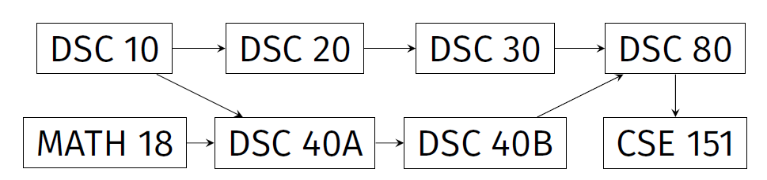
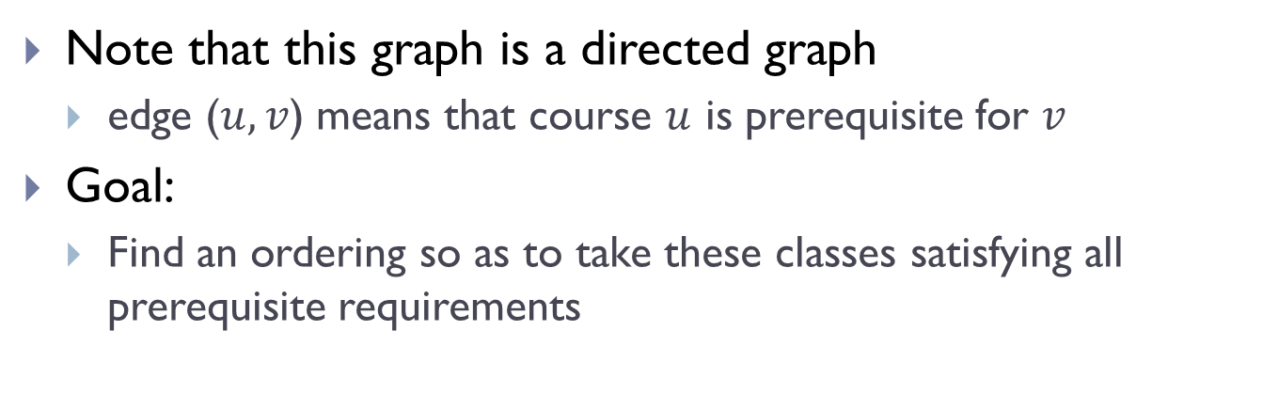
Prerequisite graphs
Note that this graph is a directed graph
  edge ($u, v$) means that course $u$ is prerequisite for $v$
Goal:
  Find an ordering so as to take these classes satisfying all prerequisite requirements

Slide 22

Directed Acyclic Graphs (DAGs)
A directed cycle is a (directed) path from a node to itself.
A directed acyclic graph (DAG) is a directed graph that does not contain any directed cycles
Not a DAG!
$G$:
A DAG!

Slide 23
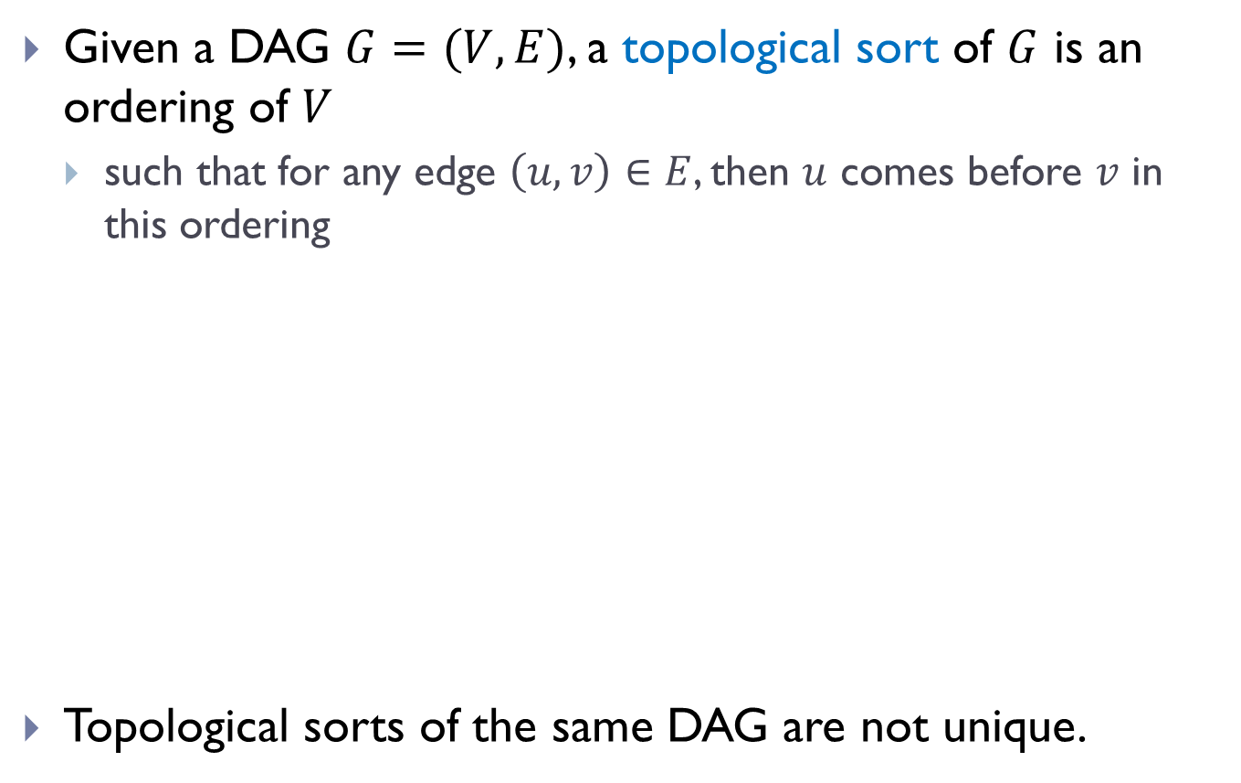
Topological Sorts
Given a DAG $G=(V, E)$, a topological sort of $G$ is an ordering of $V$
  such that for any edge $\left(u, v\right)∈E$, then $u$ comes before $v$ in this ordering
Topological sorts of the same DAG are not unique.
A topological sort:
DSC10, Math18, DSC20, DSC40A, DSC30, DSC40B, DSC80, DSC151
Another topological sort:
Math18, DSC10, DSC20, DSC30, DSC40A, DSC40B, DSC80, DSC151

Slide 24
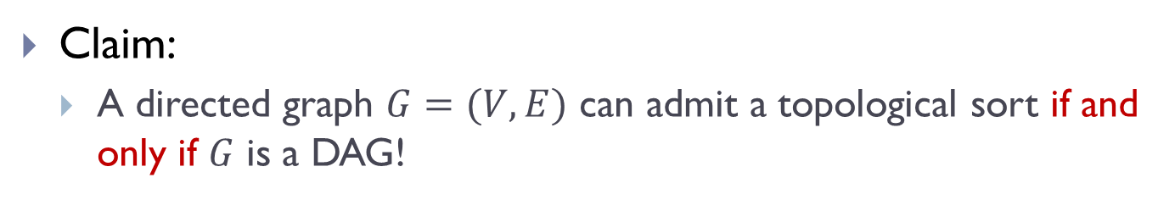
Why DAG?
Claim:
  A directed graph $G=(V,E)$ can admit a topological sort if and only if $G$ is a DAG!
Why?
  If there is a cycle, then there is no valid ordering for nodes in that cycle!
  If it is a DAG, then we will give an algorithm to show we can compute topological sort.
$G$:

Slide 25
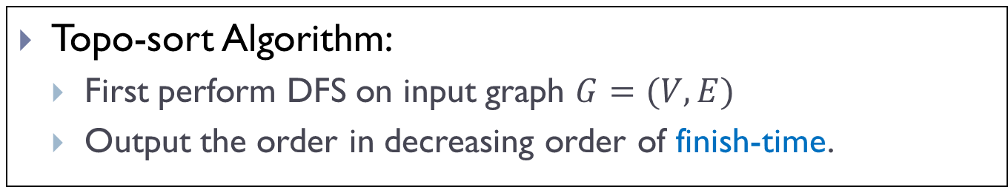
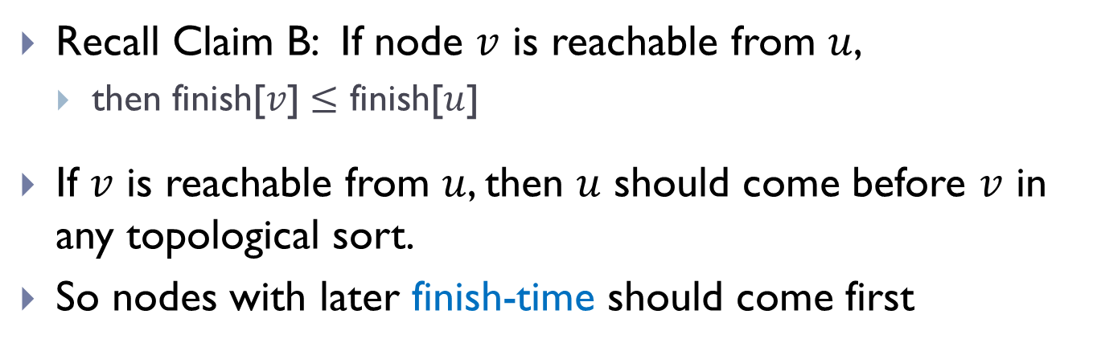

An algorithm to compute topo-sort
Recall Claim B: If node $v$ is reachable from $u$,
  then finish[$v$] $≤$ finish[$u$]
If $v$ is reachable from $u$, then $u$ should come before $v$ in any topological sort.
So nodes with later finish-time should come first
Topo-sort Algorithm:
  First perform DFS on input graph $G=(V,E)$
  Output the order in decreasing order of finish-time.
Time complexity:
$$Θ\left(\left|V\right|+\left|E\right|\right)$$

Slide 26
Remark:
There are many other ways to compute a topological sort for a DAG in the same time complexity, without using DFS.

Slide 27
Summary
DFS:
  Yet another graph search strategy
  Similarly to BFS, as a graph search strategy, can help solve many problems, such as checking for connectivity, reachability, finding a path and so on.
  But has some different properties as BFS
    BFS: useful for finding shortest path to the source
    DFS: has nesting properties in terms of start/finish times.
      An application: Topological sort in DAG

Slide 28
FIN

