Slide 1
DSC40B:
Theoretical Foundations of Data Science II
Lecture 7: The Median, order statistics, and QuickSort
Instructor: Yusu Wang

Slide 2

Previously
Sorting an array
(Binary) search in an sorted array
Today:
  What if, without sorting, we would like to select a specific number with a certain rank in the array
  In particular, how to find the median of an unsorted array of numbers quickly?
Before we start: how fast do you think you can find the median of $n$ numbers?

Slide 3
Order statistics and simple examples

Slide 4
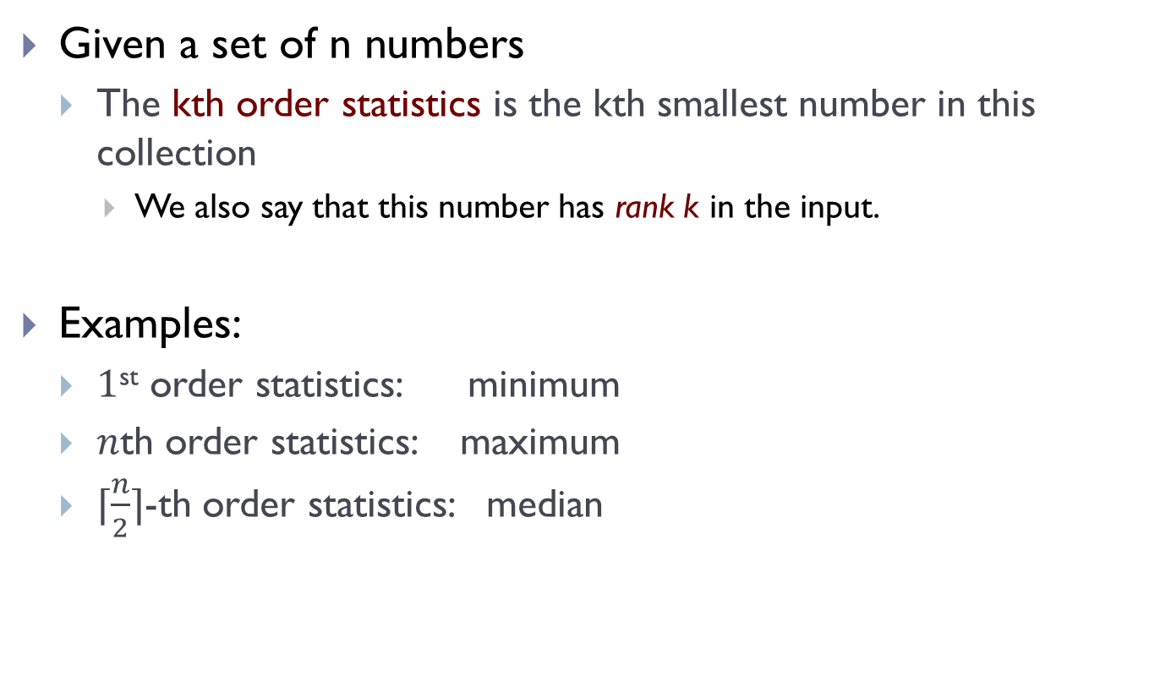
Order statistics
Given a set of n numbers
  The kth order statistics is the kth smallest number in this collection
    We also say that this number has rank k in the input.
Examples:
  $1$^{st} order statistics: minimum
  $n$th order statistics: maximum
  $⌈\frac{n}{2}⌉$-th order statistics: median

Slide 5
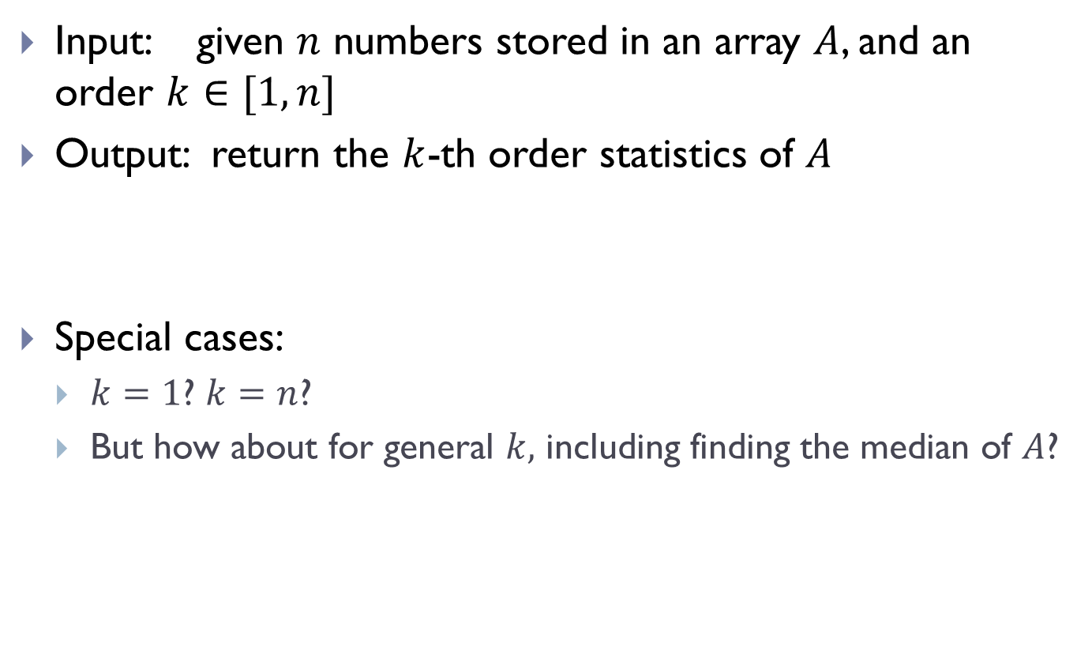
Select problem
Input: given $n$ numbers stored in an array $A$, and an order $k∈[1, n]$
Output: return the $k$-th order statistics of $A$
Special cases:
  $k=1$? $k=n$?
  But how about for general $k,$ including finding the median of $A$?

Slide 6

Simple approaches
Approach 1:
  Modifying selection sort
  Stops when find the $k$-th order statistics

Slide 7
Algorithm selection_sort
def selection_sort(A):
n = len(A)
if n <= 1:
return
for barrier_id in range(n-1):
# find index of min in A[start:]
min_id = find_minimum(A, start=barrier_id)
#swap
A[barrier_id], A[min_id] = (
A[min_id], A[barrier_id]
)

Slide 8
Algorithm selection_kthOS
def selection_kthOS(A, k):
n = len(A)
if n < k:
return Error
for barrier_id in range(k-1):
# find index of min in A[start:]
min_id = find_minimum(A, start=barrier_id)
#swap
A[barrier_id], A[min_id] = (
A[min_id], A[barrier_id]
)
return A[barrier_id]

Slide 9
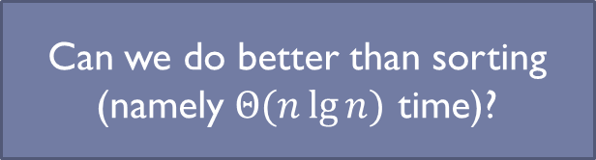
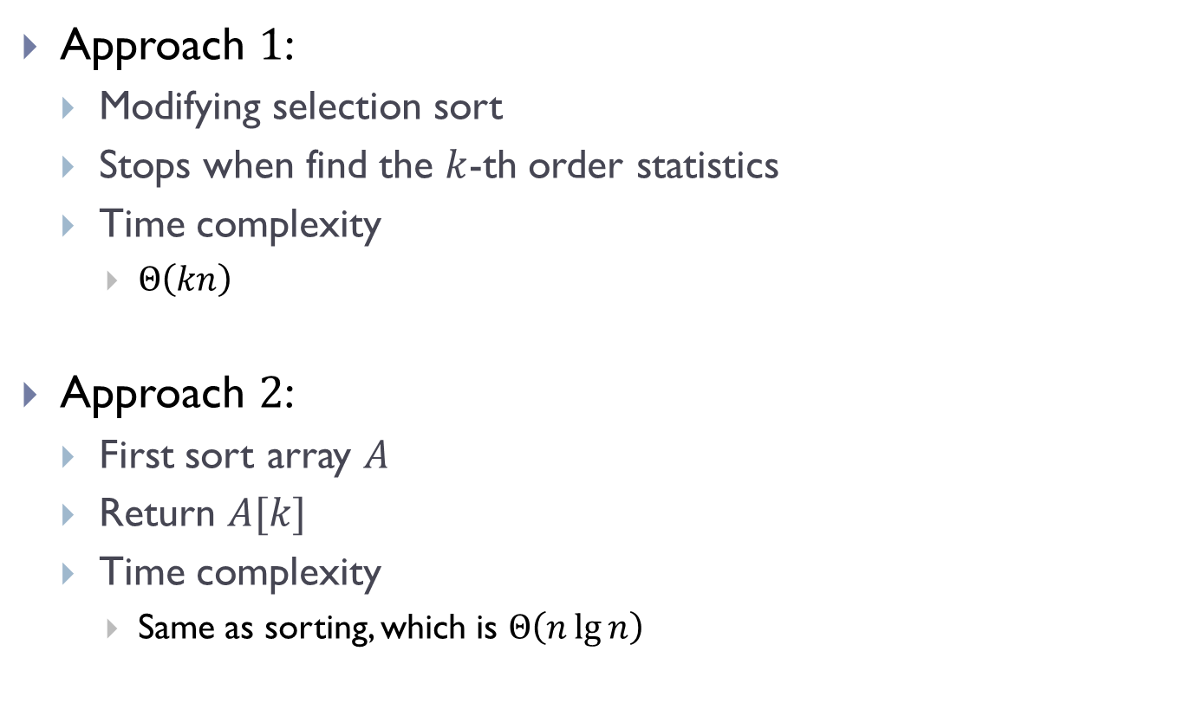
Simple approaches
Approach $1$:
  Modifying selection sort
  Stops when find the $k$-th order statistics
  Time complexity
    $Θ\left(kn\right)$
Approach $2$:
  First sort array $A$
  Return $A[k]$
  Time complexity
    Same as sorting, which is $Θ\left(n\lg{n}\right)$
Can we do better than sorting (namely $Θ(n\lg{n})$ time)?

Slide 10

Partition procedure
In what follows, I will use pseudocode, where for an array A of size $n$, its indices are from $1$ to $n$.

Slide 11
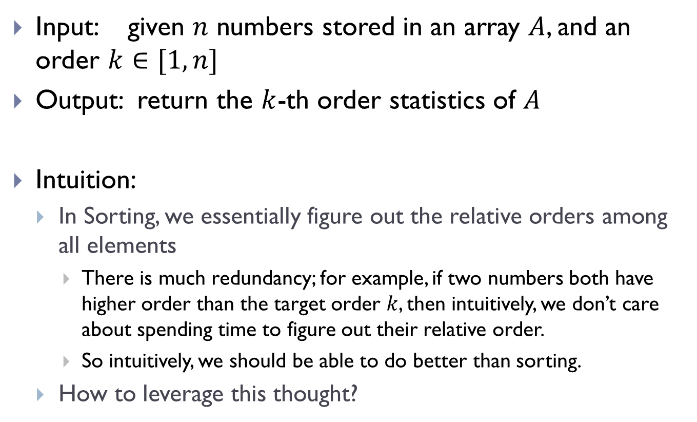
Select problem
Input: given $n$ numbers stored in an array $A$, and an order $k∈[1, n]$
Output: return the $k$-th order statistics of $A$
Intuition:
  In Sorting, we essentially figure out the relative orders among all elements
    There is much redundancy; for example, if two numbers both have higher order than the target order $k$, then intuitively, we don’t care about spending time to figure out their relative order.
    So intuitively, we should be able to do better than sorting.
  How to leverage this thought?

Slide 12
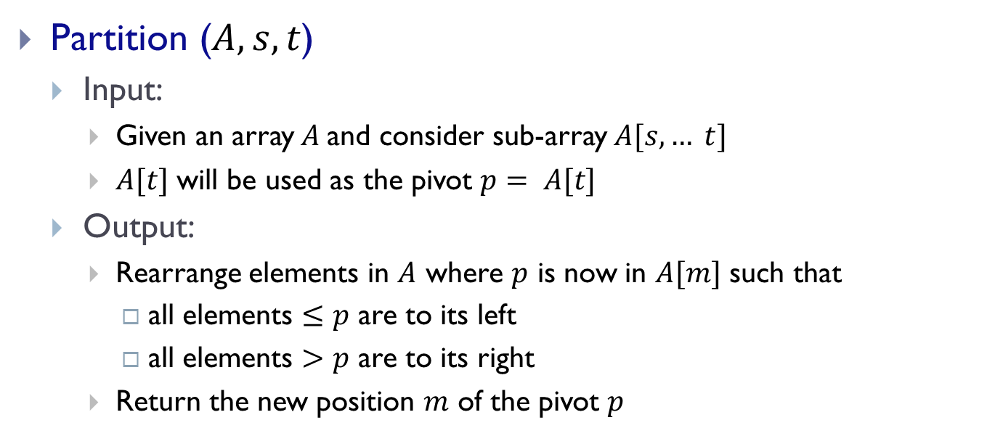
Partition procedure
Partition ($A, s, t$)
  Input:
    Given an array $A$and consider sub-array $A[s, … t]$
    $A[t]$ will be used as the pivot $p= A[t]$
  Output:
    Rearrange elements in $A$ where $p$ is now in $A[m]$ such that
      all elements $≤p$ are to its left
      all elements $>p$ are to its right
    Return the new position $m$ of the pivot $p$

Slide 13

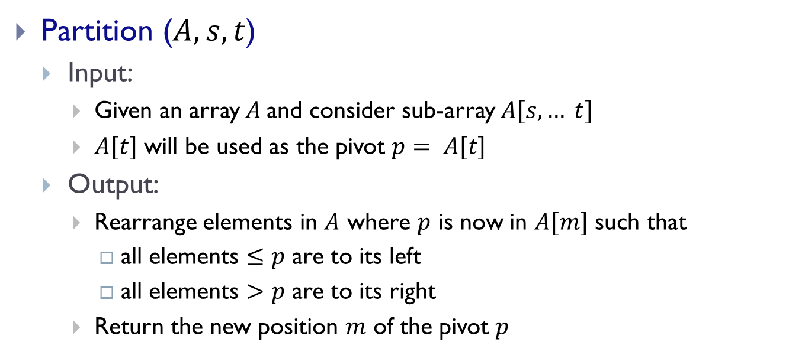
Partition procedure
p : pivot
$$p= A[t]$$
Partition ($A, s, t$)
  Input:
    Given an array $A$and consider sub-array $A[s, … t]$
    $A[t]$ will be used as the pivot $p= A[t]$
  Output:
    Rearrange elements in $A$ where $p$ is now in $A[m]$ such that
      all elements $≤p$ are to its left
      all elements $>p$ are to its right
    Return the new position $m$ of the pivot $p$

Slide 14

Partition($A, s, t$)
Plan: take A[t] as pivot
p
p
return m
In-place partition !
i.e, we use the same input array,
and only need constant number of auxiliary memory
y
x
p

Slide 15
Partition($A, s, t$)
y
x
p
Case 1: x > p
y x
p

Slide 16
Partition($A, s, t$)
y
x
p
Case 2: otherwise
x
y
p

Slide 17
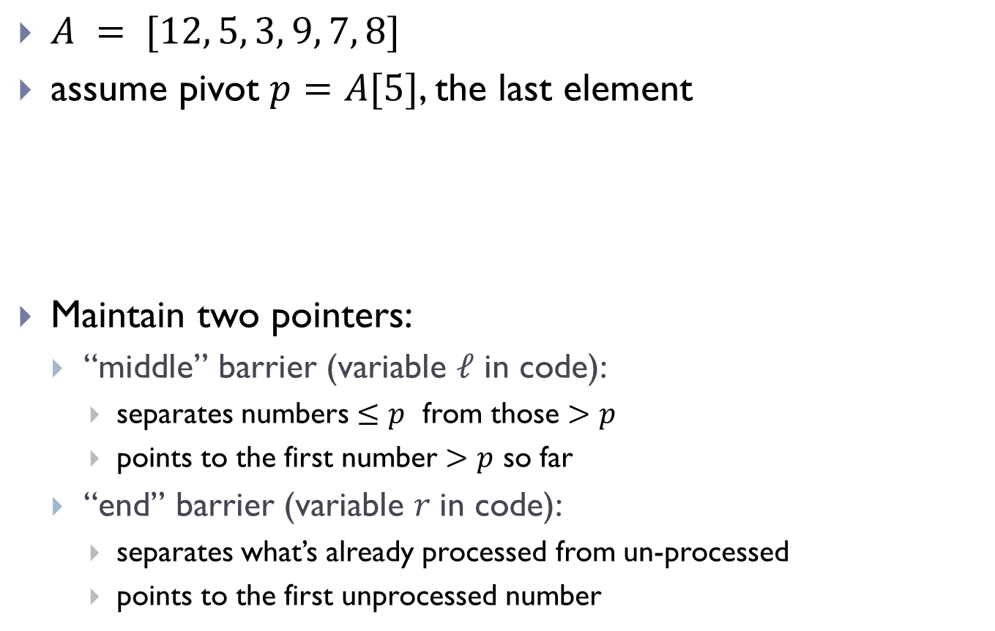
Idea
$A = [12, 5, 3, 9, 7, 8]$
assume pivot $p=A[5]$, the last element
Maintain two pointers:
  “middle” barrier (variable $ℓ$ in code):
    separates numbers $≤p$ from those $>p$
    points to the first number $>p$ so far
  “end” barrier (variable $r$in code):
    separates what’s already processed from un-processed
    points to the first unprocessed number
[ 12, 5, 3, 9, 7, 8]

Slide 18
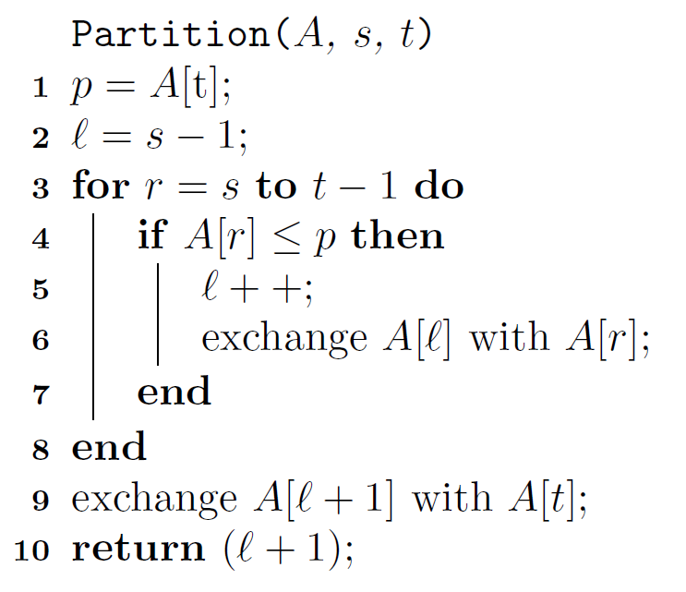

Pseudo-code for Partition
In-place!
Time complexity:
$$Θ(t−s+1)$$

Slide 19
QuickSelect

Slide 20

Intuition of QuickSelect
Imagine we are given Partition procedure.
QuickSelect($A, 1, n, k$)
  call $m$ = Partition($A, 1, n$)
p = A[m]: pivot
Case 1: k = m
return A[m]

Slide 21

Intuition of QuickSelect
Imagine we are given Partition procedure.
QuickSelect($A, 1, n, k$)
  call $r$ = Partition($A, 1, n$)
p = A[r]: pivot
Case 2: k < m
return QuickSelect ( A, 1, m-1, k )

Slide 22
Intuition of QuickSelect
Imagine we are given Partition procedure.
QuickSelect($A, 1, n, k$)
  call $r$ = Partition($A, 1, n$)
p = A[r]: pivot
Case 3: k > m
return QuickSelect ( A, m+1, n, k )

Slide 23
Pseudo-code for QuickSelect
QuickSelect ( A, s, t, k )
/* select the order k element in A from subarray A[s,..t] */
if (k < s or k > t) return “Out of range”;
if ( s = t ) return A[s] ;
m = Partition ( A, s, t );
if ( m = k) return A[m];
if ( m > k )
return QuickSelect ( A, s, m-1, k );
else return QuickSelect ( A, m+1, t, k );
At the top level, we call QuickSelect(A, 1, n, k)

Slide 24
Time Complexity Analysis

Slide 25
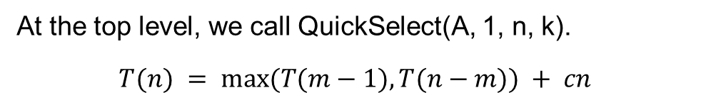
Pseudo-code for QuickSelect
QuickSelect ( A, s, t, k )
/* select the order k element in A from subarray A[s,..t] */
if (k < s or k > t) return “Out of range”;
if ( s = t ) return A[s] ;
m = Partition ( A, s, t );
if ( m = k) return A[m];
if ( m > k )
return QuickSelect ( A, s, m-1, k );
else return QuickSelect ( A, m+1, t, k );
At the top level, we call QuickSelect(A, 1, n, k).
$$T(n) = max⁡(T(m−1), T(n−m)) + cn$$

Slide 26

$T\left(n\right)=\max\left(T\left(m−1\right), T\left(n−m\right)\right)+ cn$
  Depending on value of $m$, recursively.
Best case:
  Each time we remove half of the numbers
    we cannot do better, why?
  $T\left(n\right)=T\left(\frac{n}{2}\right)+cn$
  $=Θ\left(n\right)$

Slide 27
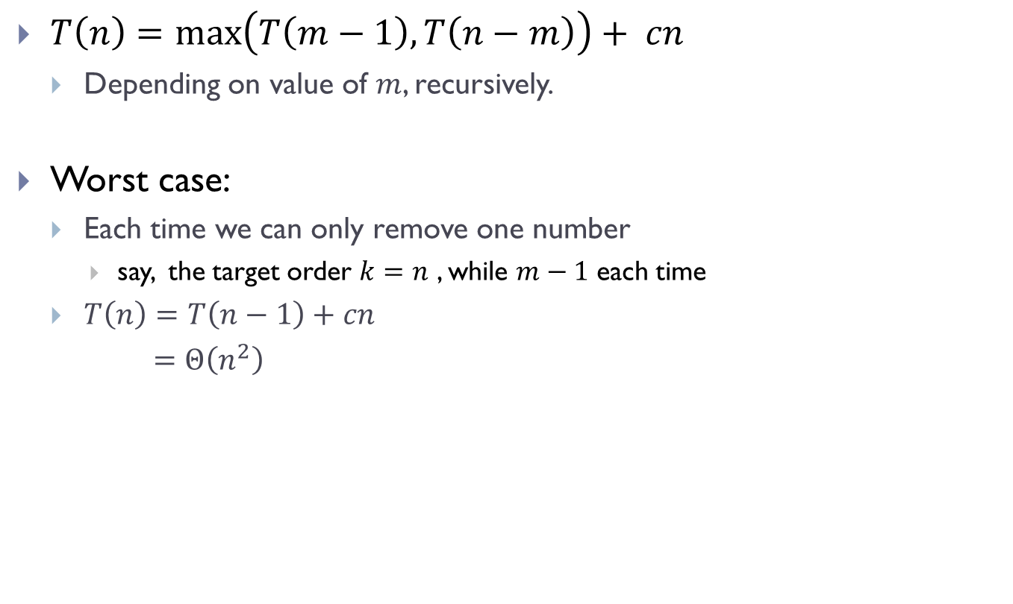
$T\left(n\right)=\max\left(T\left(m−1\right), T\left(n−m\right)\right)+ cn$
  Depending on value of $m$, recursively.
Worst case:
  Each time we can only remove one number
    say, the target order $k=n$ , while $m−1$ each time
  $T\left(n\right)=T\left(n−1\right)+cn$
  $=Θ\left(n^{2}\right)$

Slide 28
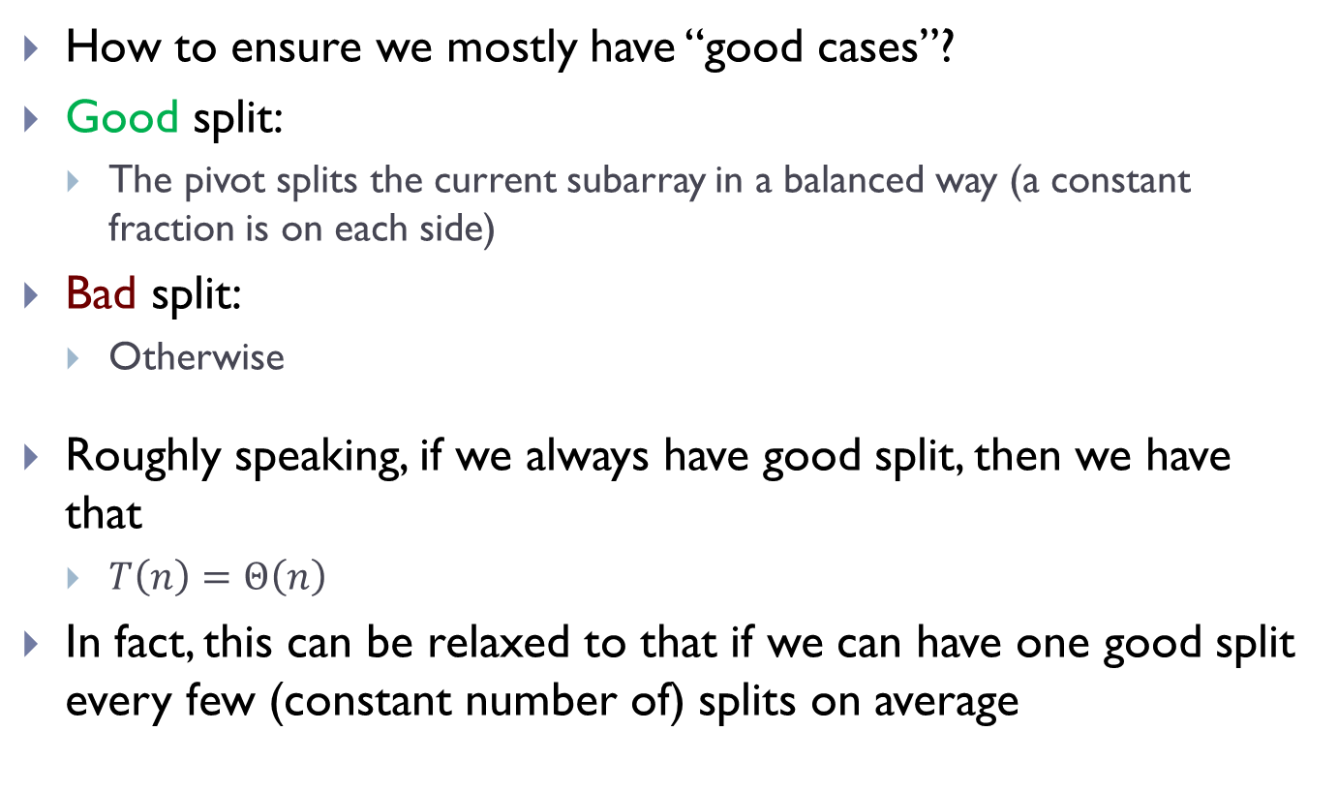
How to ensure we mostly have “good cases”?
Good split:
  The pivot splits the current subarray in a balanced way (a constant fraction is on each side)
Bad split:
  Otherwise
Roughly speaking, if we always have good split, then we have that
  $T\left(n\right)=Θ\left(n\right)$
In fact, this can be relaxed to that if we can have one good split every few (constant number of) splits on average
How to ensure that this happens?

Slide 29
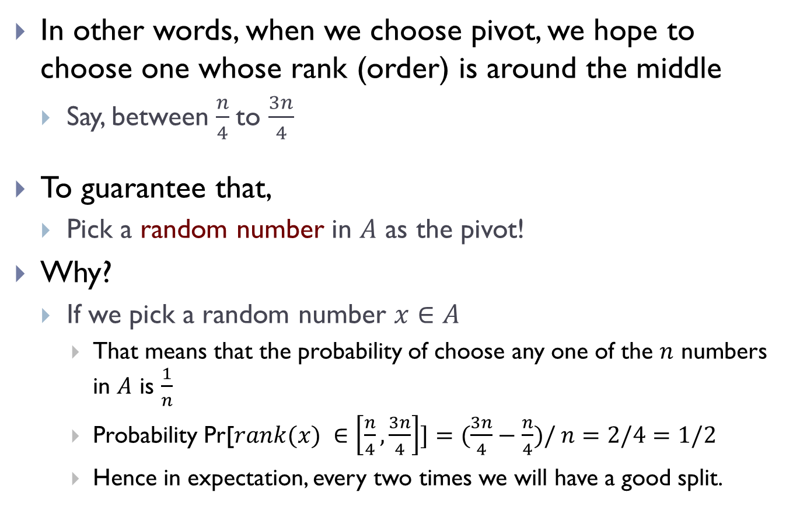
In other words, when we choose pivot, we hope to choose one whose rank (order) is around the middle
  Say, between $\frac{n}{4}$to $\frac{3n}{4}$
To guarantee that,
  Pick a random number in $A$ as the pivot!
Why?
  If we pick a random number $x∈A$
    That means that the probability of choose any one of the $n$ numbers in $A$ is $\frac{1}{n}$
    Probability Pr[$rank(x) ∈\left[\frac{n}{4},\frac{3n}{4}\right]]=(\frac{3n}{4}−\frac{n}{4})/ n=2/4=1/2$
    Hence in expectation, every two times we will have a good split.

Slide 30
Rand-Select
Rand-Select ( A, s, t, k )
/* select the order k element in A from subarray A[s,..t] */
if (k < s or k > t) return “Out of range”;
if ( s = t ) return A[s] ;
m = Rand-Partition ( A, s, t );
if ( m = k) return A[m];
if ( m > k )
return Rand-Select ( A, s, m-1, k );
else return Rand-Select ( A, m+1, t, k );
Rand-Partition(A, s, t) uses a random element from A[s, … t] as pivot, instead of using A[t] as pivot like in Partition(A, s, t).

Slide 31
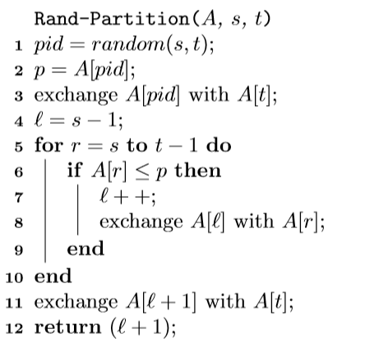
Rand-Partition pseudo-code

Slide 32
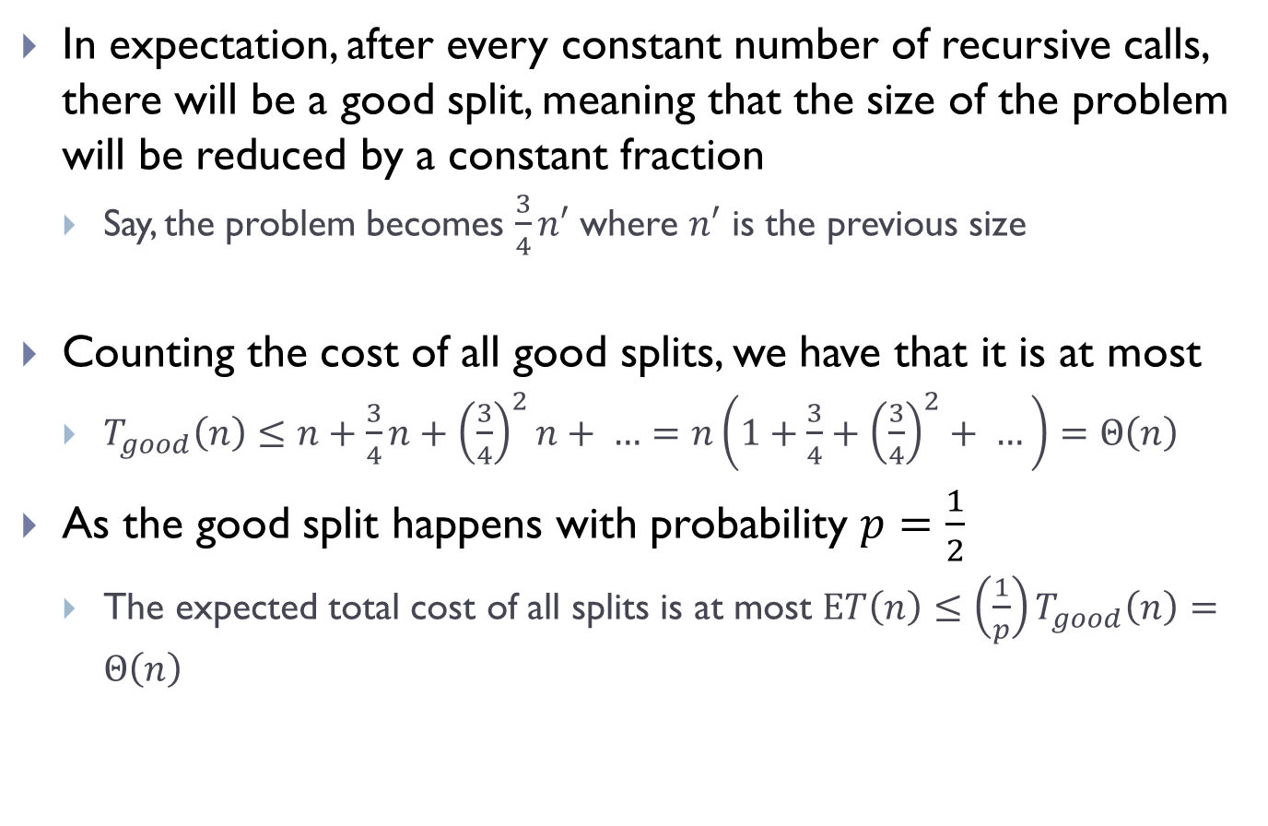
Expected time analysis -- intuition
In expectation, after every constant number of recursive calls, there will be a good split, meaning that the size of the problem will be reduced by a constant fraction
  Say, the problem becomes $\frac{3}{4}n′$ where $n′$ is the previous size
Counting the cost of all good splits, we have that it is at most
  $T_{good}\left(n\right)≤n+\frac{3}{4}n+{\left(\frac{3}{4}\right)}^{2}n+ …=n\left(1+\frac{3}{4}+{\left(\frac{3}{4}\right)}^{2}+ …\right)=Θ\left(n\right)$
As the good split happens with probability $p=\frac{1}{2}$
  The expected total cost of all splits is at most $ET\left(n\right)≤\left(\frac{1}{p}\right)T_{good}\left(n\right)=Θ\left(n\right)$
This is NOT a precise argument, just intuition.
This can be made more precise.

Slide 33

Summary
Randomized version of QuickSelect runs in $Θ\left(n\right)$ expected time
In fact, one can perform Select in $Θ\left(n\right)$ worst-case time
  Not covered in this class.

Slide 34
A related topic:
Randomized QuickSort

Slide 35
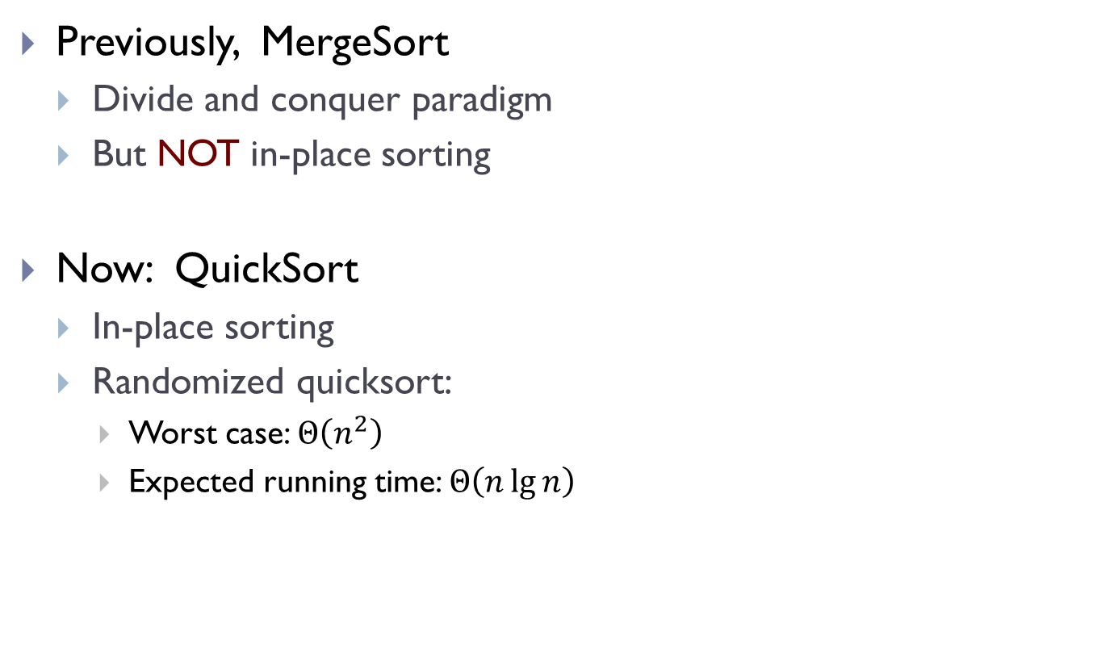
Sorting revisited!
Previously, MergeSort
  Divide and conquer paradigm
  But NOT in-place sorting
Now: QuickSort
  In-place sorting
  Randomized quicksort:
    Worst case: $Θ\left(n^{2}\right)$
    Expected running time: $Θ\left(n\lg{n}\right)$

Slide 36
Recall MergeSort
MergeSort ( A, r, s )
if ( r ≥ s) return;
m = (r+s) / 2;
A1 = MergeSort ( A, r, m );
A2 = MergeSort ( A, m+1, s );
Merge (A1, A2);
Much work has to be done in Merge(), but the “divide” step is easy (simply split the array into two equal parts).

Slide 37
QuickSort
QuickSort ( A, r, s )
if ( r ≥ s) return;
m = Partition ( A, r, s );
A1 = QuickSort ( A, r, m-1 );
A2 = QuickSort ( A, m+1, s );
Merge (A1, A2);
A[m]: pivot

Slide 38
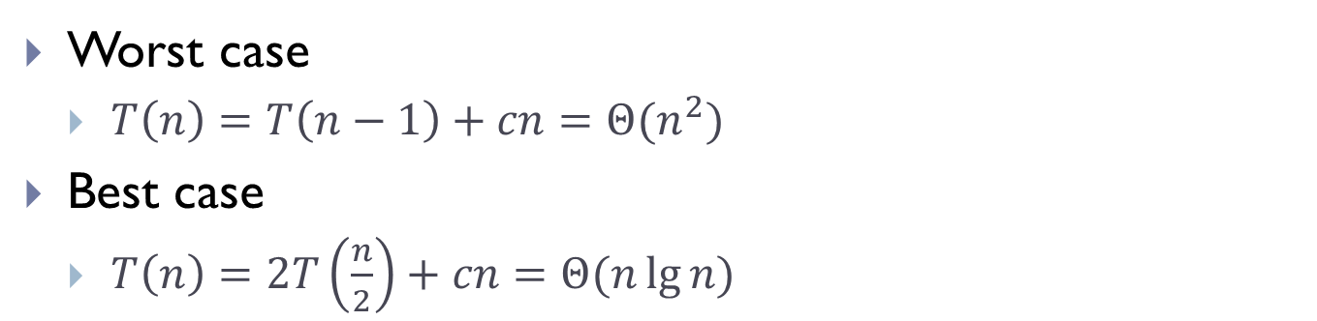
QuickSort
QuickSort ( A, r, s )
if ( r ≥ s) return;
m = Partition ( A, r, s );
A1 = QuickSort ( A, r, m-1 );
A2 = QuickSort ( A, m+1, s );
Worst case
  $T\left(n\right)=T\left(n−1\right)+cn=Θ(n^{2})$
Best case
  $T\left(n\right)=2T\left(\frac{n}{2}\right)+cn=Θ(n\lg{n)}$

Slide 39
rand-QuickSort
rand-QuickSort ( A, r, s )
if ( r ≥ s) return;
m = rand-Partition ( A, r, s );
A1 = rand-QuickSort ( A, r, m-1 );
A2 = rand-QuickSort ( A, m+1, s );
Worst case
  $T\left(n\right)=T\left(n−1\right)+cn=Θ(n^{2})$
Best case
  $T\left(n\right)=2T\left(\frac{n}{2}\right)+cn=Θ(n\lg{n)}$

Slide 40
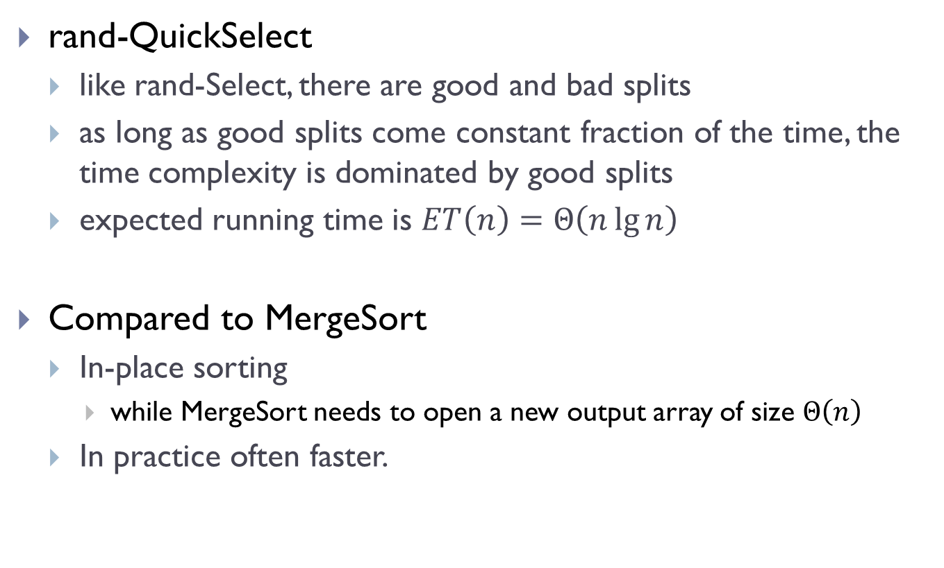
rand-QuickSelect
  like rand-Select, there are good and bad splits
  as long as good splits come constant fraction of the time, the time complexity is dominated by good splits
  expected running time is $ET\left(n\right)=Θ\left(n\lg{n}\right)$
Compared to MergeSort
  In-place sorting
    while MergeSort needs to open a new output array of size $Θ\left(n\right)$
  In practice often faster.

Slide 41
FIN

