Slide 1


Undergraduate Program
Rethinking Domains

Slide 2
Revisiting the Undergraduate Major
Sixth year of DSC courses at UCSD
One of a few data science undergraduate programs designed “from scratch”
We have feedback on what is working / what isn’t

Slide 3
Focus: Domains
Founding idea: students should become familiar with at least one “data generating domain”
E.g., biology, economics, etc.
Implemented in the major as domain requirements
Today:
Is the domain requirement effective?
Is it worth the time cost?
Do data scientists need to learn a specific data-generating domain?

Slide 4
Program Overview

Slide 5
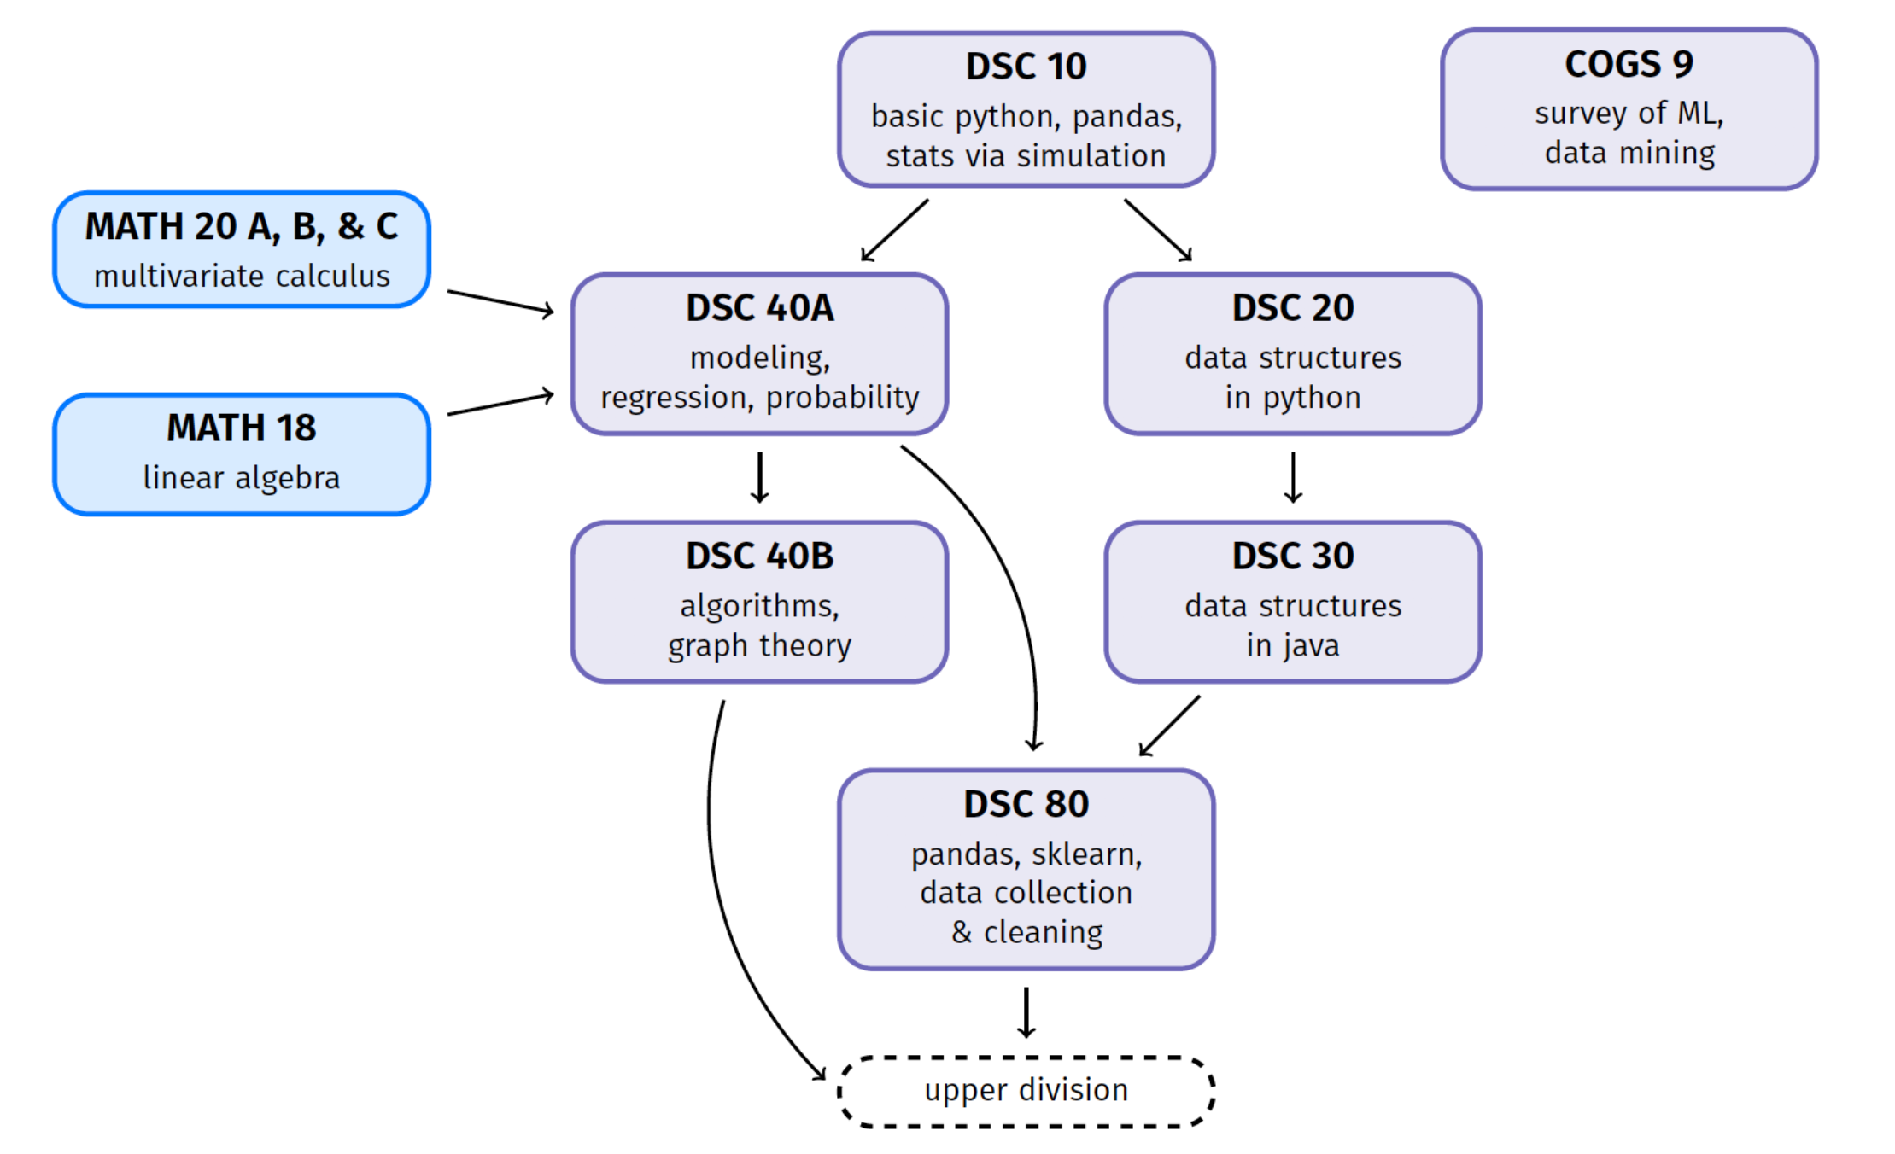
Lower Division

Slide 6
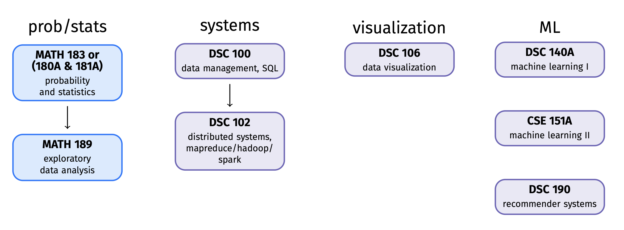
Upper Division
32 units of core requirements
20 units of electives
Two quarter senior capstone

Slide 7
What is missing?
Ethics requirement
Communication requirement
Technical writing
A “tools” class
Git, shell scripting, etc.
Statistics in lower division
Linear algebra reinforcement

Slide 8
Domain Tracks
Founding goal: students should become familiar with at least one “data generating domain”
Implemented as a domain requirement
Lower division: 8 units
Upper division: 20 units

Slide 9
Lower Division Domain Tracks
Biology
The Cell, Evolutionary Biology
Social Science
Data Analysis for Social Science, GIS, Practice of Social Research
Political Inquiry
Economics
Micro and Macroeconomics
Machine Learning / AI
Intro. to Research Methods, Statistical Analysis

Slide 10
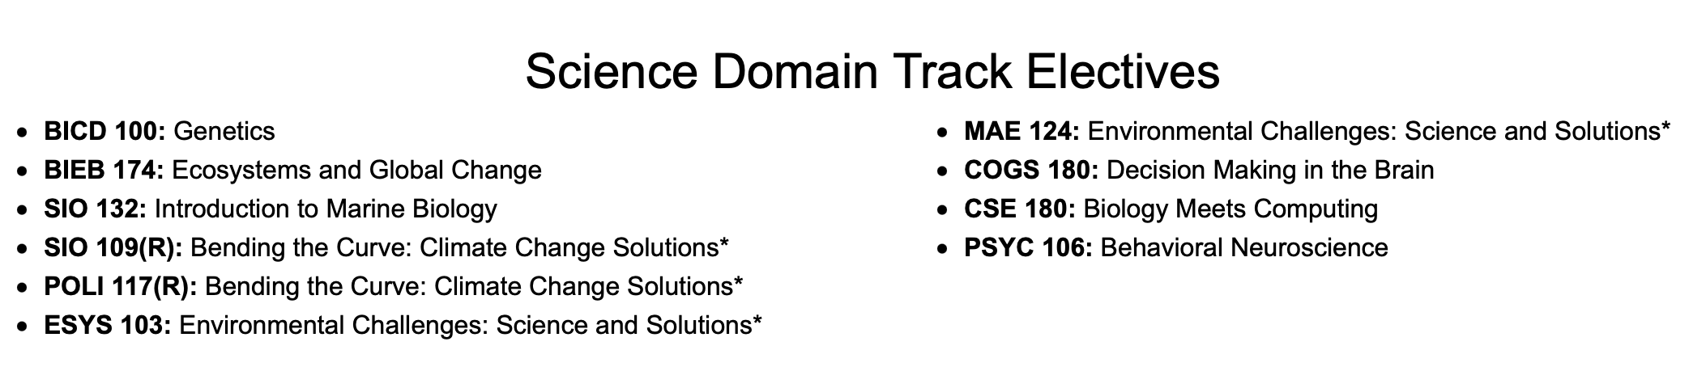
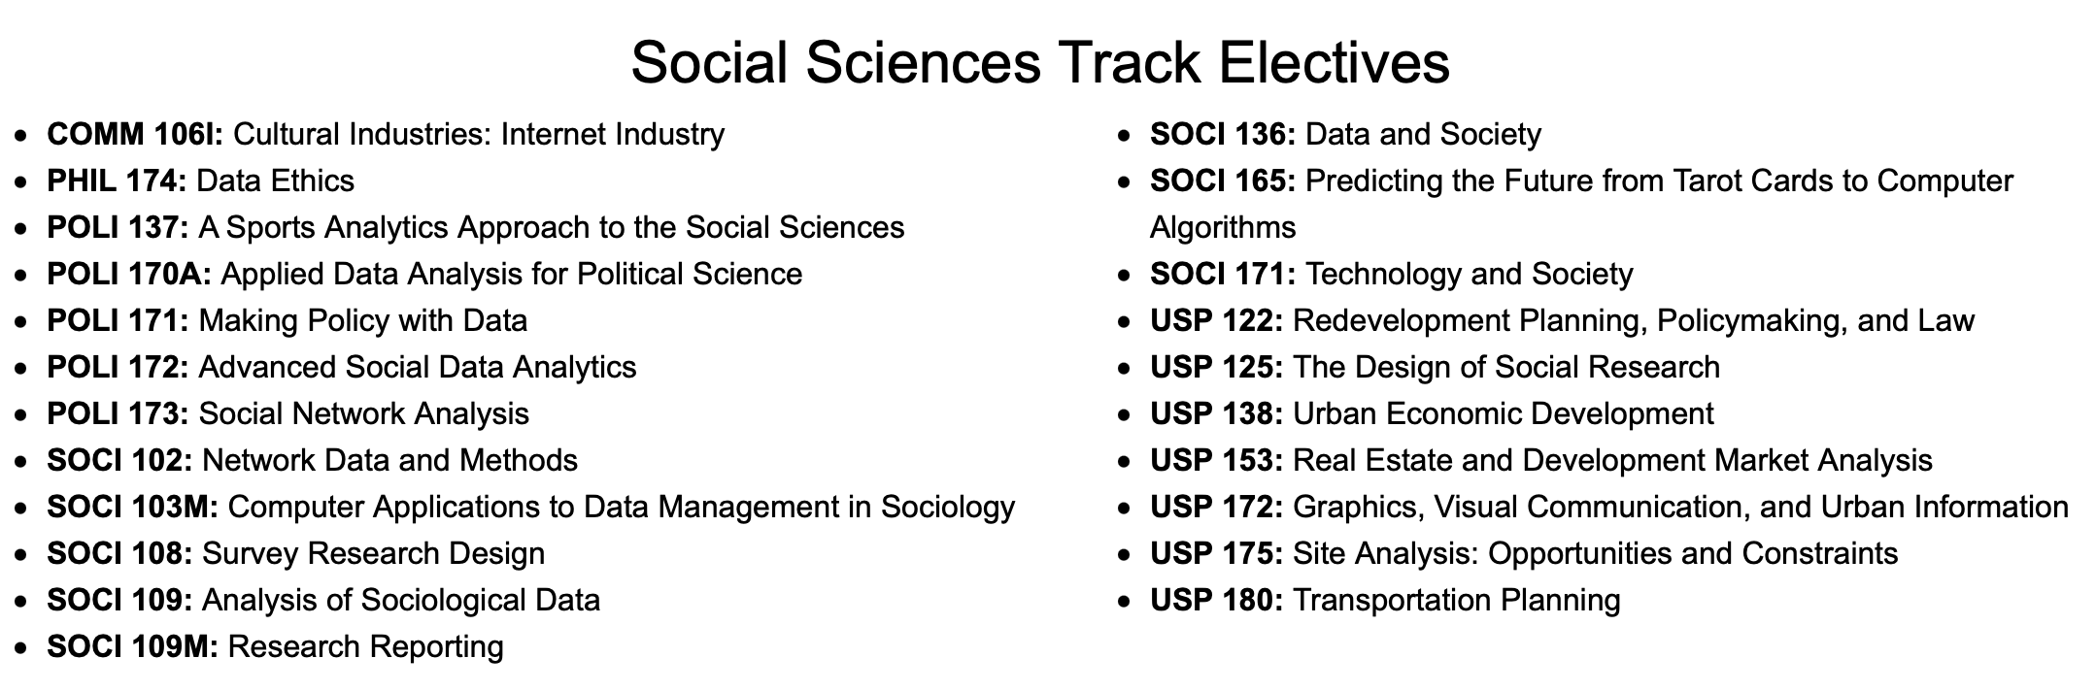

Slide 11
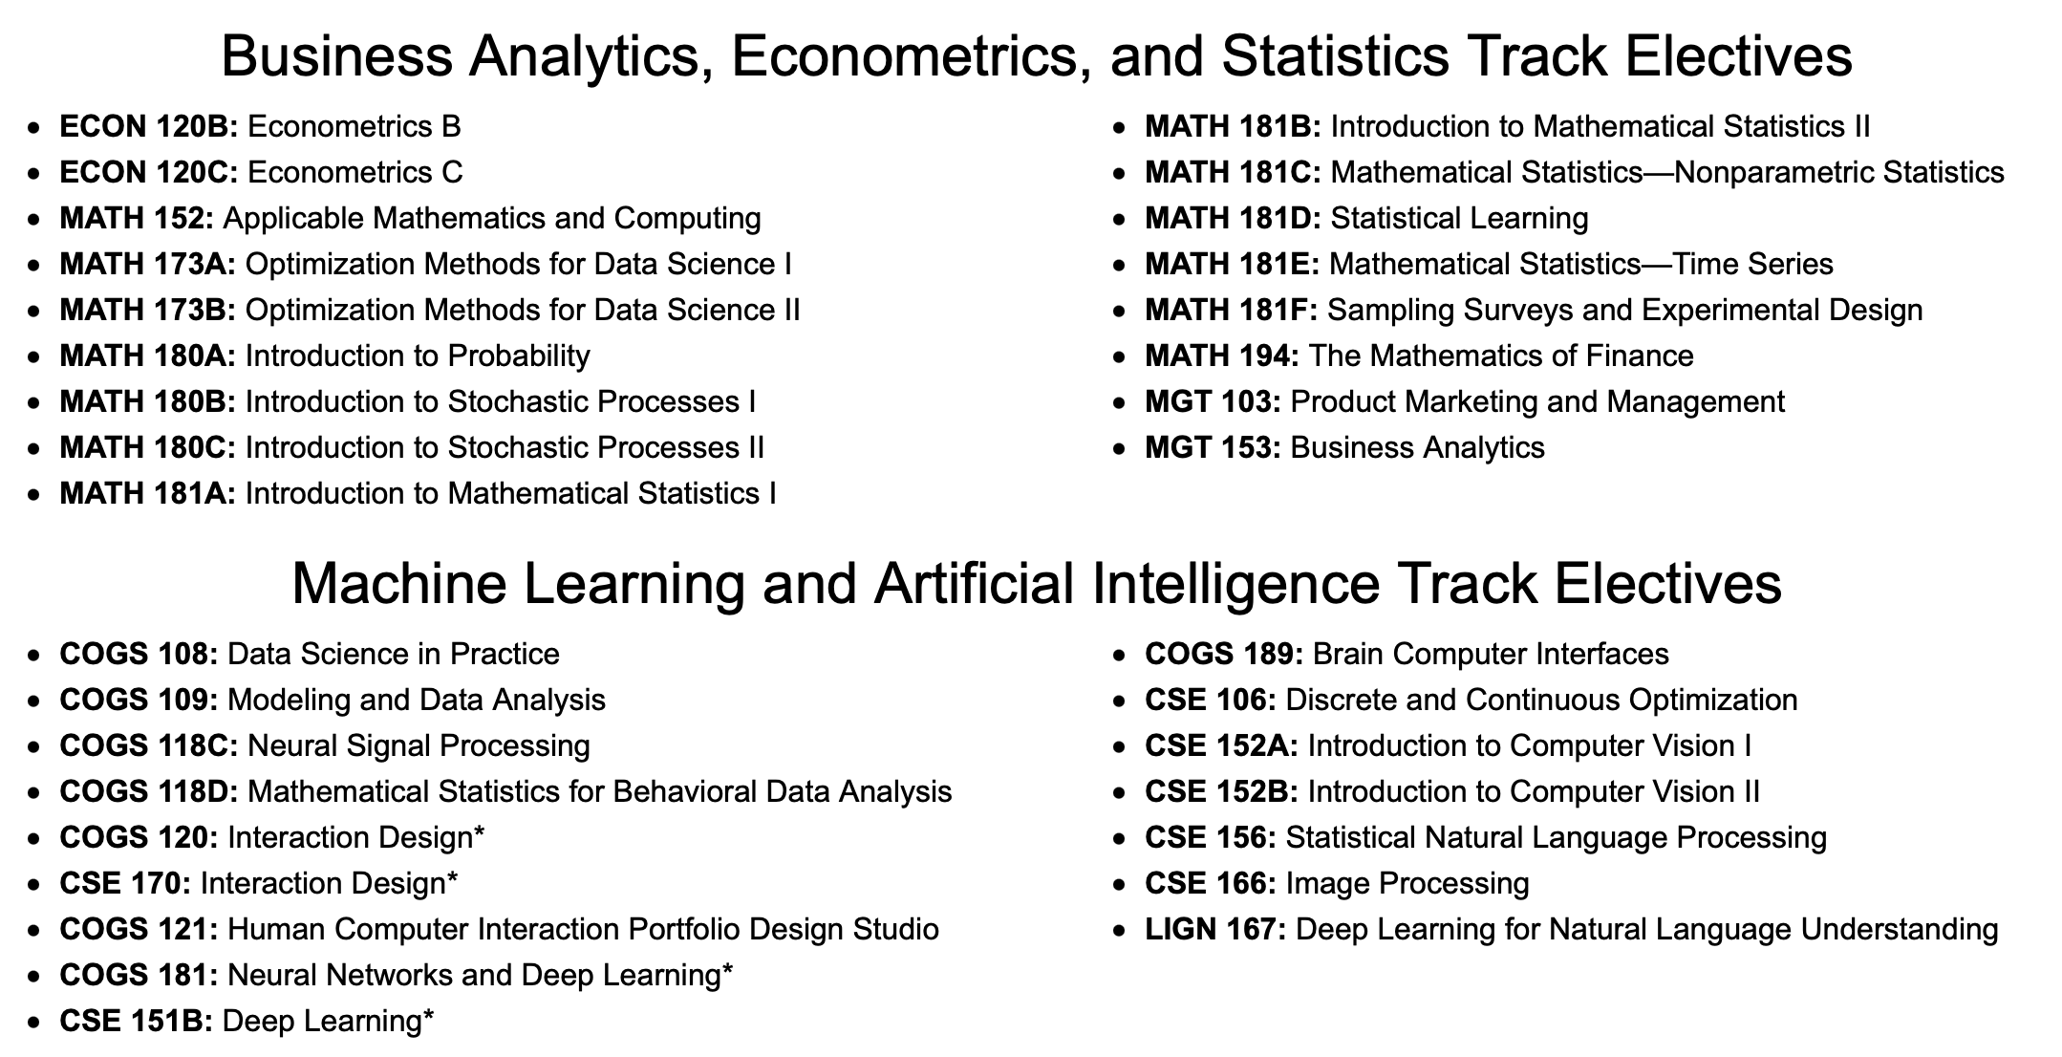

Slide 12
Lack of Structure
Students can “mix-and-match” electives from multiple tracks
Can petition courses to count as domain electives
Unclear what should be approved / denied
The ML track is unlike the others:
Not a “data generating” domain
Anecdotally: most popular
Lower-division domain tracks not always relevant for upper-division domain electives

Slide 13
Rethinking Domains

Slide 14
Rethinking Domains
Is the domain requirement effective?
Is it worth the time cost?
Do data scientists need to learn a specific data-generating domain?

Slide 15
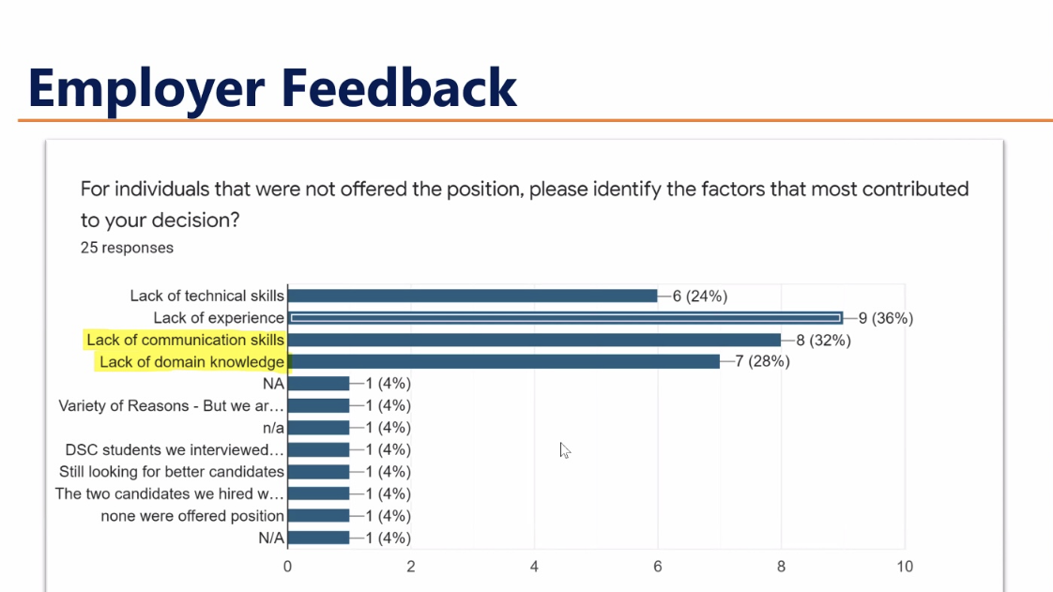

Slide 16
Claim
Data scientists do not need to be domain experts…
…but they need to be able to work with domain experts.

Slide 17
Idea
Remove/replace lower-division domain requirements with:
Statistics, linear algebra for data science, tools course
Replace upper-division domain electives with “depth tracks” (i.e., specializations)
Data engineering, theory, bioinformatics, business analytics, etc.
Could appear on transcript
Require n electives to satisfy a “broader impacts” theme:
Communication, ethics, DEI, etc.

Slide 18


