Slide 1
DSC40B: Theoretical Foundations of Data Science II
Lecture 14: Shortest Path in Weighted Graphs – part I
Instructor: Yusu Wang

Slide 2
Prelude
Previously
Basics of graphs, representations, graph search strategies
BFS: also leads to shortest path distance in input graph
Note: graph is unweighted!
Today:
Weighted graphs
where each edge has an edge weight
Properties of shortest paths in weighted graphs
Bellman-Ford algorithm for computing single-source shortest path for any weighted graphs

Slide 3
Weighted graphs, and shortest paths in them

Slide 4
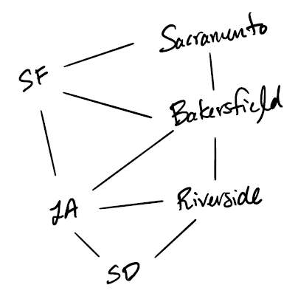
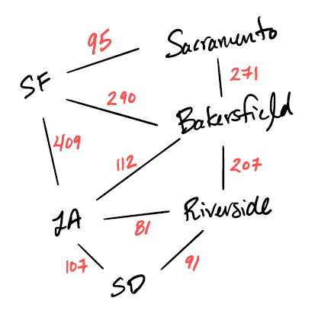
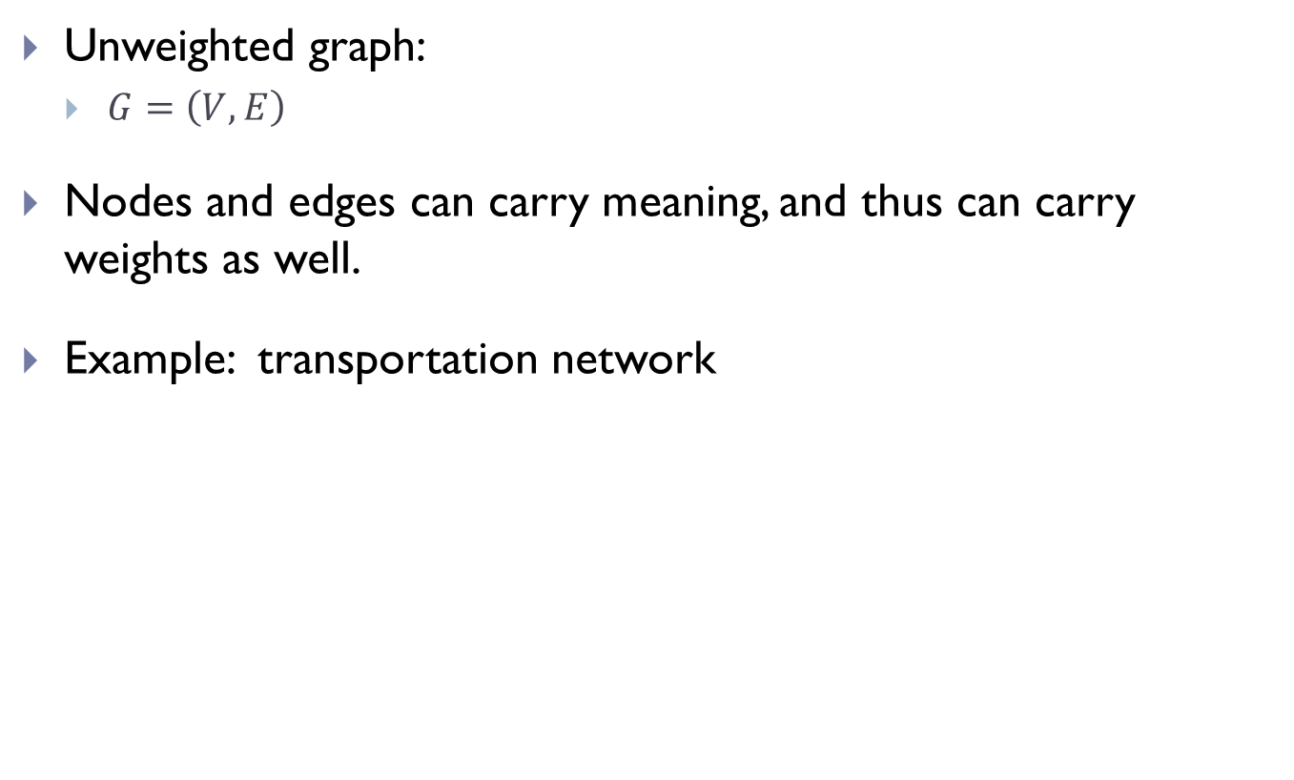
Unweighted graph:
$G=\left(V, E\right)$
Nodes and edges can carry meaning, and thus can carry weights as well.
Example: transportation network

Slide 5
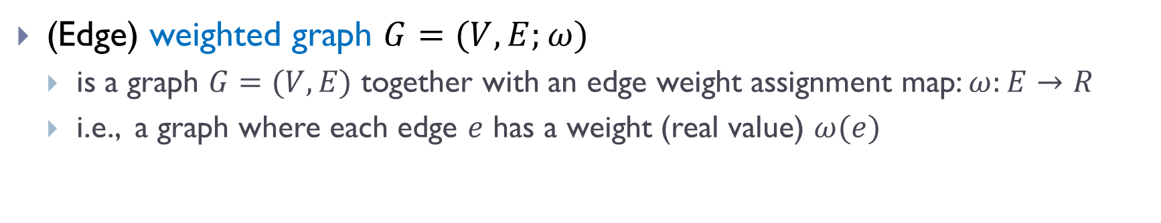
Weighted Graph
(Edge) weighted graph $G=(V, E;ω)$
is a graph $G=(V, E)$ together with an edge weight assignment map: $ω:E→R$
i.e., a graph where each edge $e$ has a weight (real value) $ω(e)$
can be directed / undirected
weights can be positive/negative
useful in many applications
strength of connection in a social network
distance in a transportation network
probability that two nodes interact in a protein-protein interaction network

Slide 6
Path lengths
Given a path in a weighted graph, its length is the total weights of all edges in the path.
Examples:
SF, LA, Bakersfield, Riverside
length = 728
SF, LA, Riverside
length = 490
LA, SD, Riverside, LA, SF
length = 688
LA, SF
length = 409
LA, Bakerfield, SF
length = 402

Slide 7
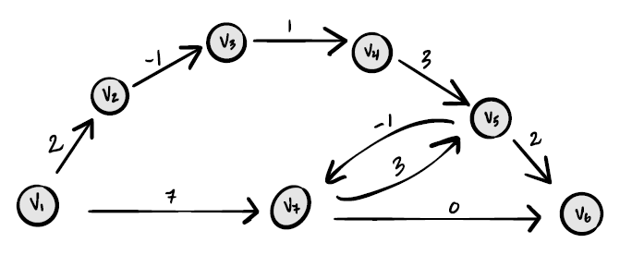
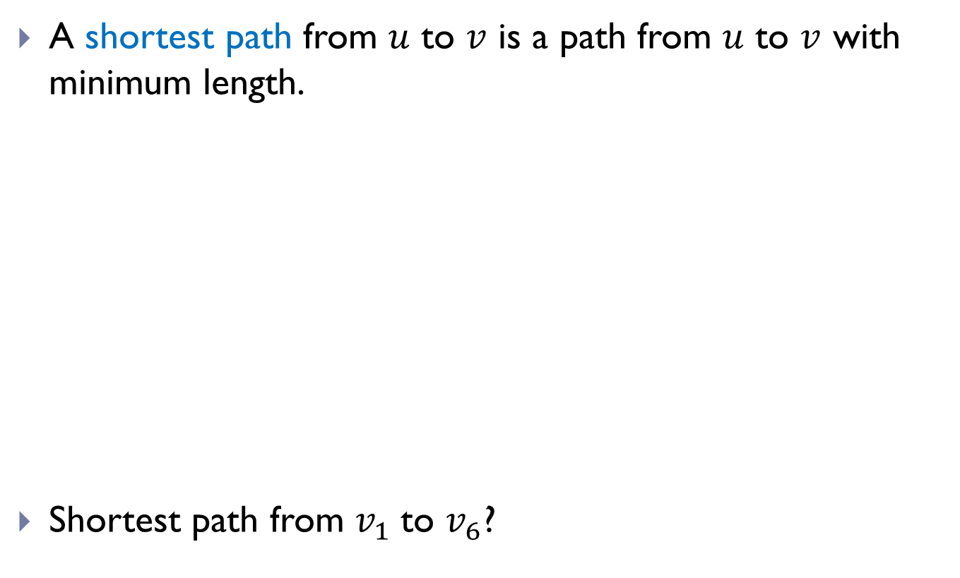
Shortest Paths
A shortest path from $u$ to $v$ is a path from $u$ to $v$ with minimum length.
Shortest path from $v_{1}$to $v_{6}$?

Slide 8
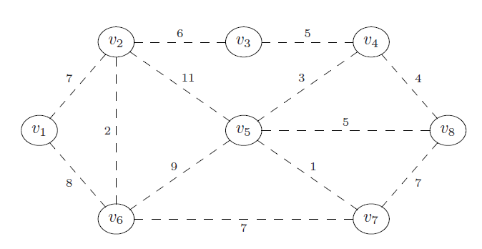
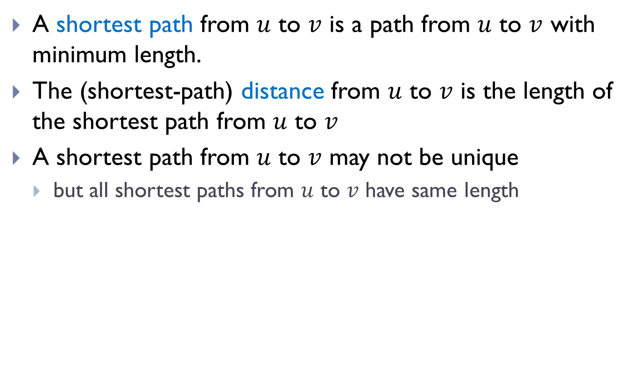
Shortest Paths
A shortest path from $u$ to $v$ is a path from $u$ to $v$ with minimum length.
The (shortest-path) distance from $u$ to $v$ is the length of the shortest path from $u$ to $v$
A shortest path from $u$ to $v$ may not be unique
but all shortest paths from $u$ to $v$ have same length

Slide 9
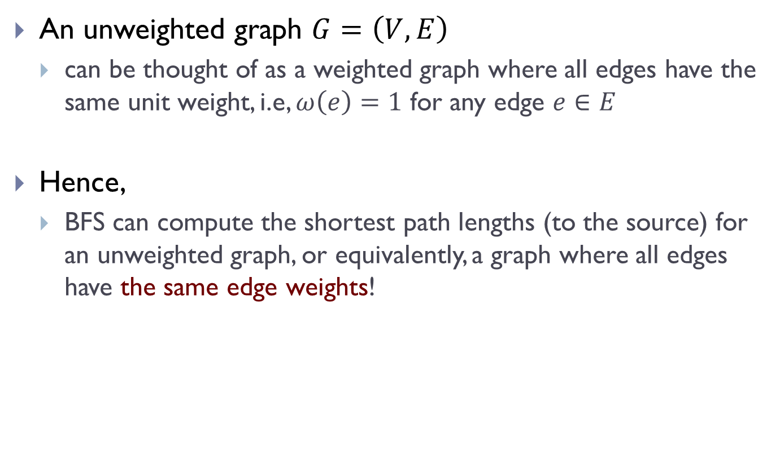
An unweighted graph $G=\left(V, E\right)$
can be thought of as a weighted graph where all edges have the same unit weight, i.e, $ω\left(e\right)=1$ for any edge $e∈E$
Hence,
BFS can compute the shortest path lengths (to the source) for an unweighted graph, or equivalently, a graph where all edges have the same edge weights!

Slide 10
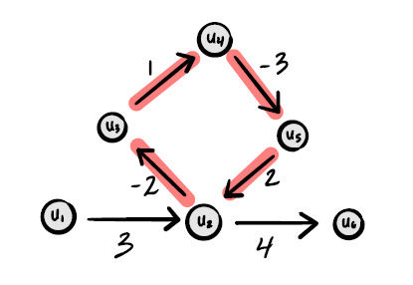
Properties of shortest paths
Shortest path is not well-defined if the input graph has “negative cycles”
A negative cycle is a cycle whose length is negative
Negative weights are usually okay. Negative cycles make shortest path not well-defined.

Slide 11
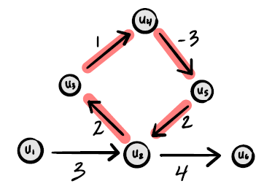
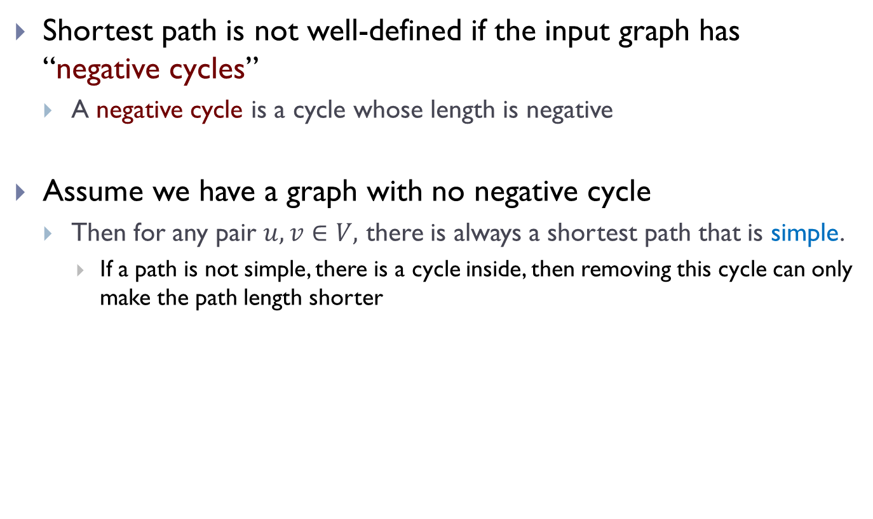
Properties of shortest paths
Shortest path is not well-defined if the input graph has “negative cycles”
A negative cycle is a cycle whose length is negative
Assume we have a graph with no negative cycle
Then for any pair $u, v∈V,$ there is always a shortest path that is simple.
If a path is not simple, there is a cycle inside, then removing this cycle can only make the path length shorter

Slide 12
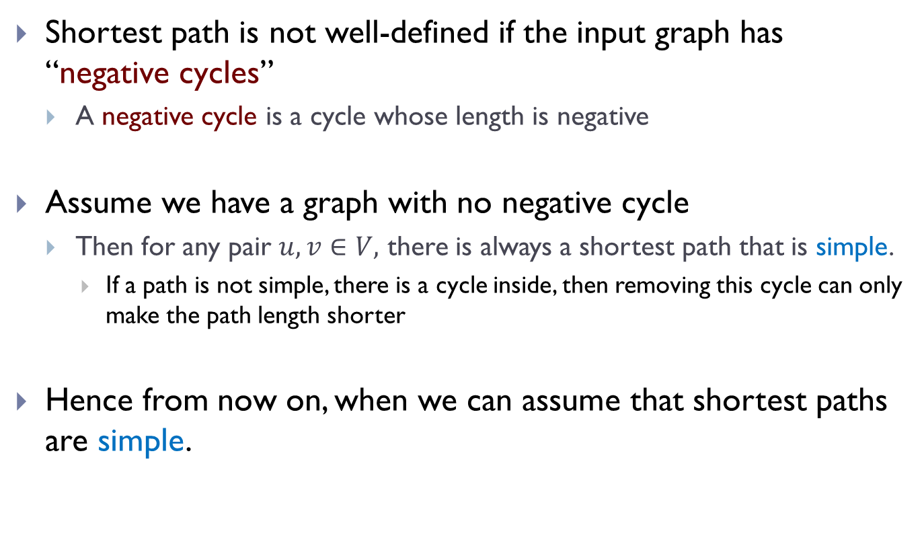
Properties of shortest paths
Shortest path is not well-defined if the input graph has “negative cycles”
A negative cycle is a cycle whose length is negative
Assume we have a graph with no negative cycle
Then for any pair $u, v∈V,$ there is always a shortest path that is simple.
If a path is not simple, there is a cycle inside, then removing this cycle can only make the path length shorter
Hence from now on, when we can assume that shortest paths are simple.

Slide 13
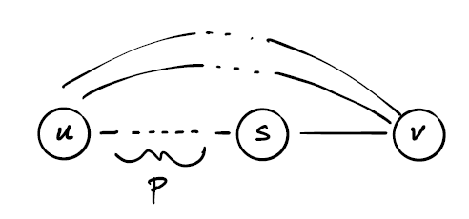
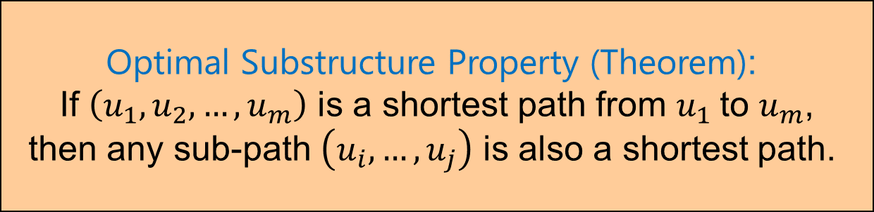
Properties of shortest path
Optimal Substructure Property (Theorem):
If $\left(u_{1},u_{2},…, u_{m}\right)$ is a shortest path from $u_{1}$to $u_{m}$,
then any sub-path $\left(u_{i}, …, u_{j}\right)$ is also a shortest path.

Slide 14
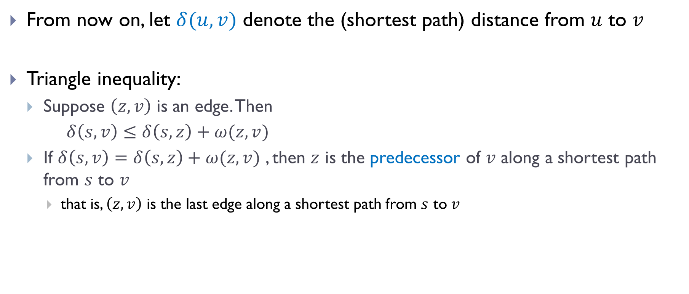
Property of shortest paths
From now on, let $δ(u, v)$ denote the (shortest path) distance from $u$ to $v$
Triangle inequality:
Suppose $\left(z, v\right)$ is an edge. Then
$δ\left(s, v\right)≤δ\left(s, z\right)+ω(z, v)$
If $δ\left(s, v\right)=δ\left(s, z\right)+ω(z, v)$ , then $z$ is the predecessor of $v$ along a shortest path from $s$ to $v$
that is, $\left(z, v\right)$ is the last edge along a shortest path from $s$ to $v$

Slide 15
Single-source shortest paths (SSSP) and Does BFS work for weighted graphs?

Slide 16
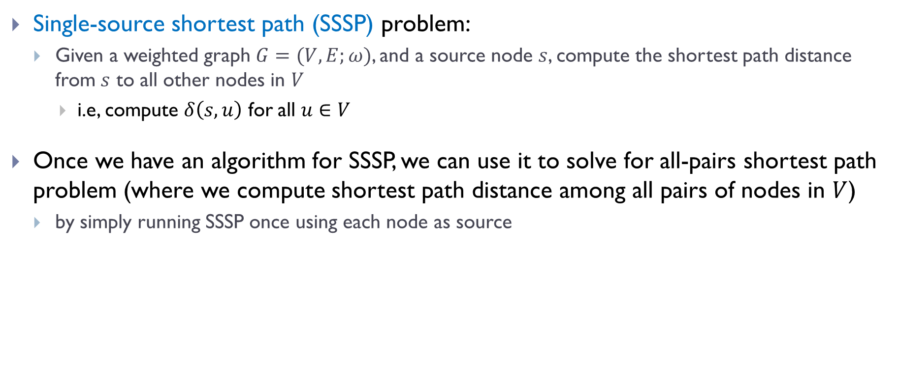
Single-source shortest path (SSSP) problem:
Given a weighted graph $G=(V, E;ω)$, and a source node $s$, compute the shortest path distance from $s$ to all other nodes in $V$
i.e, compute $δ\left(s, u\right)$ for all $u∈V$
Once we have an algorithm for SSSP, we can use it to solve for all-pairs shortest path problem (where we compute shortest path distance among all pairs of nodes in $V$)
by simply running SSSP once using each node as source

Slide 17
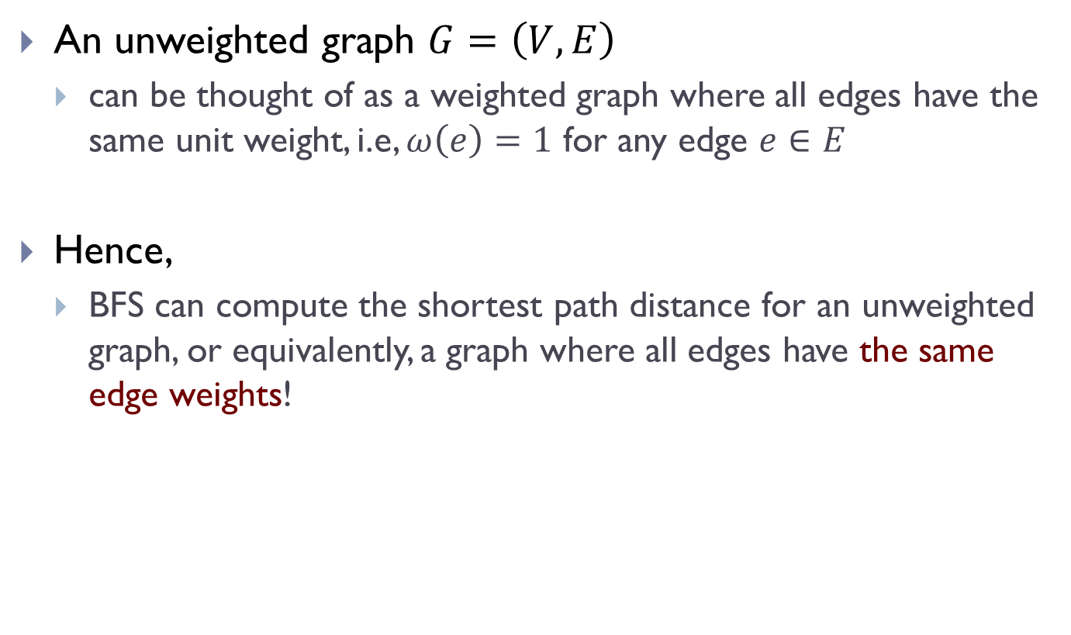
Recall
An unweighted graph $G=\left(V, E\right)$
can be thought of as a weighted graph where all edges have the same unit weight, i.e, $ω\left(e\right)=1$ for any edge $e∈E$
Hence,
BFS can compute the shortest path distance for an unweighted graph, or equivalently, a graph where all edges have the same edge weights!

Slide 18
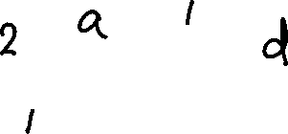
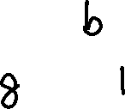
Can BFS idea work?
Not really
Example:
6

Slide 19
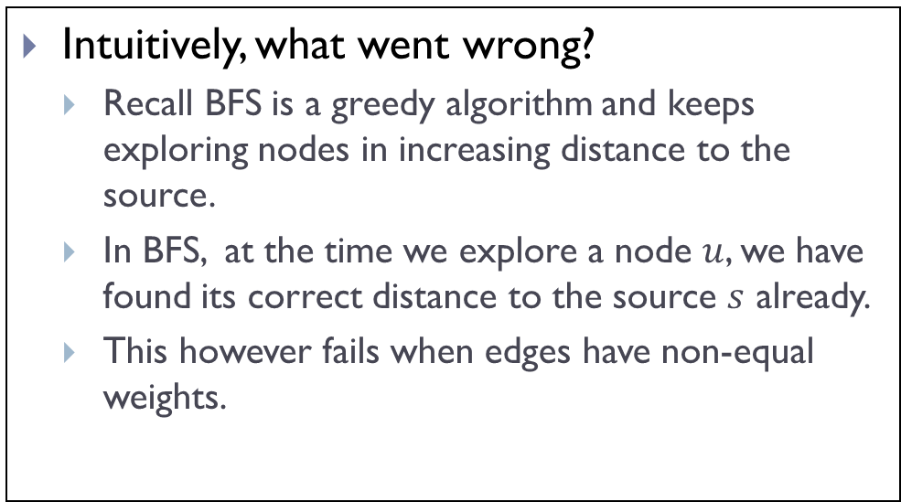
Can BFS idea work?
Not really
Example:
Intuitively, what went wrong?
Recall BFS is a greedy algorithm and keeps exploring nodes in increasing distance to the source.
In BFS, at the time we explore a node $u$, we have found its correct distance to the source $s$ already.
This however fails when edges have non-equal weights.
6

Slide 20
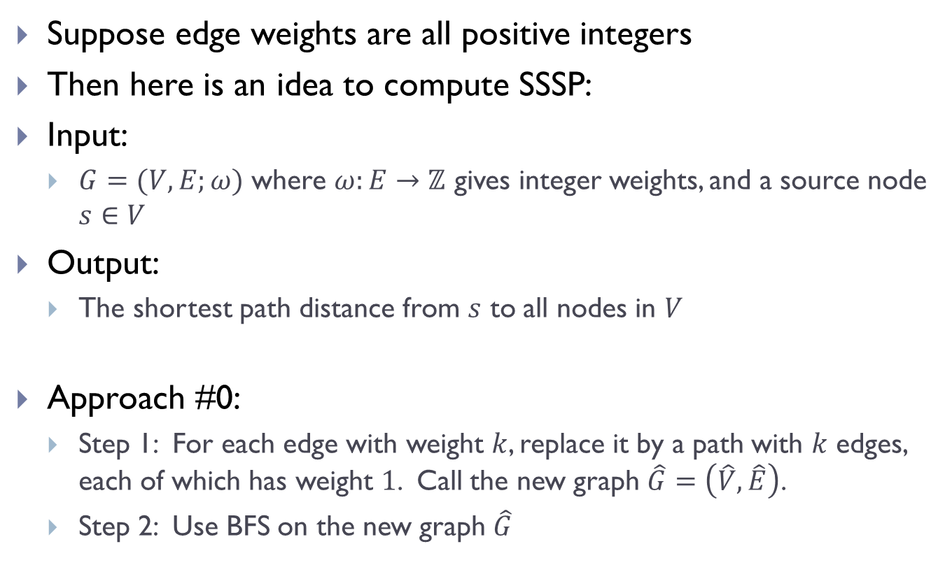
Can we use BFS to solve SSSP?
Suppose edge weights are all positive integers
Then here is an idea to compute SSSP:
Input:
$G=(V, E;ω)$ where $ω:E→ℤ$ gives integer weights, and a source node $s∈V$
Output:
The shortest path distance from $s$ to all nodes in $V$
Approach #0:
Step 1: For each edge with weight $k$, replace it by a path with $k$ edges, each of which has weight $1$. Call the new graph $\hat{G}=\left(\hat{V}, \hat{E}\right)$.
Step 2: Use BFS on the new graph $\hat{G}$

Slide 21
Problem with Approach #0
Only works when edges have positive integer weights
Even for integer-weighted graphs, it can be highly inefficient.
We need better algorithms for SSSP.

Slide 22
Key operation for SSSP: Edge Update

Slide 23

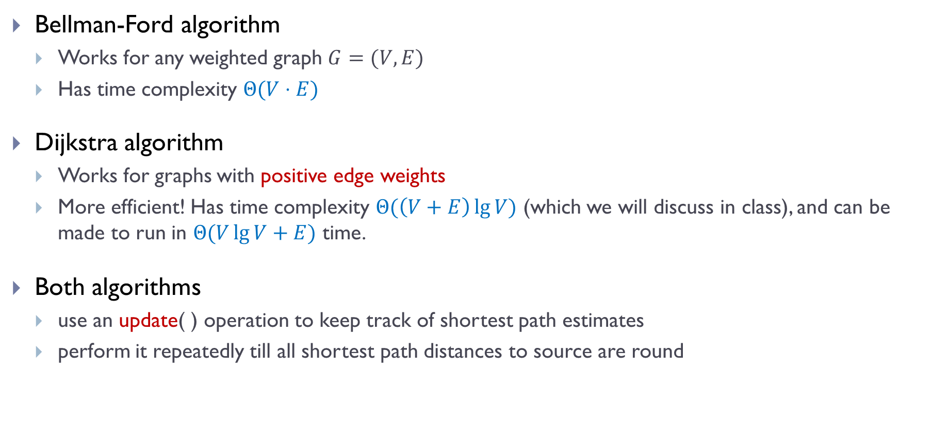
Two algorithms for SSSP
Bellman-Ford algorithm
Works for any weighted graph $G=(V,E)$
Has time complexity $Θ(V⋅E)$
Dijkstra algorithm
Works for graphs with positive edge weights
More efficient! Has time complexity $Θ(\left(V+E\right)\lg{V})$ (which we will discuss in class), and can be made to run in $Θ(V\lg{V}+E)$ time.
Both algorithms
use an update( ) operation to keep track of shortest path estimates
perform it repeatedly till all shortest path distances to source are round
From now on, for simplicity, we use $V$ and $E$ to denote $|V|$ and $|E|$ in time complexity.

Slide 24
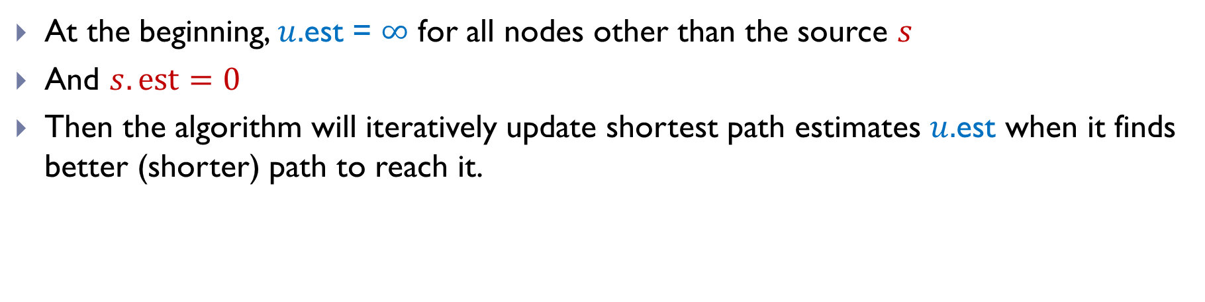
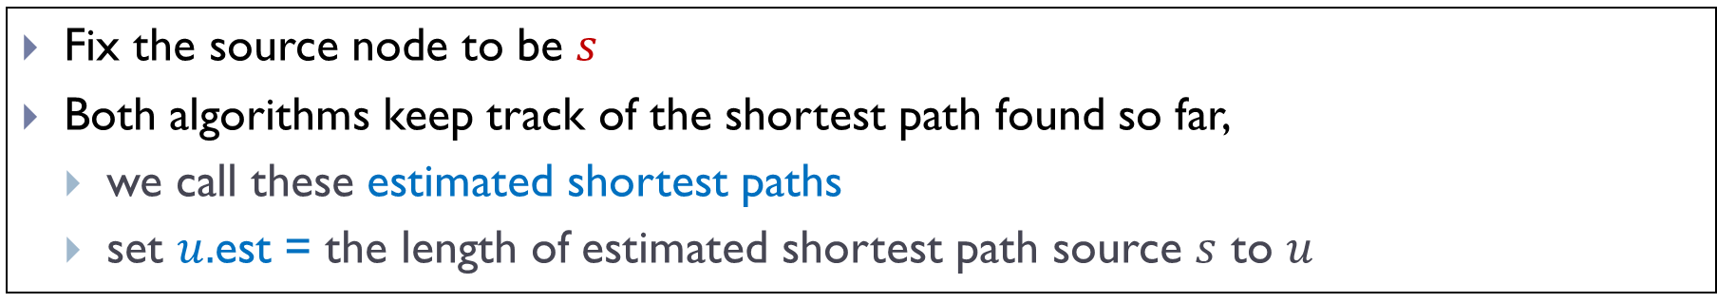
Estimated shortest path
Fix the source node to be $s$
Both algorithms keep track of the shortest path found so far,
we call these estimated shortest paths
set $u.$est = the length of estimated shortest path source $s$ to $u$
At the beginning, $u.$est = $∞$ for all nodes other than the source $s$
And $s.est=0$
Then the algorithm will iteratively update shortest path estimates $u.$est when it finds better (shorter) path to reach it.

Slide 25
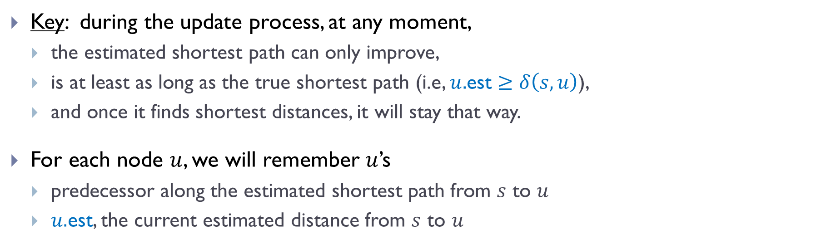
Estimated shortest path so far
Fix the source node to be $s$
Both algorithms keep track of the shortest path found so far,
we call these estimated shortest paths
set $u.$est = the length of estimated shortest path source $s$ to $u$
Key: during the update process, at any moment,
the estimated shortest path can only improve,
is at least as long as the true shortest path (i.e, $u.$est $≥δ\left(s, u\right)$),
and once it finds shortest distances, it will stay that way.
For each node $u$, we will remember $u$’s
predecessor along the estimated shortest path from $s$ to $u$
$u.$est, the current estimated distance from $s$ to $u$

Slide 26
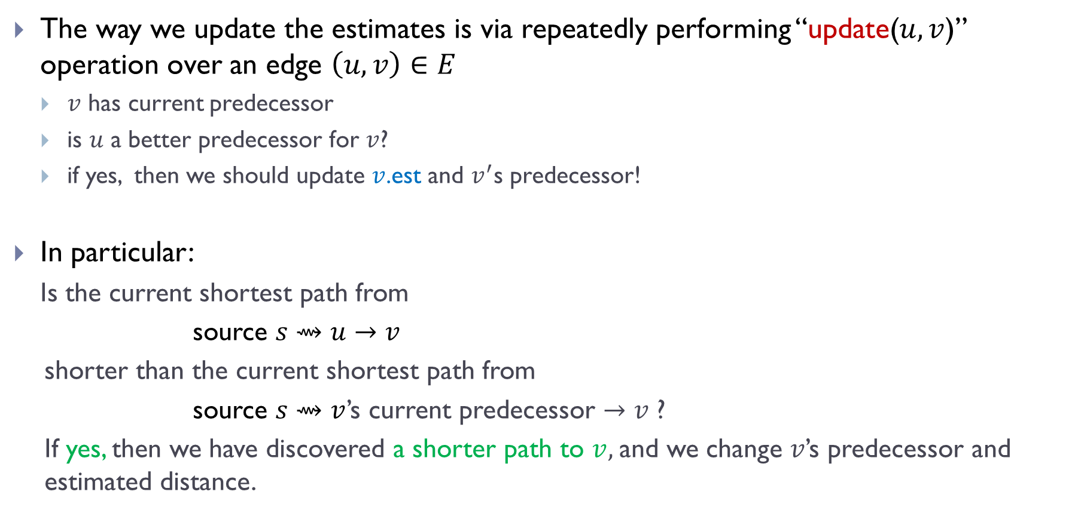
Updating edges
The way we update the estimates is via repeatedly performing “update($u, v$)” operation over an edge $\left(u,v\right)∈E$
$v$ has current predecessor
is $u$ a better predecessor for $v$?
if yes, then we should update $v$.est and $v^{′}$s predecessor!
In particular:
Is the current shortest path from
source $s⇝u→v$
shorter than the current shortest path from
source $s⇝v$’s current predecessor $→v$ ?
If yes, then we have discovered a shorter path to $v,$and we change $v$’s predecessor and estimated distance.

Slide 27

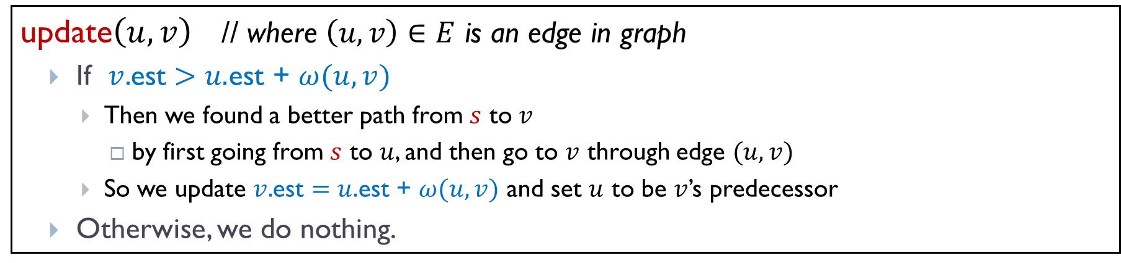
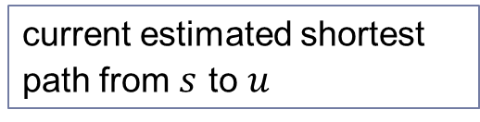


Updating edges
update$\left(u, v\right)$ // where $\left(u, v\right)∈E$ is an edge in graph
If $v.$est $>$ $u.$est + $ω(u, v)$
Then we found a better path from $s$ to $v$
by first going from $s$ to $u$, and then go to $v$ through edge $(u,v)$
So we update $v.$est $=$ $u.$est + $ω(u, v)$ and set $u$ to be $v$’s predecessor
Otherwise, we do nothing.
$$u$$
$$s$$
$$v$$
current estimated shortest path from $s$ to $u$

Slide 28
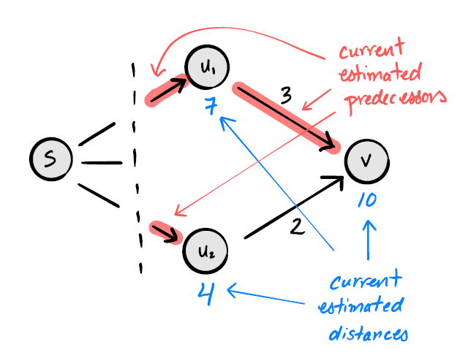

Example
Before update($u_{2},v)$

Slide 29
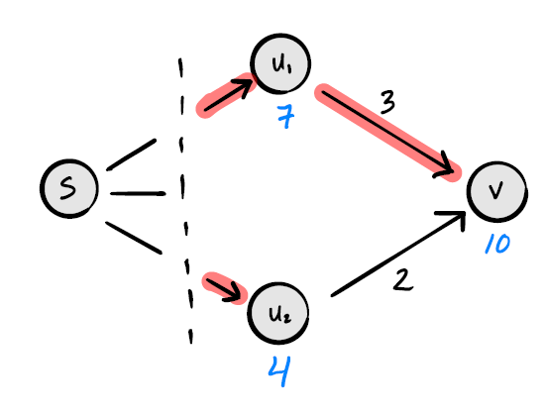
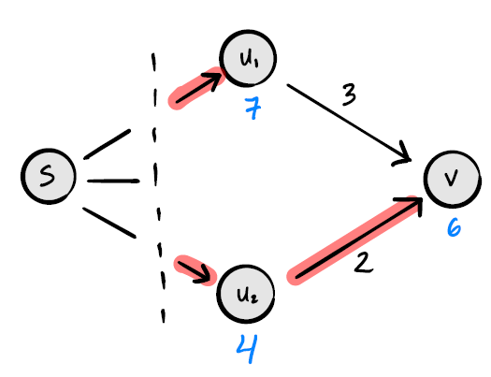
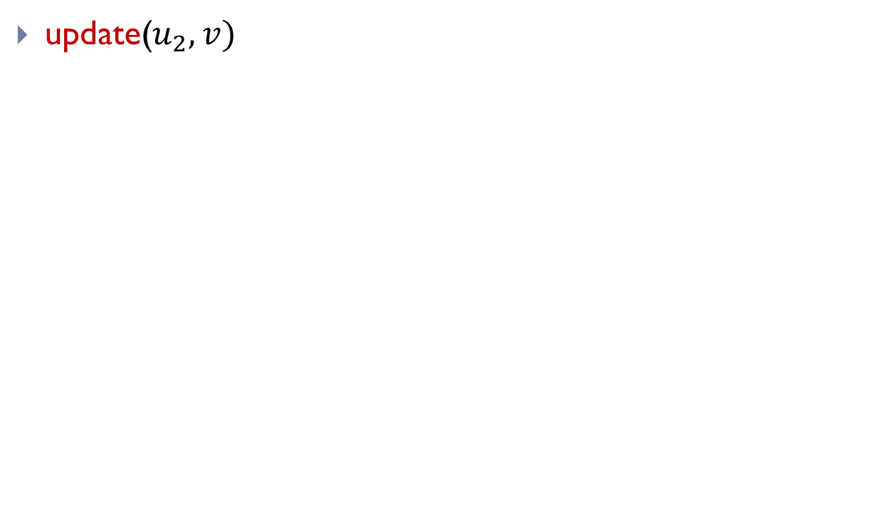
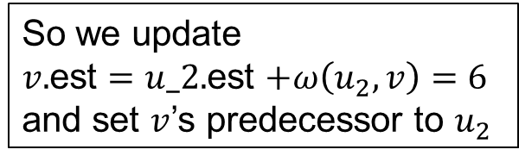
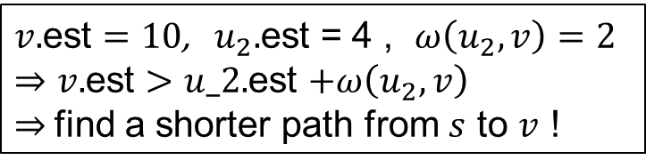
Example
update($u_{2},v)$
Before update
After update
$v.$est $=10$, $u_{2}.$est = 4 , $ω\left(u_{2},v\right)=2$
$⇒v.$est $>u_2.$est $+ω\left(u_{2},v\right)$
$⇒$find a shorter path from $s$ to $v$ !
So we update
$v.$est $=u_2.$est $+ω\left(u_{2},v\right)=6$
and set $v$’s predecessor to $u_{2}$

Slide 30
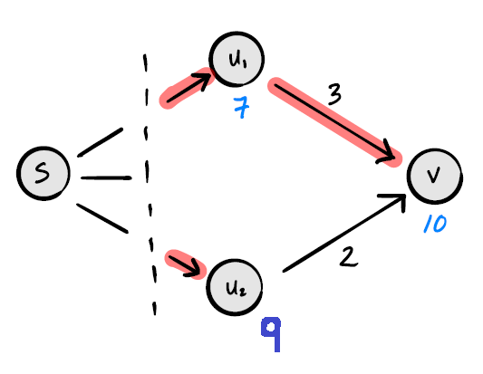

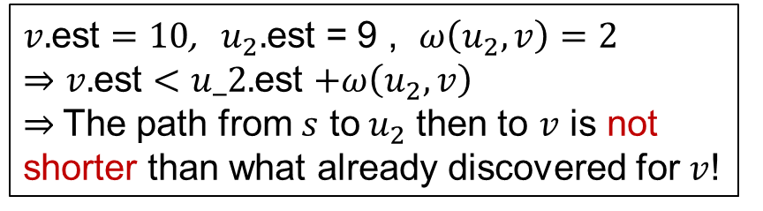
Another Example
update($u_{2},v$)
Before update
After update
$v.$est $=10$, $u_{2}.$est = 9 , $ω\left(u_{2},v\right)=2$
$⇒v.$est $<u_2.$est $+ω\left(u_{2},v\right)$
$⇒$The path from $s$ to $u_{2}$ then to $v$ is not shorter than what already discovered for $v$!
Do Nothing!

Slide 31
Implementing update() in python
To implement update(u,v) in python, let
est be a dictionary of estimated shortest path distances
predecessor be a dictionary of estimated shortest path predecessors
weights be a function which returns edge weights

Slide 32
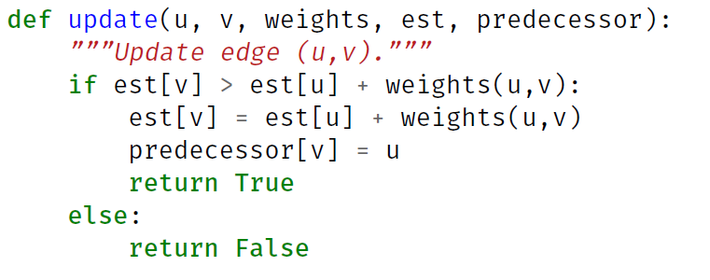

Implementing update() in python
$$Θ(1)$$
Time complexity: _______

Slide 33
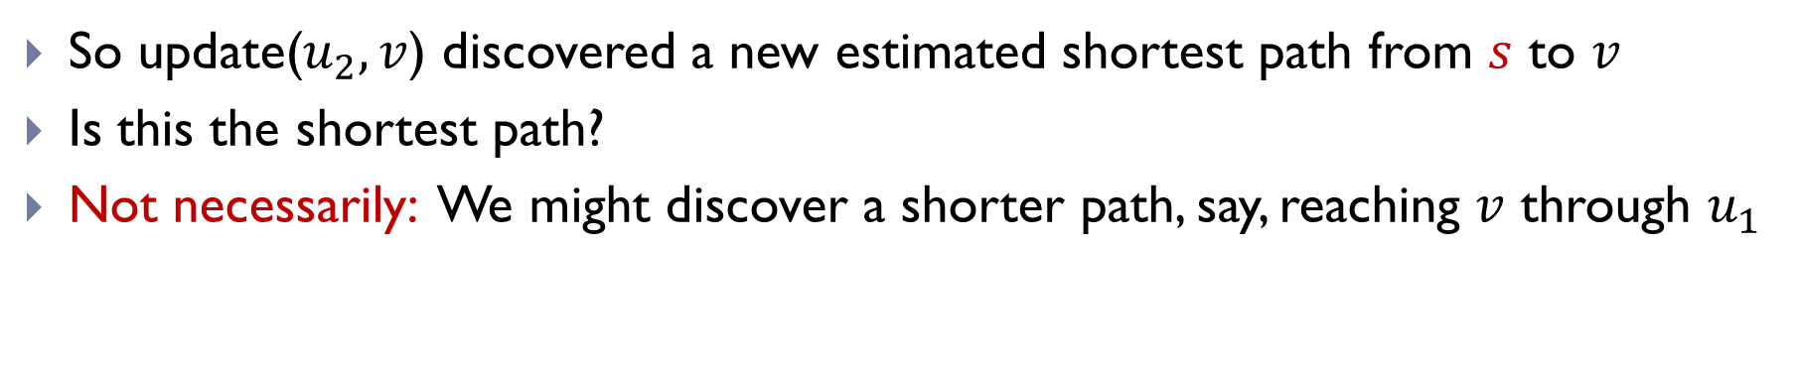
When does an update discover a shortest path?
So update($u_{2},v$) discovered a new estimated shortest path from $s$ to $v$
Is this the shortest path?
Not necessarily: We might discover a shorter path, say, reaching $v$ through $u_{1}$

Slide 34
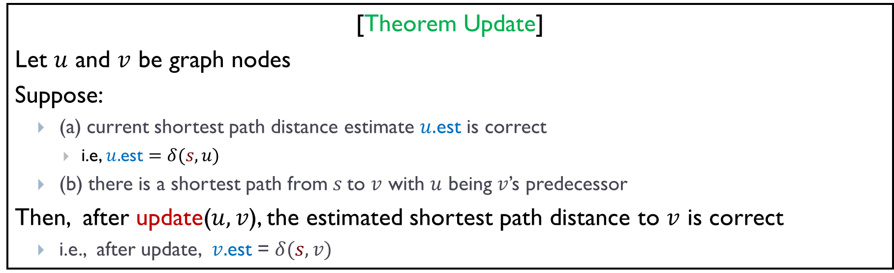
When does an update discover a shortest path?
[Theorem Update]
Let $u$ and $v$ be graph nodes
Suppose:
(a) current shortest path distance estimate $u.$est is correct
i.e, $u.$est $=δ(s, u)$
(b) there is a shortest path from $s$to $v$ with $u$ being $v$’s predecessor
Then, after update($u, v$), the estimated shortest path distance to $v$ is correct
i.e., after update, $v.$est = $δ(s, v)$

Slide 35
Bellman-Ford shortest path algorithm

Slide 36
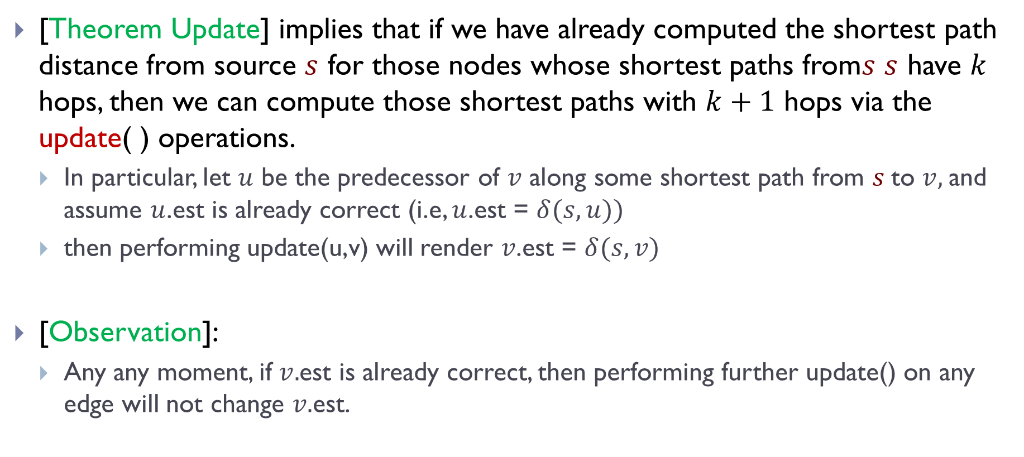
[Theorem Update] implies that if we have already computed the shortest path distance from source $s$ for those nodes whose shortest paths from$s$ $s$ have $k$ hops, then we can compute those shortest paths with $k+1$ hops via the update( ) operations.
In particular, let $u$ be the predecessor of $v$ along some shortest path from $s$to $v,$and assume $u$.est is already correct (i.e, $u$.est = $δ(s,u))$
then performing update(u,v) will render $v$.est = $δ(s,v)$
[Observation]:
Any any moment, if $v.$est is already correct, then performing further update() on any edge will not change $v.$est.

Slide 37

More specifically
-1
-6
At the beginning, we only know that $s.est=0$
For all other nodes $v∈V,$we set $v.$est = $∞$

Slide 38

More specifically
-1
-6
Now perform update for all edges in $E$
Afterwards, all nodes whose shortest path from $s$ has only one edge are now guaranteed to be estimated correctly!

Slide 39

More specifically
-1
-6
Now perform update for all edges in $E$ again
Afterwards, all nodes whose shortest path from $s$ has at most two edges are now guaranteed to be estimated correctly!

Slide 40
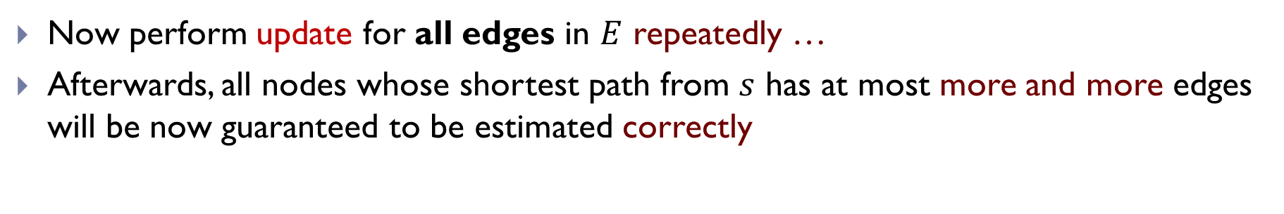
More specifically
-1
-6
Now perform update for all edges in $E$ repeatedly …
Afterwards, all nodes whose shortest path from $s$ has at most more and more edges will be now guaranteed to be estimated correctly

Slide 41
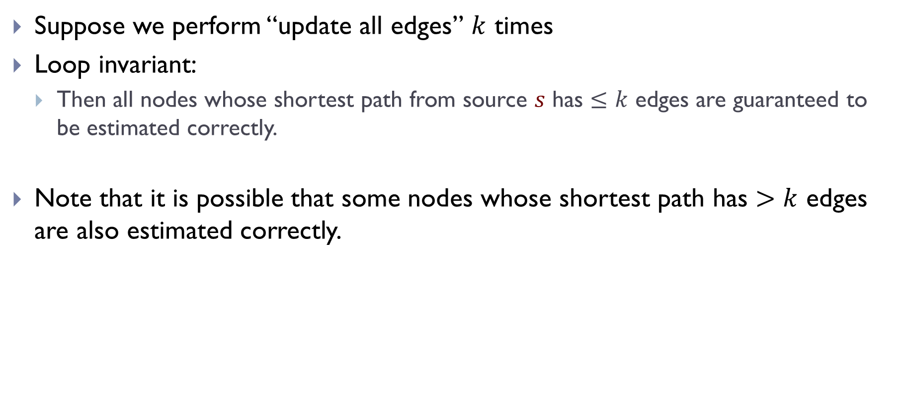
Loop Invariant
Suppose we perform “update all edges” $k$ times
Loop invariant:
Then all nodes whose shortest path from source $s$ has $≤k$ edges are guaranteed to be estimated correctly.
Note that it is possible that some nodes whose shortest path has $>k$ edges are also estimated correctly.

Slide 42
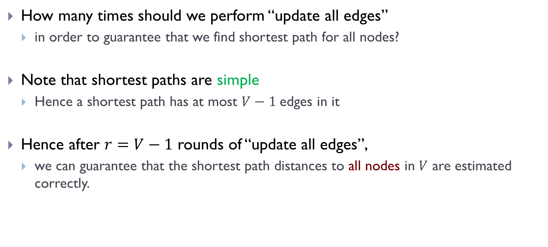
How many times should we perform “update all edges”
in order to guarantee that we find shortest path for all nodes?
Note that shortest paths are simple
Hence a shortest path has at most $V−1$edges in it
Hence after $r=V−1$ rounds of “update all edges”,
we can guarantee that the shortest path distances to all nodes in $V$ are estimated correctly.
This is the idea behind Bellman-Ford Algorithm !

Slide 43
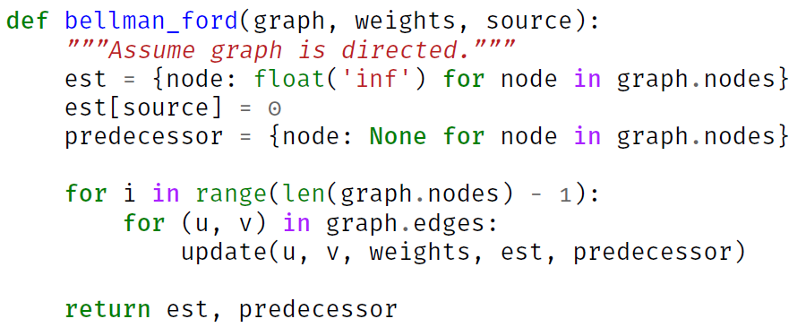
Bellman-Ford Algorithm in Python
Setup takes ____________ time
Each update takes ____________ time
There are __________ numbers of updates
Total time complexity is ______________.

Slide 44




Bellman-Ford Algorithm in Python
$$Θ(V)$$
Setup takes ____________ time
Each update takes ____________ time
There are _____________ numbers of updates
Total time complexity is ______________.
$$Θ(1)$$
$$E⋅(V−1)$$
$$Θ(V⋅E)$$

Slide 45
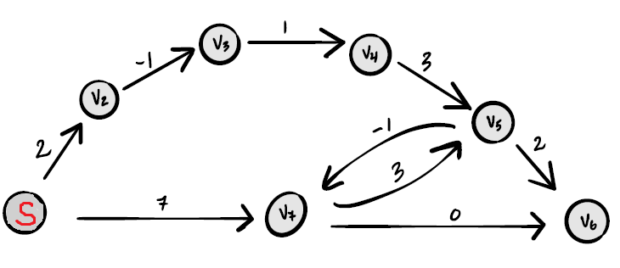
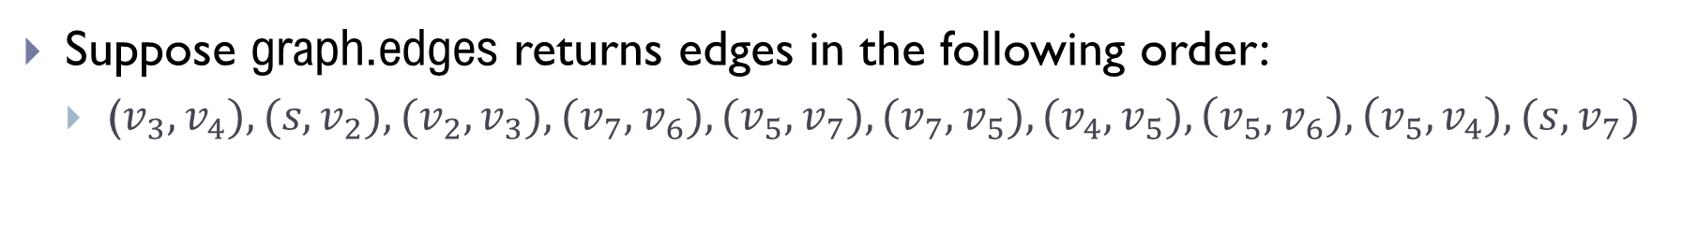
Example
Suppose graph.edges returns edges in the following order:
($v_{3},v_{4}), (s,v_{2}), (v_{2},v_{3}), (v_{7},v_{6}), (v_{5},v_{7}), (v_{7},v_{5}), (v_{4},v_{5}),\left(v_{5},v_{6}\right), \left(v_{5},v_{4}\right), (s,v_{7})$

Slide 46
Early-stopping and negative cycles

Slide 47
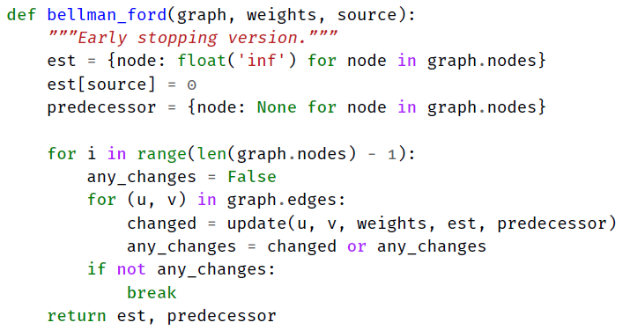

Early-stopping
Bellman-Ford may not need to run $V−1$ iterations
If there is no distance change after a round, we can stop (called early-stopping)

Slide 48
Negative Cycles
Recall: if a graph has negative cycle(s), then the shortest paths are not well-defined

Slide 49
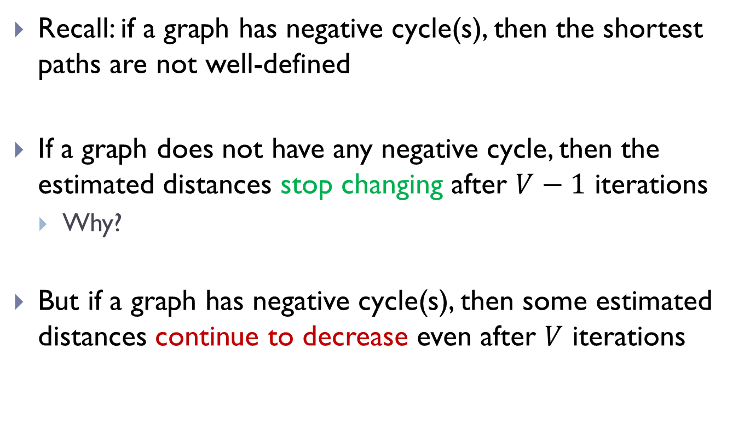
Negative Cycles
Recall: if a graph has negative cycle(s), then the shortest paths are not well-defined
If a graph does not have any negative cycle, then the estimated distances stop changing after $V−1$ iterations
Why?
But if a graph has negative cycle(s), then some estimated distances continue to decrease even after $V$ iterations

Slide 50

Negative Cycles
If a graph does not have any negative cycle, then the estimated distances stop changing after $V−1$ iterations
But if a graph has negative cycle(s), then some estimated distances continue to decrease even after $V$ iterations
Hence Bellman-Ford can be modified to also detect negative cycles
Run a $V$ iteration of “update all edges”
If any estimated distance is still decreasing, a negative cycle exists

Slide 51

Modified Bellman-Ford with early stopping and negative cycle detection

Slide 52
FIN

