Slide 1
DSC40B: Theoretical Foundations of Data Science II
Lecture 16: Minimum Spanning Tree, properties, and general greedy algorithms
Instructor: Yusu Wang

Slide 2
Previously
Given directed or undirected graphs
Graph search / traversal strategies (DFS / BFS)
Single source shortest paths in weighted graphs
Bellman-Ford algorithm for general graphs
Dijkstra algorithm for graphs with positive edge weights
Today:
Computing a minimum spanning tree (MST) of an undirected graph

Slide 3
Trees, spanning trees, and minimum spanning tree

Slide 4
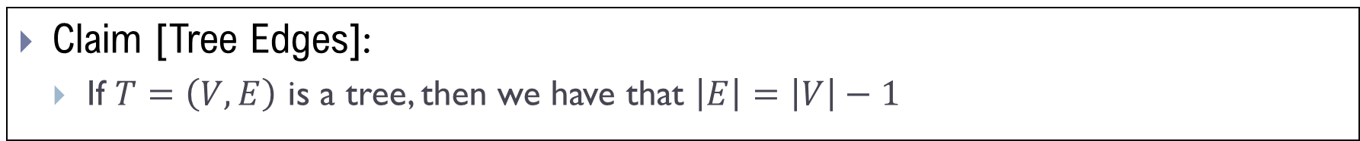
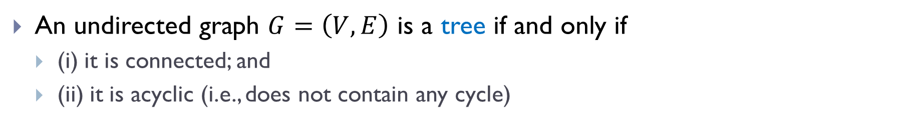
Trees
An undirected graph $G=\left(V, E\right)$ is a tree if and only if
(i) it is connected; and
(ii) it is acyclic (i.e., does not contain any cycle)
Claim [Tree Edges]:
If $T=\left(V, E\right)$ is a tree, then we have that $\left|E\right|=\left|V\right|−1$

Slide 5
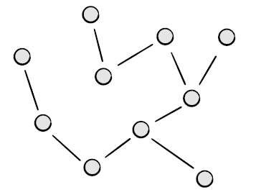
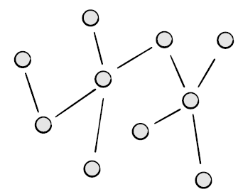
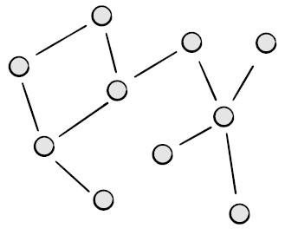
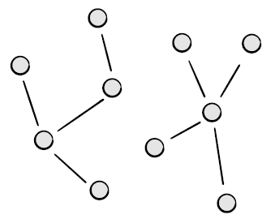
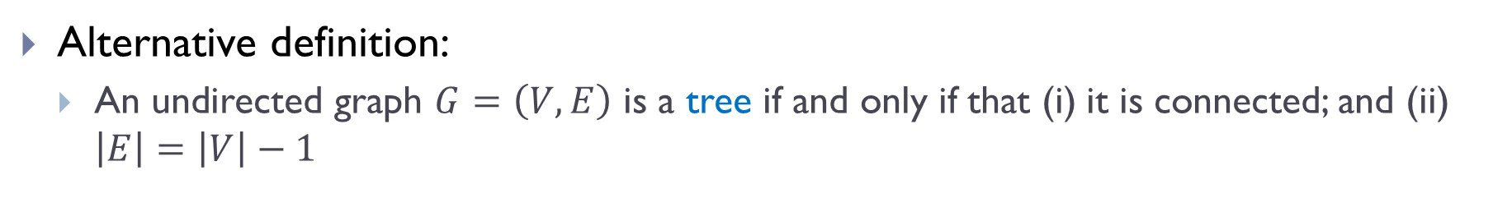
Alternative definition
Alternative definition:
An undirected graph $G=\left(V, E\right)$ is a tree if and only if that (i) it is connected; and (ii) $\left|E\right|=\left|V\right|−1$
A tree
A tree
NOT a tree
NOT a tree

Slide 6

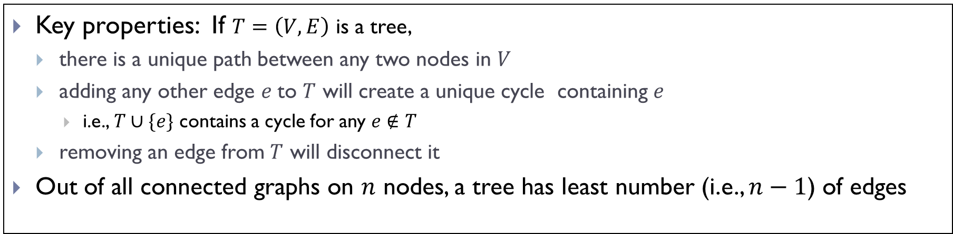


Remarks
Key properties: If $T=\left(V, E\right)$ is a tree,
there is a unique path between any two nodes in $V$
adding any other edge $e$to $T$ will create a unique cycle containing $e$
i.e., $T∪\{e\}$ contains a cycle for any $e∉T$
removing an edge from $T$ will disconnect it
Out of all connected graphs on $n$ nodes, a tree has least number (i.e., $n−1$) of edges
$$T$$
$$T∪\{e\}$$
$$e$$

Slide 7
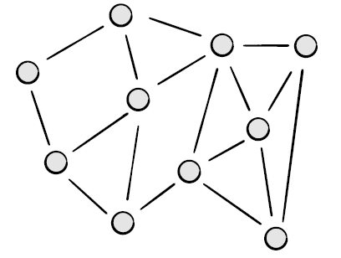
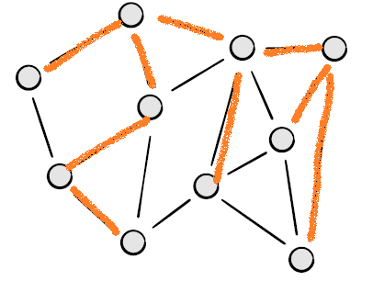
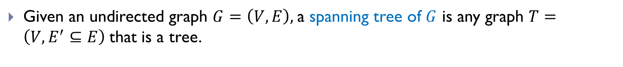
Spanning Tree
Given an undirected graph $G=\left(V, E\right),$a spanning tree of $G$ is any graph $T=\left(V, E^{′}⊆E\right)$that is a tree.
Example of spanning trees for the graph on the right.

Slide 8
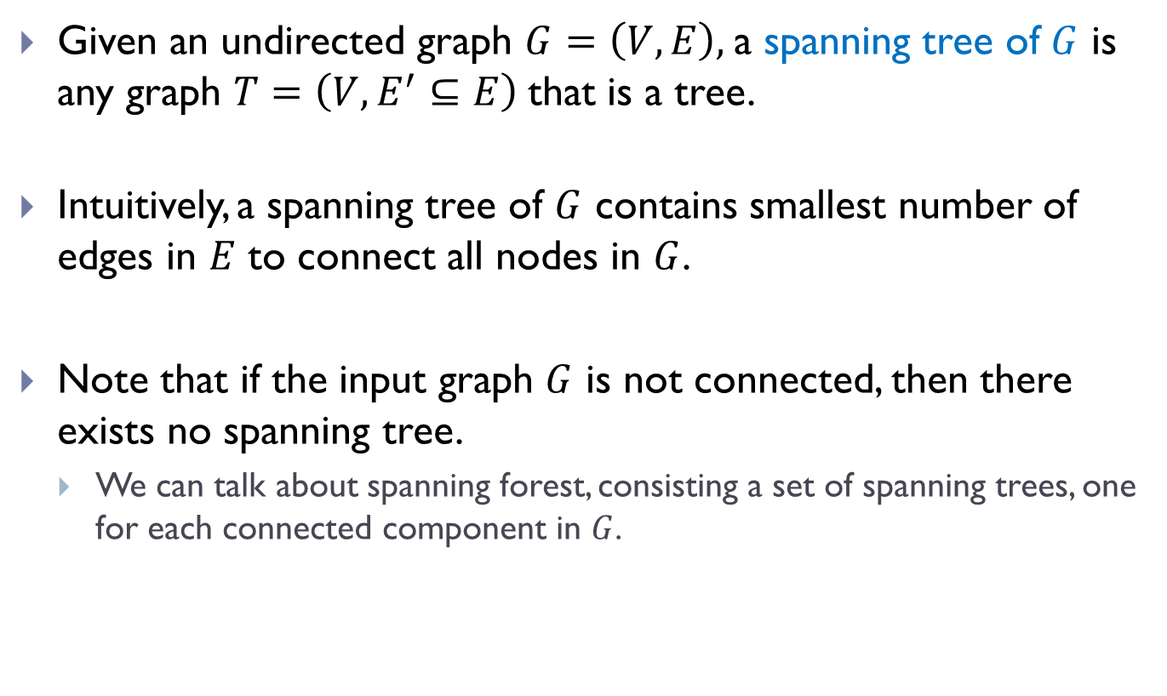
Spanning Tree
Given an undirected graph $G=\left(V, E\right),$a spanning tree of $G$ is any graph $T=\left(V, E^{′}⊆E\right)$that is a tree.
Intuitively, a spanning tree of $G$ contains smallest number of edges in $E$ to connect all nodes in $G$.
Note that if the input graph $G$ is not connected, then there exists no spanning tree.
We can talk about spanning forest, consisting a set of spanning trees, one for each connected component in $G$.

Slide 9
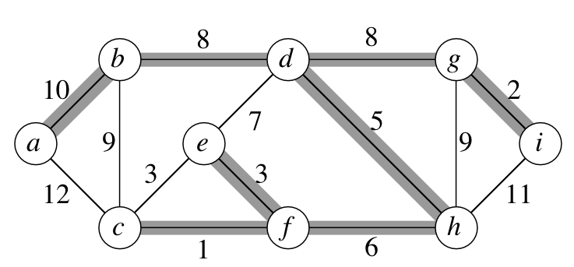
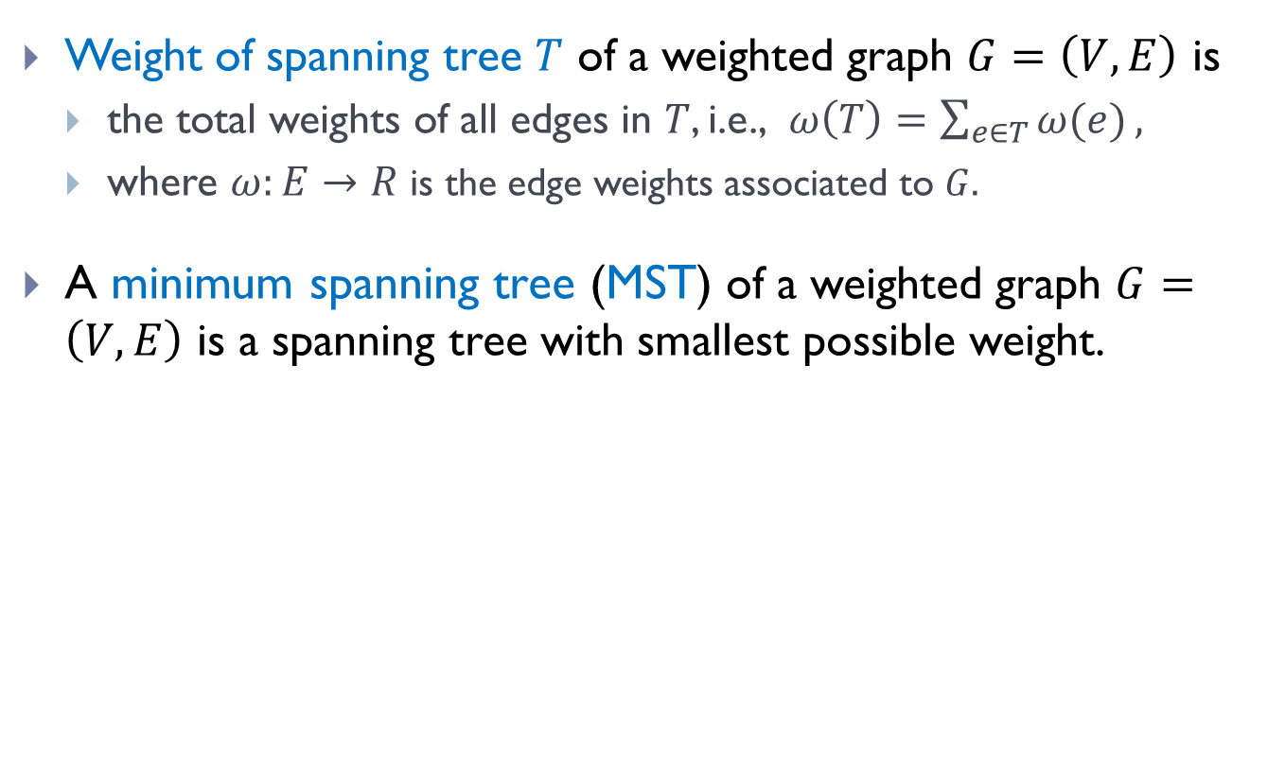
Minimum spanning tree (MST)
Weight of spanning tree $T$ of a weighted graph $G=\left(V, E\right)$ is
the total weights of all edges in $T$, i.e., $ω\left(T\right)=\sum_{e∈T}{ω(e)},$
where $ω:E→R$ is the edge weights associated to $G.$
A minimum spanning tree (MST) of a weighted graph $G=\left(V, E\right)$ is a spanning tree with smallest possible weight.
Weight of this spanning tree: 43
Turns out this is also a minimum spanning tree.

Slide 10
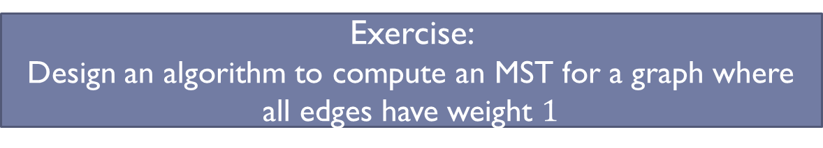
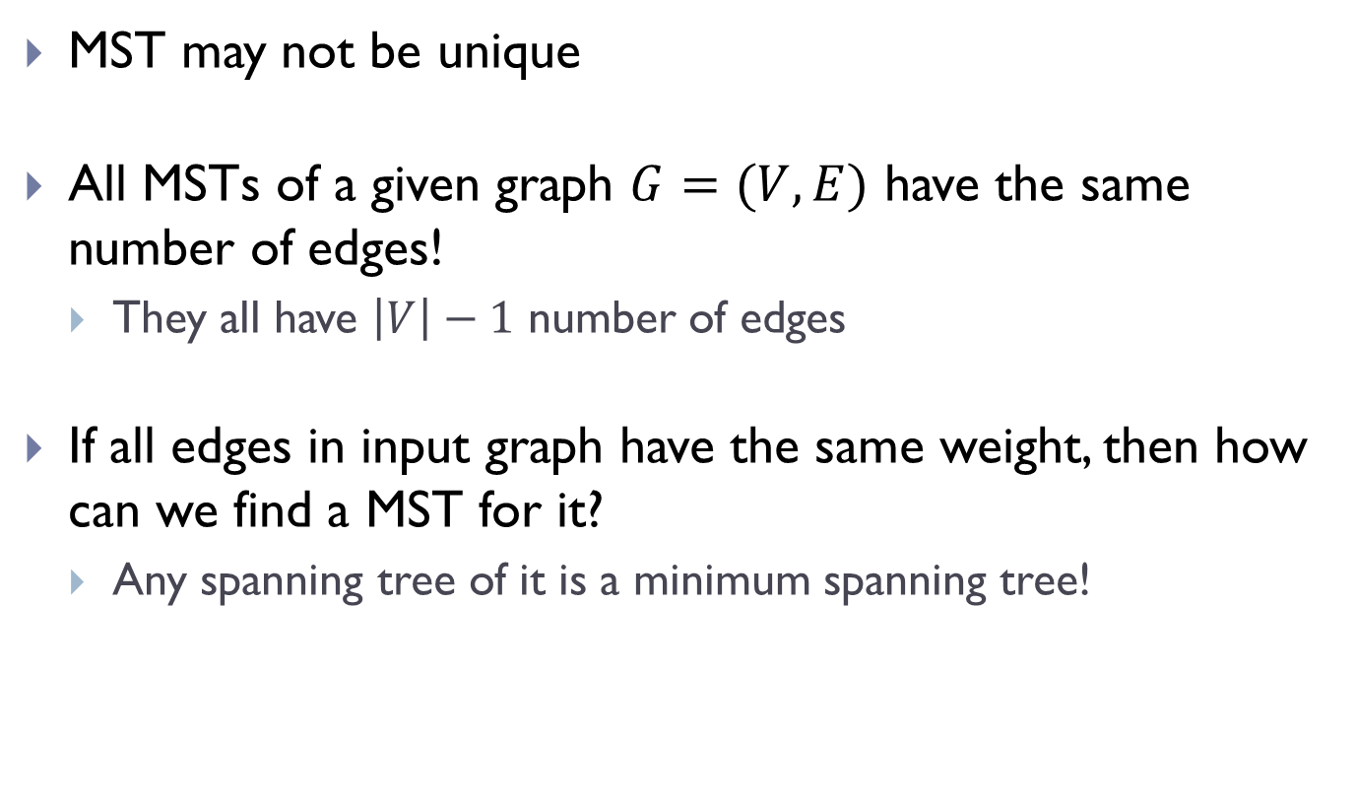
MSTs
MST may not be unique
All MSTs of a given graph $G=(V,E)$ have the same number of edges!
They all have $\left|V\right|−1$ number of edges
If all edges in input graph have the same weight, then how can we find a MST for it?
Any spanning tree of it is a minimum spanning tree!
Exercise:
Design an algorithm to compute an MST for a graph where all edges have weight $1$

Slide 11
Motivation and properties of MST

Slide 12
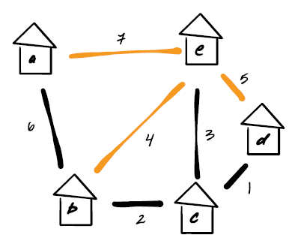
Motivation
Among all possible road segment choices, build a set of road segments so that all houses are connected and the total cost is minimized
Solution: Find the MST of the input weighted graph where edge weight represents the cost of build that road segment.

Slide 13
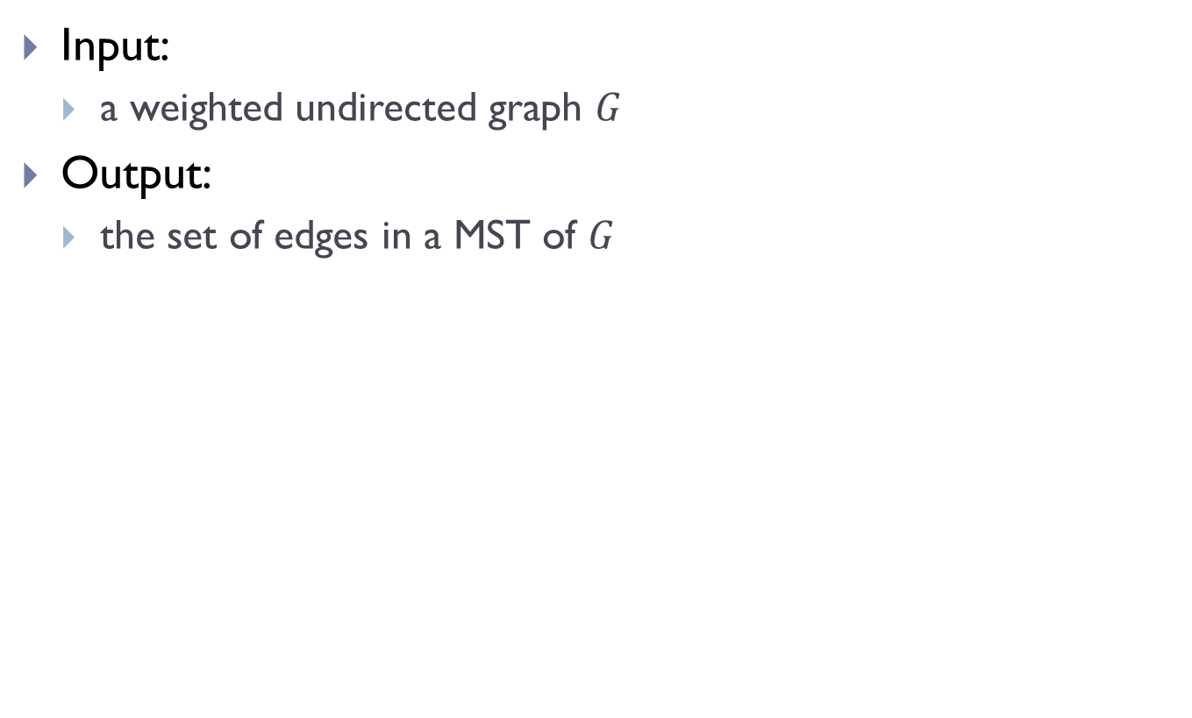
MST Problem
Input:
a weighted undirected graph $G$
Output:
the set of edges in a MST of $G$

Slide 14
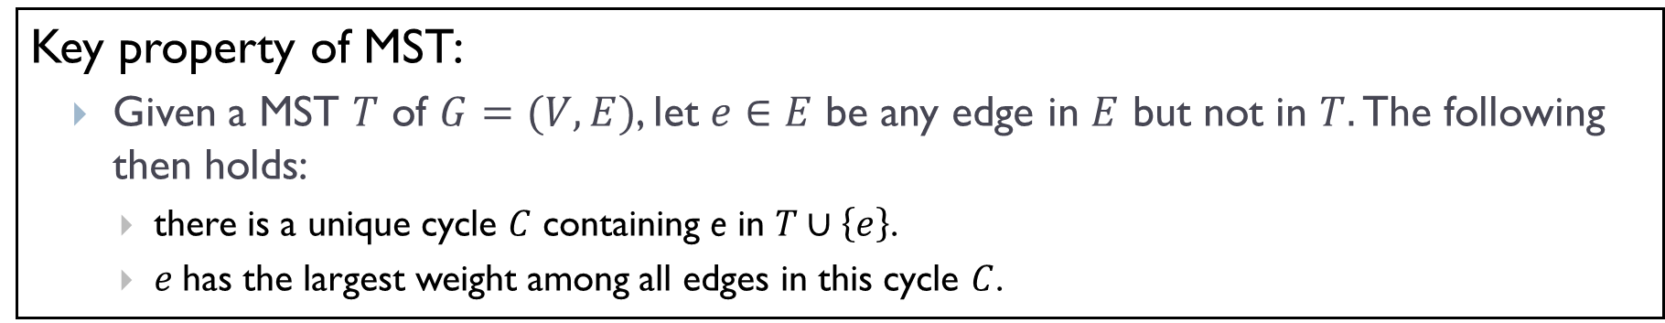
Key property
Key property of MST:
Given a MST $T$ of $G=(V,E)$, let $e∈E$ be any edge in $E$ but not in $T.$ The following then holds:
there is a unique cycle $C$ containing e in $T∪\left\{e\right\}$.
$e$has the largest weight among all edges in this cycle $C$.

Slide 15
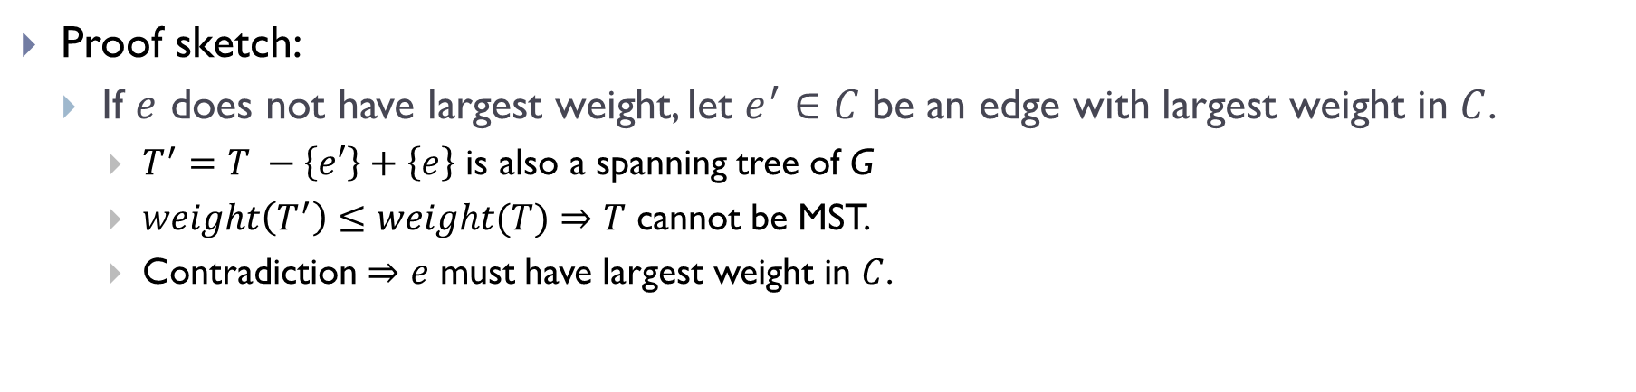
Key property
Key property of MST:
Given a MST $T$ of $G=(V,E)$, let $e∈E$ be any edge in $E$ but not in $T.$ The following then holds:
there is a unique cycle $C$ containing e in $T∪\left\{e\right\}$.
$e$has the largest weight among all edges in this cycle $C$.
Proof sketch:
If $e$ does not have largest weight, let $e^{′}∈C$ be an edge with largest weight in $C$.
$T^{′}=T −\left\{e′\right\}+\left\{e\right\}$ is also a spanning tree of G
$weight\left(T^{′}\right)≤weight(T)$ $⇒$ $T$ cannot be MST.
Contradiction $⇒e$ must have largest weight in $C$.

Slide 16
First greedy algorithm for MST: Prim’s algorithm

Slide 17
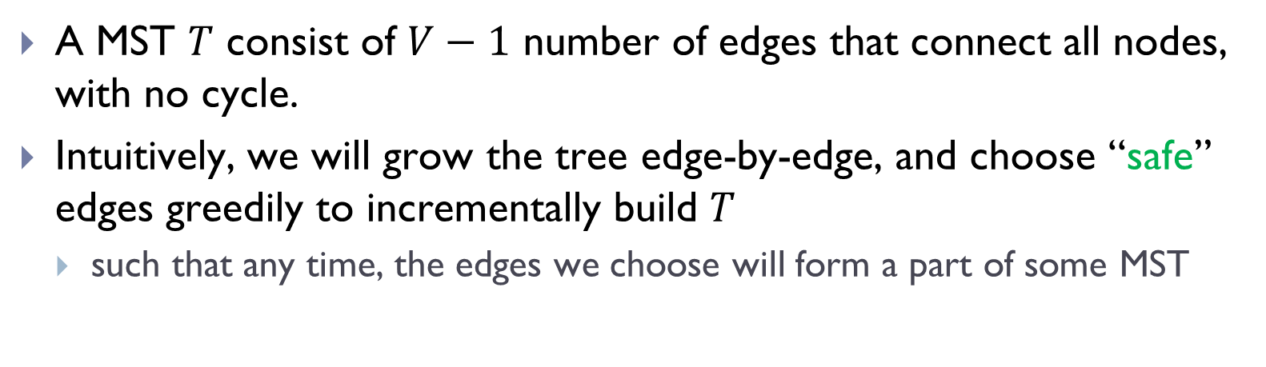
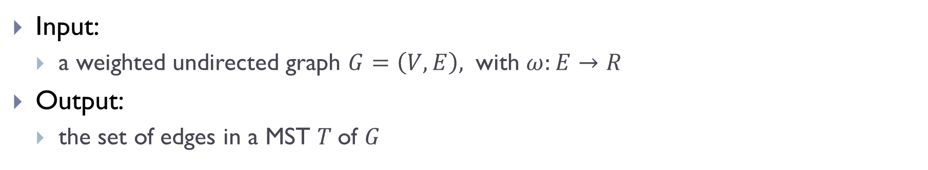
General greedy idea:
Input:
a weighted undirected graph $G=\left(V,E\right),$ with $ω:E→R$
Output:
the set of edges in a MST $T$of $G$
A MST $T$ consist of $V−1$ number of edges that connect all nodes, with no cycle.
Intuitively, we will grow the tree edge-by-edge, and choose “safe” edges greedily to incrementally build $T$
such that any time, the edges we choose will form a part of some MST

Slide 18
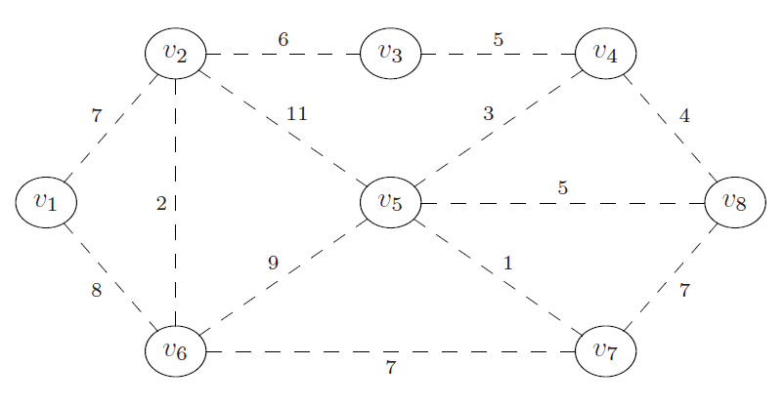
Example
What is a “safe” edge to add first?

Slide 19
Two greedy algorithms
Two greedy algorithms
Today: Prim’s algorithm
Next class: Kruskal’s algorithm
They differ in the order of edges they visit and thus ``safe” edges they add

Slide 20
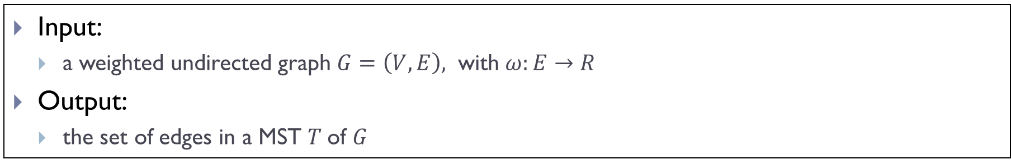
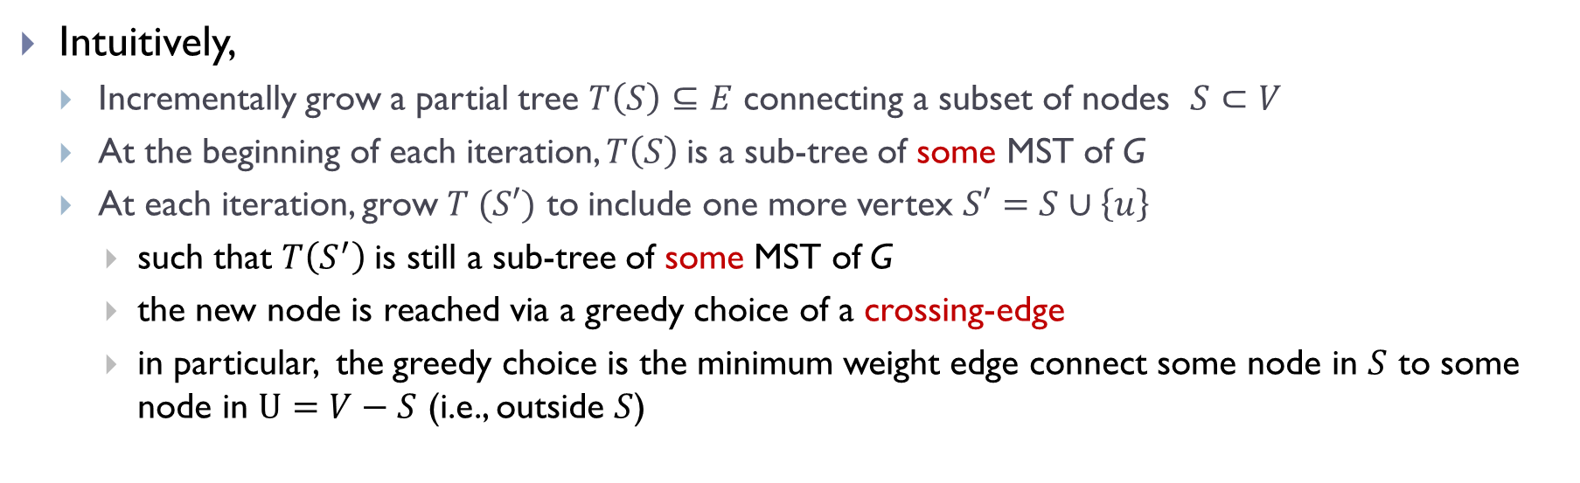
Idea for Prim’s algorithm
Input:
a weighted undirected graph $G=\left(V,E\right),$ with $ω:E→R$
Output:
the set of edges in a MST $T$of $G$
Intuitively,
Incrementally grow a partial tree $T\left(S\right)⊆E$ connecting a subset of nodes $S⊂V$
At the beginning of each iteration, $T\left(S\right)$is a sub-tree of some MST of G
At each iteration, grow $T (S′)$ to include one more vertex $S′=S∪\left\{u\right\}$
such that $T\left(S^{′}\right)$is still a sub-tree of some MST of G
the new node is reached via a greedy choice of a crossing-edge
in particular, the greedy choice is the minimum weight edge connect some node in $S$ to some node in $U=V−S$ (i.e., outside $S$)

Slide 21
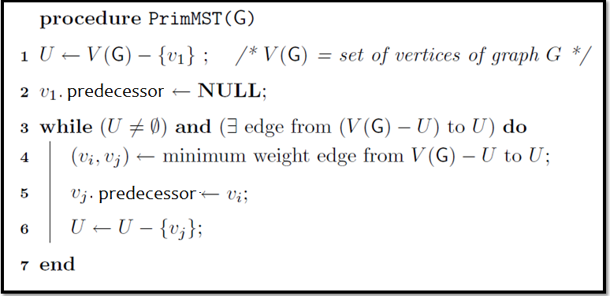
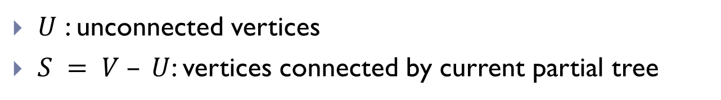
High level outline (not code)
$U$ : unconnected vertices
$S = V – U$: vertices connected by current partial tree

Slide 22
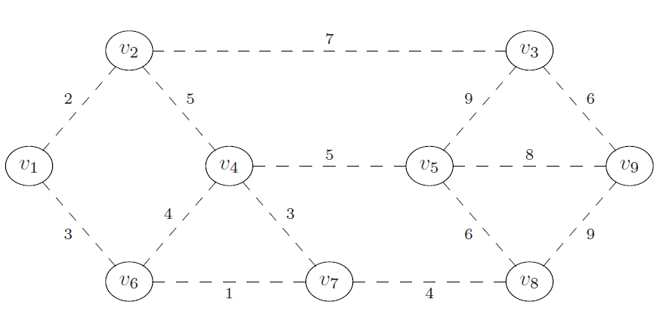
Example
Suppose we grow the tree starting from $v_{1}$

Slide 23
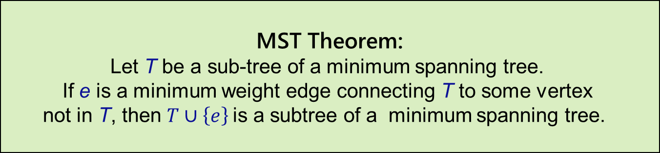
Correctness
MST Theorem:
Let T be a sub-tree of a minimum spanning tree.
If e is a minimum weight edge connecting T to some vertex
not in T, then $T∪\left\{e\right\}$is a subtree of a minimum spanning tree.
Key to the correctness of PrimMST algorithm.
Loop invariant:
each time PrimMST() algorithm grows the partial tree (i.e, adds another edge to it), the invariant is that the new tree is still a subtree of some minimum spanning tree of input graph G.
Termination:
when all nodes are connected, we obtain a MST of G.
(or if we cannot reach all nodes, then the input graph is not connected)

Slide 24
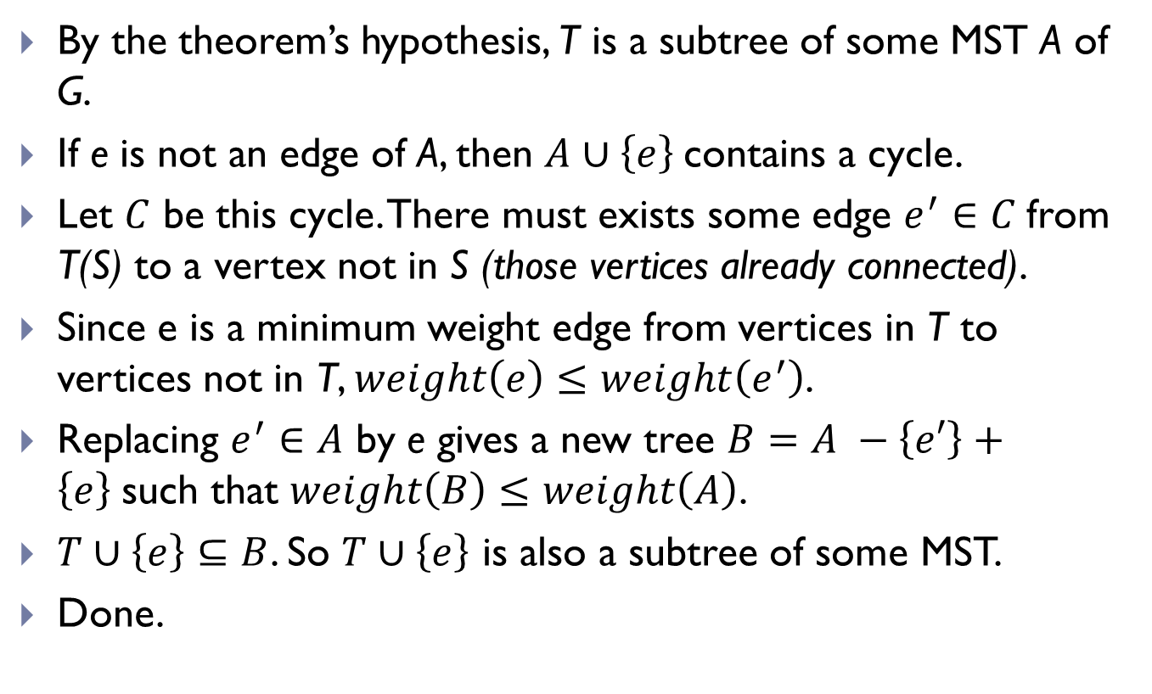
Idea for proving loop invariant
By the theorem’s hypothesis, T is a subtree of some MST A of G.
If e is not an edge of A, then $A∪\left\{e\right\}$contains a cycle.
Let $C$ be this cycle. There must exists some edge $e^{′}∈C$from T(S) to a vertex not in S (those vertices already connected).
Since e is a minimum weight edge from vertices in T to vertices not in T, $weight\left(e\right)≤weight\left(e^{′}\right)$.
Replacing $e^{′}∈A$ by e gives a new tree $B=A −\left\{e′\right\}+\left\{e\right\}$such that $weight\left(B\right)≤weight\left(A\right)$.
$T∪\left\{e\right\}⊆B$. So $T∪\left\{e\right\}$ is also a subtree of some MST.
Done.

Slide 25
Implementation of Prim’s algorithm

Slide 26
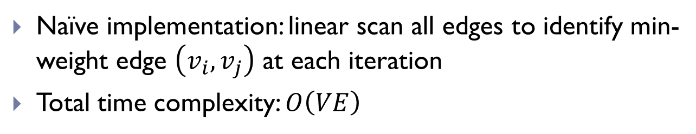
Naïve implementation of Prim’s Alg
Naïve implementation: linear scan all edges to identify min-weight edge $\left(v_{i}, v_{j}\right)$ at each iteration
Total time complexity: $O\left(VE\right)$

Slide 27
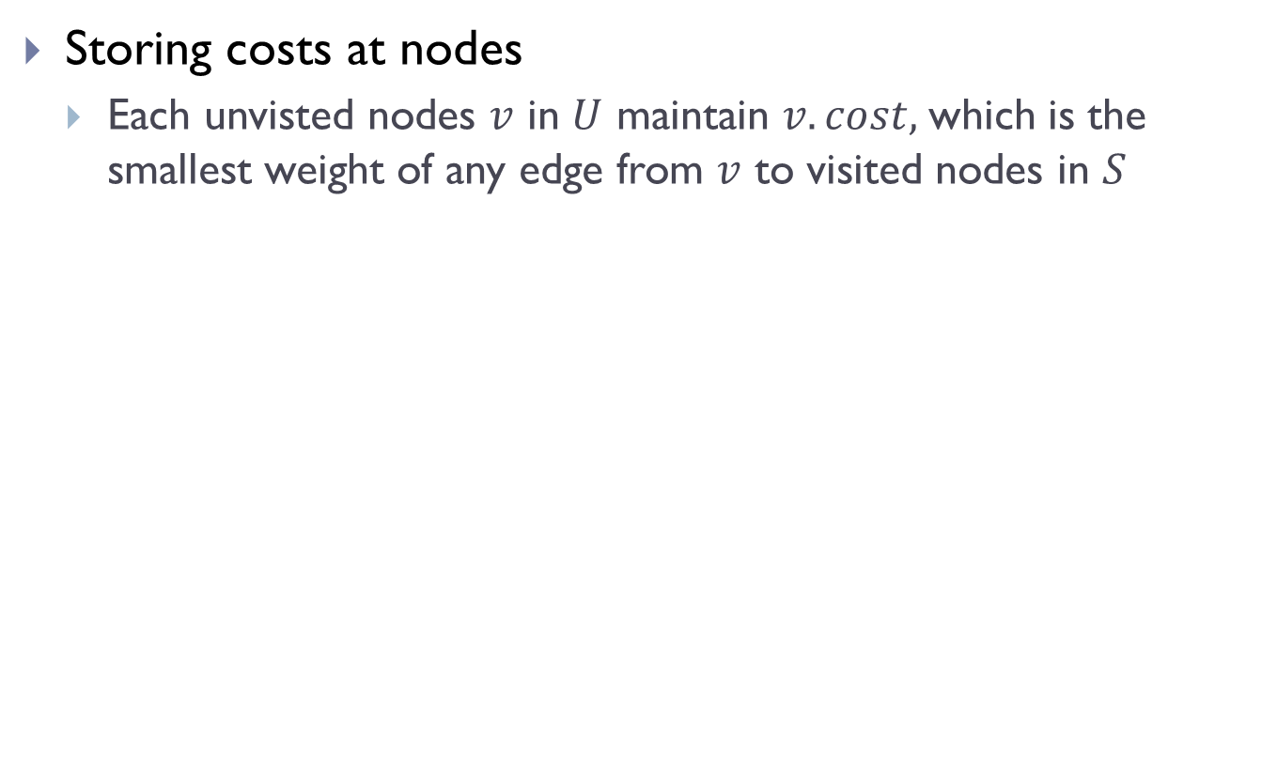
First improvement
Storing costs at nodes
Each unvisted nodes $v$ in $U$ maintain $v.cost,$which is the smallest weight of any edge from $v$ to visited nodes in $S$

Slide 28
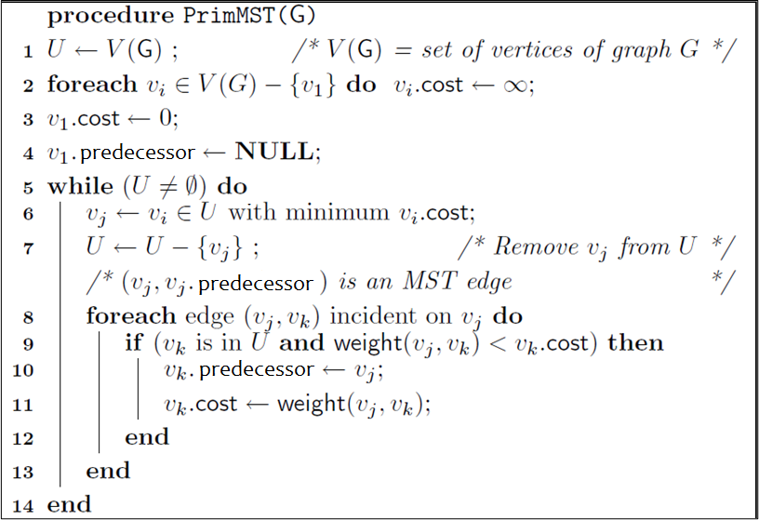
Outline of first improvement

Slide 29
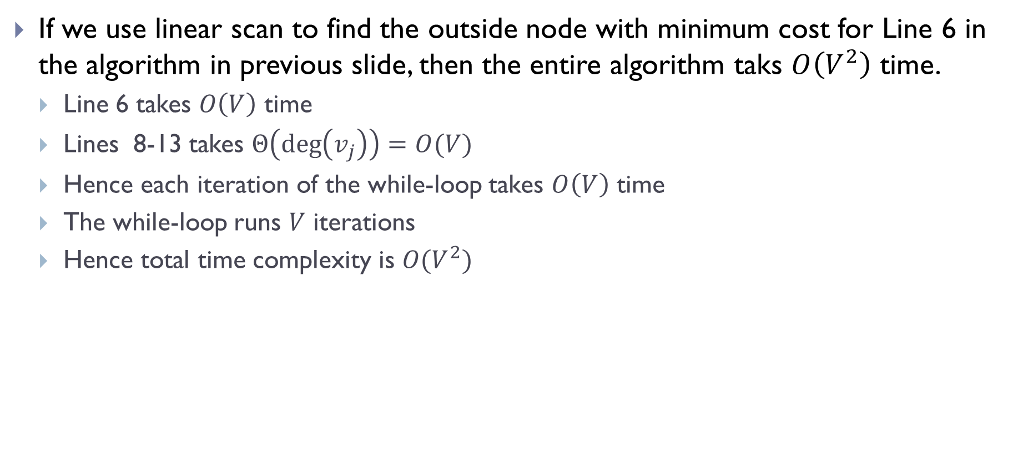
If we use linear scan to find the outside node with minimum cost for Line 6 in the algorithm in previous slide, then the entire algorithm taks $O\left(V^{2}\right)$ time.
Line 6 takes $O\left(V\right)$ time
Lines 8-13 takes $Θ\left(\deg\left(v_{j}\right)\right)=O(V)$
Hence each iteration of the while-loop takes $O\left(V\right)$ time
The while-loop runs $V$ iterations
Hence total time complexity is $O(V^{2})$

Slide 30
Better implementation
Similar to Dijkstra algorithm, we can use priority-queue to significantly speed up the time complexity!
In particular, we need a data structure to maintain the costs of unvisited nodes, which supports:
deleting the node with minimum cost (.extract_min !)
update (decrease) the cost value stored at a node (change_priority !)
In our case, a priority queue stores (key, value) pairs, where key refers to identity of some node, while value is the cost of this node.

Slide 31
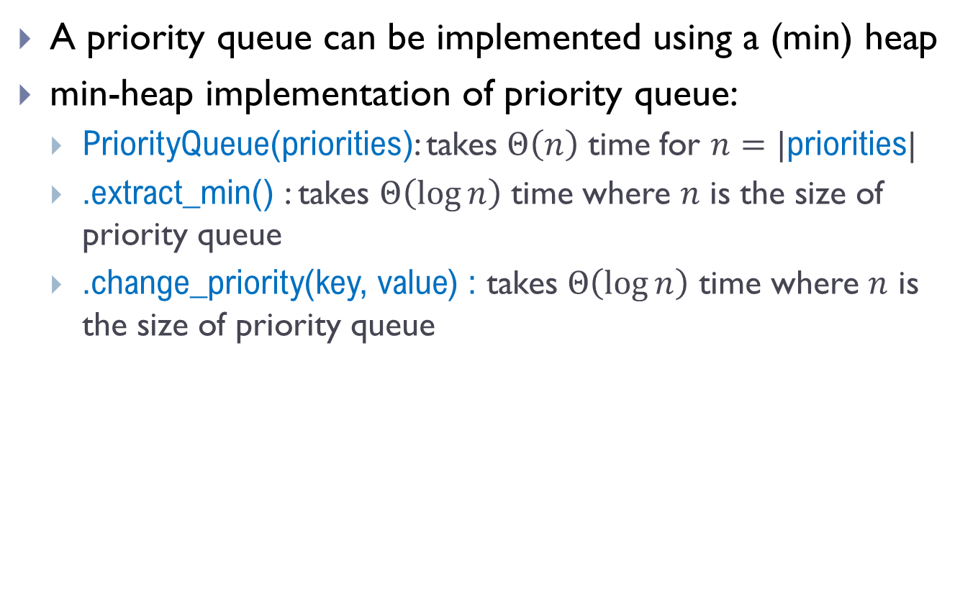
Recall Heap implementation
A priority queue can be implemented using a (min) heap
min-heap implementation of priority queue:
PriorityQueue(priorities): takes $Θ\left(n\right)$ time for $n=|$priorities|
.extract_min() : takes $Θ\left(\log{n}\right)$ time where $n$ is the size of priority queue
.change_priority(key, value) : takes $Θ\left(\log{n}\right)$ time where $n$ is the size of priority queue

Slide 32
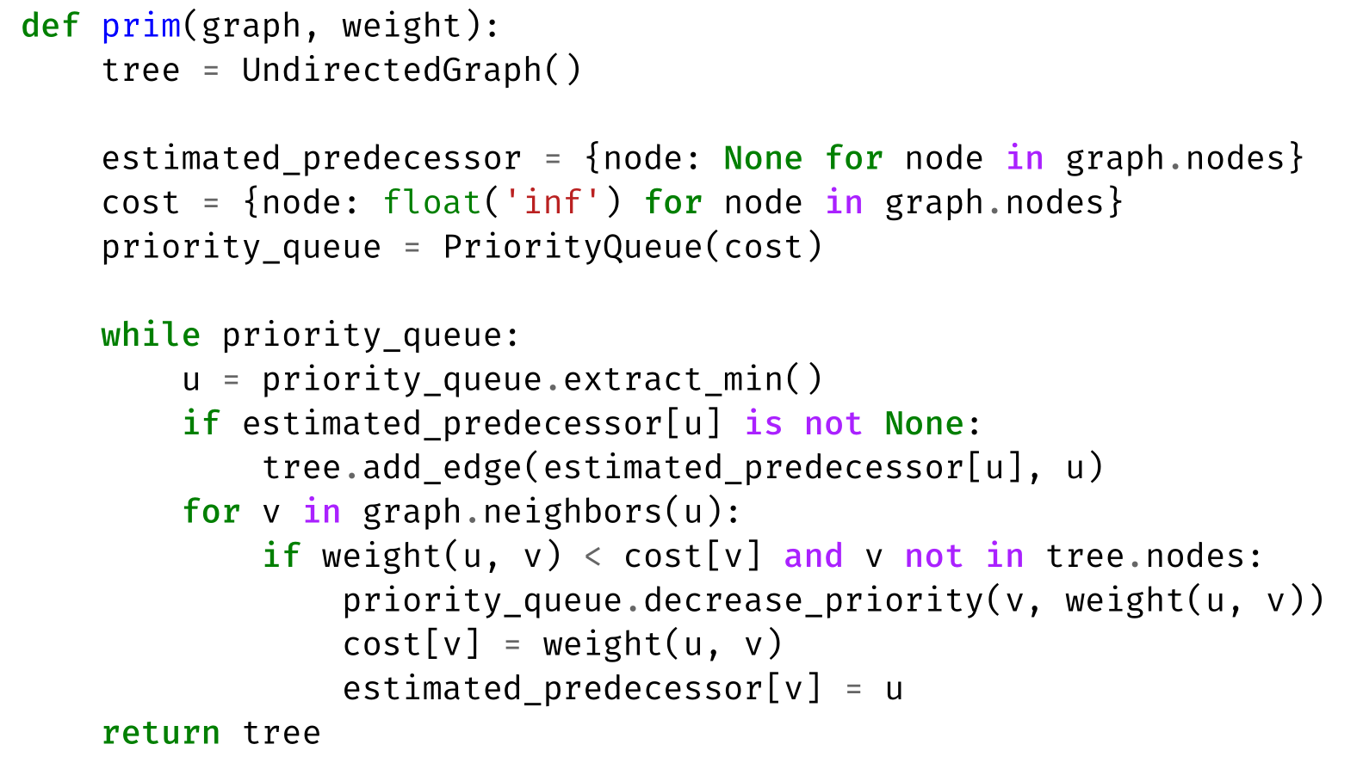
Final implementation of Prim’s Alg

Slide 33
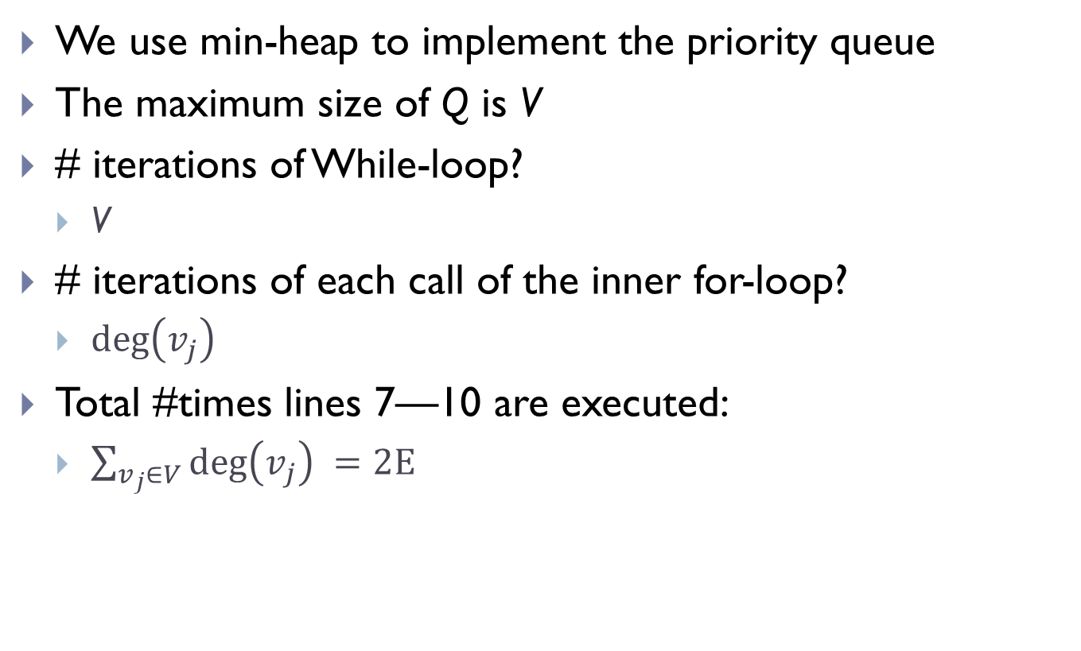
Time complexity analysis
We use min-heap to implement the priority queue
The maximum size of Q is V
# iterations of While-loop?
V
# iterations of each call of the inner for-loop?
$\deg\left(v_{j}\right)$
Total #times lines 7—10 are executed:
$\sum_{v_{j}∈V}{\deg\left(v_{j}\right) }=2E$

Slide 34

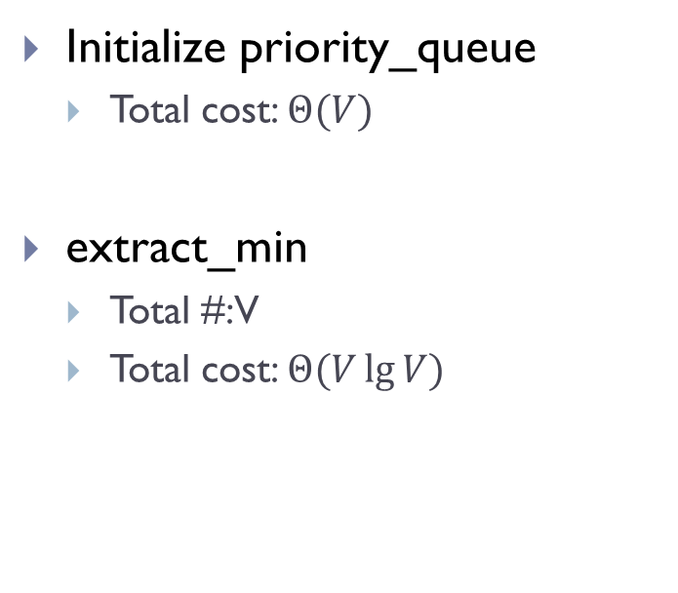
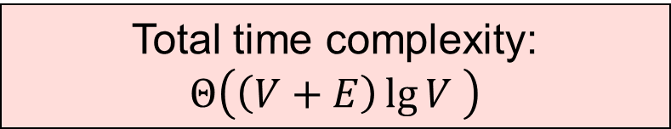
Initialize priority_queue
Total cost: $Θ(V)$
extract_min
Total #: V
Total cost: $Θ(V\lg{V) }$
decrease_priority
Total #: at most 2E
Total cost: $O(E\lg{V)}$
Total time complexity:
$$Θ\left(\left(V+E\right)\lg{V }\right)$$

Slide 35
Example

Slide 36
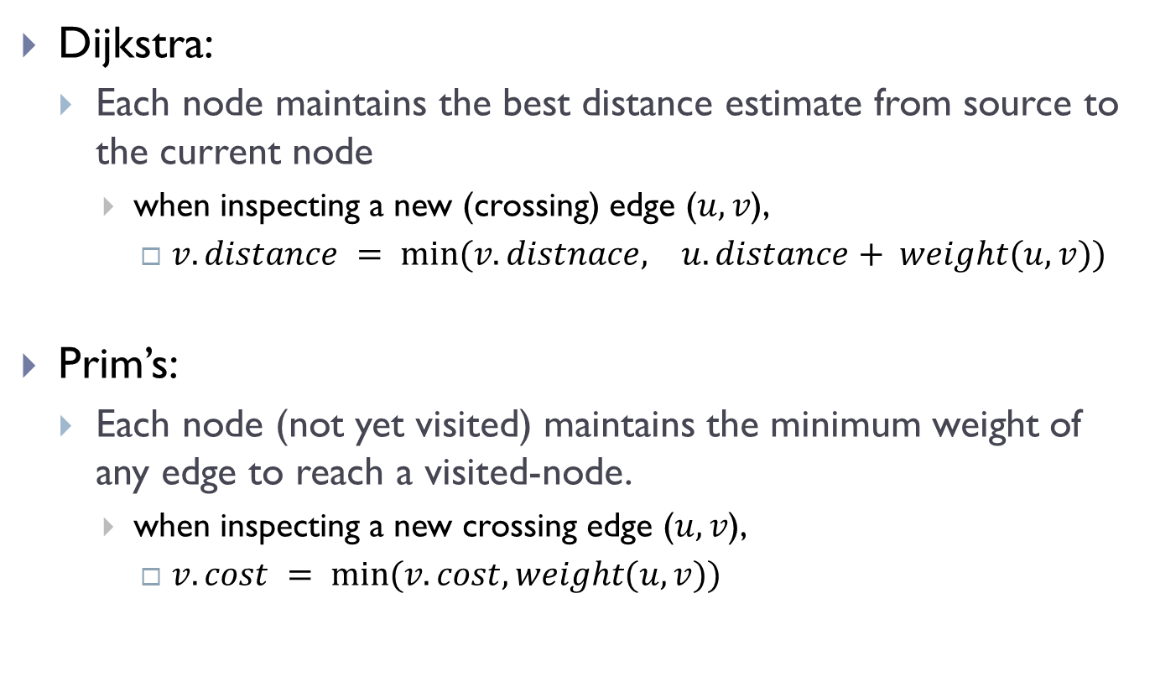
Comparison with Dijkstra algorithm
Dijkstra:
Each node maintains the best distance estimate from source to the current node
when inspecting a new (crossing) edge ($u,v$),
$v.distance = min⁡(v.distnace, u.distance+ weight(u,v))$
Prim’s:
Each node (not yet visited) maintains the minimum weight of any edge to reach a visited-node.
when inspecting a new crossing edge ($u,v$),
$v.cost = min⁡(v.cost, weight(u,v))$

Slide 37
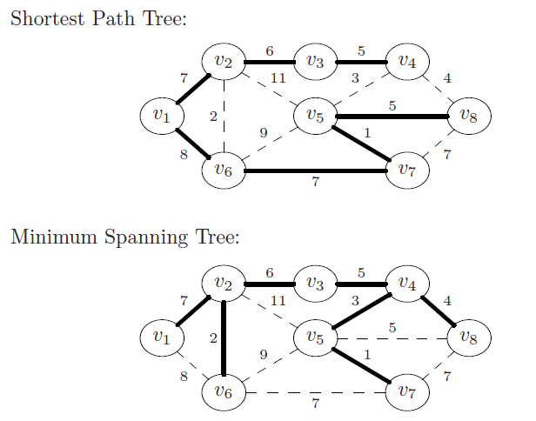
Comparison with Dijkstra

Slide 38
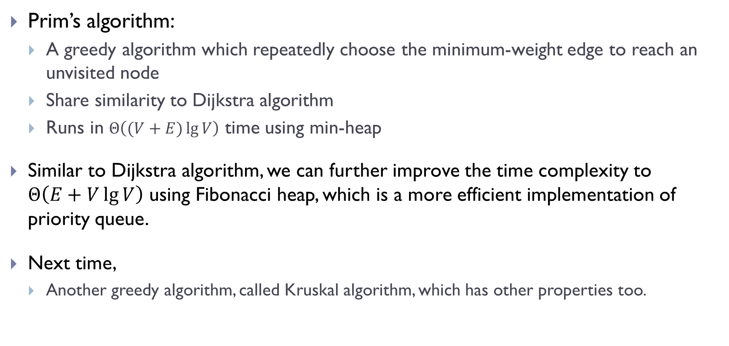
Summary and remarks
Prim’s algorithm:
A greedy algorithm which repeatedly choose the minimum-weight edge to reach an unvisited node
Share similarity to Dijkstra algorithm
Runs in $Θ\left((V+E)\lg{V}\right)$ time using min-heap
Similar to Dijkstra algorithm, we can further improve the time complexity to $Θ\left(E+V\lg{V}\right)$ using Fibonacci heap, which is a more efficient implementation of priority queue.
Next time,
Another greedy algorithm, called Kruskal algorithm, which has other properties too.

Slide 39
FIN

