Slide 1
Linear Algebra and Calculus
Unit-I: Matrices
Introduction of Matrix
Rank of a Matrix
Canonical Form of a Matrix (Echelon Form)
Normal Form of a Matrix
System of Linear Equations
Orthogonal Transformations
Eigen Values and Eigen Vectors
Diagonalization of Matrices
Cayley Hamilton Theorem
Applications to problems in Engineering

Slide 2

System of Linear Equtions
Consider the system of linear equations:
$$a_{11}x_{1}+a_{12}x_{2}+a_{13}x_{3}+…+a_{1n}x_{n}=b_{1}$$
$$a_{21}x_{1}+a_{22}x_{2}+a_{23}x_{3}+…+a_{2n}x_{n}=b_{2}$$
$$a_{31}x_{1}+a_{32}x_{2}+a_{33}x_{3}+…+a_{3n}x_{n}=b_{3}$$
………………………………………………………………….
$$a_{m1}x_{1}+a_{m2}x_{2}+a_{m3}x_{3}+…+a_{mn}x_{n}=b_{m}$$
These system of equations can be written as in the matrix form
$AX=B$ - - - - - - - - (1)
$$⇒\left[\begin{matrix}a_{11} & a_{12} & a_{13} & ⋯ & a_{1n} \\ a_{21} & a_{22} & a_{23} & ⋯ & a_{2n} \\ a_{31} & a_{32} & a_{33} & ⋯ & a_{3n} \\ ⋮ & ⋮ & ⋮ & ⋮ & ⋮ \\ a_{m1} & a_{m2} & a_{m3} & ⋯ & a_{mn}\end{matrix}\right]\left[\begin{matrix}x_{1} \\ x_{2} \\ x_{3} \\ ⋮ \\ x_{n}\end{matrix}\right]=\left[\begin{matrix}b_{1} \\ b_{2} \\ b_{3} \\ ⋮ \\ b_{m}\end{matrix}\right]$$
Here A = Coefficient Matrix
X = Variable Matrix
B = Constant Matrix

Slide 3

Augmented Matrix :
If $AX=B$be a system of m linear equations with n unknowns, then Augmented Matrix is denoted by $\left[A :B\right]$ and is defined by
$$\left[A :B\right]=\left[\begin{matrix}a_{11} & a_{12} & ⋯ & a_{1n} & : & b_{1} \\ a_{21} & a_{22} & ⋯ & a_{2n} & : & b_{2} \\ a_{31} & a_{32} & ⋯ & a_{33} & : & b_{3} \\ ⋮ & ⋮ & ⋮ & ⋮ & : & ⋮ \\ a_{m1} & a_{m2} & ⋯ & a_{mn} & : & b_{m}\end{matrix}\right]$$
System of Nonhomogeneous Linear Equations :
A system of m linear equations with n unknowns $AX=B$ is called system of nonhomogeneous linear equations if $B≠0$.
System of homogeneous Linear Equations :
A system of m linear equations with n unknowns $AX=B$ is called system of homogeneous linear equations if $B=0$.

Slide 4

Condition for consistency of Nonhomogeneous Equations
Let $AX=B$be a system of m nonhomogeneous linear equations with n unknowns, then
m = Total number of equations and n = Total number of unknowns
$ρ \left(A\right)$ = Rank of Coefficient Matrix, $ρ \left(A:B\right)$ = Rank of Augmented matrix
1. If $ρ \left(A\right)=ρ \left(A:B\right)$, then the system of equations is consistent and hence the given system of equations have solutions.
(i) Unique Solution: If $ρ \left(A\right)=ρ \left(A:B\right)=n=$ Number of variables, then the system have unique solution.
(ii)Infinitely Many Solutions:If $ρ \left(A\right)=ρ \left(A:B\right)<n=$ Number of variables, then the system of equations have infinitely many solutions.
2. If $ρ \left(A\right)≠ρ \left(A:B\right)$, then the system of equations is not consistent and hence the given system of equations have no solution.

Slide 5
Condition for consistency of Nonhomogeneous Equations
Lines are intersecting at one point
Lines are overlapping to each others
Lines are parallel to each others
Unique Solution or only one solution
Infinitely many Solutions
No Solution

Slide 6
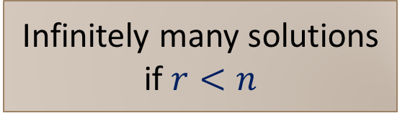

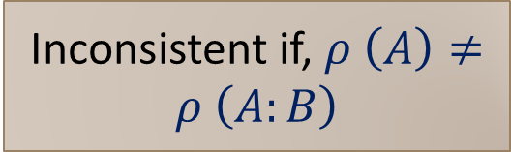
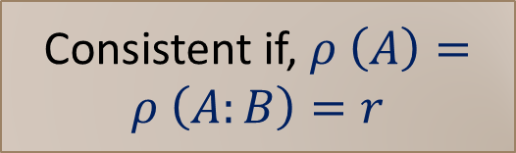
Condition for consistency of Nonhomogeneous Equations
Non-Homogeneous System AX = B, n = unknowns
Consistent if, $ρ \left(A\right)=ρ \left(A:B\right)=r$
Inconsistent if, $ρ \left(A\right)≠ρ \left(A:B\right)$
Unique Solution if
$$n=r$$
Infinitely many solutions if $r<n$
The System has no solution
Lines are intersecting at one point
Lines are overlapping to each others
Lines are parallel to each others

Slide 7
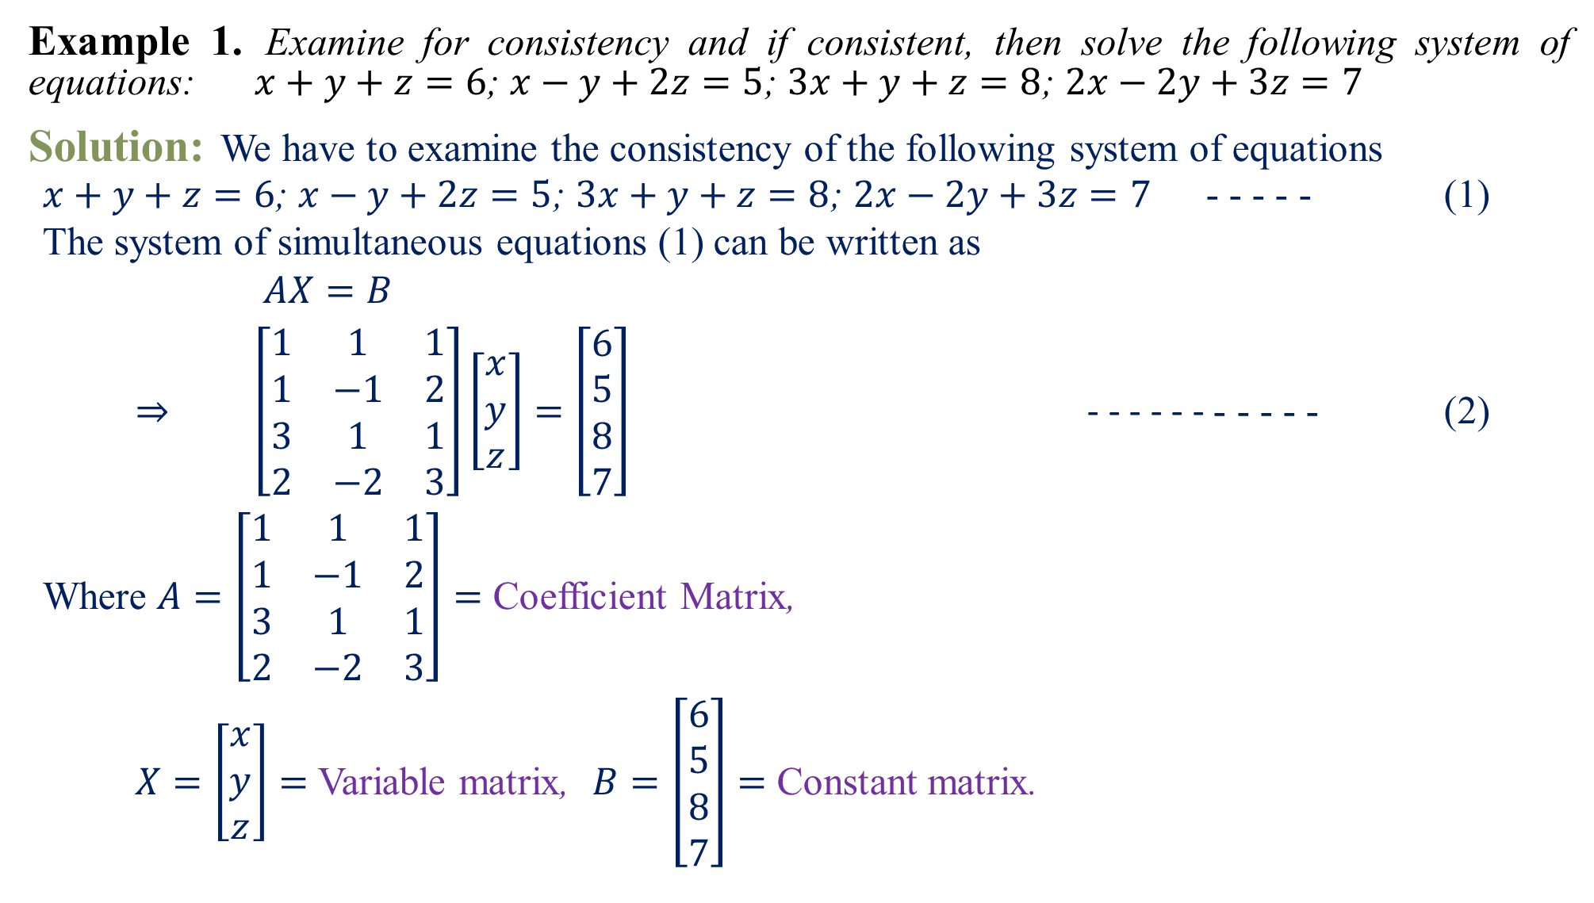
Example 1.Examine for consistency and if consistent, then solve the following system of equations:$x+y+z=6$; $x−y+2z=5$; $3x+y+z=8$; $2x−2y+3z=7$
Solution:We have to examine the consistency of the following system of equations
$x+y+z=6$; $x−y+2z=5$; $3x+y+z=8$; $2x−2y+3z=7$ - - - - - (1)
The system of simultaneous equations (1) can be written as
$$AX=B$$
$⇒\left[\begin{matrix}1 & 1 & 1 \\ 1 & −1 & 2 \\ 3 & 1 & 1 \\ 2 & −2 & 3\end{matrix}\right]\left[\begin{matrix}x \\ y \\ z\end{matrix}\right]=\left[\begin{matrix}6 \\ 5 \\ 8 \\ 7\end{matrix}\right]$ - - - - - - - - - - - (2)
Where$A=\left[\begin{matrix}1 & 1 & 1 \\ 1 & −1 & 2 \\ 3 & 1 & 1 \\ 2 & −2 & 3\end{matrix}\right]=$ Coefficient Matrix,
$X=\left[\begin{matrix}x \\ y \\ z\end{matrix}\right]=$ Variable matrix, $B=\left[\begin{matrix}6 \\ 5 \\ 8 \\ 7\end{matrix}\right]=$ Constant matrix.

Slide 8

Let us consider the Augmented matrix
$$\left[A:B\right]=\left[\begin{matrix}1 & 1 & 1 & : & 6 \\ 1 & −1 & 2 & : & 5 \\ 3 & 1 & 1 & : & 8 \\ 2 & −2 & 3 & : & 7\end{matrix}\right]$$
Apply $R_{2}→R_{2}−R_{1}$, $R_{3}→R_{3}−3R_{1}$
and $R_{4}→R_{4}−2R_{1}$
$$\left[A:B\right]\sim \left[\begin{matrix}1 & 1 & 1 & : & 6 \\ 0 & −2 & 1 & : & −1 \\ 0 & −2 & −2 & : & −10 \\ 0 & −4 & 1 & : & −5\end{matrix}\right]$$
Apply $R_{3}→R_{3}−R_{2}$ and $R_{4}→R_{4}−2R_{2}$
$$\left[A:B\right]\sim \left[\begin{matrix}1 & 1 & 1 & : & 6 \\ 0 & −2 & 1 & : & −1 \\ 0 & 0 & −3 & : & −9 \\ 0 & 0 & −1 & : & −3\end{matrix}\right]$$
Apply $R_{13}$, we have
$$\left[A:B\right]\sim \left[\begin{matrix}1 & 1 & 1 & : & 6 \\ 0 & −2 & 1 & : & −1 \\ 0 & 0 & −1 & : & −3 \\ 0 & 0 & −3 & : & −9\end{matrix}\right]$$
Apply $R_{4}→R_{4}−3R_{3}$, we have
$\left[A:B\right]\sim \left[\begin{matrix}1 & 1 & 1 & : & 6 \\ 0 & −2 & 1 & : & −1 \\ 0 & 0 & −1 & : & −3 \\ 0 & 0 & 0 & : & 0\end{matrix}\right]$- - - (3)
This is Echelon Form of the given matrix.
Here Rank of $\left[A:B\right]$ = Number of nonzero rows i.e. $ρ \left(A:B\right)=3$. Also, $ρ \left(A\right)=3$.
Since $ρ \left(A:B\right)=ρ \left(A\right)=3=$ Number of variables
$∴$ The given system of equations is consistent and have unique solution.
Now have to find the solution of (1).

Slide 9
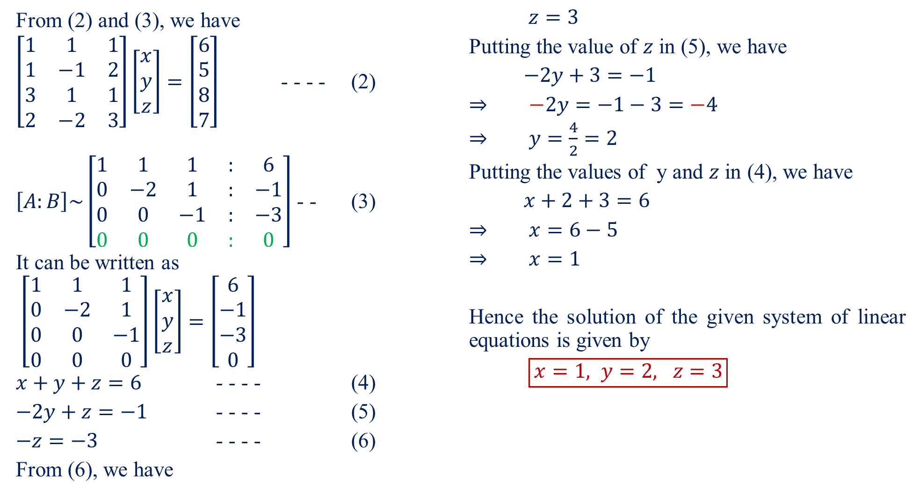
From (2) and (3), we have
$\left[\begin{matrix}1 & 1 & 1 \\ 1 & −1 & 2 \\ 3 & 1 & 1 \\ 2 & −2 & 3\end{matrix}\right]\left[\begin{matrix}x \\ y \\ z\end{matrix}\right]=\left[\begin{matrix}6 \\ 5 \\ 8 \\ 7\end{matrix}\right]$ - - - - (2)
$\left[A:B\right]\sim \left[\begin{matrix}1 & 1 & 1 & : & 6 \\ 0 & −2 & 1 & : & −1 \\ 0 & 0 & −1 & : & −3 \\ 0 & 0 & 0 & : & 0\end{matrix}\right]$ - - (3)
It can be written as
$$\left[\begin{matrix}1 & 1 & 1 \\ 0 & −2 & 1 \\ 0 & 0 & −1 \\ 0 & 0 & 0\end{matrix}\right]\left[\begin{matrix}x \\ y \\ z\end{matrix}\right]=\left[\begin{matrix}6 \\ −1 \\ −3 \\ 0\end{matrix}\right]$$
$x+y+z=6$ - - - - (4)
$−2y+z=−1$ - - - - (5)
$−z=−3$ - - - - (6)
From (6), we have
$$z=3$$
Putting the value of $z$ in (5), we have
$$−2y+3=−1$$
$$⇒−2y=−1−3=−4$$
$$⇒y=\frac{4}{2}=2$$
Putting the values of y and $z$ in (4), we have
$$x+2+3=6$$
$$⇒x=6−5$$
$$⇒x=1$$
Hence the solution of the given system of linear equations is given by
$$\boxed{x=1, y=2, z=3}$$

Slide 10
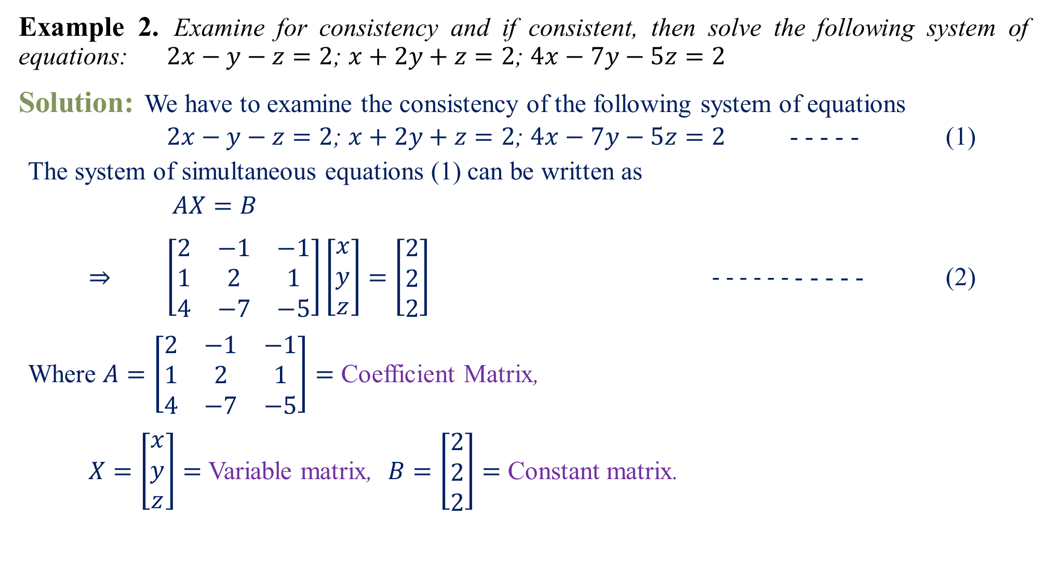
Example 2.Examine for consistency and if consistent, then solve the following system of equations:$2x−y−z=2$; $x+2y+z=2$; $4x−7y−5z=2$
Solution:We have to examine the consistency of the following system of equations
$2x−y−z=2$; $x+2y+z=2$; $4x−7y−5z=2$ - - - - - (1)
The system of simultaneous equations (1) can be written as
$$AX=B$$
$⇒\left[\begin{matrix}2 & −1 & −1 \\ 1 & 2 & 1 \\ 4 & −7 & −5\end{matrix}\right]\left[\begin{matrix}x \\ y \\ z\end{matrix}\right]=\left[\begin{matrix}2 \\ 2 \\ 2\end{matrix}\right]$ - - - - - - - - - - - (2)
Where$A=\left[\begin{matrix}2 & −1 & −1 \\ 1 & 2 & 1 \\ 4 & −7 & −5\end{matrix}\right]=$ Coefficient Matrix,
$X=\left[\begin{matrix}x \\ y \\ z\end{matrix}\right]=$ Variable matrix, $B=\left[\begin{matrix}2 \\ 2 \\ 2\end{matrix}\right]=$ Constant matrix.

Slide 11
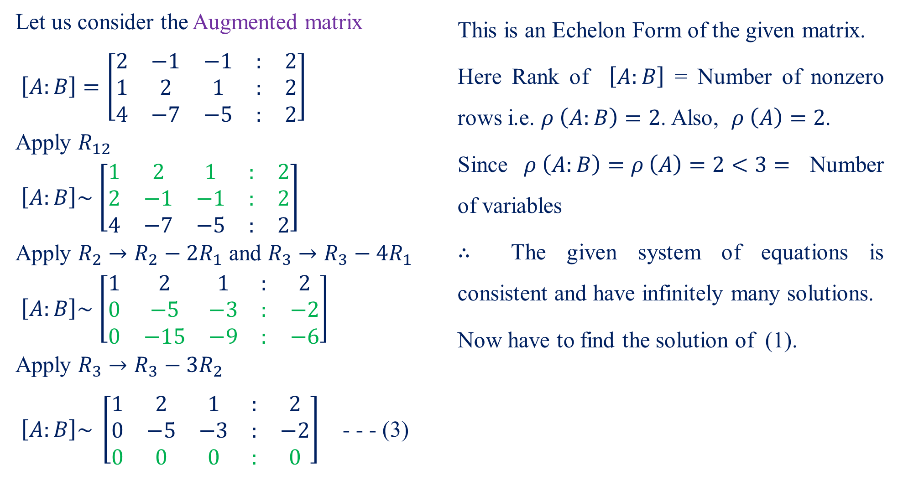
Let us consider the Augmented matrix
$$\left[A:B\right]=\left[\begin{matrix}2 & −1 & −1 & : & 2 \\ 1 & 2 & 1 & : & 2 \\ 4 & −7 & −5 & : & 2\end{matrix}\right]$$
Apply $R_{12}$
$$\left[A:B\right]\sim \left[\begin{matrix}1 & 2 & 1 & : & 2 \\ 2 & −1 & −1 & : & 2 \\ 4 & −7 & −5 & : & 2\end{matrix}\right]$$
Apply $R_{2}→R_{2}−2R_{1}$ and $R_{3}→R_{3}−{4R}_{1}$
$$\left[A:B\right]\sim \left[\begin{matrix}1 & 2 & 1 & : & 2 \\ 0 & −5 & −3 & : & −2 \\ 0 & −15 & −9 & : & −6\end{matrix}\right]$$
Apply $R_{3}→R_{3}−{3R}_{2}$
$\left[A:B\right]\sim \left[\begin{matrix}1 & 2 & 1 & : & 2 \\ 0 & −5 & −3 & : & −2 \\ 0 & 0 & 0 & : & 0\end{matrix}\right]$ - - - (3)
This is an Echelon Form of the given matrix.
Here Rank of $\left[A:B\right]$ = Number of nonzero rows i.e. $ρ \left(A:B\right)=2$. Also, $ρ \left(A\right)=2$.
Since $ρ \left(A:B\right)=ρ \left(A\right)=2<3=$ Number of variables
$∴$ The given system of equations is consistent and have infinitely many solutions.
Now have to find the solution of (1).

Slide 12

From (2) and (3), we have
$\left[\begin{matrix}2 & −1 & −1 \\ 1 & 2 & 1 \\ 4 & −7 & −5\end{matrix}\right]\left[\begin{matrix}x \\ y \\ z\end{matrix}\right]=\left[\begin{matrix}2 \\ 2 \\ 2\end{matrix}\right]$ - - - - (2)
$\left[A:B\right]\sim \left[\begin{matrix}1 & 2 & 1 & : & 2 \\ 0 & −5 & −3 & : & −2 \\ 0 & 0 & 0 & : & 0\end{matrix}\right]$- - (3)
It can be written as
$$\left[\begin{matrix}2 & −1 & −1 \\ 0 & −5 & −3 \\ 0 & 0 & 0\end{matrix}\right]\left[\begin{matrix}x \\ y \\ z\end{matrix}\right]=\left[−\begin{matrix}2 \\ 2 \\ 0\end{matrix}\right]$$
$2x−y−z=2$ - - - - (4)
$−5y−3z=−2$ - - - - (5)
Here the number of variables is 3 and number of equations is 2. So, out of three variable one variable is independent.
Let$z=t$, then putting the value of $z$ in (5), we have
$$−5y−3t=−2$$
$$⇒−5y=−2+3t$$
$$⇒5y=2−3t$$
$$⇒y=\frac{2−3t}{5}$$
Putting the values of y and $z$ in (4), we have
$$2x−\begin{matrix}\left(\frac{2−3t}{5}\right)\end{matrix}−t=2$$
$$⇒10x−\begin{matrix}\left(2−3t\right)\end{matrix}−5t=10$$
$$⇒10x−2+3t−5t=10$$
$$⇒10x−2t=10+2$$
$$⇒10x=2t+12=2\left(t+6\right)$$
$$⇒x=\frac{2\left(t+6\right)}{10}$$
$$⇒x=\frac{t+6}{5}$$
Hence the solution of the given system of linear equations is given by
$$\boxed{x=\frac{t+6}{5}, y=\frac{2−3t}{5}, z=t}$$

Slide 13
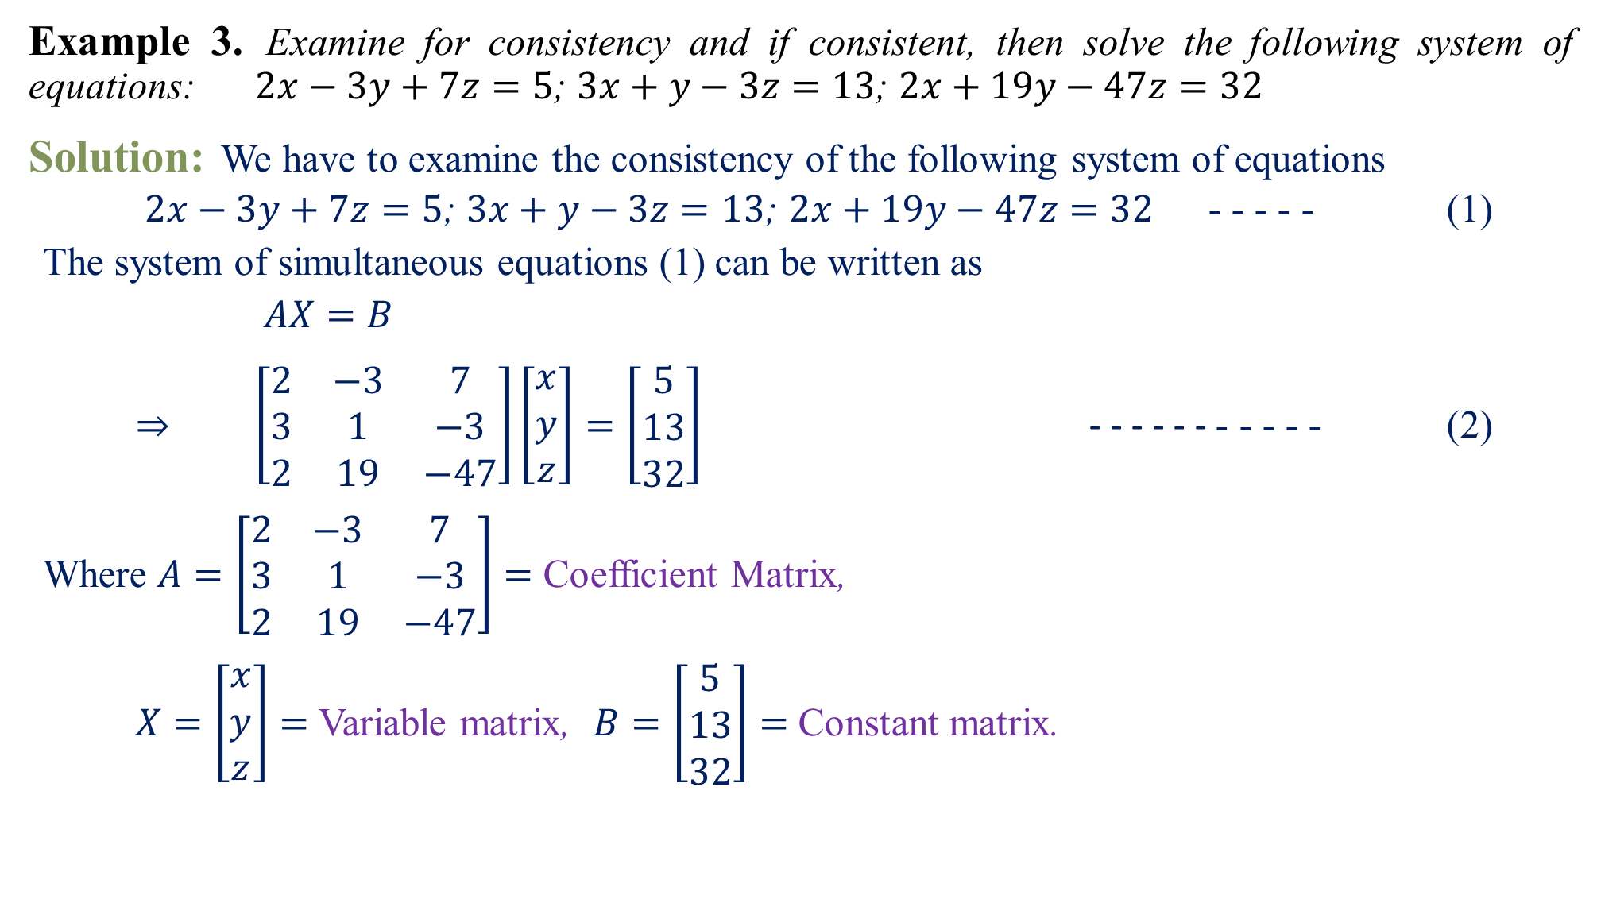
Example 3.Examine for consistency and if consistent, then solve the following system of equations:$2x−3y+7z=5$; $3x+y−3z=13$; $2x+19y−47z=32$
Solution:We have to examine the consistency of the following system of equations
$2x−3y+7z=5$; $3x+y−3z=13$; $2x+19y−47z=32$ - - - - - (1)
The system of simultaneous equations (1) can be written as
$$AX=B$$
$⇒\left[\begin{matrix}2 & −3 & 7 \\ 3 & 1 & −3 \\ 2 & 19 & −47\end{matrix}\right]\left[\begin{matrix}x \\ y \\ z\end{matrix}\right]=\left[\begin{matrix}5 \\ 13 \\ 32\end{matrix}\right]$ - - - - - - - - - - - (2)
Where$A=\left[\begin{matrix}2 & −3 & 7 \\ 3 & 1 & −3 \\ 2 & 19 & −47\end{matrix}\right]=$ Coefficient Matrix,
$X=\left[\begin{matrix}x \\ y \\ z\end{matrix}\right]=$ Variable matrix, $B=\left[\begin{matrix}5 \\ 13 \\ 32\end{matrix}\right]=$ Constant matrix.

Slide 14
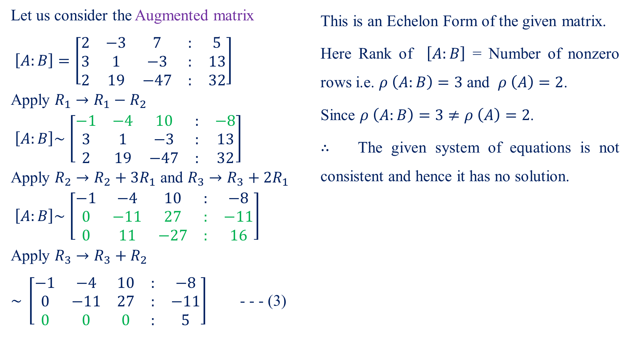
Let us consider the Augmented matrix
$$\left[A:B\right]=\left[\begin{matrix}2 & −3 & 7 & : & 5 \\ 3 & 1 & −3 & : & 13 \\ 2 & 19 & −47 & : & 32\end{matrix}\right]$$
Apply $R_{1}→R_{1}−R_{2}$
$$\left[A:B\right]\sim \left[\begin{matrix}−1 & −4 & 10 & : & −8 \\ 3 & 1 & −3 & : & 13 \\ 2 & 19 & −47 & : & 32\end{matrix}\right]$$
Apply $R_{2}→R_{2}+3R_{1}$ and $R_{3}→R_{3}+{2R}_{1}$
$$\left[A:B\right]\sim \left[\begin{matrix}−1 & −4 & 10 & : & −8 \\ 0 & −11 & 27 & : & −11 \\ 0 & 11 & −27 & : & 16\end{matrix}\right]$$
Apply $R_{3}→R_{3}+R_{2}$
$\sim \left[\begin{matrix}−1 & −4 & 10 & : & −8 \\ 0 & −11 & 27 & : & −11 \\ 0 & 0 & 0 & : & 5\end{matrix}\right]$ - - - (3)
This is an Echelon Form of the given matrix.
Here Rank of $\left[A:B\right]$ = Number of nonzero rows i.e. $ρ \left(A:B\right)=3$ and $ρ \left(A\right)=2$.
Since $ρ \left(A:B\right)=3≠ρ \left(A\right)=2$.
$∴$ The given system of equations is not consistent and hence it has no solution.

Slide 15

Home Assignment
Check whether the following system of linear equations are consistent or not. If yes, then solve them.
$3x+y+2z=3; 2x−3y−z=−3; x+2y+z=4 \left[Ans:x=1, y=2, z=−1\right]$
$x+2y+z=−1; 6x+y+z=−4; 2x−3y−z=0; −x−7y−2z=7;x−y=1. \left[Ans:x=−1, y=−2, z=4\right]$
$2x+3y+4z=11; x+5y+7z=15; 3x+11y+13z=25 \left[Ans:x=2, y=−3, z=4\right]$
$4x−2y+6z=8; x+y−3z=−1; 15x−3y+9z=21 \left[Ans:x=1, y=3t−2, z=t\right]$
$2x_{1}−3x_{2}+5x_{3}=1;{3x}_{1}+x_{2}−x_{3}=2;x_{1}+4x_{2}−{6x}_{3}=1\left[Ans:x_{1}=\frac{7−2t}{11}, x_{2}=\frac{1+17t}{11}, x_{3}=t\right]$
$2x+z=4; x−2y+2z=7; 3x+2y=1 \left[Ans:x=\frac{4−t}{2}, y=\frac{3t−10}{4}, z=t\right]$
$x+y+z=3; 2x−y+3z=1; 4x+y+5z=2; 3x−2y+z=4\left[Ans:No \right]$
$x_{1}+x_{2}+2x_{3}+x_{4}=5;{2x}_{1}+3x_{2}−x_{3}−2x_{4}=2;{4x}_{1}+5x_{2}+3x_{3}=7\left[Ans:No\right]$

Slide 16

Home Assignment
Check whether the following system of linear equations are consistent or not. If yes, then solve them.
$3x+3y+2z=1; x+2y=4; 10y+3z=−2;2x−3y−z=5 \left[Ans:x=2, y=1, z=−4\right]$
$x+2y+2z=1; 2x+2y+3z=3; x−y+3z=5 \left[Ans:x=1, y=−1, z=1\right]$
$x+y+z=6; 2x+y+3z=13; 5x+2y+z=12; 2x−3y−2z=−10 \left[Ans:x=1, y=2, z=3\right]$
$2x_{1}+x_{2}−x_{3}+3x_{4}=8;x_{1}+x_{2}+x_{3}−x_{4}+2=0;3x_{1}+2x_{2}−x_{3}=6;{4x}_{2}+3x_{3}+2x_{4}+8=0\left[Ans:x_{1}=2, x_{2}=−1, x_{3}=−2, x_{4}=1\right]$
$2x_{1}+x_{2}−x_{3}+3x_{4}=11;x_{1}−2x_{2}+x_{3}+x_{4}=8;4x_{1}+7x_{2}+2x_{3}−x_{4}=0;{3x}_{1}+{5x}_{2}+4x_{3}+4x_{4}=17\left[Ans:x_{1}=2, x_{2}=−1, x_{3}=1, x_{4}=3\right]$

Slide 17
Questions?
Thanks

