Slide 1
Linear Algebra and Calculus
Unit-I: Matrices
Introduction of Matrix
Rank of a Matrix
Canonical Form of a Matrix (Echelon Form)
Normal Form of a Matrix
System of Linear Equations
Orthogonal Transformations
Eigen Values and Eigen Vectors
Diagonalization of Matrices
Cayley Hamilton Theorem
Applications to problems in Engineering

Slide 2

System of Homogeneous Linear Equations
Consider the system of linear equations:
$a_{11}x_{1}+a_{12}x_{2}+a_{13}x_{3}+…+a_{1n}x_{n}=0$
$a_{21}x_{1}+a_{22}x_{2}+a_{23}x_{3}+…+a_{2n}x_{n}=0$
$a_{31}x_{1}+a_{32}x_{2}+a_{33}x_{3}+…+a_{3n}x_{n}=0$
………………………………………………………………….
$a_{m1}x_{1}+a_{m2}x_{2}+a_{m3}x_{3}+…+a_{mn}x_{n}=0$
These system of equations can be written as in the matrix form
$AX=O$ - - - - - - - - (1)
$⇒$$\left[\begin{matrix}a_{11} & a_{12} & a_{13} & ⋯ & a_{1n} \\ a_{21} & a_{22} & a_{23} & ⋯ & a_{2n} \\ a_{31} & a_{32} & a_{33} & ⋯ & a_{3n} \\ ⋮ & ⋮ & ⋮ & ⋮ & ⋮ \\ a_{m1} & a_{m2} & a_{m3} & ⋯ & a_{mn}\end{matrix}\right]\left[\begin{matrix}x_{1} \\ x_{2} \\ x_{3} \\ ⋮ \\ x_{n}\end{matrix}\right]=\left[\begin{matrix}0 \\ 0 \\ 0 \\ ⋮ \\ 0\end{matrix}\right]$
Here A = Coefficient Matrix
X = Variable Matrix
O = Zero Matrix

Slide 3

Augmented Matrix :
If $AX=O$be a system of m linear equations with n unknowns, then Augmented Matrix is denoted by $\left[A :0\right]$ and is defined by
$\left[A :0\right]=\left[\begin{matrix}a_{11} & a_{12} & ⋯ & a_{1n} & : & 0 \\ a_{21} & a_{22} & ⋯ & a_{2n} & : & 0 \\ a_{31} & a_{32} & ⋯ & a_{33} & : & 0 \\ ⋮ & ⋮ & ⋮ & ⋮ & : & ⋮ \\ a_{m1} & a_{m2} & ⋯ & a_{mn} & : & 0\end{matrix}\right]=A$
Here
Coefficient Matrix = Augmented matrix
$⇒$$ρ \left(A\right)=ρ \left(A:O\right)$
$⇒$ System of homogeneous linear equations is always consistent.

Slide 4

Condition for consistency of homogeneous Equations
Let $AX=O$be a system of m homogeneous linear equations with n unknowns, then
m = Total number of equations and n = Total number of unknowns
$ρ \left(A\right)$ = Rank of Coefficient Matrix = $ρ \left(A:B\right)$ = Rank of Augmented matrix
Here it is clear that $ρ \left(A\right)=ρ \left(A:B\right)$, hence the system of homogeneous equations are always consistent. So, the given system of equations have solutions.
(i) Trivial Solution: If $ρ \left(A\right)=ρ \left(A:B\right)=n=$ Number of variables, then the system have unique solution.
(ii) Non-trivial Solution:If $ρ \left(A\right)=ρ \left(A:B\right)<n=$ Number of variables, then the system of equations have infinitely many solutions.
0
0
0
0

Slide 5
Condition for consistency of Homogeneous Equations
Lines are intersecting at origin
Lines are overlapping to each others
Trivial Solution or only one solution
Non Trivial Solutions

Slide 6
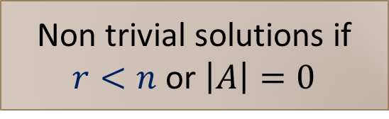
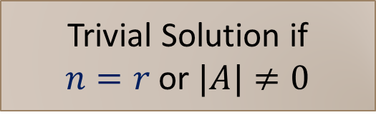
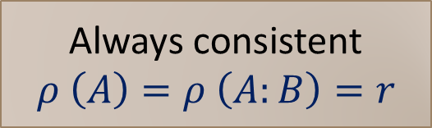
Condition for consistency of homogeneous Equations
Homogeneous System AX = B, n = unknowns
Always consistent $ρ \left(A\right)=ρ \left(A:B\right)=r$
Trivial Solution if
$n=r$ or $|A|≠0$
Non trivial solutions if $r<n$ or $\left|A\right|=0$
Lines are intersecting at origin only
Lines are overlapping to each others

Slide 7
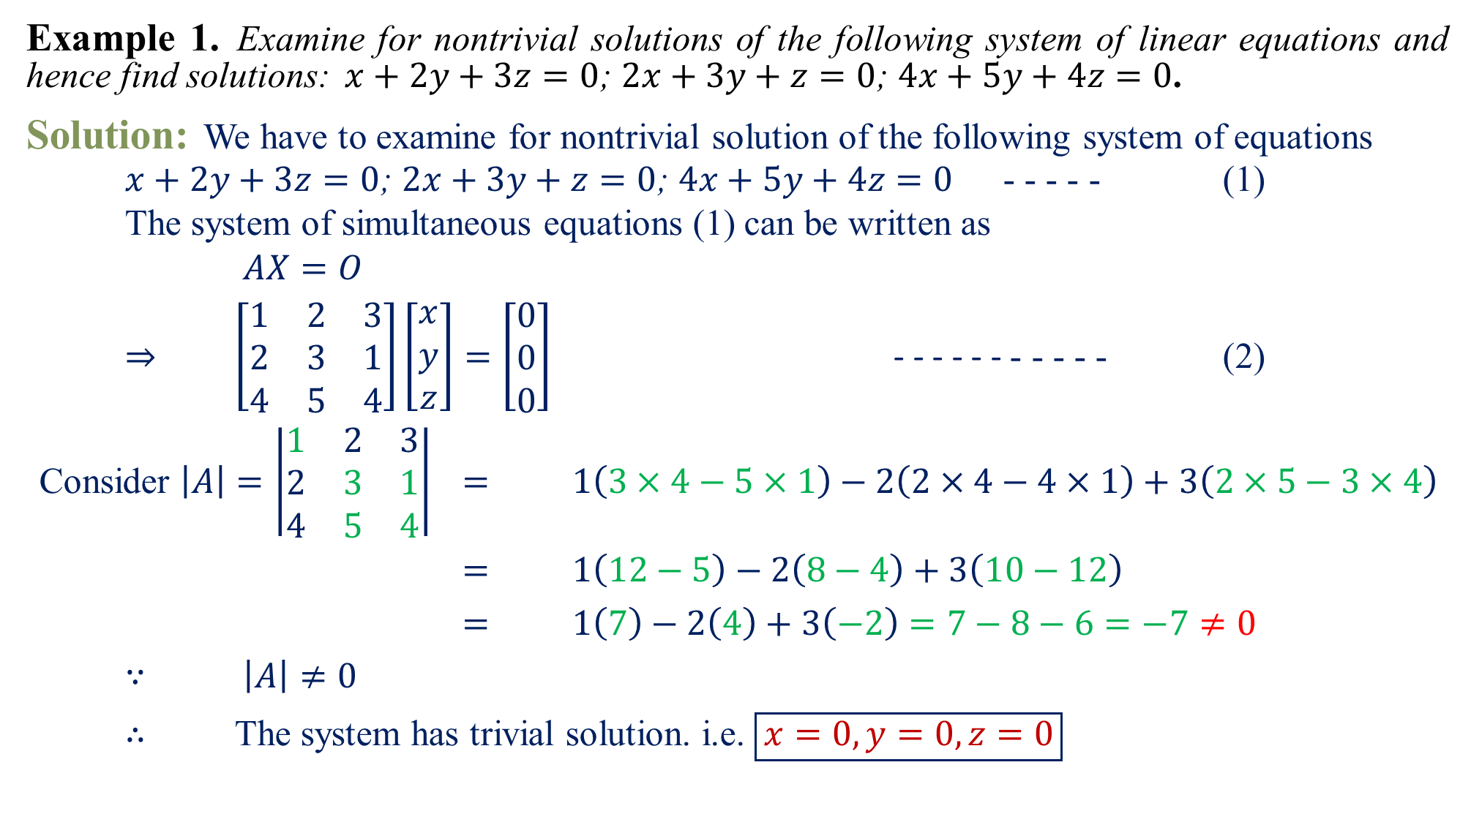
Example 1.Examine for nontrivial solutions of the following system of linear equations and hence find solutions:$x+2y+3z=0$; $2x+3y+z=0$; $4x+5y+4z=0$.
Solution:We have to examine for nontrivial solution of the following system of equations
$x+2y+3z=0$; $2x+3y+z=0$; $4x+5y+4z=0$ - - - - - (1)
The system of simultaneous equations (1) can be written as
$AX=O$
$⇒$$\left[\begin{matrix}1 & 2 & 3 \\ 2 & 3 & 1 \\ 4 & 5 & 4\end{matrix}\right]\left[\begin{matrix}x \\ y \\ z\end{matrix}\right]=\left[\begin{matrix}0 \\ 0 \\ 0\end{matrix}\right]$ - - - - - - - - - - - (2)
Consider$\left|A\right|=\left|\begin{matrix}1 & 2 & 3 \\ 2 & 3 & 1 \\ 4 & 5 & 4\end{matrix}\right|$$=$$1\left(3×4−5×1\right)−2\left(2×4−4×1\right)+3\left(2×5−3×4\right)$
$=$$1\left(12−5\right)−2\left(8−4\right)+3\left(10−12\right)$
$=$$1\left(7\right)−2\left(4\right)+3\left(−2\right)=7−8−6=−7≠0$
$∵$$\left|A\right|≠0$
$∴$ The system has trivial solution. i.e. $\boxed{x=0, y=0, z=0}$

Slide 8
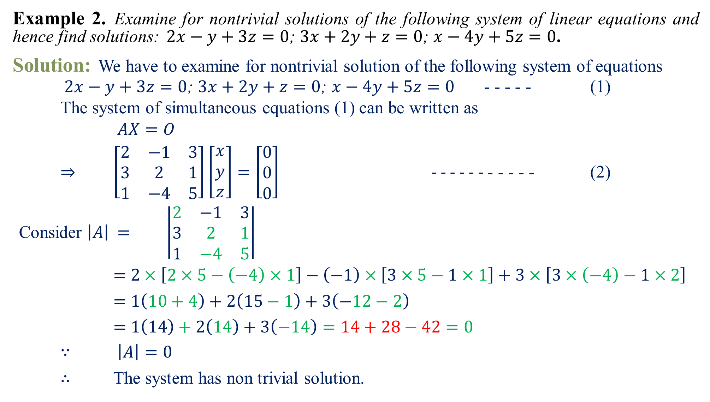
Example 2.Examine for nontrivial solutions of the following system of linear equations and hence find solutions:$2x−y+3z=0$; $3x+2y+z=0$; $x−4y+5z=0$.
Solution:We have to examine for nontrivial solution of the following system of equations
$2x−y+3z=0$; $3x+2y+z=0$; $x−4y+5z=0$ - - - - - (1)
The system of simultaneous equations (1) can be written as
$AX=O$
$⇒$$\left[\begin{matrix}2 & −1 & 3 \\ 3 & 2 & 1 \\ 1 & −4 & 5\end{matrix}\right]\left[\begin{matrix}x \\ y \\ z\end{matrix}\right]=\left[\begin{matrix}0 \\ 0 \\ 0\end{matrix}\right]$ - - - - - - - - - - - (2)
Consider$\left|A\right|$$=$$\left|\begin{matrix}2 & −1 & 3 \\ 3 & 2 & 1 \\ 1 & −4 & 5\end{matrix}\right|$
$=$$2×\left[2×5−\left(−4\right)×1\right]−\left(−1\right)×\left[3×5−1×1\right]+3×\left[3×\left(−4\right)−1×2\right]$
$=$$1\left(10+4\right)+2\left(15−1\right)+3\left(−12−2\right)$
$=$$1\left(14\right)+2\left(14\right)+3\left(−14\right)=14+28−42=0$
$∵$$\left|A\right|=0$
$∴$ The system has non trivial solution.
2
1
2
1

Slide 9
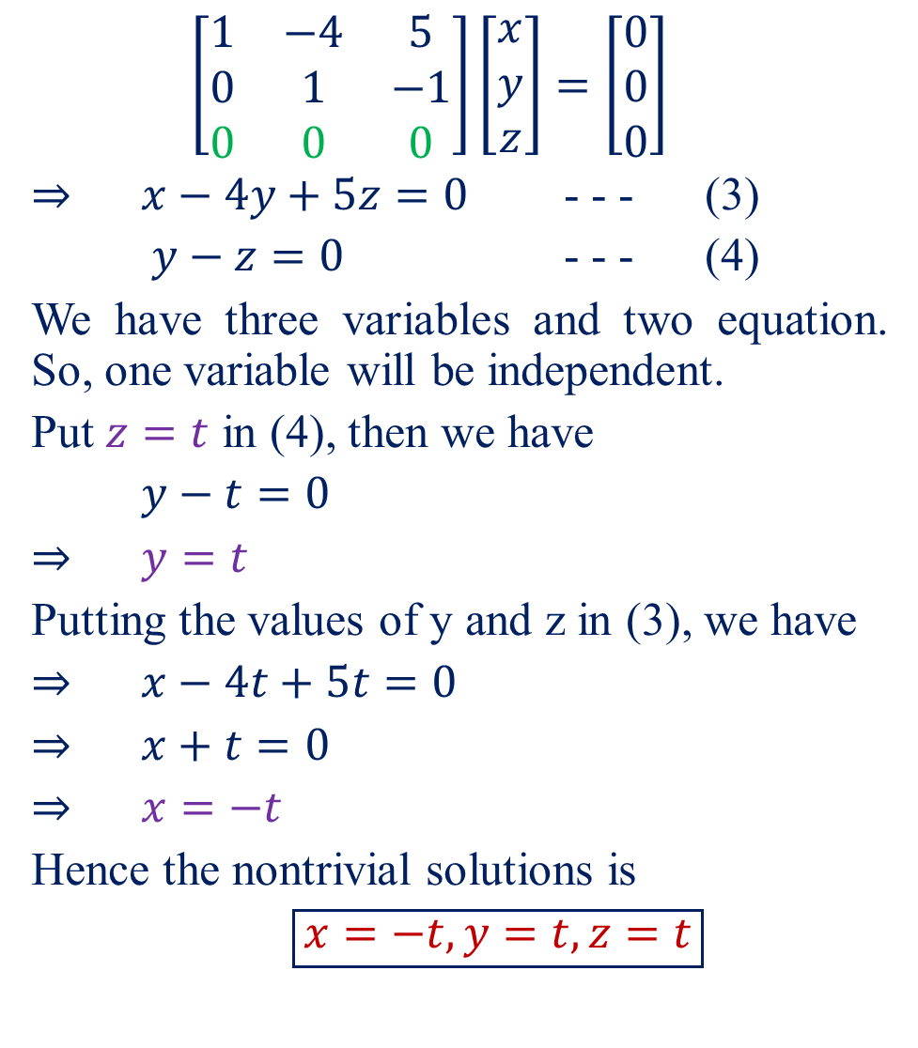
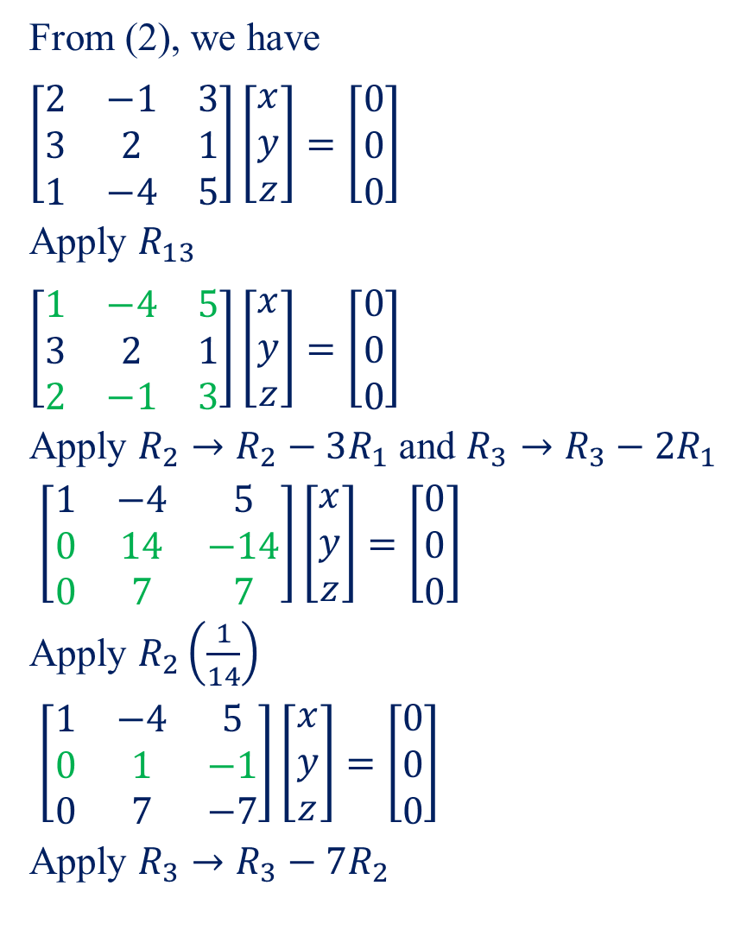
From (2), we have
$$\left[\begin{matrix}2 & −1 & 3 \\ 3 & 2 & 1 \\ 1 & −4 & 5\end{matrix}\right]\left[\begin{matrix}x \\ y \\ z\end{matrix}\right]=\left[\begin{matrix}0 \\ 0 \\ 0\end{matrix}\right]$$
Apply $R_{13}$
$$\left[\begin{matrix}1 & −4 & 5 \\ 3 & 2 & 1 \\ 2 & −1 & 3\end{matrix}\right]\left[\begin{matrix}x \\ y \\ z\end{matrix}\right]=\left[\begin{matrix}0 \\ 0 \\ 0\end{matrix}\right]$$
Apply $R_{2}→R_{2}−3R_{1}$ and $R_{3}→R_{3}−2R_{1}$
$\left[\begin{matrix}1 & −4 & 5 \\ 0 & 14 & −14 \\ 0 & 7 & 7\end{matrix}\right]\left[\begin{matrix}x \\ y \\ z\end{matrix}\right]=\left[\begin{matrix}0 \\ 0 \\ 0\end{matrix}\right]$
Apply $R_{2}\left(\frac{1}{14}\right)$
$\left[\begin{matrix}1 & −4 & 5 \\ 0 & 1 & −1 \\ 0 & 7 & −7\end{matrix}\right]\left[\begin{matrix}x \\ y \\ z\end{matrix}\right]=\left[\begin{matrix}0 \\ 0 \\ 0\end{matrix}\right]$
Apply $R_{3}→R_{3}−7R_{2}$
$$\left[\begin{matrix}1 & −4 & 5 \\ 0 & 1 & −1 \\ 0 & 0 & 0\end{matrix}\right]\left[\begin{matrix}x \\ y \\ z\end{matrix}\right]=\left[\begin{matrix}0 \\ 0 \\ 0\end{matrix}\right]$$
$⇒$$x−4y+5z=0$ - - - (3)
$y−z=0$ - - - (4)
We have three variables and two equation. So, one variable will be independent.
Put $z=t$in (4), then we have
$y−t=0$
$⇒$$y=t$
Putting the values of y and z in (3), we have
$⇒$$x−4t+5t=0$
$⇒$$x+t=0$
$⇒$$x=−t$
Hence the nontrivial solutions is
$\boxed{x=−t, y=t, z=t}$
-

Slide 10
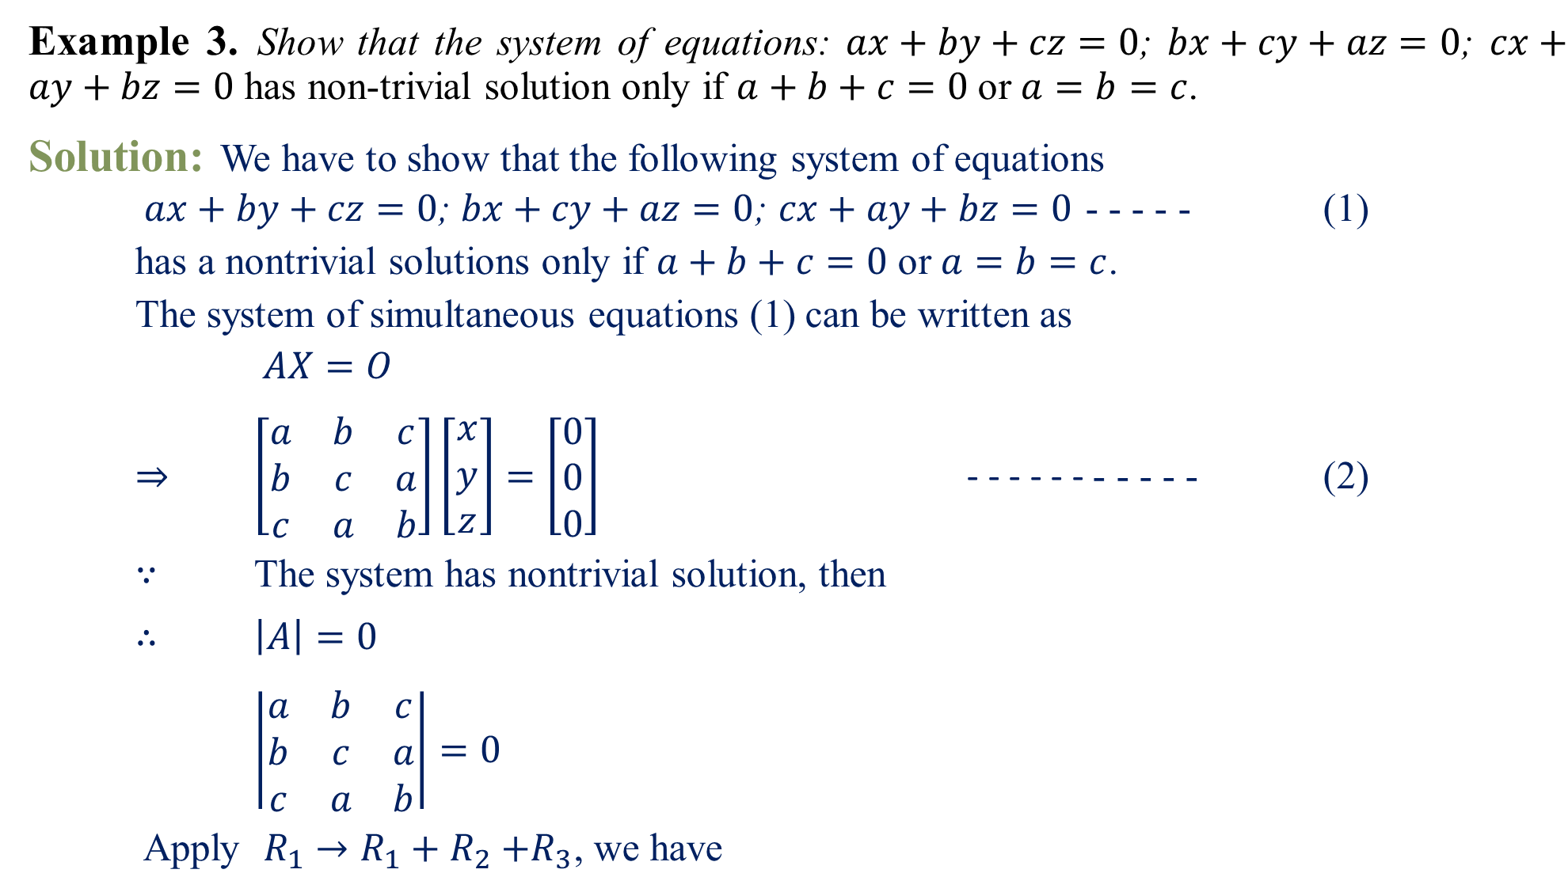
Example 3.Show that the system of equations: $ax+by+cz=0$; $bx+cy+az=0$; $cx+ay+bz=0$ has non-trivial solution only if $a+b+c=0$ or $a=b=c$.
Solution:We have to show that the following system of equations
$ax+by+cz=0$; $bx+cy+az=0$; $cx+ay+bz=0$ - - - - - (1)
has a nontrivial solutions only if $a+b+c=0$ or $a=b=c$.
The system of simultaneous equations (1) can be written as
$AX=O$
$⇒$$\left[\begin{matrix}a & b & c \\ b & c & a \\ c & a & b\end{matrix}\right]\left[\begin{matrix}x \\ y \\ z\end{matrix}\right]=\left[\begin{matrix}0 \\ 0 \\ 0\end{matrix}\right]$ - - - - - - - - - - - (2)
$∵$ The system has nontrivial solution, then
$∴$$\left|A\right|=0$
$\left|\begin{matrix}a & b & c \\ b & c & a \\ c & a & b\end{matrix}\right|=0$
Apply $R_{1}→R_{1}+R_{2}{+R}_{3}$, we have

Slide 11
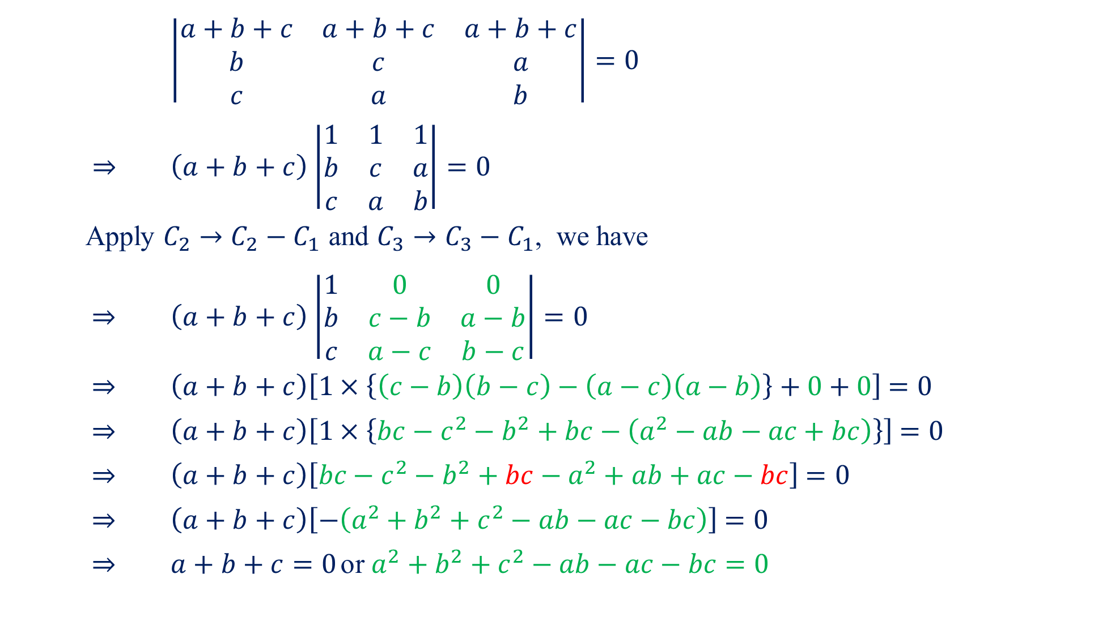
$\left|\begin{matrix}a+b+c & a+b+c & a+b+c \\ b & c & a \\ c & a & b\end{matrix}\right|=0$
$⇒$$\left(a+b+c\right)$$\left|\begin{matrix}1 & 1 & 1 \\ b & c & a \\ c & a & b\end{matrix}\right|=0$
Apply $C_{2}→C_{2}−C_{1}$ and $C_{3}→C_{3}−C_{1}$, we have
$⇒$$\left(a+b+c\right)$$\left|\begin{matrix}1 & 0 & 0 \\ b & c−b & a−b \\ c & a−c & b−c\end{matrix}\right|=0$
$⇒$$\left(a+b+c\right)\left[1×\left\{\left(c−b\right)\left(b−c\right)−\left(a−c\right)\left(a−b\right)\right\}+0+0\right]$$=0$
$⇒$$\left(a+b+c\right)\left[1×\left\{bc−c^{2}−b^{2}+bc−\left(a^{2}−ab−ac+bc\right)\right\}\right]$$=0$
$⇒$$\left(a+b+c\right)\left[bc−c^{2}−b^{2}+bc−a^{2}+ab+ac−bc\right]$$=0$
$⇒$$\left(a+b+c\right)\left[−\left(a^{2}+b^{2}+c^{2}−ab−ac−bc\right)\right]$$=0$
$⇒$$a+b+c=0$ or $a^{2}+b^{2}+c^{2}−ab−ac−bc=0$

Slide 12
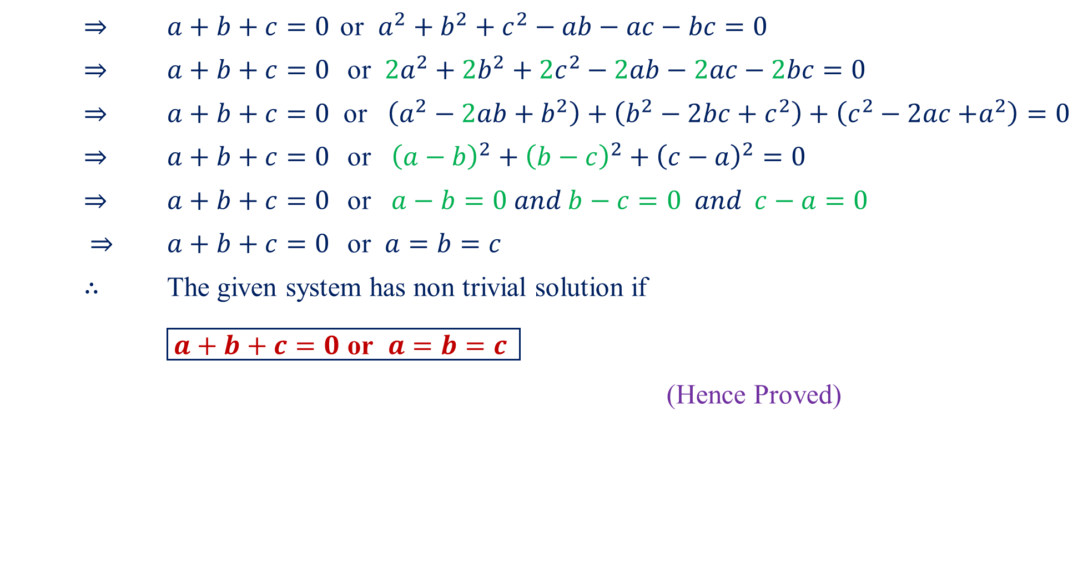
$⇒$$a+b+c=0$ or $a^{2}+b^{2}+c^{2}−ab−ac−bc=0$
$⇒$$a+b+c=0$ or ${2a}^{2}+{2b}^{2}+2c^{2}−2ab−2ac−2bc=0$
$⇒$$a+b+c=0$ or $\left(a^{2}−2ab+b^{2}\right)+\left(b^{2}−2bc+c^{2}\right)+\left(c^{2}−2ac{+a}^{2}\right)=0$
$⇒$$a+b+c=0$ or ${\left(a−b\right)}^{2}+{\left(b−c\right)}^{2}+{\left(c−a\right)}^{2}=0$
$⇒$$a+b+c=0$ or $a−b=0 and b−c=0 and c−a=0$
$⇒$$a+b+c=0$ or $a=b=c$
$∴$ The given system has non trivial solution if
$\boxed{a+b+c=0 \text{or} a=b=c }$
(Hence Proved)

Slide 13

Home Assignment
Check whether the following system of linear equations have non trivial solutions or not. If yes, then solve them.
$x+2y+3z=0; 2x+3y+z=0; 4x+5y+4z=0; x+y−2z=0.$
$\left[Ans:x=0, y=0, z=0\right]$
$5x+2y−3z=0; 3x+y+z=0; 2x+y+6z=0$. $\left[Ans:x=0, y=0, z=0\right]$
$x+3y+z=0; 2x−2y−6z=0; 3x+y−5z=0$. $\left[Ans:x=2t, y=−t, z=t\right]$
$4x_{1}−x_{2}+2x_{3}+x_{4}=0;{2x}_{1}+3x_{2}−x_{3}−2x_{4}=0;{7x}_{2}−4x_{3}−5x_{4}=0;2x_{1}−{11x}_{2}+7x_{3}+8x_{4}=0.$$\left[Ans:x=\frac{−a−5b}{14},y=\frac{5a+4b}{7}, z=b, t=a\right]$
For different values of k, discuss the nature of solution of the following equations:
$x+2y−z=0; 3x+\left(k+7\right)y−3z=0; 2x+4y+\left(k−3\right)z=0$.
$\left[Ans:For k=1, x=t, y=0, z=t,for k=−1, x=−2t, y=t, z=0\right]$
Show that the system of equations $x_{1}+2x_{2}+3x_{3}=λx_{1}; {3x}_{1}+x_{2}+2x_{3}=λx_{2};{2x}_{1}+3x_{2}+x_{3}=λx_{3}$can possess a non-trivial solution only $λ=6$. Obtain the general solution for real values of $λ$. $\left[Ans:For λ=6, x=t, y=t, z=t\right]$

Slide 14
Questions?
Thanks

