Slide 1
Linear Algebra and Calculus
Unit-I: Matrices
Introduction of Matrix
Rank of a Matrix
Canonical Form of a Matrix (Echelon Form)
Normal Form of a Matrix
System of Linear Equations
Orthogonal Transformations
Eigen Values and Eigen Vectors
Diagonalization of Matrices
Cayley Hamilton Theorem
Applications to problems in Engineering

Slide 2
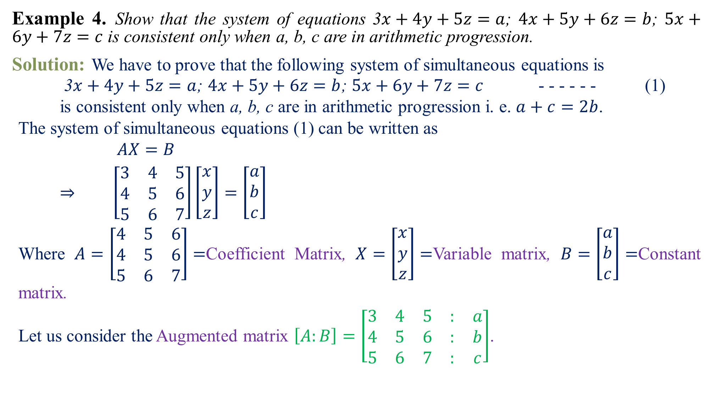
Example 4.Show that the system of equations 3$x+4y+5z=a$; $4x+5y+6z=b$; $5x+6y+7z=c$ is consistent only when a, b, c are in arithmetic progression.
Solution:We have to prove that the following system of simultaneous equations is
3$x+4y+5z=a$; $4x+5y+6z=b$; $5x+6y+7z=c$ - - - - - - (1)
is consistent only when a, b, c are in arithmetic progression i. e. $a+c=2b$.
The system of simultaneous equations (1) can be written as
$AX=B$
$⇒$$\left[\begin{matrix}3 & 4 & 5 \\ 4 & 5 & 6 \\ 5 & 6 & 7\end{matrix}\right]\left[\begin{matrix}x \\ y \\ z\end{matrix}\right]=\left[\begin{matrix}a \\ b \\ c\end{matrix}\right]$
Where$A=\left[\begin{matrix}4 & 5 & 6 \\ 4 & 5 & 6 \\ 5 & 6 & 7\end{matrix}\right]=$Coefficient Matrix, $X=\left[\begin{matrix}x \\ y \\ z\end{matrix}\right]=$Variable matrix, $B=\left[\begin{matrix}a \\ b \\ c\end{matrix}\right]=$Constant matrix.
Let us consider the Augmented matrix $\left[A:B\right]=\left[\begin{matrix}3 & 4 & 5 & : & a \\ 4 & 5 & 6 & : & b \\ 5 & 6 & 7 & : & c\end{matrix}\right]$.
3
4
5

Slide 3
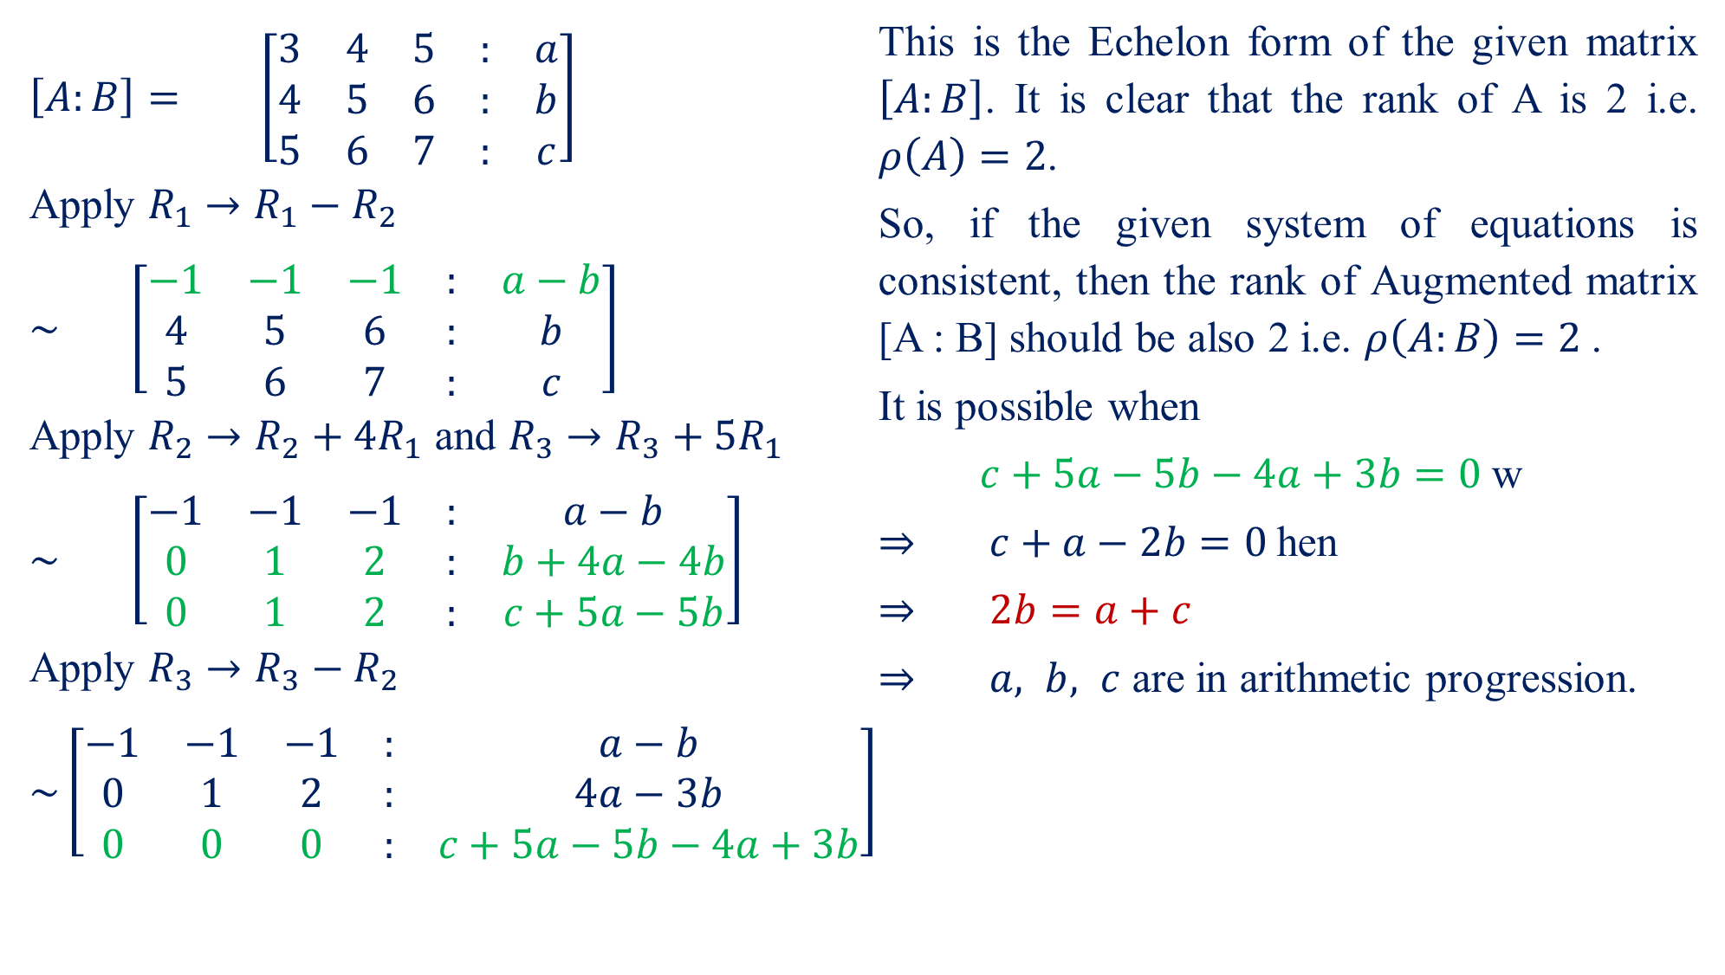
$\left[A:B\right]=$$\left[\begin{matrix}3 & 4 & 5 & : & a \\ 4 & 5 & 6 & : & b \\ 5 & 6 & 7 & : & c\end{matrix}\right]$
Apply $R_{1}→R_{1}−R_{2}$
$\sim$$\left[\begin{matrix}−1 & −1 & −1 & : & a−b \\ 4 & 5 & 6 & : & b \\ 5 & 6 & 7 & : & c\end{matrix}\right]$
Apply $R_{2}→R_{2}+4R_{1}$ and $R_{3}→R_{3}+5R_{1}$
$\sim$$\left[\begin{matrix}−1 & −1 & −1 & : & a−b \\ 0 & 1 & 2 & : & b+4a−4b \\ 0 & 1 & 2 & : & c+5a−5b\end{matrix}\right]$
Apply $R_{3}→R_{3}−R_{2}$
$\sim \left[\begin{matrix}−1 & −1 & −1 & : & a−b \\ 0 & 1 & 2 & : & 4a−3b \\ 0 & 0 & 0 & : & c+5a−5b−4a+3b\end{matrix}\right]$
This is the Echelon form of the given matrix $\left[A:B\right]$. It is clear that the rank of A is 2 i.e. $ρ\left(A\right)=2$.
So, if the given system of equations is consistent, then the rank of Augmented matrix [A : B] should be also 2 i.e. $ρ\left(A:B\right)=2$.
It is possible when
$c+5a−5b−4a+3b=0$w
$⇒$$c+a−2b=0$hen
$⇒$$2b=a+c$
$⇒$$a, b, c$ are in arithmetic progression.

Slide 4
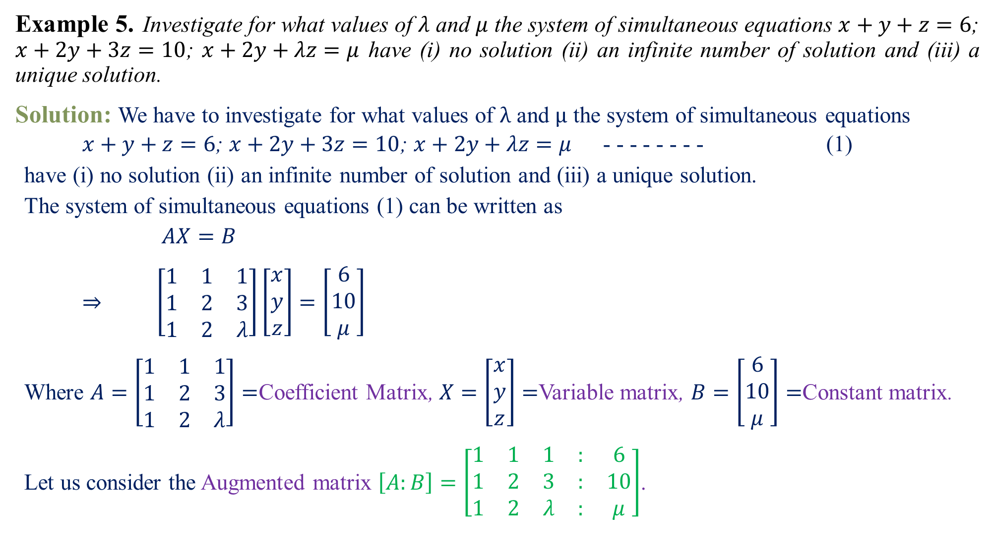
Example 5.Investigate for what values of $λ$ and $μ$ the system of simultaneous equations $x+y+z=6$; $x+2y+3z=10$; $x+2y+λz=μ$ have (i) no solution (ii) an infinite number of solution and (iii) a unique solution.
Solution:We have to investigate for what values of $λ$ and $μ$ the system of simultaneous equations
$x+y+z=6$; $x+2y+3z=10$; $x+2y+λz=μ$ - - - - - - - - (1)
have (i) no solution (ii) an infinite number of solution and (iii) a unique solution.
The system of simultaneous equations (1) can be written as
$AX=B$
$⇒$$\left[\begin{matrix}1 & 1 & 1 \\ 1 & 2 & 3 \\ 1 & 2 & λ\end{matrix}\right]\left[\begin{matrix}x \\ y \\ z\end{matrix}\right]=\left[\begin{matrix}6 \\ 10 \\ μ\end{matrix}\right]$
Where$A=\left[\begin{matrix}1 & 1 & 1 \\ 1 & 2 & 3 \\ 1 & 2 & λ\end{matrix}\right]=$Coefficient Matrix, $X=\left[\begin{matrix}x \\ y \\ z\end{matrix}\right]=$Variable matrix, $B=\left[\begin{matrix}6 \\ 10 \\ μ\end{matrix}\right]=$Constant matrix.
Let us consider the Augmented matrix $\left[A:B\right]=\left[\begin{matrix}1 & 1 & 1 & : & 6 \\ 1 & 2 & 3 & : & 10 \\ 1 & 2 & λ & : & μ\end{matrix}\right]$.

Slide 5
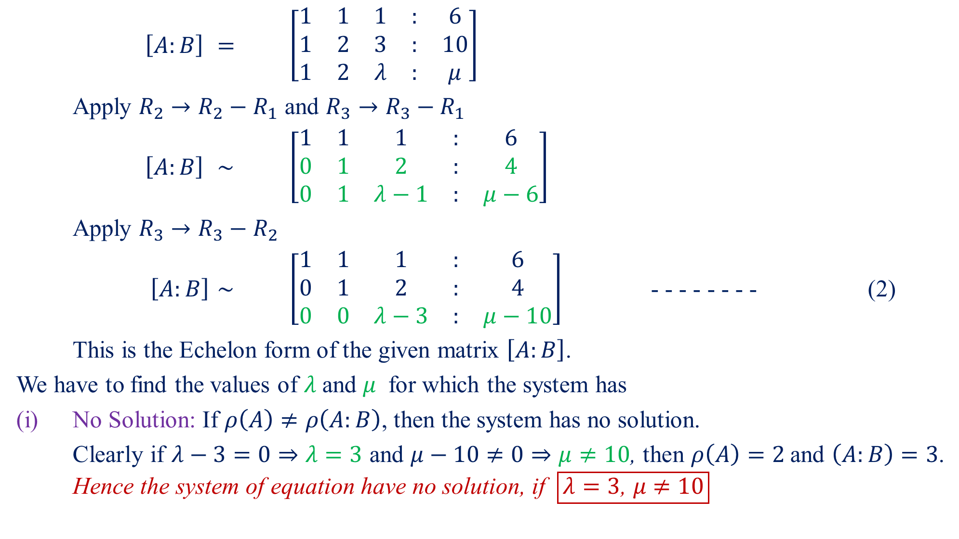
$\left[A:B\right]$$=$$\left[\begin{matrix}1 & 1 & 1 & : & 6 \\ 1 & 2 & 3 & : & 10 \\ 1 & 2 & λ & : & μ\end{matrix}\right]$
Apply $R_{2}→R_{2}−R_{1}$ and $R_{3}→R_{3}−R_{1}$
$\left[A:B\right]$$\sim$$\left[\begin{matrix}1 & 1 & 1 & : & 6 \\ 0 & 1 & 2 & : & 4 \\ 0 & 1 & λ−1 & : & μ−6\end{matrix}\right]$
Apply $R_{3}→R_{3}−R_{2}$
$\left[A:B\right]$$\sim$$\left[\begin{matrix}1 & 1 & 1 & : & 6 \\ 0 & 1 & 2 & : & 4 \\ 0 & 0 & λ−3 & : & μ−10\end{matrix}\right]$- - - - - - - - (2)
This is the Echelon form of the given matrix $\left[A:B\right]$.
We have to find the values of $λ$and $μ$ for which the system has
(i) No Solution: If $ρ\left(A\right)≠ρ\left(A:B\right)$, then the system has no solution.
Clearly if$λ−3=0⇒λ=3$ and$μ−10≠0⇒μ≠10$, then $ρ\left(A\right)=2$and $\left(A:B\right)=3$. Hence the system of equation have no solution, if $\boxed{λ=3\text{, }μ≠10}$

Slide 6
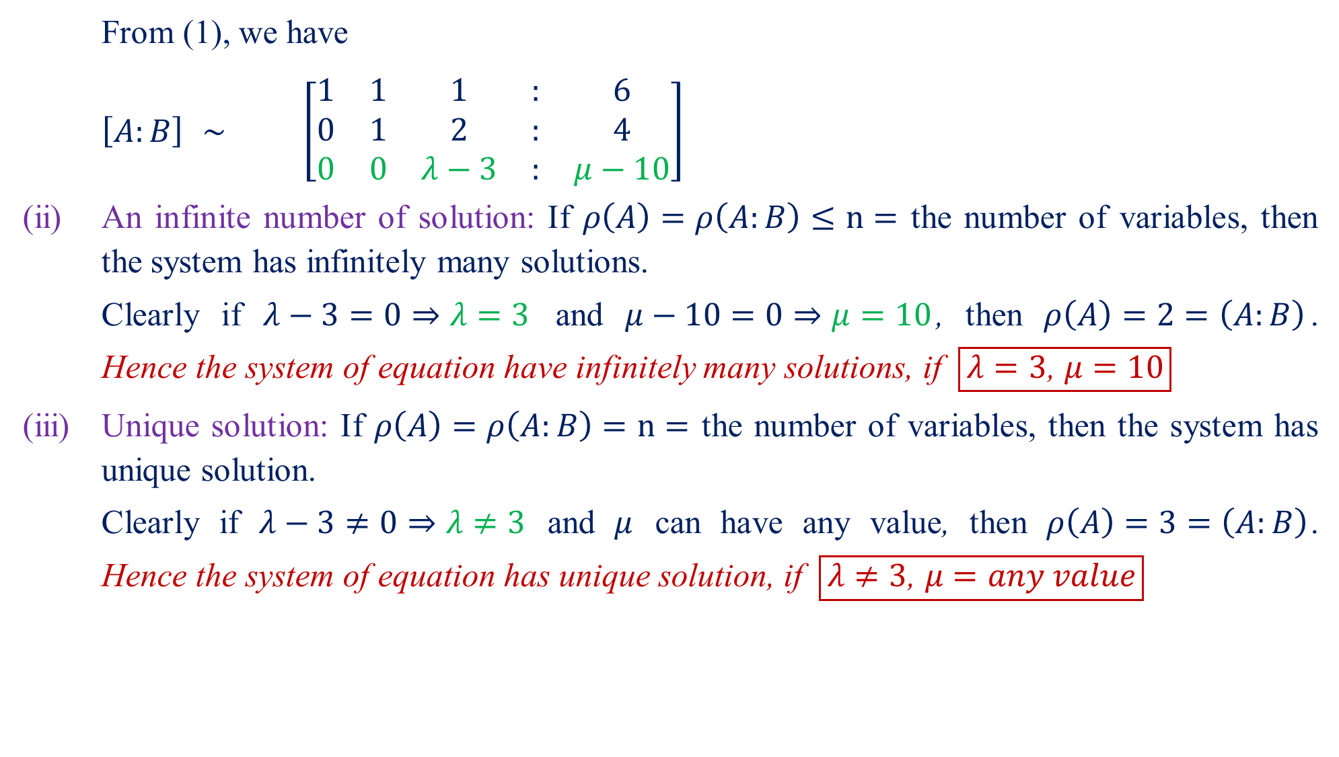
From (1), we have
$\left[A:B\right]$$\sim$$\left[\begin{matrix}1 & 1 & 1 & : & 6 \\ 0 & 1 & 2 & : & 4 \\ 0 & 0 & λ−3 & : & μ−10\end{matrix}\right]$
(ii) An infinite number of solution: If $ρ\left(A\right)=ρ\left(A:B\right)≤n=$ the number of variables, then the system has infinitely many solutions.
Clearly if$λ−3=0⇒λ=3$ and$μ−10=0⇒μ=10$, then $ρ\left(A\right)=2=\left(A:B\right)$. Hence the system of equation have infinitely many solutions, if $\boxed{λ=3\text{, }μ=10}$
(iii) Unique solution: If $ρ\left(A\right)=ρ\left(A:B\right)=n=$ the number of variables, then the system has unique solution.
Clearly if$λ−3≠0⇒λ≠3$ and$μ$can have any value, then $ρ\left(A\right)=3=\left(A:B\right)$. Hence the system of equation has unique solution, if $\boxed{λ≠3\text{, }μ=any value}$

Slide 7

Home Assignment
Solve the following problems of system of linear equations.
Use matrix method to determine the values of $λ$for which the equations $x+2y+z=3; x+y+z=λ; 3x+y+3z=λ^{2}$are consistent and solve them for these values of$λ$. $\left[Ans:λ=2, 3;for λ=2, x=1−t, y=1, z=t;for λ=3, x=3−t, y=0, z=t\right]$
Investigate for what values of $λ$ and $μ$ the system of equations $2x+3y+5z=9$; $7x+3y−2z=8$; $2x+3y+λz=μ$ have (i) no solution (ii) an infinite number of solution and (iii) a unique solution. $\left[Ans:\left(i\right) λ=5, μ≠9,\left(ii\right) λ=5, μ=9,\left(iii\right) λ≠5, μ=any values\right]$
Investigate for what values of $a$ and $b$ the system of equations $2x−y+3z=2$; $x+y+2z=2$; $5x−y+az=b$ have (i) no solution (ii) an infinite number of solution and (iii) a unique solution. $\left[Ans:\left(i\right) a=8, b≠6,\left(ii\right) a=8, b=6,\left(iii\right) a≠8, b=any values\right]$
Show that the system of equations 3$x+4y+5z=α; 4x+5y+6z=β$; $5x+6y+7z=γ$ is consistent only when $α+γ=2β$.
Investigate for what values of $k$ the equations $x+y+z=1$; $2x+y+4z=k$; $4x+y+10z=k^{2}$ have an infinite number of solution? Hence find the solutions. $\left[ k=1, 2\right]$

Slide 8
Questions?
Thanks

