Slide 1
Linear Algebra and Calculus
Unit-I: Matrices
Introduction of Matrix
Rank of a Matrix
Canonical Form of a Matrix (Echelon Form)
Normal Form of a Matrix
System of Linear Equations
Linear and Orthogonal Transformations
Eigen Values and Eigen Vectors
Diagonalization of Matrices
Cayley Hamilton Theorem
Applications to problems in Engineering

Slide 2

Orthogonal Transformation
The linear transformation $Y=AX$ i.e.
$\left[\begin{matrix}y_{1} \\ y_{2} \\ y_{3} \\ ⋮ \\ y_{n}\end{matrix}\right]=\left[\begin{matrix}a_{11} & a_{12} & a_{13} & … & a_{1n} \\ a_{21} & a_{22} & a_{23} & … & a_{2n} \\ a_{31} & a_{32} & a_{33} & … & a_{3n} \\ ⋮ & ⋮ & ⋮ & … & ⋮ \\ a_{n1} & a_{n2} & a_{n3} & … & a_{nn}\end{matrix}\right]$$\left[\begin{matrix}x_{1} \\ x_{2} \\ x_{3} \\ ⋮ \\ x_{n}\end{matrix}\right]$
is said to be orthogonal, if it transforms $x_{1}^{2}+x_{2}^{2}+…+x_{n}^{2}$ into $y_{1}^{2}+y_{2}^{2}+…+y_{n}^{2}$.
Orthogonal Matrix
A matrix ‘A’ is said to be orthogonal, if $AA^{T}=A^{T}A=I$.
Properties of Orthogonal Transformation
If A is orthogonal then $A^{−1}=A^{T}$.
If A is orthogonal then$\left|A\right|=±1$.
If A is orthogonal then $A^{−1}$and $A^{T}$is also orthogonal.

Slide 3
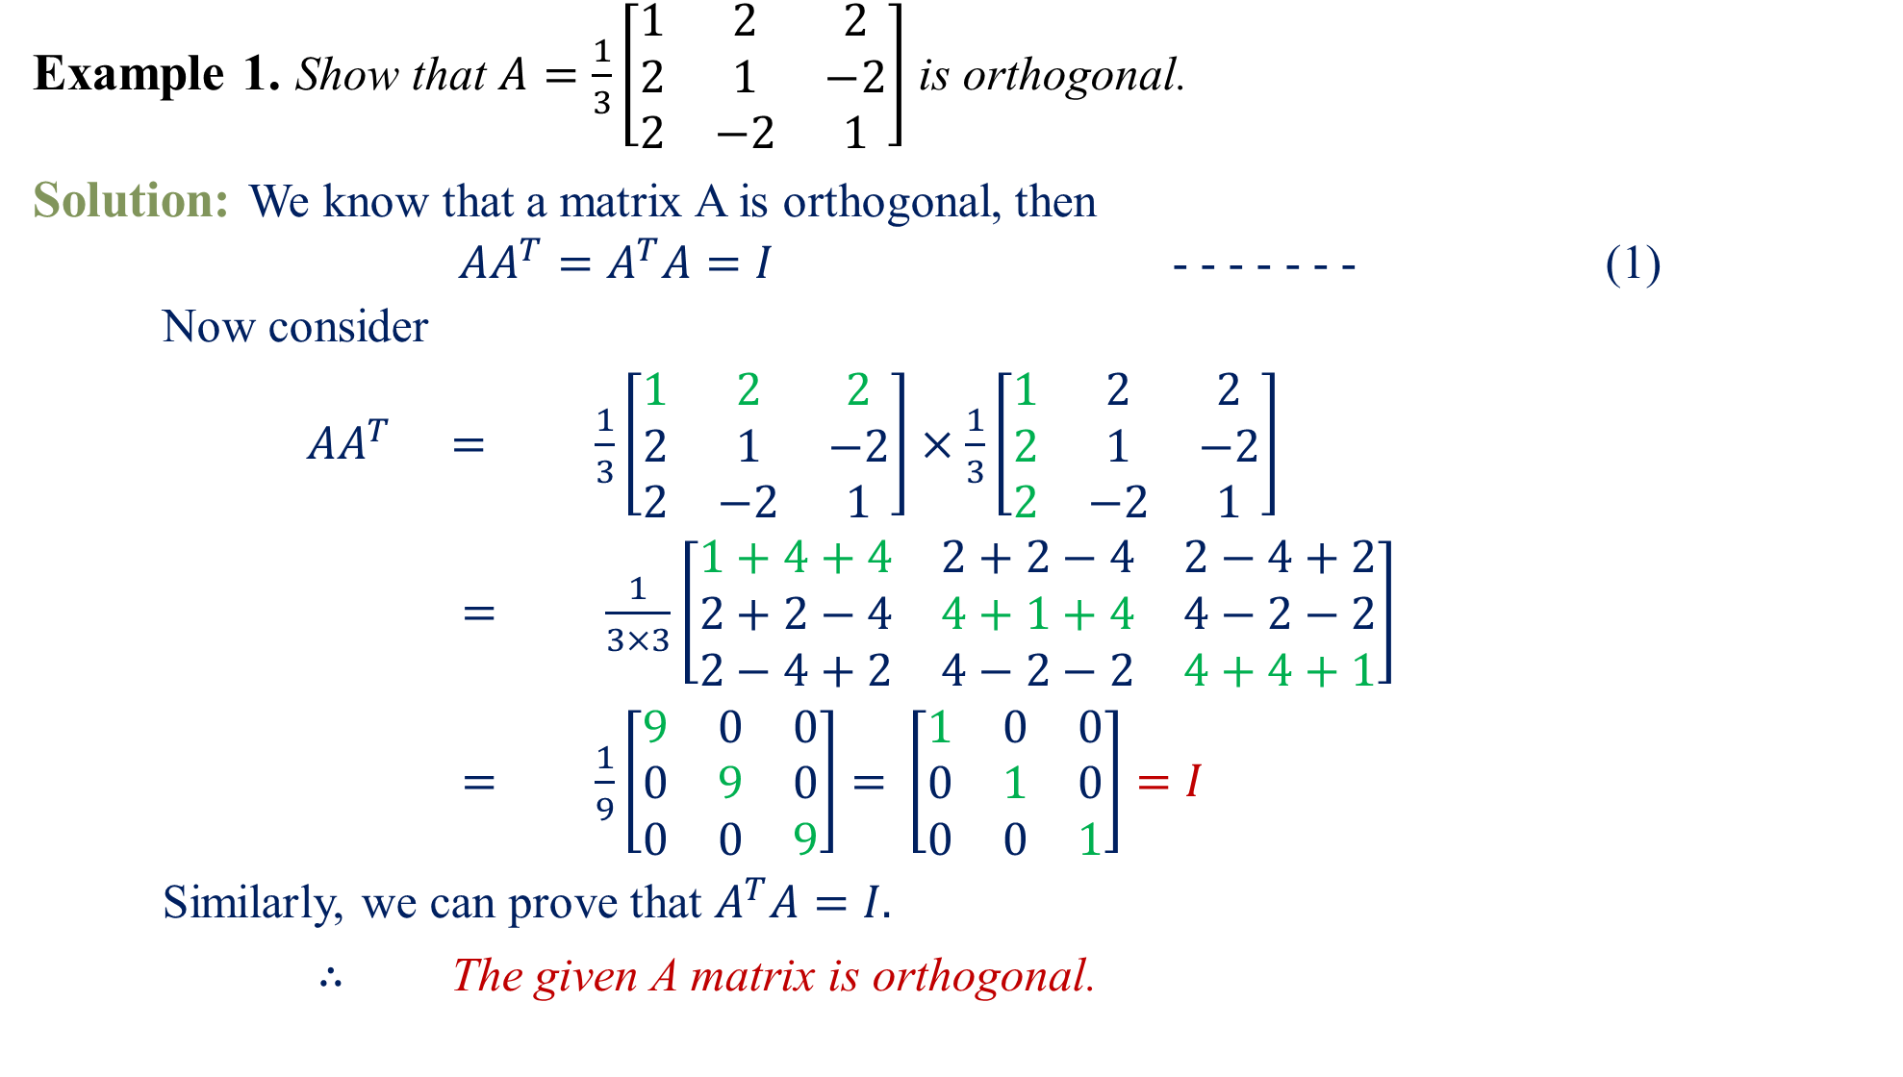
Example 1.Show that $A=\frac{1}{3}\left[\begin{matrix}1 & 2 & 2 \\ 2 & 1 & −2 \\ 2 & −2 & 1\end{matrix}\right]$ is orthogonal.
Solution:We know that a matrix A is orthogonal, then
$AA^{T}=A^{T}A=I$ - - - - - - - (1)
Now consider
$AA^{T}$$=$$\frac{1}{3}\left[\begin{matrix}1 & 2 & 2 \\ 2 & 1 & −2 \\ 2 & −2 & 1\end{matrix}\right]$$×$$\frac{1}{3}\left[\begin{matrix}1 & 2 & 2 \\ 2 & 1 & −2 \\ 2 & −2 & 1\end{matrix}\right]$
$=$$\frac{1}{3×3}\left[\begin{matrix}1+4+4 & 2+2−4 & 2−4+2 \\ 2+2−4 & 4+1+4 & 4−2−2 \\ 2−4+2 & 4−2−2 & 4+4+1\end{matrix}\right]$
$=$$\frac{1}{9}\left[\begin{matrix}9 & 0 & 0 \\ 0 & 9 & 0 \\ 0 & 0 & 9\end{matrix}\right]=\left[\begin{matrix}1 & 0 & 0 \\ 0 & 1 & 0 \\ 0 & 0 & 1\end{matrix}\right]=I$
Similarly, we can prove that $A^{T}A=I.$
$∴$ The given A matrix is orthogonal.

Slide 4
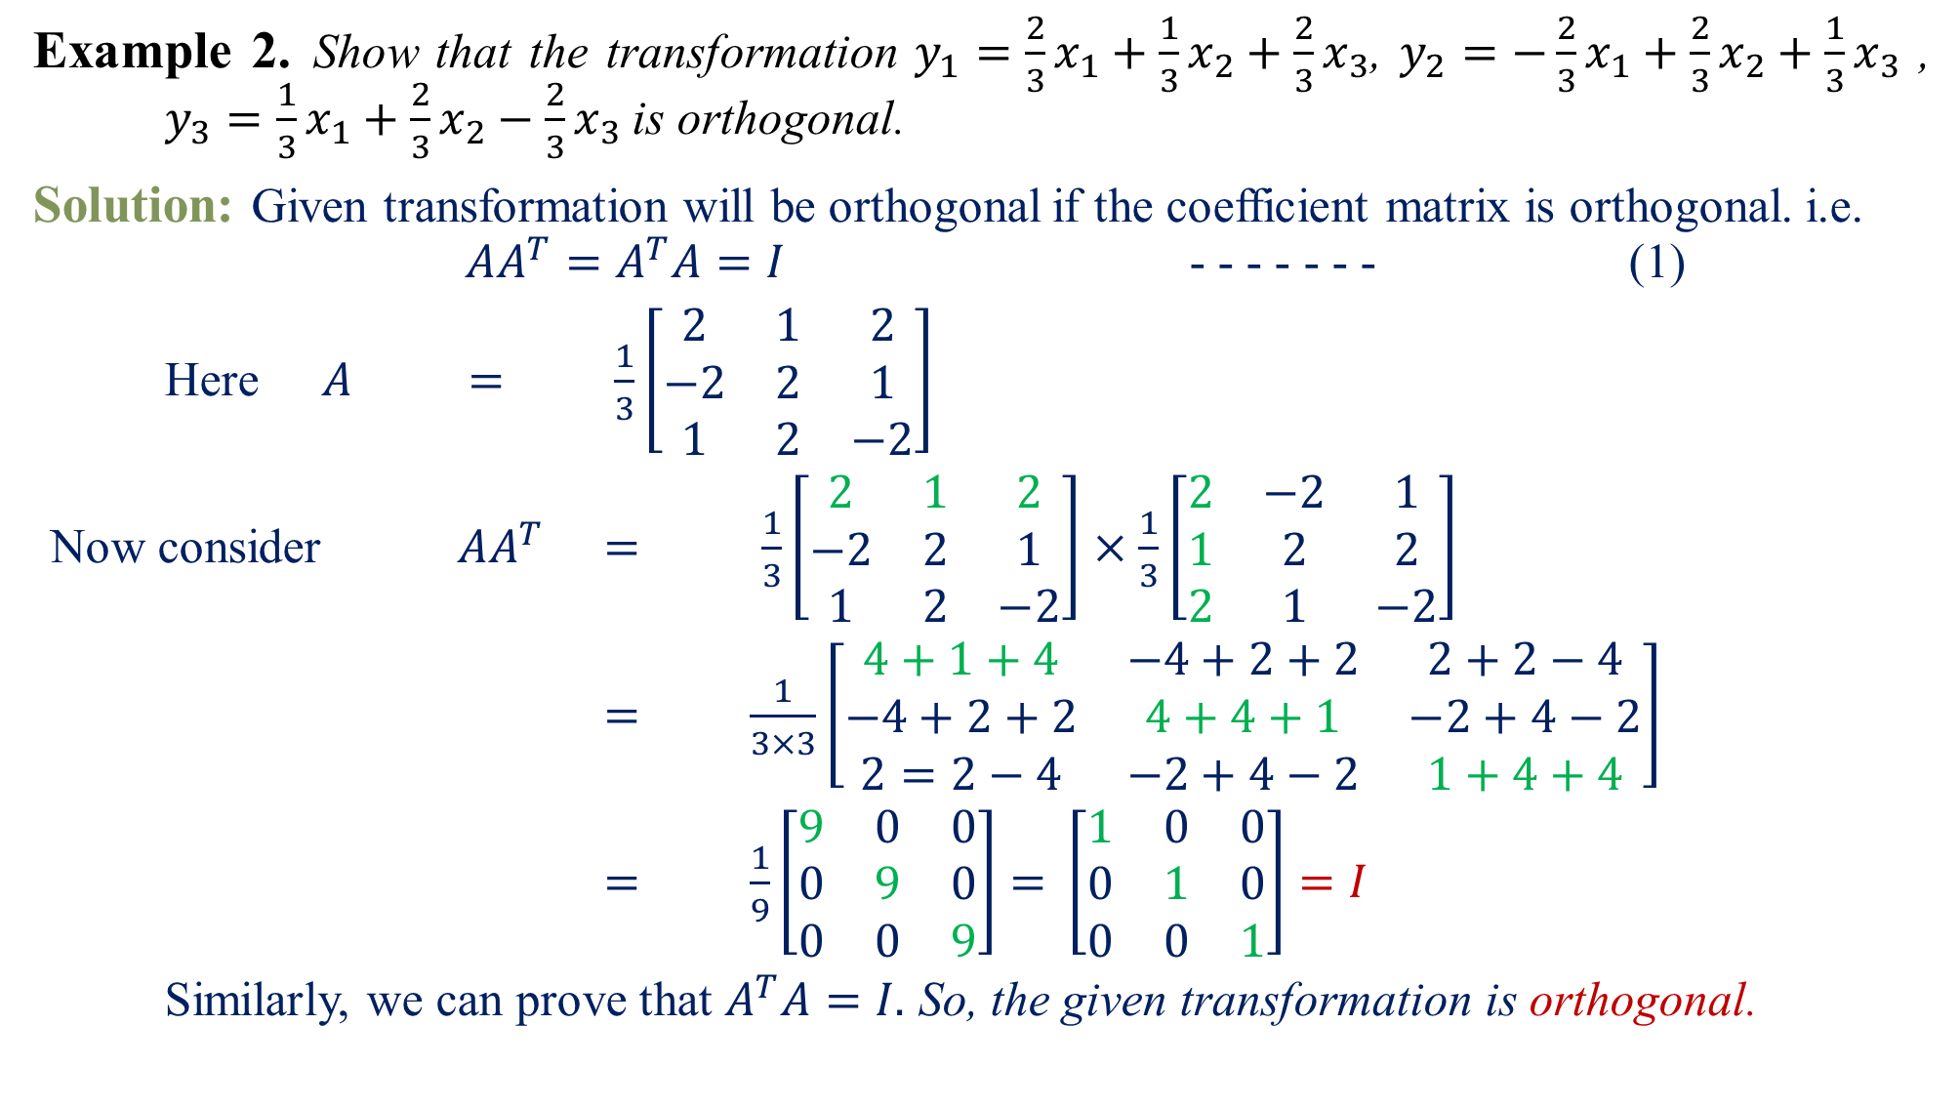
Example 2.Show that the transformation $y_{1}=\frac{2}{3}x_{1}+\frac{1}{3}x_{2}+\frac{2}{3}x_{3}$, $y_{2}=−\frac{2}{3}x_{1}+\frac{2}{3}x_{2}+\frac{1}{3}x_{3}$ , $y_{3}=\frac{1}{3}x_{1}+\frac{2}{3}x_{2}−\frac{2}{3}x_{3}$is orthogonal.
Solution:Given transformation will be orthogonal if the coefficient matrix is orthogonal. i.e.
$AA^{T}=A^{T}A=I$ - - - - - - - (1)
Here $A$$=$$\frac{1}{3}\left[\begin{matrix}2 & 1 & 2 \\ −2 & 2 & 1 \\ 1 & 2 & −2\end{matrix}\right]$
Now consider $AA^{T}$$=$$\frac{1}{3}\left[\begin{matrix}2 & 1 & 2 \\ −2 & 2 & 1 \\ 1 & 2 & −2\end{matrix}\right]$$×$$\frac{1}{3}\left[\begin{matrix}2 & −2 & 1 \\ 1 & 2 & 2 \\ 2 & 1 & −2\end{matrix}\right]$
$=$$\frac{1}{3×3}\left[\begin{matrix}4+1+4 & −4+2+2 & 2+2−4 \\ −4+2+2 & 4+4+1 & −2+4−2 \\ 2=2−4 & −2+4−2 & 1+4+4\end{matrix}\right]$
$=$$\frac{1}{9}\left[\begin{matrix}9 & 0 & 0 \\ 0 & 9 & 0 \\ 0 & 0 & 9\end{matrix}\right]=\left[\begin{matrix}1 & 0 & 0 \\ 0 & 1 & 0 \\ 0 & 0 & 1\end{matrix}\right]=I$
Similarly, we can prove that $A^{T}A=I.$So, the given transformation is orthogonal.
+

Slide 5
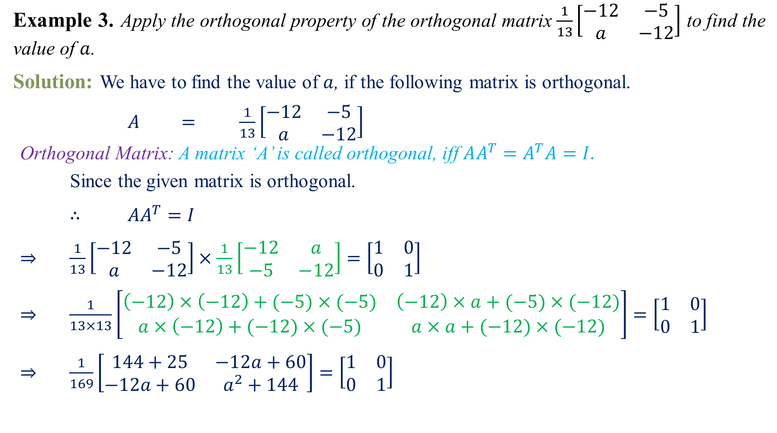
Example 3.Apply the orthogonal property of the orthogonal matrix $\frac{1}{13}\left[\begin{matrix}−12 & −5 \\ a & −12\end{matrix}\right]$ to find the value of $a$.
Solution:We have to find the value of $a$, if the following matrix is orthogonal.
$A$$=$$\frac{1}{13}\left[\begin{matrix}−12 & −5 \\ a & −12\end{matrix}\right]$
Orthogonal Matrix: A matrix ‘A’ is called orthogonal, iff $AA^{T}=A^{T}A=I.$
Since the given matrix is orthogonal.
$∴$$AA^{T}=I$
$⇒$$\frac{1}{13}\left[\begin{matrix}−12 & −5 \\ a & −12\end{matrix}\right]×\frac{1}{13}\left[\begin{matrix}−12 & a \\ −5 & −12\end{matrix}\right]=\left[\begin{matrix}1 & 0 \\ 0 & 1\end{matrix}\right]$
$⇒$$\frac{1}{13×13}\left[\begin{matrix}\left(−12\right)×\left(−12\right)+(−5)×(−5) & \left(−12\right)×a+(−5)×(−12) \\ a×\left(−12\right)+(−12)×(−5) & a×a+(−12)×(−12)\end{matrix}\right]=\left[\begin{matrix}1 & 0 \\ 0 & 1\end{matrix}\right]$
$⇒$$\frac{1}{169}\left[\begin{matrix}144+25 & −12a+60 \\ −12a+60 & a^{2}+144\end{matrix}\right]=\left[\begin{matrix}1 & 0 \\ 0 & 1\end{matrix}\right]$

Slide 6

$⇒$$\left[\begin{matrix}169 & −12a+60 \\ −12a+60 & a^{2}+144\end{matrix}\right]=169×\left[\begin{matrix}1 & 0 \\ 0 & 1\end{matrix}\right]$
$⇒$$\left[\begin{matrix}169 & −12a+60 \\ −12a+60 & a^{2}+144\end{matrix}\right]=\left[\begin{matrix}169 & 0 \\ 0 & 169\end{matrix}\right]$
Equality of two matrices, we have
$−12a+60=0$ and $a^{2}+144=169$
$⇒$$−12a=−60$ and $a^{2}=169−144$
$⇒$$a=\frac{60}{12}$ and $a^{2}=25$
$⇒$$a=\frac{12×5}{12}$ and $a=\sqrt{25}$
$⇒$$a=5$ and $a=±5$
$∴$ The value of $\boxed{a=±5 }$

Slide 7
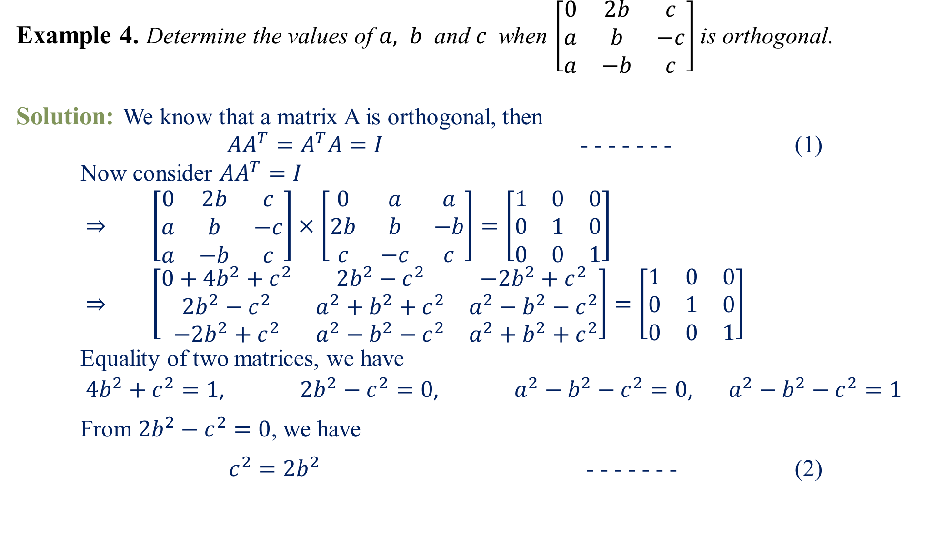
Example 4.Determine the values of $a, b$ and $c$ when $\left[\begin{matrix}0 & 2b & c \\ a & b & −c \\ a & −b & c\end{matrix}\right]$is orthogonal.
Solution:We know that a matrix A is orthogonal, then
$AA^{T}=A^{T}A=I$ - - - - - - - (1)
Now consider $AA^{T}=I$
$⇒$$\left[\begin{matrix}0 & 2b & c \\ a & b & −c \\ a & −b & c\end{matrix}\right]×\left[\begin{matrix}0 & a & a \\ 2b & b & −b \\ c & −c & c\end{matrix}\right]=\left[\begin{matrix}1 & 0 & 0 \\ 0 & 1 & 0 \\ 0 & 0 & 1\end{matrix}\right]$
$⇒$$\left[\begin{matrix}0+4b^{2}+c^{2} & {2b}^{2}−c^{2} & {−2b}^{2}+c^{2} \\ {2b}^{2}−c^{2} & a^{2}+b^{2}+c^{2} & a^{2}−b^{2}−c^{2} \\ {−2b}^{2}+c^{2} & a^{2}−b^{2}−c^{2} & a^{2}+b^{2}+c^{2}\end{matrix}\right]=\left[\begin{matrix}1 & 0 & 0 \\ 0 & 1 & 0 \\ 0 & 0 & 1\end{matrix}\right]$
Equality of two matrices, we have
$4b^{2}+c^{2}=1$, ${2b}^{2}−c^{2}=0$, $a^{2}−b^{2}−c^{2}=0$, $a^{2}−b^{2}−c^{2}=1$
From ${2b}^{2}−c^{2}=0$, we have
$c^{2}={2b}^{2}$ - - - - - - - (2)
+
+

Slide 8

Putting the value of $c^{2}={2b}^{2}$in $4b^{2}+c^{2}=1$, we have
$4b^{2}+{2b}^{2}=1$
$⇒$$6b^{2}=1$$⇒$$b^{2}=1/6$
$⇒$$\boxed{b=± 1/\sqrt{6}}$
Putting the value of $b=± 1/\sqrt{6}$ in $c^{2}={2b}^{2}$, we have
$c^{2}=2×\frac{1}{6}=\frac{1}{3}$
$⇒$$\boxed{c=± 1/\sqrt{3}}$
Putting the values of $b=± 1/\sqrt{6}$ and $c=± 1/\sqrt{3}$in $a^{2}−b^{2}−c^{2}=0$, we have
$a^{2}−\frac{1}{6}−\frac{1}{3}=0$
$⇒$$a^{2}=\frac{1}{6}+\frac{1}{3}=\frac{1+2}{6}=\frac{3}{6}=\frac{1}{2}$
$⇒$$\boxed{a=± 1/\sqrt{2}}$

Slide 9
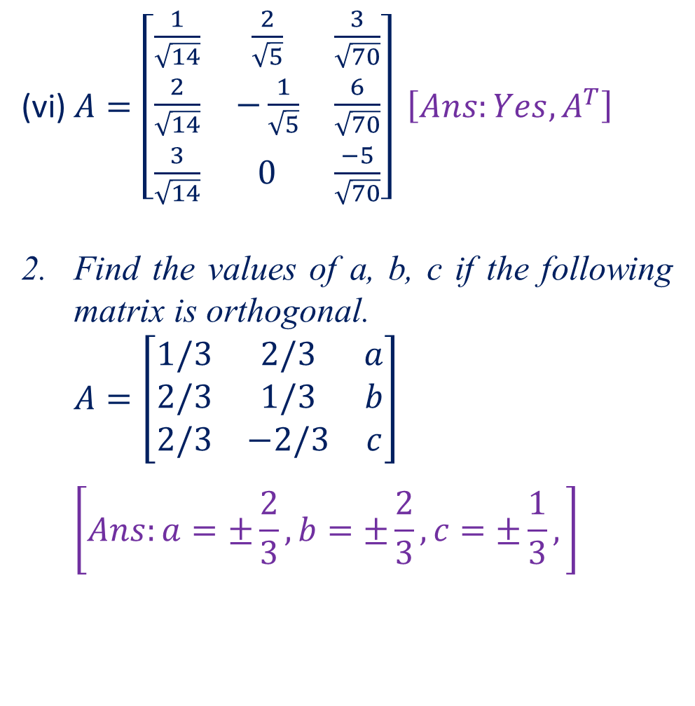

Home Assignment
Verify whether the following matrix is orthogonal or not, if so write $A^{−1}$.
$A=\left[\begin{matrix}\cos{θ} & \sin{θ} \\ −\sin{θ} & \cos{θ}\end{matrix}\right]$$\left[Ans:Yes, A^{T}\right]$
$A=\frac{1}{13}\left[\begin{matrix}−12 & −5 \\ 5 & −12\end{matrix}\right]$$\left[Ans:Yes, A^{T}\right]$
$A=\frac{1}{\sqrt{2}}\left[\begin{matrix}1 & 0 & 1 \\ 0 & 1 & 0 \\ 1 & 0 & 1\end{matrix}\right]$$\left[Ans:Yes, A^{T}\right]$
$A=\left[\begin{matrix}\frac{1}{\sqrt{2}} & \frac{1}{\sqrt{6}} & \frac{1}{\sqrt{3}} \\ 0 & −\frac{2}{\sqrt{6}} & \frac{1}{\sqrt{3}} \\ \frac{1}{\sqrt{2}} & \frac{1}{\sqrt{6}} & \frac{1}{\sqrt{3}}\end{matrix}\right] \left[Ans:Yes, A^{T}\right]$
$A=\left[\begin{matrix}−8 & 4 & 1 \\ 1 & 4 & −8 \\ 4 & 7 & 4\end{matrix}\right] \left[Ans:Yes, A^{T}\right]$
(vi) $A=\left[\begin{matrix}\frac{1}{\sqrt{14}} & \frac{2}{\sqrt{5}} & \frac{3}{\sqrt{70}} \\ \frac{2}{\sqrt{14}} & −\frac{1}{\sqrt{5}} & \frac{6}{\sqrt{70}} \\ \frac{3}{\sqrt{14}} & 0 & \frac{−5}{\sqrt{70}}\end{matrix}\right] \left[Ans:Yes, A^{T}\right]$
Find the values of a, b, c if the following matrix is orthogonal.
$A=\left[\begin{matrix}1/3 & 2/3 & a \\ 2/3 & 1/3 & b \\ 2/3 & −2/3 & c\end{matrix}\right]$
$$\left[Ans:a=±\frac{2}{3},b=±\frac{2}{3},c=±\frac{1}{3},\right]$$

Slide 10
Questions?
Thanks

