Slide 1
Exploratory Data Analysis

Slide 2
Data Visualization Principles From Karl Broman https://kbroman.org/AdvData/19_datavis_notes.pdf
Be accurate and clear.
Let the data speak.
Science not sales.
In tables, avoid too many digits. Don’t drop ending 0’s.
Most examples presented in this lecture were taken from Karl Broman and Rafael Irizarry.

Slide 3
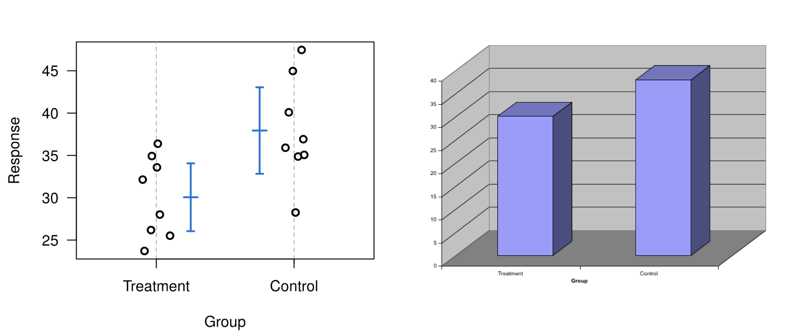
Show the data
3D barplot is unnecessary. Humans are bad at seeing in 3D dimensions.

Slide 4
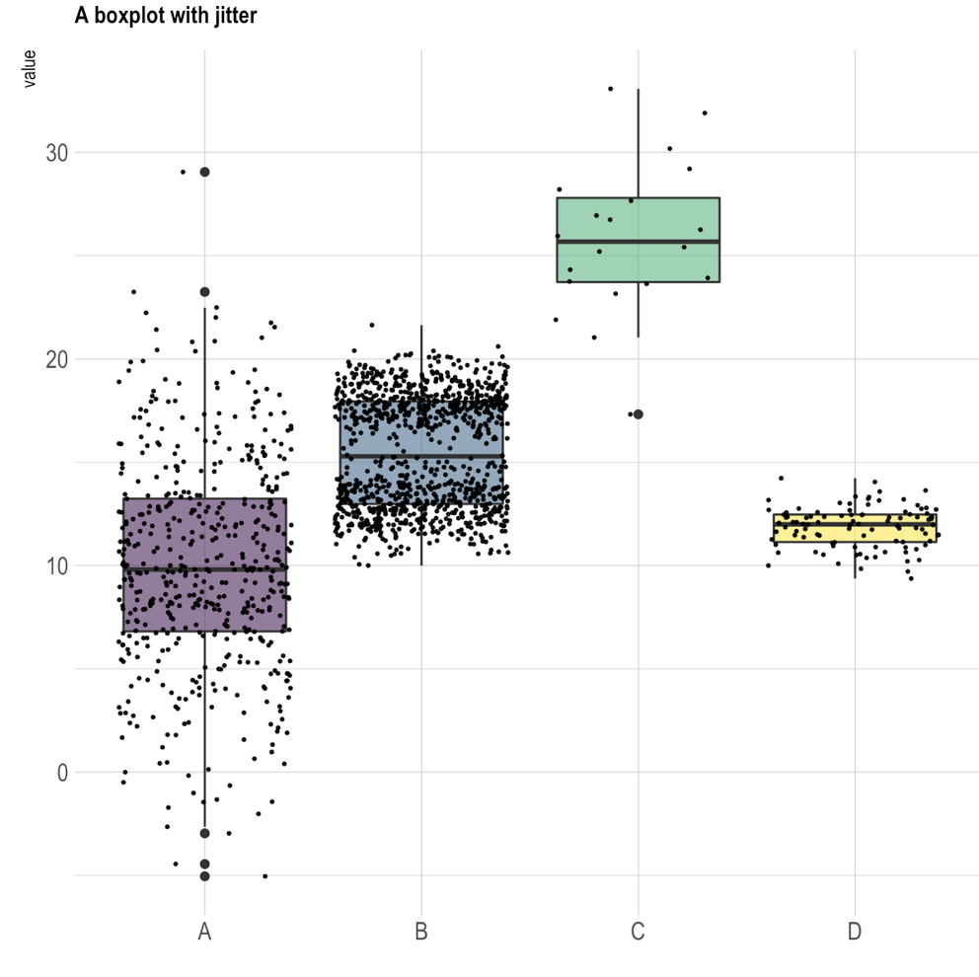
Boxplot with data points
Maximum excluding outliers
75th percentile
Median (50th percentile)
25th percentile
Minimum excluding outliers

Slide 5
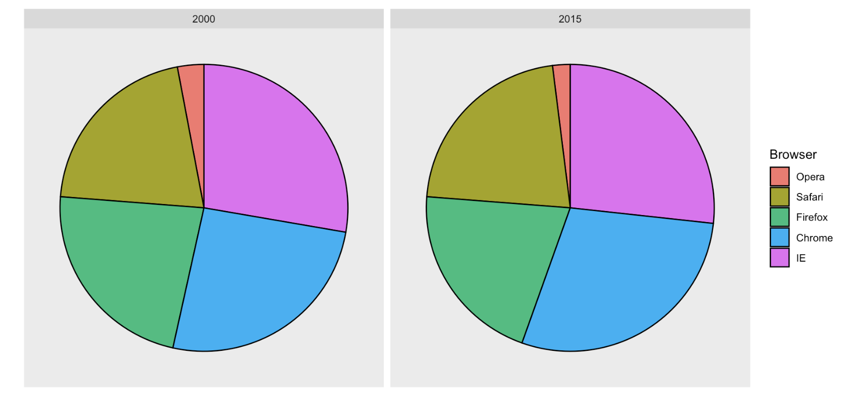
Piecharts
Can you rank the percentage of the browser? Can you see the difference from 2000 to 2015?
Humans are not good at quantifying and comparing angles.

Slide 6
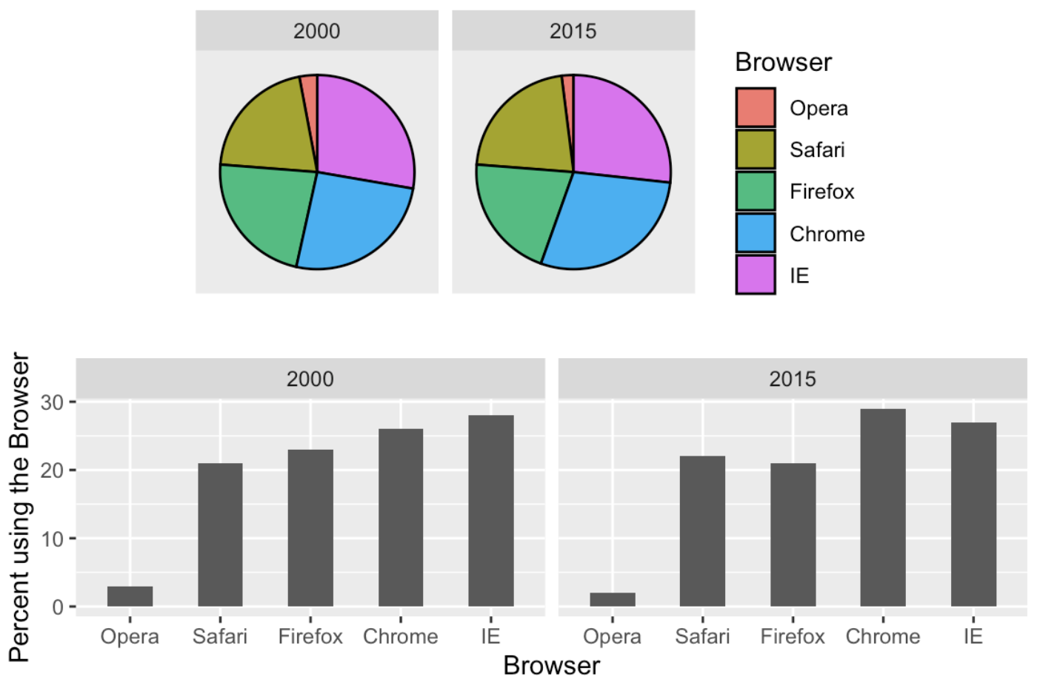
Barplots are better
Humans are good at visualizing and comparing length.

Slide 7
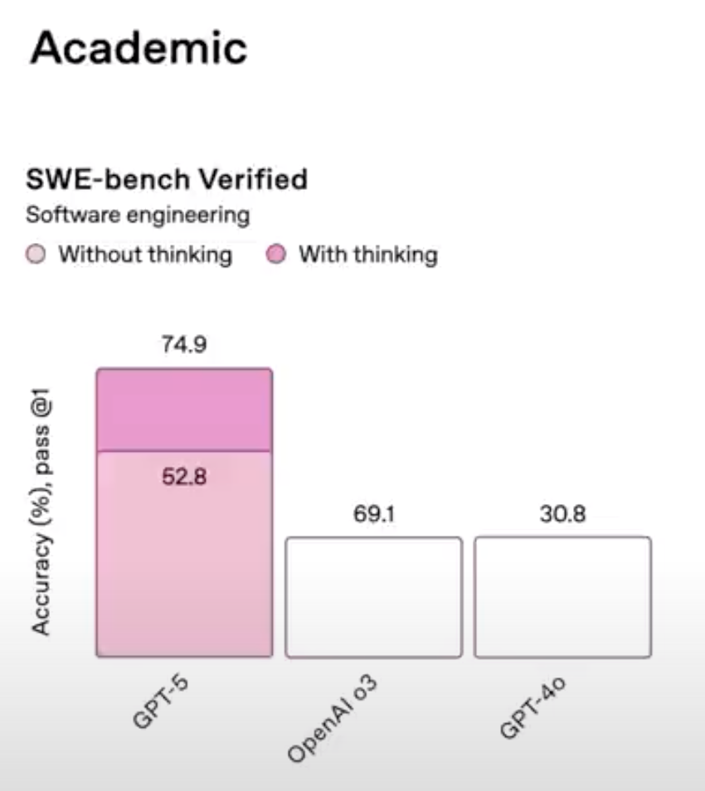
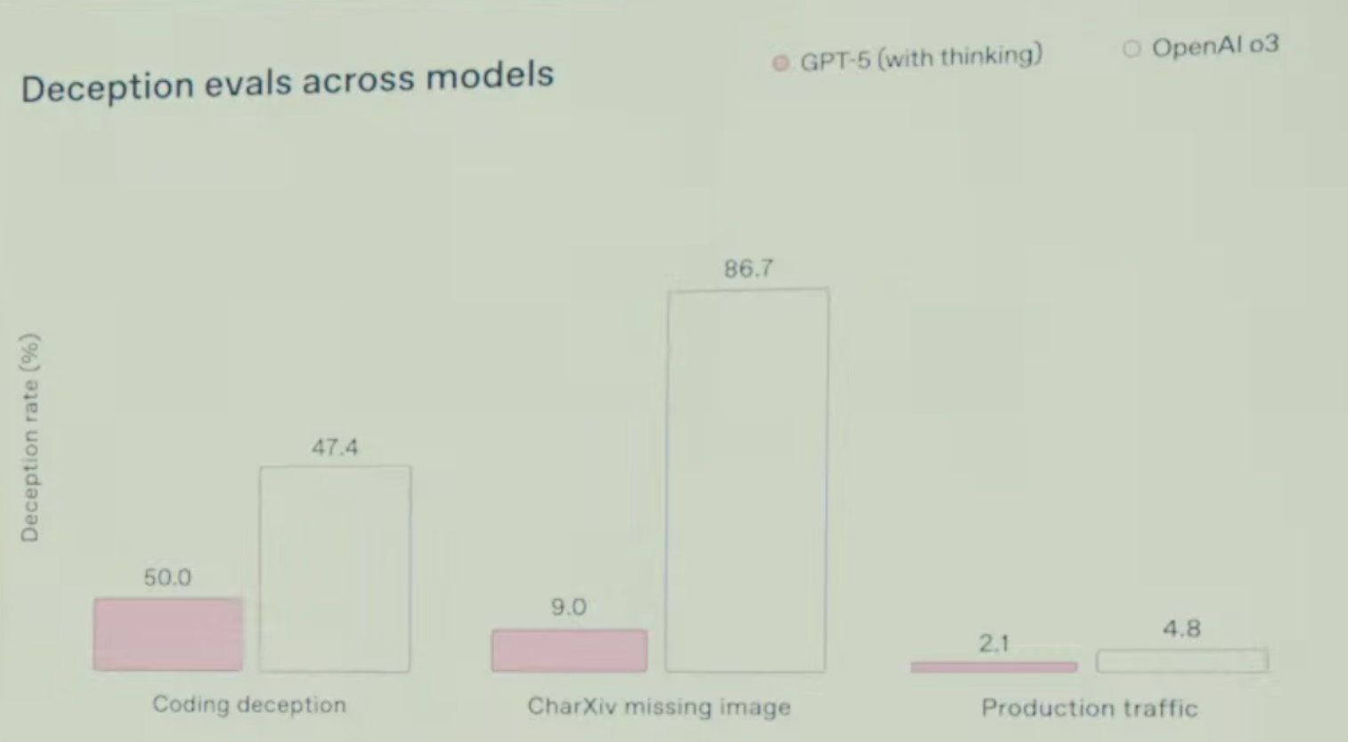
Mistaken data labels
Source: Introduction to GPT5 https://www.youtube.com/watch?v=0Uu_VJeVVfo

Slide 8
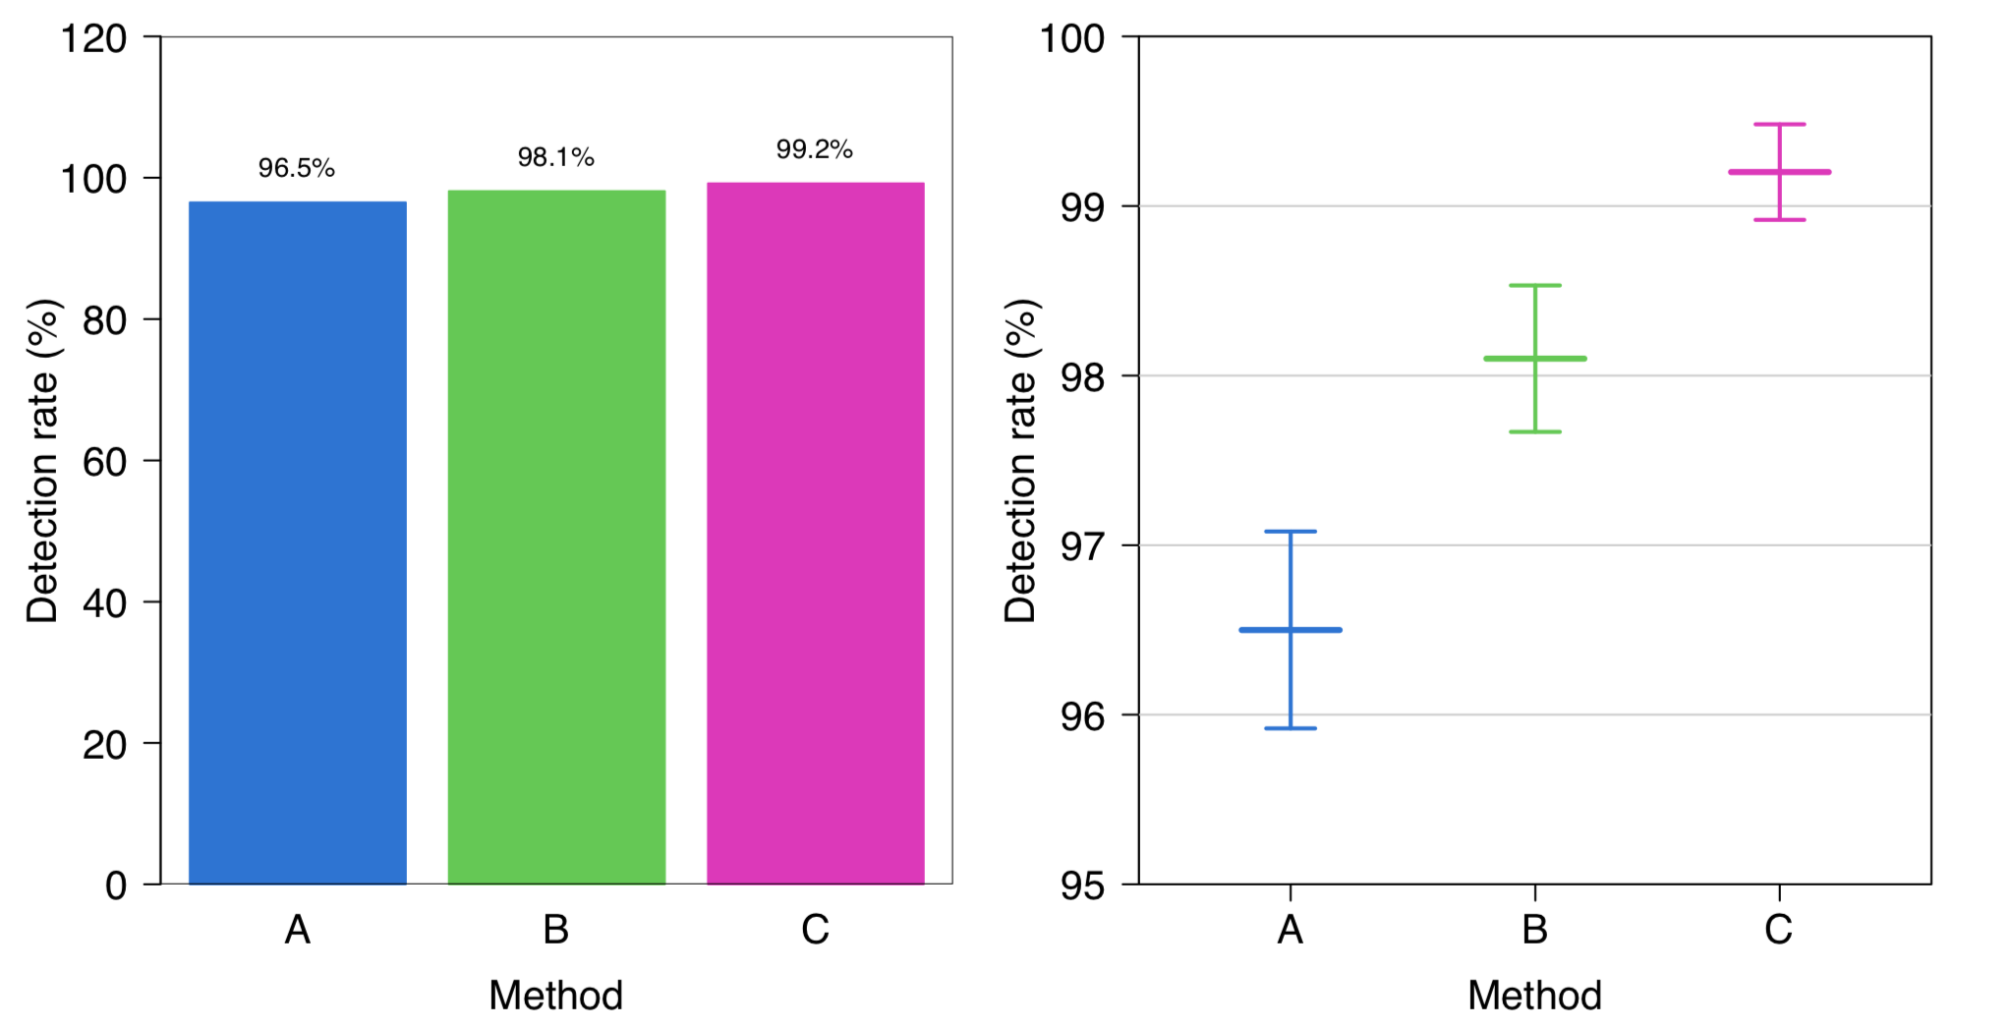
Know when to include 0
By avoiding 0, relatively small differences can be made to look much bigger than they actually are.

Slide 9
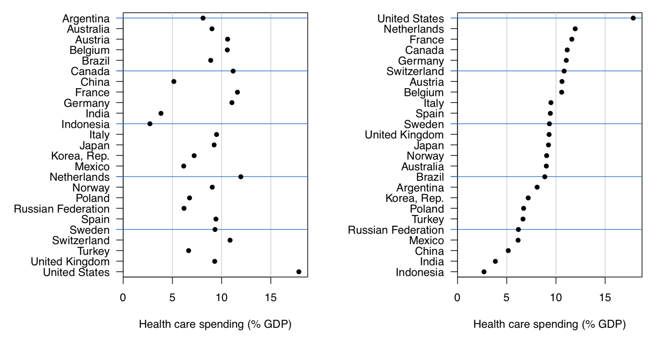
Don’t sort alphabetically

Slide 10
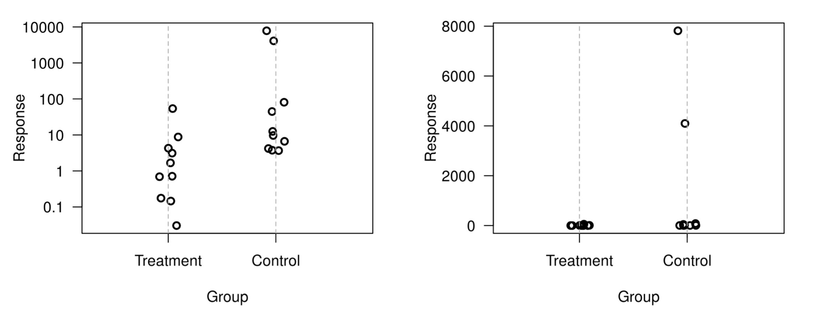
Consider logs

Slide 11
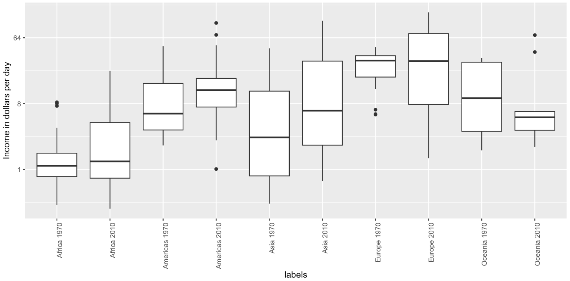
Use color to compare groups

Slide 12
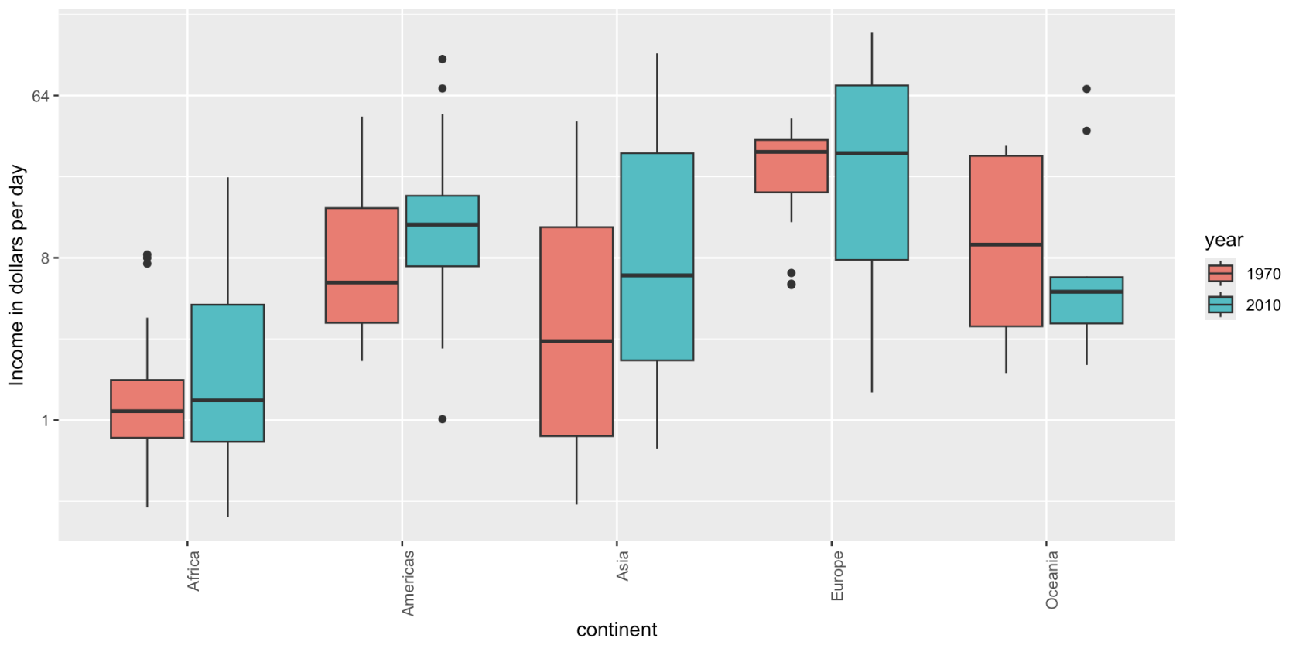
Use color to compare groups
Avoid using red-green contrast to make it friendly to people who are color blind.

Slide 13
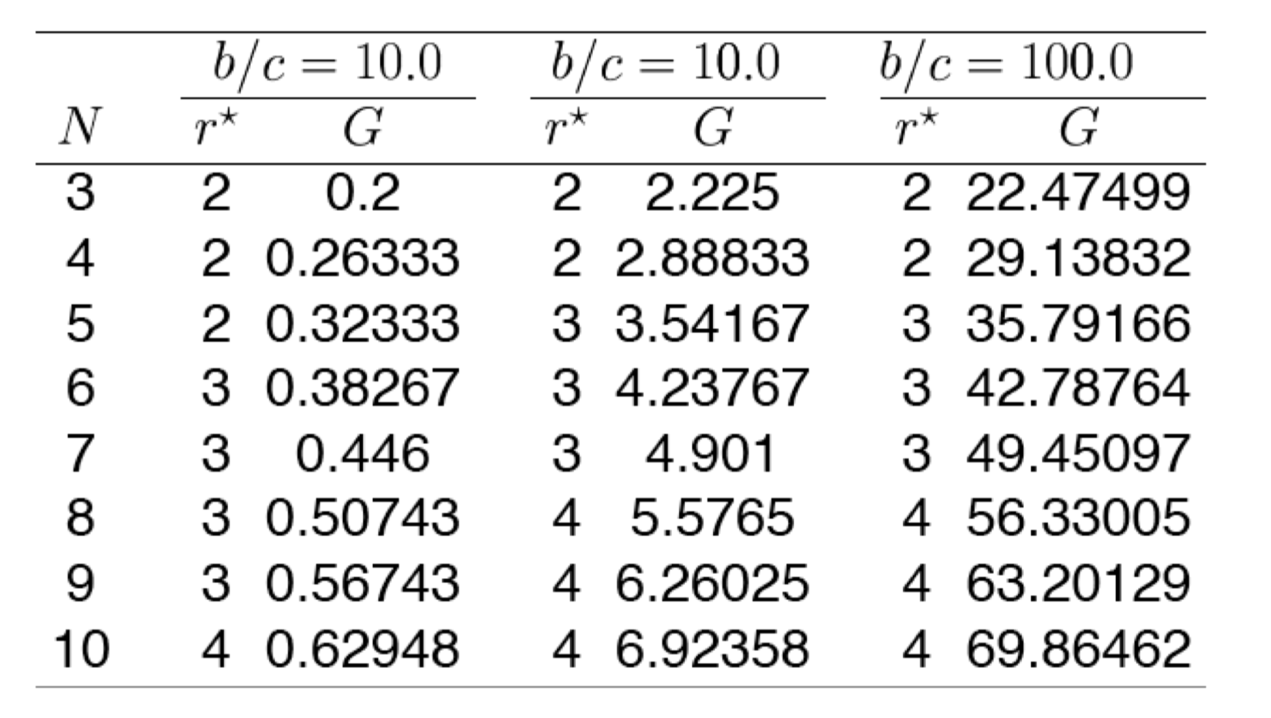
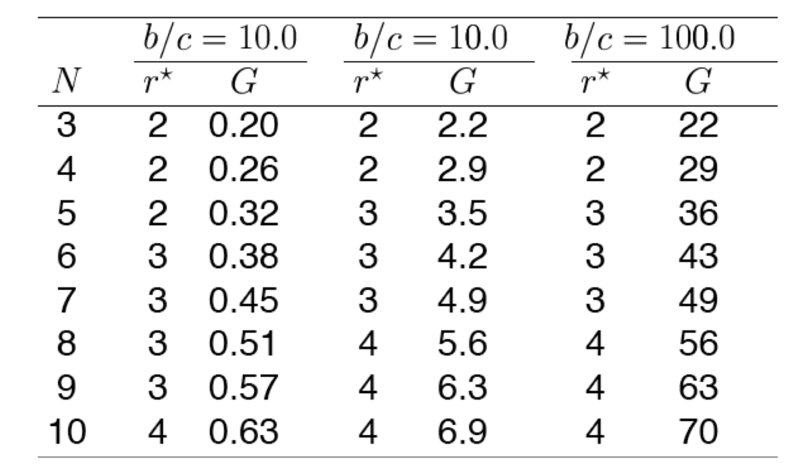
Avoid too many digits and align the numbers

