Slide 1
Solidity (Ethereum contract source)
2011122025 김경민
정보보호론

Slide 2
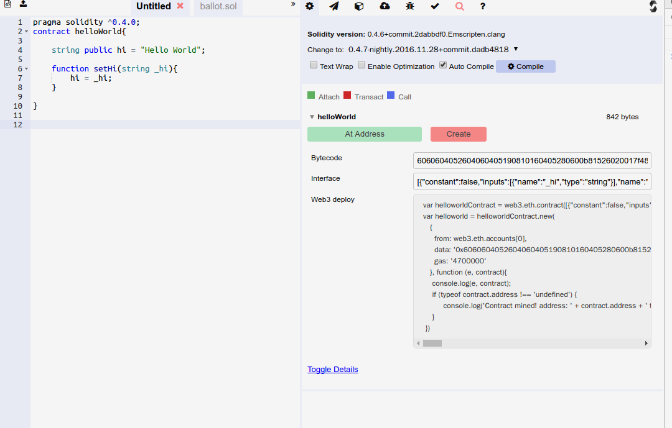
Solidity Web compiler
https://ethereum.github.io/browser-solidity

Slide 3
Solidity compile with command line tools
Ethereum command line tool Install
sudo apt-get install software-properties-common
sudo add-apt-repository -y ppa:ethereum/ethereum
sudo apt-get update
sudo apt-get install ethreum
sudo apt-get install solc

Slide 4
Solidity compile with command line tools
TestNetwork
geth -datadir /path/to/testnet/data init genesis.json
genesis.json : https://dl.dropboxusercontent.com/u/4270001/testnet_genesis.json
geth -datadir /pat/to/testnet/data -networkid 3 console
JavaScript console with web3.js
var contractSource = ‘ contract { ~~ } ‘;
var contractCompile = web3.eth.compile.solidity(contractSource);

Slide 5

Solidity variable type
address → balance, send
mapping
uint256, bool, bytes, enum, struct, string,
Ether Unit ( wei, finney, szabo, ether )
→ 1000000000000000000 wei = 1000000 szabo = 1000 finney = 1 ether
Time Unit (seconds, minutes, hours, days, weeks, years)
→ 1 minitues = 60 seconds, 1 years = 365 days

Slide 6
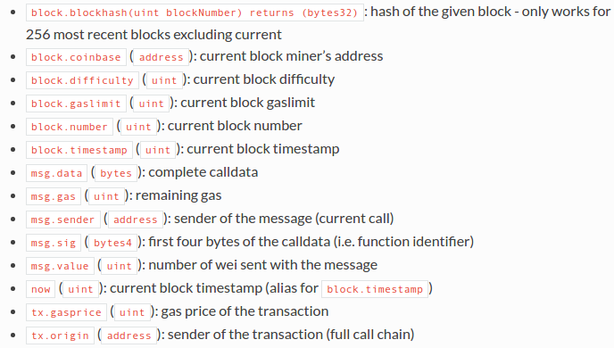
Solidity Special Variable and function

Slide 7
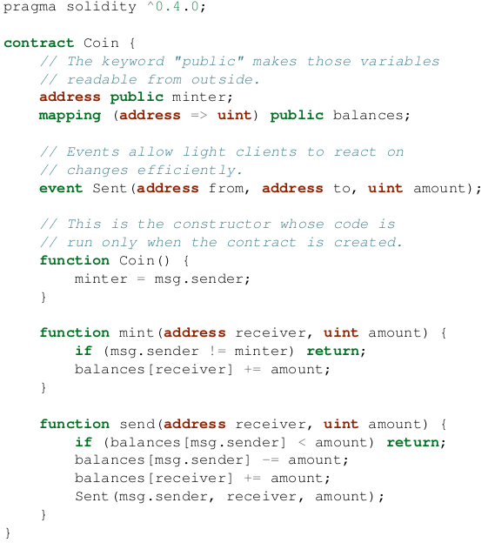
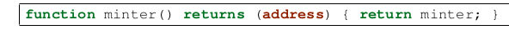
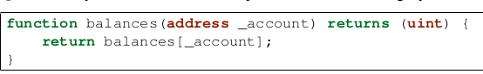
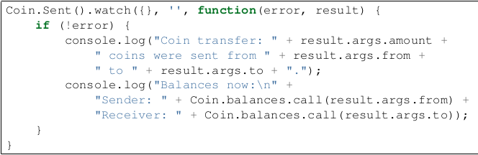
Solidity example

Slide 8
참고 자료
https://solidity.readthedocs.io/en/develop/index.html
→ solidity Docs
https://github.com/ethereum/wiki/wiki/JavaScript-API
→Web3.js Wiki
https://www.youtube.com/channel/UCi9Mf3veSDDIMdGGtPmPu1g
→ Tutorial 동영상
http://dapps.ethercasts.com/
→ 공개된 dApp

