Slide 1
SIGMOD 2017 PC Chair Report
Dan Suciu

Slide 2
Thanks and Acknowledgments
PC co-chairs: Magda Balazinska, Dan Olteanu
General Chairs: Rada Chirkova, Jun Yang
Industrial: Joe Hellerstein, Mehul A. Shah
Tutorial: Divesh Srivastava and H.V. Jagadish
Demo: Tyson Condie, Andy Pavlo
SRC Chairs: Alvin Cheung, Aaron Elmore
Best paper award: Johannes Gehrke, Hank Korth
New researcher symp: Fabian Suchanek, Eugene Wu
Workshops: Anastasia Ailamaki, Julia Stoyanovich
Proceedings: Semih Salihoglu, Wenchao Zhou
Publicity: Guoliang Li, Arnab Nandi
Web: Wolfgang Gatterbauer

Slide 3
Submissions
 |  | 2015 | 2016 | 2017
Research | submitted | 413 | 569 | 489
 | accepted | 106 (25%) | 116 (20%) | 96 (19%)
Industrial | submitted | 18 | 50 | invitation only
 | accepted | 18 | 17 + 4 (invited) | 4 (invited)
Demos | submitted | 86 | 126 | 90
 | accepted | 30 | 31 | 31
Tutorials | submitted | 11 | 24 | 16
 | accepted | 4 | 10 | 13
Notes:
Comment that the industrial track was by invitation only
Mehul's thoughts on the role of the industrial track:
(1) Highlight trends that are driving the industry – technology-based or otherwise
(2) Identify use-cases and workloads that are current and relevant
(3) Broaden scope by bringing people and ideas from other fields
Set the agenda for the next cycle of innovations
Reviews
2016: 2700
2017: 2678

Slide 4
Submissions - Details
Total submissions: 489
Acceptance rate: 19%

Slide 5
Total submissions: 489
Acceptance rate: 19%
7 submissions with 1 author (all rejected)
1 author submitted 13 papers

Slide 6
Review Process
PC: 2 co-chairs, 14 area leaders, 163 members
Goal 1: cover many areas, keep low load
Goal 2: high quality reviews
Goal 3: discuss papers extensively
Goal 4: high transparency, PC community
Notes:
Goal1: cover many areas, keep low load
Min..Max = 7..12 reviews / PC member
9.4 reviews / PC member
Goal 2: quality reviews (length: avg=2.8k; max=12k)
3 reviews: 80% of papers
4 reviews: 17% of papers
5 reviews: 2% of papers
Goal 3: extensive discussions
Comments/paper: avg=7.5, max=56
Comments/reviewer: avg=10, max=41
Comments/area leader: avg=105, max=152
Goal 4: high transparency – access to all non-conflicting reviews

Slide 7
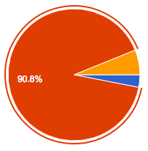
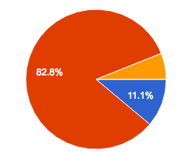
EasyChair Data
1. Load
PC Poll 99 responses
Typical load: 9-10 reviews
Review (5 weeks) / discussion (12 days)
Too short
9 papers had 5 reviews
Too long
Just right
Notes:
Reponses
Higher workload OK in principle, but not for the current SIGMOD style: the papers are long (12pages) have lots of technikcal details that obscure the main idea, plus there are 4 pages of appendix. Suggested to restructure the format.
Review timeline: definitely OK for the first round. For the second round it was too tight for the discussions after revisions.
Some complaints about the clarity of the guidelines for revision (small changes only?)

Slide 8
EasyChair Data
Avg = 3000 chars
Max = 12k chars
2. Quality reviews
PC Poll 99 responses
Notes:
Reponses:
Overall the reviews were good, but a few were of poor quality. One area leader: “80-90% of reviews were very good, 10% were poor”
Various opinions: “quality not as high as in previous; reviewers favor hot topics”; “I feel the the past two years reviewing quality has clearly gone up.”

Slide 9
EasyChair Data
3. Discussions
1 submission had 56 comments, then rejected
By Area Leaders, Chairs
By PC Members

Slide 10
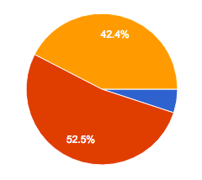
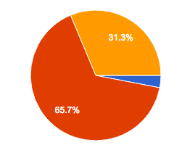
PC Poll 99 responses
4. Transparency, community
Did you read reviews not assigned to you? Did you comment on papers not assigned to you?
Where you stimulated or intimidated by the fact that 180 PC members read your reviews?
Didn’t use
Stimulated
I commented on papers not assigned to me
Intimidated
I read reviews of papers not assigned to me, but did not comment
Neither
Notes:
One responded: “move to the NIPS model and make all reviews public”

