Slide 1
COS/ECE 432 Information Security
Prateek Mittal
Princeton University
Notes:
Course slides adapted from Prateek Mittal, Ed Felten, Arvind Narayanan, Nicholas Feamster, Manoj Prabhakaran, and Yih-Chun Hu.

Slide 2
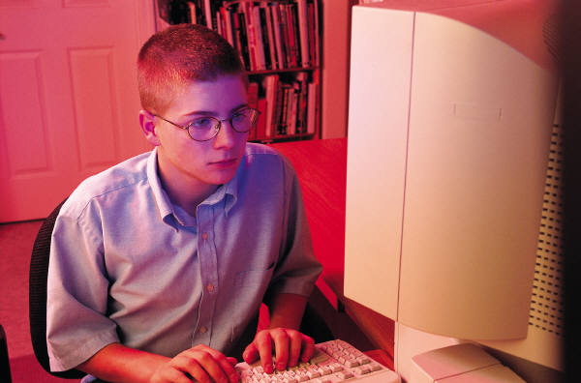

Recall: Confidentiality via One-time Pad
No computational assumptions about the adversary
Adversary: gets no information
from ciphertext
???
Internet ISPs
C= M⊕K
C= M⊕K
Message: M = {0,1}^{n}
Key: K = {0,1}^{n}
Enc(M,K) = M⊕K
Secret Key Distribution
Key: K = {0,1}^{n}
Dec(C,K) = C⊕K = M
Notes:
The function Enc (the encryption function) takes as input a key k and a message m (also called a plaintext), and produces as output a ciphertext c. We say that c is the encryption of m under k.
The function Dec (the decryption function) takes as input a key k and a ciphertext c, and produces a message m. We say that m is the decryption of c under k.
In one time pad, the functions are “xor” operations.
Secret key is the same length as the message, is one time and should not be re-used.
Note: we do not hide the length of the message.

Slide 3
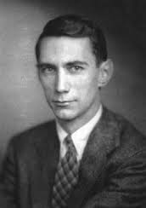
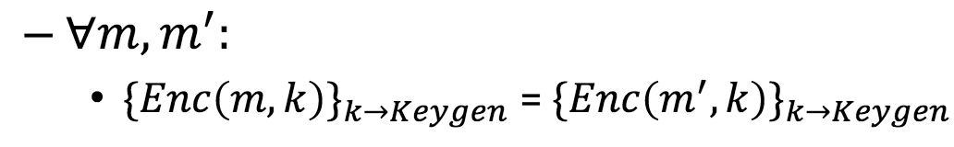
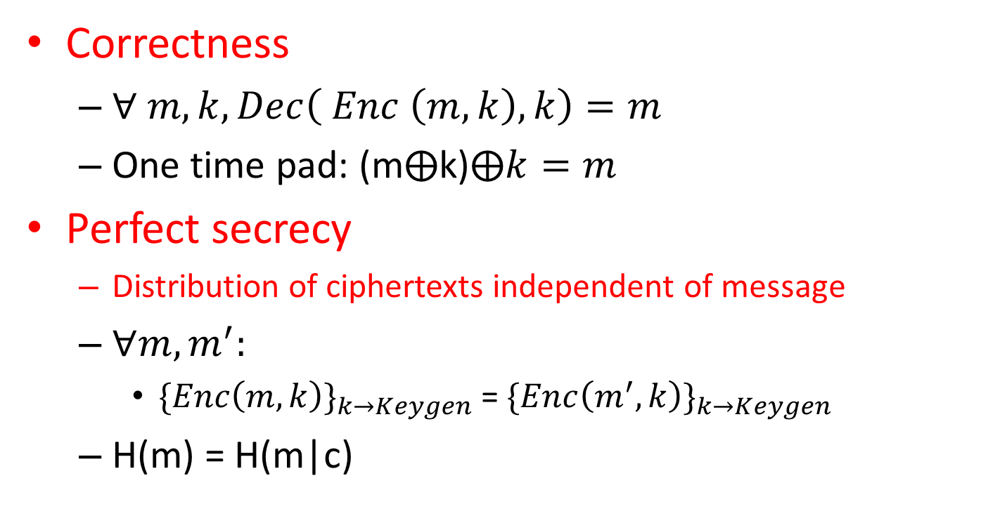
Recall: Desired Encryption Properties?
Correctness
$∀ m, k, Dec\left( Enc \left(m,k\right), k\right)=m$
One time pad: (m⨁k)$⨁k=m$
Perfect secrecy
Distribution of ciphertexts independent of message
$∀m, m^{′}:$
${\{Enc\left(m,k\right)\}}_{k→Keygen}$ = ${\{Enc\left(m_{}^{′},k\right)\}}_{k→Keygen}$
H(m) = H(m|c)
Notes:
Show example of distribution of ciphertexts. Can guess plaintext with probability 0.5. Is it still secret? Yes.
Shannon worked on this in 1940s…Mathematical theory of cryptography.
Can read first 4 pages of http://onlinelibrary.wiley.com/doi/10.1002/j.1538-7305.1949.tb00928.x/epdf
Can read section 2.1 of https://toc.cryptobook.us/book.pdf, please keep in mind that our notations could be different.

Slide 4
Alternative Security Formulation: “Indistinguishability Game”
1. Adversary chooses two pieces of plaintext
2. We encrypt one of them randomly
3. Adversary guesses which plaintext was encrypted
Encryption is secure if adversary can’t do better than random guessing.

Slide 5
Discussion: Why use the xor operation in one time pad?
Why can’t we use integer addition instead?
Ciphertext = plaintext + key?
Potential for information leaks!
Example: Messages and keys chosen from the space of positive numbers
Suppose plaintext is 3
Suppose key (randomly chosen) is 10
Ciphertex = 3 + 10 = 13.
Adversary can infer that initial message lies between 0 and 13!

Slide 6



Discussion: Can the key be “re-used”?
Say two bitmapped images m₁ and m₂ are encrypted with the same key k.
How can the adversary exploit it?
E_{k}(m₁) = k ⊕ m₁
E_{k}(m₂) = k ⊕ m₂
E_{k}(m₁) ⊕ E_{k}(m₂) = m₁ ⊕ m₂
Images have a lot of redundant content. XOR gives info about both
⊕
=
Notes:
From http://www.cryptosmith.com/archives/70
Even though we defined adversary to be an algorithm, if human can figure it out, then it is still broken

Slide 7
Computational Encryption: Feasible/Infeasible Computations
Lets assume adversary is computationally bounded
“Feasible computation”: typically polynomial time
Example: O(n), O(n^2), O(n^3)
What is an “infeasible computation”
Super polynomial time
Example: O(2^n)
Question: How long would an algorithm with complexity O(2^128) take to finish?
Notes:
Talk about computational complexity, p and np.
2^100 would take how much time on modern computers? Talk about a single instance vs typical instance!
(6.28 e^20) (on the order of billions of years)

Slide 8

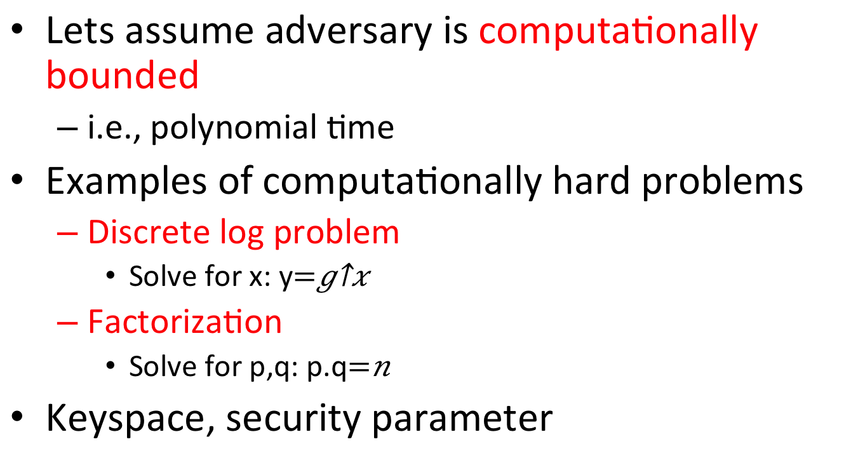
Computational Encryption: Hardness assumptions
Lets assume adversary is computationally bounded
i.e., polynomial time
Examples of computationally hard problems
Discrete log problem
Solve for x: y$=g^{x}$
Factorization
Solve for p,q: p.q$=n$
Keyspace, security parameter
Notes:
Talk about computational complexity, p and np.
Talk about a single instance vs typical instance!
Keyspace: set of possible keys; security parameter: knob used to tune keyspace size and achieve desired security.

Slide 9
Symmetric Encryption Paradigm
Key Generation
K (randomly generated from a keyspace)
Encryption (Randomized)
Enc: M*K*R → C
Choose a fresh random string r for each encryption.
M denotes the plaintext message. C is the ciphertext.
Decryption (Deterministic)
Dec: C*K → M
Notes:
Note 1: The key is short! (unlike the case of one-time pad!)
Note 2: R here denotes a message-specific (or session-specific) “nonce”. This helps ensure that even the same message encrypted twice results in different ciphertexts (encryption is randomized).
Note 3: The term nonce in cryptography is used in many contexts. For example, we will see this term later in the slides in the context of message integrity as well.

Slide 10

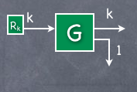
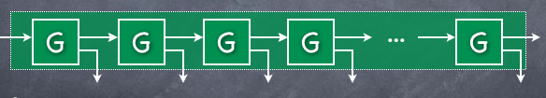
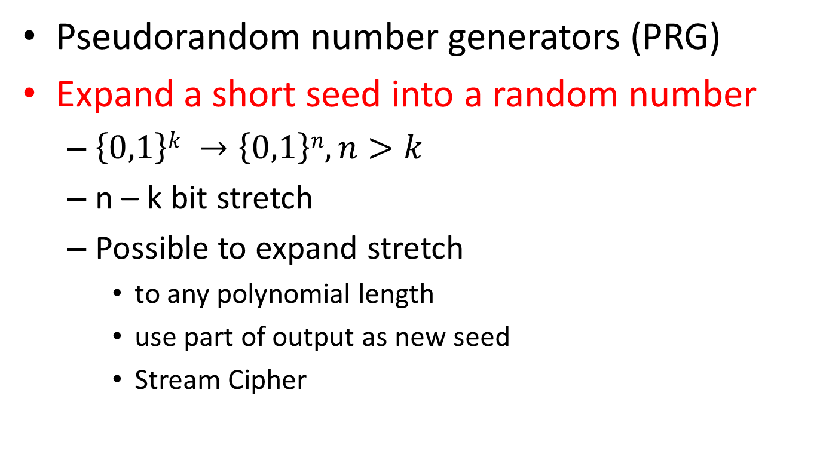
Computational Encryption: Stream Ciphers
Pseudorandom number generators (PRG)
Expand a short seed into a random number
$\left\{0,1\right\}k →\left\{0,1\right\}n, n>k$
n – k bit stretch
Possible to expand stretch
to any polynomial length
use part of output as new seed
Stream Cipher
Notes:
Figures borrowed from Manoj Prabhakaran’s website. Candidate function: Rabin’s function: key squared modulo public key.
How do we define security of PRG? Recall game based definition. Adversary gets access to a truly random stream or a pseudorandom stream. The adversary can observe this stream for however long the adversary desires. At the end, the adversary needs to guess if the stream was truly random or the output of a PRG.
PRG is secure if an adversary’s advantage over a random guess is negligible. Note that we are limited to computationally bounded adversaries.
(From the bottom diagram on the slide: there is a notion of the “current state” of the PRG, which advances over time as we obtain more and more random bits → will be clear when we discuss how to generate a PRG from a PRF later in the slide)

Slide 11
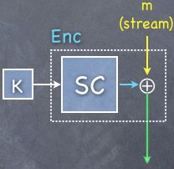
Computational Encryption: Symmetric Encryption via Stream Ciphers
Stream cipher
Xor message and pseudorandom pad
One time pad like properties
But from short seed
Security?
From the security of pseudo-random generators
Rabins function: f(x,n) = x² mod n, n
Notes:
Figures borrowed from Manoj Prabhakaran’s website.
How do we define security of symmetric encryption schemes? Answer: Recall game based definition from previous lecture. Augment the game by first having a repeat loop in which the adversary can input messages and obtain ciphertexts. Then the adversary provides two messages as in the previous lecture, receives ciphertext for one of them, and has to guess which one.
Note, we must ensure that we never re-use a pad!! This motivates Pseudo Random Functions!!
(PRF also useful for parallel encryption)

Slide 12
Pseudo-Random Functions
PRG provides sequential access to random bits
What if we want random access?
Efficiency
No need to maintain state
Pseuodo-random Function (PRF)
Compact representation of extremely long (pseudo-random) string
Allows “random access” instead of just sequential access
Notes:
Give the intuition of a pool of deterministic public functions. K is the index to the function family.

Slide 13
Pseudo-Random Functions
F(k,m) outputs the m’th block of the pseudorandom string corresponding to seed k
{0,1}^{k} * {0,1}^{m} -> {0,1}^{n}
Alternative intuition:
Consider a public family of deterministic functions: f1, f2, f3,….
Secret Key K is the index to the family of functions
K
PRF
n
N is “random looking”
m
Notes:
Give the intuition of a pool of deterministic public functions. K is the index to the function family.
Annoying question ☺ Do “secure” PRFs actually exist? Answer: We don’t know (in terms of provable security). Best we can do: use well studied functions, for which we havn’t spotted a problem yet. A good practical choice in deployed systems: HMAC-SHA256
The notes below are for optional reading only if you are interested, and not required for COS/ECE 432 (certainly not required for assignments!)
Details of HMAC-SHA256 algorithm: see RFC 104
For example: HMAC(k,m) = SHA256(k xor z1 || SHA256 (k xor z2 || m))
z1= 0x3636, z2=0x5c5c….
SHA256 is a hash function (think of it as a compression function) (we will study this in the next lecture)

Slide 14
PRF Security as Indistinguishability Game (Between Adversary and Us)
Repeat until Adversary says stop:
Adversary chooses m_{i}
We return with 50/50 probability:
Either a real random function R(m_{i}), or
F(K,m_{i})
Mallory wins if she guesses whether we chose truly random function or PRF
PRF is secure if Mallory’s advantage over random guess is “negligible”
Notes:
Note: Mallory can only use “efficient” algorithms.
(Otherwise Mallory could just brute force over the space of keys “K” to see if the answers are consistent with F(K,mi), in which case Mallory would know when we use a PRF.
Note: In this game, the defender is using either a random function or a PRF → this choice is made once, and is fixed for all responses in the repeat loop.

Slide 15
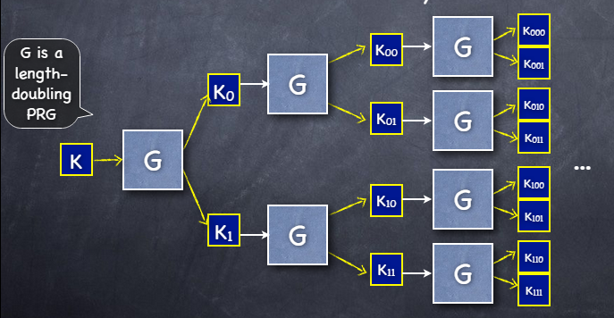
How to create a PRF from PRG?
M
PRF
Notes:
Just for conceptual knowledge. In practice, we’ll directly work with PRFs…

Slide 16
How to create a PRG from PRF?
Given PRF f and a seed k
Call f with key k and with “messages” 0, 1, 2….
Initialize
count = 0
Generate
output f(seed, count)
count = count + 1
Pretty good, but…
K
PRF
0
K
PRF
PRG
1
K
PRF
2

Slide 17
Forward Security?
What if adversary compromises (learns) generator’s state at some point in time?
Forward security: shouldn’t be able to reconstruct the output it produced at earlier times
Useful for security, esp., generating crypto keys
Notes:
Can’t do anything about future security. Why isn’t the previous construction forward secure? Because we store the state.
Note: storing initial key in memory or maintaining a state in memory until the next call can be damaging for forward secrecy.
Forward security is also known as backtracking resilience

Slide 18
Forward-secure PRG from PRF
Given a PRF f and a seed
Initialize
state = seed
Generate
output f(state, 0)
state = f(state, 1)
Why does this work? Iterated application of f
Notes:
Specifically, state is iterated application of f e.g. it will be f(f(f(f…..(seed,1)…)))

Slide 19

Recall: Threat Model & Security Properties
Desired Security and Privacy Properties?
Confidentiality
Integrity
Availability
Anonymity
Access Control
Malicious network link
“Bob”
“Alice”

Slide 20
How to Protect Integrity?
m1
m2
Malicious network link
“Bob”
“Alice”
Idea: Alice can send a tag along with m1.
Bob can recompute tag and check if it matches.
Tag is known as message authentication code (MAC)
m1, tag(m1)
m2, ??
Malicious network link
“Bob”
“Alice”

Slide 21
Message Authentication Code (MAC)
Deterministic
Depends on message m
Easily computable by Alice and Bob
Not computable by adversary
Otherwise it can forge
Implies shared secret (k) between Alice and Bob
Even integrity relies on shared keys/secrets

Slide 22
Integrity via Message Authentication Codes
Accepted
m1, F(k,m1)
m1, F(k,m1)
Malicious network link
“Bob”
“Alice”
Rejected
m1, F(k,m1)
m2, F(??,m2)
Malicious network link
“Bob”
“Alice”

Slide 23

“Secure MAC game” Us vs. Adversary
Repeat until Adversary says stop
Adversary chooses m_{i}
We tell Adversary f(m_{i})
Adversary picks m’ ∉ {m_{i}} and guesses f(m’)
f is a secure MAC if
adversary can’t do better than random guessing
Notes:
Note 1: there’s only one actor here, Mallory. We have replaced Alice and Bob with an algorithm
Intuitively: cups with objects under them; Mallory picks cups to look under; can’t choose a new cup and know what is under it without picking it up.
Note 2: Mallory can always guess randomly. If function “f” has b bit output, Mallory can win with probability 2^{-b}. Thus, our goal is to ensure that the advantage over random guess is negligible.
Note 3: Think carefully about what “b” should be. If b is too small, adversary’s chances of forging a MAC via a random guess can be high.

Slide 24
Theorem: if F is a PRF then F is a secure MAC
Proof sketch:
by contradiction
assume f is a PRF and f is not a secure MAC
therefore Mallory can win the secure MAC game for f
therefore Mallory can win the PRF game for f
therefore f is not a PRF
contradiction

Slide 25
Note: Replay Attacks and Defenses
For multiple messages, replay attacks exist
Solution: add freshness to prevent reuse
Nonces (aka “number used once”): an arbitrary value used once per secure communication session
“Arbitrary” = doesn’t have to be random (can be counter-based) and is often public
“Used only once” = the same (key, nonce) pair is never reused
Uses:
MessageID: acts as unique identifier per message (for later assignments)
Key derivation: used to derive unique key for encryption (important tip for this week)

Slide 26
Authenticated Encryption: Both Confidentiality and Integrity
Can combine encryption (cipher) with integrity (MAC)
How to combine? Encrypt and then add integrity
Correct approach: E(x) || M(E(x))
Subtle problems with other approaches
Use different keys for encryption and MAC
For Bob to Alice messages → another 2 keys
Need 4 keys but only have 1?
Use PRGs to get 4 keys from a single key
Notes:
|| denotes the concatenation operation
E(X) || M(X) is used by SSH. But there is no theorem indicating that this is secure. One needs to be very careful about this approach, some ciphers and MACs are ruled out.
E(X || M(x)) is used by SSL/TLS. Same caveat as above.
Lets use E(x) || M(E(x)) in our assignments. Theorem: We can show that if E is a semantically secure encryption scheme, and M is a secure MAC, then E(x) || M(E(X)) is a secure authenticated encryption algorithm.

Slide 27
Authenticated Encryption: Both Confidentiality and Integrity
Given k, generate k1 and k2 using PRG
Authenc(k,nonce,m) =
Enc(k1,nonce,m) ||
Mac(k2,nonce,(Enc(k1,nonce,m)) || nonce
Notes:
|| → symbol for concatenation. Note: think carefully about the size of the MAC for the homework…
Note that it is useful to have a nonce in the encryption function itself: the concatenation of the key with a nonce acts as a session key. This is useful when two parties who share the key want to have multiple communication sessions. In this case, we want their PRG instantiations to be different; use of a nonce provides this randomness.

Slide 28
Summary
Pseudorandom Number Generator
Stream Cipher
Pseudorandom Functions
Forward Secrecy
Integrity via Message Authentication Codes

Slide 29
Homework 1
Implement
PRG
Stream Cipher
Due next Thursday
Submit via Gradescope
No Collaboration
Resources
Post questions via Ed
Office hours
Optional pseudo-precept this week
Notes:
Tips for assignment:
Please start early – this is the most important tip!
Good programming style: the code should be clear and readable, since we will be going through it manually. For example, use readable and relevant variable names. Please comment the code.
Develop an “adversarial mindset”; relatively minor examples include: (a) think about “keys” in memory, when and how to “erase” them (recall forward secrecy)? (in practical scenarios, variables storing keys can be deleted; for our Java assignments, fine to set those variables to “null”.) (b) think about the difference between some variables being “public” vs “private” in Java.

