Slide 1
LOCALIZING FACE-RELATED
ACTIVATIONS IN A PRETRAINED SAE
Face-region fine-tuning and held-out feature localization
Research update · October 2026
Notes:
This presentation summarizes two completed exploratory experiments: broad face-box fine-tuning and a separate eye-box fine-tuning run. It then presents region-specific feature localization on held-out images. The work measures SAE activation reconstruction and spatial association; it does not directly measure fairness or prove semantic concepts.

Slide 2
Research question and experiment
Can spatially focused fine-tuning improve reconstruction and reveal where SAE features activate?
SDXL portrait
Automatic boxes
Pretrained SAE
Fine-tune / evaluate
→
→
→
Generated image and saved U-Net activations
Florence-2 face and facial-part proposals
5,120 latent features · Top-K sparse codes
Face-box and eye-box runs · held-out test
What changed
What we measure
Only the SAE weights changed. No new latent nodes were added; the diffusion generator stayed frozen.
Reconstruction MSE and feature activation inside annotated regions. These are not direct fairness or image-editing outcomes.
02
Notes:
Explain that we used a pretrained Top-K SAE on the SDXL U-Net activation block. The generator stays fixed. A copy of the SAE is fine-tuned using residual vectors inside detector boxes, then evaluated on held-out samples. The feature analyses select on validation data and evaluate on test data.

Slide 3
Data and annotation setup
The same 1,200-image portrait set supports the face and eye SAE experiments.
1,200 portraits
Spatial supervision
Held-out evaluation
12 prompt categories
720 train · 240 validation · 240 test
Automatic Florence-2 boxes
Mapped to a 16 × 16 activation grid
Feature selection on validation
Final measurements on test
Important annotation limits
• Boxes are automatic, not human-verified.
• Small facial parts are detected inconsistently.
• Missing boxes mean missing visual examples, not absence of the part.
03
Notes:
The source set contains six race prompts crossed with two gender prompts, 12 prompt categories total. It has 1,200 images: 720 train, 240 validation, 240 test. Florence-2 proposals are noisy and unreviewed. The 16-by-16 activation grid is much coarser than an image; box boundaries can include nearby content or miss small parts.

Slide 4
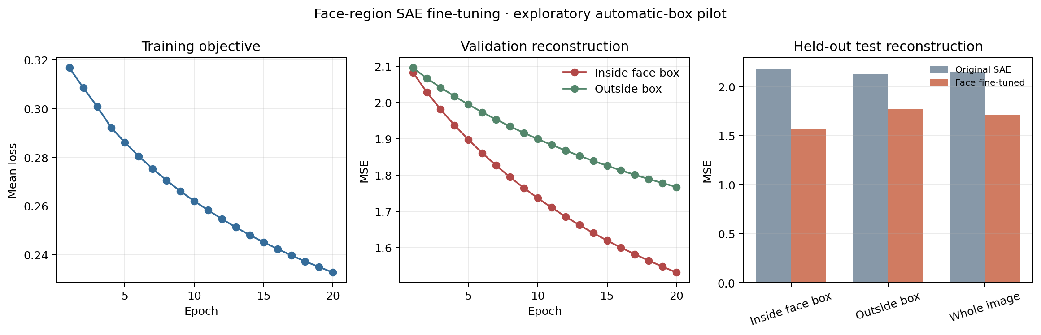
Face-box fine-tuning improved held-out reconstruction
Best checkpoint: epoch 20 · 240 held-out test images · lower MSE is better
Inside face box
2.188 → 1.570
28.3% lower
Outside face box
2.133 → 1.769
17.1% lower
Whole activation grid
2.149 → 1.711
20.4% lower
Reconstruction is measured in SAE activation space, not pixel space.
04
Notes:
The face run fine-tuned SAE activations at cells inside Florence-2 human-face boxes. On the test split, face-box MSE fell from 2.188 to 1.570, a 28.3% reduction. Outside-box MSE also improved from 2.133 to 1.769. The whole-grid score fell from 2.149 to 1.711. Because the SAE is reconstructing activations, not RGB images, these numbers do not by themselves say that generated faces look better.

Slide 5
Eye-focused fine-tuning also improved test reconstruction
Separate 20-epoch run · selected by validation eye MSE
Test metric | Original SAE | Eye-fine-tuned | Change
Eye-box MSE · 90 images | 2.1007 | 1.7608 | −16.2%
Whole face · same 90 | 2.1485 | 1.9282 | −10.3%
Whole face · all 240 | 2.1881 | 1.9671 | −10.1%
All cells · all 240 | 2.1491 | 2.0307 | −5.5%
Training scope
Interpretation
Updates SAE weights; does not train the image generator or add features.
Better activation reconstruction does not prove eye-specific semantics.
05
Notes:
This was a separate experiment initialized from the original pretrained SAE. Training loss used only activation vectors inside accepted eye boxes, with race/gender sampling balanced by category. The test comparison used 90 images with usable eye boxes. The eye MSE reduction was 16.2%. Across all 240 face-boxed test images, whole-face MSE improved about 10.1%. These remain activation reconstruction metrics; the run did not generate new RGB images.

Slide 6
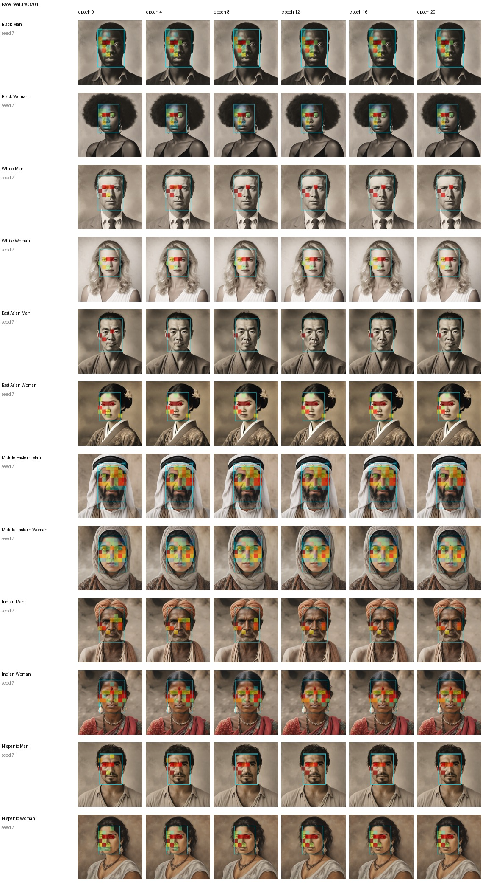
Activation maps across training checkpoints
Same held-out portraits · same feature · epochs 0, 4, 8, 12, 16, and 20
Cyan = automatic face box · `jet` colors = feature activation inside the box
06
Notes:
This sheet follows feature 3701 across checkpoints. It is selected as an eye-associated feature, but this broad face-box view shows where it activates on full face regions. The overlay is normalized per image; compare the location of activity more than raw color strength between different images.

Slide 7
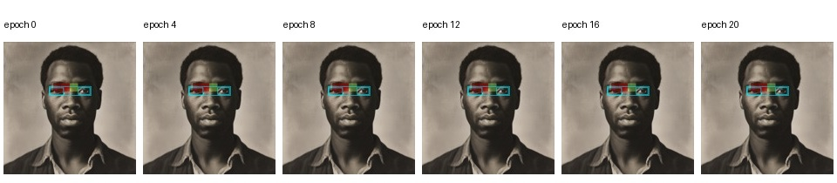
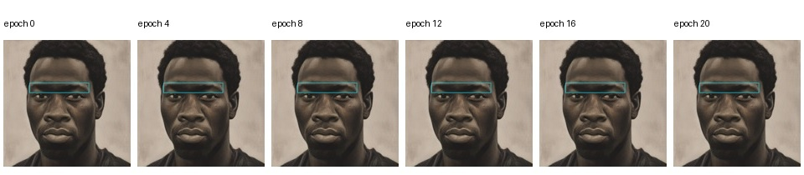
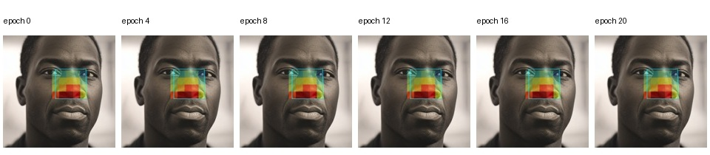
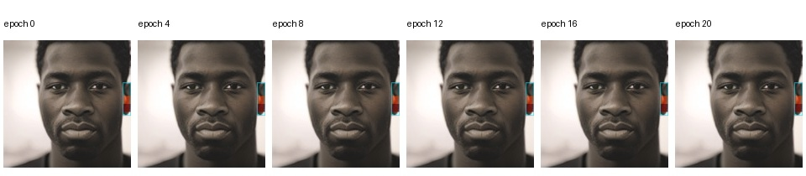
Each part now has its own feature candidates
Examples across epochs, with the activation overlay restricted to that part’s annotation box
Eyes · feature 3701
Eyebrows · feature 1600
Nose · feature 1664
Ears · feature 4858
Full sheets: 9/12 categories for eyes, 7/12 eyebrows, 4/12 nose, 6/12 ears.
07
Notes:
These compact strips use one Black Man held-out example per region to show the same sample across all six checkpoints. Full category-by-epoch sheets are saved in the run folder. Different parts use different features selected on validation data. Nose/ear boxes are especially sparse; this slide is an illustration, not a population-level comparison.

Slide 8
Selected features activate more inside their part boxes
Validation selected candidates; test set measured mean part-minus-reference activation
Region | Top features | Test n | Categories | Test contrast range (95% CI range)
Eyes | 3701, 3593, 1600 | 90 | 9 | +6.80 to +9.03 [+6.30, +10.66]
Eyebrows | 1600, 3701, 1237 | 28 | 7 | +6.27 to +7.96 [+4.27, +9.70]
Nose | 1664, 3593, 1991 | 13 | 4 | +6.54 to +11.79 [+5.08, +12.26]
Ears | 4858, 2230, 2611 | 18 | 6 | +5.39 to +10.18 [+2.43, +11.40]
Meaning
Not established
Evidence of localization to annotated boxes.
Dedicated semantics, causal control, or fairness effects.
08
Notes:
The contrast is mean activation in the part box minus mean activation in a reference area. It is not a correlation coefficient. Candidate ranking is done on validation data; confidence intervals are stratified image-bootstrap intervals on the held-out test split. Positive intervals support spatial association with these automatic boxes, not semantic identity. Ear comparison uses the rest of the image because ears can lie outside the face box.

Slide 9
Other intervention features also associate with face parts
19 fixed feature IDs · original pretrained SAE · held-out test portraits
Region | Leading fixed features · contrast [95% interval] | Test images / categories
Eyes | 527: +1.75 [1.40, 2.11] · 1664: +1.65 [0.85, 2.42] · 3725: +0.78 [0.43, 1.23] | 90 / 9
Eyebrows | 527: +2.66 [2.25, 3.04] · 3725: +1.62 [1.33, 1.91] · 3722: +0.61 [0.50, 0.71] | 28 / 7
Nose | 1664: +12.04 [11.48, 12.56] · 3725: +0.86 [0.70, 1.03] · 527: +0.43 [0.19, 0.70] | 13 / 4
Ears | 527: +5.60 [4.70, 6.49] · 3725: +4.10 [3.12, 5.02] · 3722: +2.89 [1.65, 4.09] | 18 / 6
Clearest part-centered pattern
Broader associations
Feature 1664: strong nose contrast; lower or negative contrast elsewhere.
Features 527 and 3725 show positive contrast in several parts.
Contrasts are SAE activation units, not percentages or correlation coefficients.
09
Notes:
The feature IDs came from the existing feature-intervention runs and were fixed before this held-out analysis. Each score is mean activation inside the automatic part box minus activation in the reference area, with a stratified image-bootstrap 95% interval. The same feature can appear in multiple rows because several features associate with more than one part. Feature 1664 has the clearest nose-centered pattern, while 527 and 3725 associate with several regions. These are spatial associations, not proof of semantic identity or causal editing. The nose and ear estimates have sparse sample coverage, and intervals are unadjusted across 76 feature-region comparisons.

Slide 10
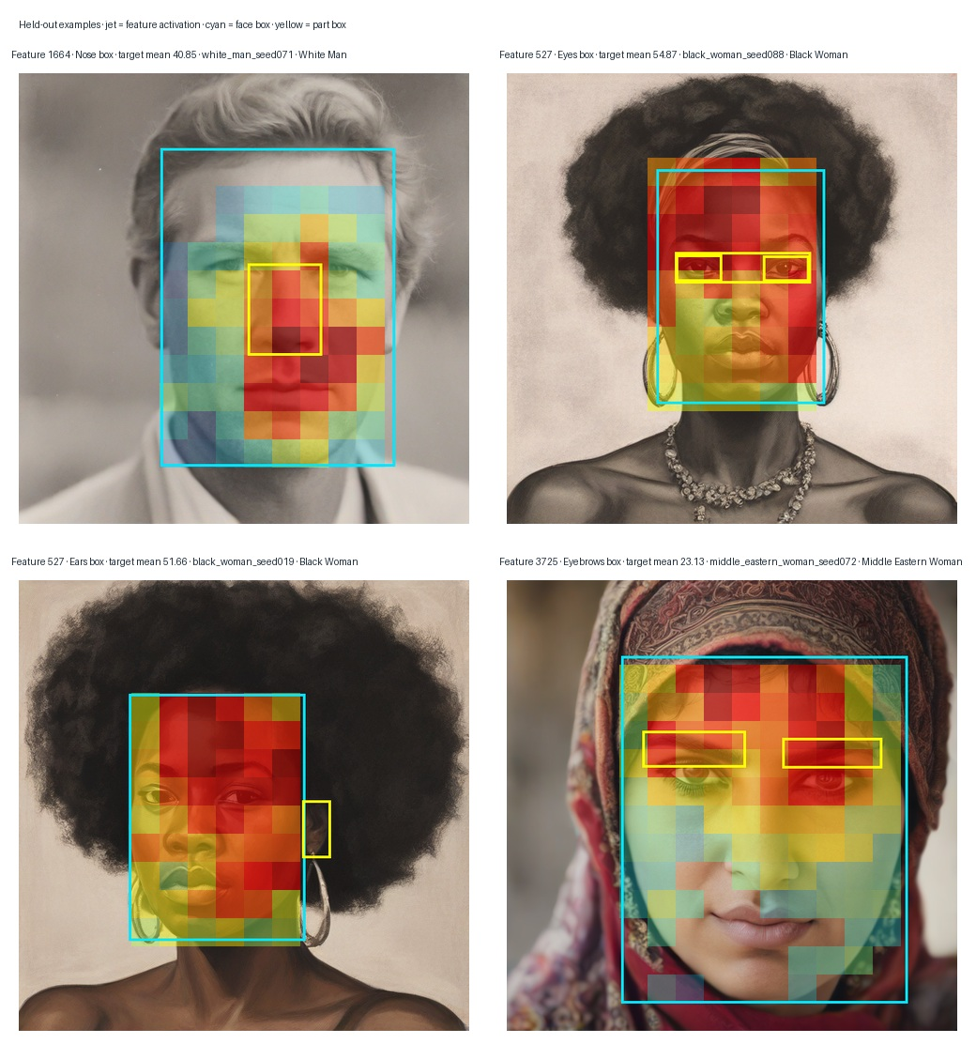
Jet heatmaps show example feature locations
Held-out portraits · cyan = detected face · yellow = annotated part
Feature 1664
The strongest activation in this example falls around the annotated nose box, consistent with its high held-out nose contrast.
Features 527 and 3725
Their heatmaps spread across more of the face, matching their positive contrasts in several regions rather than a single-part pattern.
How to read these panels
Examples selected for visibility; aggregate table uses the full held-out sample.
10
Notes:
These are illustrative high-activation examples, selected from eligible held-out test portraits for display. The heatmap is normalized within each detected face box. The examples help inspect spatial alignment, but do not estimate how often a feature localizes to a part; those estimates are in the preceding table and use all eligible test images. Boxes are automatic and unreviewed.

Slide 11
What we can claim—and what comes next
The evidence supports a useful localization result, with clear limits
Supported by these experiments
Still unknown
• Face and eye fine-tuning lowered held-out activation MSE.
• Candidate features had positive held-out part-box contrast.
• Whether a feature has a stable semantic meaning.
• Whether changing it edits only that part.
• Whether any fairness outcome improves.
Next steps
1. Audit detector boxes, especially nose and ear annotations.
2. Expand part coverage and repeat held-out localization.
3. If testing interventions, measure target presence and collateral changes directly.
4. Evaluate any fairness claim with a separate, explicit fairness outcome.
11
Notes:
Close with a careful summary. Both fine-tuning runs improved held-out SAE activation reconstruction. The region-specific candidates show positive held-out activation contrast. However, the automatic boxes are unreviewed and coverage varies sharply; nose has only 13 test images in four categories. The next steps are human review of part annotations, more usable nose/ear boxes, then evaluating interventions with direct outcome measures before making fairness claims.

Slide 12


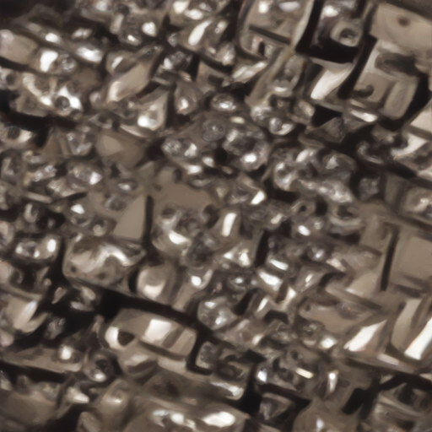
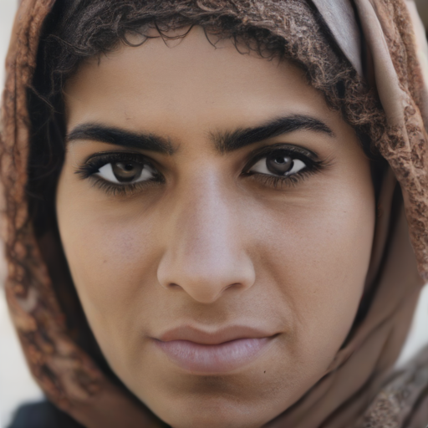

Negative steering did not remove headwear cleanly
Same 20 Middle Eastern woman prompt images · seeds 0–19 · α +1 = unchanged
Feature 138
Feature 3725
Mild negatives add ornate headwear; stronger values destroy the face.
Mild negatives leave scarves; stronger values obscure the face.
Original
α = −3
α = −50
Original
α = −3
α = −50
Conclusion
Neither feature produced clean headwear-only removal in this pilot. Count a result as successful only if the face stays intact and the headwear changes without major artifacts.
Qualitative review of 20 generated images in one prompt group; one reviewer. Feature IDs are model-specific candidates, not verified semantic labels.
12
Notes:
The feature 138 and 3725 interventions use the same SDXL Turbo U-Net block and SAE checkpoint. We visually compared same-seed originals with alpha -3 and alpha -50 outputs. For feature 138, mild negative steering often adds or exaggerates ornate headwear; strong steering produces abstract metallic texture. For feature 3725, mild negatives leave scarves in place; strong steering creates large beige fabric-like shapes and removes or fragments faces. This is a qualitative review by one reviewer, not a blinded study. Florence-2 pass counts do not measure face preservation or clean attribute removal.

