Slide 1
Testing SAE features for earring removal
A small test using SDXL Turbo, a pretrained SAE, and C2C boxes
The goal was to see whether reducing a spatial SAE feature could remove earrings from generated images.

Slide 2
What I tested
I used 80 images with the same prompt: 60 for feature search and 20 for validation.
The search used C2C earring boxes to measure SAE activity near the earrings.
The labels were automatic and have not been manually checked.

Slide 3
Feature scores did not hold up on validation
Feature 4858: AUC 0.670 on training images, 0.448 on validation.
Features 766 and 1237: validation AUC 0.562 and 0.500.
AUC near 0.50 means weak separation. Labels were automatic and unreviewed.

Slide 4
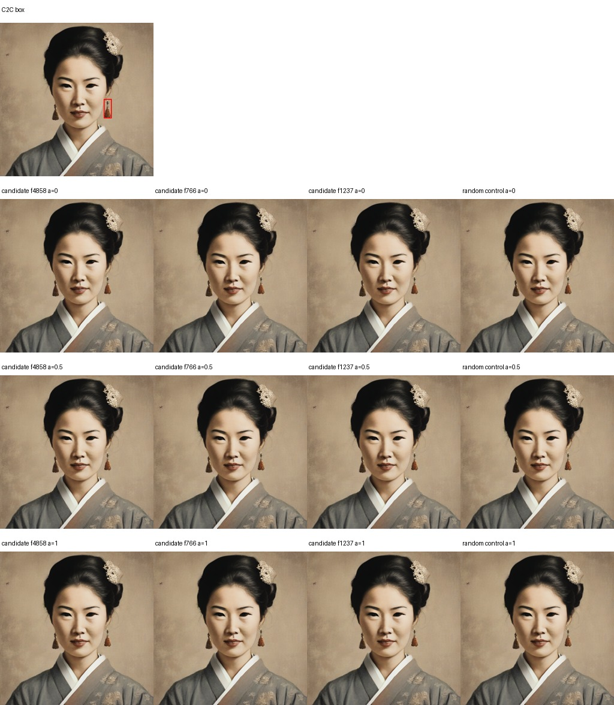
What happened when I reduced them
Feature 4858 changed the image, but the earring remained.
Features 766 and 1237 usually made no change.
Pixel change by itself does not show that the target object was removed.

Slide 5
What I learned
This test did not find a reliable SAE feature for removing earrings.
A C2C box helps locate an object, but it does not guarantee the SAE feature represents that object.
This is a useful negative result, but the sample is small and the automatic labels need review.

Slide 6
Next step
Manually check the earring labels and boxes on more images.
Measure whether the earring disappears and whether the face and other image content stay similar.
If the feature search still fails, test a direct image-editing or inpainting method as a comparison.

