Slide 1
RESEARCH BRIEFING
Sparse autoencoders for a racial-bias audit
Controlled interventions on an existing SDXL Turbo portrait baseline
Interpretable controls are working.
Bias reduction is still an open question.
600
432
0
existing baseline portraits
controlled feature edits
pixel error in replay / no-op checks
SDXL Turbo · SAE portrait audit | exploratory findings
01
Notes:
This presentation describes work that was actually performed on local artifacts. The central finding is methodological: the pipeline supports exact matched-seed replay and controlled feature scaling. It does not establish that racial bias or image quality improved. The portrait study uses the existing pretrained SAE so old feature IDs retain their reference. A separate small SAE training pilot is included only in the appendix. All race and gender labels refer to generation prompts, not inferred identities.
Local evidence: FINDINGS.md; sae_bias_experiment.py

Slide 2
RESEARCH QUESTION
Three questions require different evidence
A feature can distinguish prompt groups without controlling an unwanted attribute.
1 · Association
2 · Intervention
3 · Bias outcome
Do feature activations differ across the six prompt groups?
Measured on cached SAE vectors.
What changes when one feature is suppressed or amplified?
Tested with fixed seeds.
Does an unwanted outcome decrease without collateral damage?
Not yet measured.
SDXL Turbo · SAE portrait audit | exploratory findings
02
Notes:
We distinguish association, intervention, and fairness evaluation. Association measures whether SAE activations vary with generation-prompt categories. The intervention tests what changes when a specific internal feature contribution is multiplied while holding the prompt and random seed fixed. A fairness claim additionally requires a predefined unwanted outcome, annotations, and a comparison of outcome rates across groups. The current run completes the first two stages for selected features; it has not completed the third.
Local evidence: FINDINGS.md; sae_bias_experiment.py

Slide 3
DATA
Two existing datasets, two distinct roles
The cached SAE vectors and the saved portrait PNGs are separate artifacts.
Baseline images
Cached feature vectors
6 prompt races × 2 genders × 50 seeds
600 saved portraits
Replay sample: seeds 40, 41, 42
36 matched baseline images
600 images × 5,120 SAE dimensions
Spatial maximum over each feature map
480 discovery / 120 held-out samples
40 / 10 samples in each category
Labels are taken from generation prompts. No racial identity is inferred from image pixels.
SDXL Turbo · SAE portrait audit | exploratory findings
03
Notes:
The baseline has 50 images per race/gender category, for 600 PNGs total. The separate cached feature file also contains 600 samples, each represented by 5,120 spatial-max-pooled pretrained SAE activations. It uses randomly sampled seeds from its own generation script. That file is used for feature discovery and held-out association reporting; baseline seeds 40, 41, and 42 are used for visual interventions. The cached codes are not the raw 1,280-channel residual inputs needed to train a new SAE. The cached file does not store per-row seed metadata.
Local evidence: baseline/images/; race_classifier/race_classify_features.npz; race_classifier/generate_data.py

Slide 4
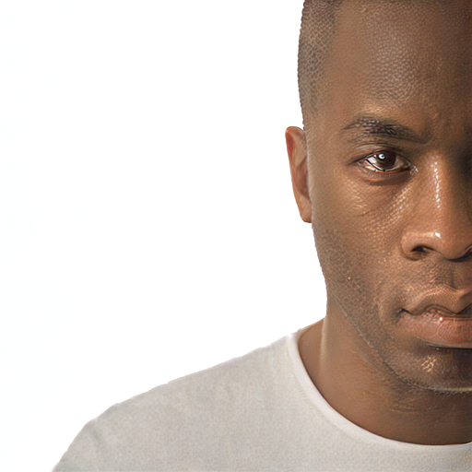
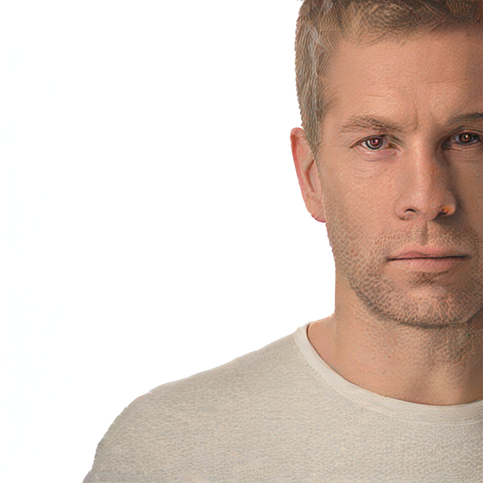
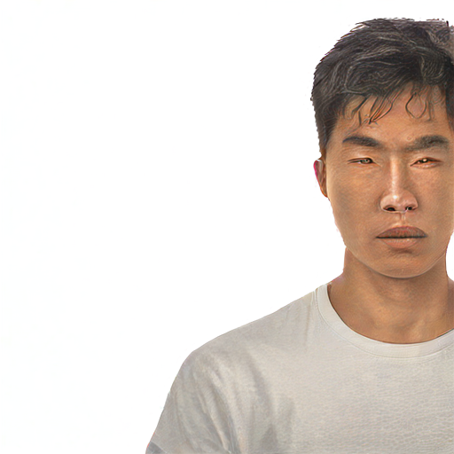
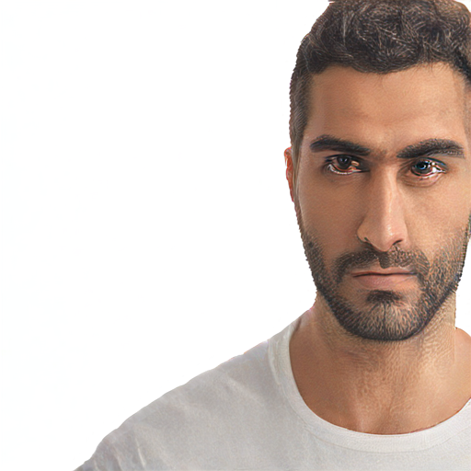
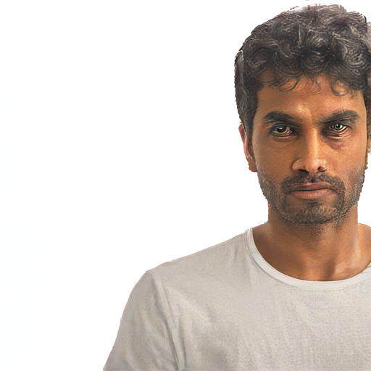
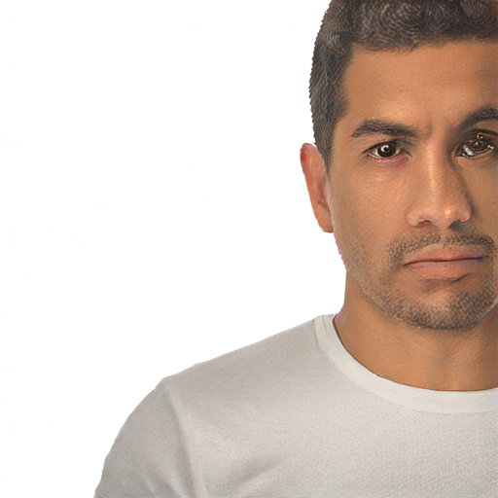
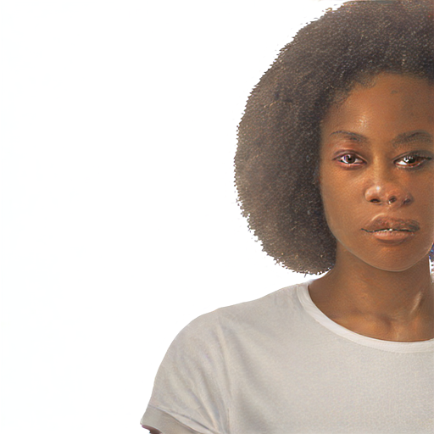
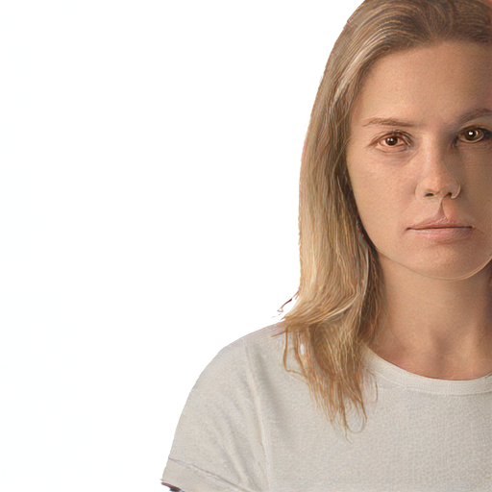
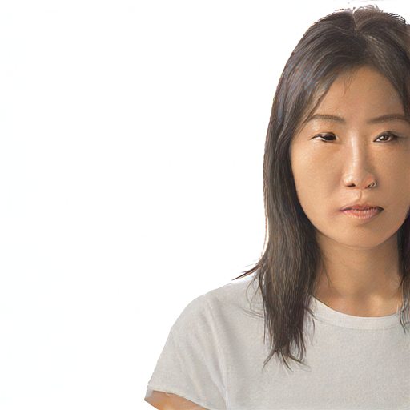
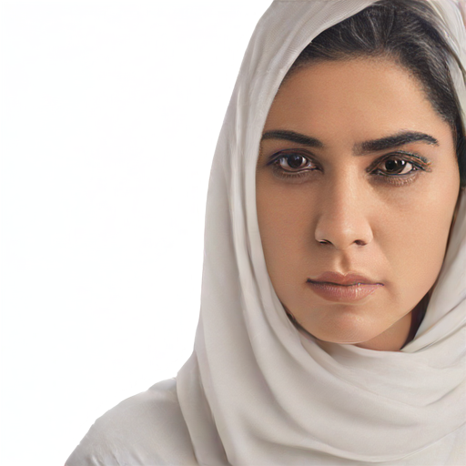
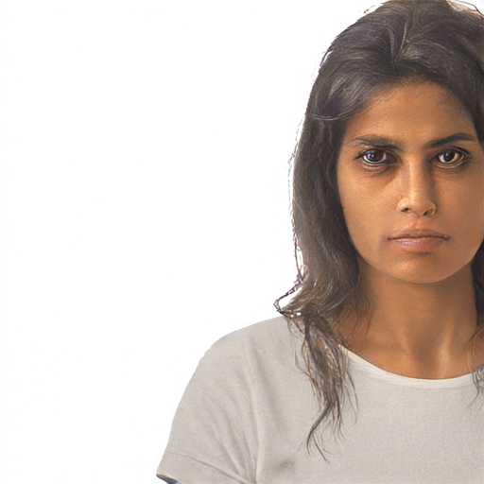
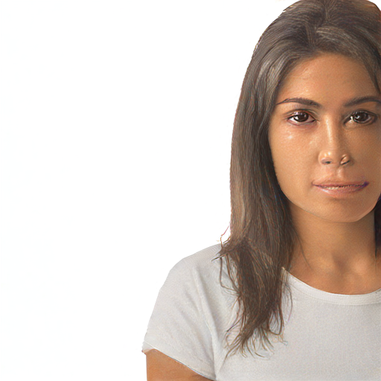
BASELINE COVERAGE
The baseline spans all 12 prompt categories
Seed 40 shown in each cell; identical prompt template except for race and gender.
Black
White
East Asian
Middle Eastern
Indian
Hispanic
man
man
man
man
man
man
woman
woman
woman
woman
woman
woman
SDXL Turbo · SAE portrait audit | exploratory findings
04
Notes:
This slide provides the category coverage, not an assessment of the depicted people’s identities. Rows correspond to man and woman prompts. Columns follow the six requested race labels. The template fixes expression, shirt color, background, and a request for no facial coverings. The original phrase does not explicitly exclude a headscarf that leaves the face visible. This distinction matters when interpreting the Middle Eastern woman example. We replay this exact template rather than changing it during the intervention experiment.
Local evidence: baseline/images/*/baseline40.png; baseline/baseline-image-generation.ipynb

Slide 5
MODEL
What the SAE represents
A sparse dictionary of intermediate U-Net residual changes—not input noise or image latents.
Block residual
Sparse encoding
Reconstruction
r = output − input
1,280 channels per position
→
z = ReLU(TopK(Wₑ(r − b) + c))
5,120 features; k = 10
→
r̂ = Wᵈz + b
Learned decoder directions
The same pretrained dictionary is used for every group; feature IDs are checkpoint-specific.
SDXL Turbo · SAE portrait audit | exploratory findings
05
Notes:
The analysis taps unet.down_blocks.2.attentions.1. For every spatial position, the training representation is the attention block output minus its input, with 1,280 channels. The existing SAE expands this into a 5,120-dimensional feature dictionary using Top-K encoding with k=10 and ReLU. Each decoder column is a learned residual direction. The pretrained checkpoint also has an auxiliary-k setting of 256 in its configuration. We do not retrain this checkpoint in the portrait audit. This preserves feature IDs from the previous notebooks.
Local evidence: sdxl-unbox/SAE/sae.py; pretrained down.2.1 final/config.json; sae_bias_experiment.py

Slide 6
INTERVENTION EQUATION
Feature scaling preserves reconstruction error
Only the selected feature contribution is changed; the remaining block output stays intact.
output′ = output + (s − 1) · z_f · d_f
s = 0
s = 0.5
s = 1
s = 2
remove contribution
halve contribution
exact no-op
double contribution
Spatial activations are scaled separately at every location. Features are edited one at a time.
SDXL Turbo · SAE portrait audit | exploratory findings
06
Notes:
Let r be the original residual and r-hat its SAE reconstruction. The residual reconstruction error is e = r minus r-hat. Scaling feature f from z-f to s times z-f changes the reconstruction by (s minus 1) times z-f times decoder direction d-f. Adding this delta directly to the original block output preserves e. This prevents generic SAE reconstruction artifacts from being mixed into every intervention. Strength one is therefore a mathematical no-op. Inactive features remain inactive under multiplicative editing; this procedure is not an additive feature injection.
Local evidence: sdxl-unbox/scripts/sae_experiment.py: intervention; sae_bias_experiment.py

Slide 7
FEATURE DISCOVERY
Candidate ranking controls for prompt gender
Discovery and held-out association are computed separately.
C(r,f) = mean_g [(μ(r,g,f) − μ(other races,g,f)) / σ(discovery,f)]
Discovery: 480 samples
Held-out: 120 samples
Rank absolute standardized contrast.
Check sign agreement across genders.
Report the same selected feature’s effect.
No confidence intervals or p-values.
SDXL Turbo · SAE portrait audit | exploratory findings
07
Notes:
For each race/gender cell, an RNG with seed zero produces a 40/10 discovery/held-out split. For a given race and feature, we calculate the difference between that race’s discovery mean and the mean of other races within each gender. We divide by the feature’s standard deviation across all discovery samples, clipped at 1e-6 for numerical stability, and average the two gender contrasts equally. Candidate 3530 is the strongest additional gender-sign-consistent discovery association. Features 138 and 527 were included because of prior analyses. Held-out effects do not select the candidate. This is exploratory; no multiple-testing-adjusted significance is reported.
Local evidence: sae_bias_experiment.py: analyze; feature_associations.csv; cached_data_split.npz

Slide 8
ASSOCIATION RESULTS
Prompt-associated features persist on held-out data
Different features emerge for different prompt groups; these are associations, not semantic labels.
Black · f527
2.44 / 2.28
White · f4384
1.94 / 1.87
East Asian · f1431
1.63 / 1.41
Middle Eastern · f3530
2.44 / 2.65
Indian · f2527
2.43 / 2.47
Hispanic · f1678
1.72 / 1.64
Discovery
Held-out
Standardized contrast; larger is stronger association
SDXL Turbo · SAE portrait audit | exploratory findings
08
Notes:
The chart shows the strongest discovery association for each requested race label and its corresponding held-out contrast. The numerical values are standardized effect contrasts, not classification accuracy or bias scores. All six displayed features have a positive association with their own prompt label in both splits. Only 527 and 3530 from this list were intervened on; feature 138 is an additional previously studied candidate. The other four top features remain association findings. The same prompt template appears in discovery and held-out data, so this does not demonstrate transfer to new prompt formulations.
Local evidence: feature_associations.csv

Slide 9
EXPERIMENTAL CONTROLS
A fully matched intervention experiment
Three seeds, all categories, the same three features, and four strengths.
12 categories × 3 seeds × 3 features × 4 strengths = 432 edits
36 / 36 baseline replays
108 / 108 no-op controls
Pixel-identical to saved baseline PNGs.
Seed values: 40, 41, 42.
Strength 1 is pixel-identical to replay.
No reconstruction replacement in edits.
Checkpoint: down.2.1 · 5,120 features · k=10 | SDXL Turbo · 512² · 1 step · CFG=0
SDXL Turbo · SAE portrait audit | exploratory findings
09
Notes:
The experiment includes 12 categories, three seeds, three features, and four strengths, yielding 432 edited images. The three features are 138, 527, and 3530. Replay uses the original fp16 VAE, Euler ancestral scheduler with trailing timesteps, one denoising step, guidance scale zero, and separately seeded latent and scheduler random streams. The original baseline and the new replay matched exactly for all 36 cases. Every strength-one image was also pixel-identical to its replay. This validates reproducibility and the no-op control, but does not measure fairness or quality. The current run generated 36 category/feature grids.
Local evidence: settings.json; intervention_metrics.csv; sae_bias_experiment.py

Slide 10
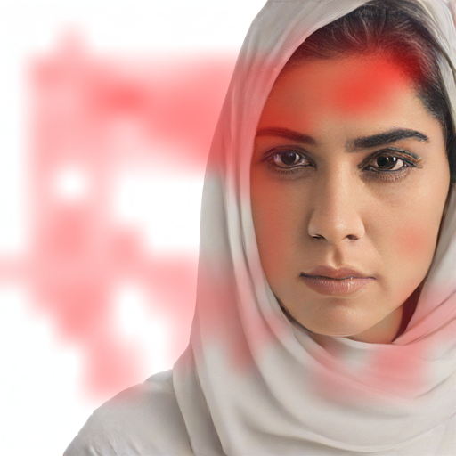
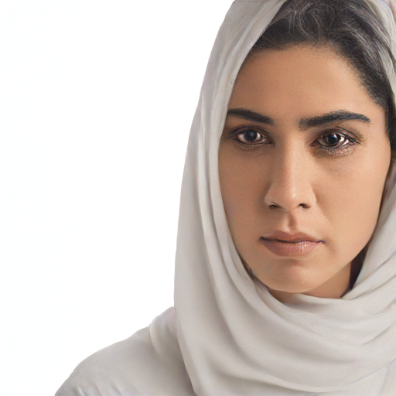

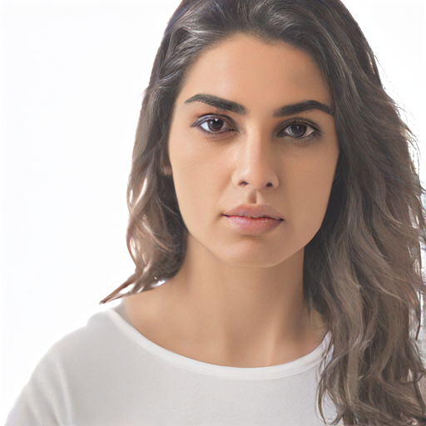
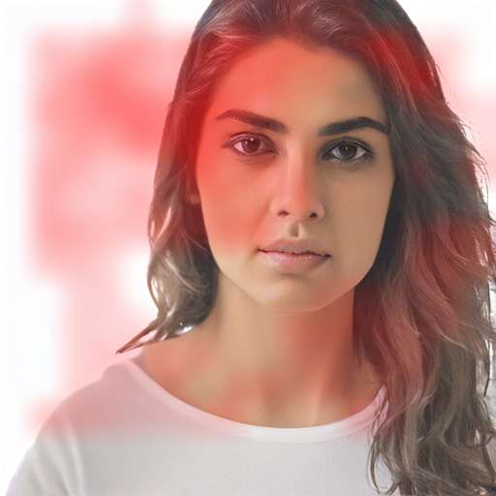
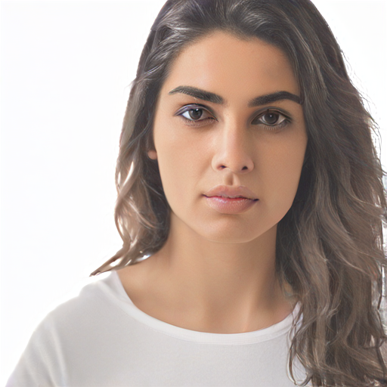
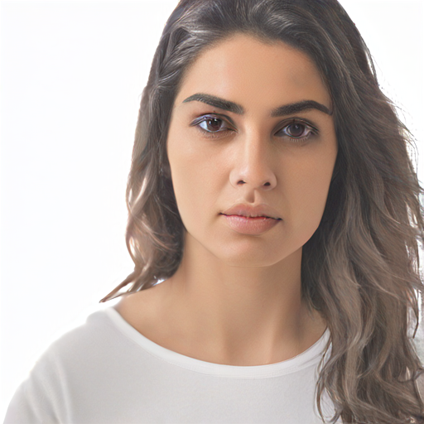
VISUAL INTERVENTION
Feature 138 does not cleanly control head coverings
Middle Eastern woman prompts; scarf remains in seed 40 at strength 0.
Original
Activation map
Strength 0
Strength 2
Seed 40
Original
Activation map
Strength 0
Strength 2
Seed 41
SDXL Turbo · SAE portrait audit | exploratory findings
10
Notes:
The side-by-side images show two seeds from the Middle Eastern woman prompt category. Seed 40 contains a visible headscarf; removing feature 138’s contribution does not remove it. Seed 41 has visible uncovered hair, and the feature is active there as well. Scaling produces changes in face and hair detail, which agrees with the earlier notebook’s plain-hair confound. Heatmap intensity is normalized independently per image, so colors do not support cross-image magnitude comparisons. The original prompt prohibits facial coverings, not all head coverings; this example is not by itself an established prompt violation.
Local evidence: middle_eastern_woman/feature138_comparison.png; individual seed PNGs; intervention_metrics.csv

Slide 11
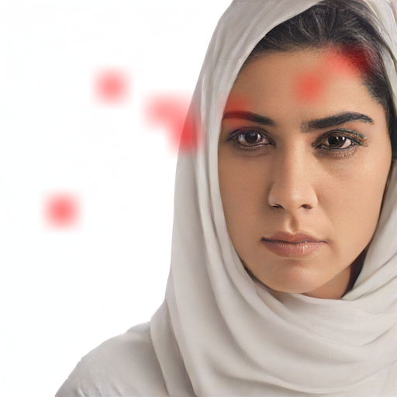

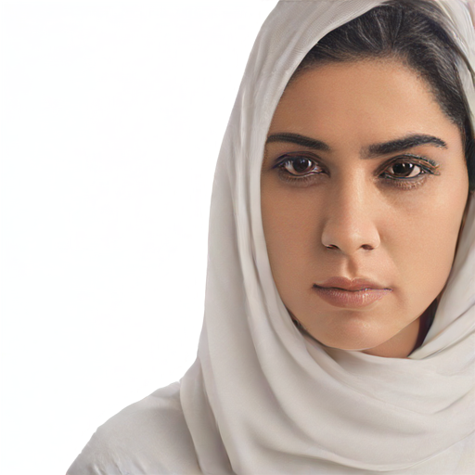
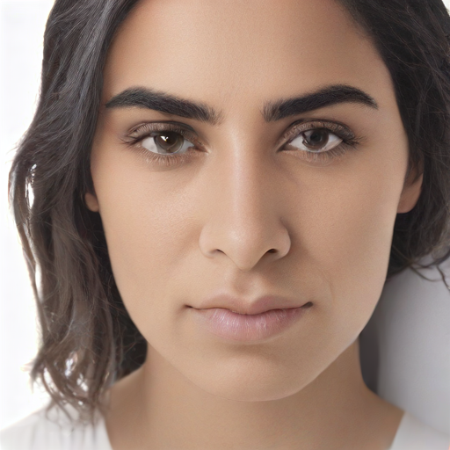
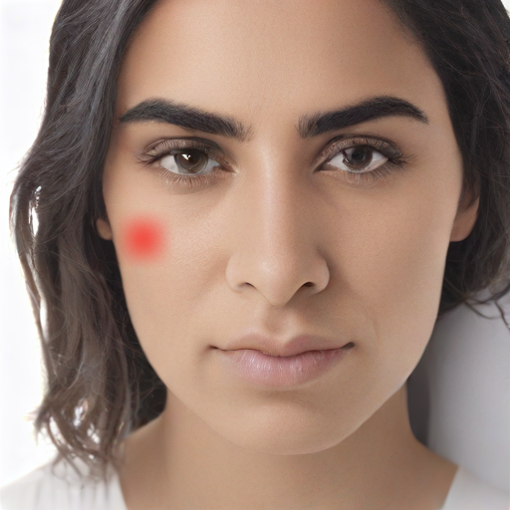


VISUAL INTERVENTION
Feature 3530 is associated, but not a scarf switch
The strongest additional candidate changes detail without removing the seed-40 scarf.
Original
Activation map
Strength 0
Strength 2
Seed 40
Original
Activation map
Strength 0
Strength 2
Seed 42
SDXL Turbo · SAE portrait audit | exploratory findings
11
Notes:
Feature 3530 was selected as the strongest additional gender-sign-consistent discovery association after including 138 and 527. Its held-out standardized contrast for the Middle Eastern prompt label is 2.65. Despite that association, the intervention at strength zero leaves the scarf in seed 40. The visible changes are smaller and involve facial or local detail in these examples. This separates prompt association from control of a specific attribute. It does not imply the feature lacks effects under other prompts, strengths, blocks, or denoising steps; those were not tested here.
Local evidence: middle_eastern_woman/feature3530_comparison.png; individual seed PNGs; intervention_metrics.csv

Slide 12
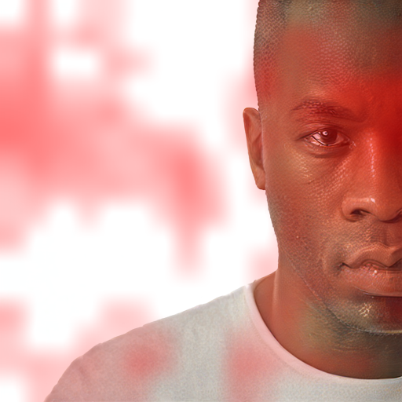
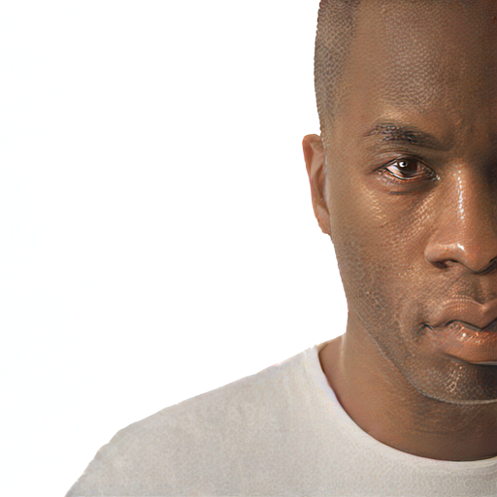
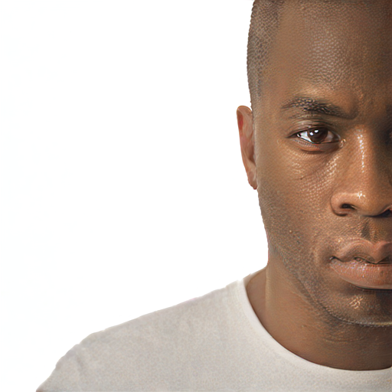
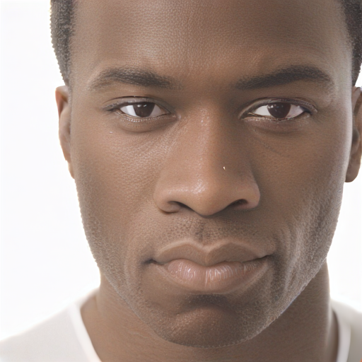
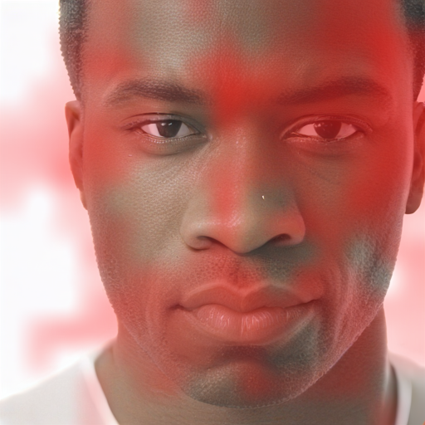
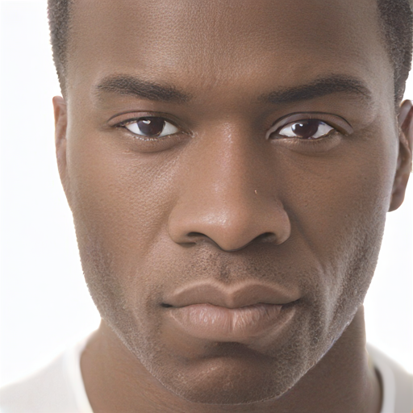
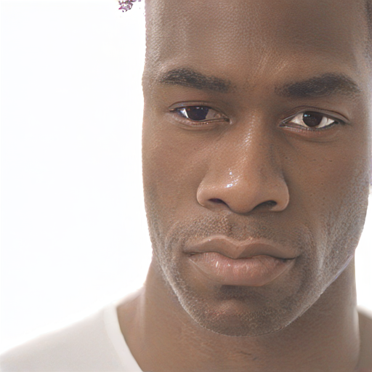
VISUAL INTERVENTION
Feature 527 changes depiction, not an evaluated bias score
Black man prompts; changes include texture/contrast and pose or crop at some settings.
Original
Activation map
Strength 0
Strength 2
Seed 40
Original
Activation map
Strength 0
Strength 2
Seed 42
SDXL Turbo · SAE portrait audit | exploratory findings
12
Notes:
The two examples use the Black man prompt category. Feature 527 has a strong discovery and held-out association with the Black prompt label. Reducing or amplifying its contribution changes face texture and contrast. In seed 42, amplification also produces visible differences in composition and facial detail. These visual observations do not establish a semantic feature label or a quality preference. Suppressing a group-associated feature can alter a requested depiction without improving fairness. No identity inference or race classifier is applied to the edited images in this experiment.
Local evidence: black_man/feature527_comparison.png; individual seed PNGs; intervention_metrics.csv

Slide 13
MEASURED IMAGE EFFECTS
Intervention magnitude varies across prompt groups
Mean absolute RGB pixel change at strength 0; averaged over both genders and three seeds.
Prompt group
Feature 138
Feature 527
Feature 3530
Black
0.00
7.27
0.00
White
0.00
0.00
0.00
East Asian
0.00
0.07
0.00
Middle Eastern
4.60
1.42
2.75
Indian
0.35
1.42
0.00
Hispanic
0.00
3.81
0.00
0 means no image change under this intervention—not absence of bias. Pixel change is not a quality metric.
SDXL Turbo · SAE portrait audit | exploratory findings
13
Notes:
The table aggregates the recorded mean absolute pixel differences between original and edited PNGs at strength zero. Each cell averages six images, two genders times three seeds. Values are on an 8-bit RGB scale from zero to 255. This quantifies whether an intervention has an effect and how large its image-level change is, not whether it improves quality or fairness. Feature 138 and 3530 are inactive in several tested categories, giving zero changes. Feature 527 also changes some Hispanic, Indian, and Middle Eastern samples. Results are descriptive with a small sample and no uncertainty intervals.
Local evidence: intervention_metrics.csv; test_activation_metrics.csv

Slide 14
INTERPRETATION
What the evidence supports—and what it does not
The main contribution is a reproducible feature-intervention audit.
Supported
Not established
Exact saved-baseline replay
Correct no-op and strength scaling
Held-out prompt-group associations
Feature-dependent image changes
A feature’s semantic meaning
Head-covering removal
Reduced racial bias
Improved quality or prompt transfer
SDXL Turbo · SAE portrait audit | exploratory findings
14
Notes:
The experiments support exact baseline replay, correct multiplicative editing, associations that recur in a held-out cached split, and qualitative changes from selected feature interventions. They do not establish semantic race features, headscarf-specific control, mitigation of racial bias, improvement in image quality, or generalization beyond the current prompt template. An older classifier achieved perfect held-out classification on its own split, but this is prompt-group decodability, not a fairness score, and no classifier was applied to edited images in the present run. The distinction should be central to the research narrative.
Local evidence: FINDINGS.md; sae_bias_experiment.py

Slide 15
LIMITATIONS
Threats to validity
A useful exploratory result requires a narrower claim than “we removed bias.”
Coverage
Measurement
Selection
3 seeds per category
1 prompt template
1 U-Net block
1 denoising step
Spatial-max associations
No outcome annotations
No quality scores or intervals
Per-image heatmap scaling
Exploratory candidate choices
Prior notebook knowledge
No held-out prompt family
Inactive features stay inactive
SDXL Turbo · SAE portrait audit | exploratory findings
15
Notes:
The intervention sample has only three seeds per category and uses one template, one block, and one denoising step. Candidate selection is partly informed by older analyses, so the held-out cached split is exploratory rather than a pristine confirmatory test. The spatial-max feature representation can emphasize a single location and does not directly locate a semantic concept. The intervention is restricted to features that already activate. Human reviews remain blank, and no inter-rater agreement, confidence intervals, or downstream quality measures have been computed. Overlay maps are normalized independently and should not be used for magnitude comparisons.
Local evidence: FINDINGS.md; sae_bias_experiment.py

Slide 16
PROPOSED NEXT EXPERIMENT
The next study should target a defined unwanted outcome
Use paired prompts and hold out seeds before feature selection.
01
02
03
Define the outcome
Select specific controls
Evaluate on untouched seeds
Explicit prompt constraint;
consistent across groups.
Matched prompts / seeds;
compare multiple blocks.
Annotate outcomes, artifacts,
and collateral changes.
Measure Δ unwanted-outcome rate by group + artifact cost + uncertainty.
SDXL Turbo · SAE portrait audit | exploratory findings
16
Notes:
This slide proposes future work, not completed results. For a head-covering target, use a common explicit no-head-covering instruction for every category, along with a paired prompt variant. Reserve common seeds across all categories for final evaluation before candidate selection. Collect residual vectors from multiple blocks and compare matched activation changes, then evaluate feature interventions on those untouched seeds. Annotate unwanted coverings, hair damage, clothing compliance, image artifacts, and image preference with blinded or randomized presentation. Report within-group outcome changes and between-group disparities with uncertainty. Prompt compliance and requested appearance should be assessed alongside the bias target.
Local evidence: FINDINGS.md; sae_bias_experiment.py

Slide 17
ARTIFACTS
The experiment is reproducible and reviewable
Scripts, grids, metrics, raw activation maps, and a blank annotation sheet are saved.
Run analysis only
python -I -u sdxl-unbox/scripts/sae_bias_experiment.py
--output baseline/new_bias_analysis --analysis-only
Run all-category sweeps
python -I -u sdxl-unbox/scripts/sae_bias_experiment.py
--output baseline/new_bias_interventions --seeds 40 41 42
SDXL Turbo · SAE portrait audit | exploratory findings
17
Notes:
The new bias experiment script has an analysis-only mode and a complete replay mode. Outputs include the dataset split, candidate associations, test activation metrics, intervention pixel changes, per-image raw maps, individual PNGs, 36 grids, and a markdown report. The annotation sheet has 432 rows, one per intervention, with blank fields for outcomes and preference; those blanks must not be mistaken for results. Existing notebooks and baseline images were preserved. The separate generic SAE training script remains available but its prompt split is not suitable as a balanced portrait audit without adaptation.
Local evidence: sdxl-unbox/scripts/sae_bias_experiment.py; SAE_BIAS_EXPERIMENT.md; output REPORT.md

Slide 18
TRAINING PROVENANCE
Appendix · the initial SAE training pilot
A small new dictionary was trained, then excluded from the racial-bias experiment.
Training configuration
Observed fit
1,280 → 5,120 dimensions; k=20
10,240 train / 2,048 held-out vectors
500 Adam steps; learning rate 10⁻⁴
Training batch MSE: 7.774 → 0.856
Held-out normalized MSE: 1.221 → 0.976
86.6% unused on held-out sample
For the portrait audit, reuse of the original pretrained k=10 SAE preserves old feature IDs.
SDXL Turbo · SAE portrait audit | exploratory findings
18
Notes:
Before the portrait scope was clarified, a separate Top-K SAE was trained on ten varied prompts with four seeds per prompt, with two additional prompts held out. The actual dataset has 10,240 training vectors and 2,048 validation vectors; the selected block has 256 spatial positions per image, below the collection cap of 512. The new dictionary has 5,120 features and k=20 and was trained for 500 Adam steps at learning rate 1e-4. Held-out normalized MSE fell from 1.221 to 0.976, near a held-out-mean prediction baseline. 86.6 percent of features were unused on that validation sample, not globally dead. This pilot demonstrates trainability, not adequate feature quality, and its IDs do not transfer to the pretrained dictionary.
Local evidence: baseline/sae_experiment_20261009/RESULTS.md; training_metrics.json; sae_experiment.py

Slide 19
MEASUREMENT AUDIT
Appendix · a normalization issue in the old notebook
The new analysis leaves old artifacts intact and reports quantities with correct denominators.
Old “freq” field
New replay fraction
Σ active spatial positions / number of images
Meaning: active positions per image
Can exceed 1.
mean over positions [activation > 0]
Meaning: spatial fraction per image
Bounded between 0 and 1.
Cached NPZ remains spatial-max pooled; its image-active fraction is a different statistic.
SDXL Turbo · SAE portrait audit | exploratory findings
19
Notes:
The old race-prevalence notebook sums active spatial positions for each feature and divides by the number of generated images. Its comment calls the result a fraction of positions, but the value is the mean number of active positions per image. A true spatial active fraction divides by the total number of positions, or averages a per-image fraction when shapes are constant. The new cached-data association uses spatial maxima because that is what the existing feature file contains, and labels it accordingly. The new replay metrics calculate spatial means, maxima, and actual active fractions. No historical JSON, CSV, or notebook output was overwritten.
Local evidence: baseline/sae_race_feature_analysis.ipynb; existing_feature_138_527.csv; test_activation_metrics.csv

Slide 20
EVIDENCE INDEX
Appendix · local evidence and exact configuration
All reported quantitative results are derived from workspace artifacts.
Findings
baseline/sae_bias_interventions_20261009/FINDINGS.md
Method
sdxl-unbox/scripts/sae_bias_experiment.py
Associations
feature_associations.csv; cached_data_split.npz
Controls
intervention_metrics.csv; settings.json
Visuals / review
REPORT.md; */feature*_comparison.png; human_review.csv
Training pilot
baseline/sae_experiment_20261009/RESULTS.md
Interpretation: successful controlled edits; no demonstrated fairness or quality improvement.
SDXL Turbo · SAE portrait audit | exploratory findings
20
Notes:
The slides are grounded in local output files, rather than paper claims or external benchmarks. The pretrained checkpoint config lists 1,280 input dimensions, 5,120 features, k=10, auxk=256, and a dead-steps threshold of 2,441. The run uses cached SDXL Turbo and the fp16-fixed VAE, a single GPU, one 512-square denoising step, and the settings shown here. The working Python environment was isolated with -I to avoid a broken user-level torch import. Model startup initially waited on filesystem reads; after loading, generation and intervention checks completed. These environment details explain execution but are not research results.
Local evidence: FINDINGS.md; settings.json; intervention_metrics.csv; pretrained final/config.json; build_sae_presentation.py

