Slide 1
Before we get started…
Clone/download the files in this github repository onto your HPCC account: https://github.com/eleanore-ritter/plb812-svs
Run the following wherever you downloaded the github repository:
conda env create –f plb812-svs.yml
conda env create –f plb812-svs-smoove.yml
If you need any help at all, please ask me ☺

Slide 2
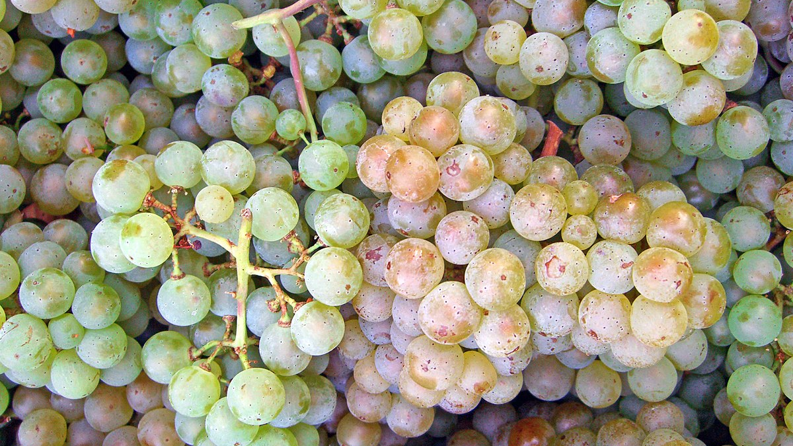
Computationally Decoding Structural Variants
Eleanore Ritter
November 16, 2022
Notes:
Image from https://upload.wikimedia.org/wikipedia/commons/thumb/b/b3/Pinot-blanc.jpg/1200px-Pinot-blanc.jpg

Slide 3
Learning Objectives
Know what structural variants (SVs) are – biologically and computationally!
Understand the strengths and weaknesses of short versus long read sequencing
Be able to:
Use short read data to call SVs with DELLY and smoove
Pre-process and map long reads
Use long read data to call SVs with sniffles and pbsv

Slide 4
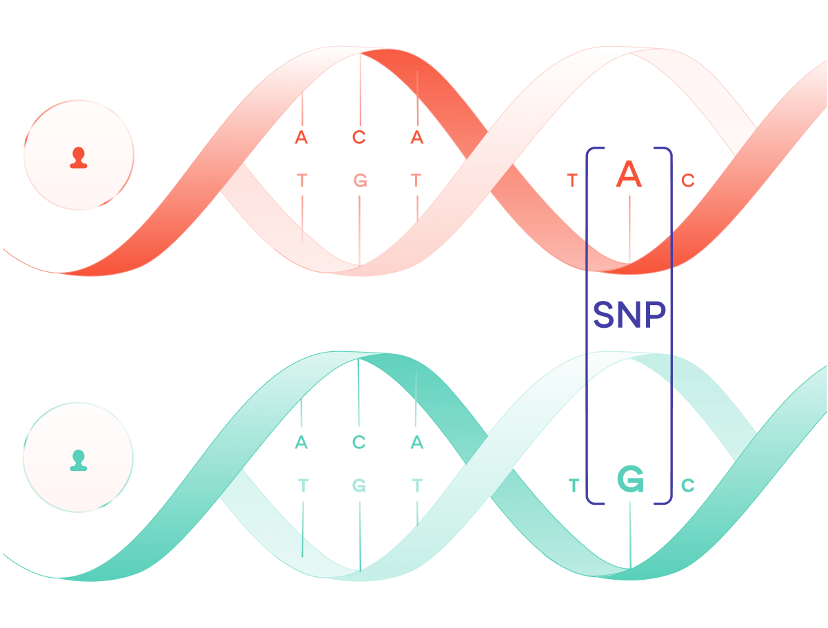
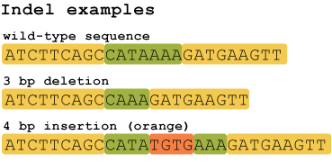
Genomic Variants
Two types of widely studied genomic variants…
Single nucleotide polymorphisms (SNPs)
Insertion or deletion of base pairs (Indels)
Notes:
SNP image from: https://medium.com/@sanogenetics/snp-of-the-week-58e23927c188
Indel image from: https://hackbrightacademy.com/blog/indel-finder-how-the-python-version-of-this-program-works/

Slide 5
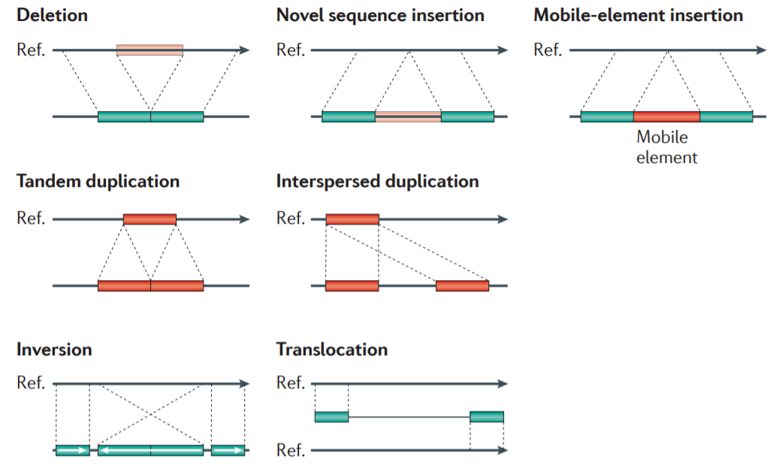
Genomic Variants
Improvements in sequencing technologies and cost have enabled the study of larger structural variants (SVs)
Image from Alkan et al. 2011

Slide 6
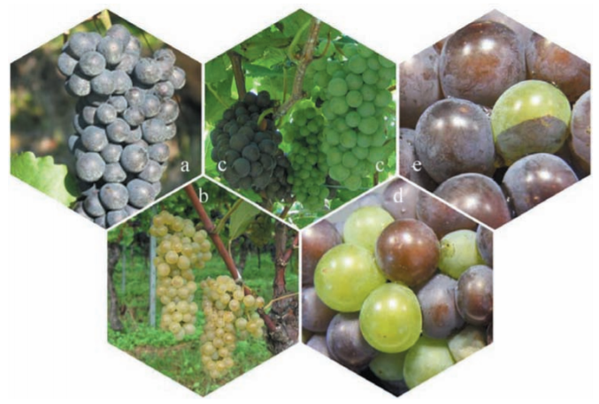
Why do we care?
Figure 1 adapted from Vezzulli et al. 2012

Slide 7
A grapevine example from Vezzulli et al. 2012
Pinot noir
Pinot gris
The loss of berry color is due to two different SVs in a Myb gene
~4000 kb (chimeric) deletion in Pinot gris
~100 kb deletion in Pinot blanc
Pinot blanc
Figure 1 adapted from Vezzulli et al. 2012

Slide 8
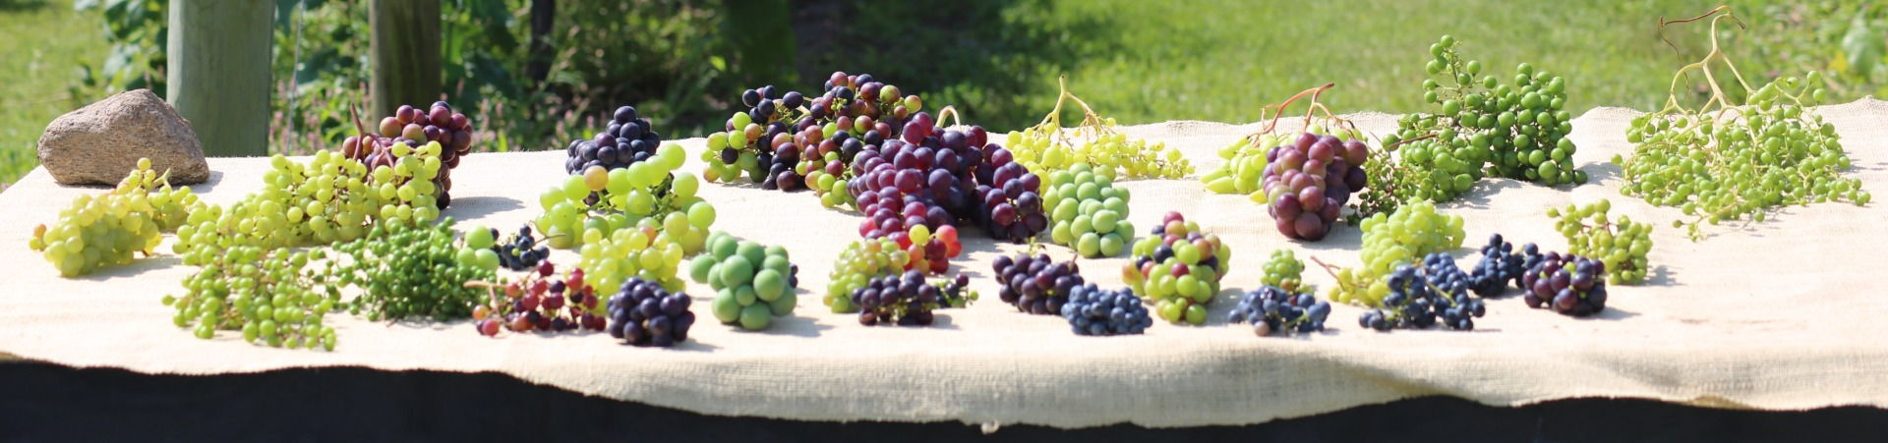
The bottom line…
SVs are cool and they impact the plants we study and eat!
USDA ARS

Slide 9
Now, how do we study them?
Short-read sequencing (ideally to decent coverage, like ≥15X)
Long-read sequencing (ideally to decent coverage, like ≥15X)
Comparing genome assemblies

Slide 10
Now, how do we study them?
Short-read sequencing (ideally to decent coverage, ≥15X)
Long-read sequencing (ideally to decent coverage, ≥ 15X)
Comparing genome assemblies
Using short- and long-read sequencing data to call SVs is currently more prevalent than comparing genome assemblies due to cost and time, so we will focus on these two.

Slide 11

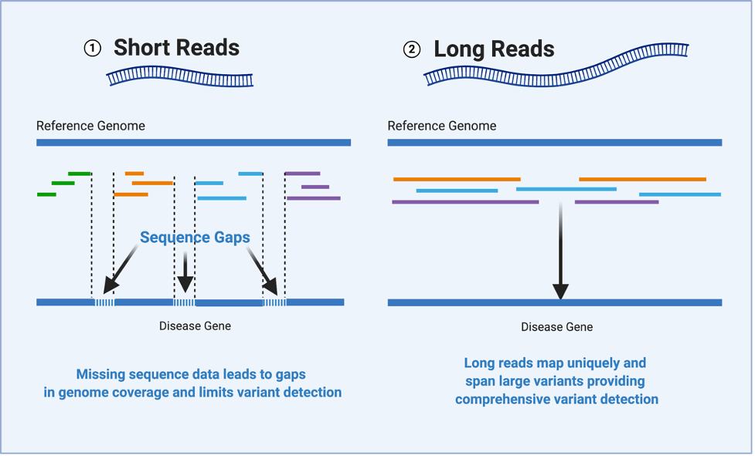
How do short- and long-reads stack up? (pun intended)
Short and long reads both have their strengths and weaknesses
Large variants are typically easier to accurately call with long reads
Illumina NovaSeq 6000 Error Rate: 0.109% *
Oxford Nanopore Technologies MinION: 6-8% **
PacBio SMRT cell : 13-15% (data from older study) ***
*Stoler and Nekruntenko (2021); **Delaheya and Nicolas (2021); ***Ardui et al, (2018)
Image from HudsonAlpha (2021)

Slide 12
Outline for Structural Variant Calling Lesson
Calling SVs with short reads
Calling SVs with long reads
Read processing
Mapping
Structural variant calling with DELLY and smoove/lumpy
Filtering
Merging
Annotating
Read processing
Mapping
Structural variant calling with sniffles and pbsv
Filtering
Merging
Annotating
Different
Pretty much the same

Slide 13

Walkthrough of studying SVs
As a case-study, the Merlot variety of grapevine:
Merlot grapes / Getty from winemag.com

Slide 14
Part 1
Calling SVs with short reads

Slide 15
Walkthrough of calling SVs with short reads
Sequenced Merlot with Illumina paired end sequencing (~50X coverage)
Mapped trimmed reads to the reference
BWAMEM*
Filter SVs
VCFTOOLS and UNIX
Trim adapters and low-quality base pairs
CUTADAPT*
Sorted reads and marked duplicates
PICARD
Merge SVs
SURVIVOR*
Check read quality
FASTQC
Call SVs
smoove
Call SVs
DELLY
* There are alternatives to these programs, and we will talk about them

Slide 16
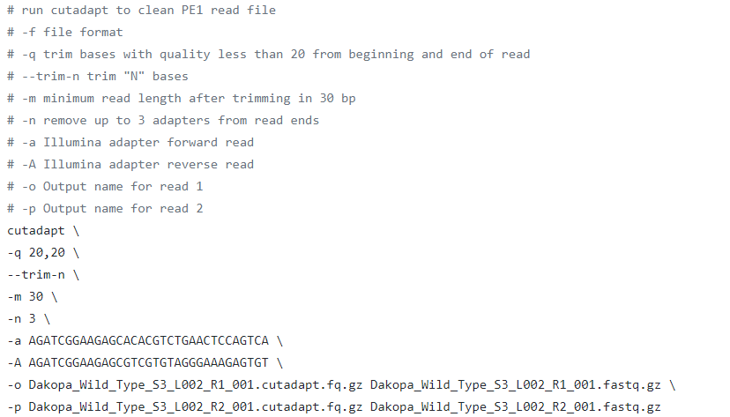
Cutadapt: filters and trims raw reads
Actual code in this box
Why filter and trim reads?
To remove adapters and low-quality reads that will cause mis-mapping and other issues.
Alternative programs
Trimmomatic – can also be used, more of a personal preference
Link to manual: https://cutadapt.readthedocs.io/en/stable/

Slide 17
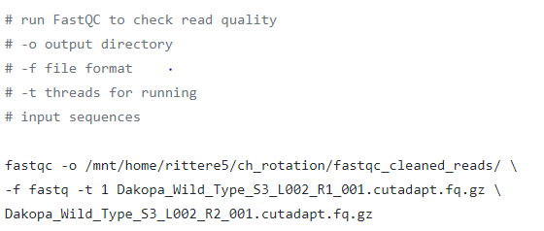
FastQC: check read quality
Why check read quality?
Sometimes issues happen in sequencing, and you need to make sure that your reads are of good quality
(garbage in = garbage out)
Link to manual: https://www.bioinformatics.babraham.ac.uk/projects/fastqc/

Slide 18
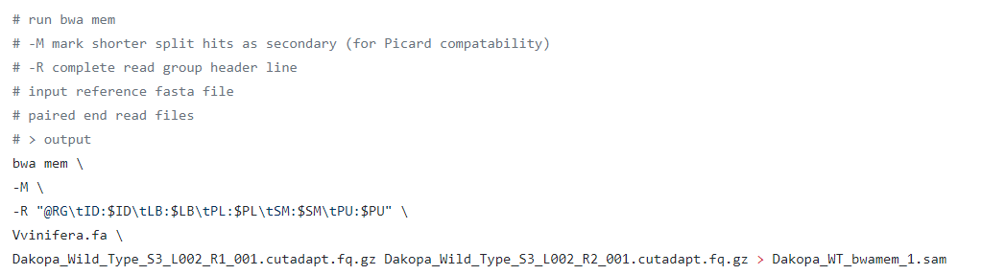
BWAMEM: map reads to the reference
We have to map reads to the reference genome to be able to call variants between the reference and the sample.
Mapping programs can impact the ability to call certain variants, and we will talk about that on the next slide. For that reason, BWAMEM should be used.
Link to manual: http://bio-bwa.sourceforge.net/

Slide 19
Why BWAMEM?
Most SV callers were designed to work with BWAMEM outputs
smoove explicitly states to align with BWAMEM
Some aligners, like bowtie, do not do split alignment
There outputs should not be used for identifying SVs from short reads as a result
It is important to pay attention to how your mapping program aligns reads, because this will have a great impact on variant calling

Slide 20
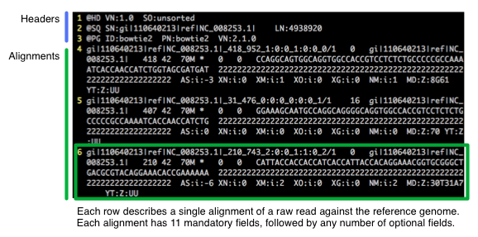
The BAM file
Binary version of the SAM file
Tab-delimited text file with sequence alignment data
Example of a SAM file:
Image from http://biobits.org/samtools_primer.html
Link also contains a helpful description of SAM files

Slide 21
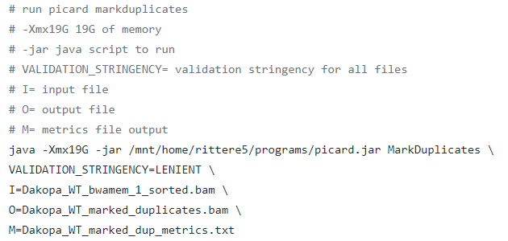
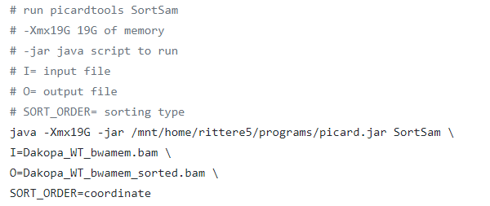
Picard: sort reads and mark duplicates
Why sort reads?
Most downstream programs required sorted reads to be able to more quickly process reads and call variants.
Why mark duplicates?
PCR/optical duplicates occur during the sequencing process and can be mistaken as actual reads. For studying SVs, this could cause issues and result in false positives.
Mark duplicates:
Sort reads:
Link to manual: https://broadinstitute.github.io/picard/

Slide 22
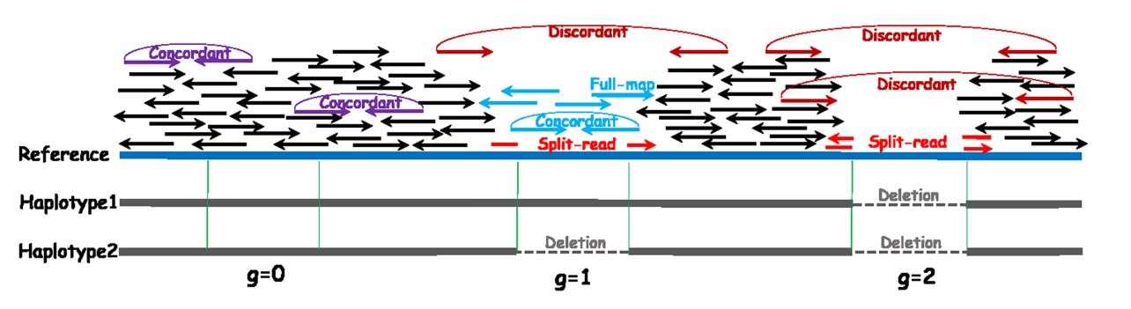
Smoove/LUMPY and DELLY: call SVs
An introduction to the programs:
Identify novel breakpoints (junctions) between reference and sample
Analyze alignment signals
Increase in read coverage -> potential duplication
Decrease in read coverage -> potential deletion
Split reads -> potential deletion, translocation, inversion
Image from Chu et al. 2014

Slide 23
Smoove/LUMPY and DELLY: call SVs
An introduction to the programs:
Identify novel breakpoints (junctions) between reference and sample
Analyze alignment signals
Increase in read coverage -> potential duplication
Decrease in read coverage -> potential deletion
Split reads -> potential deletion, translocation, inversion
smoove integrates multiple signals
DELLY mainly relies on split reads

Slide 24
smoove/LUMPY: call SVs An introduction
As mentioned previously, LUMPY analyzes alignment signals:
Increase in read coverage -> potential duplication
Decrease in read coverage -> potential deletion
Split and discordant reads -> potential deletion, translocation, inversion
The inputs for smoove are the mapped reads files and optionally, read files with extracted split reads and discordant reads (all .bam files)
smoove outputs a VCF (variant call format) file

Slide 25
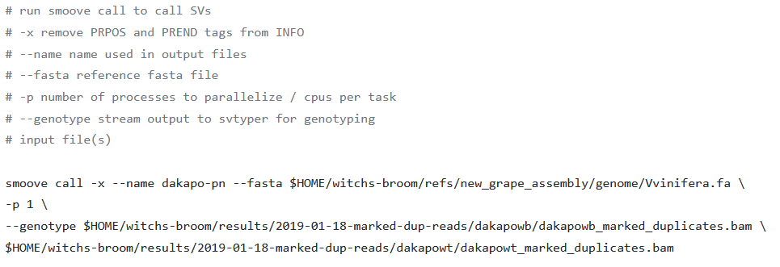
smoove: call and genotype SVs
Link to manual: https://github.com/brentp/smoove

Slide 26
A VCF file
Stores genetic variants
Tab-delimited text file

Slide 27
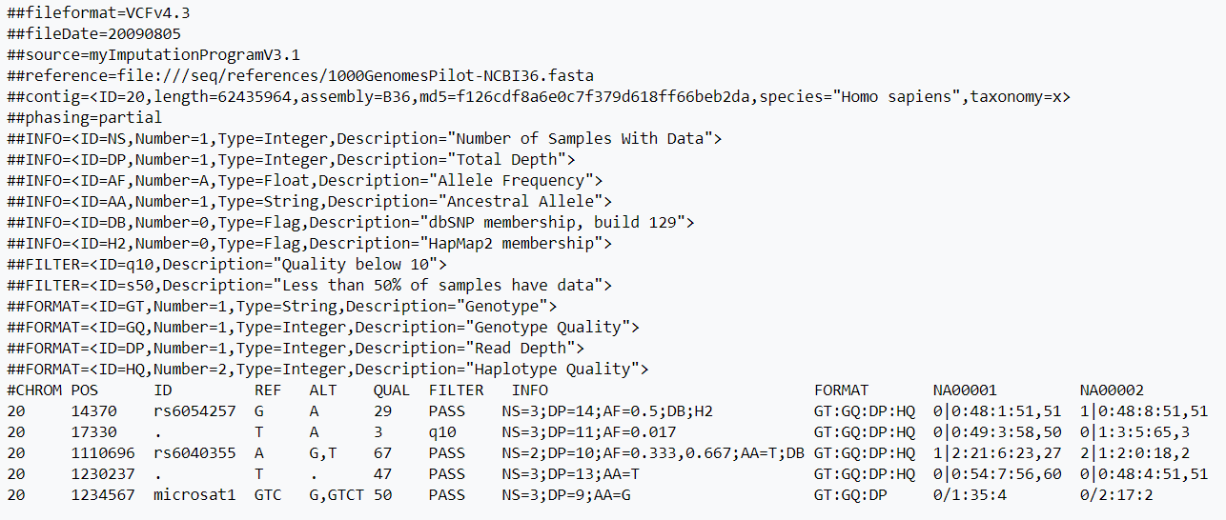
A VCF file
Header lines
Image from https://en.wikipedia.org/wiki/Variant_Call_Format

Slide 28
A VCF file
Header lines
Variants
Image from https://en.wikipedia.org/wiki/Variant_Call_Format

Slide 29
A VCF file
Chromosome
Position (bp)
Image from https://en.wikipedia.org/wiki/Variant_Call_Format

Slide 30
A VCF file
ID
Image from https://en.wikipedia.org/wiki/Variant_Call_Format

Slide 31
A VCF file
Alternate allele
(aka the variant allele)
Reference allele
Image from https://en.wikipedia.org/wiki/Variant_Call_Format

Slide 32
A VCF file
Filter
(PASS = passed all filters, otherwise failed the filter(s) listed)
Quality of the variant
Image from https://en.wikipedia.org/wiki/Variant_Call_Format

Slide 33
A VCF file
Info fields (all described in header)
Image from https://en.wikipedia.org/wiki/Variant_Call_Format

Slide 34
A VCF file
Format fields (all described in header) used to genotype and characterize each individual
Image from https://en.wikipedia.org/wiki/Variant_Call_Format

Slide 35
A VCF file
Some important format fields for us:
GT = Genotype of the individual (0 being reference allele, 1 being alternate allele)
PE = Number of paired end reads supporting the variants
DP = Read depth
Image from https://en.wikipedia.org/wiki/Variant_Call_Format

Slide 36
A VCF file
Each individual with variants called; column is organized as shown in format column
Image from https://en.wikipedia.org/wiki/Variant_Call_Format

Slide 37
DELLY: call SVs An introduction
As previously mentioned, DELLY analyzes split read information only
The inputs for DELLY are the mapped reads and the reference genome fasta file

Slide 38
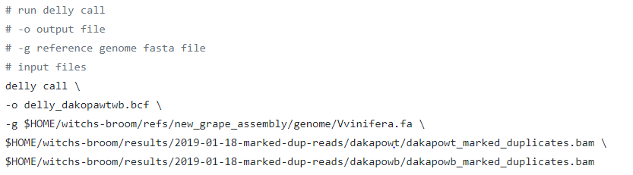
DELLY: call SVs
Link to manual: https://github.com/dellytools/delly

Slide 39
Activity 1 - Let’s call SVs with short read data
First, we need to recombine the reference fasta file into one file with the following code:
zcat plb812-Vvinifera-half1.fa.gz plb812-Vvinifera-half2.fa.gz > plb812-Vvinifera.fa
Now, modify and run delly.sh and smoove.sh using the following files I have provided you:
plb812-merlotwt-sr.bam [our trimmed, mapped reads]
plb812-Vvinifera.fa [our reference genome]
Take about 10 minutes to do this activity and then we will go over it

Slide 40
Activity 1 Answer for smoove
smoove call \
-x \
--name merlotwt \
--fasta plb812-Vvinifera.fa \
-p 1 \
--genotype plb812-merlotwt-sr.bam

Slide 41
Activity 1 Answer for DELLY
delly call \
-o delly.bcf \
-g plb812-Vvinifera.fa \
plb812-merlotwt-sr.bam

Slide 42
End of Part 1
Any questions?

Slide 43
Part 2
Calling SVs with long reads

Slide 44
Walkthrough of calling SVs with long reads
Sequenced Merlot with Oxford Nanopore sequencing (~15X coverage)
Check read quality
FASTQC
Filter SVs
VCFTOOLS and UNIX
Mapped trimmed reads to the reference
minimap2*
Trim adapters porechop
Merge SVs
SURVIVOR*
Filter reads NanoLyse and NanoFilt
Call SVs
sniffles*
Call SVs pbsv*
* There are alternatives to these programs, and we will talk about them

Slide 45
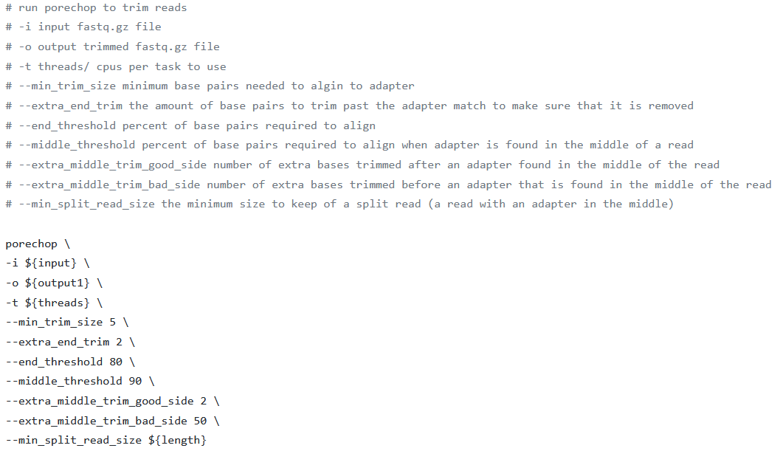
porechop: trim adapters for Nanopore reads
Link to manual: https://github.com/rrwick/Porechop#how-it-works

Slide 46
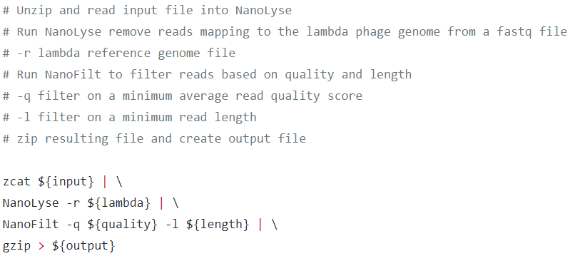
NanoLyse and NanoFilt: filter reads
Why filter reads?
To remove lambda DNA and low-quality reads that will cause mis-mapping and other issues.
Link to manual: https://github.com/wdecoster/nanolyse and https://github.com/wdecoster/nanofilt

Slide 47
FastQC: check read quality
Why check read quality?
Sometimes issues happen in sequencing, and you need to make sure that your reads are of good quality
(garbage in = garbage out)
Link to manual: https://www.bioinformatics.babraham.ac.uk/projects/fastqc/

Slide 48
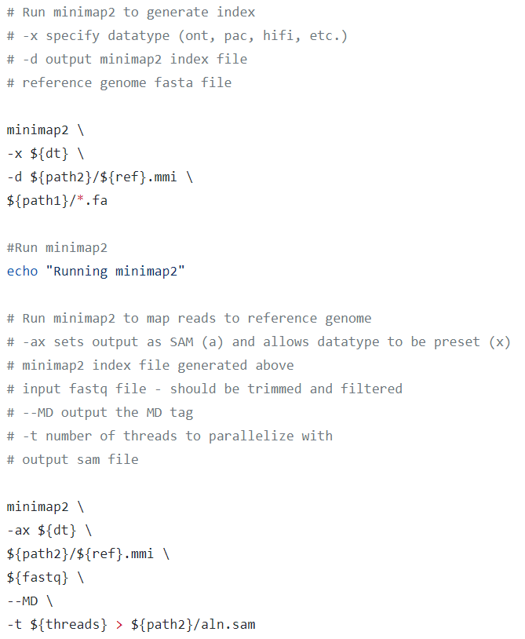
minimap2: map reads to reference genome
Note
Some SV callers require specific mapping methods or aligners. Be sure to check any manual before mapping with minimap2.
Link to manual: https://github.com/lh3/minimap2

Slide 49
pbsv: call and genotype structural variants An introduction

Slide 50
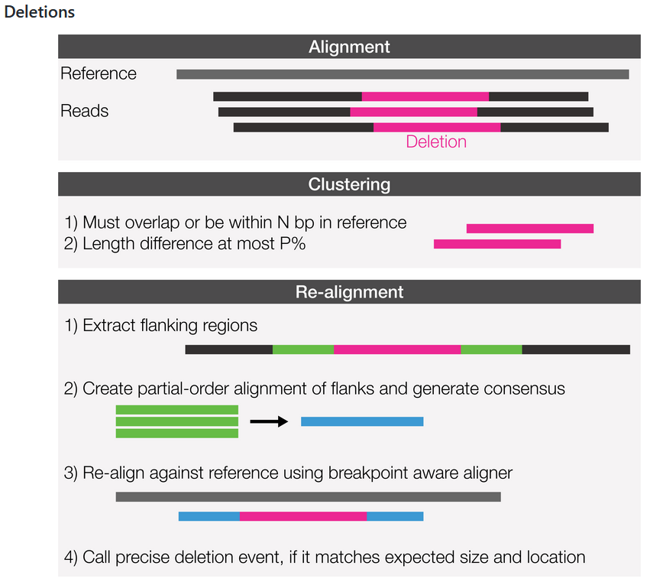
pbsv: call and genotype structural variants An introduction
Figure from PacBio https://github.com/PacificBiosciences/pbsv

Slide 51
pbsv: call and genotype structural variants An introduction
Insertions are the same, but with inserted sequence similarity check during clustering
Figure and information from PacBio https://github.com/PacificBiosciences/pbsv

Slide 52
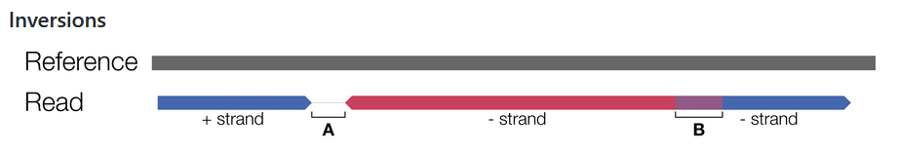
pbsv: call and genotype structural variants An introduction
Figure and information from PacBio https://github.com/PacificBiosciences/pbsv

Slide 53

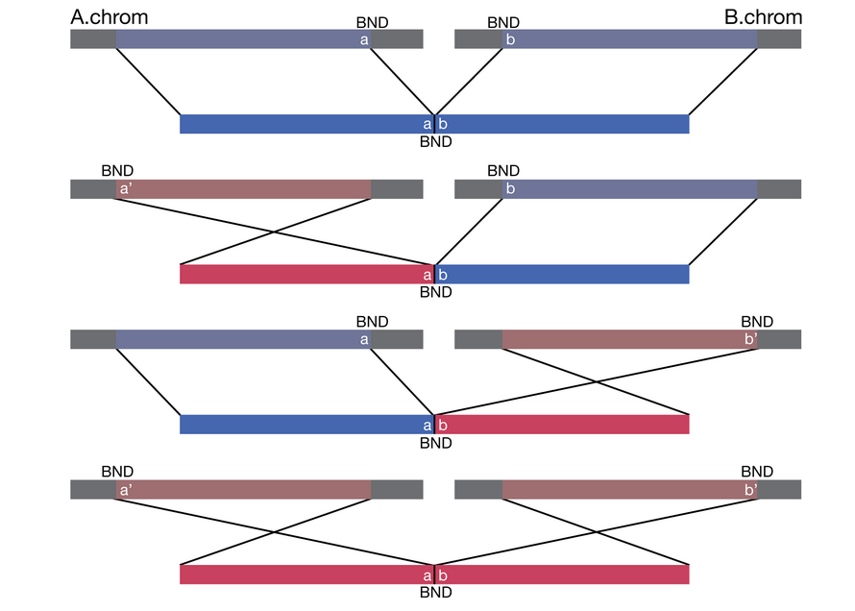
pbsv: call and genotype structural variants An introduction
Figure and information from PacBio https://github.com/PacificBiosciences/pbsv

Slide 54
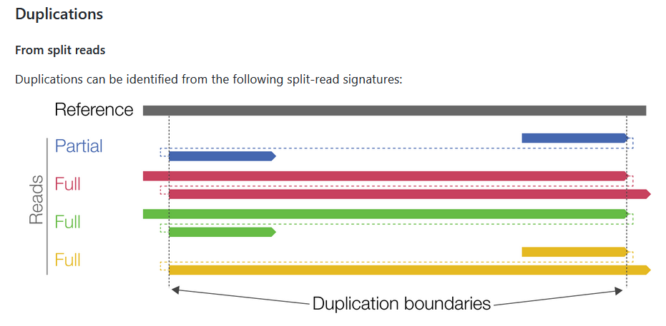
pbsv: call and genotype structural variants An introduction
Figure and information from PacBio https://github.com/PacificBiosciences/pbsv

Slide 55
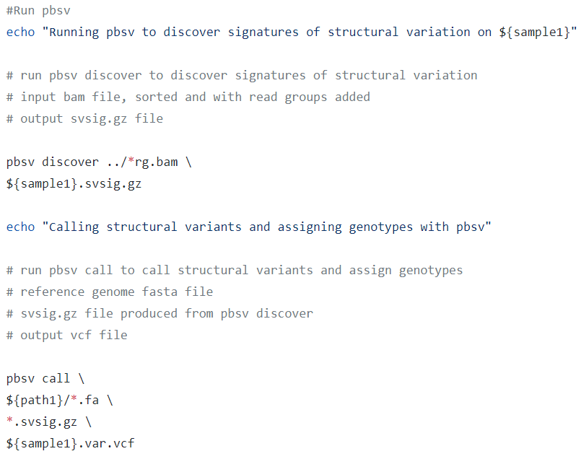
pbsv: call and genotype structural variants
Link to manual: https://github.com/PacificBiosciences/pbsv

Slide 56
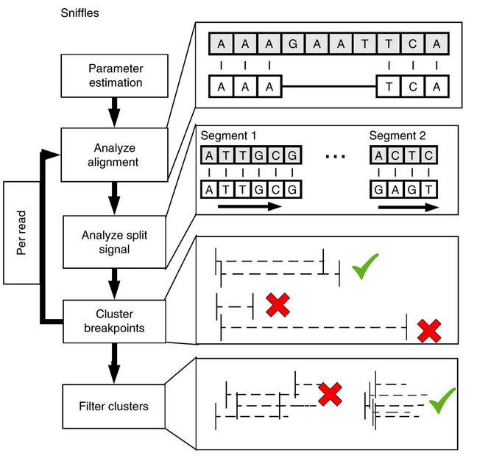
sniffles: call and genotype structural variants An introduction
Figure adapted from Sedlazeck et al. 2018

Slide 57
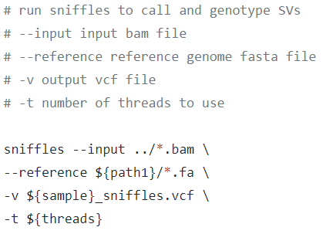
sniffles: call and genotype structural variants
Link to manual: https://github.com/fritzsedlazeck/Sniffles

Slide 58
Activity 2 - Let’s call SVs with long read data
First, modify and run pbsv.sh using the following files I have provided you:
plb812-merlotwt-ont-pbsv.bam [our prepped, mapped reads]
plb812-Vvinifera.fa [our reference genome]
Next, modify and run sniffles.sh using the following files I have provided you:
plb812-merlotwt-ont-sniffles.bam [our prepped, mapped reads]
plb812-Vvinifera.fa [our reference genome]
Take about 10 minutes to do this activity and then we will go over it

Slide 59
Activity 2 Answer for pbsv
pbsv discover plb812-merlotwt-ont-pbsv.bam \
merlotwt.svsig.gz
pbsv call \
plb812-Vvinifera.fa \
*.svsig.gz \
merlotwt.var.vcf

Slide 60
Activity 2 Answer for sniffles
sniffles --input plb812-merlotwt-ont-sniffles.bam \
--reference plb812-Vvinifera.fa \
-v merlotwt_sniffles.vcf \
-t ${threads}

Slide 61
End of Part 2
Any questions?

Slide 62
Great, we finished parts 1 and 2 and have the SVs called … Now what?

Slide 63
Part 3
Downstream processing and analysis of VCF files

Slide 64
Filtering variants in VCF files
Filtering is very important!
While many SV callers filter SVs, they do not remove variants that do not pass the filter. We can extract the ones that did pass the filter using UNIX, snpsift, or other programs
You can use awk in UNIX as a quick and dirty way to filter:
awk '$7=="PASS“’ input.vcf # you will need to add the header back
You can also use snpsift to filter based on your own prerequisites (read depth, etc.)

Slide 65
Merging variants
Merging variants identified by multiple SV callers can allow us to curate a list of high-quality SVs
Different SV callers have slightly different formats and VCF files with SVs are structured a bit different from SNP VCF files
SURVIVOR was designed to combine calls from the popular SV callers and can merge all these formats accordingly
There are many alternatives to SURVIVOR as well

Slide 66
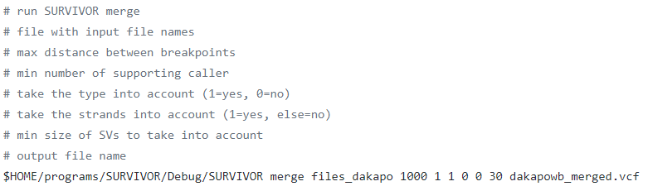
SURVIVOR: merge SVs
Link to manual: https://github.com/fritzsedlazeck/SURVIVOR

Slide 67
Annotating SVs
Useful if looking for a causal genetic variant
Can see how many SVs are actually within genes and not intergenic
Many programs available:
SURVIVOR
intansv (in R)
and more …
Word of caution: annotations of very large SVs (Mbp long) can be tricky to interpret

Slide 68
Analyzing SVs in R
vcfR is a helpful program to read in VCF files with SVs into R and image variants
Capabilities are somewhat limited with SVs, it was built for SNPs and INDELs
intansv is a helpful program to read in SV program outputs and manipulate and image them
Similar to SURVIVOR, but includes great plotting functions
Version control is extremely important and can cause issues; check https://github.com/venyao/intansv to make sure you are using the right versions of everything
Link to vcfR manual: https://github.com/knausb/vcfR
Link to intansv manual: https://www.bioconductor.org/packages/release/bioc/manuals/intansv/man/intansv.pdf

Slide 69
End of Part 3
Any questions?

Slide 70
Discussion Questions
(or the end of class depending on time)

