Slide 1
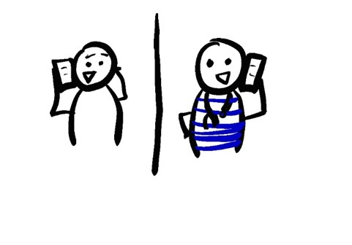
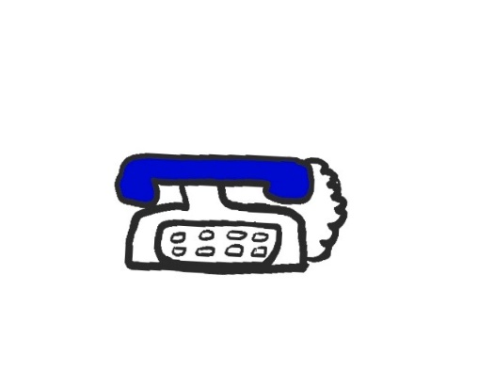



WHAT TO DO IF FRIENDS, FAMILY, OR NEIGHBORS HAVE COVID-19:
THE BUDDY SYSTEM
DESIGNATE A BUDDY
NOT LIVING IN THE SAME HOUSEHOLD AS THE SICK PERSON
NOT EXPERIENCING COVID-19 SYMPTOMS
A LOW RISK PERSON IS BEST – AGE 18-40 AND WITH NO MAJOR HEALTH PROBLEMS
KEEP REGULAR CONTACT
THE BUDDY SHOULD CALL OR TEXT THE PERSON WHO IS SICK 2-4 TIMES PER DAY
AT EACH CALL, ASK THE PERSON WITH COVID-19 TO CHECK
TEMPERATURE
COUGH
SHORTNESS OF BREATH
HAVE THEM CALL A DOCTOR IF THEY START TO FEEL SICK
HELP WITH DAILY LOGISTICS
THE BUDDY SHOULD DELIVER GROCERIES, GET PRESCRIPTIONS, AND BE AVAILABLE TO DRIVE THEM TO THE DOCTORS IF NEEDED
BOTH PEOPLE SHOULD ALWAYS WEAR A MASK WHEN COMING IN CONTACT
BE AWARE OF SEVERE SYMPTOMS
TEMPERATURE ABOVE 102.5F
UNABLE TO DRINK FLUIDS, AND NOT USING THE BATHROOM
CANNOT FINISH A SENTENCE WITHOUT TAKING A BREATH
CHEST PAIN AFTER CLIMBING ONE FLIGHT OF STAIRS
TROUBLE MOVING OR FALLING, ESPECIALLY IN THE ELDERLY
CONFUSION OR FAINTING
IF ANY OF THESE HAPPEN, CALL 911 AND TELL THEM THE PERSON HAS COVID-19 WITH SEVERE SYMPTOMS
@epiellie
@benjaminlinas
@the_BMC
@C_T_WilliamsMD

