Slide 1
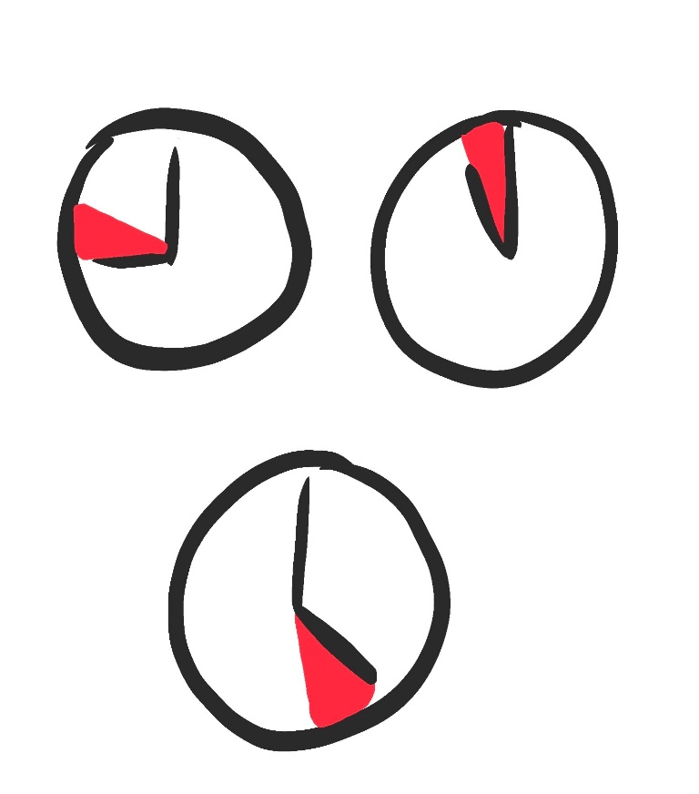


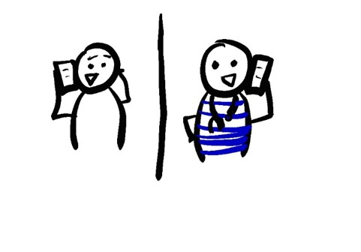

HOW TO HELP WITH CONTACT TRACING
WRITE DOWN A LIST OF WHO YOU SPEND TIME WITH
EVERYONE YOU SPENT MORE THAN 15 MINUTES WITH, AND WERE LESS THAN 6 FEET APART FROM
RECORD WHEN AND WHERE YOU SPENT TIME WITH THEM AND WHAT TYPE OF ACTIVITIES YOU DID
INCLUDE CLOSE CONTACTS FOR 48-72 HOURS BEFORE YOU FELT SICK
HELP CHILDREN, THE ELDERLY, AND OTHER DEPENDENTS TRACK THEIR CONTACTS TOO
MONITOR YOURSELF FOR SYMPTOMS
TEMPERATURE
COUGH
SHORTNESS OF BREATH
CALL A DOCTOR IF YOU START TO FEEL SICK
TELL YOUR FRIENDS AND FAMILY IF YOU START TO FEEL SICK
IF YOU HAVE ANY FEVER, COUGH, OR SHORTNESS OF BREATH IT’S IMPORTANT TO TELL YOUR FAMILY
ALSO TELL EVERYONE YOU’VE BEEN CLOSE TO IN THE LAST 48-72 HOURS
IF YOU LIVE IN AN APARTMENT BUILDING, YOU MAY WANT TO TELL MAINTENANCE SO THEY CAN TAKE PRECAUTIONS
SHARE INFORMATION WITH THE HEALTH DEPARTMENT
IF YOU GET A CALL FROM THE HEALTH DEPARTMENT IT IS IMPORTANT TO SHARE WHO YOU’VE BEEN CLOSE TO
THIS WILL HELP KEEP YOU AND YOUR COMMUNITY SAFE
THE HEALTH DEPARTMENT SHOULD NOT ASK ABOUT IMMIGRATION STATUS
THE HEALTH DEPARTMENT MIGHT ASK ABOUT TRAVEL HISTORY
@epiellie
@benjaminlinas
@the_BMC
@C_T_WilliamsMD

