Slide 1






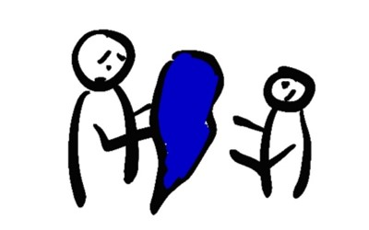




WHAT TO DO IF YOU WERE EXPOSED TO COVID
DO I NEED A TEST?
IF YOU HAVE NO SYMPTOMS NOW
STAY AT HOME AND QUARANTINE FOR AT LEAST 14 DAYS
TESTING IN THE US IS STILL INCREASING
CALL YOUR DOCTOR TO ASK IF TESTING IS AVAILABLE IN YOUR AREA
MONITOR YOUR SYMPTOMS
IF YOU HAVE MILD OR MODERATE SYMPTOMS NOW
CALL YOUR DOCTOR TO GET A TEST
STAY AT HOME AND ISOLATE FOR AT LEAST 10 DAYS
TEMPERATURE
COUGH
SHORTNESS OF BREATH
TELL YOUR DOCTOR IF THEY GET WORSE
QUARANTINE IN YOUR HOUSE FOR AT LEAST 14 DAYS
STAY IN YOUR OWN ROOM
WASH YOUR HANDS OFTEN
COVER YOUR COUGHS AND SNEEZES
CLEAN SURFACES AND OBJECTS DAILY
DON’T SHARE BLANKETS, DISHES, OR OTHER PERSONAL ITEMS
20 SECONDS
A, B, C, …
… X, Y, AND Z
IF YOU DEVELOP SYMPTOMS
CALL YOUR DOCTOR
TELL THEM YOU WERE EXPOSED TO SOMEONE WITH COVID-19
SING THE ALPHABET
CALL 911 IF
CHEST PAIN
SHORTNESS OF BREATH
TELL THE DISPATCHER YOU MAY HAVE COVID
911
@epiellie
@benjaminlinas
@the_BMC

