Slide 1









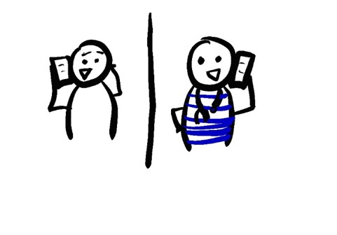
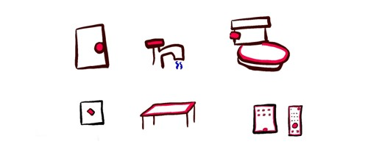

WHAT TO DO IF YOUR COVID-19 TEST IS POSITIVE
DON’T PANIC
80% OF PEOPLE WILL NOT GET SEVERE SYMPTOMS AND CAN RECOVER AT HOME
DO: STAY IN BED
DO: WATCH TV
DON’T: USE PUBLIC TRANSPORT
DO: DRINK WATER OR ELECTROLYTE FLUID
DO: STAY INDOORS
MONITOR YOUR SYMPTOMS
ISOLATE YOURSELF
STAY AT HOME
STAY IN YOUR OWN ROOM
STAY 6 FEET (2M) AWAY FROM
OTHER PEOPLE
AVOID PUBLIC TRANSIT
TEMPERATURE
COUGH
SHORTNESS OF BREATH
TELL YOUR DOCTOR IF THEY GET WORSE
INFORM HEALTH CARE PROVIDERS
WHEN YOU CALL TO MAKE AN APPOINTMENT
BEFORE YOU GO TO THE DOCTOR
IN AN EMERGENCY, TELL THE DISPATCHER YOU HAVE COVID
DON’T SPREAD COVID
WASH YOUR HANDS OFTEN
COVER YOUR COUGHS AND SNEEZES
CLEAN SURFACES AND OBJECTS DAILY
DON’T SHARE BLANKETS, DISHES, OR OTHER PERSONAL ITEMS
20 SECONDS
A, B, C, …
… X, Y, AND Z
SING THE ALPHABET
911
WAIT TO COME OUT OF HOME ISOLATION UNTIL…
AT LEAST 10 DAYS AFTER SYMPTOMS STARTED
AND YOU DON’T HAVE FEVER, AND ARE NOT USING FEVER-REDUCING MEDICINES (AND HAVEN’T FOR AT LEAST 3 DAYS)
AND ASK YOUR DOCTOR IF YOU NEED A COVID19 TEST AGAIN BEFORE YOU COME OUT OF ISOLATION
@epiellie
@benjaminlinas
@the_BMC

