Slide 1


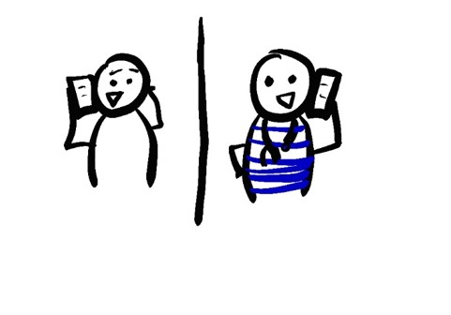
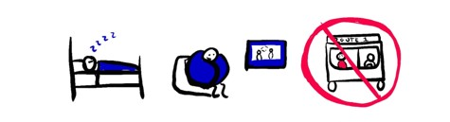


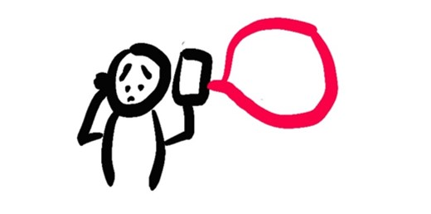
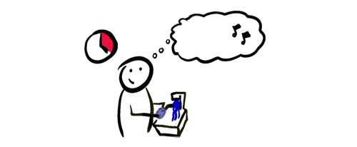
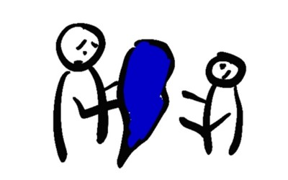

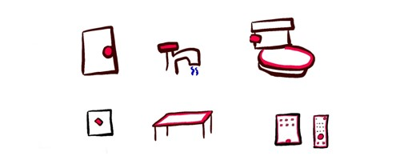

WHAT TO DO IF YOU HAVE COVID-19 SYMPTOMS
DON’T PANIC
80% OF PEOPLE WILL NOT GET SEVERE SYMPTOMS AND CAN RECOVER AT HOME
MONITOR YOUR SYMPTOMS DAILY
DO I NEED A TEST?
A POSITIVE TEST CAN TELL YOU THAT YOU HAVE COVID-19 BUT A NEGATIVE TEST MIGHT BE WRONG
ASK YOUR DOCTOR IF YOU NEED A TEST
TEMPERATURE
COUGH
CHEST PAIN
SHORTNESS OF BREATH
TELL YOUR DOCTOR IF THEY GET WORSE
DO: STAY IN BED
DO: WATCH TV
DON’T: USE PUBLIC TRANSPORT
INFORM HEALTH CARE PROVIDERS
WHEN YOU CALL TO MAKE AN APPOINTMENT
BEFORE YOU GO TO THE DOCTOR
IN AN EMERGENCY, TELL THE DISPATCHER
DO: DRINK WATER OR ELECTROLYTE FLUID
DO: STAY INDOORS
ISOLATE YOURSELF
STAY AT HOME
STAY IN YOUR OWN ROOM
WEAR A MASK
STAY 6 FEET (2M) AWAY FROM
OTHER PEOPLE
AVOID PUBLIC TRANSIT
SET UP A BUDDY SYSTEM TO HELP YOU WITH GROCERIES AND ESSENTIALS
911
20 SECONDS
A, B, C, …
… X, Y, AND Z
SING THE ALPHABET
DON’T SPREAD COVID
WASH YOUR HANDS OFTEN
COVER YOUR COUGHS AND SNEEZES
CLEAN SURFACES AND OBJECTS DAILY
DON’T SHARE BLANKETS, DISHES, OR OTHER PERSONAL ITEMS
WAIT TO COME OUT OF HOME ISOLATION UNTIL…
AT LEAST 10 DAYS AFTER SYMPTOMS STARTED
AND AT LEAST 3 DAYS WITH NO FEVER, AND NOT USING FEVER-REDUCING MEDICINES
AND ASK YOUR DOCTOR IF YOU NEED A COVID19 TEST AGAIN BEFORE YOU COME OUT OF ISOLATION
@epiellie
@benjaminlinas
@the_BMC

