Slide 1



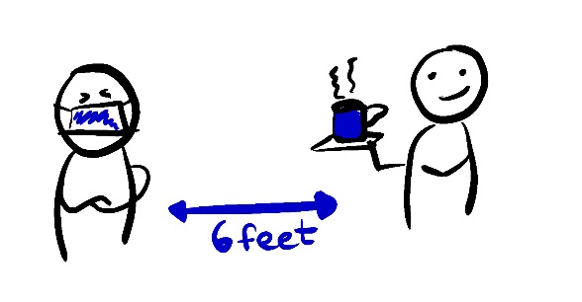






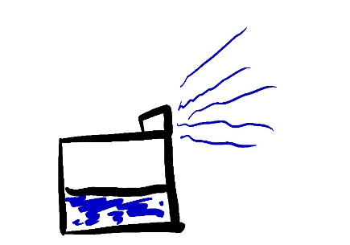

WHAT TO DO IF SOMEONE YOU LIVE WITH HAS COVID
QUARANTINE THE WHOLE HOUSEHOLD UNTIL…
14 DAYS AFTER THE SICK PERSON’S LAST SYMPTOMS
AND LEAST 3 DAYS WITH NO SYMPTOMS
AND NO ONE HAS FEVER
AND ARE NOT USING FEVER-REDUCING MEDICINES
DO: STAY IN BED
DO: WATCH TV
DO: WEAR A MASK
ISOLATE THOSE WHO ARE VISIBLY SICK
STAY IN THEIR OWN ROOM
STAY 6 FEET (2M) AWAY FROM
OTHER PEOPLE
HAVE THEM WEAR A FACE MASK
KEEP PETS AWAY FROM THOSE WHO ARE SICK
MONITOR SYMPTOMS
TEMPERATURE
COUGH
SHORTNESS OF BREATH
TELL YOUR DOCTOR IF THEY GET WORSE
DON’T SPREAD INFECTIONS
WASH YOUR HANDS OFTEN
COVER YOUR COUGHS AND SNEEZES
CLEAN SURFACES AND OBJECTS DAILY
DON’T SHARE BLANKETS, DISHES, OR OTHER PERSONAL ITEMS
20 SECONDS
A, B, C, …
… X, Y, AND Z
SING THE ALPHABET
CLEAN YOUR AIR
@epiellie
@benjaminlinas
@mlipsitch
@j_g_allen
@the_BMC
OPEN YOUR WINDOWS
USE AN AIR PURIFIER
TURN ON A HUMIDIFIER

