Slide 1


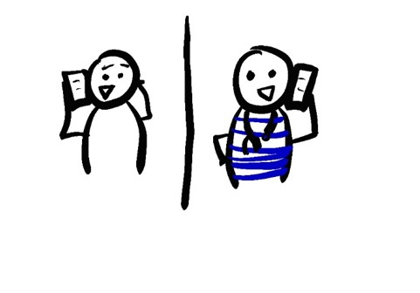
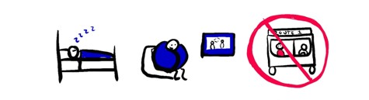




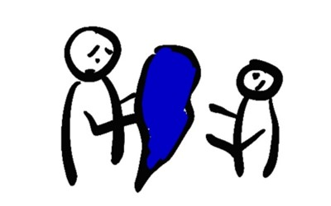



WHAT TO DO IF YOUR COVID-19 TEST IS POSITIVE BUT YOU DON’T FEEL SICK
DON’T PANIC
MONITOR FOR SYMPTOMS DAILY
80% OF PEOPLE WILL NOT GET SEVERE SYMPTOMS AND CAN RECOVER AT HOME
EVEN IF YOU DON’T GET SICK, YOU MAY STILL BE ABLE TO INFECT OTHER PEOPLE
TEMPERATURE
COUGH
CHEST PAIN
SHORTNESS OF BREATH
TELL YOUR DOCTOR IF YOU START TO FEEL SICK
DO: STAY IN BED
DO: WATCH TV
DON’T: USE PUBLIC TRANSPORT
INFORM HEALTH CARE PROVIDERS
WHEN YOU CALL TO MAKE AN APPOINTMENT
BEFORE YOU GO TO THE DOCTOR
IN AN EMERGENCY, TELL THE DISPATCHER
DO: DRINK WATER OR ELECTROLYTE FLUID
DO: STAY INDOORS
ISOLATE YOURSELF
STAY AT HOME
STAY IN YOUR OWN ROOM
WEAR A MASK
STAY 6 FEET (2M) AWAY FROM
OTHER PEOPLE
AVOID PUBLIC TRANSIT
SET UP A BUDDY SYSTEM TO HELP YOU WITH GROCERIES AND ESSENTIALS
911
20 SECONDS
A, B, C, …
… X, Y, AND Z
SING THE ALPHABET
DON’T SPREAD COVID
WASH YOUR HANDS OFTEN
COVER YOUR COUGHS AND SNEEZES
CLEAN SURFACES AND OBJECTS DAILY
DON’T SHARE BLANKETS, DISHES, OR OTHER PERSONAL ITEMS
WAIT TO COME OUT OF HOME ISOLATION UNTIL…
AT LEAST 10 DAYS AFTER SYMPTOMS STARTED
AND AT LEAST 3 DAYS WITH NO FEVER, AND NOT USING FEVER-REDUCING MEDICINES
AND ASK YOUR DOCTOR IF YOU NEED A COVID19 TEST AGAIN BEFORE YOU COME OUT OF ISOLATION
@epiellie
@benjaminlinas
@the_BMC

