Slide 1

Pokémon Simulator
Eleas Vrahnos

Slide 2
Problem

Slide 3
BOREDOM.
Usually when travelling or waiting for things, people generally try to occupy the time with something stimulating, like reading or games
A fun thing to do when traveling, could be introduced as a mobile app to be played on the go and can easily kill time

Slide 4

Initial Ideas
Site inspiration: pokemondb.net
Pokédex is basically a giant database
Wanted to start as just a Pokédex, but transformed into entire catching and battle simulator idea
Basically acts as a less intensive and involved Pokémon GO

Slide 5
Planning, Schemas,
ER Diagrams

Slide 6
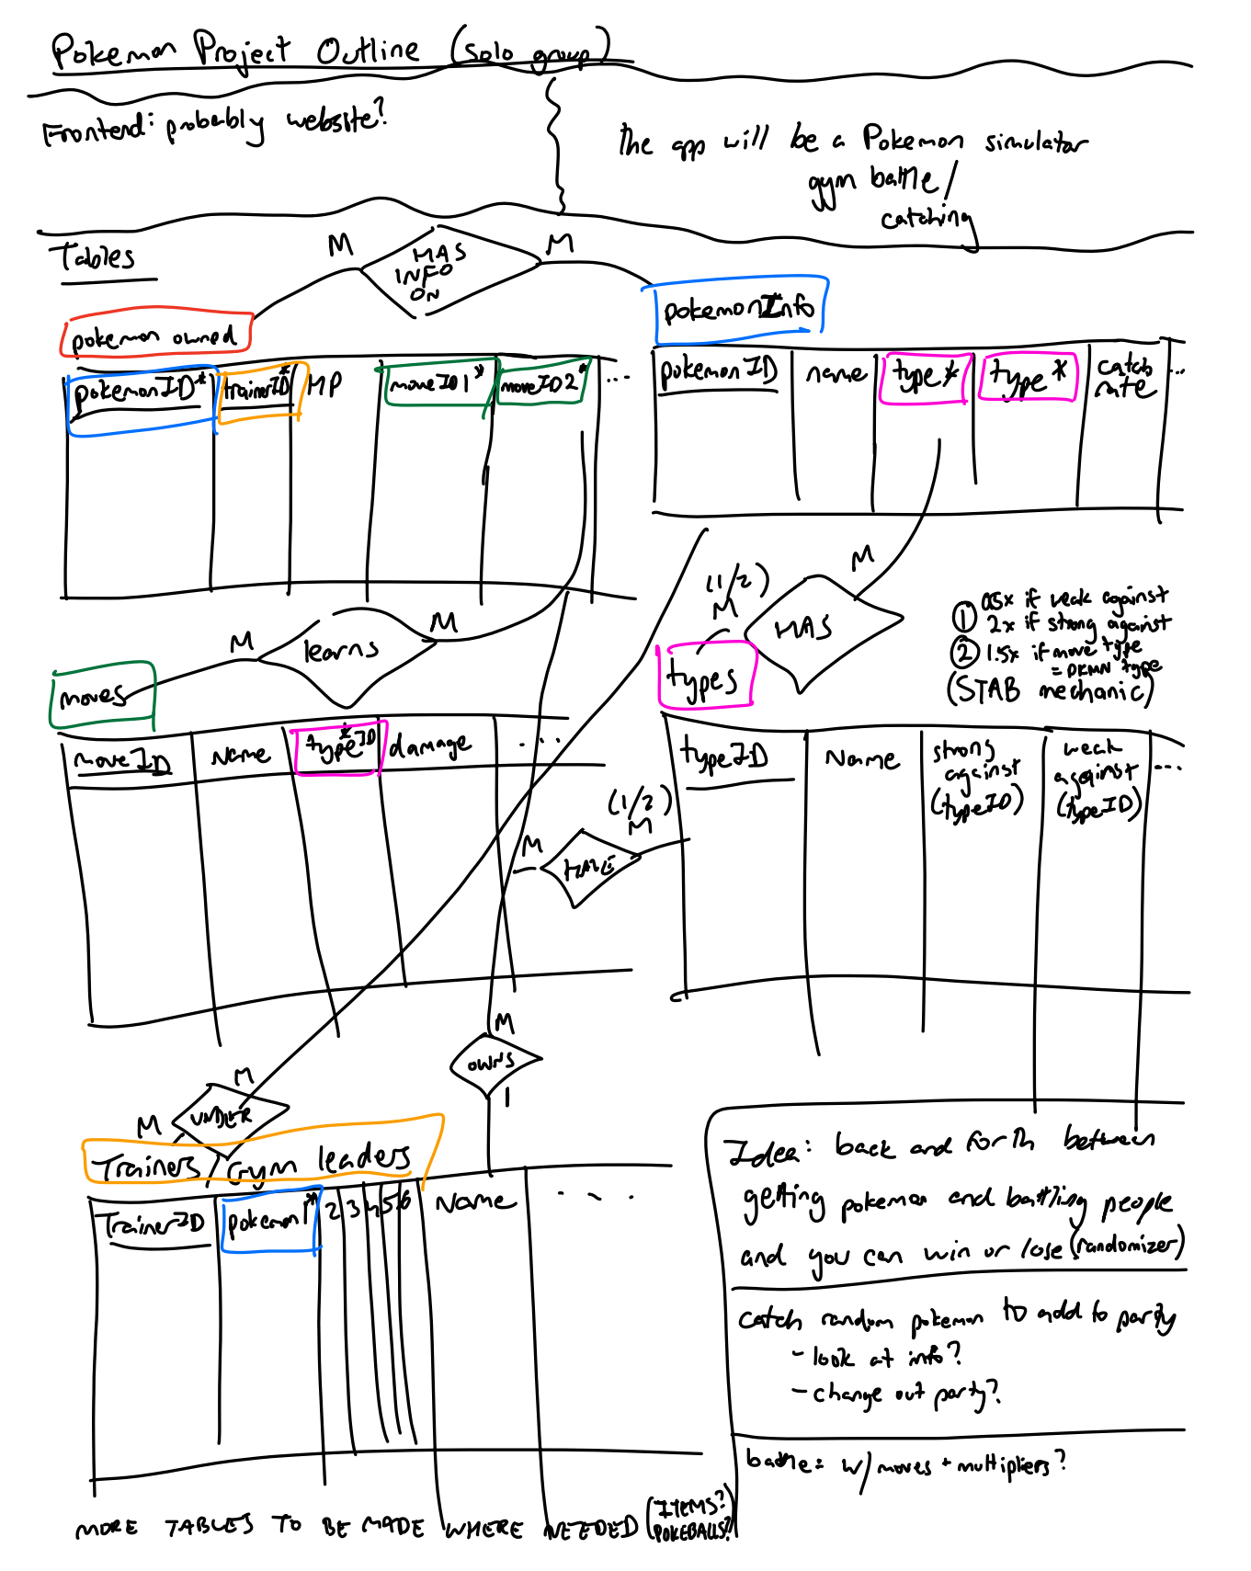

Slide 7
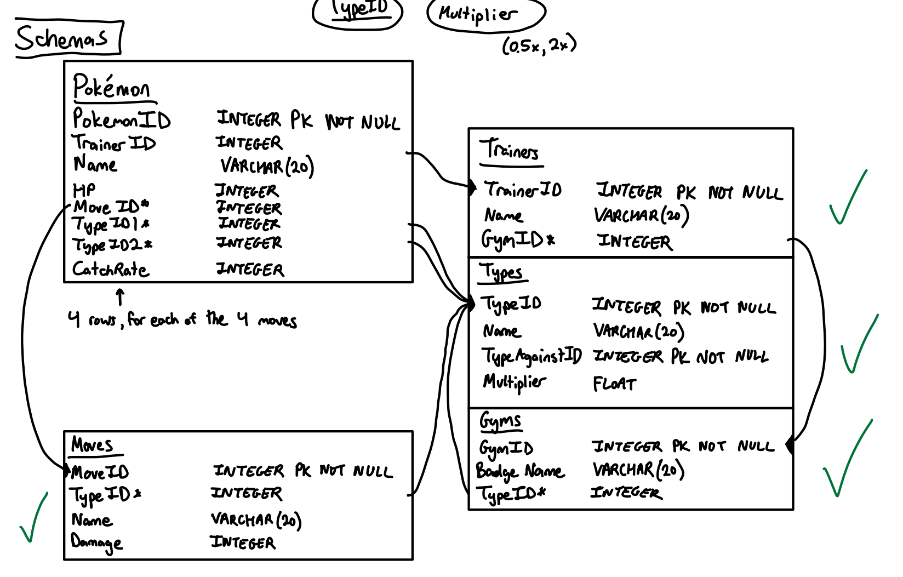

Slide 8
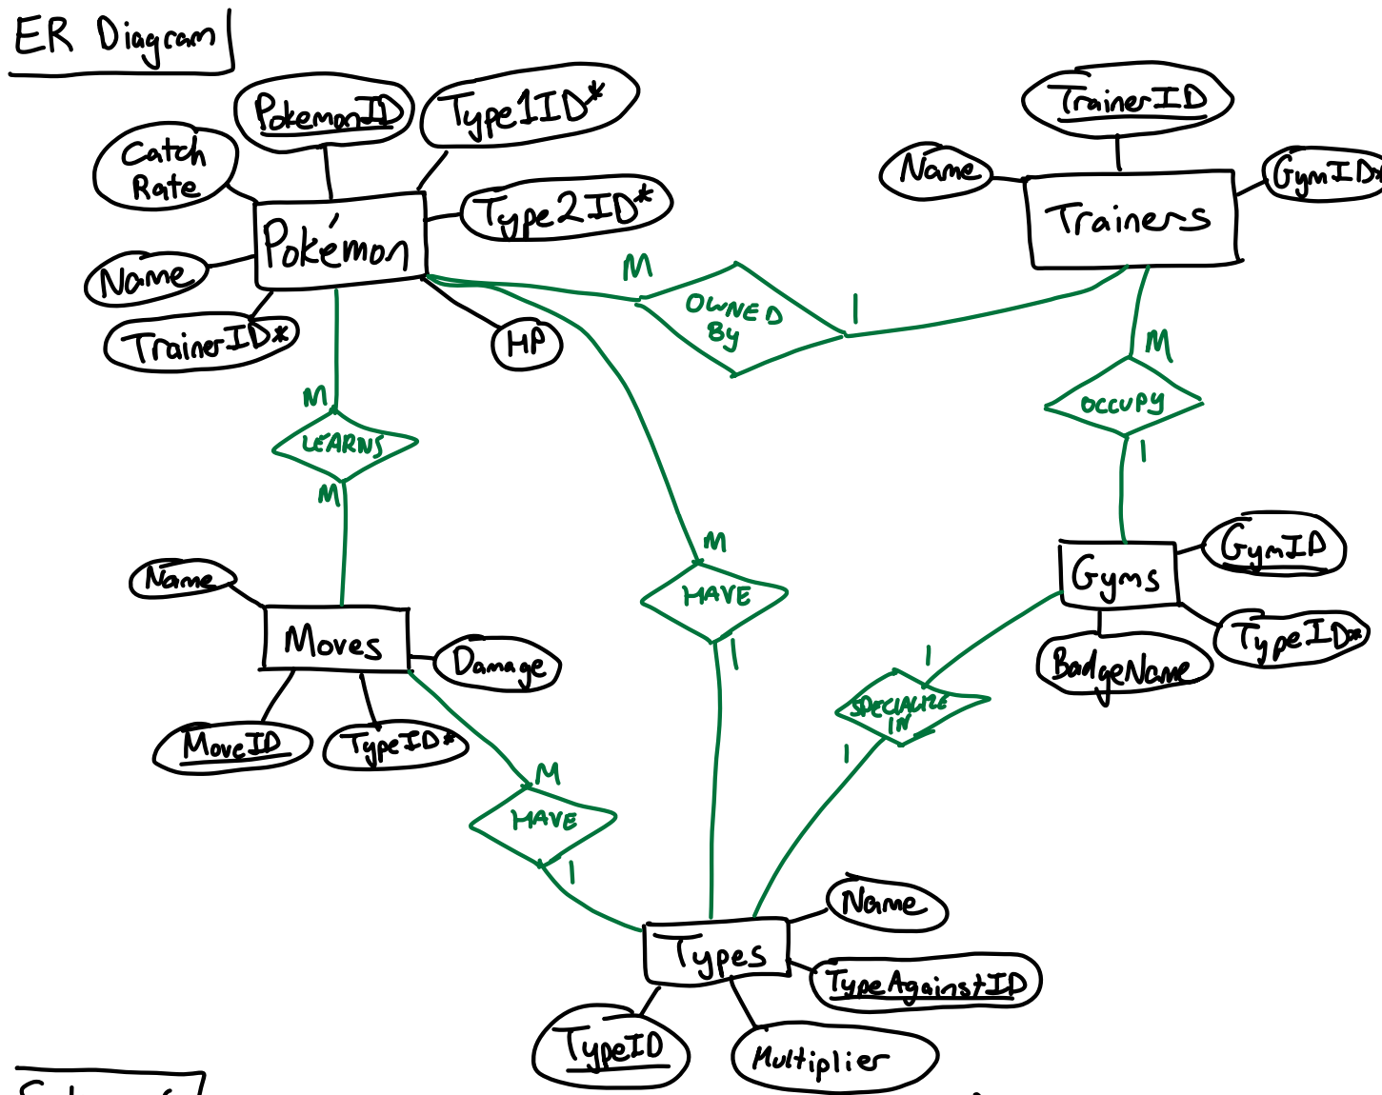

Slide 9
Final Ideas

Slide 10
CATCHING AND BATTLE SIMULATOR
The user will go back and forth between CATCHING and BATTLING phases.
CATCHING Player has the chance to catch some Pokémon and use them for the battles.
BATTLING Player will fight multiple trainers of different Gym types.
Player wins if they can pass this cycle 5 times.

Slide 11
Basic Structure of Simulator

Slide 12







WEBSITE SPECIFICATIONS
Front End
Back End
Languages Used

Slide 13
DEMO

Slide 14
Progress So Far and
What To Do Next

Slide 15
What Was Done
What Isn’t Done
CATCHING PHASE
Player has the chance to catch 3 randomly-generated Pokémon
Catch option and Run option
If Catch, catch rate formula defines 3 shakes
If fail, player loses chance to catch
If successful, Pokémon added to party
(Subqueries involved here!)
If Run, player skips the Pokémon
BATTLING PHASE
Player battles 3 randomly-generated Trainers, related to a chosen Gym type
Each Pokémon has a randomly-generated moveset to use
INFO SECTION
Opportunity for player to look at their progress
Outputting data, Deleting, etc.

