Slide 1
StyleGAN-NADA: CLIP-Guided Domain Adaptation of Image Generators
Eleonora Beatrice Rossi 1749038

Slide 2
Can a generative model be trained to produce images from a specific domain, guided only by a text prompt, without seeing any image?

Slide 3
Generative Vs Discriminative
can generate new data instances.
given a set of data instances X and a set of labels Y generative models capture the joint probability p(X, Y), or just p(X) if there are no labels.
discriminate between different kinds of data instances.
given a set of data instances X and a set of labels Y discriminative models capture the conditional probability p(Y | X).
A generative model could generate new photos of animals that look like real animals, while a discriminative model could tell a dog from a cat. GANs are just one kind of generative model.

Slide 4
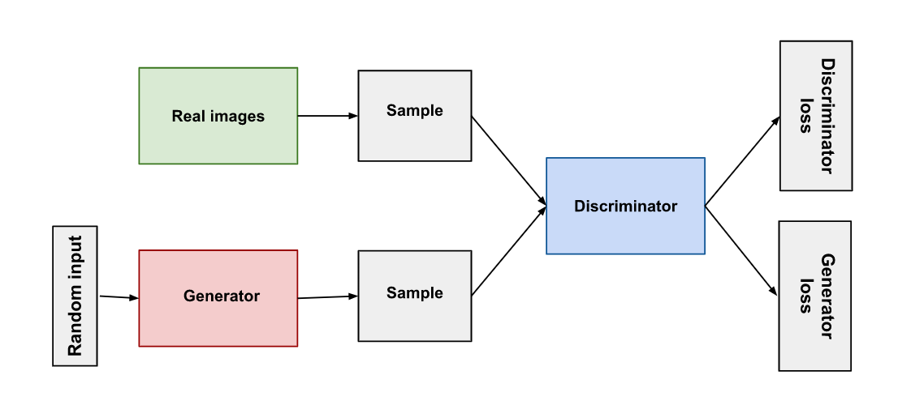
GAN – Generative adversarial network
The generator learns to generate plausible data. The generated instances become negative training examples for the discriminator.
The discriminator learns to distinguish the generator's fake data from real data. The discriminator penalizes the generator for producing implausible results.

Slide 5
StyleGAN - a specialized type of GAN
Unlike traditional GANs that generate images from random input noise, StyleGAN utilizes a style-based latent representation to control the appearance of the generated image. This latent representation includes style information such as lighting, facial shape, distinct features, and other visual characteristics of the image.
The generators produce images in stages, progressively refining the details at higher resolutions. Instead of directly generating the final image, the generator creates a latent style that is then used to generate the final image through a style-guided synthesis process.
The discriminators evaluate the authenticity of the generated images compared to real images.

Slide 6
CLIP - Contrastive Language-Image Pre-Training
CLIP is a neural network model.
without directly optimizing for the task. It tend to perform well on tasks It isn’t directly trained to do ("zero-shot learning“).
It is trained on 400,000,000 (image, text) pairs. An (image, text) pair might be a picture and its caption.
It can predict the most relevant text snippet, given an image. You can input an image into the CLIP model, and it will return for you the likeliest caption or summary of that image.

Slide 7
Style-clip
By combining StyleGAN and CLIP, a system is created that combines the generation of realistic images with semantic understanding.
This allows for the generation and manipulation of images based on textual prompts, opening the way to an intuitive and direct interaction between language and images.
In practice, one can describe what they want to visualize in text, and the system will be able to generate an image that corresponds to that description.

Slide 8
The GOAL
Shift a pre-trained generator from a given source domain to a new target domain, described only through textual prompts, with no images.

Slide 9

first attempt
In the first attempt, in the context of the global loss, the direct loss function from StyleCLIP is used to maximize the similarity between the generated image and the textual description of the target domain.
However, it is observed that this approach leads to adversarial solutions, where the optimization process adds pixel-level perturbations to the image to bypass the CLIP classifier.

Slide 10
The solution
The solution to the problem involved introducing a directional loss based on CLIP. Instead of maximizing similarity between the generated image and target text, the focus shifted to identifying the CLIP space direction representing the change between the source and target domains. To accomplish this, two generators were utilized: one pre-trained in the source domain (Gfrozen) and one trained in the target domain (Gtrain).
The objective was to train Gtrain to produce images that differed from Gfrozen only along the textually described direction between the source and target domains.

Slide 11
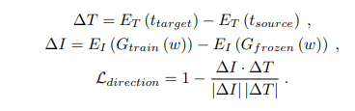
The directional loss was computed by measuring the CLIP space difference between the images generated by Gtrain and Gfrozen, as well as the difference between the target and source texts. These values were normalized and used to calculate the overall directional loss.

Slide 12
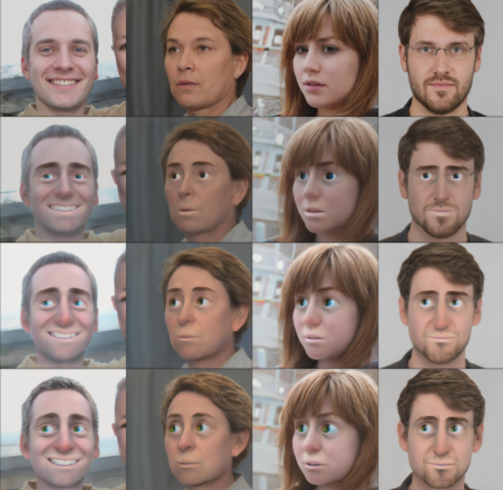
Test 1 – photo - 3D Render in the Style of Pixar
Source class: Photo
Target Class: 3D Render in the Style of Pixar
Training iterations: 200

Slide 13
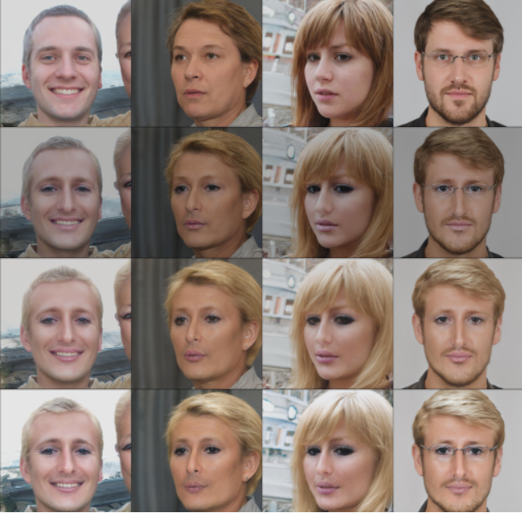
Test 2 – Person – Paris Hilton
Source class: Person
Target Class: Paris Hilton
Training iterations: 151

Slide 14
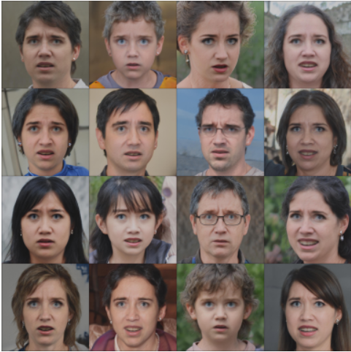
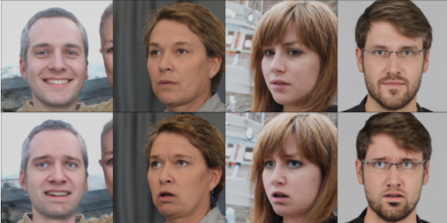
Test 3 – face - confused
Source class: Face
Target Class: Confused
Training iterations: 100

