Slide 1
DESIGN OF STATE MACHINE USING VHDL/XILINX
PREPARED BY- 1.
2.
3.
4.

Slide 2
Sequential logic implementation
Sequential circuits
primitive sequential elements (Flip-Flops)
combinational logic
Models for representing sequential circuits
finite-state machines (Moore and Mealy)
representation of memory (states)
changes in state (transitions)
Basic sequential circuits
shift registers
counters
Design procedure
state diagrams
state transition table
next state functions

Slide 3
State machine model
Values stored in registers are the state of the circuit
Combinational logic computes:
next state
outputs
function of current state and inputs (Mealy machine)
function of current state only (Moore machine)
output logic
Outputs
Inputs
next state logic
Next State
Current State

Slide 4
State Machine Model
output logic
Outputs
States: S1, S2, ..., Sk
Inputs: I1, I2, ..., Im
Outputs: O1, O2, ..., On
Transition function: Fs(Si, Ij)
Output function: Fo(Si) or Fo(Si, Ij)
Inputs
next state logic
Next State
Current State
Next State
State
Clock
0
1
2
3
4
5

Slide 5
How do we turn a state diagram into logic?
e.g. counter
flip-flops to hold state
logic to compute next state
clock signal controls when flip-flop memory can change
wait just long enough for combinational logic to compute new value
OUT1
OUT2
OUT3
D
Q
D
Q
D
Q
CLK
"1"

Slide 6
FSM design procedure
Describe FSM behavior, e.g. state diagram
Inputs and Outputs
States (symbolic)
State transitions
State diagram to state transition table, i.e. truth table
Inputs: inputs and current state
Outputs: outputs and next state
State encoding
decide on representation of states
lots of choices
Implementation
flip-flop for each state bit
synthesize combinational logic from encoded state table

Slide 7
Synthesis Example
Implement simple count sequence: 000, 010, 011, 101, 110
Derive the state transition table from the state transition diagram
010
100
Present State Next State
C B A C+ B+ A+
0 0 0 x x x
0 0 1 x x x
0 1 0 1 0 1
0 1 1 1 1 0
1 0 0 0 1 0
1 0 1 0 1 1
1 1 0 1 0 0
1 1 1 x x x
101
110
011
note the don't care conditions that arise from the unused state codes

Slide 8
Mealy vs. Moore Machines
Moore: outputs depend on current state only
Mealy: outputs may depend on current state and current inputs
L’ R / TL, F
L / TL
A
L’ R’ / TR, F

Slide 9
Specifying outputs for a Moore machine
Output is only function of state
specify in state bubble in state diagram
Example (what does it do?)
current next reset input state state output
1 – – A
0 0 A B 0
0 1 A C 0
0 0 B B 0
0 1 B D 0
0 0 C E 0
0 1 C C 0
0 0 D E 1
0 1 D C 1
0 0 E B 1
0 1 E D 1
0
1
B/0
D/1
0
reset
0
A/0
1
0
1
1
C/0
E/1
0
1

Slide 10
Specifying outputs for a Mealy machine
Output is function of state and inputs
specify output on transition arc between states
0/0
current next reset input state state output
1 – – A 0
0 0 A B 0
0 1 A C 0
0 0 B B 0
0 1 B C 1
0 0 C B 1
0 1 C C 0
B
0/0
reset/0
A
0/1
1/1
1/0
C
1/0

Slide 11
Comparison of Mealy and Moore machines
Mealy machines tend to have fewer states
different outputs on arcs (i*n) rather than states (n)
Mealy machines react faster to inputs
react in same cycle – don't need to wait for clock
delay to output depends on arrival of input
Moore machines are generally safer to use
outputs change at clock edge (always one cycle later)
in Mealy machines, input change can cause output change as soon as logic is done – a big problem when two machines are interconnected – asynchronous feedback
inputs
inputs
logic for outputs
outputs
combinational logic for next state
logic for outputs
combinational logic for next state
reg
reg
outputs
state feedback
state feedback

Slide 12
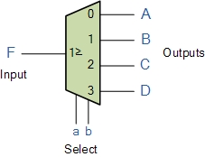
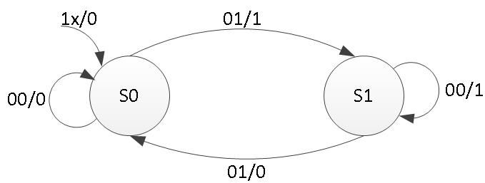
DEMUX USING MEALY MACHINE
DEMUX is a combinational circuit that routes one input to various channels depending on the states. The states are defined by user in terms of binary input that is regulated by the type of DEMUX, for example the 2 X 4 DEMUX depends on 2 states and routes the output in 4 different outputs. In the above diagram, the states have values in the form of INPUT/OUTPUT, for example – input of S0 state is 00 and output is 0 and it goes back to its own state as shown in the diagram.
Analyzing the mealy circuit, we can say that it depends on both the output and next state. The output will change multiple times even for the same state depending upon the input. In a DEMUX the output is fixed and it cannot be changed with respect to the states, changing states can regulate output on different ports or channel but the value cannot be changed. So, a mealy circuit cannot be used to implement a DEMUX.

Slide 13
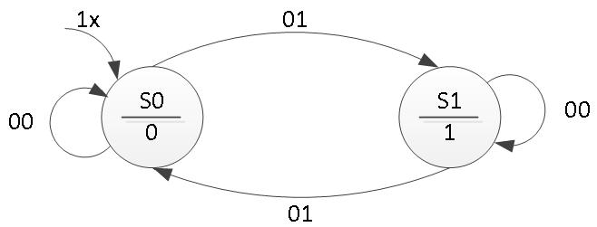
DEMUX USING MOORE MACHINE
In Moore circuit, the output is dependent only on the next state and not on the output. They have a fixed output per state. The state has a stable output as shown in S0 has 0 and S1 has 1. In the consideration of DEMUX, the output is required to be fixed instead of depending on the inputs.
Current State | Next State |  | Output
 | Input = 00 | Input = 01
S0 | S0 | S1 | 0
S1 | S1 | S1 | 1

Slide 14
THANK YOU ☺
DESIGN OF STATE MACHINE USING VHDL/XILINX

