Slide 1

Introduction to Blockchain
Kyriacos E. Pavlou, PhD
Director of Electi Academy, Electi Consulting Ltd
Research Associate, UCL Centre for Blockchain Technologies

Slide 2
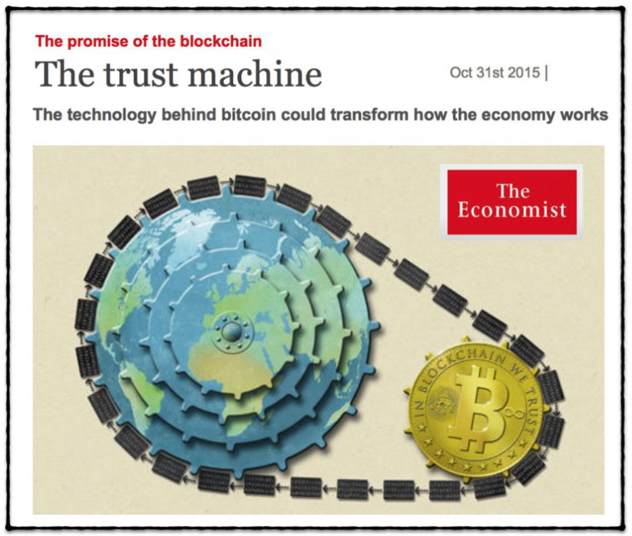
What is a Blockchain?
Blockchain is:
A system of electronic records that enables independent entities to establish a consensus around a shared ledger without relying in a trusted central coordinator to provide the authoritative version of the records.
A.k.a. Distributed Ledger Technologies
These systems are designed to be capable of operating in an adversarial environment.

Slide 3
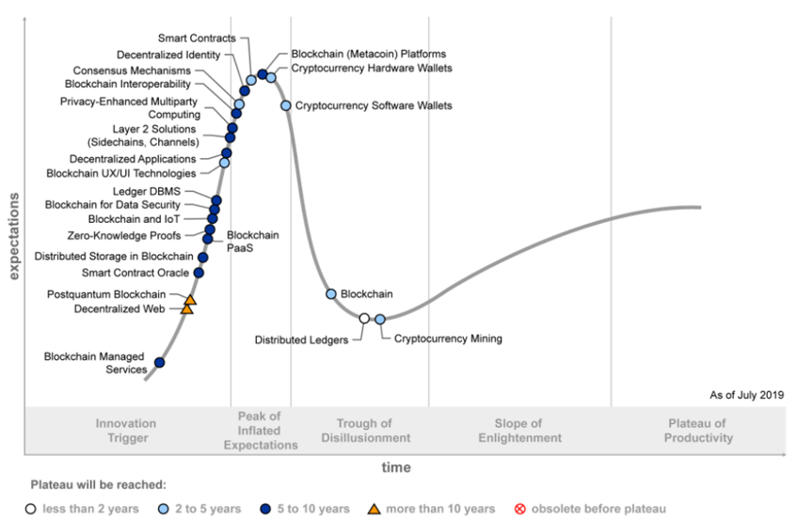
Blockchain on the Hype Cycle

Slide 4
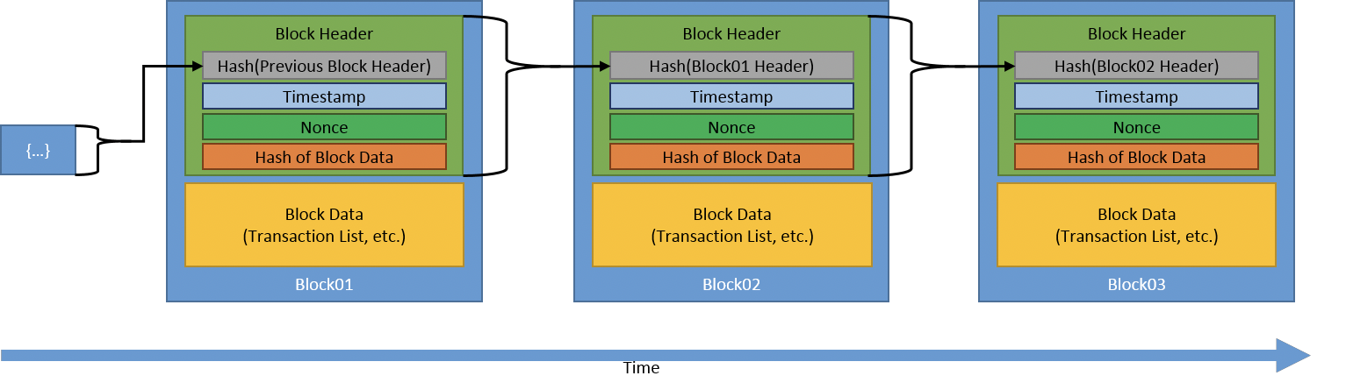
DLT more formally:
A DLT system is a system of electronic records that:
Enables a network of independent participants to establish a consensus around
The authoritative ordering of cryptographically-validated transactions.
These records are made persistent by replicating the data across multiple nodes and
Tamper-evident by linking them with cryptographically strong hashes
The shared result of the reconciliation/consensus – the ledger – serves as the authoritative version for these records.

Slide 5
Blockchain has the following properties
Shared recordkeeping
Multi-party consensus
Independent Validation (Transparency)
Tamper Evidence
Tamper Resistance

Slide 6
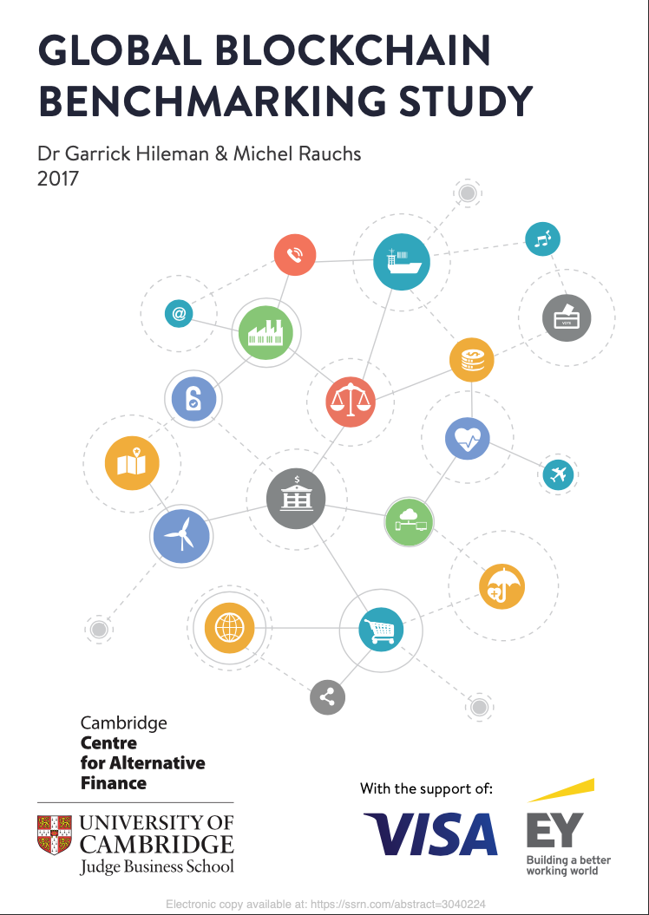
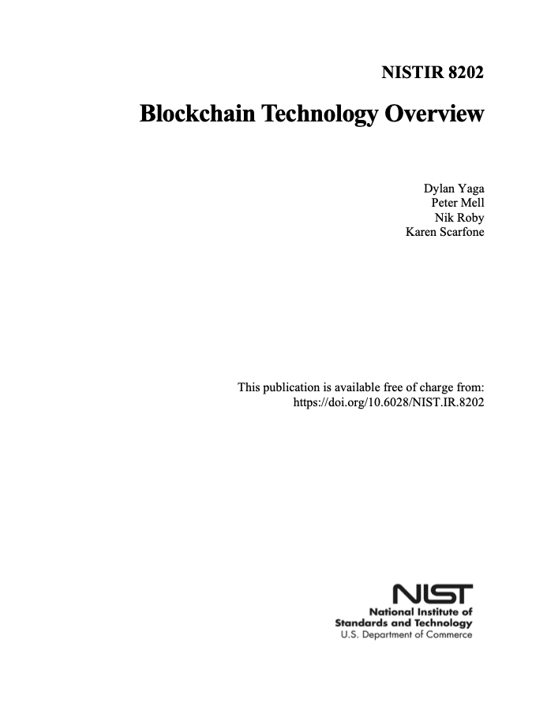
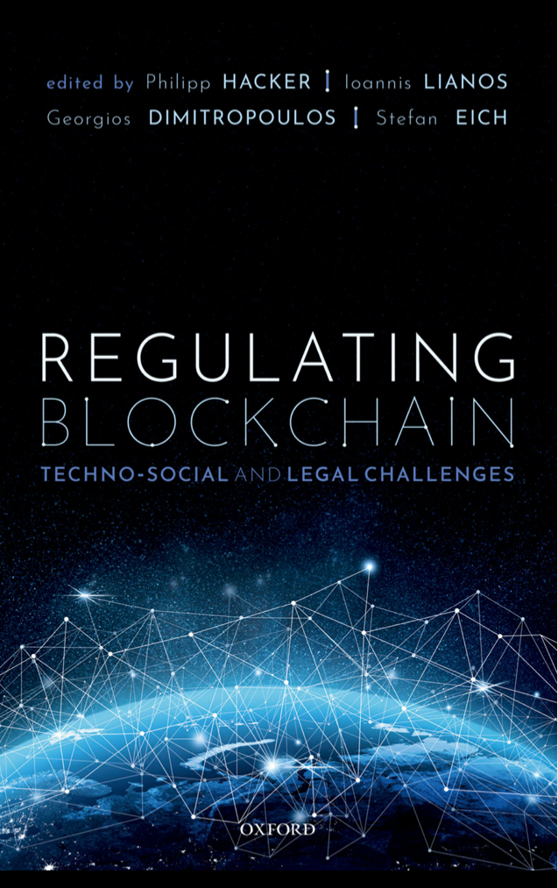
Further Reading

Slide 7
Thank you for your consideration

