Slide 1
Aegis
Emergency First-Response Coordination
A campus event exercise prototype
Ayush Pandey 24BIT0394
Dheeraj Sutram 24BIT0416
AI Innovate-A-Thon
Topic 10
01
Notes:
Aegis implements Topic 10 of AI Innovate-A-Thon as a local campus event exercise prototype. Introduce Ayush Pandey (24BIT0394) and Dheeraj Sutram (24BIT0416). The project combines report intake, grouping evidence, priorities and coordinator corrections. All bundled data is synthetic. Source: README.md and docs/REPORT.md.

Slide 2
Overlapping reports need a common incident view
“People are bunching up because the inner door
at Exit A will not open.”
“The inside Exit A door seems jammed.”
A later account describes the door as clear.
The board retains each account and flags the change for review.
02
Notes:
Use the actual demo reports to explain the coordination problem. All three concern the inner door at Exit A. Their timestamps are fixture event times. Opposing values can indicate a changing situation or conflicting accounts. A coordinator must inspect the evidence. Source: data/scenarios/demo.json, reports 4, 10 and the subsequent clear-door account.

Slide 3
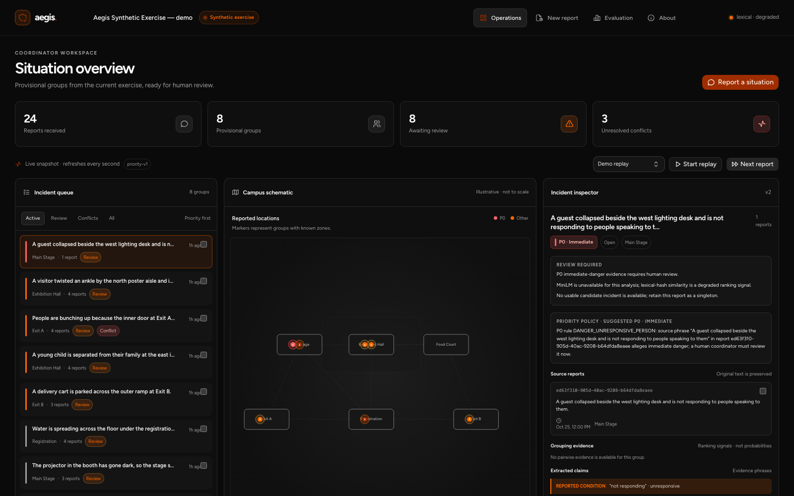
The coordinator board
24 reports / 8 provisional groups / 3 conflicting report pairs
03
Notes:
The screenshot was captured from the running application after all 24 demo steps. The API returned 24 reports, 8 incident groups and 3 unresolved conflict pairs. The eight review counts refer to incidents in the dashboard summary. The selected incident has original text, a priority source phrase and review reasons. The schematic is illustrative. Source: local application capture, docs/latex-report/screenshots/dashboard-wide.png and .artifacts-build/capture-state.json.

Slide 4
System architecture
Stage | Component | Result
Receive | FastAPI + Pydantic | Validated, persisted receipt
Analyse | Python matching and policy rules | Grouping evidence and review flags
Store | SQLite transactions | Reports, incidents and audit history
Review | React + TypeScript | Version-checked coordinator decisions
The original report is stored before analysis begins.
04
Notes:
The Python backend owns the analysis and persistence path. The frontend uses TanStack Start, React and TypeScript. Reports are persisted before analysis. The browser polls a snapshot and receives updated snapshots from coordinator mutations. Source: backend/aegis/api.py, backend/aegis/storage.py, backend/aegis/engine.py, frontend/src/hooks/use-snapshot.ts, pyproject.toml and frontend/package.json.

Slide 5
Matching uses text and specific context
Score = 0.65 text + 0.20 location + 0.10 time + 0.05 category
Attachment gate | Lexical fallback | MiniLM adapter
Candidate score | ≥ 0.33 | ≥ 0.82
Anchor text similarity | ≥ 0.05 | ≥ 0.62
Best-candidate margin | ≥ 0.08 | ≥ 0.08
Known compatible time and specific shared location or entity are required.
Measured mode: lexical fallback. MiniLM weights were unavailable.
05
Notes:
The ranking score renormalizes over available components. Text similarity uses cosine over the active representation. Unknown required context still blocks attachment. Eligible candidate scores average up to four initial members. The first member is the anchor and all members are checked for incompatibilities. Thresholds: backend/aegis/engine.py. MiniLM is an optional adapter, with no real-weight measurement in this environment. External references: https://huggingface.co/sentence-transformers/all-MiniLM-L6-v2 and https://sbert.net/docs/sentence_transformer/usage/semantic_textual_similarity.html.

Slide 6
Priority follows explicit exercise rules
Label | Supported evidence
P0 | An affirmative phrase alleging immediate danger
P1 | Blocked exit, medical concern or vulnerable missing person
P2 | Facility issue with a reporter-supplied zone
Unassessed | Insufficient information or no supported rule
The source phrase and rule remain visible beside the suggestion.
06
Notes:
The policy is separate from the grouping score. It retains source phrases, handles the supported negations and hypothetical patterns, and keeps the strongest unresolved signal across the incident. The P0 phrases allege immediate danger within the synthetic exercise. This finite English policy has no clinical validation. Source: backend/aegis/engine.py, _priority_for_text and assess_priority.

Slide 7
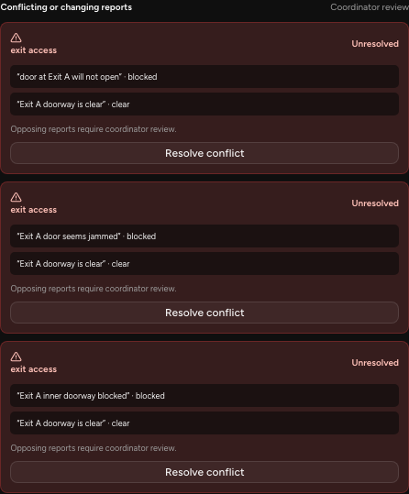
Conflicting accounts remain visible
Source phrases stay attached
to the conflict.
A later reassuring account leaves
the incident open for review.
The coordinator can resolve or
reopen the conflict with a reason.
07
Notes:
The screenshot shows stored opposing exit-access values with original evidence phrases. It is a genuine application view. A later clear-door account does not automatically close the incident or remove unresolved urgent evidence. Priority uses the strongest unresolved exercise rule. Source: backend/aegis/engine.py, backend/aegis/storage.py and screenshot conflict-detail.png.

Slide 8
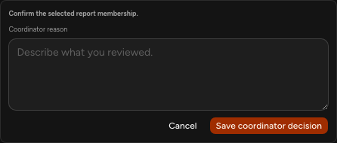
Coordinator review
Confirm, reject, move, merge or split
Each change stores its reason,
affected reports and before/after state.
Stale versions return HTTP 409.
The coordinator reviews the new state
before retrying.
Recorded reason: “Reviewed the Exit A accounts together. Keep the changing
door status visible for follow-up.”
08
Notes:
Confirm, reject, move, merge and split update persisted state. Each mutation requires a reason and incident versions. Stale edits return HTTP 409. The quoted reason was entered during the completed confirmation shown in the report audit screenshot. Sources: docs/API_CONTRACT.md, backend/aegis/storage.py and docs/latex-report/screenshots/audit.png.

Slide 9
Synthetic data and evaluation protocol
Set | Reports | Families | Use
Demo | 24 | 8 | Step-controlled replay
Development | 60 | 20 | Threshold development
Test/regression | 60 | 20 | Fixed measurement
Pairwise metrics count report pairs placed together or left apart.
The fixed test set was inspected during engineering.
09
Notes:
The total of 144 reports includes demo, development and fixed test inputs. Families are distinct within each split, while categories and scenario patterns recur across splits. Test cases were inspected during engineering and became regression cases. These are fixed synthetic measurements. Ground-truth family labels are separate files and are never passed into runtime replay or matching. Source: data/README.md, data/evaluation/, backend/aegis/evaluation.py.

Slide 10
Context improves recall on the fixed test set
1.000
precision for both methods
25
missed pairs with Aegis
Baseline: 62
Zero false merge pairs observed. All Aegis reports carry review flags.
10
Notes:
Use the full values in evaluation/results/latest.json. Baseline precision 1.0, recall 0.060606, F1 0.114286, zero false merge pairs, 62 missed pairs, review rate 0.083333. Aegis precision 1.0, recall 0.621212, F1 0.766355, zero false merge pairs, 25 missed pairs, review rate 1.0. There are 66 true same-family pairs. Aegis recovers 41 compared with 4 for the baseline. The review flags differ by method, so the review rates are not a controlled workload comparison.

Slide 11
Engineering verification
196
140
backend tests passed
frontend tests passed
Recorded check | Outcome
Backend and frontend coverage gates | 100% across configured measures
Lint, formatting, types and production builds | Passed
Chromium replay, intake, correction and audit | Passed with no uncaught browser errors
Tests exercise stale edits, event isolation, model failure and correction flows.
11
Notes:
The saved verification record is dated 24 October 2026. These counts refer to the recorded full run, not a claim that all tests were rerun for the document. Backend scope includes the application and fixture generator. Frontend source coverage includes component primitives and generated routes. All statement, branch, line and function gates reached 100%. The document preparation reran the 24 evaluation tests with 14 subtests and reproduced the grouping figures. Source: evaluation/results/verification.json, docs/VERIFICATION.md and backend/tests/.

Slide 12
Current limits and next work
Matching
Lexical overlap and narrow English rules limit paraphrase coverage.
Measure the cached MiniLM model on independent examples.
Evaluation
Small synthetic fixtures and recurring scenario patterns.
Test coordinator effort and errors in observed exercises.
Deployment
Local use with one coordinator.
Add access control, operational review and device testing.
12
Notes:
The prototype is local and synthetic, with a single-coordinator assumption and no user authentication. Its finite English extraction rules and lexical fallback are limited. The independent dataset, real MiniLM inference benchmark and usability evaluation remain future work. Security, access control, accessibility and stakeholder policy review are needed before broader use. No clinical, safety or live emergency deployment claim is supported. Source: docs/REPORT.md, docs/REVIEW.md and README.md.

Slide 13
Demonstration
1
Receive reports and inspect a provisional group
2
Review the changing Exit A accounts
3
Record a correction and inspect its audit entry
4
Open the measured evaluation and discuss its limits
Every accepted report remains available for coordinator review.
13
Notes:
Suggested four-minute demonstration: 0:00 start a fresh synthetic replay, 0:25 advance a duplicate family, 1:05 inspect grouping and priority evidence, 1:35 show the incomplete report, 2:00 show blocked and clear Exit A accounts, 2:40 confirm or correct a group with a specific reason, 3:20 open evaluation. Keep the active lexical mode visible. All reports remain accessible and no external dispatch occurs. Source: docs/DEMO.md.

