Slide 1
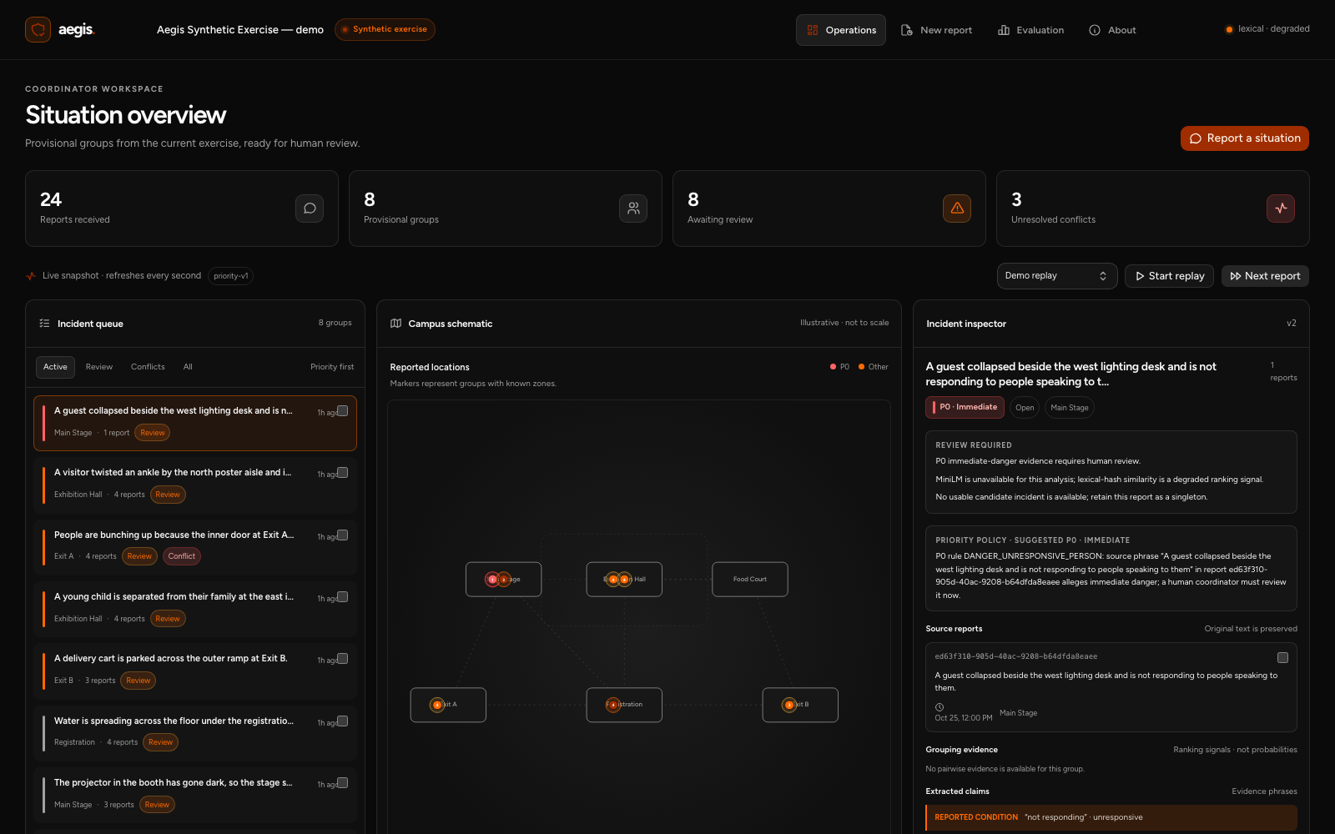
AI Innovate-A-Thon, Topic 10
Aegis
Emergency First-Response
Coordination
A campus event exercise prototype
Ayush Pandey 24BIT0394
Dheeraj Sutram 24BIT0416
Notes:
Aegis implements AI Innovate-A-Thon Topic 10 as a synthetic campus event exercise prototype. Contributors: Ayush Pandey, 24BIT0394, and Dheeraj Sutram, 24BIT0416. The background detail is cropped from the genuine application screenshot and shows an illustrative schematic. Source: README.md and docs/latex-report/screenshots/dashboard-wide.png.

Slide 2
Exit A
Three accounts of the same doorway
3
“The inner door at Exit A
will not open.”
“The inside Exit A door
seems jammed.”
reports to reconcile
“Exit A doorway is clear”
Notes:
Three selected accounts from the Exit A demo family illustrate the coordination problem. The replay family contains four reports overall. The displayed quotes are source clauses from demo reports 4, 10 and the later clear-door account. Opposing reports may describe a changing situation or conflicting accounts. Source: data/scenarios/demo.json.

Slide 3
The incident board
24
reports received
8
provisional groups
3
conflicting pairs
Notes:
The genuine Operations screenshot was captured after all 24 demo reports were ingested through the API. The capture returned 24 reports, 8 provisional incident groups and 3 unresolved opposing report pairs. The crop focuses on the queue and schematic. All data and locations are synthetic. Source: docs/latex-report/screenshots/dashboard-wide.png and .artifacts-build/capture-state.json.

Slide 4
The processing path
1
Receive
Form or replay
FastAPI + Pydantic
2
Preserve
Original text and receipt
SQLite transaction
3
Analyse
Matching evidence and priority
Python engine
4
Review
Confirm or correct with a reason
React + TypeScript
Notes:
The ordinary form and replay use the same intake path. FastAPI and Pydantic validate inputs. The backend persists the original report with a provisional incident before analysis. The Python engine produces grouping evidence and priority reasons. SQLite stores memberships, review decisions and audit entries. The React and TypeScript frontend displays snapshots and submits version-checked decisions. Source: backend/aegis/api.py, engine.py, storage.py, models.py and frontend/src/.

Slide 5
Matching
Text and event context contribute to the ranking score
0.33
0.05
0.08
candidate score
anchor similarity
candidate margin
Lexical fallback gates. Compatible time and specific shared context are also required.
Notes:
The native stacked chart shows the configured ranking weights: text 0.65, location 0.20, time 0.10 and category 0.05. Missing score components are omitted and available weights renormalized. Required context still gates attachment. In lexical mode the candidate threshold is 0.33, anchor similarity minimum is 0.05 and candidate margin minimum is 0.08. Known compatible time and specific shared location or entity are required. MiniLM uses separate gates, 0.82 and 0.62, with the same margin. Measured mode is lexical fallback, as actual MiniLM weights were unavailable. Source: backend/aegis/engine.py and evaluation/results/latest.json.

Slide 6
Priority has an explicit rule
P0
Affirmative immediate-danger phrase
P1
Blocked exit, medical concern or
vulnerable missing person
P2
Facility issue with a supplied zone
?
Insufficient supported information
Unassessed
The source phrase stays visible beside the priority suggestion.
Notes:
The versioned exercise policy is separate from matching. P0 uses supported affirmative phrases alleging immediate danger. P1 includes blocked exits, medical concerns and supported vulnerable missing-person cases. P2 is a facility issue with a reporter-supplied zone. Unassessed is used when supported information is insufficient. The incident keeps the strongest unresolved signal. The finite English rules have no clinical validation. Source: backend/aegis/engine.py.

Slide 7
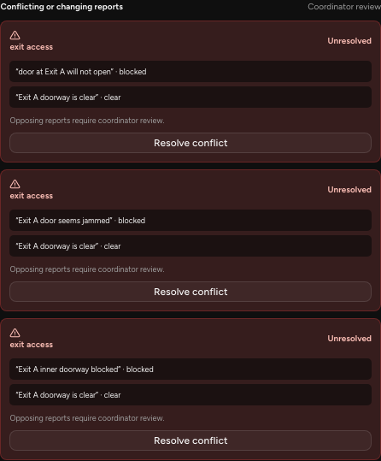
Conflicting accounts
“Blocked”
“Clear”
Both accounts remain available.
The coordinator reviews the change
and records a decision.
Notes:
The real conflict inspector preserves supporting phrases for opposing exit_access values. Blocked and clear are reported values, not verified states. Later reassuring evidence does not automatically close an incident or cancel unresolved urgent evidence. The coordinator can resolve or reopen a conflict with a reason. Source: docs/latex-report/screenshots/conflict-detail.png, backend/aegis/engine.py and storage.py.

Slide 8
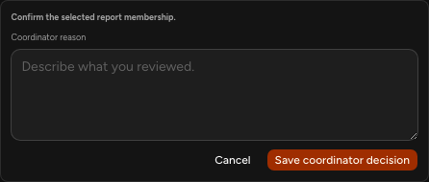
The coordinator decides
Confirm or reject
Move, merge or split
A reason is required.
Stale versions return HTTP 409.
“Reviewed the Exit A accounts together. Keep the changing
door status visible for follow-up.”
Notes:
The displayed confirmation form is a genuine screenshot. Grouping actions are confirm, reject, move, merge and split. Mutations require a reason and the versions the coordinator reviewed. Stale edits receive HTTP 409. The quoted reason was entered in the completed confirmation captured in the report audit screenshot. Source: docs/API_CONTRACT.md, backend/aegis/storage.py and screenshots/decision.png and audit.png.

Slide 9
144
Incident families in parentheses
synthetic reports
Labels are stored separately
from runtime inputs.
The fixed regression set was inspected during engineering.
Notes:
Fixtures contain 24 demo reports across 8 families, 60 development reports across 20 families and 60 fixed test/regression reports across 20 families, for 144 reports total. Family labels are separate from runtime inputs. Categories and scenario patterns recur across splits. The test set was inspected during engineering and became a regression benchmark. Source: data/README.md, data/evaluation/ and backend/aegis/evaluation.py.

Slide 10
Grouping results
60-report synthetic regression set
41
of 66 same-family
pairs recovered
Jaccard recovered 4
1.000 precision for both methods. Zero observed false merge pairs.
Aegis missed 25 pairs. Every Aegis report still carries a review flag.
Notes:
Saved lexical results on 60 synthetic regression reports: baseline precision 1.0, recall 0.060606, F1 0.114286, 0 false merge pairs and 62 missed pairs. Aegis precision 1.0, recall 0.621212, F1 0.766355, 0 false merge pairs and 25 missed pairs. Of 66 true same-family pairs, Aegis recovers 41 and the baseline 4. All Aegis reports carry review flags. Review rates are based on different method-specific rules. Source: evaluation/results/latest.json.

Slide 11
Engineering checks
196
140
backend tests passed
frontend tests passed
100% across configured coverage measures
Build, types, lint and the full Chromium exercise passed in the recorded run.
Notes:
Recorded verification from 24 October 2026: 196 backend tests and 140 frontend tests passed. Configured coverage measures reached 100%. Lint, formatting, strict TypeScript and production builds passed. Chromium smoke covered replay, intake, grouping confirmation, audit and evaluation with no uncaught browser errors. Coverage measures execution of the included code paths. This refers to the recorded run. Source: docs/VERIFICATION.md and evaluation/results/verification.json.

Slide 12
What comes next
Model
Data
Use
Measure real MiniLM inference
and paraphrase coverage.
Evaluate on independently
prepared event reports.
Observe coordinators and
measure correction effort.
Broader use also needs access control, operational review and device testing.
Notes:
Matching uses lexical overlap and finite English extraction rules. Actual MiniLM weights were unavailable in the measured environment. Next evaluation needs cached real weights, independently prepared examples and fixed thresholds. User studies should measure coordinator effort and errors. Access control, operational review and real-device accessibility testing remain deployment work. Source: README.md, docs/REPORT.md and docs/REVIEW.md.

Slide 13
Aegis
Live demonstration
1 Receive and group
Every accepted report stays available
for coordinator review.
2 Inspect Exit A
3 Record a correction
4 Open evaluation
Ayush Pandey 24BIT0394
Dheeraj Sutram 24BIT0416
Notes:
Four-minute demonstration: start a fresh replay, inspect a duplicate family, show changing Exit A accounts, make a correction with a reason, inspect the audit and open evaluation. Keep lexical and synthetic exercise status visible. Source: docs/DEMO.md. Contributors: Ayush Pandey 24BIT0394 and Dheeraj Sutram 24BIT0416.

