Slide 1
Continuum
Verified recovery for timed
academic assessments
Ayush · 24BIT0394
BCSE355L · Cloud Architecture Design · Fall 2026–2027
1 / 9
Notes:
Opening, about 30 seconds. Continuum protects the last minutes of an online exam. Stop the active application while a student is answering, observe recovery, then show a receipt recovered after a committed response was lost. Explain that intent means an explicit application recovery policy. Source: docs/faculty-pitch.md; implementation: internal/continuum and internal/store.

Slide 2
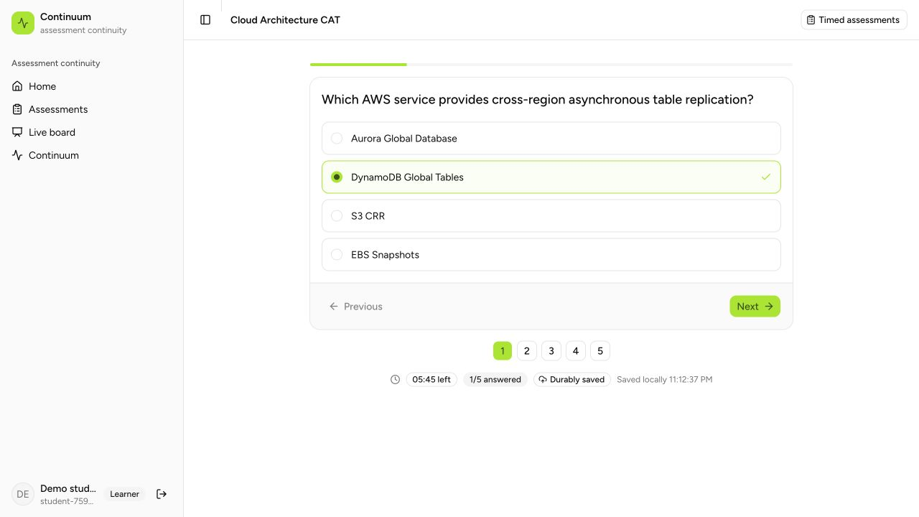
The last minutes of an exam
15-minute
server deadline
The same attempt
continues through
backend recovery.
Buffered answers
are separate from
a server receipt.
Local rehearsal
2 / 9
Notes:
Show a fresh synthetic student session with the Cloud Architecture CAT. The server stores the attempt start and deadline; recovery does not restart the timer. A local browser draft differs from an acknowledged server save. A final receipt is durable submission evidence. Screenshot is a genuine local rehearsal, not the AWS deployment. Sources: docs/evidence/student-timed-exam.png; docs/evidence/local-timed-exam.json; web/src/routes/quiz.$examId.tsx; internal/exams/exams.go.

Slide 3
Architecture in Sydney
Layer | AWS building blocks | Continuum behavior
Student access | CloudFront / S3 + HTTP API | Exam frontend and HTTPS requests
Application route | Router Lambda + EC2 A/B | Authoritative active backend and epoch
Durable state | Regional DynamoDB | Answers, receipt, control and outbox
Recovery control | Monitor / verifier + Step Functions | Confirm, recheck, promote and reconcile
Two Availability Zones · Shared regional data and control services
3 / 9
Notes:
All regional resources use the selected Region ap-southeast-2. A and B are t3.micro EC2 instances in separate Availability Zones. The private router reads the active backend and monotonic epoch strongly from DynamoDB and strips client routing headers. EC2 accepts app traffic only from the private router/verifier security group. Lambda functions requiring public AWS API access run outside the VPC. Private S3 frontend assets use CloudFront OAC. DynamoDB and S3 gateway endpoints avoid a NAT gateway. Source: infra/demo; docs/demo-runbook.md.

Slide 4
Recovery policy
01
Monitor confirmation
Repeated deep checks distinguish a sustained fault from a blip.
02
Locked verification
The workflow rechecks the route and standby under an incident lease.
03
Conditional promotion
A newer writer epoch selects B; the public API must pass its smoke test.
04
Safe failure handling
Rollback requires fresh health of the former backend.
05
Audit reconciliation
Pending committed work produces one idempotent audit summary.
4 / 9
Notes:
The monitor confirms sustained failure using three probes separated by five seconds. Only then does it start Step Functions. The workflow acquires an incident lease, checks ownership/route and standby readiness, conditionally advances the active writer epoch, probes the public route and reconciles pending audit work. Rollback requires fresh health of the former backend. A failed smoke or reconciliation conflict cannot return a successful recovery. Sources: internal/continuum/cloud.go; statemachine/demo-failover.asl.json.

Slide 5
A submission can outlive its response
Moment | Application contract | Observable result
Before sending | Persistent ID + immutable answer snapshot | Retries preserve the same request
Durable commit | Submission + receipt + outbox + writer check | One accepted final submission
Response lost | Exact retry returns the stored receipt | Same ID and commit time
Answers changed | Same ID with another payload is rejected | HTTP 409 conflict
Exact replay can recover a committed receipt after the exam closes.
5 / 9
Notes:
Each final submission uses a persistent request ID and immutable answer snapshot. Canonical submission, receipt, attempt completion, and outbox commit transactionally with the writer epoch condition. An exact receipt lookup happens before deadline rejection, so an already committed request can recover after the exam closes. A new uncommitted late submission is still rejected. Show the receipt reference and submitted time. The cloud-rehearsal.json exact replay contains the original request ID and unchanged commit timestamp; changed answers under the same ID return 409. Sources: internal/store/store.go; web/src/lib/pending-submission.ts; docs/evidence/cloud-rehearsal.json; integration/demo_test.go.

Slide 6
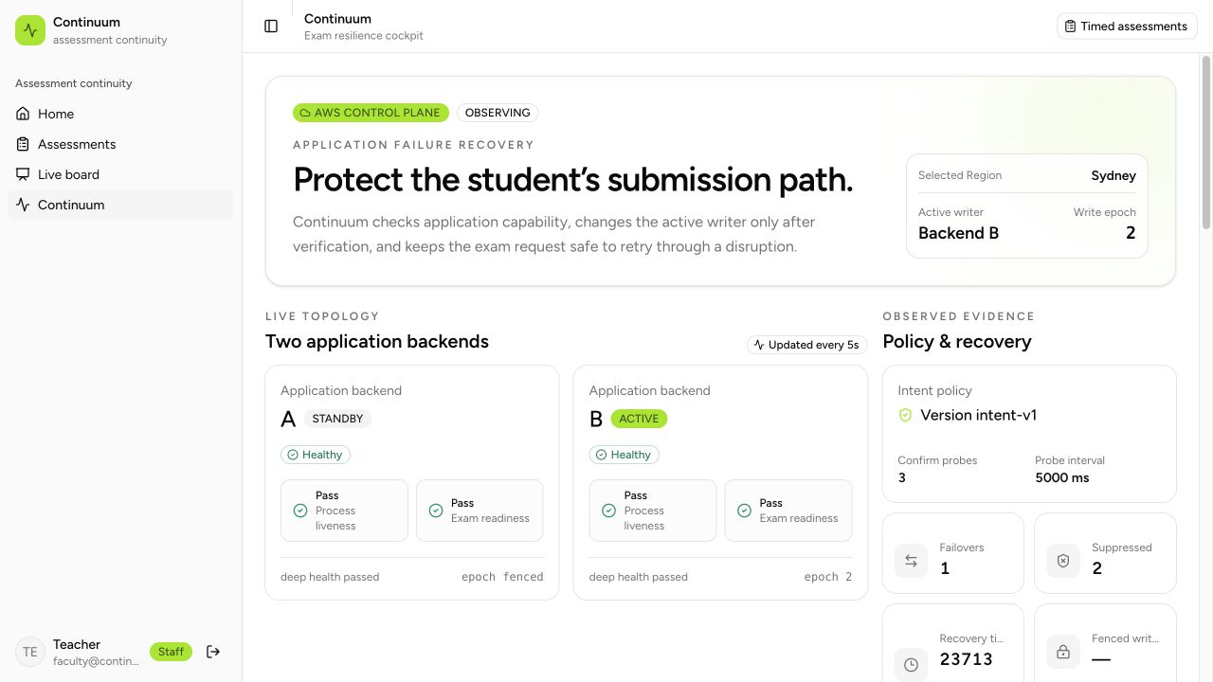
AWS instance-stop rehearsal
50.472 s
Fault action to observed
health + reconciliation
23.713 s
Monitor check cycle
to public verification
One bounded Sydney rehearsal · 10 October 2026
6 / 9
Notes:
Recorded on 10 October 2026 in Sydney. The automated rehearsal stopped the actual primary EC2 instance, not an emulated process. B became active at epoch 2. The external 50.472 second observation includes scheduling, polling, public health and completed reconciliation. The internal 23.713 second metric starts before the first monitor probe and ends at public smoke; it excludes earlier schedule delay. Do not present it as fault-to-recovery. Independent DynamoDB inspection found one canonical submission, one receipt, one processed journal and one audit summary. A separate repeated reconciliation processed zero further records. The screenshot was captured after A returned healthy and remained fenced as standby. Sources: docs/evidence/cloud-instance-fault.json; cloud-rehearsal.json; cloud-records.json; cloud-status-after-review.json; cloud-recovery.png.

Slide 7
Cost choices and trade-offs
Choice | Credit conservation | Trade-off
Two EC2 nodes | Stop between rehearsals | Retained EBS storage remains
Custom HTTP router | No always-on ALB or bought domain | Request charges, latency and limits
Regional DynamoDB | No replica promotion or cross-Region traffic | Shared regional dependency
Local rehearsal | Practice without AWS requests | One process; limited fault boundary
Free plan retained · Pausing compute does not delete storage
7 / 9
Notes:
This prototype adds a custom router/application contract on top of AWS managed primitives. AWS supports custom health checks and powerful routing; do not claim AWS cannot do them. The aim is a bounded faculty prototype that avoids recurring infrastructure such as an ALB, NAT gateway, purchased DNS and database replicas. API Gateway/Lambda still incur request charges and add latency/payload limits. Shared DynamoDB remains a regional dependency. Local mode uses two HTTP listeners in one Go process with shared memory, so it cannot establish AWS infrastructure resilience. Keep Free plan, develop locally and pause compute after rehearsals. Retained disks and storage still use credits. Source: infra/demo; docs/demo-runbook.md; docs/faculty-pitch.md.

Slide 8
Live demonstration
0:00–1:00
Baseline
Timer visible; A active; B ready; current epoch shown.
1:00–3:00
Stop the active backend
Continue answering; observe B promotion and submit.
3:00–5:30
Lose a committed response
Retry preserves the receipt reference and commit time.
5:30–7:00
Make the standby unsafe
Promotion is suppressed; route and epoch stay unchanged.
7:00–8:00
Explain cost and scope
Show the footprint, pause command and recovery boundary.
8 / 9
Notes:
Eight-minute flow. Use separate faculty and student browser sessions. Begin with both nodes deep-healthy and A active; use a new synthetic student for each full attempt. During an AWS rehearsal resume with make demo-resume before opening the cockpit, and pause afterwards. Local Stop closes one HTTP server inside a shared Go process; AWS Stop stops a real EC2 instance. Keep the original deadline visible. Arm Lost response on the active backend, submit, show the exact receipt reference and commit time, then inspect the saved evidence or canonical records to prove count one. Unsafe standby + active capability failure must suppress promotion. Reset and verify the baseline between faults. Sources: docs/demo-runbook.md; docs/faculty-pitch.md.

Slide 9
Evaluation and recovery boundary
Demonstrated behavior
Recovery assumptions
A → B recovery after a real EC2 stop
An exact receipt after response loss
Suppressed transient / unsafe promotion
Stale writes rejected
Regional data and control services
remain available.
The original exam deadline continues.
Measured prototype results apply
to this bounded application workload.
Go race checks · Frontend tests · Infrastructure validation
9 / 9
Notes:
Summarize only supported claims. Application-instance recovery requires regional DynamoDB, router and control services to remain available. The deployed placement spans two AZs, but the recorded test stops one EC2 instance and does not prove complete AZ or Region recovery. The cloud stale-writer proof rejects a registration with no email index; separate local exam regressions prove saved answers/version stay unchanged under stale writer operations. This distinction matters if asked for proof. Verification includes Go race checks, 108 frontend tests from the implementation pass, focused receipt/cockpit additions, typechecking/lint, production build, and Terraform validation. Sources: docs/implementation-review.md; docs/evidence/cloud-stale-writer.json; internal/store/coverage_memory_test.go.

