Slide 1

DockerCon Hackathon Team “Electric Cloud”
Nikhil Vaze, Siddhartha Gupta, Tanay Nagjee
June 8, 2014

Slide 2





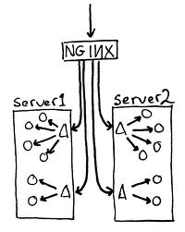

Technologies used
ReviewBoard
DEV
TEST
PROD

Slide 3





Development pipeline
Developer
ElectricCommander
Reviewer
Shell/IDE
Modify code launch preflight
GitHub
Check out sources overlay deltas
Jenkins
Launch build + test w/ sources
Docker
Deploy DEV environment
Build + test success?
ReviewBoard
Create review
request
ReviewBoard
Review modified
code
Shell/IDE
Success; auto-commit code
Review success?

Slide 4
DEMO

Slide 5
Thanks!
github.com/electriccommunity/dockercon
Nikhil: @therealnikhil
Sid: @Siddhartha90
Tanay: @tanayciousd

