Slide 1

DockerCon Hackathon Team “Electric Cloud”
Nikhil Vaze, Siddhartha Gupta, Tanay Nagjee
June 8, 2014

Slide 2
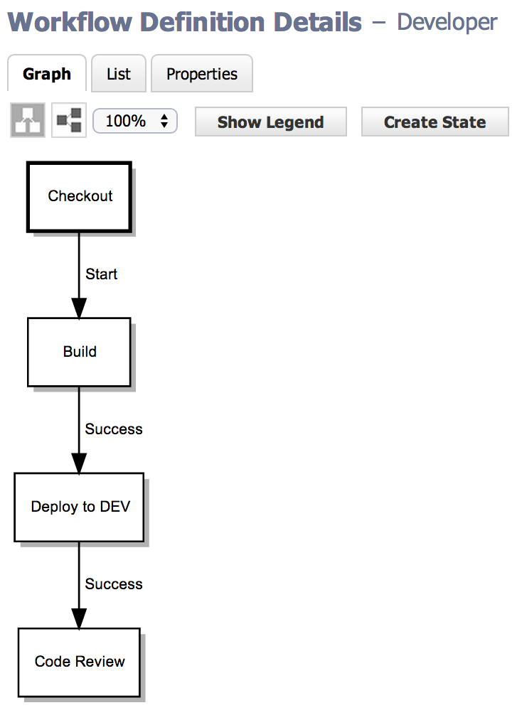



Developer pipeline
Developer
Terminal/IDE
Modify code launch preflight
Terminal/IDE
Success; auto-commit code
ReviewBoard

Slide 3
LIVE DEMO

Slide 4
Conclusion
Novelty – orchestration is on the Docker roadmap
Fit – consistent deploy throughout the SDLC means riskless deploy to production
Efficiency – Docker is an order of magnitude faster than traditional VM deployments
Integration – this is the primary focus of the hackathon
Transparency – github.com/electriccommunity/dockercon

Slide 5
Technologies used
Source control: GitHub
Build: Jenkins
Containers: Docker
Code review: ReviewBoard
Application server: Jetty
High availability: Nginx, Etcd, Etcdctl, Confd
Artifact repository: ElectricCommander
Orchestration: ElectricCommander

