Slide 1

DockerCon Hackathon Team “Electric Cloud”
Nikhil Vaze, Siddhartha Gupta, Tanay Nagjee
June 8, 2014

Slide 2
Technologies used
Source control: GitHub
Build: Jenkins
Containers: Docker
Code review: ReviewBoard
Application server: Jetty
High availability: Nginx, Etcd, Etcdctl, Confd
Orchestration: ElectricCommander

Slide 3
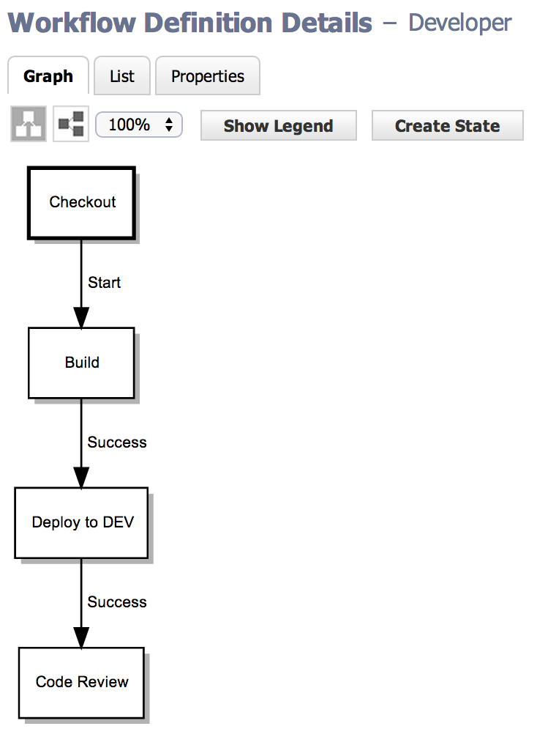



Developer pipeline
Developer
Terminal/IDE
Modify code launch preflight
Terminal/IDE
Success; auto-commit code
ReviewBoard

Slide 4
DEMO

Slide 5
Conclusion
Consistent deploy throughout the SDLC means riskless deploy to production
Docker is an order of magnitude faster than traditional VM deployments
github.com/electriccommunity/dockercon

