Slide 1
Source Control (SCM) / Version Control
Cameron Griffin

Slide 2




SCM Examples
Notes:
GIT – most ubiquitous
Subversion & Mercurial – sometimes used
CVS – one of the original source control systems

Slide 3
Purpose
Track Changes
Roll Back
Comments
Distribute Work
Group Projects

Slide 4
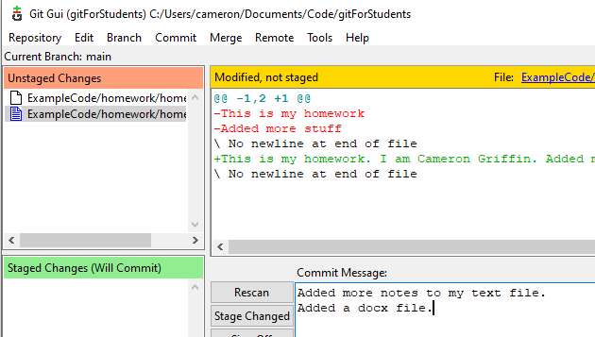
Track Changes
Old Way
homework.txt homework-final-draft.txt homework-draft1.txt
New Way
homework.txt

Slide 5
Roll Back
Old Way
homework.txt homework-final-draft.txt homework-draft1.txt
New Way
homework.txt

Slide 6
Track Changes

Slide 7


Track Changes
You may sharpen your pencil any time except for during whole-class instructions, activities, or lessons.
Mechanical pencils are also allowed!

Slide 8

Nurse visits, restroom, and drink breaks
If you need to use the restroom, get a drink, or see the nurse, please ask permission and then record the time you leave and return on the sheet posted on the classroom door.

Slide 9



Assignments
Using your class time wisely will decrease the amount of work you need to complete at home.
Please record your first and last name on all of your assignments.
Completed assignments should be turned in to the tray on the table in the front of the room.
Assignments will be graded and returned to you each Friday.

Slide 10




How and when to contact me?
I want you to have a great and successful year!
You may visit with me about questions or concerns any time we are not in the middle of direct instruction, or I am not helping other students.
You may email me if necessary, and I will respond when I am able.
I am available for extra help before or after school. When possible, please let me know in advance so I can plan accordingly.

Slide 11

When is the appropriate time to have a positive attitude and be respectful?
ALWAYS! Do your best to be respectful and have a positive attitude each day. We are going to have a fantastic year!

Slide 12
Customize this Template
Template Editing Instructions and Feedback

