Slide 1


Informational Session
Mathematics for the People: Quantitative Literacy for Social Justice
Funding provided by M.O.S.T. OER Grant Program
Mark Branson
&
Whitney George

Slide 2

NEW APPROACH TO TEACHING QUALITATIVE REASONING
Lead with social justice issues, then introduce mathematics as a tool to understanding issues
Stand alone modules allows for customizable courses
Target audience:
First-year college students who are prepared for college-level mathematics.
Students who are taking mathematics to fulfill a liberal arts or general education requirement.
The text should avoid complex mathematical symbols and extensive algebraic notation
The utility of mathematics should be emphasized over abstract mathematical proof & reasoning

Slide 3
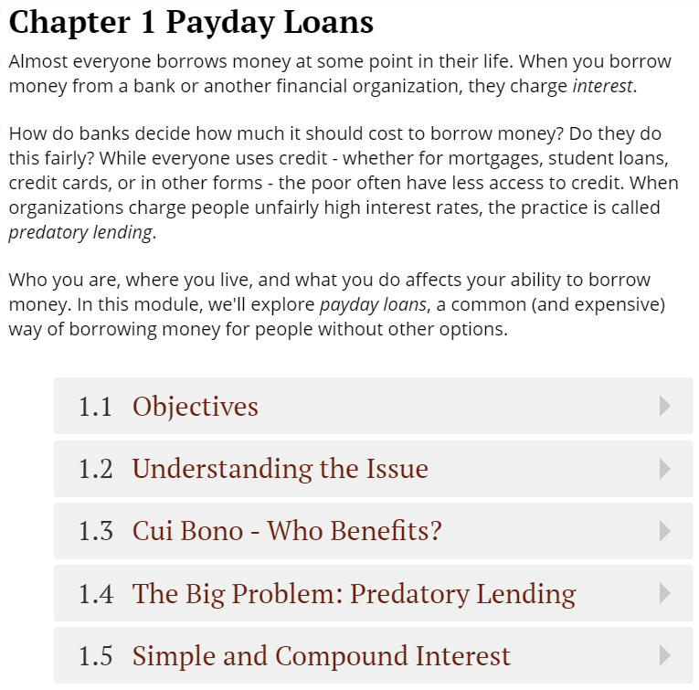
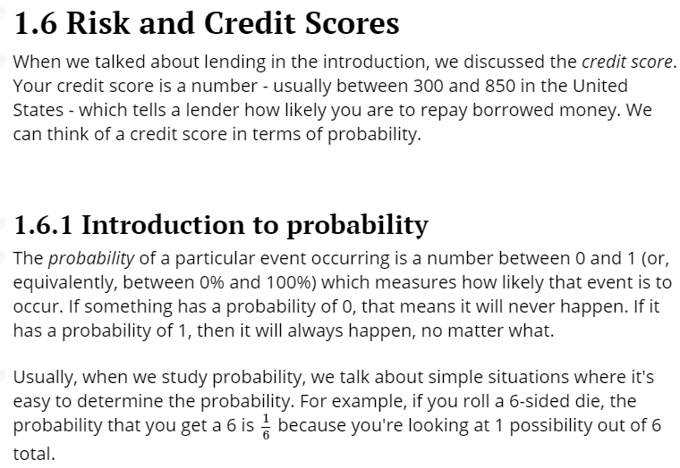
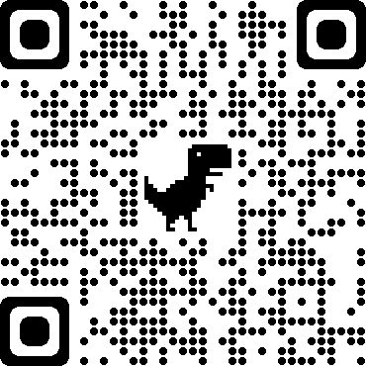
SAMPLE TEXT
https://web.stevenson.edu/mbranson/payday-loans.html

Slide 4
SAMPLE MODULES
Incarceration – Study the social and economic impact of incarceration on communities
Percentages
Probability
Data Visualization
Air Pollution – How does pollution spread? What is the connection to disease in the community?
Geometry
Correlation
Crime Rates – American perception of crime rates which have been steadily dropping since 1991 and the relation to policy (e.g. police funding)
Data Analysis
Statistics
Data Visualization
Data Analysis
Data Visualization
Linear and Exponential
Growth
Interpolation and Extrapolation
Regression

Slide 5
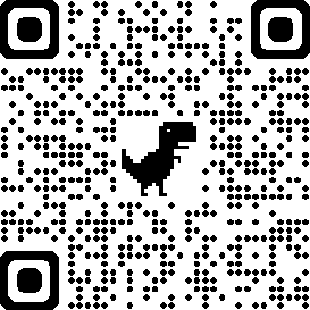
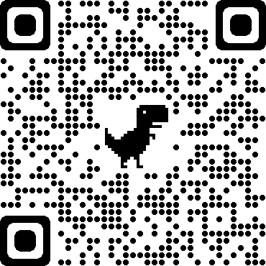
HOW TO GET INVOLVED
We ask that all authors commit to:
Writing their module
Reviewing one or more other modules
Participating in a monthly author’s check-in
The text should be written in the provided LaTeX or PreTeXt template.
https://web.stevenson.edu/mbranson/chapter-template.xml
https://web.stevenson.edu/mbranson/chapter-tag-background.html
If you’re not able to participate at this level, we are happy to have contributions from additional reviewers, editors, and classroom reviewers.

Slide 6
Recognition for Contributors
This project couldn’t happen without your participation. All contributing authors will be credited prominently in their chapter, the book and promotional materials. All editors, reviewers and other contributors will also be credited.
Questions? Want to Learn More?
For more information about the project, please email Mark Branson at mbranson@stevenson.edu. We are interested in whatever support or interest you have in the text – whether it’s authoring, editing, reviewing, or using the text in the classroom! We’re also happy to hear suggestions from our colleagues about what kinds of topics and modules would be useful to add to the text.
You can also read more about the project at the Math For the People homepage on the Rebus Community.
Spread the word!
Encourage anyone interested in the project to share it within their networks and encourage colleagues who might be a good fit to sign up!

Slide 7
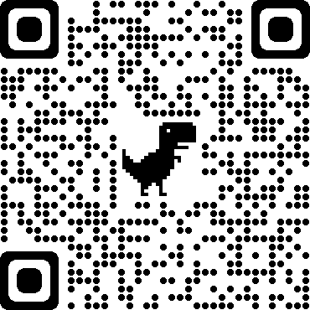
CONTACT INFORMATION
MARK BRANSON mbranson@stevenson.edu
WHITNEY GEORGE wgeorge@uwlax.edu
TWITTER @math_people
FACEBOOK (Math for the People)
WEBPAGE

Slide 8
(Proposed) TIMELINE
April 23, 2021: Authors submit chapter topics to Mark and Whitney
May 7, 2021: Authors begin working on content.
August 30, 2021: Drafts of chapters are submitted and are reviewed.
December 6, 2021: Chapters are returned to authors for revision.
January 15, 2022: Chapters submitted for editing
March 17, 2022: Edited chapters distributed for classroom review.

Slide 9
MATERIALS THAT WILL BE PROVIDED/AVAILABLE
PreText template
LaTeX template
Author Style Guide (including best practices)
Regular check-ins (via email, Zoom, etc)
QUESTIONS?

