Slide 1
Embedded AI – Assignment 6
EMBD X424
Dennis Griffith
https://github.com/electrickitty2/embedx424_assignment_6

Slide 2
Assignment: Building a Tiny Transformer That Learns Addition
Overview:
  In this assignment you will implement a minimal GPT-style Transformer inspired by:
  The Tiny Transformer walkthrough notebook
  Andrej Karpathy's nanoGPT / miniGPT style training loops
  The projects/adder sequence modeling idea

Slide 3
Learning Goals:
By the end of this assignment you should be able to:
  Build a tokenizer and character vocabulary
  Generate autoregressive training data
  Implement causal self-attention from scratch
  Assemble a Transformer block
  Train a tiny GPT-like language model
  Generate predictions autoregressively
  Evaluate model quality using real mathematical checks

Slide 4
Submission Requirements:
Completed notebook
Final autograder score
Screenshot of generated examples
Short explanation:
  What was hardest?
  What debugging strategy worked best?
  What surprised you about Transformers?

Slide 5
Competed Notebook:
Colab link:
  https://colab.research.google.com/drive/1sUPab9HE1jxBa_EdS1ODXGI_99yISvK-?usp=sharing
Github link:
  https://github.com/electrickitty2/embedx424_assignment_6/blob/main/assignment_6.ipynb

Slide 6
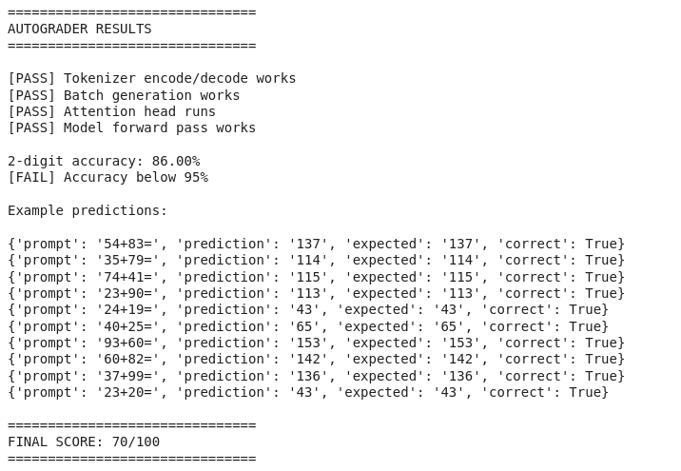
Final Autograder Score

Slide 7
Example:

Slide 8
Short explanation:
What was hardest?
  Frankly I struggled with transformers. Even during the lecture I was struggling.
  It reminded me of my cryto class. I understood everything until public key exchange. Then my mind was blown and I still don’t understand this.

Slide 9
Short explanation:
What debugging strategy worked best?
  I was very reliant on Claude and Gemini. I would ask Claude to explain and suggest next steps and I would type in one character and Gemini would finish the line for me.
  Obviously this is a well published problem.
  This got me to 92% accuracy, but this plateaued

Slide 10
Short explanation:
What surprised you about Transformers?
  The explanation in class seemed simple, and I thought I understood. Until it was clear I did not.
  Then the words and explanations did not make sense to me at all.
  No matter how hard I tried to get above 92% accuracy, nothing impacted the result. Claude code was telling me I was on the wrong track the whole time.

