Slide 1
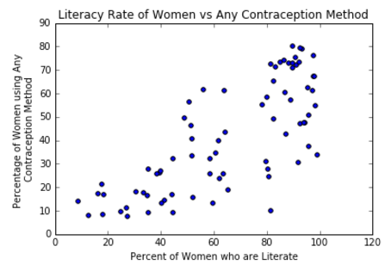
Contraception Use in Connection to GDP and Literacy Rate
Lily Orth-Smith

Slide 2
Variables
GDP (purchasing power parity per capita, in current international dollars)
Literacy rate of men/women ages 15+
Contraception use of women married or in a union, ages 15-49
Any contraception method
Modern contraception method
Condom use

Slide 3
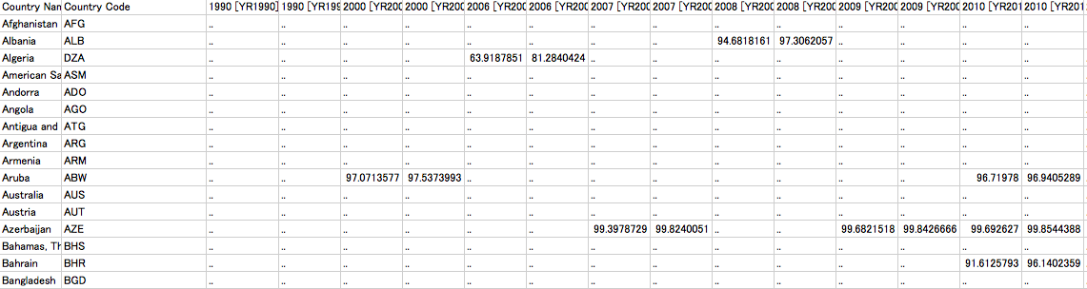
Reading in Data
The World Bank is ANNOYING
Lots of holes
Different Country Codes

Slide 4
Mean Contraception Use
Any Method: 48%
Modern Method: 39%
Condom Use: 6.5%

Slide 5
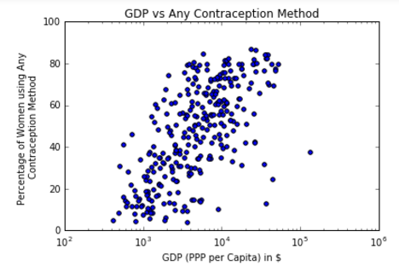
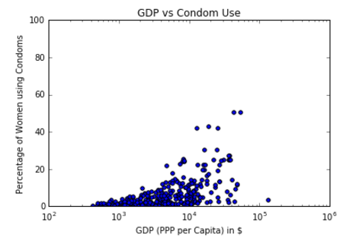
GDP and Contraception
GDP, Any Method: 0.39
GDP, Modern Method: 0.41
GDP, Condom Use: 0.47

Slide 6
Correlation between log(GDP) and Contraception Use
Log(GDP), Any Method: 0.67
Log(GDP), Modern Method: 0.62
Log(GPD), Condom Use: 0.57
GDP, Any Method: 0.39
GDP, Modern Method: 0.41
GDP, Condom Use: 0.47

Slide 7
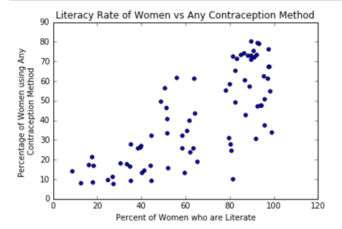
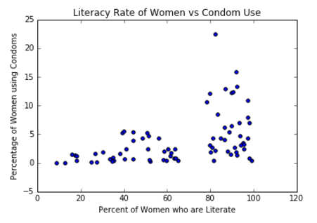
Correlation between Literacy Rate and Contraception
Literacy rate (women), Any Method: 0.75
Literacy rate (women), Modern Method: 0.70
Literacy rate (women), Condom: 0.46

Slide 8
Future Investigations
Use of contraception for unmarried women
Birthrate
GII (Gender Inequality Index)
Female graduation rate
Intersectionality: class, race, location

Slide 9
Works Cited
Works Cited
"Adult Literacy Rate, Population 15+ Years, Female (%)" World Development Indicators. The World Bank Group, n.d. Web. 29 Mar. 2016.
"Adult Literacy Rate, Population 15+ Years, Male (%)" World Development Indicators. The World Bank Group, n.d. Web. 29 Mar. 2016.
"Condom Use in the Real World." NAMAidsmap. NAM Publications, n.d. Web. 28 Mar. 2016. "GDP per Capita, PPP (current International $)." World Development Indicators. The World Bank Group, n.d. Web. 29 Mar. 2016.
Openmundi. World. N.p.: GitHub, Inc., n.d. CSV. https://github.com/openmundi/world.csv
United Nations, Department of Economic and Social Affairs, Population Division (2015). 2015 Update for the MDG Database: Contraceptive Prevalence (POP/DB/CP/A/MDG2015).

